Slide 1

ALGORITHM INTERNSHIP DEFENSE
Multi-source Spatiotemporal Data for Urban Crowd Forecasting and Anomaly Alerts
Ride-hailing Safety Algorithm Internship
Name: Zheyi Liu
Student ID: A0298521X
Supervisor: Shulan Zhao
Notes:
Good morning. My project is an urban crowd forecasting and anomaly alert system built during a ride-hailing safety algorithm internship. The objective was to convert city-grid movement signals into forecasts, anomaly events and actionable alerts. I will start with the complete outcome, then move through the five-month development path.

Slide 2
From Data to Alerts: A Complete Loop
01 / OVERVIEW 02
A reproducible chain across data, forecasting, detection, service and evaluation.
24h
3 tiers
48 half-hour steps
API · Web · alerts
1,024
3-way
spatial nodes
anomaly fusion
Urban crowd forecasting, anomaly detection and tiered alert system
Notes:
This was not an isolated forecasting experiment. I built a reproducible chain across 1,024 spatial nodes, a 24-hour forecast horizon, three complementary anomaly branches, and an API and Web layer with tiered alerts. The next slide explains why the business problem naturally becomes three connected decisions.

Slide 3
Ride-hailing Safety Requires Anticipate–Detect–Respond
03
Anticipate
How will each region change over 24h?
Internship role
Ride-hailing Safety Algorithm Intern
Detect
Which deviations exceed normal behavior?
Respond
The goal is not one prediction, but an actionable safety event.
What type and alert tier should be triggered?
Region × time × anomaly type × response action
Notes:
Ride-hailing safety requires three decisions: anticipate how each region will change, detect deviations beyond normal behavior, and respond with an event type and alert tier. A model score alone is insufficient; it must retain time, space and evidence so it can become an operational event. The next slide shows how the five-month workload was distributed.

Slide 4
Five-Month Work Allocation
04
Nearly half the period focused on model training, selection and validation.
WORKSTREAM
W1
W5
W9
W13
W17
W20
Requirements & papers
3 weeks
Data, features, graphs, pipeline
4 weeks
Baselines, models, ablations, multi-seed
7 weeks · core effort
Anomaly fusion & classification
3 weeks
API, Web, XAI, performance, defense
3 weeks
Retrospective estimate based on project workload; model development accounts for 35% of the period.
Notes:
This 20-week timeline is a retrospective workload estimate for the defense, not a claim that every task started on an exact calendar boundary. The largest block, seven weeks, went to baselines, AGFormer and Spacetimeformer training, ablation and multi-seed validation. Data engineering and system delivery consumed most of the remaining time. Next, I show the shared technical route behind these stages.

Slide 5
End-to-End Technical Route
05
One time, space and data contract connects models directly to detection and service.
Governance
Features
Forecast
Anomaly
Delivery
gap-aware windows chronology · no leakage
flow · time · static candidate graphs
baselines · AGFormer STF · residual · ensemble
three scores · fusion events · classes
batch / realtime API · map · alerts
valid samples
model input
24h forecast
event object
usable service
SHARED GATES
continuity
no leakage
fair windows
validation selection
reproducibility
Notes:
The pipeline has five stages: governance produces valid continuous windows; feature engineering produces aligned model inputs; forecasting produces 24-hour sequences; anomaly fusion produces event objects; and delivery exposes them through APIs, maps and alerts. Continuity, leakage prevention, fair windows, validation-based selection and reproducibility apply across every stage. Next is the literature route.

Slide 6
From Spatiotemporal Graphs to Transformers
06
Literature shaped a testable combination of spatial priors, long context and anomaly learning.
Transformer
Spacetimeformer
GCN
STGCN
Graph WaveNet
VAE / SHAP
graph propagation
space + time
global context
adaptive graph
variable × time tokens
detect & explain
Project decision
Explicit graph + adaptive graph + temporal attention + three-way fusion
AGFormer is project-specific; it is not claimed as an external paper reproduction.
Notes:
I studied GCN, STGCN, Transformers, adaptive adjacency, Spacetimeformer, VAE-based detection and SHAP. Instead of copying one paper, I combined explicit spatial priors, learned graph relations, temporal attention and complementary anomaly evidence under one evaluation contract. AGFormer here is a project-specific implementation, not a claimed reproduction of an external namesake model. Next, I describe the data foundation.

Slide 7
Data Foundation: Flow, Space and Context
07
1,024
anonymized city-grid nodes
A shared half-hour clock aligns dynamic, static and exogenous signals.
Dynamic flow
Static space
Context
grid inflow / outflow
roads · POI · transit · remote sensing
weather · workdays · holidays
DATA BOUNDARY
Public-benchmark prototype; designed for compliant, authorized internal deployment.
Notes:
All sources are aligned to 1,024 anonymized city-grid nodes and a half-hour clock. Dynamic channels contain inflow and outflow; static channels describe roads, POIs, public transport and remote-sensing context; exogenous channels cover weather and calendars. Prototype validation uses public benchmarks, while the design is intended for compliant, authorized internal deployment. The next slide covers the main data-quality risk.

Slide 8
Gap-Aware Windows, Chronological Splits, No Leakage
08
The critical risk was false continuity, not simply missing values.
fake window across a gap
Wrong merge
True sequence
window stops at the gap
01 Time rules
02 Split rules
03 Leakage gate
real timestamps + gap filter 48 history → 48 future
train / val / test = 7:1:2 chronological, never shuffled
scaler fitted on training only 4,022 valid test windows
Checkpoints retain configuration, data rules and scaling metadata to prevent stale-model reuse.
Notes:
The most serious issue was false temporal continuity. If two segments around a missing interval are concatenated, a complete-looking window contains a nonexistent transition. I reconstructed true timestamps, filtered windows that cross gaps, split chronologically and fitted scaling only on training data. This preserved 4,022 valid test windows. Next, I show how feature and graph candidates were audited.

Slide 9
Features and Graphs: Build Broadly, Ablate Strictly
09
More sources do not imply indiscriminate feature injection.
Static-feature audit
Four candidate graphs
41
Spatial adjacency
POI similarity
final explicit graph
candidate graph
candidate dimensions
Flow correlation
Rail topology
33
candidate graph
candidate graph
leakage-safe static features
explicit spatial graph
learned adaptive graph
Final input also includes 7 calendar/time and 2 flow channels.
Final: dual-graph path
Multi-graph fusion did not win; context works better through gates than unconditional addition.
Notes:
The initial feature inventory contained 41 static dimensions. Leakage and usefulness audits reduced this to 33 static features, together with seven time and calendar channels and two flow channels. Four graph candidates were tested, but the final predictor uses an explicit spatial graph plus a learned adaptive graph. The next slide begins the model-selection evidence with unified baselines.

Slide 10

From ARIMA and LSTM to Graph Spatiotemporal Models
10
Long input helps
LSTM: 19.4941
AGFormer: 16.9376
48-step history improves RNNs, but misses explicit propagation.
gap-aware, three seeds ± 0.1373 MAE
Time + Static, three seeds temporal context + graph prior
The main path became temporal attention plus explicit and adaptive spatial graphs.
Notes:
Longer history clearly improved recurrent baselines, but temporal modeling alone was not enough. The three-seed gap-aware LSTM averaged 19.4941 MAE, while AGFormer with time and static context reached 16.9376. This shifted the main research path toward temporal attention combined with explicit and adaptive spatial propagation. The next slide shows an important negative architecture result.

Slide 11

Architecture Selection: Task Priors Beat Generic Global Attention
11
Expected
Observed
Explained
local/global attention captures cross-variable context
aligned embedding and cross-attention still remained behind
1024 × 48 tokens require approximation; regular grids reward explicit graph priors
The lesson is not “Transformers fail,” but that inductive bias, scale and data volume must match.
Notes:
I expected Spacetimeformer to outperform the task-specific model, so I aligned local and global attention, value and time embedding, encoder-decoder behavior and cross-attention. It still remained behind. With 1,024 nodes and 48 time steps, global attention requires approximation, while a regular city grid strongly rewards explicit neighborhood priors. The next slide presents the final AGFormer design.

Slide 12
Final AGFormer: Gated Context + Dual Graph + Linear Residual
12
Input
48-step inflow / outflow
7 time/calendar
33 static
All sequences and context share the same node/time indexing contract
Gated fusion
Current flow controls the contribution of time and static context
Temporal path
Dual spatial path
2 layers · 4 heads · d_model=32
Predefined GCN + adaptive adjacency
Self-attention over the 48-step context
Stable neighborhood prior plus data-driven node relations
Output
prediction = nonlinear AGFormer + Linear(history inflow)
Four-seed mean ensemble: 42 / 7 / 21 / 123
Notes:
The final model fuses 48-step flow history with calendar and static context through gates. Two layers of four-head temporal attention learn long context. Spatial modeling combines a predefined GCN path with adaptive adjacency learned from node embeddings. A linear residual preserves inertial trends while the nonlinear branch learns deviations, and four random-seed predictions are averaged. The next slide tests each choice through ablation.

Slide 13

Strict Ablation: What Actually Helped?
13
2×2 gate ablation
Calendar rerun
Matched windows
Negative results kept
1
2
3
4
flow / time / static
removed false gains
3,433 for periodic lags
weather / multi-graph
Wins: gated context + residual | No gain: weather, lags, multi-graph
Notes:
Every ablation keeps the relevant data rules and comparison windows fixed. The 2-by-2 gate study separates flow, time and static context. Calendar baselines were rerun after repair, and periodic lags used the same 3,433 test windows. Gated context and the linear residual helped, while weather, periodic lags and simple global multi-graph weights did not produce stable gains. Next are the final forecast metrics.

Slide 14


Final Forecast: 15.9030 MAE over 24h
14
Same 4,022 test windows
11.3019
h1 MAE · RMSE 19.8621
15.9030
24h average MAE
RMSE 30.2250 · MAPE 35.4350
MAE ↓ 3.82% vs gated baseline
Error boundary
Error grows with forecast horizon; the Web UI should surface uncertainty.
Validation selected the model. Ensemble led MAE; one model retained slightly lower RMSE.
Notes:
On the same 4,022 test windows, the four-seed ensemble reached 15.9030 average MAE over 24 hours, a 3.82 percent improvement over the gated baseline. The first-step MAE was 11.3019, while error increased with horizon. Selection was made on validation data, and the ensemble optimized MAE although one single model retained a slightly better RMSE. Next, forecasting residuals become one input to anomaly detection.

Slide 15
Three-Way Anomaly Fusion
15
Complementary evidence becomes a mergeable, classifiable event.
Statistical
3σ + IQR
node × time-slot range
Event builder
Output
Weighted fusion
Reconstruction
time continuity spatial IoU / centroid main-region overlap
event type severity tier evidence fields
0.70 / 0.20 / 0.10
VAE + Transformer AE
threshold 0.56
weak-normal windows only
Prediction error
AGFormer ensemble residual
Validation selects the weights and threshold; space and time turn detections into events.
Notes:
The anomaly framework combines statistical ranges from 3-sigma and IQR, reconstruction error from VAE and Transformer autoencoders trained on weak-normal windows, and prediction residuals from the final AGFormer ensemble. Validation selected weights of 0.70, 0.20 and 0.10 and a threshold of 0.56. Detections are merged by temporal and spatial continuity before classification. The next slide reports performance and limitations.

Slide 16


Anomaly Results: Event-Level Evaluation
16
Level-A timestep
Level-A event
P .4322 R .5688 F1 .4912
P .4580 R .5085 F1 .4819
EVALUATION BOUNDARY
131 events; metrics reflect weak-label agreement. Manual review is not ground truth.
Notes:
The fused detector produced 131 events and outperformed individual branches under the weak-label protocol. Level-A timestep F1 was 0.4912 and event-level F1 was 0.4819. These numbers must not be presented as real-world event accuracy because authoritative labels are unavailable and statistical rules influence both weak labels and fusion. A 50-event manual sample is only a sanity check. Next, I show how the events are operationalized.

Slide 17
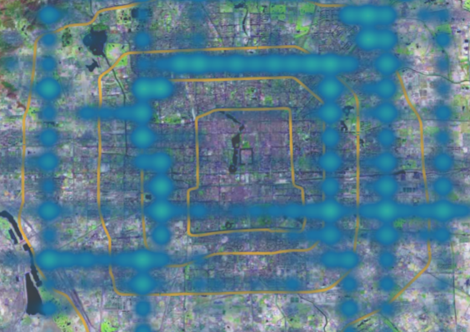
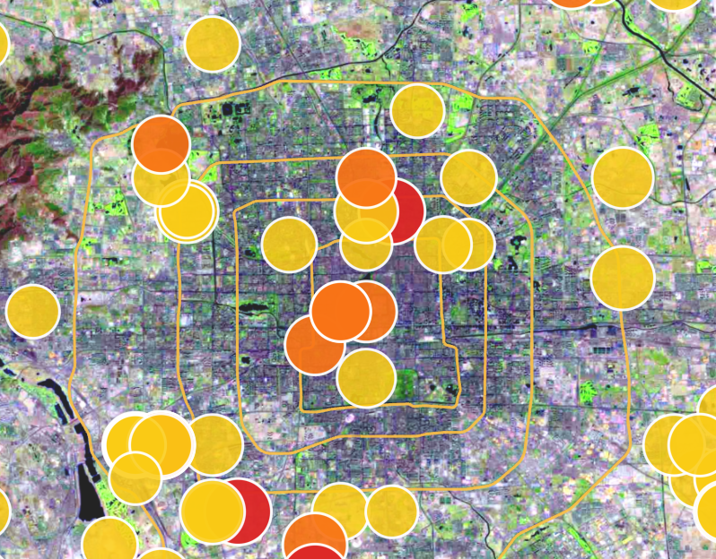
System Delivery: Pipeline → API → Map → Tiered Alerts
17
Batch / realtime micro-batch
preprocess, features, ensemble inference, anomaly fusion
FastAPI service
heatmap, 24h forecast, events, region/time queries
Streamlit map Web
live heatmap, forecast animation, event details and history
Three alert tiers
General 110 · Important 15 · Urgent 6
Important: popup · Urgent: popup + sound
All 131 events are map-locatable: 108 main centroids + 23 top-cell fallbacks.
Notes:
The system wraps each event with time, location, class, severity and evidence fields. Batch and realtime micro-batch modes share preprocessing and inference. FastAPI exposes heatmap, forecast and event queries, while Streamlit provides maps, animation and history. The 131 events are all locatable, and the alert distribution is 110 general, 15 important and 6 urgent. Two placeholders are retained for the latest screenshot and a short demo. Next is explainability.

Slide 18


Attention, TreeSHAP and External Context Evidence
18
Attention entropy: 0.9956
TreeSHAP surrogate R²: 0.9926
Aggregated attention does not collapse onto a small set of lags.
Flow history contributes 97.43%; calendar context contributes 2.33%.
ANOMALY CONTEXT
82 of 131 events match weather/calendar candidates; 49 have no external match.
Attention, SHAP and context associations explain contribution—not causation.
Notes:
Normalized temporal-attention entropy is 0.9956, so aggregate attention does not collapse onto a few lags. A TreeSHAP surrogate reaches 0.9926 R-squared; flow history contributes 97.43 percent and calendar context 2.33 percent. Of 131 events, 82 match weather or calendar candidates. Attention, SHAP and context associations describe contribution and correlation, not causation. The next slide covers performance optimization.

Slide 19


System Performance: Faster, Leaner, Numerically Consistent
19
1.39×
−53.9%
0.038s
0.9945×
warm FP32: 6.416s → 4.613s
process-tree RSS
stats cache, from 1.723s
FP16 speed ratio
DEPLOYMENT DECISION: KEEP OPTIMIZED FP32
Shared full-sequence inference and batch=8 accelerate; FP16 saves memory but misses the speed gate.
Notes:
Optimization was driven by measured bottlenecks. Sharing full-sequence inference and batching reduced warm FP32 runtime from 6.416 to 4.613 seconds, a 1.39-times speedup. Process-tree RSS fell 53.9 percent, and cached statistics dropped from 1.723 to 0.038 seconds. FP16 passed quality checks but did not improve speed, so optimized FP32 remains the deployment choice. Next, I summarize the highlights and limits.

Slide 20
Highlights, Limitations and Next Steps
20
The key outcome is verifiable completeness—not one isolated model.
01
02
03
Trusted data
Verifiable model
Actionable system
gap-aware and no leakage; 41 → 33 audited dimensions
dual graph + gate + residual; strict ablation and multi-seed
fusion becomes classified events, maps and tiered alerts
Limits
public prototype · weak labels · offline micro-batch
Next
authorized data → human labels → transfer → Optuna → streaming
Hard problems: time gaps, spatial mapping, 1024×48 attention, missing labels and resource limits.
Notes:
The project has three main strengths: trusted data rules, a model validated through ablation and multiple seeds, and an anomaly output that becomes a classified, mapped and tiered operational event. Limitations include public-benchmark prototyping, weak labels, offline micro-batch simulation and missing news or activity ground truth. The next steps are authorized data, human labels, cross-city transfer, Optuna and concurrent streaming. The next slide lists the principal research sources.

Slide 21
Key Papers and Technical References
21
SPATIAL
LONG CONTEXT
ANOMALY & XAI
GCN · STGCN · Graph WaveNet
Transformer · Spacetimeformer
VAE · Anomaly Transformer · SHAP · Optuna
Graph learning and forecasting
Anomaly, explainability and optimization
[1] Yu et al. STGCN. IJCAI, 2018.
[2] Vaswani et al. Attention Is All You Need. NeurIPS, 2017.
[3] Kipf & Welling. GCN. ICLR, 2017.
[4] Wu et al. Graph WaveNet. IJCAI, 2019.
[5] Grigsby et al. Spacetimeformer. arXiv:2109.12218, 2021.
[6] Kingma & Welling. Variational Autoencoder. ICLR, 2014.
[7] Xu et al. Anomaly Transformer. ICLR, 2022.
[8] Lundberg & Lee. SHAP. NeurIPS, 2017.
[9] Akiba et al. Optuna. KDD, 2019.
PROJECT POSITION
Engineering combination and empirical selection; AGFormer is project-specific.
Full paper links and report citations are retained in the project documentation.
Notes:
The spatial foundation comes from GCN, STGCN and Graph WaveNet; long-context modeling comes from Transformers and Spacetimeformer; anomaly and interpretation work builds on VAE, Anomaly Transformer and SHAP, with Optuna planned for automated tuning. The contribution is the engineering combination and empirical selection under one controlled workflow. I will close with the three measurable outcomes.

Slide 22
CONCLUSION
15.9030
From Urban Flow to Safety Signals
24h average MAE
131
fused anomaly events
Making city movement predictable, explainable and actionable.
1.39×
end-to-end speedup
Q&A
Five-month algorithm internship · research to working system
Notes:
Over five months, I completed the full algorithm-engineering loop from research and data contracts to forecasting, anomaly detection, service delivery and performance evaluation. The final system achieved 15.9030 average MAE over 24 hours, produced 131 fused anomaly events and obtained a 1.39-times end-to-end speedup. My summary is simple: turn urban movement into predictable, explainable and actionable safety signals. Thank you, and I welcome your questions.

