Slide 1
ALGORITHM INTERNSHIP DEFENSE
Multi-source Spatiotemporal Data
for Urban Crowd Forecasting
and Anomaly Alerts
Ride-hailing Safety Algorithm Internship
Name: ______ Student ID: ______ Supervisor: ______
Defense date: __________
Notes:
Good morning, professors. My project is titled Multi-Source Spatiotemporal Data for Urban Crowd Forecasting and Anomaly Alerts. I worked in a ride-hailing safety algorithm context, with the goal of turning city-grid mobility signals into forecasts, anomaly events and operational alerts. I will present the work through research, data, modeling, anomaly detection and system delivery.

Slide 2
From Data to Alerts: A Complete Loop
01 / OVERVIEW 02
A reproducible chain across data, forecasting, detection, service and evaluation.
24h
3 tiers
48 half-hour steps
API · Web · alerts
1,024
3-way
spatial nodes
anomaly fusion
Urban crowd forecasting, anomaly detection and tiered alert system
Notes:
This was not only a forecasting-model exercise. I completed a full chain from data to service: 1,024 spatial nodes, a 24-hour forecasting horizon, three anomaly evidence branches, and a FastAPI plus map-based Web system with three alert levels. The next slide translates that technical chain into three connected safety decisions.

Slide 3
Ride-hailing Safety Requires Anticipate–Detect–Respond
03
Anticipate
How will each region change over 24h?
Internship role
Ride-hailing Safety
Detect
Algorithm Intern
Which deviations exceed normal behavior?
Respond
The goal is not one prediction,
What type and alert tier should be triggered?
but an actionable safety event.
Region × time × anomaly type × response action
Notes:
The business problem has three stages. Anticipation asks how mobility will change across regions. Detection asks which deviations exceed a normal range. Response requires location, event type and alert severity. A model score is therefore only an intermediate artifact; the final output must be a queryable and explainable event that can trigger an operational action.

Slide 4
Five-Month Work Allocation
04
Nearly half the period focused on model training, selection and validation.
WORKSTREAM
W1
W5
W9
W13
W17
W20
Requirements & papers
3 weeks
Data, features, graphs, pipeline
4 weeks
Baselines, models, ablations, multi-seed
7 weeks · core effort
Anomaly fusion & classification
3 weeks
API, Web, XAI, performance, defense
3 weeks
Internship effort: model development ran for seven weeks, 35% of the full project and the longest single workstream.
Defense pacing: 11 model slides, about 7–8 minutes or 45% of the talk, focused on evidence and negative results.
Notes:
This 20-week timeline is a retrospective workload estimate. The first seven weeks covered research, cleaning, features and graph construction. Weeks 7 to 14 formed the longest workstream: baseline training, architecture selection, ablation and multi-seed replication. I also allocate roughly seven to eight minutes, close to half of this defense, to the model section because the important story is not only the final score, but why each module was added and why several reasonable ideas failed.

Slide 5
End-to-End Technical Route
05
One time, space and data contract connects models directly to detection and service.
Governance
Features
Forecast
Anomaly
Delivery
gap-aware windows
flow · time · static
baselines · AGFormer
three scores · fusion
batch / realtime
chronology · no leakage
candidate graphs
STF · residual · ensemble
events · classes
API · map · alerts
valid samples
model input
24h forecast
event object
usable service
SHARED GATES
continuity
no leakage
fair windows
validation selection
reproducibility
Notes:
The end-to-end route has five layers. Data governance produces continuous windows; feature engineering creates aligned model inputs; forecasting generates 48 future half-hour steps; anomaly detection converts scores into event objects; and the API and Web layers expose queries and alerts. The common rules are continuity, leakage control, matched-window comparison, validation-only selection and reproducible outputs.

Slide 6
From Spatiotemporal Graphs to Transformers
06
Literature shaped a testable combination of spatial priors, long context and anomaly learning.
GCN
STGCN
Transformer
Graph WaveNet
Spacetimeformer
VAE / SHAP
graph propagation
space + time
global context
adaptive graph
variable × time tokens
detect & explain
Project decision
Explicit graph + adaptive graph + temporal attention + three-way fusion
AGFormer is project-specific; it is not claimed as an external paper reproduction.
Notes:
The literature review created testable hypotheses rather than a list of model names. STGCN motivated explicit graph propagation, Transformer motivated long-context attention, Graph WaveNet motivated learned adjacency, and Spacetimeformer provided a general variable-by-time token formulation. Slides 10 through 19 trace those mechanisms into code, experiments and retention decisions.

Slide 7
Data Foundation: Flow, Space and Context
07
1,024
anonymized city-grid nodes
A shared half-hour clock aligns dynamic, static and exogenous signals.
Dynamic flow
Static space
Context
grid inflow / outflow
roads · POI · transit · remote sensing
weather · workdays · holidays
DATA BOUNDARY
Public-benchmark prototype; designed for compliant, authorized internal deployment.
Notes:
All sources were aligned to 1,024 anonymized city-grid nodes and a half-hour clock. Dynamic inputs are inflow and outflow. Static inputs include road, POI, transit and remote-sensing attributes, while exogenous inputs include weather and calendar information. The prototype evaluation uses public benchmark data; the engineering design is intended for compliant transfer to authorized internal data rather than falsely relabeling public data as proprietary.

Slide 8
Gap-Aware Windows, Chronological Splits, No Leakage
08
The critical risk was false continuity, not simply missing values.
fake window across a gap
Wrong merge
True sequence
window stops at the gap
01 Time rules
02 Split rules
03 Leakage gate
real timestamps + gap filter
train / val / test = 7:1:2
scaler fitted on training only
48 history → 48 future
chronological, never shuffled
4,022 valid test windows
Checkpoints retain configuration, data rules and scaling metadata to prevent stale-model reuse.
Notes:
The most serious data risk was treating missing periods as continuous. Such windows have the correct length but connect two unrelated sides of a gap, contaminating both training and evaluation. I rebuilt true timestamps, removed windows crossing gaps, kept the split chronological and fit scalers on the training segment only. The final test set contained 4,022 valid continuous windows.

Slide 9
Features and Graphs: Build Broadly, Ablate Strictly
09
More sources do not imply indiscriminate feature injection.
Static-feature audit
Four candidate graphs
41
Spatial adjacency
POI similarity
final explicit graph
candidate graph
candidate dimensions
Flow correlation
Rail topology
33
candidate graph
candidate graph
leakage-safe static features
explicit spatial graph
learned adaptive graph
Final input also includes 7 calendar/time and 2 flow channels.
Final: dual-graph path
Multi-graph fusion did not win; context works better through gates than unconditional addition.
Notes:
The initial static candidate set had 41 dimensions across geography, roads, POI, remote sensing, transit and historical statistics. Leakage review removed eight dimensions that depended on full-period statistics, leaving 33 static features, seven time and calendar features, and two flow channels. Candidate graphs included spatial, flow, POI and transit relations; the final model retained the explicit spatial graph plus learned adaptive adjacency.

Slide 10
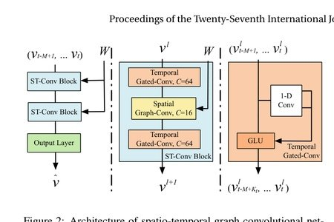
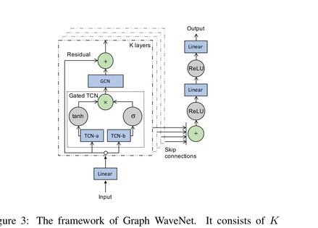
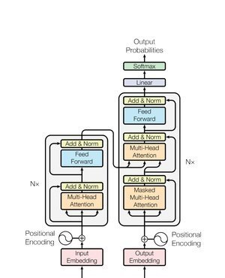
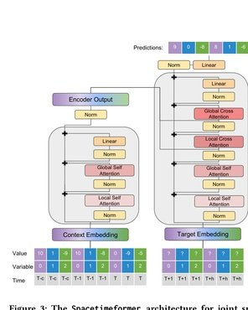
Paper-to-Project Module Map
10
Mechanisms were transferred selectively; the original tasks and full architectures were not copied wholesale.
STGCN
Graph WaveNet
Used: explicit graph convolution and
Used: node embeddings for
alternating spatiotemporal blocks
adaptive adjacency
Changed: temporal conv → self-attention
Kept: the known regular-grid graph
Why: model the full 48-step history
Goal: known + latent dependencies
Yu et al., IJCAI 2018, Fig. 2
Wu et al., IJCAI 2019, Fig. 3
Transformer
Spacetimeformer
Used: attention, residuals, norm and FFN
Used: variable × time tokens and
Changed: encoder-style temporal path
local/global attention
Avoided: full decoder complexity
Aligned: value/time, given, target
Role: long dependencies per node
Aligned: encoder-decoder cross-attention
Role: general-attention challenger
Vaswani et al., NeurIPS 2017, Fig. 1
Grigsby et al., arXiv:2109.12218, Fig. 3
AGFormer is a project-specific composition: papers supplied hypotheses; controlled experiments decided what stayed.
Notes:
This slide maps papers to project mechanisms. STGCN contributed explicit graph convolution and alternating spatiotemporal processing, but I replaced temporal convolution with attention. Graph WaveNet contributed node-embedding adaptive adjacency. Transformer contributed multi-head attention, residual connections, normalization and feed-forward layers. Spacetimeformer acted as a more general challenger with variable-by-time tokens, local and global attention, embeddings and encoder-decoder cross-attention. AGFormer is a project-specific composition, not a claimed reproduction of an external same-name paper.

Slide 11
Five Evidence Gates to the Final Model
11
Each step tested one question: spatial value, context injection, linear trend, or training variance.
01 · Temporal baseline
02 · Add spatial prior
03 · Gate context
04 · Linear residual
05 · Reduce variance
LSTM
AGFormer
Gated
Gated + Linear
4-seed Ensemble
Time + Static
19.4941
16.9376
16.5350
16.1132
15.9030
avg MAE · 3 seeds
avg MAE · 3 seeds
avg MAE · seed42
avg MAE · seed42
avg MAE · 4,022 windows
48-step history helps,
Explicit + adaptive
Scale time/static by
Linear trend +
Prediction averaging
but no spatial flow.
graphs beat temporal-only.
the current flow state.
nonlinear correction.
reduces MAE and MAPE.
How to read the staircase
The first two are three-seed metric means; the next two are seed42 models; the last averages predictions across four models.
It documents the R&D path, while strict claims use matched seeds/windows or independent multi-seed checks.
Final gain: ensemble MAE is 3.82% below the original gated baseline.
Notes:
The experiments progressed through five evidence gates. Gap-aware LSTM reached 19.4941 MAE. Adding explicit and adaptive spatial paths reduced the three-seed AGFormer Time-plus-Static mean to 16.9376. Context gating reached 16.5350 at seed42. A linear residual reduced the matched seed42 result to 16.1132. Finally, prediction-level averaging across four seeds reached 15.9030. The metrics use different seed summaries, so this slide documents the R and D path; strict claims use matched seeds, matched windows or separate multi-seed checks.

Slide 12

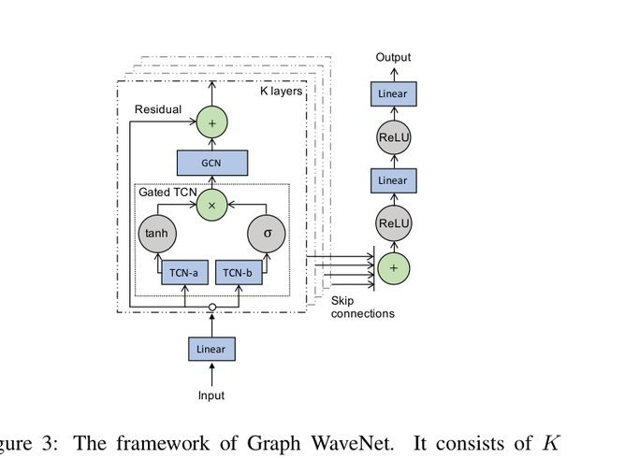
Spatial Lineage: Known Graph + Learned Links
12
STGCN: local propagation on a known graph
Graph WaveNet: latent links from data
Its T-GCN-T block injects adjacency W directly.
Node embeddings recover links omitted by the prior graph.
Source: Yu et al., IJCAI 2018, Fig. 2
Source: Wu et al., IJCAI 2019, Fig. 3
AGFormer's spatial path
spatial GCN
+
adaptive node-embedding graph
→
fused prediction
Why it worked: the 32×32 grid has stable neighbors; the explicit graph narrows search while the adaptive graph adds non-local links.
Notes:
The spatial path combines two complementary ideas. STGCN injects a known adjacency matrix into local propagation, while Graph WaveNet learns links that a prior graph may miss through node embeddings. The project therefore keeps a predefined spatial GCN and learns adaptive adjacency. This worked because a 32-by-32 regular grid has stable neighbors: the explicit graph narrows the search space, and the adaptive graph adds non-local dependencies.

Slide 13
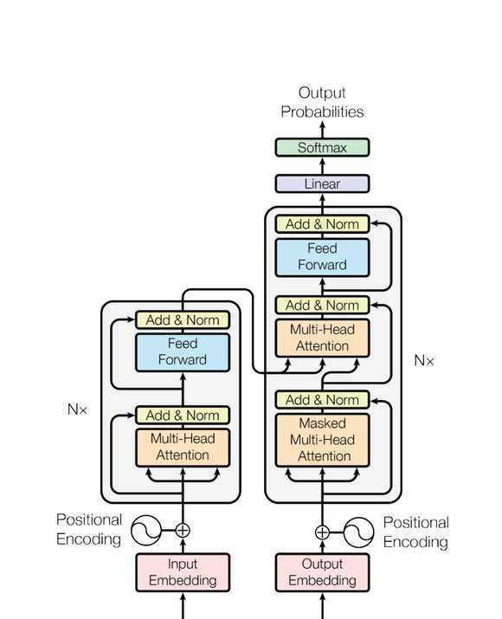
Temporal Lineage: Transformer Core in AGFormer
13
Original encoder-decoder
Project: 48-step attention per node
Input token
4-head Self-Attn
FFN + Norm
flow + context
2 layers
Mechanisms retained
Intentional simplification
• Attention over 48 half-hour steps
• No language-style decoder
• Residuals, LayerNorm and FFN
• Temporal/spatial paths split
• Calendar and time encoding
• Direct 48-step projection
Why this is not a literal Transformer copy
Attention models dependencies; the project structure also respects
graph topology, memory limits and 24-hour forecasting.
Vaswani et al., NeurIPS 2017, Fig. 1
Configuration: d_model=32, four heads, two layers; the final single model has about 0.052M parameters.
Notes:
The temporal path uses the core Transformer computation without copying the translation architecture. Within each node, 48 half-hour steps form a sequence processed by two layers, four heads and model dimension 32. Residual connections, LayerNorm and feed-forward blocks are retained. A language-style full decoder is intentionally omitted, and temporal and spatial modeling are separated to avoid applying standard global attention to all 1,024 times 48 tokens.

Slide 14

Spacetimeformer: Five-Step Paper Alignment
14
Paper: variable × time tokens
Implementation alignment sequence
Fix input facts first
1
True timestamps, 33 static features, gap-aware windows
Match AGFormer capacity
2
d=32, four heads, two layers; 0.030M → 0.082M
Align attention structure
3
Local temporal attention + linear global attention
Align embeddings
4
Separate value/time, given/missing, context/target tokens
Complete encoder-decoder
5
Local/global cross-attention; full aligned model ≈ 0.089M
Grigsby et al., arXiv:2109.12218, Fig. 3
Context tokens: 1,024 × 48 = 49,152; standard global attention is impractical.
The goal was to test the architectural hypothesis, not claim a 100% reproduction of every training detail.
Notes:
I evaluated Spacetimeformer through five alignment steps. First, I corrected timestamps, static features and gap-aware windows. Second, I matched AGFormer capacity. Third, I implemented local temporal and linear global attention. Fourth, I added separate value and time embeddings, given or missing embeddings, and context and target tokens. Fifth, I completed the encoder-decoder and local or global cross-attention. The aligned model had about 0.089 million parameters, but its 49,152 context tokens still required approximate attention.

Slide 15

Why the Better-Aligned Spacetimeformer Still Lost
15
1 · Capacity was not the bottleneck
0.030M → 0.082M; MAE 17.9967 → 18.6715
More parameters generalized worse
2 · Global attention needed approximation
49,152 tokens make quadratic attention infeasible
Approximation complicated optimization
3 · Future time context added noise
MAE 18.4433 → 18.2950 after disabling it
RMSE 34.4038 → 33.4965
4 · Explicit grid bias fit better
Known neighbors did not need relearning
Best STF + linear MAE: 17.0688
Transferable discovery: the linear output path
It lowered STF MAE from 18.2950 to 17.0688. Gated STF improved MAPE, but its worse MAE/RMSE made it unsuitable for absolute-residual detection.
A failed challenger still identified the inductive-bias mismatch and produced a module worth transferring.
Notes:
A larger and better-aligned model still did not win. Expanding from 0.030 to 0.082 million parameters changed MAE from 17.9967 to 18.6715, so capacity was not the bottleneck. Disabling future time context improved both MAE and RMSE, suggesting decoder-side future context acted as noise. The explicit regular-grid prior also matched the task better than relearning all relationships as tokens. The useful discovery was the linear output path, which reduced Spacetimeformer MAE from 18.2950 to 17.0688 and was then transferred to AGFormer.

Slide 16
Final AGFormer: Evidence-Based Module Composition
16
Input
48-step inflow / outflow
7 time/calendar features
33 static features
Aligned node indices, true timestamps and gap-aware continuous windows
Context gate
Scale time and static signals conditional on flow
Temporal path
Explicit spatial path
Adaptive spatial path
2 layers · 4 heads · d=32
spatial graph GCN
node-embedding adjacency
Transformer self-attention
Stable neighbor propagation
Data-driven non-local links
Source: Vaswani et al.
Source: STGCN lineage
Source: Graph WaveNet idea
Output
nonlinear AGFormer + Linear(history inflow)
The linear residual came from the useful part of the failed Spacetimeformer branch;
four seed predictions are then averaged.
0.052M per model · real-time fallback: seed42
AGFormer is a project-specific implementation, not a claimed reproduction of an external same-name paper.
Notes:
The final AGFormer has four parts. Inputs are 48 flow steps, seven time features and 33 static node features. A context gate makes the contribution of time and static information conditional on the current flow state. The backbone combines a Transformer temporal path, an STGCN-lineage explicit spatial GCN and Graph-WaveNet-style adaptive adjacency. The output adds the linear residual discovered in the Spacetimeformer ablation. Each model has about 0.052 million parameters; the offline path averages four seeds, while real-time inference can fall back to seed42.

Slide 17

Context Gating vs. Feature Overload
17
Why did gating help?
Time and static signals are not equally useful
for every node and period.
gate(flow) makes their effect conditional.
Why did the repaired calendar hurt?
Fixing shifted workdays removed the earlier
apparent gain.
MAE 17.8542 vs gated 16.5350.
Why was weather marginal?
Calendar + Weather: 17.8316, only 0.0226 better.
Effects are sparse and spatially heterogeneous;
strong flow history absorbs part of the signal.
Retention decision
Keep seven time and 33 leakage-free static features, but inject them through gates.
Weather was excluded because no stable gain survived the corrected data rules.
Feature engineering also means correcting rules, matching windows and removing inputs without reproducible value.
Notes:
Gating helped, but adding more exogenous features did not guarantee improvement. The gate prevents time and static context from entering every node and period with equal importance. After correcting shifted workdays, Calendar MAE was 17.8542 and the previous apparent gain disappeared. Calendar plus Weather reached 17.8316, only 0.0226 better than calendar alone and still worse than the gated model at 16.5350. Weather effects are sparse and spatially heterogeneous, while strong flow history absorbs part of the signal. The final forecaster keeps time and static context through gates but excludes weather.

Slide 18
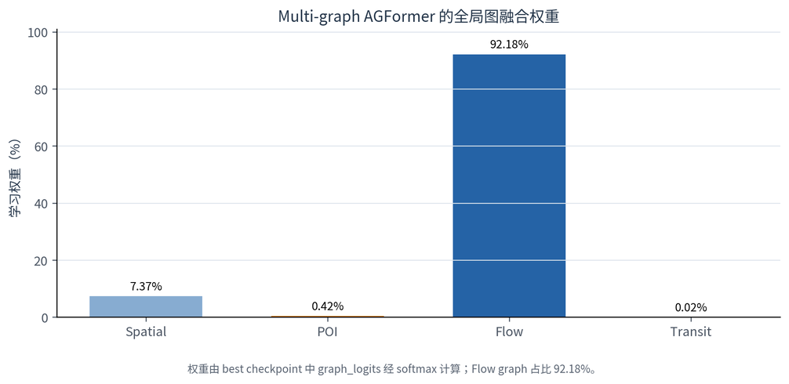
Negative Results: Multi-Graph and Periodic Lags
18
A · Multi-graph AGFormer
B · lag_48 / lag_336 and deltas
Strict comparison on the same 3,433 test windows
Matched baseline
16.2443
Periodic lags
17.9614
avg MAE; lower is better
flow 92.18% · spatial 7.37%
lag_48 overlaps with strong daily persistence;
POI 0.42% · transit 0.02%
lag_336 is brittle around holidays and gaps;
One global softmax collapsed toward the flow graph.
delta features amplify irregular shocks.
It could not express node- or time-specific graph value.
Next design
Node/head/layer graph routing and a learnable seasonal branch, instead of global graph scalars
or raw lag concatenation.
Future hypotheses, not gains.
Multi-graph avg MAE was 16.9569, also behind the single-graph gated model at 16.5350.
Notes:
Two additional negative results shaped the design. In multi-graph AGFormer, the global softmax assigned 92.18 percent to the flow graph and almost ignored POI and transit, showing that one global scalar cannot express node- or time-specific relevance. For periodic lags, the matched 3,433-window baseline had 16.2443 MAE, while lag 48, lag 336 and delta features produced 17.9614. Daily lags were partly redundant, weekly lags were brittle around holidays and gaps, and deltas amplified shocks. Future work should use node-, head- or layer-level graph routing and a learnable seasonal branch.

Slide 19
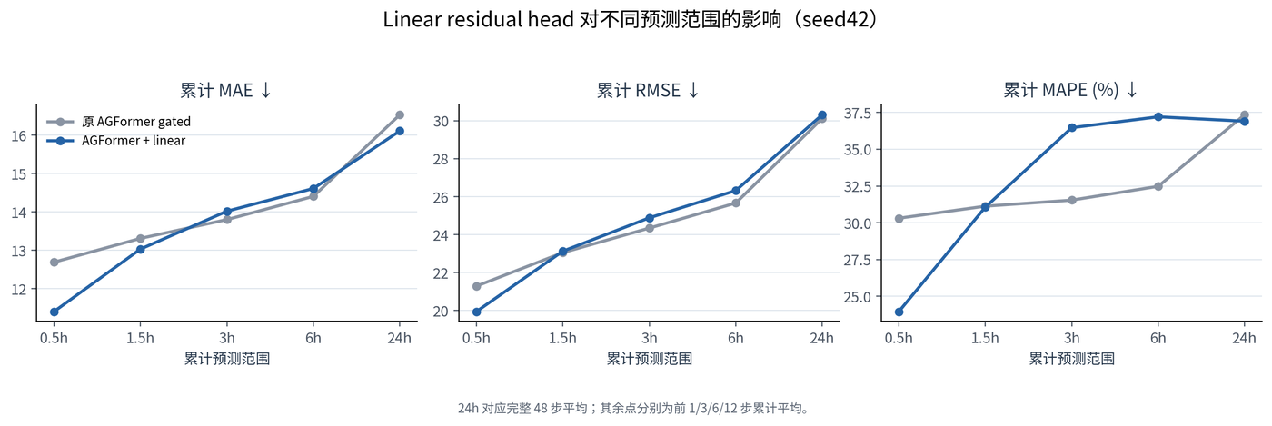
A Useful Module From a Failed Model
19
prediction = nonlinear backbone + Linear(history inflow)
Each node's past 48 inflow values map directly to 48 future steps; the backbone learns the remaining nonlinear correction.
Discovered in Spacetimeformer
18.2950 → 17.0688
avg MAE, about 6.70% lower
Transferred to AGFormer
16.5350 → 16.1132
same seed42, 2.55% lower
Why did RMSE not improve?
Lower average bias can still smooth peaks.
RMSE 30.1288 → 30.3198, up 0.19.
Mechanism
Urban flow has strong autoregressive inertia; the linear branch handles it directly.
The nonlinear backbone can then focus on residual structure.
The module was then tested across four seeds to avoid mistaking a seed42 accident for structural value.
Notes:
The linear residual was the most reliable structural improvement. The formula is a nonlinear backbone plus a direct linear mapping from 48 past inflow values to 48 future values. It first reduced Spacetimeformer MAE from 18.2950 to 17.0688, then reduced matched seed42 AGFormer MAE from 16.5350 to 16.1132. The linear path handles autoregressive inertia, leaving nonlinear residual structure to the backbone. RMSE moved slightly from 30.1288 to 30.3198, showing that lower average error does not automatically reduce extreme-peak error.

Slide 20
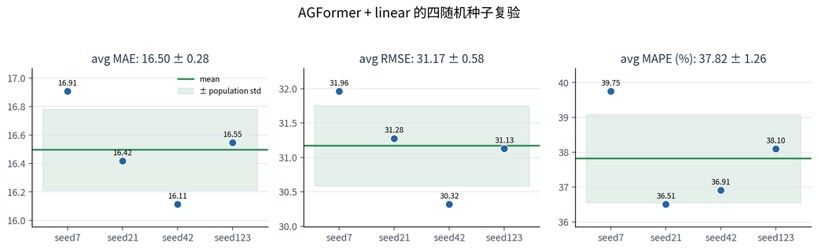
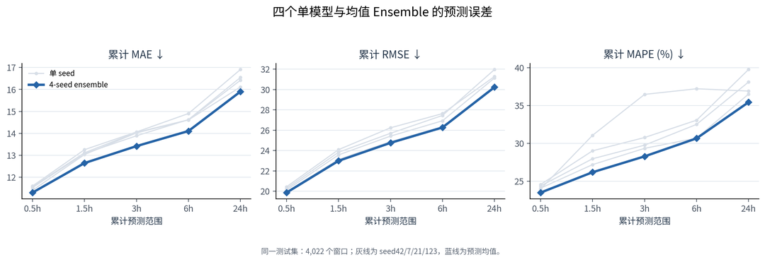
Multi-Seed Replication and Ensemble
20
Four independently trained seeds
Ensemble error across forecast horizons
Best single model: seed42
Four-seed model mean
Prediction-level mean
Deployment trade-off
16.1132
16.4961
15.9030
Offline detection: 4 models
Real-time API: seed42
lowest single-model MAE
± 0.2850
MAE · RMSE 30.2250
roughly 4× forward cost
h1 / h3 / h6 / h12 MAE: 11.3019 / 12.6473 / 13.4194 / 14.1068; full 24-hour average: 15.9030.
Notes:
To test whether seed42 was accidental, I trained seeds 7, 21 and 123. The four single-model MAEs were 16.1132, 16.9079, 16.4172 and 16.5463, with mean 16.4961 and standard deviation 0.2850. Prediction-level averaging reduced MAE further to 15.9030, with h1 MAE at 11.3019. The offline anomaly pipeline uses all four models to lower the normal residual noise floor, while the real-time API can use seed42 only and trade a small amount of accuracy for roughly four times less forward computation.

Slide 21
Three-Way Anomaly Fusion
21
Complementary evidence becomes a mergeable, classifiable event.
Statistical
3σ + IQR
node × time-slot range
Event builder
Output
Weighted fusion
Reconstruction
time continuity
event type
0.70 / 0.20 / 0.10
spatial IoU / centroid
severity tier
VAE + Transformer AE
threshold 0.56
main-region overlap
evidence fields
weak-normal windows only
Prediction error
AGFormer ensemble residual
Validation selects the weights and threshold; space and time turn detections into events.
Notes:
Anomaly detection combines three branches. Three-sigma and IQR define statistical normal ranges. VAE and Transformer autoencoders learn weak-normal reconstruction patterns. The prediction branch uses the residual between observations and the final AGFormer forecast. Weights of 0.70, 0.20 and 0.10, together with decision threshold 0.56, were selected on validation data. Detected timesteps are then merged by temporal and spatial continuity and classified into events.

Slide 22


Anomaly Results: Event-Level Evaluation
22
Level-A timestep
Level-A event
P .4322 R .5688 F1 .4912
P .4580 R .5085 F1 .4819
EVALUATION BOUNDARY
131 events; metrics reflect weak-label agreement. Manual review is not ground truth.
Notes:
Under the weak-label evaluation, fusion outperformed individual branches and produced 131 events. Level-A timestep F1 was 0.4912 and event-level F1 was 0.4819. These values are not real-world event-detection accuracy because authoritative labels are unavailable and the statistical rule contributes to both weak labels and fusion. A manual sample of 50 events provides a sanity check, not an independent ground truth.

Slide 23

System Delivery: Pipeline → API → Map → Tiered Alerts
23
Batch / realtime micro-batch
preprocess, features, ensemble inference, anomaly fusion
FastAPI service
Replace with latest home /
heatmap, 24h forecast, events, region/time queries
tiered-alert screenshot
Streamlit map Web
live heatmap, forecast animation, event details and history
Current Web prototype
Three alert tiers
Short Web demo video
General 110 · Important 15 · Urgent 6
Insert a 20–30 second map interaction recording
Important: popup · Urgent: popup + sound
All 131 events are map-locatable: 108 main centroids + 23 top-cell fallbacks.
Notes:
The system represents each result as an event object with time, location, type, severity and explanation fields. Batch and real-time micro-batch modes share preprocessing and inference. FastAPI provides heatmap, forecast and event queries, while Streamlit provides the map, forecast animation and historical statistics. All 131 events are locatable; the alert distribution is 110 general, 15 important and 6 urgent. Two placeholders remain for the latest dashboard screenshot and a short Web demo video.

Slide 24

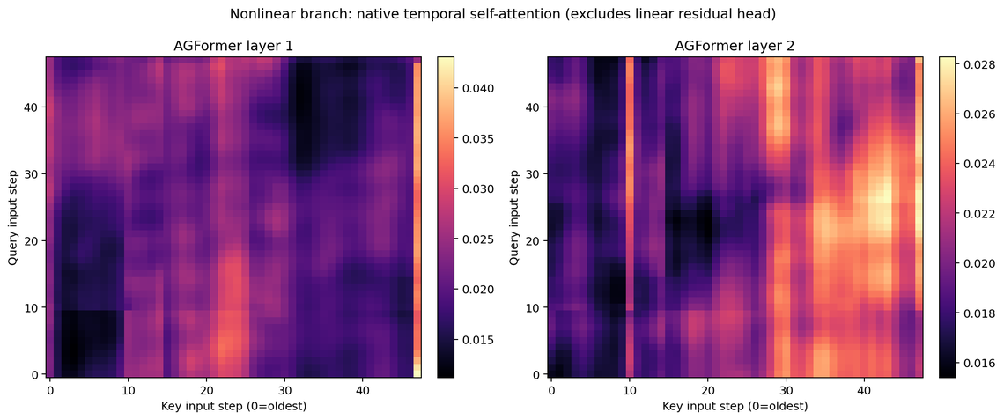
Attention, TreeSHAP and External Context Evidence
24
Attention entropy: 0.9956
TreeSHAP surrogate R²: 0.9926
Aggregated attention does not collapse
Flow history contributes 97.43%;
onto a small set of lags.
calendar context contributes 2.33%.
ANOMALY CONTEXT
82 of 131 events match weather/calendar candidates; 49 have no external match.
Attention, SHAP and context associations explain contribution—not causation.
Notes:
The normalized temporal-attention entropy is 0.9956, indicating that aggregated attention is not concentrated on only a few lags. A TreeSHAP surrogate achieved R-squared 0.9926; historical flow contributed 97.43 percent and calendar features 2.33 percent. Among 131 events, 82 matched weather or calendar candidate evidence. Attention, SHAP and external context describe association and contribution, not causality.

Slide 25
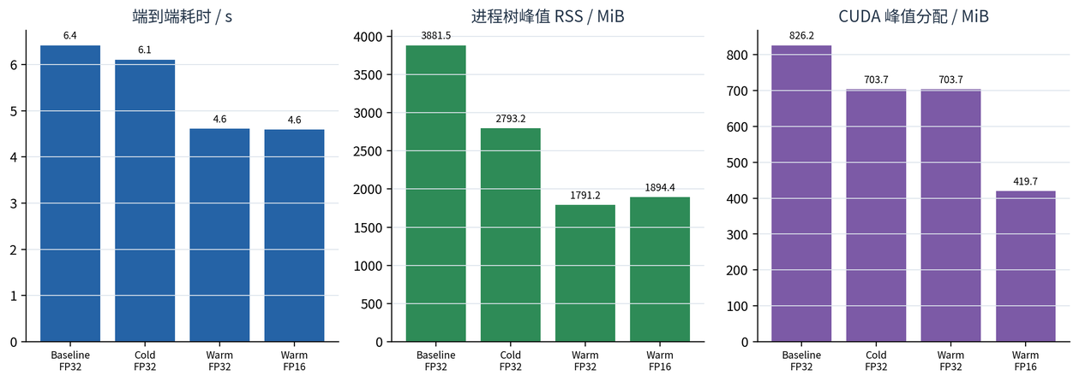

System Performance: Faster, Leaner, Numerically Consistent
25
1.39×
−53.9%
0.038s
0.9945×
warm FP32: 6.416s → 4.613s
process-tree RSS
stats cache, from 1.723s
FP16 speed ratio
DEPLOYMENT DECISION: KEEP OPTIMIZED FP32
Shared full-sequence inference and batch=8 accelerate; FP16 saves memory but misses the speed gate.
Notes:
Performance optimization began with measurement. Shared full-sequence inference and batching reduced warm FP32 end-to-end time from 6.416 to 4.613 seconds, a 1.39-times speedup. Process-tree RSS fell by 53.9 percent, and statistical caching reduced 1.723 seconds to 0.038 seconds. FP16 passed quality checks but achieved a speed ratio of only 0.9945, so it was not selected for deployment.

Slide 26
Highlights, Limitations and Next Steps
26
The key outcome is verifiable completeness—not one isolated model.
01
02
03
Trusted data
Verifiable model
Actionable system
gap-aware and no leakage;
dual graph + gate + residual;
fusion becomes classified events,
41 → 33 audited dimensions
strict ablation and multi-seed
maps and tiered alerts
Limits
public prototype · weak labels · offline micro-batch
Next
authorized data → human labels → transfer → Optuna → streaming
Hard problems: time gaps, spatial mapping, 1024×48 attention, missing labels and resource limits.
Notes:
The project has three main strengths. The data foundation is trustworthy through gap-aware and leakage-free rules. The model process is evidence-driven through paper-to-module mapping, explicit and adaptive graphs, context gating, residual transfer, strict ablation and multi-seed replication. The system is actionable because anomaly scores become classified, mapped and tiered alerts. Limitations include public-benchmark prototyping, weak labels, offline micro-batches and limited news or event ground truth. Next steps are authorized data, human labels, transfer studies, Optuna and true streaming deployment.

Slide 27
Key Papers and Technical References
27
SPATIAL
LONG CONTEXT
ANOMALY & XAI
GCN · STGCN · Graph WaveNet
Transformer · Spacetimeformer
VAE · Anomaly Transformer · SHAP · Optuna
Graph learning and forecasting
Anomaly, explainability and optimization
[1] Yu et al. STGCN. IJCAI, 2018.
[6] Kingma & Welling. Variational Autoencoder.
ICLR, 2014.
[2] Vaswani et al. Attention Is All You Need.
NeurIPS, 2017.
[7] Xu et al. Anomaly Transformer. ICLR, 2022.
[3] Kipf & Welling. GCN. ICLR, 2017.
[8] Lundberg & Lee. SHAP. NeurIPS, 2017.
[4] Wu et al. Graph WaveNet. IJCAI, 2019.
[9] Akiba et al. Optuna. KDD, 2019.
[5] Grigsby et al. Spacetimeformer.
arXiv:2109.12218, 2021.
PROJECT POSITION
Engineering combination and empirical selection;
AGFormer is project-specific.
Full paper links and report citations are retained in the project documentation.
Notes:
This slide lists the main technical sources. The model section directly uses STGCN Figure 2, Graph WaveNet Figure 3, Transformer Figure 1 and Spacetimeformer Figure 3, with authors and venues or arXiv identifiers shown on the relevant slides. The contribution is not claiming invention of these foundations; it is combining and evaluating them under one controlled data and engineering framework.

Slide 28
CONCLUSION
15.9030
From Urban Flow
24h average MAE
to Safety Signals
131
fused anomaly events
Making city movement predictable,
explainable and actionable.
1.39×
end-to-end speedup
Q&A
Five-month algorithm internship · research to working system
Notes:
Over five months, I completed an algorithm-engineering loop from research questions and data rules to model training, anomaly detection, system services and performance evaluation. The final 24-hour average MAE is 15.9030, the anomaly framework produced 131 fused events, and the optimized pipeline achieved a 1.39-times end-to-end speedup. My final summary is: turning urban mobility into signals that are predictable, explainable and actionable. Thank you, and I welcome your questions.

