Slide 1
DoConnect
Capstone project
C1 – G5

Slide 2
DoConnect
Mentor : Javeed Mohammed Husnuddin
Batch Members
Ayush Raj
Akhila Kommana
Ankit Vishwakarma
Hema Kumar Undrajavarapu
Sarika Lalam

Slide 3
Problem Statement
DoConnect doConnect is a popular Q and A form in which techniques questions was asked and answered.
To do the above application there are two types of users
1. User
2. Admin

Slide 4
Introduction
doConnect is a popular Q n A site for professional and enthusiast technologist in which techniques questions were asked and answered.
There are many websites where people can ask and answer their questions like StackOverflow, Quora, AskDev etc.
doConnect features questions and answers on a wide range of topics in computer programming.
In this project we created a website to provide all the services to the users through online.
There are 2 users in this application:
1. User
2.Admin

Slide 5
Introduction
doConnect is process of posting technical questions and answers.
A user can easily access all the facilities of the Internet to find relevant answers of their technical domain.
Unlike traditional users have to wait till the next day to get their doubt cleared from their respective mentors but now they can easily get the solutions within few minutes
To achieve this we used Java Full Stack to develop an project called doConnect.
We used angular for developing the frontend part and java spring boot for backend and to store the data we used MySQL.

Slide 6
Objectives
The main Objective of the project DoConnect is to create a simple Online platform where users can find answers for their questions with the experts approval.

Slide 7
Functional requirements of User
User should be able to login, Logout and Register into the application.
User I should be able to ask any question under any topic
User should be able to search the question on any string written in search box
User should be able to Answer any question asked
User should be able to answer more than one question and more than one time
User should be able to chat with other users.
User should be able to upload images to refer

Slide 8
Functional Requirements of Admin
Admin should be able to login, Logout and Register into the application.
Admin should be able to get mail as soon as any new Question is asked or any Answers given.
Admin should be able to approve the question and Answer. Any Question or Answer will be visible on the platform only if it is approved.
Admin should be able to delete inappropriate Questions or Answers.

Slide 9
Software Requirements
Technologies and Languages
IDE
Technologies:
-Angular
-Spring Boot
Languages:
-TypeScript
-Java
-SQL
Visual Studio Code
Spring Tool Suite
MySql Workbench

Slide 10
Hardware Requirements
Operating System : Windows 7/8/10/11 OR MacOS X .
Processor : Intel or AMD dual core x86 processor.
RAM : 2GB or more.
Hard disk: 500MB free space or more.

Slide 11
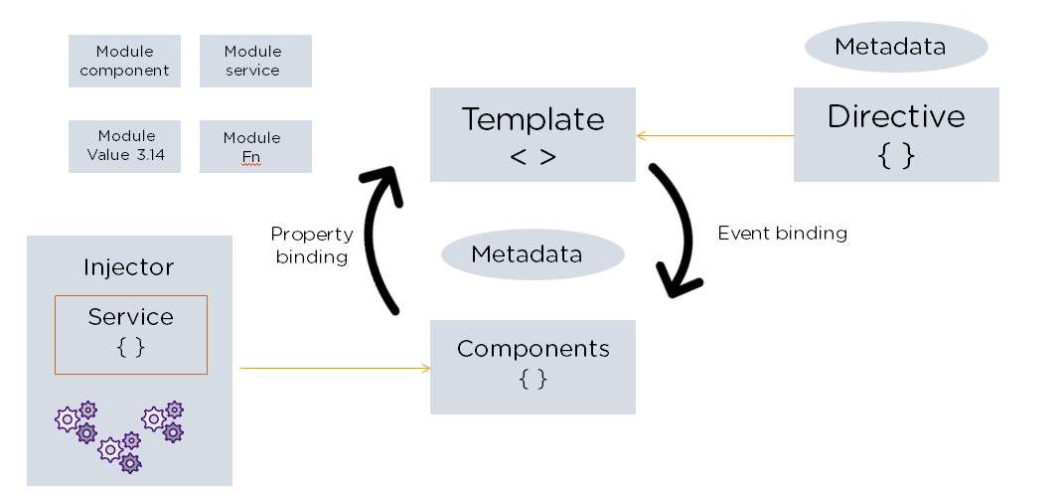
Angular Architecture

Slide 12
Angular Architecture
There are main eight blocks of Angular:
Module
Component
Metadata
Template
Data Binding
Service
Directive
Dependency Injection

Slide 13
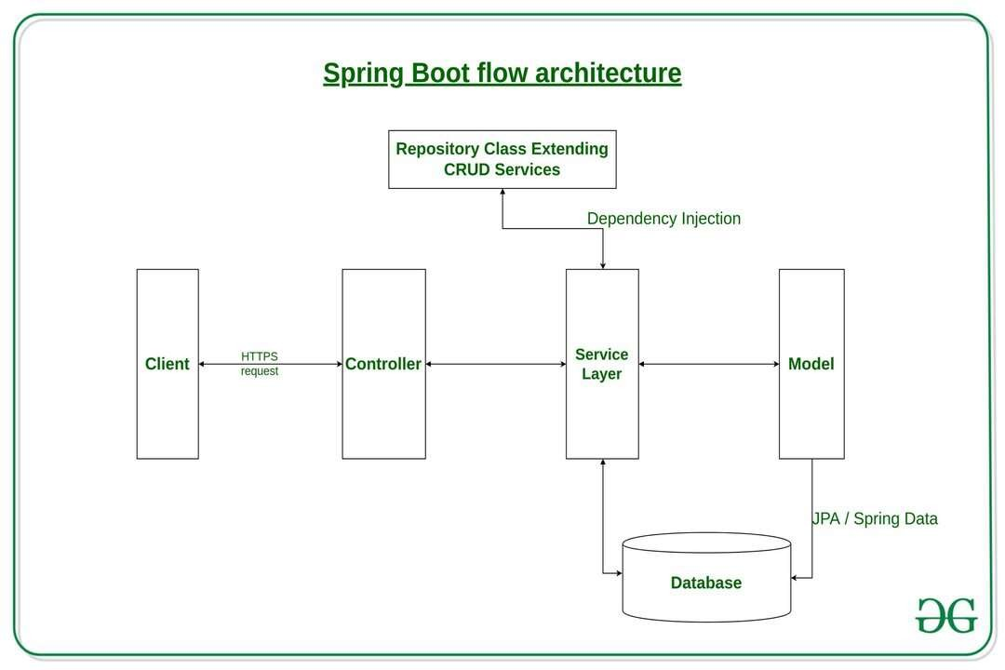
SpringBoot Architecture

Slide 14
Spring Boot Architecture
The Spring Boot consists of the following four layers:
-Presentation Layer: Authentication and JSON Translation.
-Business Layer : Business Logic, Validation and Authorization.
-Persistence Layer : Storage Logic.
-Database Layer: Actual Database.

Slide 15
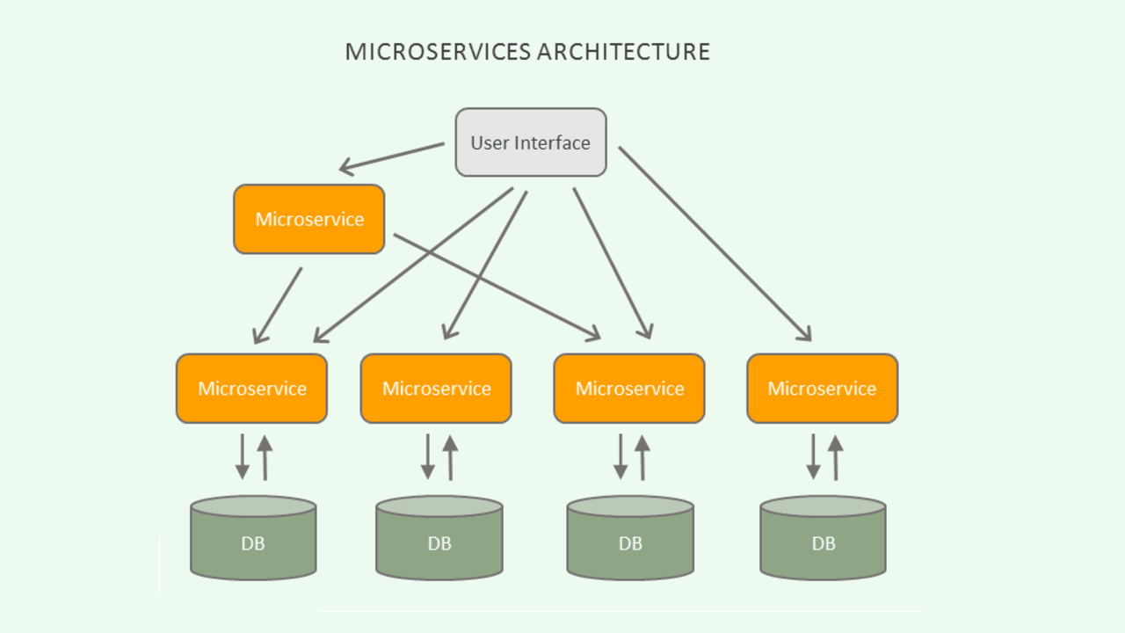
Micro service Architecture

Slide 16
Micro service Architecture
-Typically, microservices are used to speed up application development.
-Microservices architecture built using Java are common, especially Spring Boot ones.

Slide 17
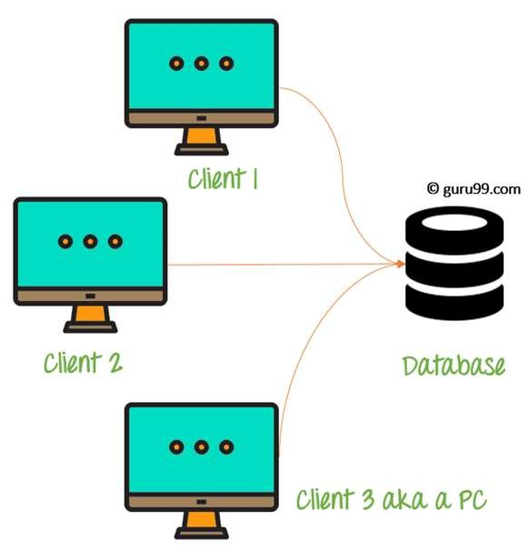
Data Base Architecture

Slide 18
Database Structure
Entities include in the database
-User
-Admin
-Question
-Answer

Slide 19
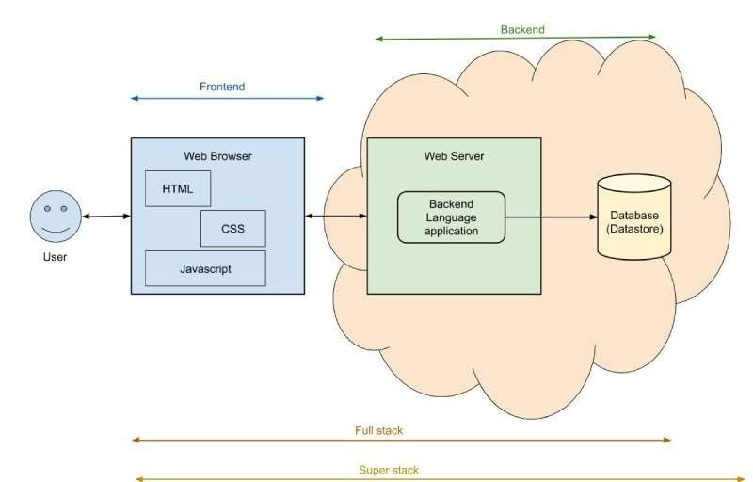
Total Project View

Slide 20
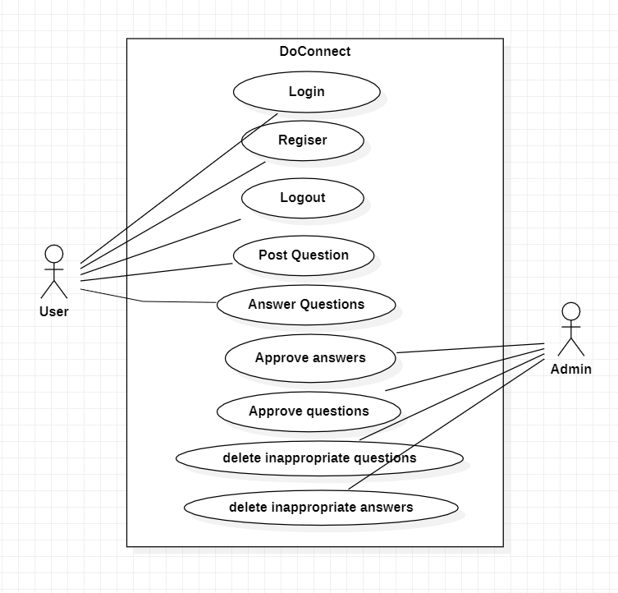
Use Case Diagram

Slide 21
Front End
Technologies used in front end:
-Angular
-Ng-Zorro

Slide 22
Backend
Technologies Used:
Spring Boot
Java
JWT
Hibernate
SQL
Maven

Slide 23
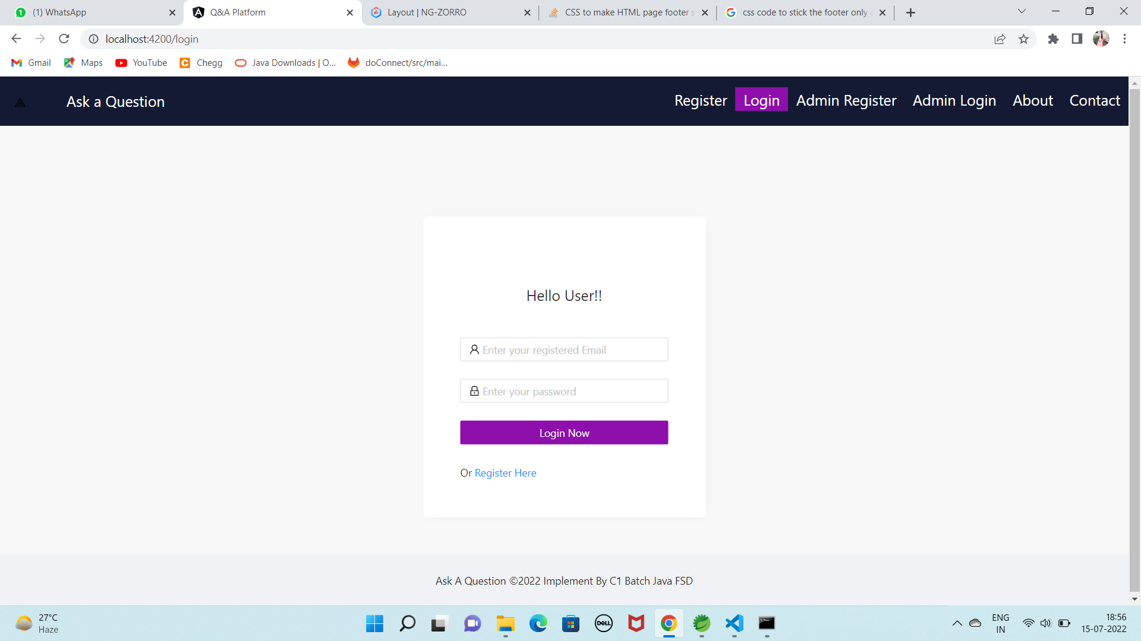
RESULTS

Slide 24
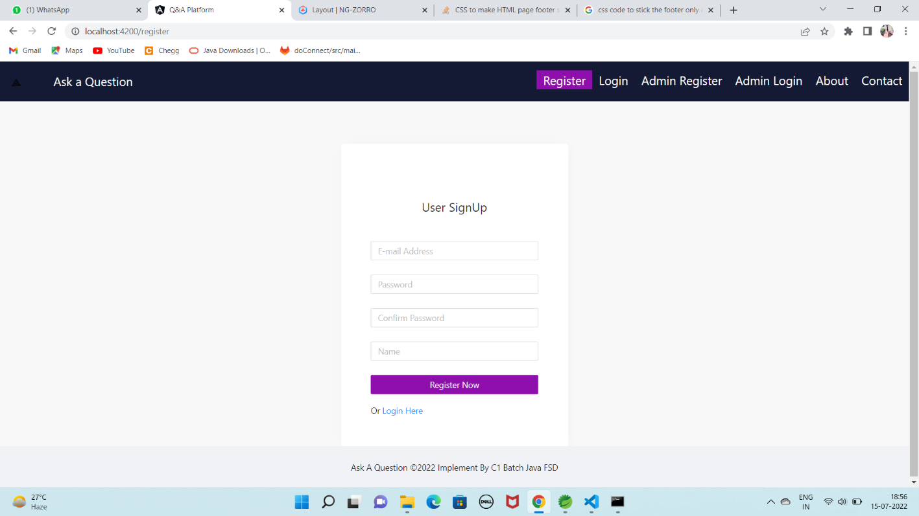
User Signup

Slide 25
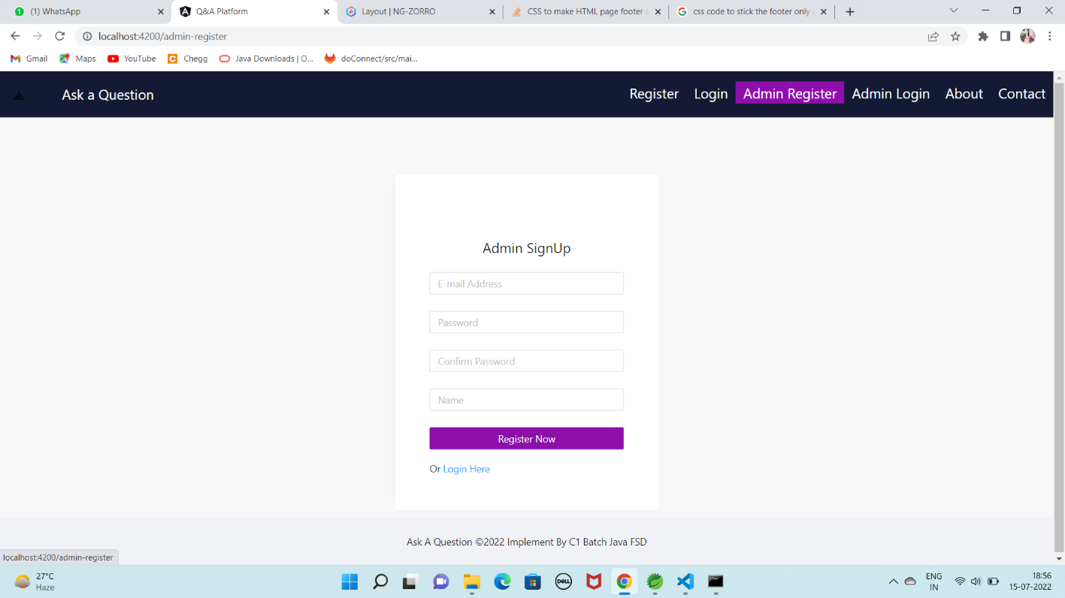
ADMIN SIGNUP

Slide 26
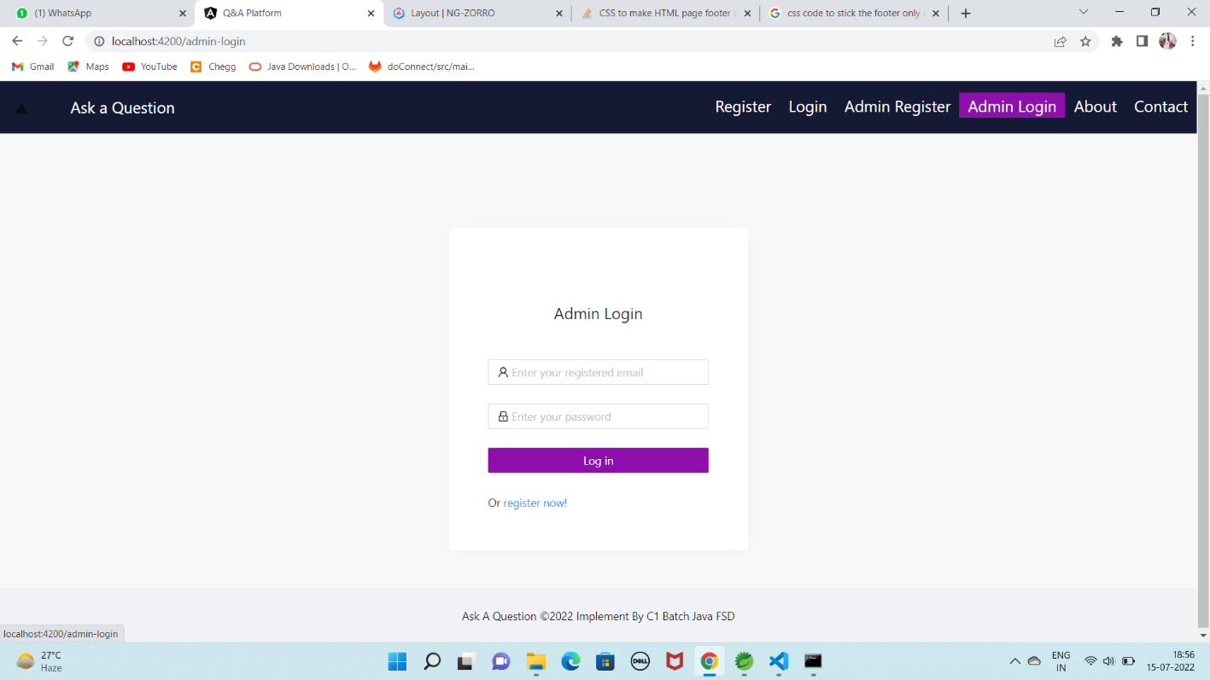
Admin Login

Slide 27
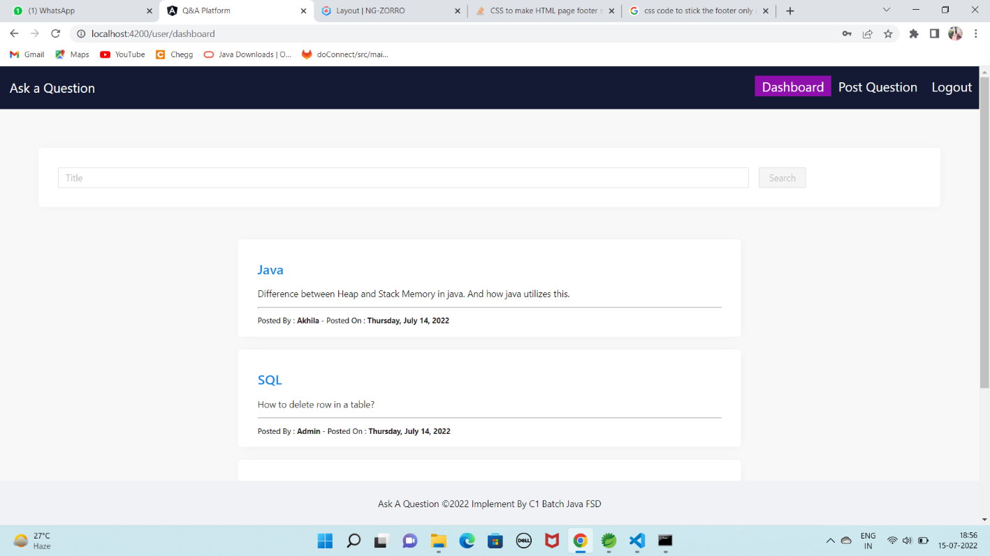
USER FUNCTIONALITES – View approved questions and answers

Slide 28
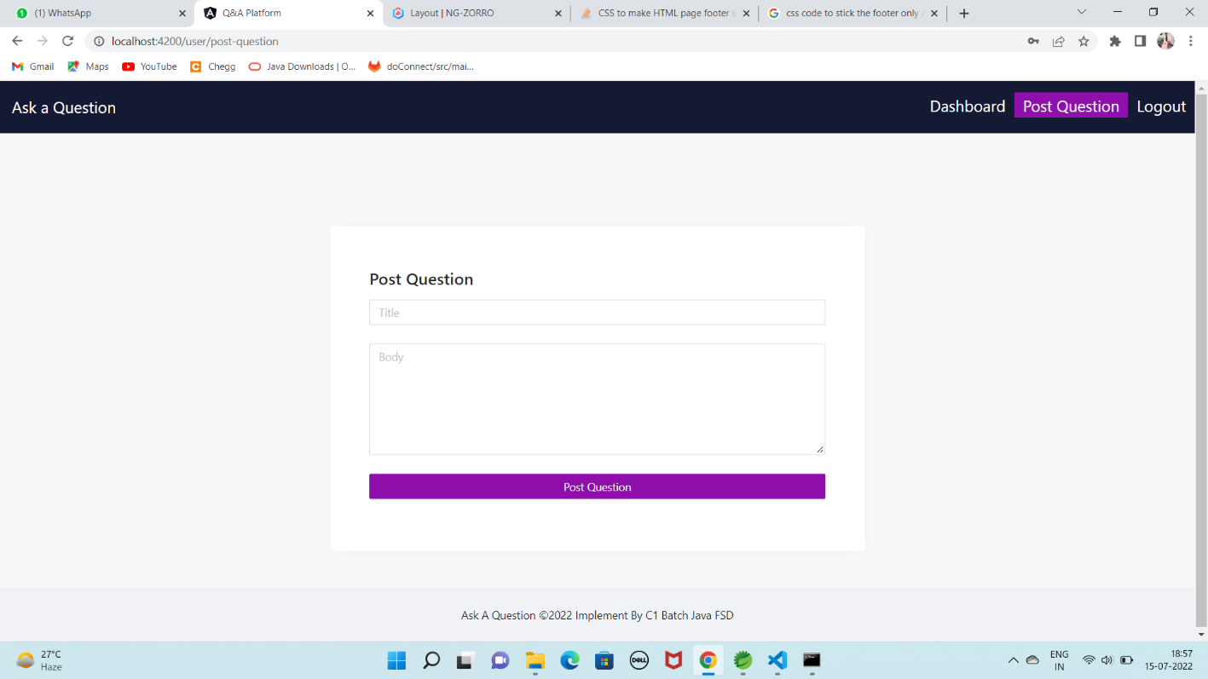
Page to post the Question

Slide 29
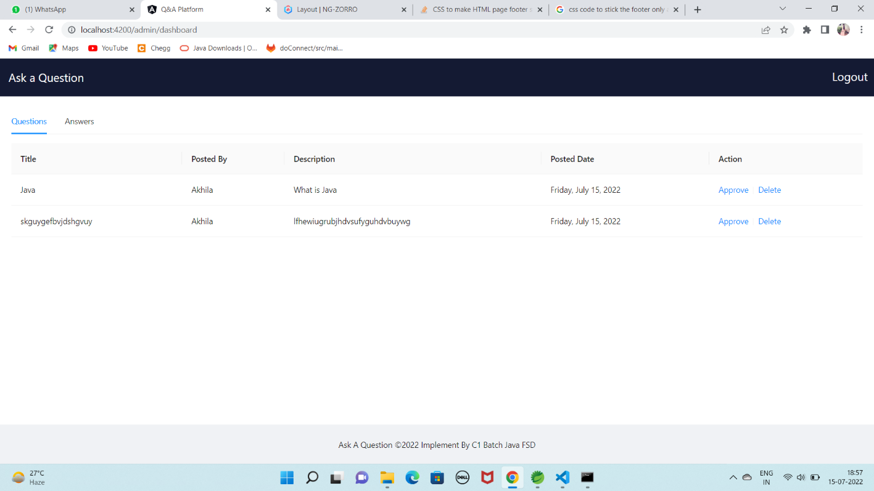
List of questions posted

Slide 30
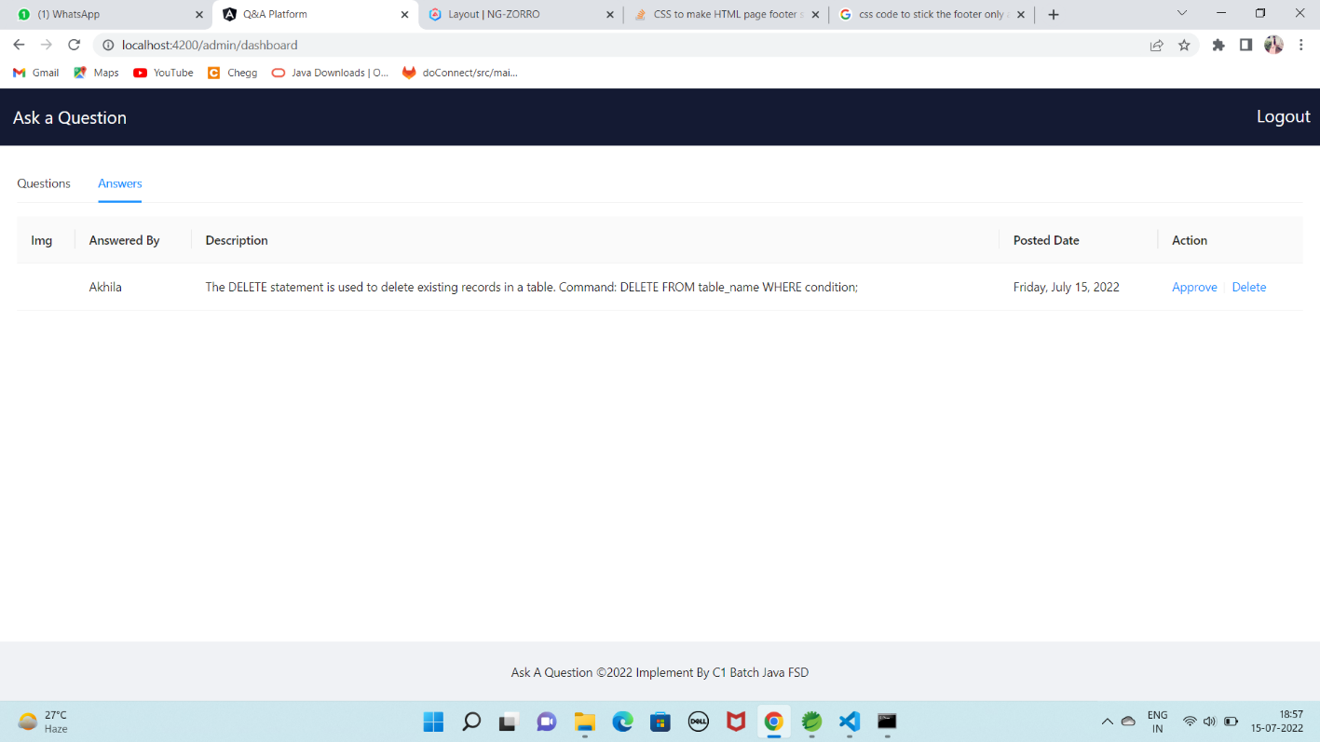
List of Answers posted

Slide 31
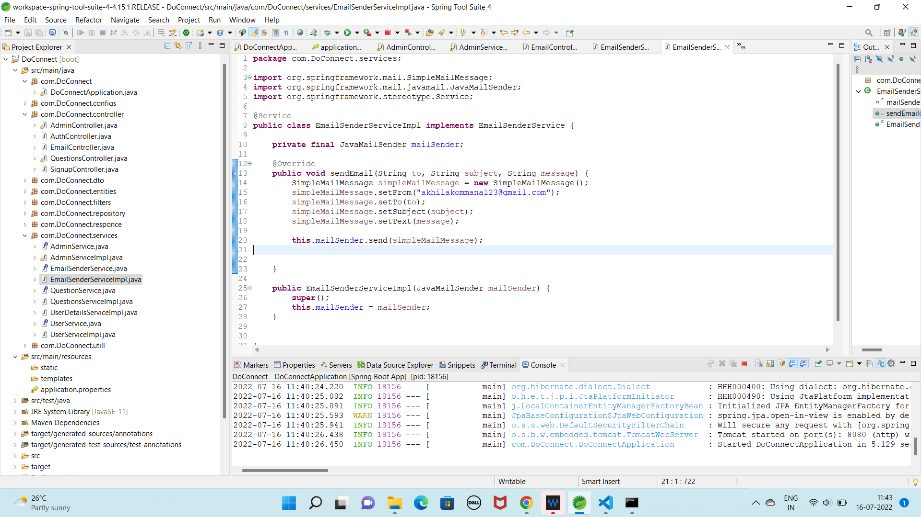
STRUCTURE OF BACKEND

Slide 32
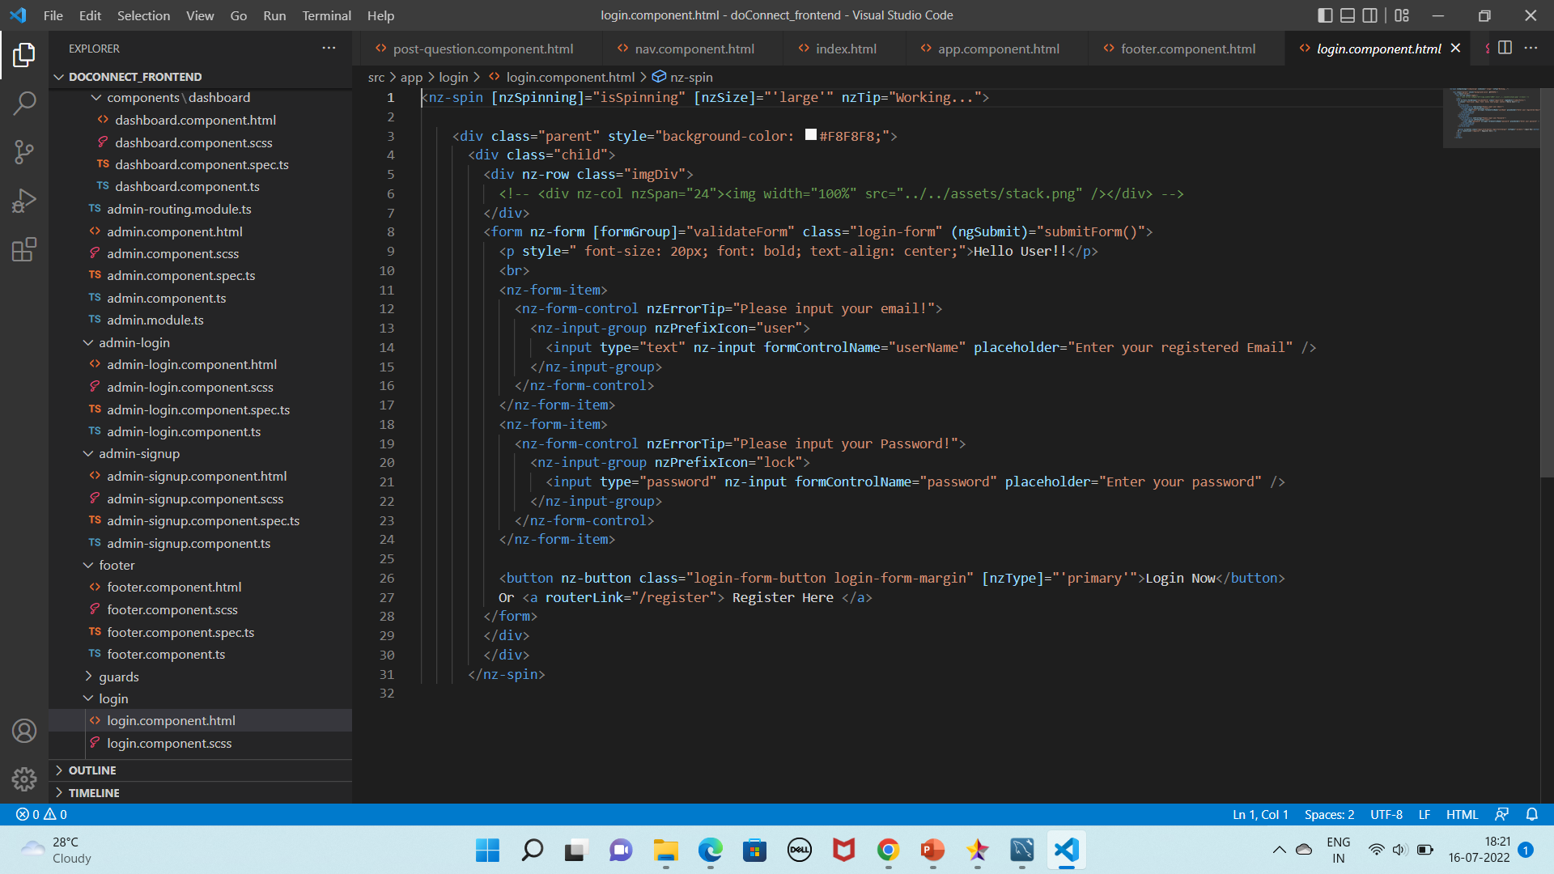
Structure Of Frontend

Slide 33
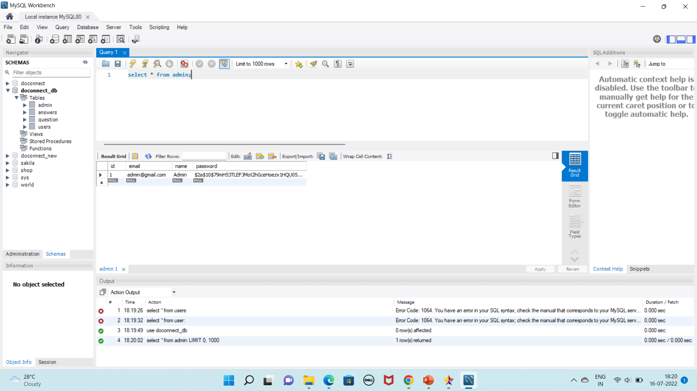
Database

Slide 34
THANK YOU

