Slide 1


Plexo-Enhanced
How one laptop downloads a single file over several networks at once: TCP, HTTP Range, interface binding and P2P at layer 7, plus the eight features we added
Presentation by
Harshul Kala · 1RUA25CSE0188
Khushi Krishna · 1RUA25CSE0217
Medha Umesh · 1RUA25CSE0257
Meghna Pant · 1RUA25CSE0259
Guide: Prof. Sunil Kumar J
Notes:
CS2403 CIE 3 mini project. Base Plexo (github.com/anmolkapil/plexo, v1.0.0-rc.15) is by Anmol Kapil and contributors, not us. Parts: the idea, how bytes move, disk/limits/failure, P2P and security, our work, and a narrated three-minute film of the whole backend on slide 17.

Slide 2
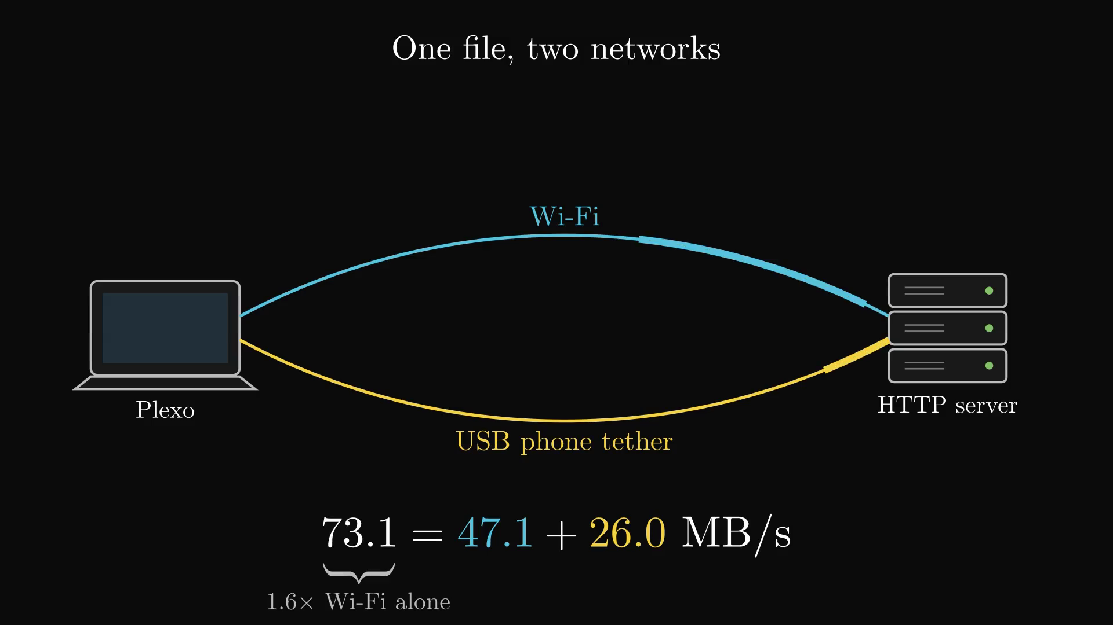
One laptop, many networks: the CN ideas inside Plexo
PREFACE · THE IDEA
CN concept | In plain words | Where it appears in Plexo
Multi-homing | one host, several networks | Wi-Fi + USB phone tether + Ethernet
TCP (L4) | reliable, ordered byte stream | every HTTP stream and every peer
HTTP Range (L7) | ask for bytes s–e (RFC 9110) | each block = one Range GET → 206
Socket programming | create connections in code | Node net/tls, libc via koffi
Source binding | choose the local IP | localAddress = 10.3.19.42
Interface binding | lock a socket to a device | setsockopt SO_BINDTODEVICE
DNS resolution | name → IPv4 / IPv6 | lookup(all) + Happy Eyeballs 250 ms
Load balancing | spread work over paths | free stream pulls the next block
Flow control | receiver slows the sender | token bucket → pause → rwnd 0
Connection pooling | reuse a warm connection | keep-alive agent per stream
Fault tolerance | survive a failed path | blocks re-queue from the frontier
Peer-to-peer | many peers send pieces | BitTorrent peers spread per network
Network security | TLS, CORS, localhost, SSRF | 127.0.0.1 bridge, SSRF guard
The idea in one line
Open many TCP connections, pin each one to a different network, and ask each for a different byte range of the same file.
Wi-Fi 47.1 + phone 26.0 = 73.1 MB/s, 1.6× Wi-Fi alone.
Not used: WebSockets (not a download transport here) and proxies (sockets are pinned and direct).
Notes:
This is the vocabulary for the rest of the deck. HTTP Range and TCP are not interchangeable: Range is an application-layer header naming a byte interval; TCP is the transport that delivers the request and its 206 response reliably and in order. Plexo opens many TCP connections, each carrying Range requests for different blocks, and pins each connection to a different network.

Slide 3
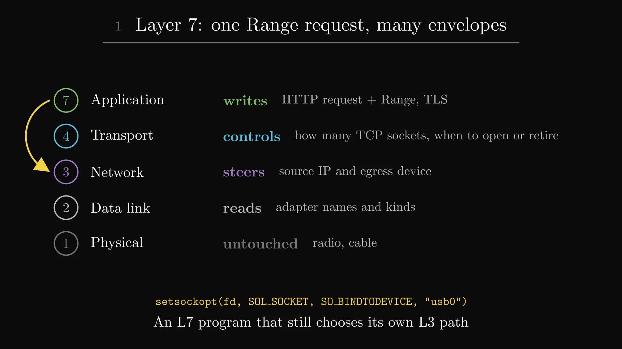
At layer 7 Plexo writes the request; it steers layers 4 and 3
PART I · HOW BYTES MOVE
01
Layer 7: Plexo writes
GET /file + Range: bytes=2457600-4915199, Host, cookies when needed. TLS then encrypts it into records.
02
Layer 4: Plexo controls
how many TCP sockets, and when to open, pace or retire them. The kernel still runs SYN/ACK, retransmission and congestion control.
03
Layer 3: Plexo steers
each socket's source IP and egress device with SO_BINDTODEVICE. Layers 2 and 1 are only read, never built.
▶ Click the picture to play · 25 s · silent animation
Figure 1. One Range request wrapped by TLS, TCP, IP and the Wi-Fi frame.
From HOW-PLEXO-WORKS.md §2 and src/main/network/.
Notes:
An application-layer program normally has no say over the path. Plexo is still pure L7 software, but socket options let it choose the L3 source and egress device, so no VPN, tunnel or server change is needed. TLS sits between HTTP and TCP: Plexo opens the TCP socket on the chosen network, then hands it to Node's TLS, which verifies the certificate against the host name.

Slide 4
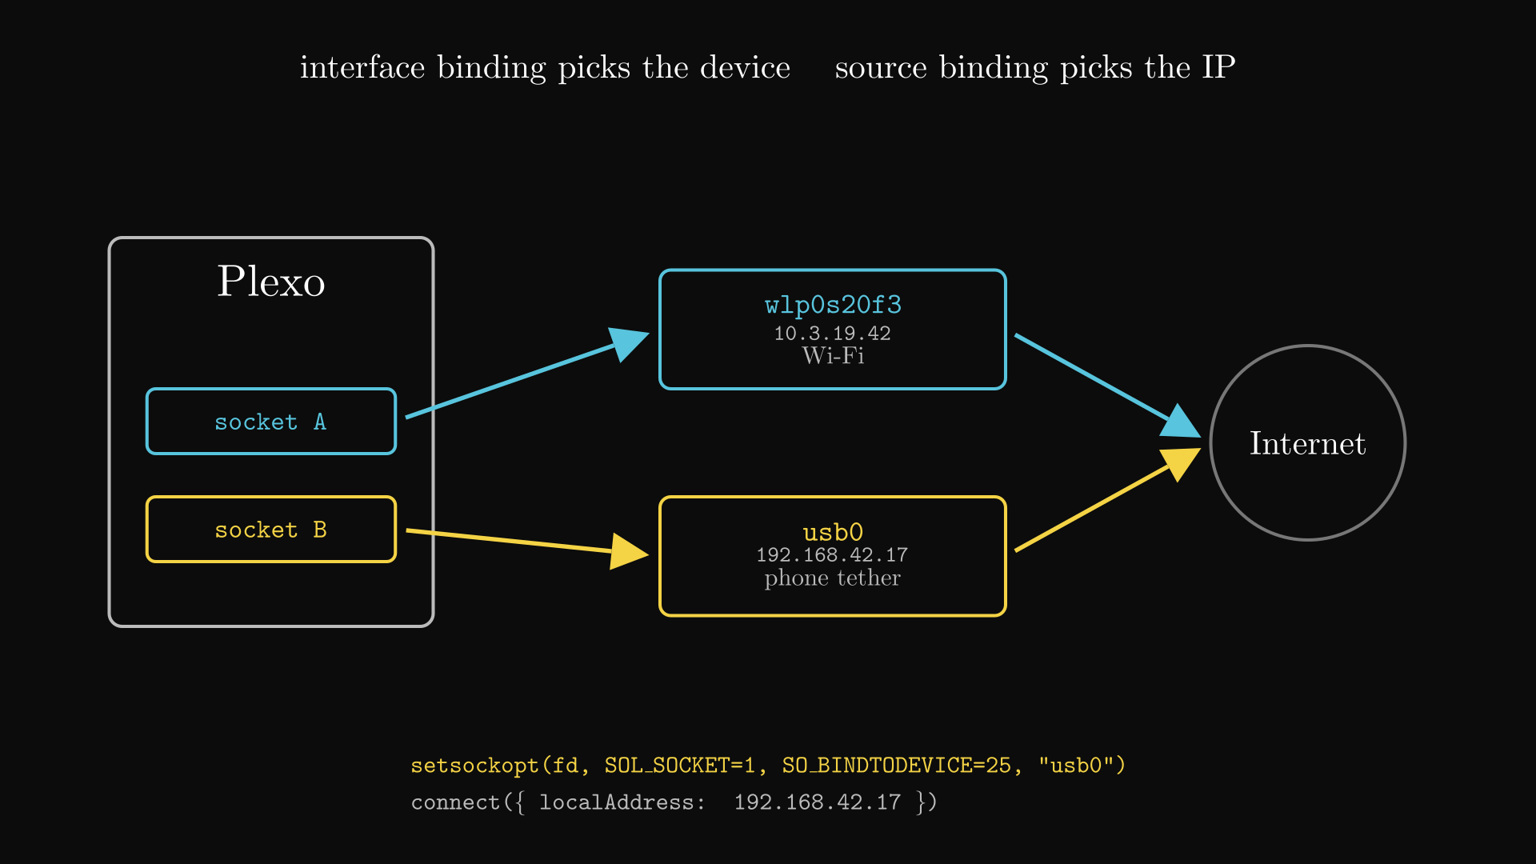
Interface binding makes each TCP socket leave through a chosen network
PART I · HOW BYTES MOVE
Multi-homing alone does nothing: the OS still sends every packet through the default route. Plexo chooses the network for each socket before it connects.
pick network
DNS lookup (all)
Happy Eyeballs 250 ms
socket()
SO_BINDTODEVICE
connect (localAddress)
TLS handshake
01
Source binding
connect({localAddress}) sets the local IP. Windows and macOS route by source address, so that is enough there.
02
Interface binding
Linux routes by destination only. Plexo calls setsockopt(SOL_SOCKET=1, SO_BINDTODEVICE=25) through koffi; no root since kernel 5.7.
03
DNS + Happy Eyeballs
lookup(all:true) gets IPv4 and IPv6; attempts race 250 ms apart (RFC 8305) and the winner is cached per network.
Code: src/main/network/deviceBinding.ts, routes.ts.
Notes:
Plexo uses both binding kinds: the device for egress and the address for the source, because one adapter can have several IPv6 addresses. A phone source IP sent out of Wi-Fi would be dropped upstream by ingress filtering. If an IPv6 path is blackholed, Happy Eyeballs costs 250 ms instead of a 10 s timeout. Family matching means an IPv4-only tether is never asked to reach an IPv6-only host.

Slide 5
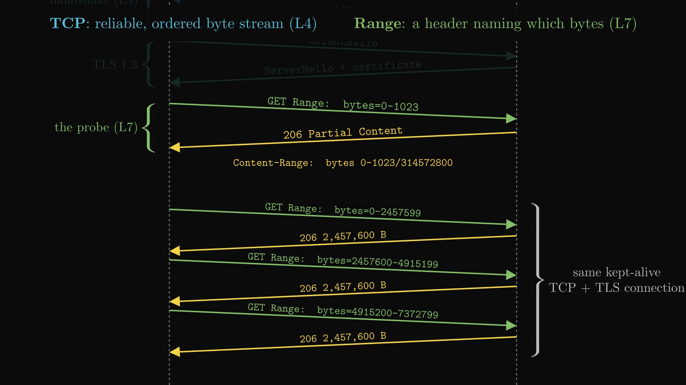
TCP carries the bytes; HTTP Range says which bytes to send
PART I · HOW BYTES MOVE
They are not interchangeable: Range is a header inside the request, TCP is the reliable pipe that carries the request and its 206 reply.
TCP · layer 4 · the kernel
HTTP Range · layer 7 · Plexo
Unit
segment, MSS 1,460 B
Unit
byte interval s–e of a file
Job
reliable, ordered byte stream
Job
names which bytes to send
Setup
SYN → SYN-ACK → ACK, then TLS 1.3
Setup
GET Range: bytes=0-1023 → 206
Flow
receive window rwnd, congestion window
Check
Content-Range, ETag, size
01
Connection pooling
SYN, TLS and slow start are paid once per stream; the same kept-alive connection then carries Range after Range.
On loss
retransmits by itself
On loss
re-asks from the frontier
Code: download/probe.ts, network/routes.ts StreamConnection. HEAD is not trusted: it can claim Accept-Ranges while GET ignores Range.
Notes:
The 206 response carries Content-Range so Plexo can check the server sent exactly what was asked: bytes 0-1023/314572800 also tells the total size, 300 MiB. If the server closed an idle socket, Plexo retries once on a fresh one.

Slide 6
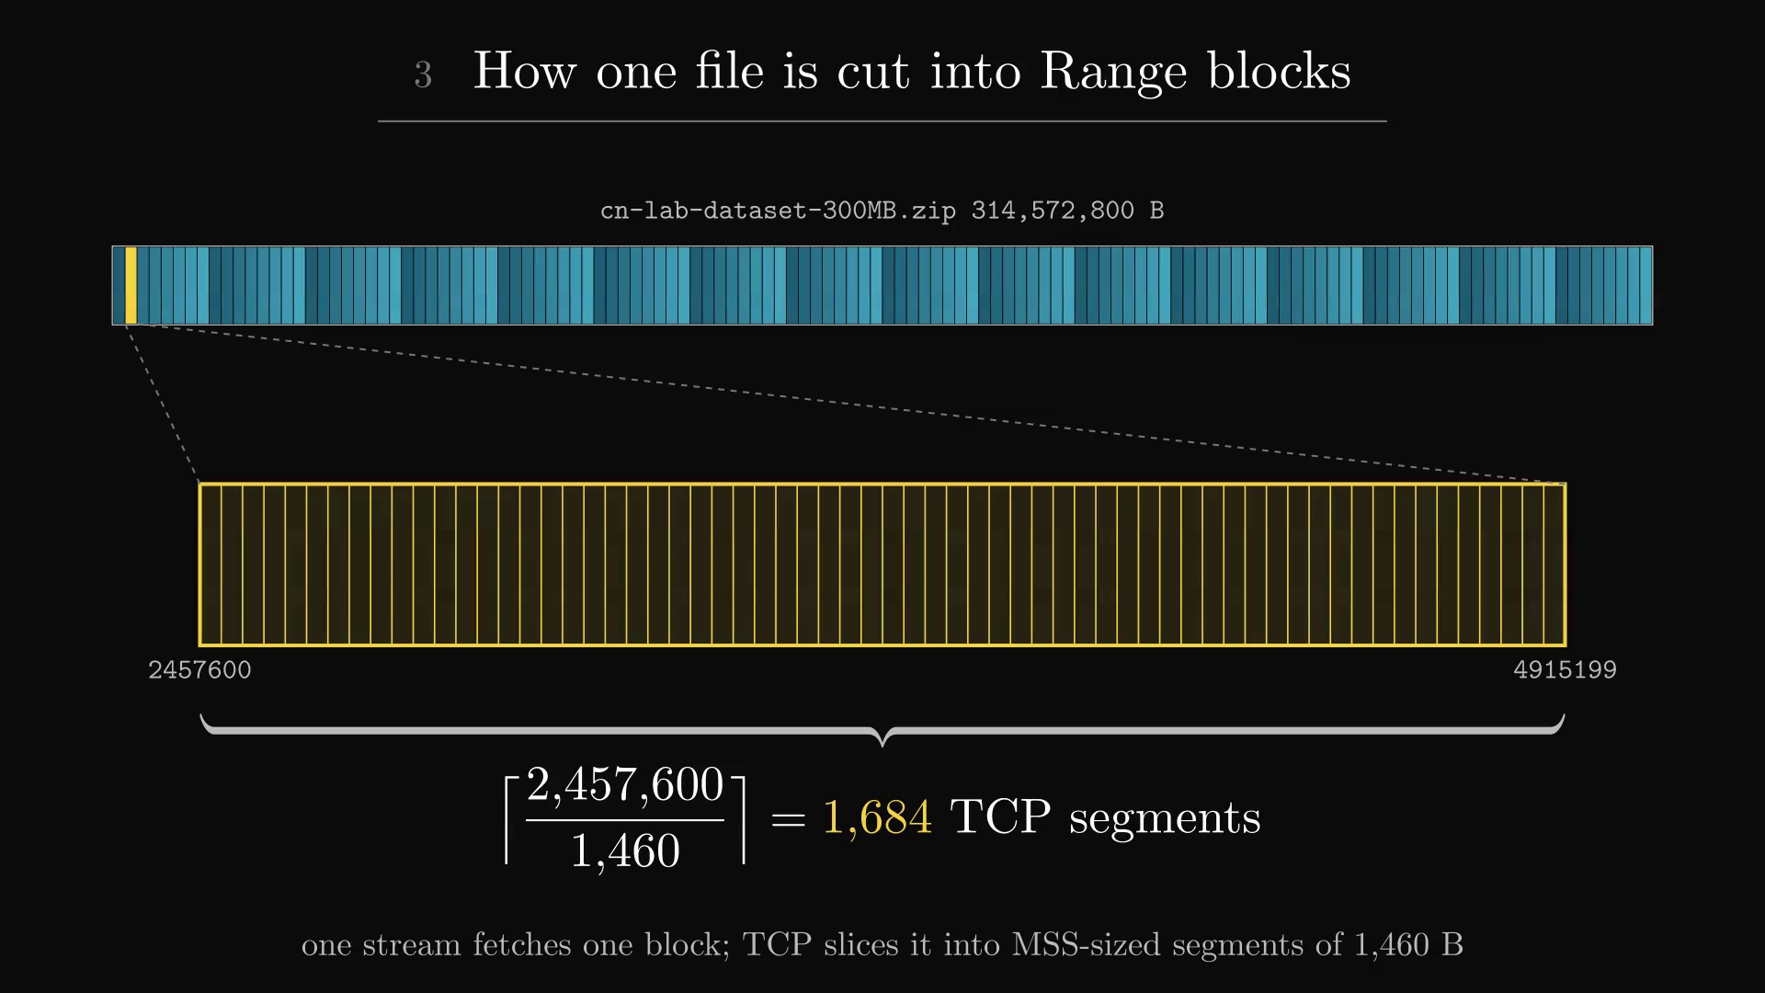
A 300 MiB file becomes 128 Range blocks of 2,457,600 bytes
PART I · HOW BYTES MOVE
01
How many blocks
target = networks × 32 × 2. With two networks: 2 × 32 × 2 = 128.
02
How big each block is
size = clamp(⌈T ÷ target⌉, 1 MiB, 8 MiB) = 2,457,600 B. A 1 GB file caps at 8 MiB; 5 MB floors at 1 MiB.
03
What goes on the wire
block k = Range: bytes=k·s – (k+1)·s−1. TCP slices one block into about 1,684 segments of 1,460 B.
▶ Click the picture to play · 39 s · silent animation
Figure 4. The file bar splits into 128 blocks; one block zooms into TCP segments.
Code: src/main/download/plan.ts (planDownload).
Notes:
Chunks are not separate files: a block is a byte interval of one staging file. The 8 MiB cap bounds the cost of re-fetching a slow tail block; the 1 MiB floor keeps request overhead small; 2 blocks per stream keep every stream busy. Without a 206 there is one open-ended block on one stream.

Slide 7
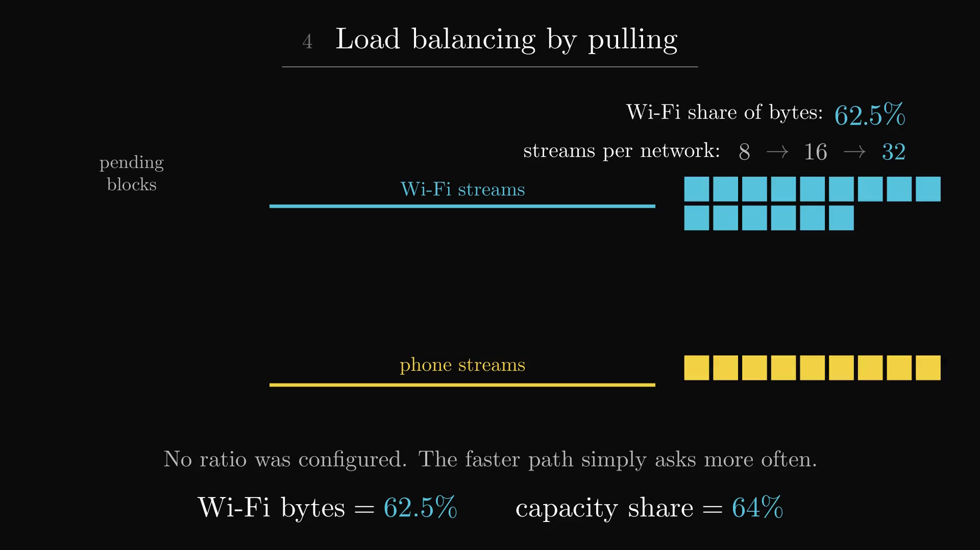
Load balancing is pull-based, so the faster path ends up asking more often
PART I · HOW BYTES MOVE
No speed ratio is configured anywhere. Each stream asks for work the moment it finishes, so throughput decides the split by itself.
stream is free
pending block?
empty here last time?
take the block
Range GET → 206
write, then free
01
Pull, not push
the first pending block goes to whichever stream asks. A block that gave nothing on this network last time is skipped if another network is free.
02
Grow, then back off
8 → 16 → 32 streams per network while all are served. On 403/429/503 the ceiling drops to what worked; +1 per 60 s.
03
Measured result
62.5 % of bytes over Wi-Fi against a 64 % capacity share, with no speeds known in advance.
Code: download/scheduler.ts, concurrency.ts.
Notes:
Same principle as work stealing. The refusal rule treats a server's per-IP connection limit as a signal, not an error. Concurrent downloads share 32 streams per network; a slow disk halves the cap. Growth uses no timers, so noisy Wi-Fi cannot make it oscillate.

Slide 8
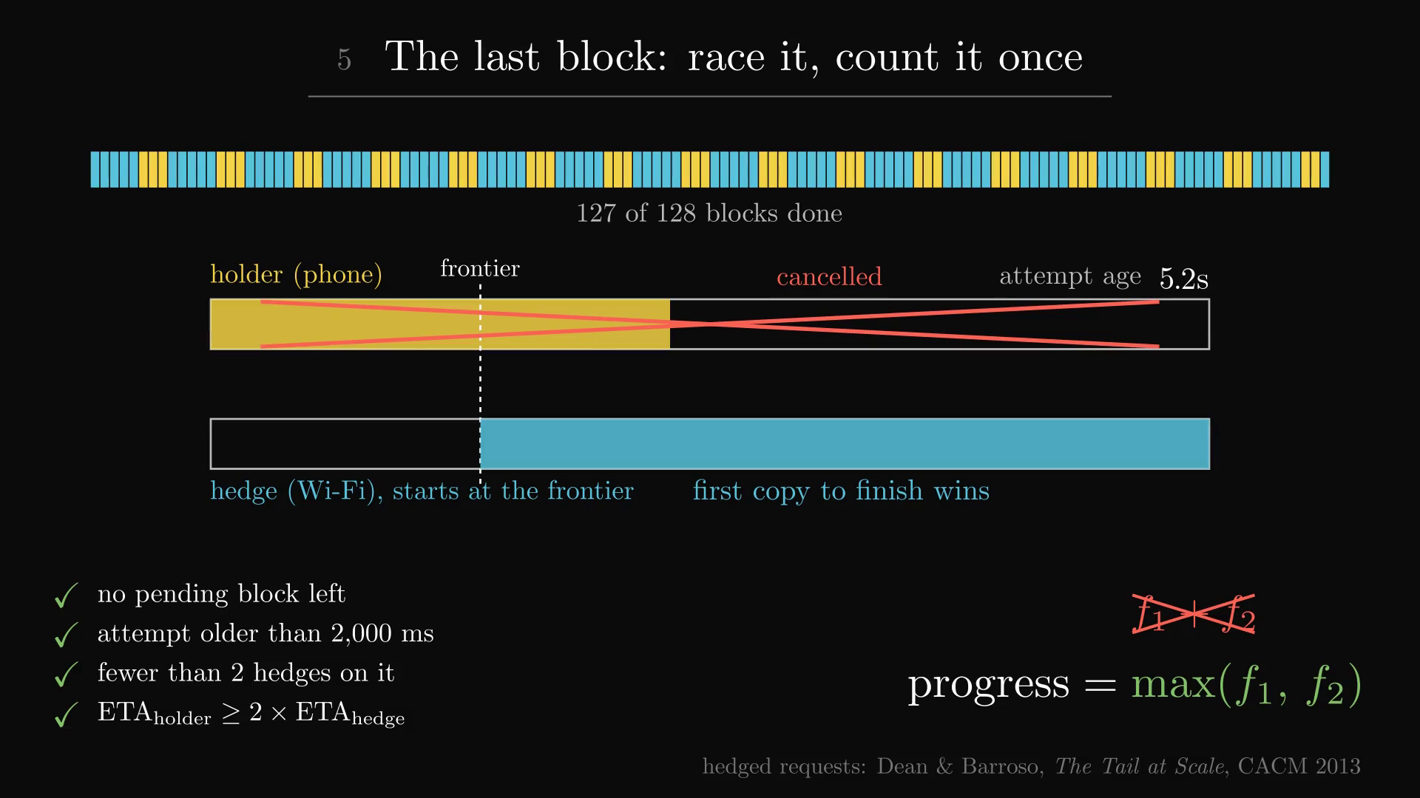
At the tail Plexo races the slow block and still counts each byte once
PART I · HOW BYTES MOVE
The last block decides the finish time. A hedge is allowed only when all four conditions hold, and at most twice per block.
no pending blocks
attempt > 2,000 ms
hedges < 2
ETA ≥ 2× hedge
hedge from frontier
first copy wins
01
Hedged request
an idle stream re-fetches the slow block from its frontier; the first copy to finish wins (Dean & Barroso, 2013).
02
Count once
progress = max(f₁, f₂), never the sum, so two racing copies cannot inflate the byte count.
03
Check everything
a reply must be 206 with matching Content-Range start; ETag, Last-Modified and size must not change.
Code: scheduler.ts nextHedgeTarget(), blockProgress.ts, chunkDownloader.ts.
Notes:
Hedging is the only deliberate duplication. A crawling stream below 10% of its network's median for 10 s is reconnected instead. If the size changes the file was replaced and the download stops; a changed ETag alone is only a hint, so Plexo re-reads 8 samples of 16 KiB and compares bytes.

Slide 9
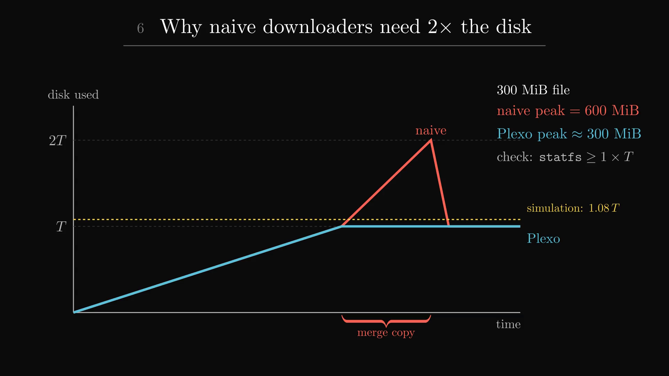
Naive chunk downloaders need 2× the disk; Plexo needs about 1×
PART II · DISK, LIMITS, FAILURE
01
Naive design: 2×
save part001…part128, then copy them into the final file. During the merge both exist: 300 + 300 = 600 MiB.
02
Plexo: one staging file, ≈ 1×
each writer opens file.zip.plexo at its own offset (flags 'r+', start). fsync, then rename: 0 bytes copied.
03
Where 1.08× comes from
a fixed safety margin in the pre-download simulation, not a measured need. ensureDiskSpace checks statfs ≥ 1 × size.
▶ Click the picture to play · 33 s · silent animation
Figure 7. Disk used over time: the naive merge peaks at 2T, Plexo stays at T.
Code: downloadFile.ts, downloadManager.ts, simulationEngine.ts.
Notes:
Worked numbers for 300 MiB: naive peak 600 MiB, Plexo about 300 MiB, the simulation shows 324 MiB. Auto-organize picks the folder before the staging file is created, so the final move stays a same-folder rename. On Windows the staging file is marked sparse so NTFS does not zero-fill the gaps.

Slide 10
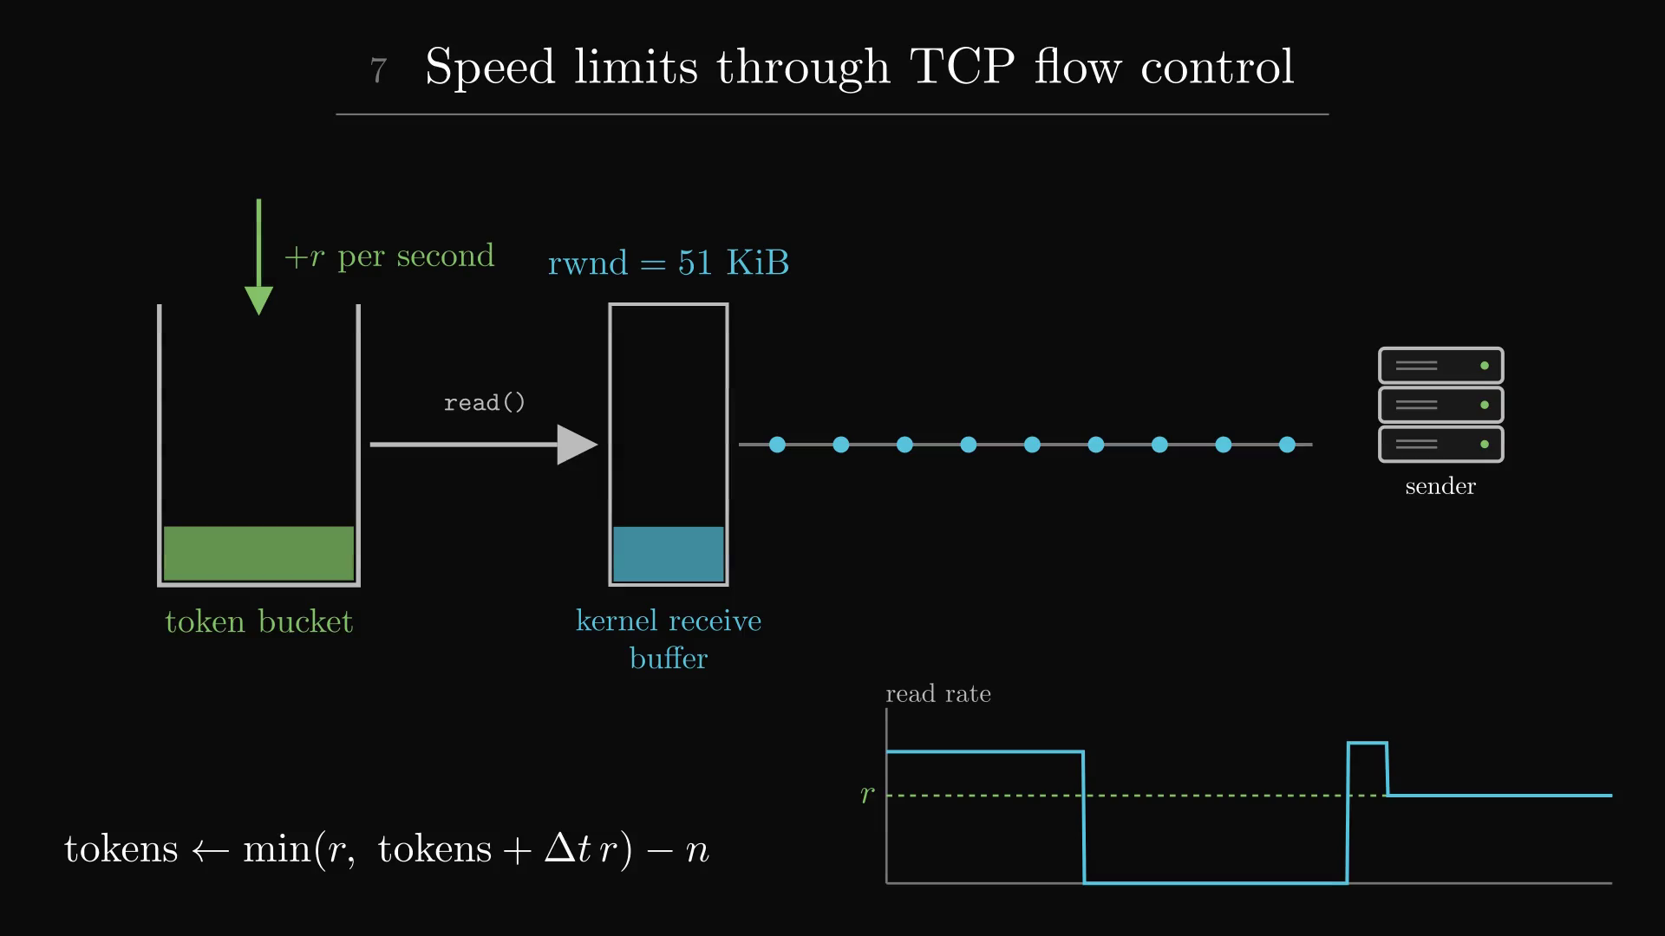
Speed limits use TCP flow control: pause reading and the sender waits
PART II · DISK, LIMITS, FAILURE
Plexo never drops packets to slow down. It simply stops reading, and TCP's own window tells the server to wait.
bucket empty
res.pause()
kernel buffer fills
rwnd = 0
sender waits
tokens refill
res.resume()
01
Token bucket
tokens ← min(r, tokens + Δt·r) − n. It holds 1 s of tokens, so idle time never banks a burst.
02
Backpressure
the paused socket leaves bytes in the kernel buffer; the advertised window falls to 0. No loss, no RST, no retransmission.
03
Not congestion control
TCP's congestion window still governs the wire. With a total and a per-network limit, the longer wait wins.
Code: src/main/network/limits.ts take(), chunkDownloader.ts hold().
Notes:
Slow mode is 2 MiB/s. Data caps are counted per day, week and month per network; at the cap the network shows 'limit'. Torrents use the same bucket by patching socket.push, where inbound bytes enter.

Slide 11
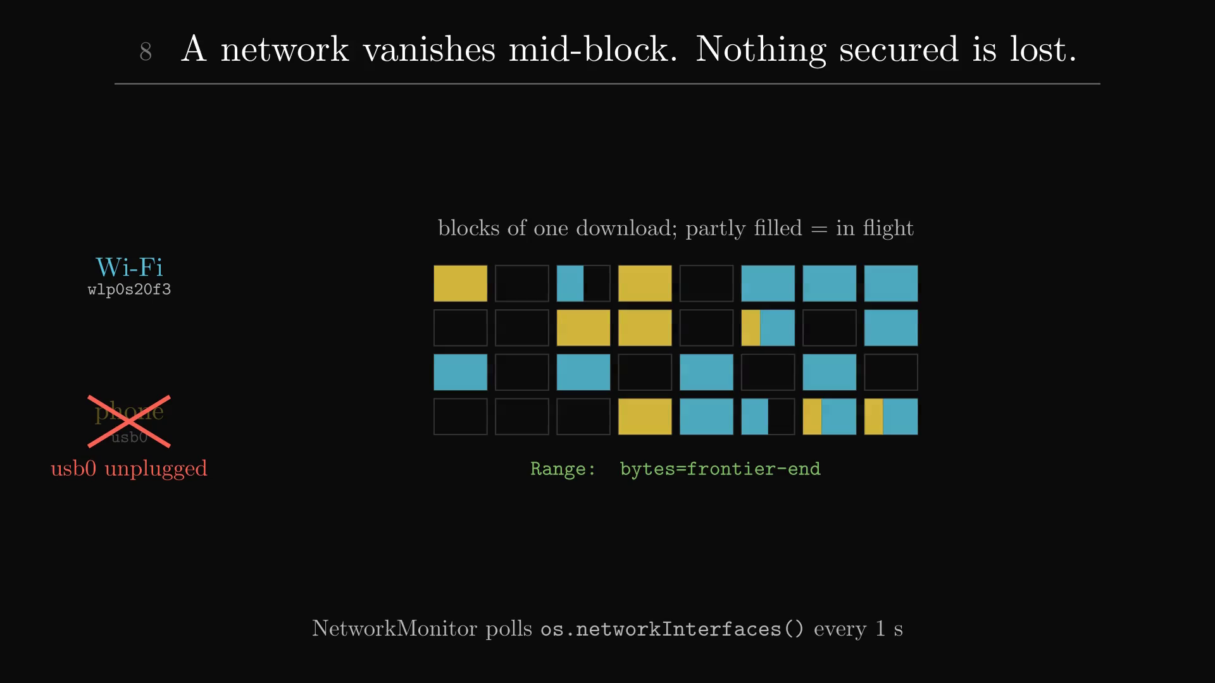
Fault tolerance: a network can vanish mid-block and no secured byte is lost
PART II · DISK, LIMITS, FAILURE
Progress is stored per block as a frontier, so a failure costs only the bytes that were still in flight on the lost network.
poll every 1 s
usb0 gone
retire its streams
blocks → pending
frontier kept
resume on Wi-Fi
01
Detect
NetworkMonitor reads os.networkInterfaces() every second; no bytes for 5 s while others serve marks a network unreachable.
02
Recover
another network resumes each block with Range: bytes=frontier-end; the manifest is checkpointed every 15 s.
03
Retry policy
delay = min(15 s, 2ⁿ s)·(1 ± 0.2); Retry-After honoured up to 120 s; five strikes and a stream stops.
Code: network/interfaces.ts, httpTransfer.ts, downloadManager.ts.
Notes:
Jitter avoids a thundering herd when many streams retry together. A network that appears mid-download starts switched off, so mobile data is never used by surprise. An address change forces a reconnect, like Chrome's ERR_NETWORK_CHANGED.

Slide 12
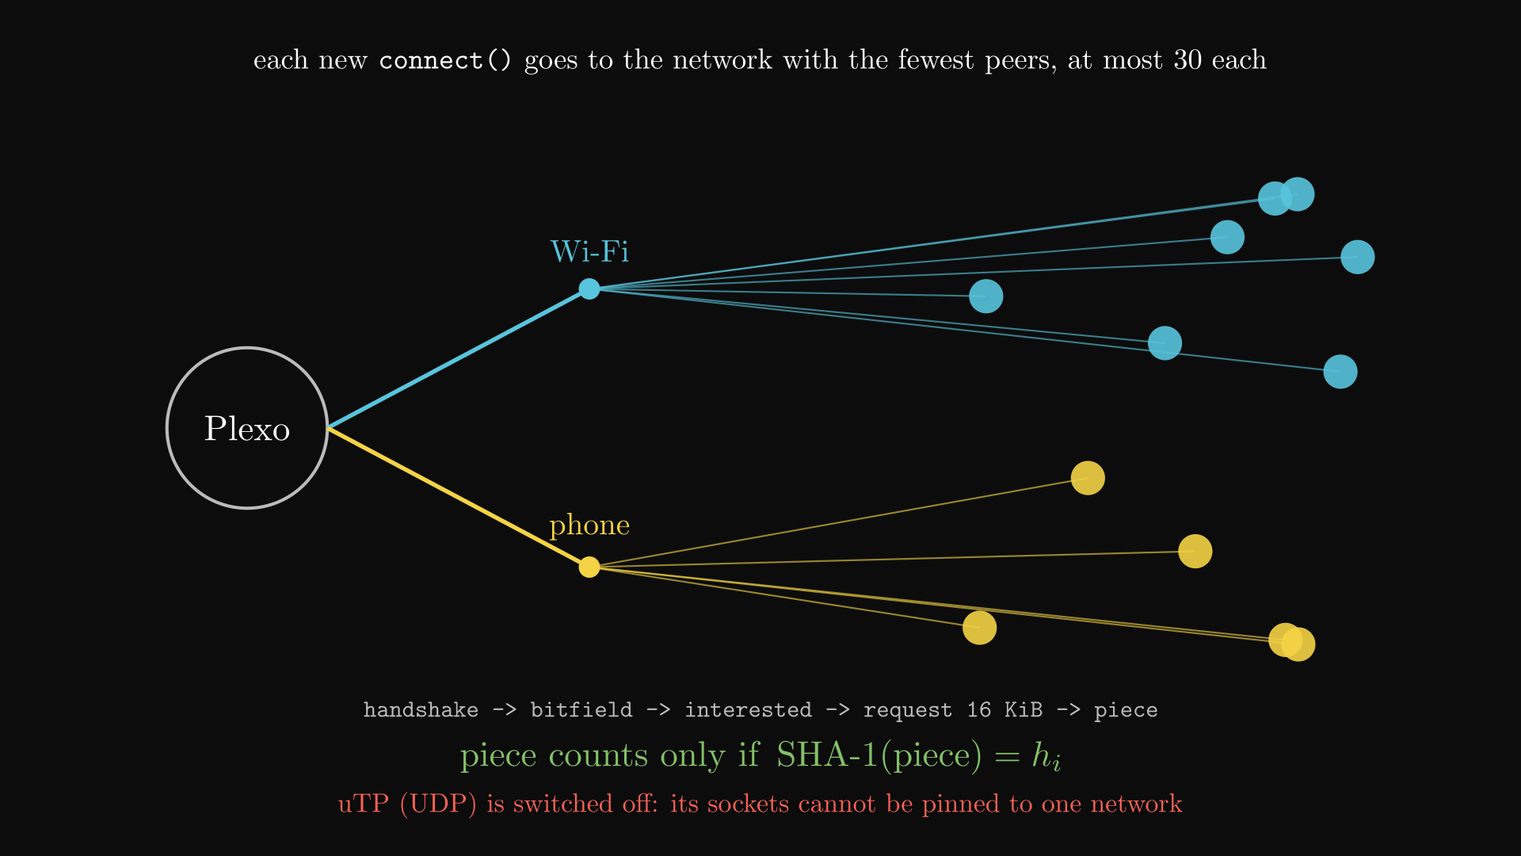
BitTorrent spreads peers across networks, one TCP connection at a time
PART III · P2P AND SECURITY
The same multi-path idea applied to peer-to-peer: every new peer connection goes out through the network that has the fewest peers.
magnet link
DHT + trackers
fewest-peers network
handshake
bitfield / have
request 16 KiB
SHA-1 check
01
Spread the peers
connect() is hooked so each peer socket is pinned like an HTTP stream, at most 30 peers per network.
02
Integrity
a piece counts only when its SHA-1 hash matches the torrent's piece list; a bad piece is fetched again.
03
TCP only
uTP runs on UDP and those sockets cannot be pinned to one network, so Plexo turns it off.
Code: download/torrent/engine.ts, peers.ts; patches/webtorrent+3.0.21.patch.
Notes:
A two-hunk patch to webtorrent injects one connect hook, so every outgoing peer socket goes through Plexo's network chooser and SO_BINDTODEVICE. A faster network earns more pieces by itself. Uploads happen on every network because tit-for-tat rewards peers that upload.

Slide 13
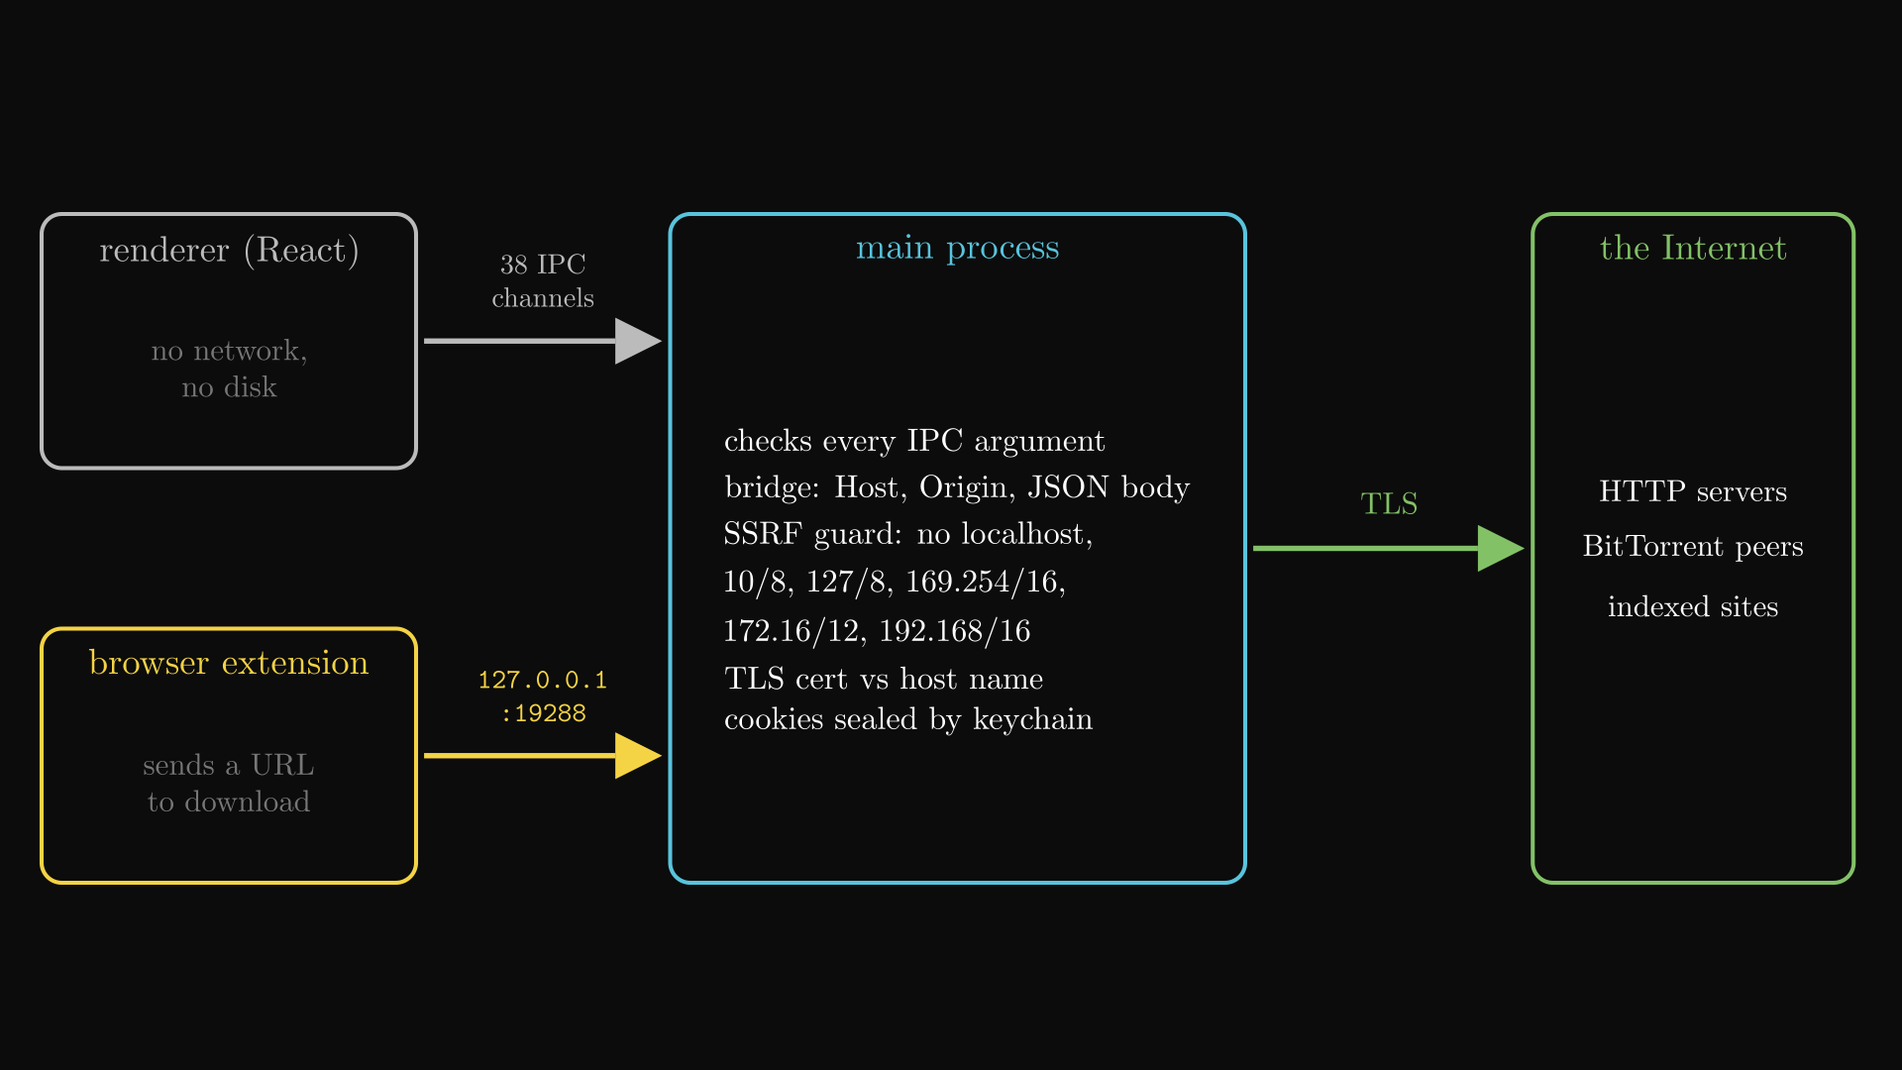
Every trust boundary checks what crosses it: IPC, localhost, TLS, SSRF
PART III · P2P AND SECURITY
Five places where data crosses from a less trusted side to a more trusted one, and the check that guards each crossing.
Boundary | Threat | Check in Plexo
Renderer → main | a compromised UI | 38 typed IPC channels; every argument validated
Browser → bridge | web page posts, DNS rebinding | 127.0.0.1 only; Host + Origin; JSON; ≤ 64 KiB
Main → Internet | man in the middle | TLS certificate checked against the host
Indexer → URL | SSRF into the LAN | rejects localhost, 10/8, 127/8, 169.254/16 …
Cookies at rest | theft from disk | sealed by the OS keychain (safeStorage)
01
Gaps we found
the SSRF guard checks host text only: no IPv6 ULA, no DNS-rebinding check, redirects not re-checked.
Code: src/preload, browserBridge.ts, discovery/sourceIndex.ts isPrivateOrLocalUrl(). Not used: WebSockets, proxies.
Notes:
The React window has no network or disk access at all. The localhost bridge needs Content-Type JSON, which forces a CORS preflight, so a web page cannot post to it silently. On Linux without a keychain, cookies are dropped rather than stored in clear.

Slide 14
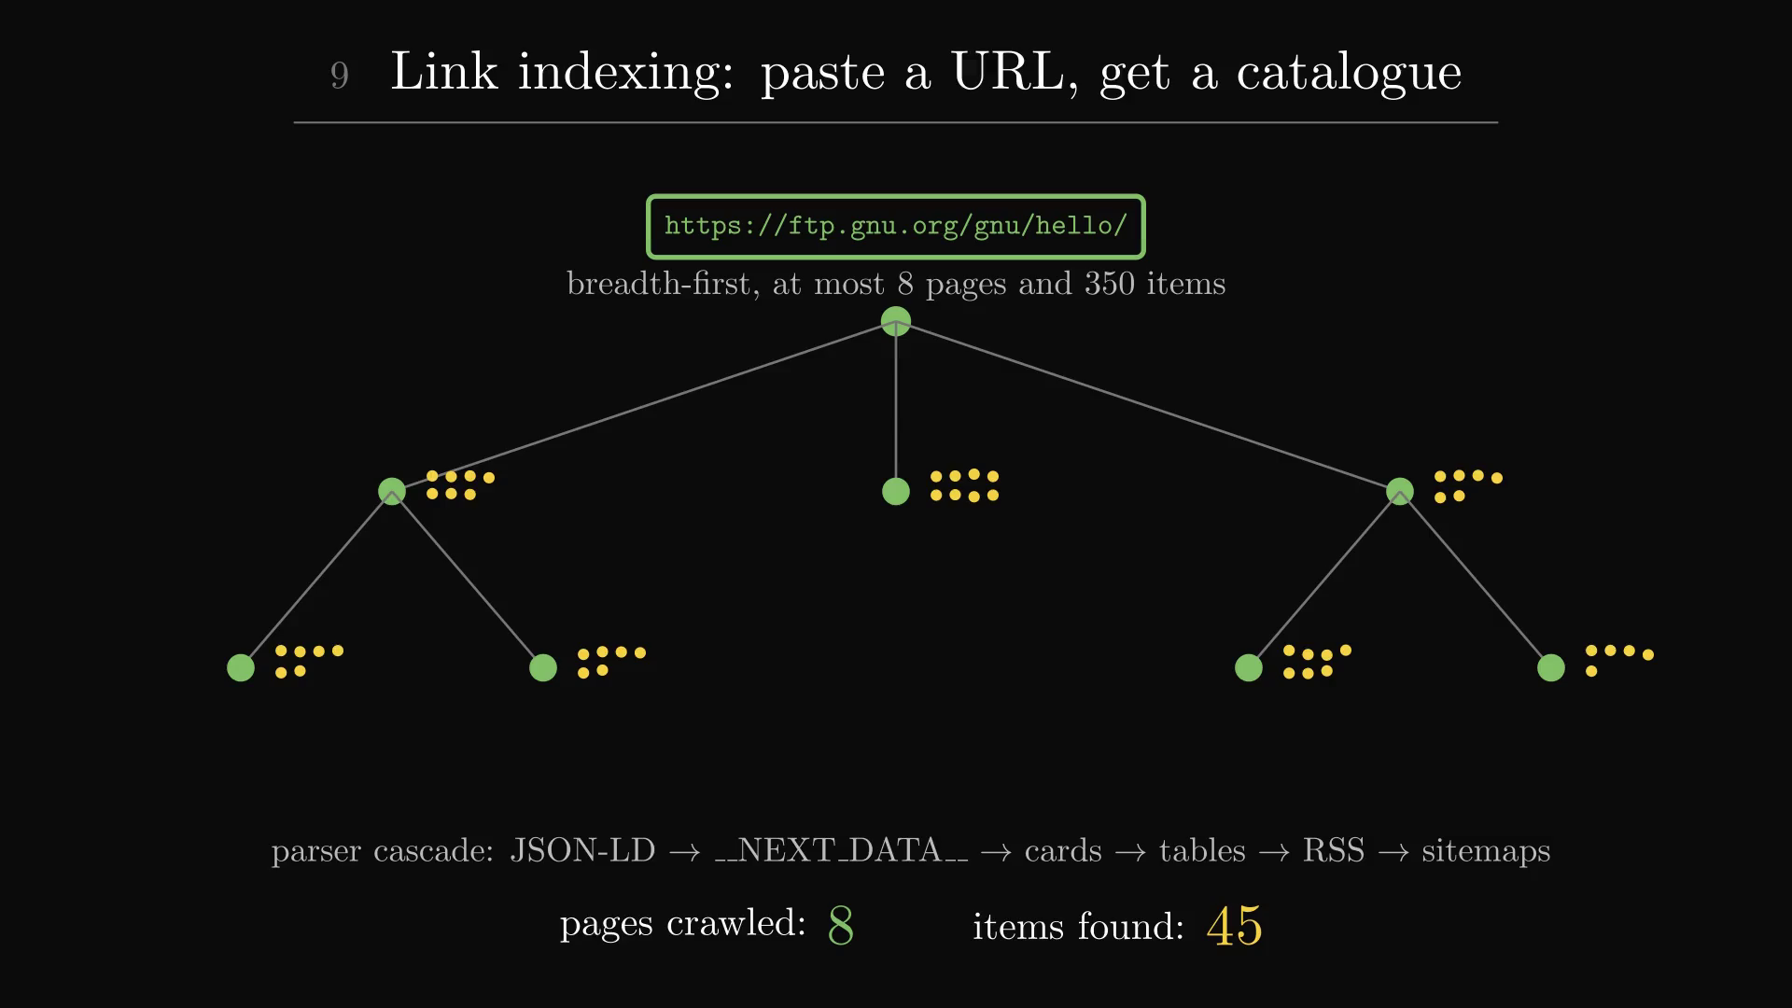
Our eight enhancements, in computer-networks terms
PART IV · OUR WORK
# | Enhancement | CN concept it uses | Status
1 | Auto-organize | Content-Disposition name → folder, rename not copy | built
2 | Network learning | Thompson Sampling tunes streams + hedge delay | built
3 | Translucent UI | Electron window materials (not networking) | built
4 | Speed test | per-path throughput, warm-up skips slow start | built
5 | Checksum repair | hash file, re-fetch only damaged ranges | designed
6 | Link indexing | HTTP crawl, parsers, cache, SSRF guard | built
7 | Pre-download simulation | capacity planning: ETA, split, disk margin | built
8 | Bufferbloat control | BDP = BtlBw × minRTT; delay-based, like BBR | built
▶ Click the picture to play · 29 s · silent animation
paste URL
SSRF guard
robustFetch
BFS ≤ 8 pages
parser cascade
45 items cached
probe + simulate
bonded download
Link indexing, the feature our brief named: robustFetch tries Electron net.fetch, then curl, then Node fetch (8 s each); parsers read JSON-LD, __NEXT_DATA__, cards, tables, RSS and sitemaps.
Notes:
About 7,800 lines added. The learning bandit has three arms: 4 streams and hedge after 4 s, 8 and 2 s (the old default), 16 and 1 s. Its reward is the tail time saved minus a retry penalty, with Welford mean and variance, untried arms first, then epsilon 0.1. The speed test reads real bytes over pinned sockets and throws them away. Checksum repair is designed only. Feature 8, bufferbloat control, has its own slide next. Code: src/main/discovery/, download/learning/, download/organize.ts, download/rttEstimator.ts.

Slide 15
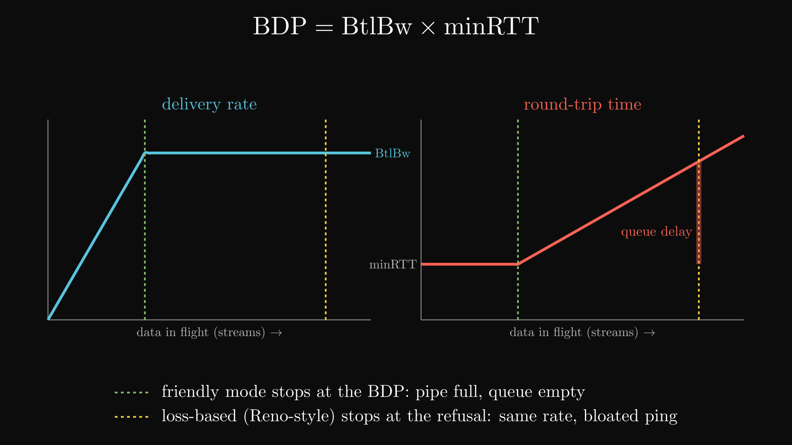
Bufferbloat control: stop adding connections once the pipe is full
PART IV · OUR WORK
More connections fill the router's queue, not the pipe. Plexo watches ping and stops at the bandwidth-delay product.
reused-socket TTFB
minRTT + sRTT
queue = sRTT − minRTT
queue > 2 × minRTT?
yes: streams × 3/4
no: grow ×2, then +1
01
BDP
BDP = BtlBw × minRTT: the bytes in flight that fill the pipe exactly. Past it, extra data only waits in the router's queue.
02
Queue vs travel
minRTT is travel time with an empty queue. sRTT − minRTT is time spent waiting in line: that is bufferbloat.
03
Loss vs delay
the old rule grew until the server refused (Reno-style). Now the rule also listens to delay, like BBR: same speed, low ping.
Code: download/rttEstimator.ts, concurrency.ts judgeDelay().
Notes:
Simple version: Plexo opens many connections. Too many fill the router's waiting line, so ping for everyone on the Wi-Fi jumps from about 20 ms to hundreds, and the download is no faster because the pipe was already full. Plexo measures the smallest ping (travel time) and the current ping. When the current ping is more than double the smallest, the line is filling, so it removes a quarter of the connections. When ping is low and more connections still raise the speed, it adds more: doubling first (slow start), then one at a time (congestion avoidance). RTT samples come from requests on reused sockets, so no handshake is counted; sRTT uses the RFC 6298 gain of 1/8. Demo: start a big download with ping 1.1.1.1 running, then flip 'Keep ping low while downloading' in Network learning.

Slide 16
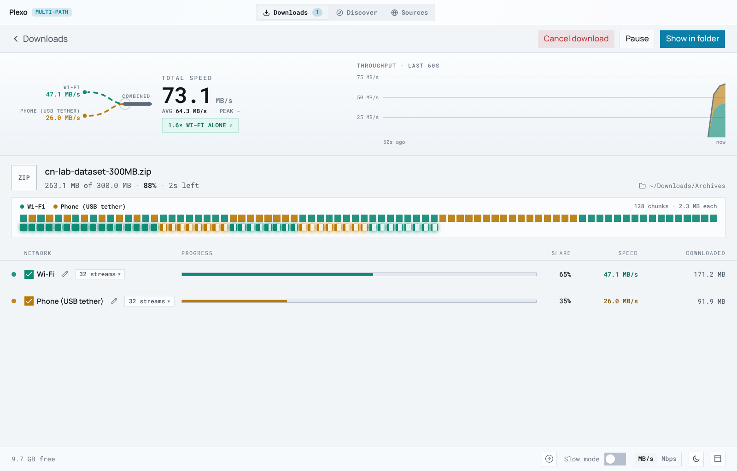
Measured: 73.1 MB/s over two paths, split in proportion to capacity
PART IV · OUR WORK
73.1 MB/s
Wi-Fi 47.1 + phone 26.0 MB/s = 1.6× Wi-Fi alone
delivered
Wi-Fi 62.5%
phone 37.5%
predicted from capacity
64.0%
36.0%
300 MiB
64
0
45
31 / 31
in 6 s
streams
retries
files indexed
checks pass
01
Limits we found
02
Next
checksum repair not coded · simulation uses assumed speeds · crawler ignores robots.txt · bench paths share one machine
build checksum repair · feed measured speeds into the simulation · honour RFC 9309 · rerun on two real ISPs
Bench: loopback + LAN source IPs, server throttled 1.6 / 0.9 MB/s per connection, 5 Nov 2026.
Notes:
Ceilings at 32 streams are 51.2 and 28.8 MB/s; we observed 92% and 90% of them. Plexo never learned the server's limits, yet the byte split matched capacity because of pull-based scheduling.

Slide 17
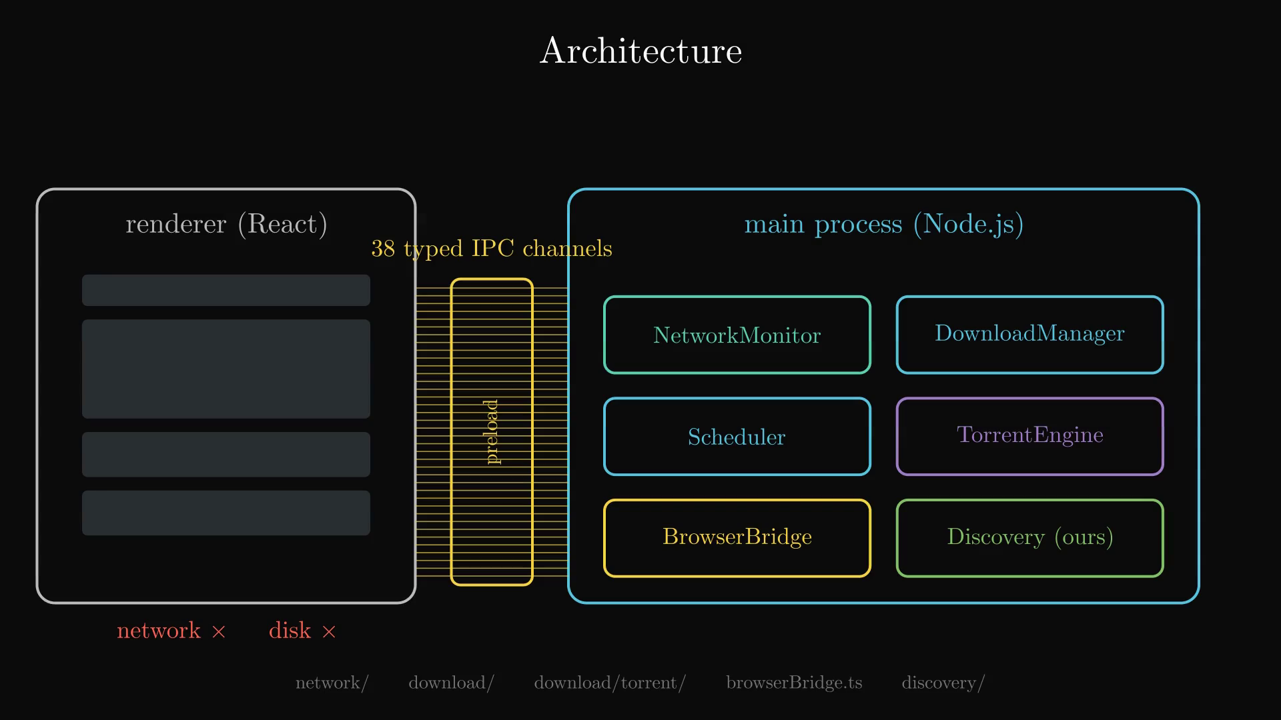
The whole backend in three minutes, narrated
PART V · THE WHOLE PICTURE
Inside the film
0:00
one file, every network
0:18
Electron architecture, IPC
0:47
NetworkMonitor, binding
1:10
probe → plan → pull → write
1:56
hedging, limits, failures
2:27
our features 1 to 7
3:00
measured results
voice: Kokoro TTS · 3 min 19 s
▶ Click the picture to play · 3 min 19 s · with narration (turn the sound on)
Notes:
This film is the whole backend end to end, with narration: the Electron split and its 38 IPC channels, the network monitor and socket binding, the download pipeline from probe to rename, hedging, speed limits, fault tolerance, our first seven features and the measured result. Subtitles are in Plexo-Enhanced_Backend_Narrated.srt.

Slide 18
Thank you
Questions are welcome. Try it live: paste https://ftp.gnu.org/gnu/hello/ into Sources and watch the blocks split across both networks.
Harshul Kala · Khushi Krishna · Medha Umesh · Meghna Pant
Guide: Prof. Sunil Kumar J
CS2403 Computer Networks · CIE 3 · RV University
Base Plexo: github.com/anmolkapil/plexo
Notes:
Close by pasting the GNU link live in Sources, then take questions.

Slide 19
Thank You
Thank you, Sunil Sir!
We love you ♥
The best guide we could have asked for. Thank you for your guidance and support throughout this project.
Plexo-Enhanced: one file, downloaded over many networks at once
Notes:
Thank Prof. Sunil Kumar J for guiding the project, then take questions.

