Slide 1
User Management
Quick walkthrough of the Project

Slide 2
Overview
UserManagement Project created servers as project that exposes 6 Restful API’s giving ability to perform insert/update/delete and get all the user details from the database.
Currently the project is using MySQL Database to connect to and store the details in.

Slide 3
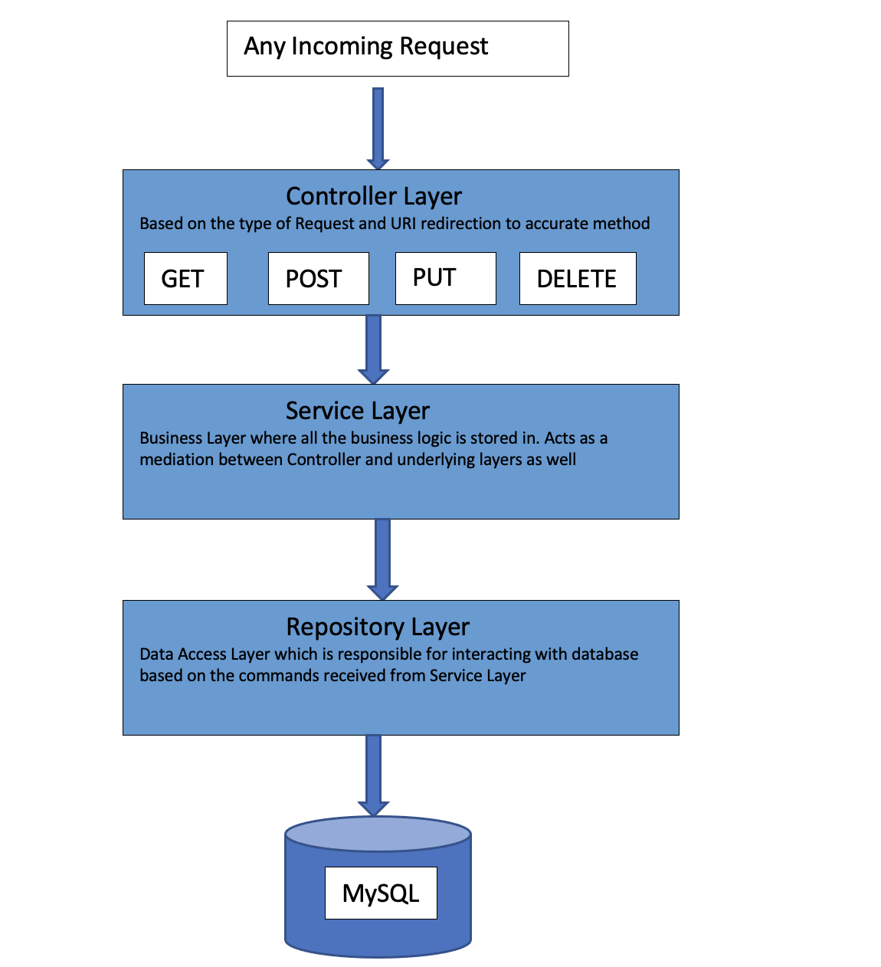
Architecture

Slide 4
High Level Code Package Walkthrough
Package name | Contents decription
com.wiredcraft.java.backend.UserManagement | Spring main class where the application initialization is started
com.wiredcraft.java.backend.UserManagement.config | Sample package created for customized actuator endpoint . In the project used for creating features endpoint
com.wiredcraft.java.backend.UserManagement.controller | Controller package contain the main Controller class to accept and process the request based on URI and HTTP method used
com.wiredcraft.java.backend.UserManagement.entity | Package containing the VO objects that are used for the project
com.wiredcraft.java.backend.UserManagement.error | Package to place in the customized error handling
com.wiredcraft.java.backend.UserManagement.repository | Package that handles Data Access or Repository interaction using JPA
com.wiredcraft.java.backend.UserManagement.securityAdapter | Package that helps in to place basic authentication and authorization
com.wiredcraft.java.backend.UserManagement.service | Service Layer containing the Business logic and interacting with Repository layer as per the need

Slide 5
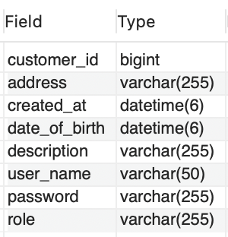
DB screenshot

Slide 6
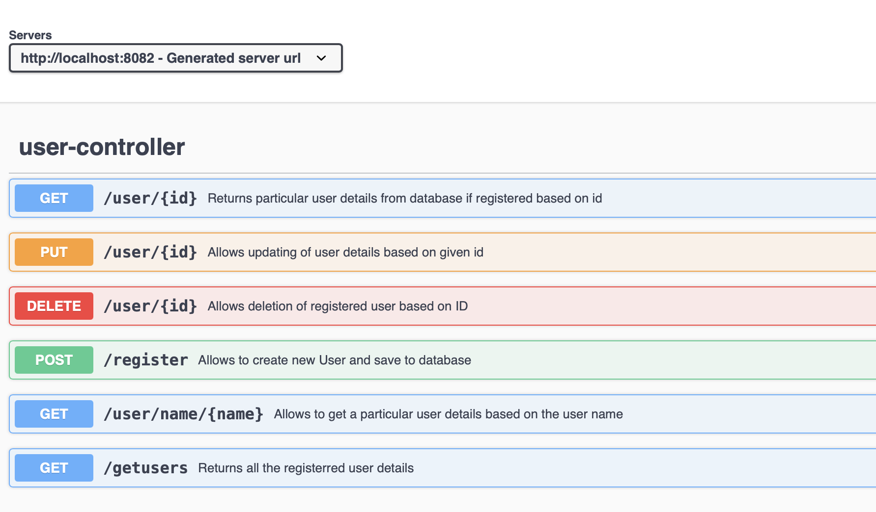
Overview of available RestAPI’s
Using Spring openapi ui jar showcasing the swagger documentation

Slide 7
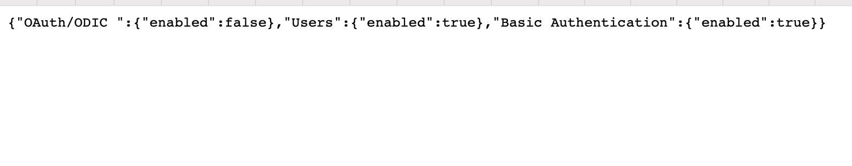
Additional details
Table creation is dynamic using JPA during application first time start up
Sample unit test are created
Customized actuator to showcase the high level features that are developed
http://localhost:8082/actuator/features/
Password storage in DB uses Bcrypt encoder functionality

Slide 8
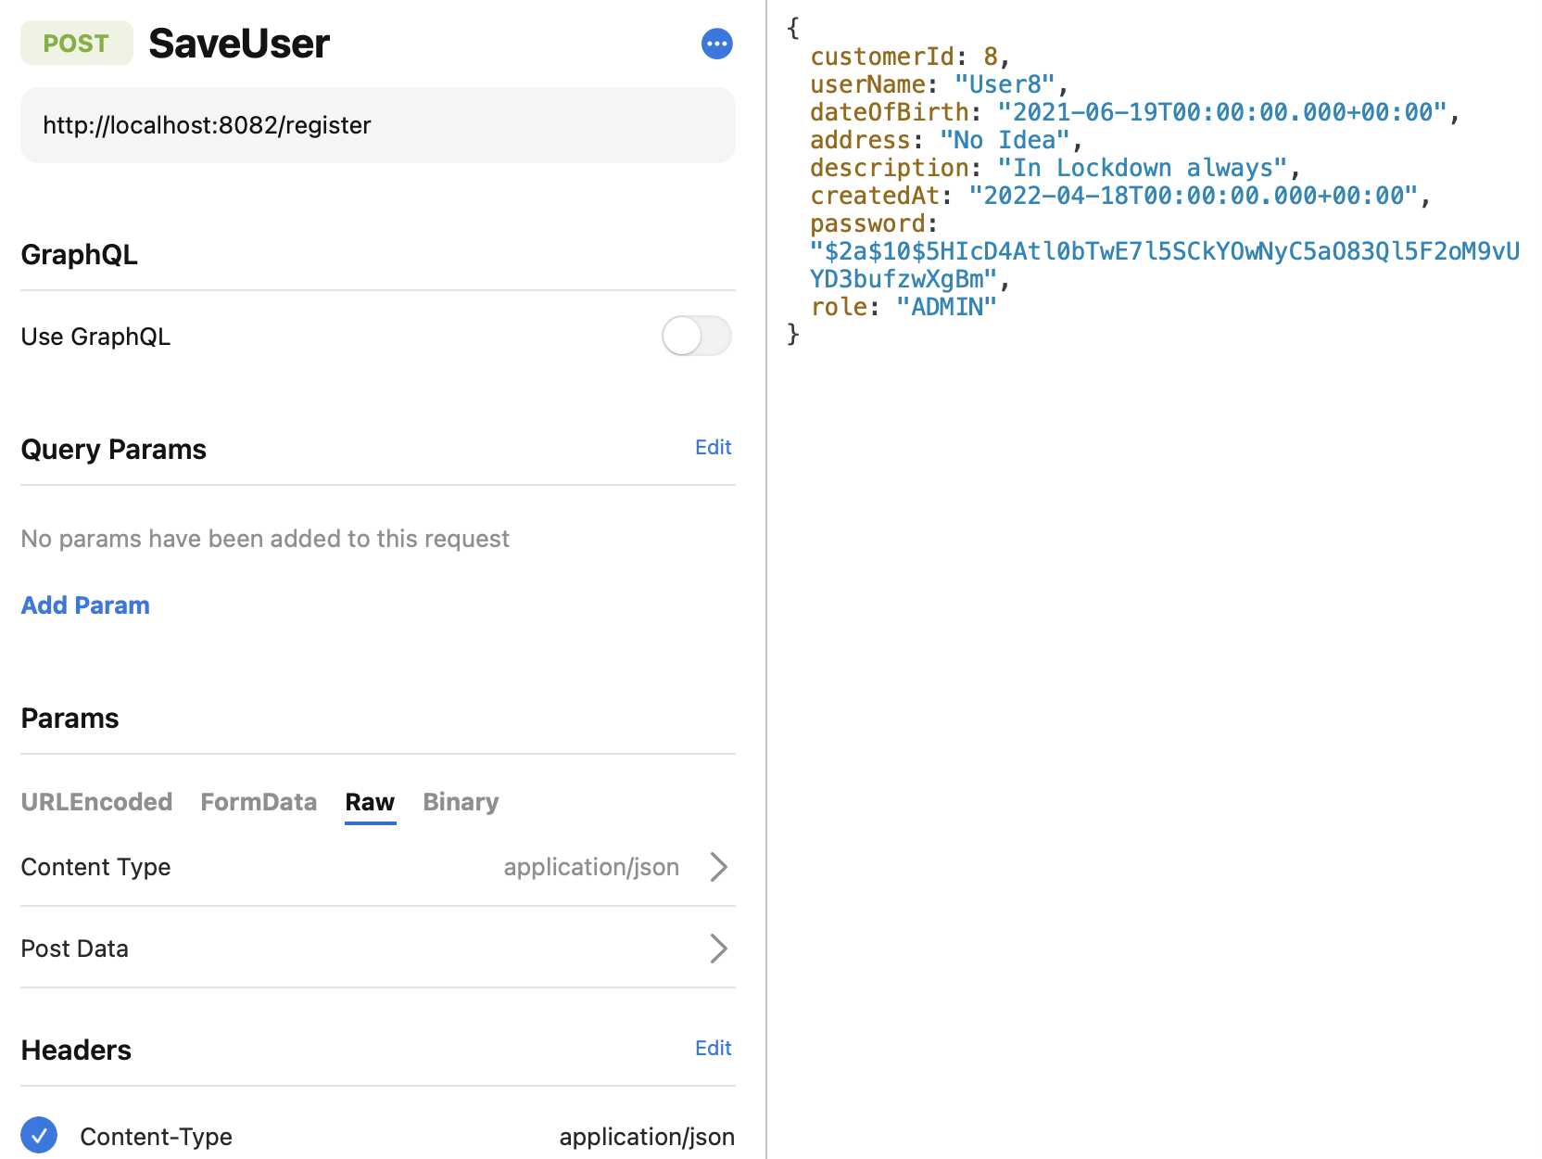
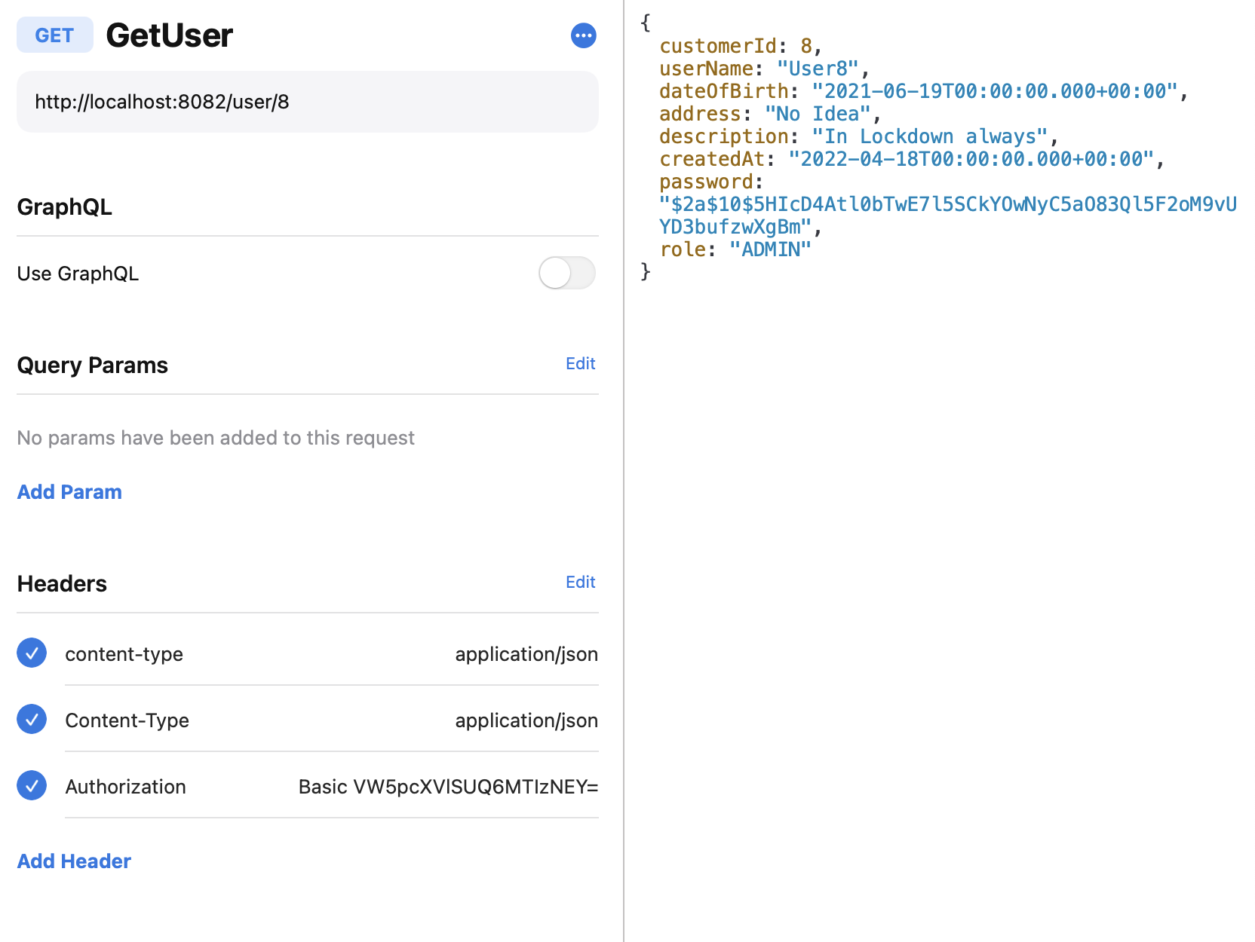
Registration and Retrival

Slide 9
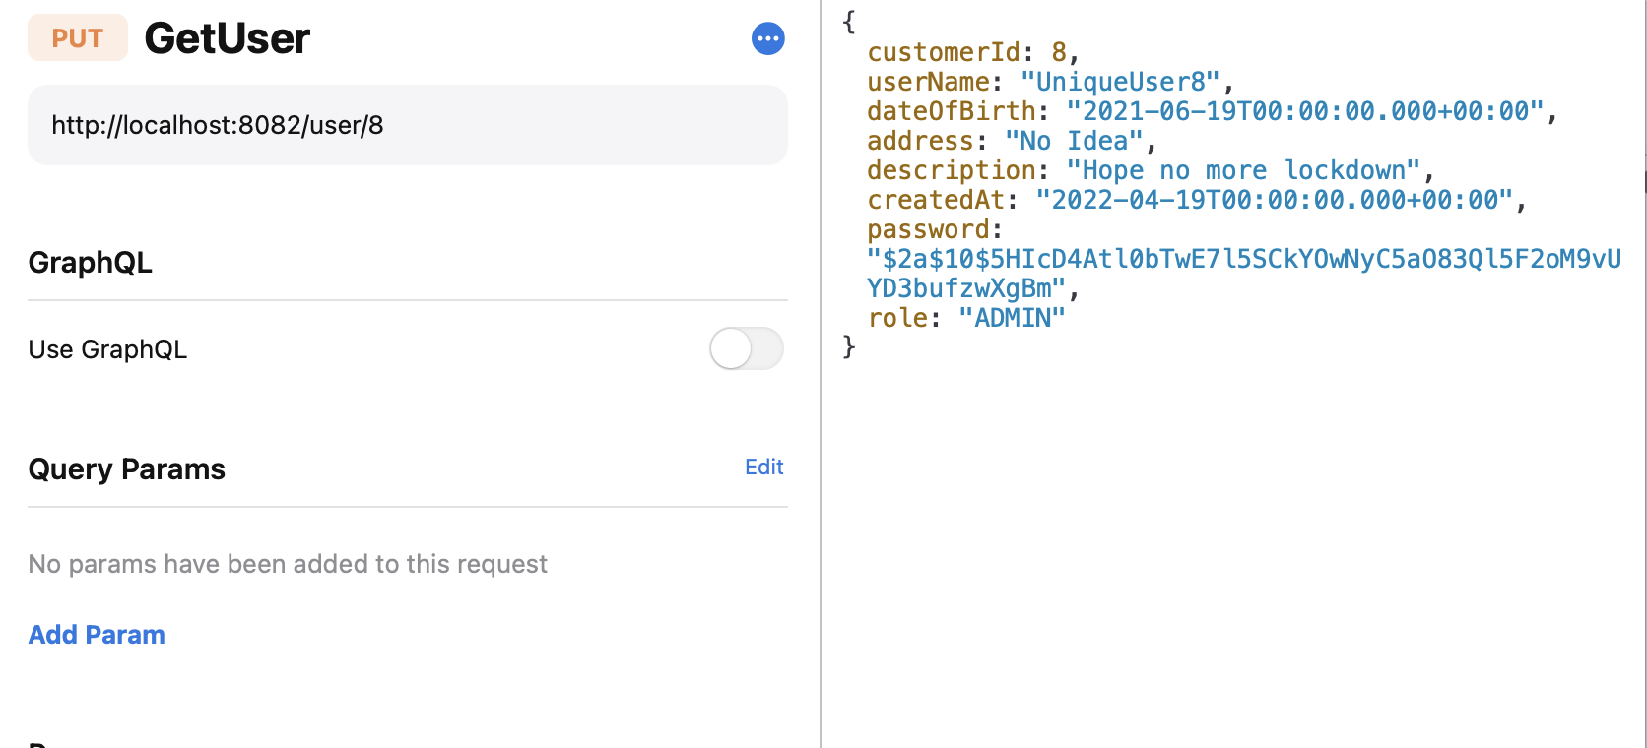
Update user API

Slide 10
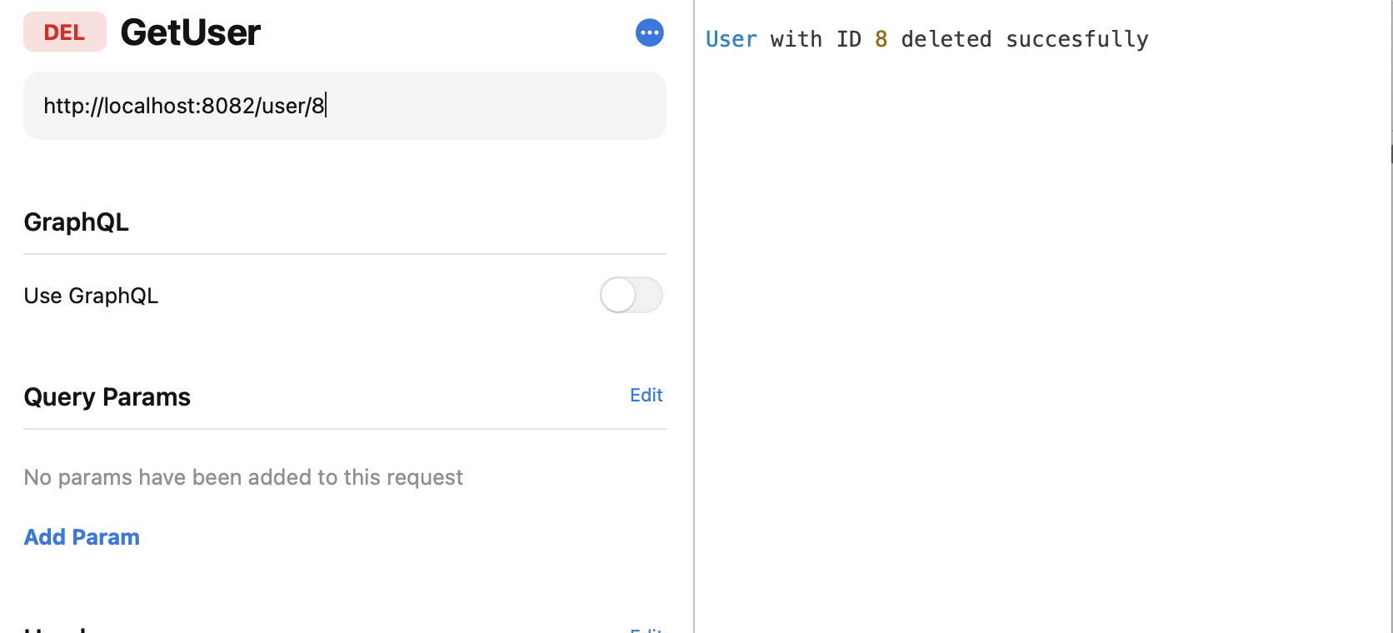
Delete User API

Slide 11
DB snapshot
DB when row User8 was added

