Slide 1
Obstacle Avoidance by Crazyflie drone using Model Predictive Control(MPC)
Presented By:
Vishal Sivakumar

Slide 2
Contents
Drone overview
Approach using MPC
Simulation plot
Videos of Inferences
Possible advancements
References
Discussion

Slide 3
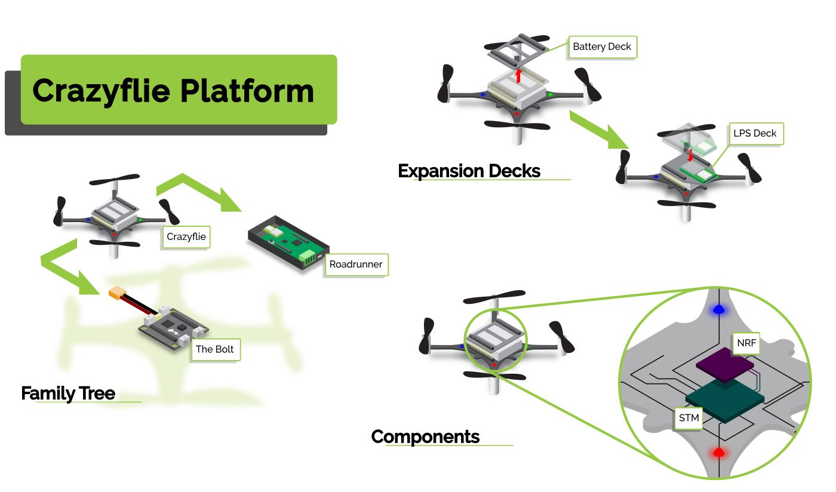

Drone overview
It consists of:
STM32F4 that handles the main Crazyflie firmware with all the low-level and high-level controls.
The NRF51822 handles all the radio communication and power management.
Notes:
-Considering these challenges, we introduced the AdapNet++ architecture that provides effective solutions these problems
-Our architecture has a encoder-decoder topology with the ResNet-50 structure as our encoder backbone
-We introduced new multiscale residual units that are used in our encoder for efficiently learning multiscale features throughout the network without increasing the number of params
-and the new eASPP or the efficient Atrous spatial pyramid pooling module to further learn multiscale features and to capture long range context
-Finally, in order to unsample the features back to the input dimensions, we also proposed a new decoder topology

Slide 4
Approach using MPC
MPC - A control strategy, predicts future behavior based on the model specified and provides optimized control inputs to achieve a desired performance.
Objective Function
Optimal Control
Set of constraints

Slide 5

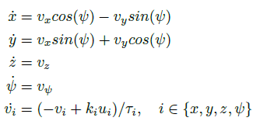
Goal: It is to avoid obstacles based on set of constraints, provide optimal control inputs(velocity) to the drone and make it maneuver based on the state estimation using Lighthouse Positioning system.
Some definitions:
Github link to this definition in code
State vector:
Model:

Slide 6
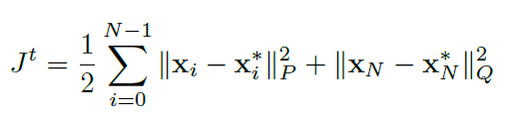
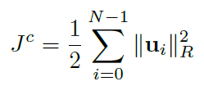
Objective functions
Static-Obstacle constraints

Slide 7
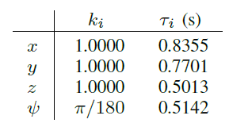
Solver used: IPOPT (Interior Point OPTimizer)
Control input limits: −0.4 ≤𝑢 ≤0.4
OCP horizon length: N = 5 - 15 control intervals
Sampling time: dt = 0.1s or 100 msec
Discretization method: multiple shooting
Numerical integration method: Runge-Kutta 4th order

Slide 8
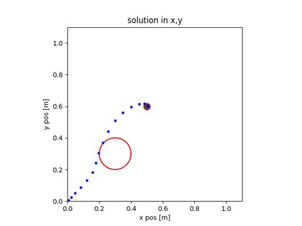
Simulation plot

Slide 9
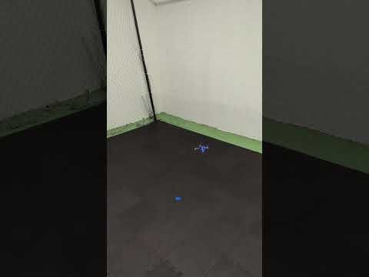
Videos of Inferences
Movement from origin O(0, 0, 0) to a point A(0.5, 0.5, 0.5)
ClosedloopWithoutObstacle

Slide 10
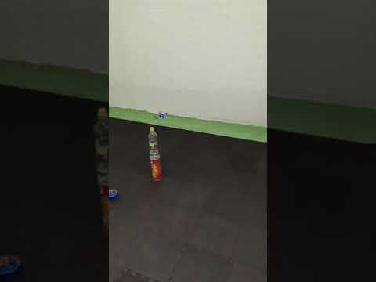
Movement from origin O(0, 0, 0) to a point A(0.5, 0.5, 0.5) with an obstacle at (0.3, 0.2)
ClosedloopWithObstacle

Slide 11
Possible advancements
Include Dynamic obstacle constraints.
Use of different solvers and packages to produce a comparative results for better performance and latency, this could be for example SNOPT, KNITRO, APOPT, ACADOS and BONMIN.
Inclusion of Utility theory(RL) considering similar finite horizon problems to have a reward based agent, environment interaction.
Include multiple shooting with other techniques, such as direct collocation, to improve the accuracy and efficiency of the solution.

Slide 12
References
Castillo-Lopez, M., Sajadi-Alamdari, S. A., Sanchez-Lopez, J. L., Olivares-Mendez, M. A., & Voos, H. (2018). Model Predictive Control for Aerial Collision Avoidance in Dynamic Environments. Mediterranean Conference on Control and Automation. https://doi.org/10.1109/med.2018.8442967
meco-group. (n.d.). GitHub - meco-group/rockit: Github Mirror of https://gitlab.mech.kuleuven.be/meco-software/rockit. GitHub. https://github.com/meco-group/rockit
M. (n.d.). GitHub - MohamadSayegh/MPC_Quadrotor: Model Predictive Control for a quadrotor in static and dynamic environments. GitHub. https://github.com/MohamadSayegh/MPC_Quadrotor

Slide 13
Discussion

Slide 14
Thank you !
Github link to this work: Flight-Control

