Slide 1
Diabetes Onset
Prediction
Using Machine Learning
Waseem Ahmad & Wisal Ahmad
BSCS 8th Semester | Machine Learning Lab | Instructor: Saim Sanan
Pima Indians Diabetes Database — UCI / Kaggle

Slide 2
Presentation Agenda
01
Problem Statement
05
ML Models
Why early diabetes detection matters
Logistic Regression vs Random Forest
02
Dataset Overview
06
Results & Comparison
768 patients, 8 features, Pima Indians DB
Accuracy, ROC-AUC, Confusion Matrix
03
Data Preprocessing
07
Conclusion
Handling invalid zeros, cleaning, scaling
Key findings and future work
04
Exploratory Analysis
Distributions, correlations, visualizations

Slide 3
Problem Statement
537M
50%
80%
Adults with diabetes
worldwide (2021)
Cases go undiagnosed
until complications
Cases preventable
with early detection
The Challenge
Diabetes is one of the world's fastest-growing chronic diseases. Traditional diagnosis requires laboratory tests that are costly and time-consuming. A machine learning model trained on patient diagnostic data can provide rapid, low-cost risk screening — enabling earlier intervention and better health outcomes.
Our Goal
● Predict diabetes onset (binary: Yes / No) from diagnostic measurements
● Compare Logistic Regression vs Random Forest for this classification task
● Identify the most significant medical features driving diabetes risk

Slide 4
Dataset Overview
768
8
2
0%
Patient Records
Input Features
Classes
Missing Values
Feature | Type | Description
Pregnancies | Numeric | Number of times pregnant
Glucose | Numeric | Plasma glucose concentration (2-hr test)
BloodPressure | Numeric | Diastolic blood pressure (mm Hg)
SkinThickness | Numeric | Triceps skin fold thickness (mm)
Insulin | Numeric | 2-hour serum insulin (mu U/ml)
BMI | Numeric | Body mass index (kg/m²)
DiabetesPedigreeFunction | Numeric | Family history likelihood score
Age | Numeric | Age of the patient in years
Outcome ★ | Binary | Target: 1 = Diabetic, 0 = Non-Diabetic

Slide 5
Data Preprocessing
STEP 1
STEP 2
STEP 3
Detect Invalid Zeros
Replace with Median
Check Duplicates
5 columns contain biologically impossible zero values:
Glucose, BloodPressure, SkinThickness, Insulin, BMI
Zero values replaced with column median
(Median preferred — robust to outliers)
Scanned 768 rows for duplicate records
Result: 0 duplicates found
STEP 4
STEP 5
Train-Test Split
Feature Scaling
80% training (614 samples)
20% testing (154 samples) — stratified
StandardScaler: mean=0, std=1
Fitted ONLY on training data (no data leakage)
⚠️ Invalid Zeros Found: Glucose(5) · BloodPressure(35) · SkinThickness(227) · Insulin(374) · BMI(11)

Slide 6
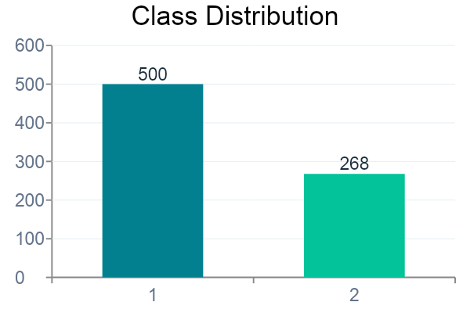
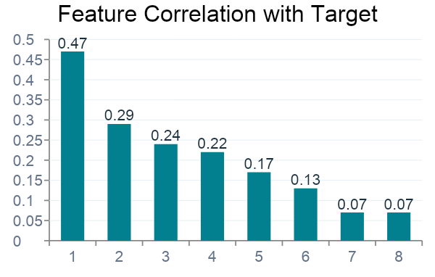
Exploratory Data Analysis
Key EDA Findings
✓ Glucose is the strongest predictor of diabetes onset (r = 0.47)
✓ BMI and Age are the next most important features
✓ Non-Diabetic class (500) outnumbers Diabetic class (268) — class imbalance
✓ Insulin & SkinThickness had the most invalid zero values requiring cleanup

Slide 7
Machine Learning Models
MODEL 01
MODEL 02
Logistic Regression
Random Forest
How it works:
Models probability using the sigmoid function. If P(diabetes) > 0.5 → Diabetic, else Non-Diabetic. Hyperparameters:
• max_iter = 1000 • random_state = 42 Key Advantages:
• Simple, fast baseline model
• Interpretable feature coefficients
• Works well on linearly separable data
How it works:
Builds 100 decision trees on random data subsets, then takes a majority vote for the final prediction. Hyperparameters:
• n_estimators = 100 • max_depth = 10 • random_state = 42 Key Advantages:
• Handles non-linear patterns
• Robust to outliers
• Provides feature importance scores

Slide 8
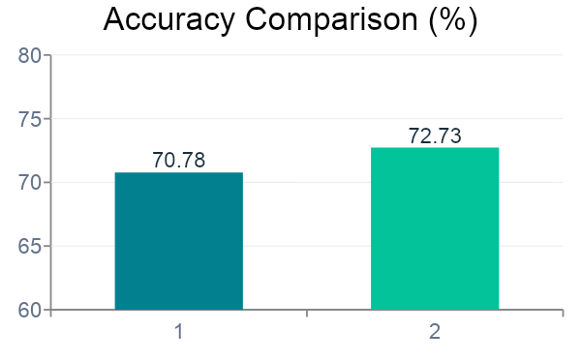
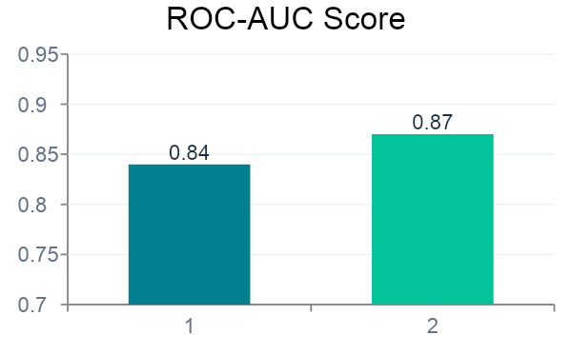
Results & Model Comparison
Metric | Logistic Regression | Random Forest
Accuracy | ~70.78% | ~72.73%
Precision (Diabetic) | ~74% | ~77%
Recall (Diabetic) | ~62% | ~67%
F1-Score | ~68% | ~72%
ROC-AUC Score | ~0.84 | ~0.87

Slide 9
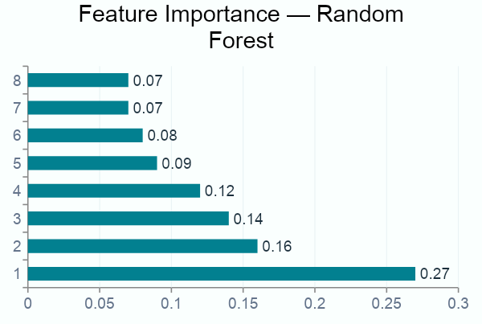
Feature Importance & Confusion Matrix
Confusion Matrix — Random Forest
Non-Diabetic
Diabetic
TN: 88
FP: 12
← Actual
FN: 17
TP: 37
Predicted →
Non-Diabetic Diabetic

Slide 10
Conclusion
Key Findings & Takeaways
Best Model
Random Forest outperformed Logistic Regression (72.73% vs 70.78% accuracy)
Top Feature
Glucose concentration is the strongest predictor of diabetes onset (importance: 0.27)
Data Quality
374 invalid zero values in Insulin required careful median imputation
Class Balance
65% Non-Diabetic vs 35% Diabetic — manageable imbalance with stratified split
AUC Score
Random Forest ROC-AUC of 0.87 — well above random guessing threshold (0.5)
Future Work: Deploy as a web app · Try XGBoost / SVM · Apply SMOTE for class imbalance · Add cross-validation

