Slide 1
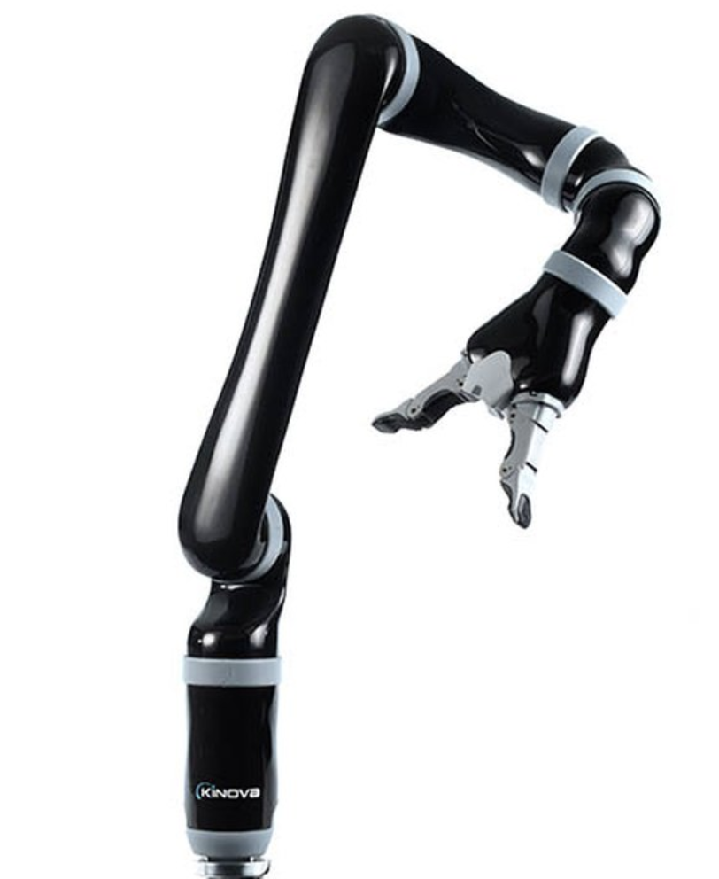
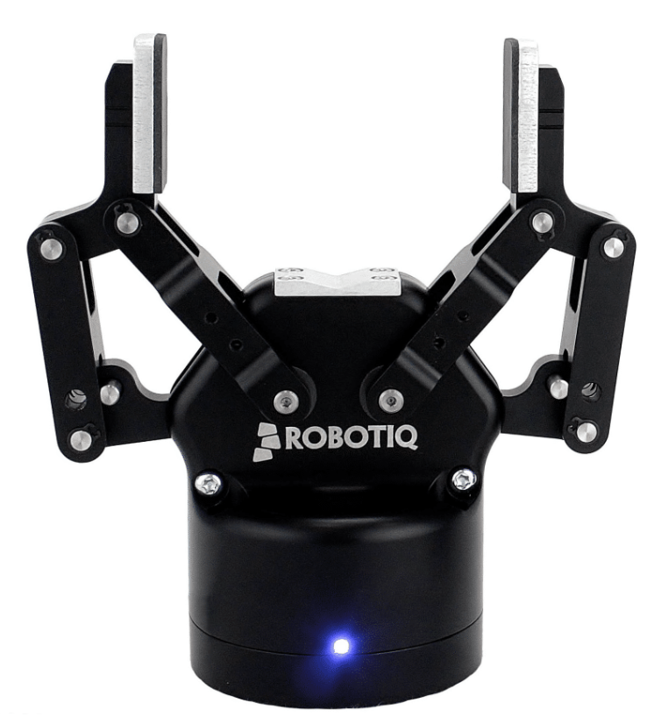
MICO Parser
Overview Diagram of the NRI-authoring-Backend Codebase
Motion Planning & Arm Movement
Read from json
kinova-ros & MoveIt
MICO Master
Requests
1.CheckROSLive
2.LaunchROS
3.ExecutePlan
4.Exit
Pass the therbligs json
End-Effector Position
UI NodeJs Server
Python HttpServer
MICO Planner
Response
MICO Gripper
Notes:
Circle-shaped components are implemented by our own code.
Rectangular-shaped components represent the imported packages.
Open & Close Commands
robotiq_85_gripper

