Slide 1
How to ‘git’ gud
Version Control for scrubs people like you and me

Slide 2
Roadmap
What is Version Control?
What is Git?
Essential Git Commands
Hands-on!

Slide 3
What is version control?
Ideas?
A way to monitor the history of files
Doesn’t have to be complicated!
3 different types:
Local, Centralized, Distributed

Slide 4

Local Version Control
Common behavior:
file.txt → file_old.txt → file_really_old.txt
Idea: store “diffs” between versions
Mark diffs with a version number
Now can go back and forth in history
Problem: can’t collaborate with others!

Slide 5
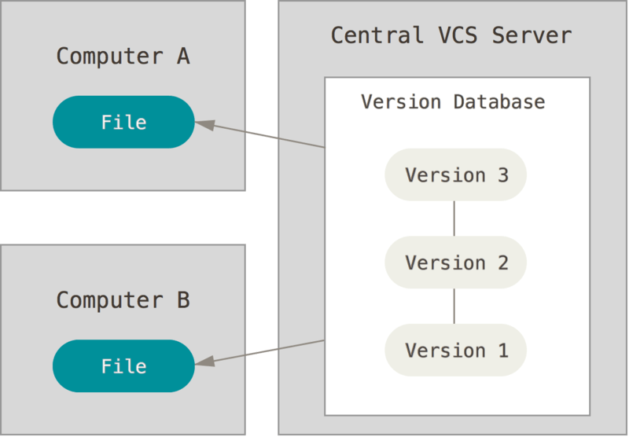
Centralized Version Control
Solution: Put files on external server!
All operations go through server
Need an old version? Ask!
Any change must be made at “head”
Problem: server goes offline
No one can work!
Server HDD dead = lost history
Notes:
If the server HDD dies, the only copies of the repo we have are those of the people who have it checked out. Keep in mind ALL operations go through the server. If you want to roll back to version 2, you have to ask the server. Hence, losing the server is a big deal, since the only thing you have left is actually just individual versions that people just happen to have.

Slide 6
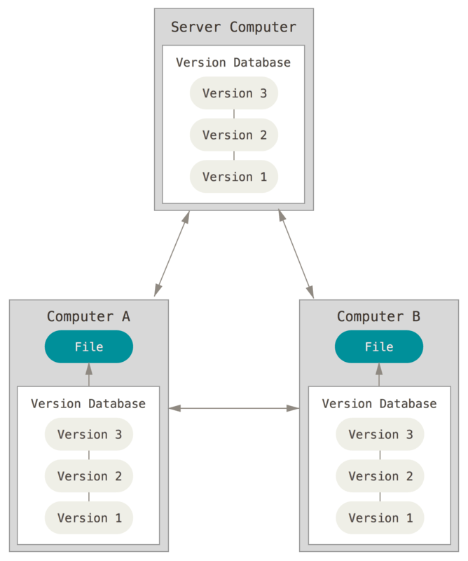
Distributed Version Control
Solution: everyone stores all of the history
Can work offline
Can have multiple servers
Decentralized model allows no loss of history
A bit more complicated to create, though!

Slide 7

What is Git?
Distributed Version Control System
Originally created for version controlling the Linux kernel
We use this for our code as well!

Slide 8
Git Essential Concepts & Terminology

Slide 9
An example
Suppose we have some code that is version controlled by Git
This folder is called a Git repository
HEAD is the most current version of the code
Cool – how does Git manage changes?
$ tree motor-test/
motor-test/
├── .gitignore
├── include
│ └── motor.h
├── makefile
└── src
├── main.c
└── motor.c

Slide 10
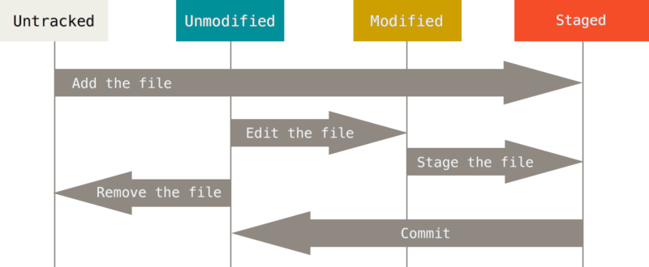
Tracking file history
New files come in as untracked
New and changed files must be manually added (“staged”)
A commit is a group of staged changes, generally functionally related

Slide 11
Back to our example...
Let’s make some changes!
Fix a bug in main.c
Add util.h
Git reports util.h is untracked and main.c is changed
Let’s get our changes to everyone else on the team!
$ tree motor-test/
motor-test/
├── .gitignore
├── include
│ └── motor.h
│ └── util.h
├── makefile
└── src
├── main.c
└── motor.c
$ git status
Changes not staged for commit:
modified: src/main.c
Untracked files:
include/util.h

Slide 12
Example, cont.
Stage changes by `git add`
Bundle ‘em up with `git commit`
[master cb8d0d0]
master – the “branch” we are committing to, more on this later
cb8d0d0 – commit #
$ git add include src/main.c
$ git status
On branch master
Changes to be committed:
new file: include/util.h
modified: src/main.c
$ git commit –m “Init motor correctly, and add util header.”
[master cb8d0d0] Init motor correctly, and add util header.
2 files changed, 5 insertions(+)
create mode 100644 include/util.h

Slide 13
Example, cont.
Take a look at the commit via `git log`
Push the commit to the server (“remote”)
Success! Everyone has our changes!
To get the changes, we run `git pull`
$ git log
commit cb8d0d0… | Author: <…> | Date: <…>
Init motor correctly, and add util header.
commit 5356ece… | Author: <…> | Date: <…>
Initial commit
$ git push
Counting objects: 3, done.
Delta compression using up to 4 threads.
Compressing objects: 100% (2/2), done.
Writing objects: 100% (3/3), 273 bytes | 0 bytes/s, done.
Total 3 (delta 1), reused 0 (delta 0)
remote: Resolving deltas: 100% (1/1), completed with 1 local objects.
To http://toteslegitwebsite.com/motor-test
5356ece..cb8d0d0 master -> master

Slide 14
The .gitignore file
Might have noticed this file
Git’s blacklist of files when staging
Use this file for binaries or intermediate build files
e.g. *.hex, *.bin, *.o, *.so, etc.
$ tree motor-test/
motor-test/
├── .gitignore
├── include
│ └── motor.h
├── makefile
└── src
├── main.c
└── motor.c

Slide 15
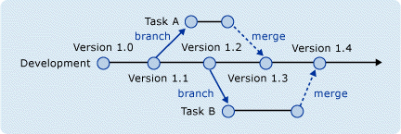
Branching & Merging
Usually, ‘master’ branch is used for stable code
Large teams “branch” off to work on small tasks
Or very experimental code
When branch is stable, “merge” back into master

Slide 16
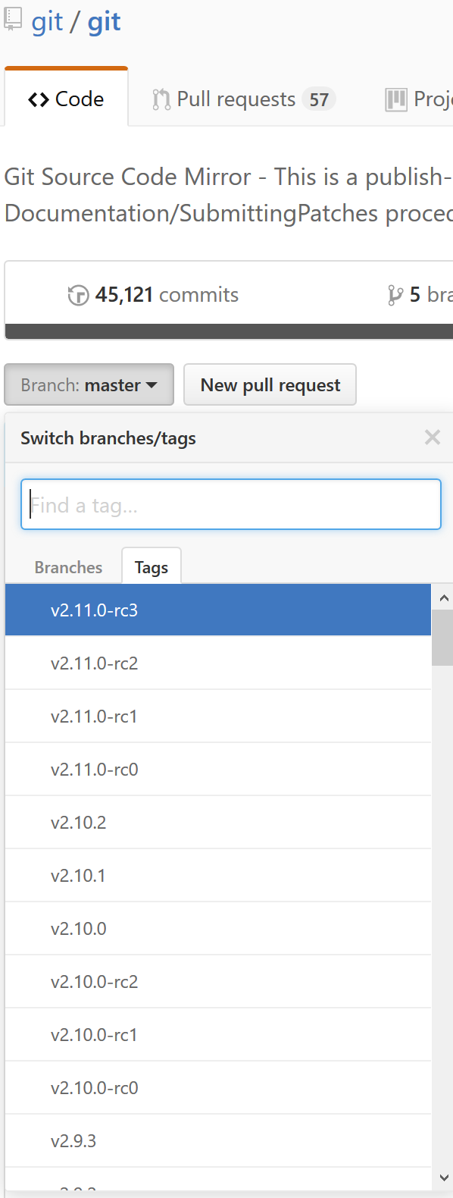
Tagging
Mark important history points
Commonly used for releases
We don’t really use it…

Slide 17
Common Git Commands

Slide 18
Repository Information
git status – See what changed in the repo
git log – Look at the commit history
git show [commit hash] – See changes of the latest or the specified commit
git diff [> file.diff] – See local, unstaged changes. Can output to patch file for other people to apply

Slide 19
Repository Manipulation
git clone – Download the repo for the first time
git pull – Download the latest commits and apply it
git add <file/dir> - Stages a file/directory for a commit
git [remove|rm] <file/dir> - Unstages file/directory and deletes it
git [move|mv] <file/dir> - Moves a file/directory to a new place

Slide 20
Repository Manipulation, cont.
git commit [-m “<message>”] – Bundle up changes with an attached message describing the changes
git push – Send all commits to the server
git apply <patch file> - Puts the changes in the file into the repo. File usually generated by git diff.
git reset --hard HEAD – Give up and start over (undo all tracked changes!)
git clean -xdf – Permanently delete all untracked files

Slide 21
Branching, Merging, & Tagging
git push <remote> <branch> - Push to specific remote & branch.
Usually remote = origin, branch = branch name (e.g. master)
git branch -a – List all branches
git checkout <branch> - Switch to an existing branch
git checkout -b <branch> - Create and switch to new branch
git merge <branch> - Merges branch to master
git tag - list all tags

Slide 22
Git Tips and Pitfalls
Always pull before starting work!
Commit carefully! Don’t commit binaries! If you’re not sure, ask!
Common workflow
`git pull`
Modify files
`git status` to see changes
`git add <file/folder>` to stage changes
`git status`, `git diff --cached` to verify
`git commit -m “<msg>”` - make sure it’s descriptive!
`git push` to send to server

Slide 23
Wisconsin Robotics Project Hosting
We use GitHub to host all of our code
Has issue tracking, wikis, and other nice features
Private repositories for testing/unstable code

Slide 24
Let’s “Git” you set up!
Download and install Git
https://www.git-scm.com/
Run the following in the terminal:
$ git config --global user.name "Your Name"
$ git config --global user.email email@email.com
Can’t remember all the commands?
https://education.github.com/git-cheat-sheet-education.pdf
Run git help <command> - a webpage will popup!
Register for a GitHub account
We’ll get you added to the WR GitHub
If you have code/schematics to version control:
We’ll help you make a new repo and upload to GitHub

Slide 25
Thank you –

Slide 26
References
The progit2 book - https://github.com/progit/progit2

