Slide 1
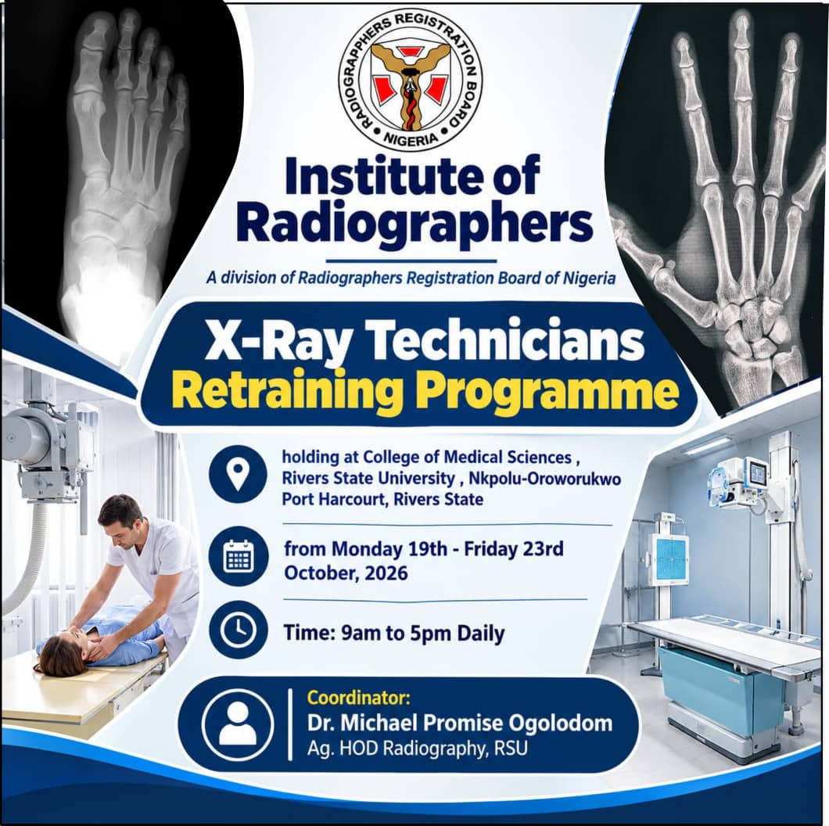

Slide 2
LECTURES ON INTRODUCTION TO DAYLIGHT AND DIGITAL IMAGE PROCESSING
(MXT 303)
BY
DIR. GBARABE, KENT

Slide 3
COURSE OUTLINE
INTRODUCTION/THE CONCEPT OF DAYLIGHT FILM PROCESSING
MODE OF OPERATION OF DAYLIGHT FILM PROCESSOR
COMPONENT OF A DAYLIGHT FILM PROCESSOR
ADVANTAGE AND DISADVANTAGES OF DAYLIGHT PROCESSING
DAYLIGHT FILM PROCESSOR VERSUS DARKROOM PROCESSING
PRECAUTION IN FILM PROCESSING
BASIC PRINCIPLES OF DIGITAL IMAGING
TYPES OF DIGITAL X RAY RECEPTOR
MAIN STAGES IN DIGITAL IMAGE PROCESSING
THE COMPUTED RADIOGRAPHY IMAGING RECEPTOR (CR)

Slide 4
COURSE OUTLINE CONTD
STAGES OF CR DETECTOR IMAGE PROCESSING
SCIENTIFIC PRINCIPLES OF CR DETECTOR
COMPONENTS OF CR DETECTOR
ADVANTAGES OF CR IMAGING DETECTOR
DISADVANTAGES OF CR IMAGING DETECTOR
SUMMARY OF CR IMAGING OPERATION
THE DIGITAL IMAGING (DR ) RECEPTOR
TYPES OF ( DR )DIGITAL IMAGE PROCESSING
COMPONENTS/CROSS SECTION OF DR PLATE
SUMMARY OF DR IMAGING PROCESSING OPERATIONS
ADVANTAGES AND DISADVANTAGES OF DR IMAGING PROCESSING
DIFFERENCES BETWEEN CONVENTIONAL AND DIGITAL IMAGING PROCESSING

Slide 5
CONCEPT OF DAYLIGHT FILM PROCESSING
A daylight film processor is a radiographic film processing system that allows radiographers to handle and process X-ray films in normal room light without using a darkroom.
It uses a special light-tight system to protect the unexposed film from unwanted light while the film is being loaded, processed, and removed.

Slide 6
MODE OF OPERATION
The process generally follows these steps:
1. Film loading
The exposed X-ray cassette is placed into the daylight loading compartment.
Film extraction
The system opens the cassette inside a light-protected compartment and removes the exposed film.
Film processing
The film passes through the processing stages: developing, fixing, washing, and drying. Some systems integrate these stages into an automatic processor.
Film collection
The processed, dry radiograph is delivered for viewing and interpretation.

Slide 7
Components of a daylight film processor
The main components may include:
Film loading compartment — receives the exposed cassette.
Cassette opening mechanism — opens the cassette safely within the protected chamber.
Film extraction mechanism — removes the film from the cassette.
Light-tight chamber — prevents unwanted light from reaching the film.
Film transport system — moves the film through the processor.
Processing unit — carries out developing, fixing, washing, and drying.
Film collection tray — receives the finished radiograph.

Slide 8
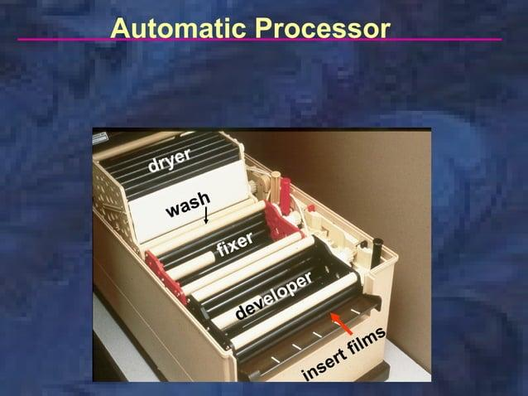
A DAYLIGHT FILM PROCESSOR

Slide 9
ADVANTAGES AND DISADVANTAGES OF DAYLIGHT PROCESSING
Advantages
Eliminates the need for a conventional darkroom for routine film handling.
Reduces the risk of accidental film fogging.
Speeds up the film-handling workflow.
Improves convenience and cleanliness.
Allows films to be loaded and unloaded in normal room lighting.
Disadvantages
Equipment can be expensive to purchase and maintain.
Mechanical faults may interrupt film processing.
Processing chemicals require regular maintenance and replacement.
It is mainly used with conventional screen-film radiography, not as the normal processing method for digital radiography.

Slide 10
Daylight film processor versus darkroom processing
Feature | Daylight processor | Darkroom processing
Room required | Normal room lighting | Darkroom or appropriate safelight conditions
Film handling | Enclosed, light-protected system | Manual handling in darkness or under a suitable safelight
Workflow | Usually faster and more convenient | Often more labour-intensive
Film protection | Light-tight loading system | Controlled lighting environment
Common use | Conventional film-based radiography | Conventional film-based radiography

Slide 11
PRECAUTIONS
A daylight film processor does not mean that X-ray film can be exposed directly to ordinary light. The film remains protected inside a light-tight compartment until it has been processed.
Also, a daylight loader and an automatic film processor are not necessarily the same device: the daylight loader protects and transfers the film, while the processor performs the chemical processing.

Slide 12
BASIC PRINCIPLES OF DIGITAL IMAGING
The concept of digital X-ray processing is the acquisition of X-ray information by a digital detector, conversion of the information into numerical data, computer processing of the data to form an image, and subsequent display, storage and transmission of that image for diagnostic purposes.
Unlike conventional film-screen radiography, which uses photographic film and chemical processing, digital radiography uses electronic detectors and computer technology to produce images.

Slide 13
TYPES OF DIGITAL X RAY RECEPTORS
There are two main types of digital X-ray receptors:
Computed Radiography (CR) — uses a photostimulable phosphor imaging plate.
Digital Radiography (DR) — uses a digital detector panel to convert X-rays into digital signals.

Slide 14
Main stages of digital X-ray processing
Image acquisition: The detector captures the X-ray information after the beam passes through he patient.
Signal conversion: The detected information is converted into an electrical signal and then into digital data. In indirect digital detectors, X-rays first produce light; in direct detectors, they produce electrical charge.
Analog-to-digital conversion: Where an analog signal is used, an analog-to-digital converter (ADC) converts it into numerical values.

Slide 15
Main stages of digital X-ray processing Contd
Image processing: The computer adjusts image characteristics, such as brightness, contrast, sharpness and noise, using appropriate processing algorithms.
Image display: The processed image is displayed on a diagnostic monitor.
Image storage and transmission: The image can be stored in a Picture Archiving and Communication System (PACS) and transmitted electronically to other departments.

Slide 16
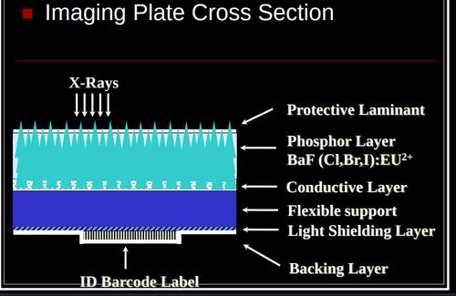
Cross section of the CR imaging plate

Slide 17
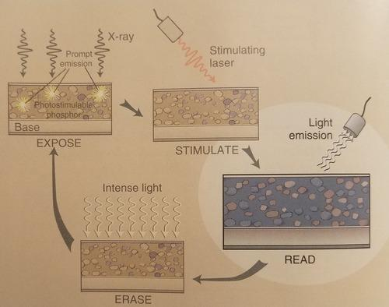
X-ray exposure
The imaging plate is placed inside a cassette and positioned behind the patient. When X-rays pass through the patient, the transmitted X-rays strike the phosphor layer of the plate.

Slide 18
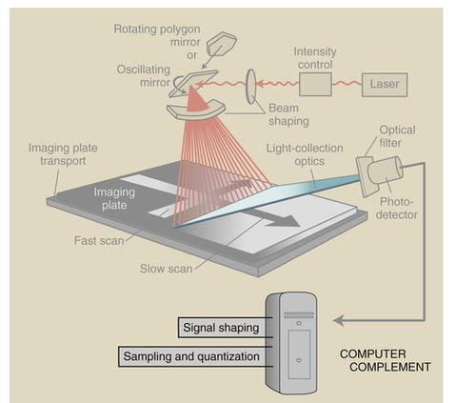
Formation of a latent image
The phosphor absorbs X-ray energy, causing electrons to become trapped in energy levels within the phosphor crystals. The pattern of trapped electrons forms a latent image, which is an invisible stored image.

Slide 19
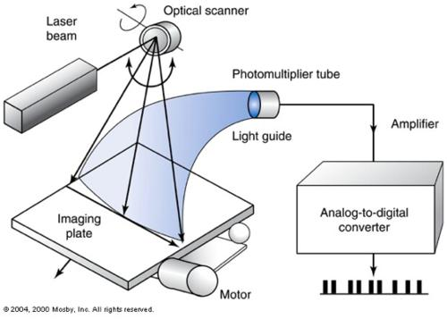
Laser scanning
The exposed plate is inserted into a CR reader. A laser beam scans the plate and stimulates the trapped electrons, causing them to release energy as visible light.

Slide 20
Light detection
A light-collection system directs the emitted light to a photomultiplier tube or another suitable detector, which converts the light into an electrical signal.
Erasure and reuse
The plate is exposed to intense light to release residual trapped energy. It is then ready for another X-ray examination.

Slide 21
The scientific principle behind CR
The operation of a CR imaging plate is based on photostimulable luminescence (PSL).
This means that the plate stores energy from X-ray exposure and releases some of that energy as light when stimulated by a laser beam.

Slide 22
Components of a Computed Radiography (CR) receptor
A CR receptor uses an imaging plate rather than the electronic flat-panel detector described above.
Its main components are:
Protective layer — protects the imaging plate surface.
Photostimulable phosphor layer — stores energy from the X-ray exposure as a latent image.
Support layer — provides mechanical strength.
Light-reflecting or absorbing layer — helps control light collection and image quality, depending on the plate design.
Backing layer — supports and protects the plate.
The CR imaging plate is placed in a reader, where a laser releases stored energy as light. This light is detected and converted into a digital image.

Slide 23
COMPONENTS AND FUNCTIONS OF CR DETECTOR
Scintillator or conversion layer
Converts X-rays into light or electrical charge
Photodiode array
Converts light into electrical charge in indirect DR
TFT array
Controls pixel readout
Readout electronics
Collects detector signals
ADC
Converts analog signals into digital data
Protective housing
Protects the detector
Computer/image processor
Processes and displays the digital image

Slide 24
Advantages of a CR imaging plate
It is reusable.
It allows digital image processing.
It has a wide exposure latitude compared with conventional film.
It can be used with many existing X-ray units.
It supports digital image storage and transmission.

Slide 25
Disadvantages of a CR imaging plate
Image acquisition is slower than with most DR systems.
Plates can be scratched, damaged or contaminated.
Dust and dirt may produce image artefacts.
Plates require regular erasure, cleaning and maintenance.
Improper exposure can still result in poor image quality or unnecessary radiation exposure.

Slide 26
During an X-ray exposure
Patient's body attenuates the X-rays
Digital imaging receptor detects transmitted X-rays
Signals are converted into digital data
Image processing and display on the monitor

Slide 27
THE FLAT PANEL (DR) RECEPTOR
Computed Radiography (CR) — uses a photostimulable phosphor imaging plate.
Digital Radiography (DR) — uses a digital detector panel to convert X-rays into digital signals.

Slide 28
TYPES OF DR IMAGE FORMATION
Indirect-conversion DR: Uses a scintillator to convert X-rays into visible light, a photodiode array to convert light into electrical signals, and a TFT array to read out the signals.
Direct-conversion DR: Uses a direct-conversion material, such as amorphous selenium (a-Se), to convert X-rays directly into electrical charges. It does not require a scintillator or photodiode layer.
Important distinction: Computed radiography (CR) typically uses a photostimulable phosphor imaging plate, which stores a latent image that is later read by a laser scanner. The scintillator–photodiode–TFT arrangement describes an indirect-conversion flat-panel DR detector, rather than a typical CR imaging plate.

Slide 29
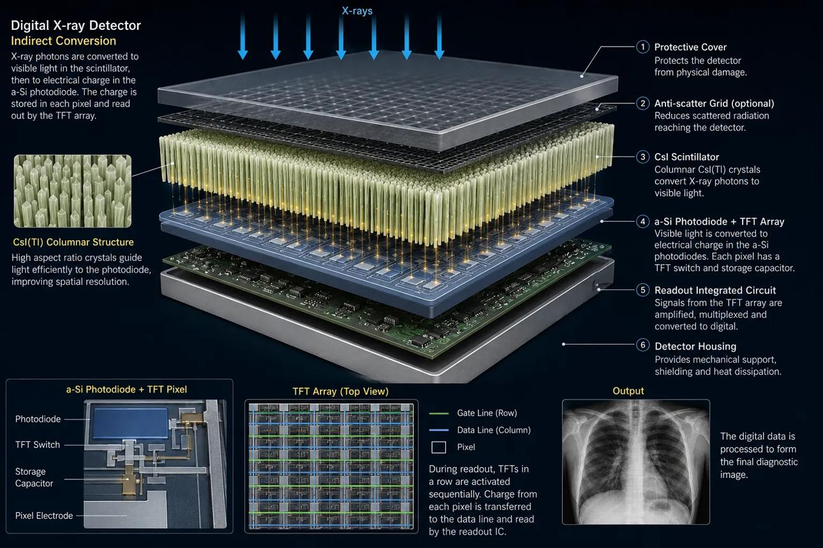
Main components/Cross section of a Digital Radiography (DR) detector

Slide 30
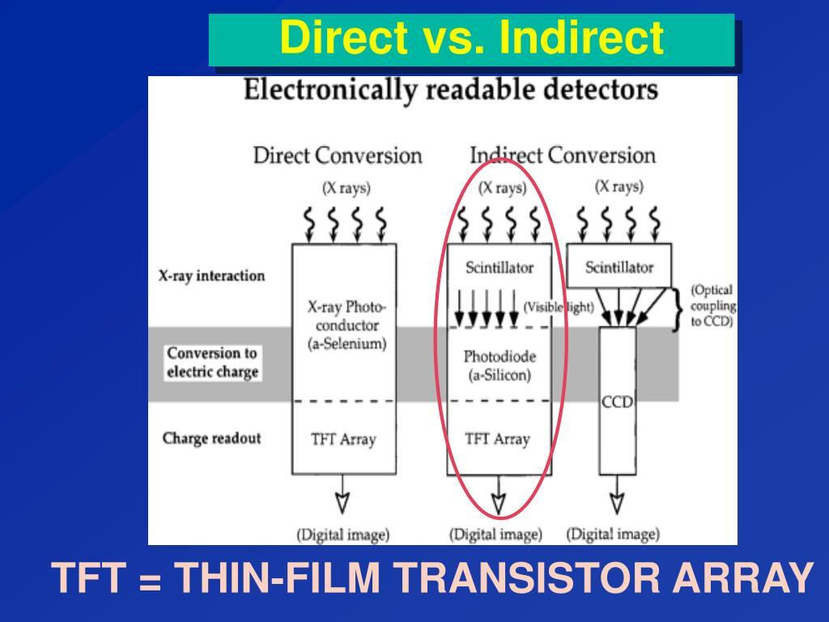
X-ray exposure
The X-ray tube produces X-rays that pass through the patient. Different tissues absorb different amounts of radiation, and the remaining X-rays reach the DR detector.

Slide 31
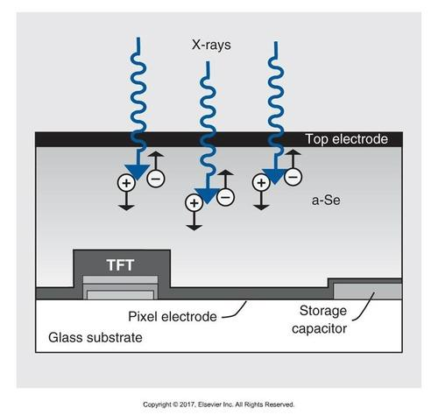
Conversion of X-rays
In an indirect-conversion detector, a scintillator—commonly cesium iodide (CsI) or gadolinium oxysulfide (GOS)—converts X-rays into visible light.

Slide 32
. Conversion layer
Converts incoming X-ray energy into a form that can be detected electronically.
Indirect conversion: a scintillator, such as cesium iodide (CsI) or gadolinium oxysulfide (GOS), converts X-rays into light.
Direct conversion: amorphous selenium (a-Se) converts X-rays directly into electrical charge.

Slide 33
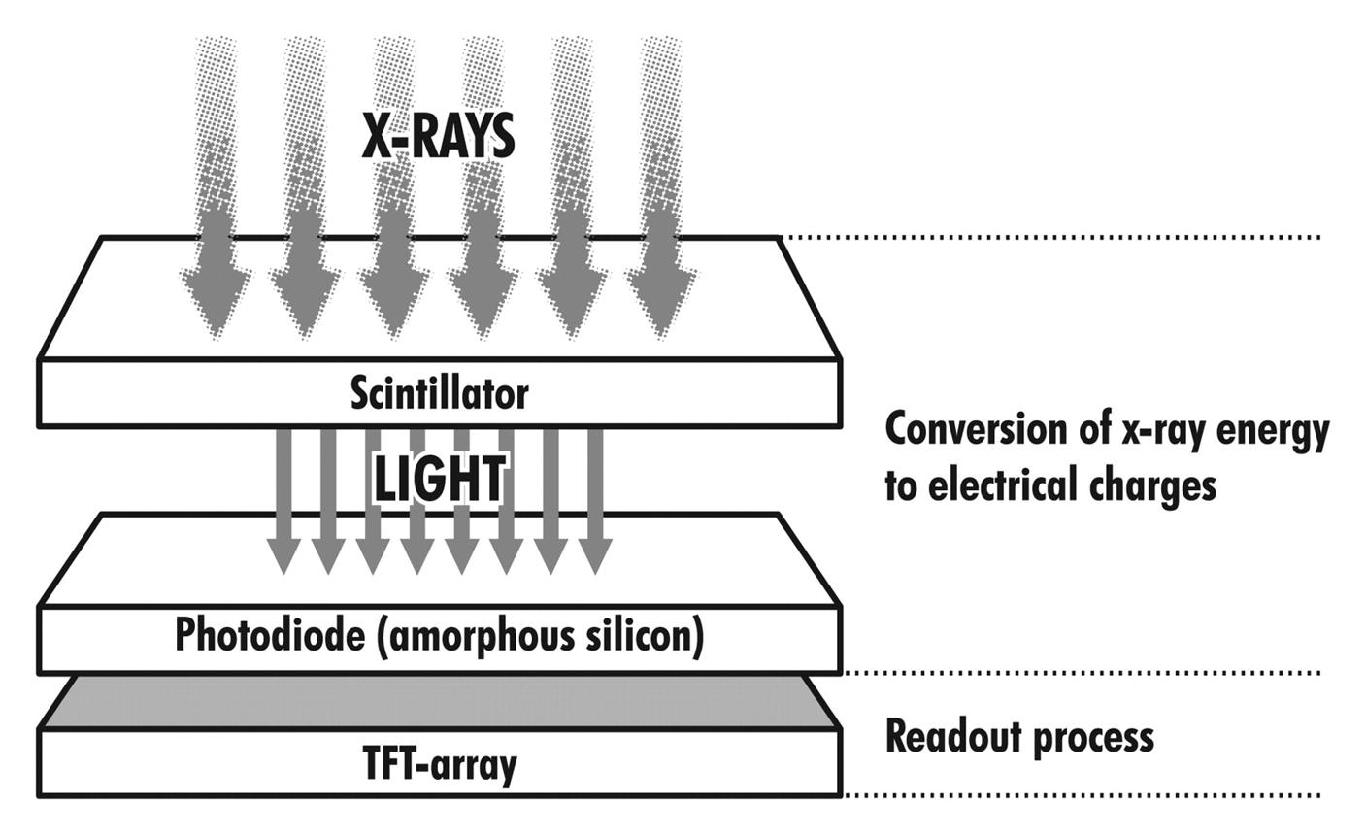
Electrical charge formation
In indirect detectors, photodiodes convert the light into electrical charge. In direct detectors, X-rays generate electrical charge directly in the photoconductor. The amount of charge varies with the local X-ray exposure.

Slide 34
FUNCTIONS OF DR DETECTOR PLATE SEGMENTS
Thin-film transistor (TFT) array
Acts as an electronic switching system. It allows the stored electrical charge from individual pixels to be read out
Readout electronics
Collect and measure the electrical signals from the detector pixels and send them for conversion into digital data.
Readout electronics
Collect and measure the electrical signals from the detector pixels and send them for conversion into digital data.
Analog-to-digital converter (ADC)
Converts the measured analog electrical signals into digital numerical values that a computer can process.
Protective housing and support layers
Protect the sensitive detector components from physical damage and help support the detector assembly.

Slide 35
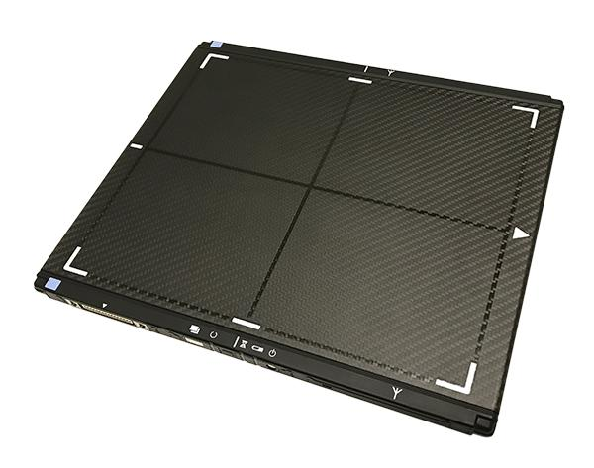
A FLAT PANEL DETECTOR

Slide 36
SUMMARY OF THE COMPONENTS AND THEIR FUNCTIONS
1. Conversion layer
Converts incoming X-ray energy into a form that can be detected electronically.
Indirect conversion: a scintillator, such as cesium iodide (CsI) or gadolinium oxysulfide (GOS), converts X-rays into light.
Direct conversion: amorphous selenium (a-Se) converts X-rays directly into electrical charge
2. Photodiode array
In indirect-conversion detectors, photodiodes convert light from the scintillator into electrical charge. They are usually made from amorphous silicon.

Slide 37
SUMMARY OF THE COMPONENTS AND THEIR FUNCTIONS CONTD
3. Thin-film transistor (TFT) array
Acts as an electronic switching system. It allows the stored electrical charge from individual pixels to be read out.
4. Readout electronics
Collect and measure the electrical signals from the detector pixels and send them for conversion into digital data.
5. Analog-to-digital converter (ADC)
Converts the measured analog electrical signals into digital numerical values that a computer can process.
6. Protective housing and support layers
Protect the sensitive detector components from physical damage and help support the detector assembly.

Slide 38
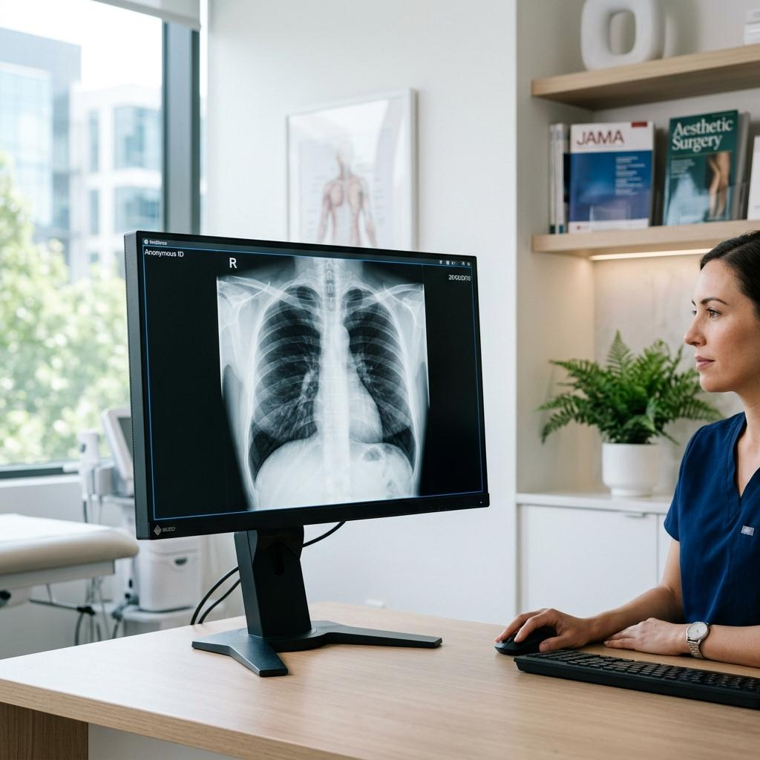
Signal readout
The thin-film transistor (TFT) array reads the electrical charge stored at each pixel. The detector electronics convert these signals into digital values
Digital image formation
The computer processes the digital values to produce a radiographic image. The image can be viewed, adjusted, stored in PACS and transmitted electronically.

Slide 39
Difference between CR and DR imaging plates
Feature | CR | DR
Image receptor | Photostimulable phosphor plate | Digital flat-panel detector or another electronic detector
Image storage | Energy stored in a latent image | Electrical charge or electronic signal
Image reading | Laser scans the plate | Detector electronics read the pixels
Separate reader | Required | Usually not required
Image availability | Slower | Usually faster
Reuse | Plate is erased and reused | Detector is reset and reused electronically

Slide 40
Advantages of DR
Produces images rapidly.
Allows immediate image review.
Supports digital image enhancement and manipulation.
Facilitates electronic storage and transmission.
Eliminates routine cassette transport to a separate CR reader.
Can improve workflow and, with appropriate technique, help optimize patient radiation dose.

Slide 41
Disadvantages of DR
Higher initial equipment cost.
Detectors can be expensive to repair or replace.
Electronic faults can interrupt imaging.
Image quality can be affected by detector artefacts and calibration problems.
Easy image processing may conceal overexposure, so radiation exposure must still be monitored carefully.

Slide 42
Important image Post processing operations
Windowing and leveling: Adjusts the displayed contrast and brightness.
Noise reduction: Reduces unwanted variations in the image.
Edge enhancement: Improves the visibility of boundaries between structures.
Image inversion: Reverses displayed grayscale values when useful.
Image cropping and rotation: Changes the displayed image area or orientation without changing the original exposure.
These operations can improve image presentation, but they cannot reliably recover anatomical information that was never captured.

Slide 43
Advantages of digital X-ray processing
Images are available quickly.
Image brightness and contrast can be adjusted after exposure.
Images can be stored and retrieved electronically.
Images can be transmitted easily between healthcare facilities.
There is no need for conventional photographic film or chemical processing.
Digital workflows can improve efficiency and reduce repeat examinations when properly managed.
Important: Digital processing does not automatically reduce radiation dose. Appropriate exposure factors, detector performance and radiation protection practices remain essential.

Slide 44
Main disadvantages
1. High initial cost: Digital X-ray equipment, computers, software, and detectors are expensive to purchase and install.
2. High maintenance cost: The equipment requires regular servicing, repairs, and software updates.
3. Dependence on electricity: Digital radiography systems require a reliable power supply to operate.
4. Risk of radiation overexposure: Image processing can make overexposed images appear acceptable, potentially encouraging unnecessary repeat exposures or gradual increases in patient dose (dose creep).
5. Technical failures: Detector malfunction, computer breakdown, or software errors can interrupt imaging services.
6. Need for trained personnel: Radiographers require appropriate training to operate the equipment and process images correctly.

Slide 45
Main disadvantages contd
7. Image-processing errors: Excessive enhancement, incorrect windowing, or inappropriate manipulation may hide important details or create misleading appearances.
8. Data storage requirements: Digital images require substantial storage capacity and reliable backup systems.
9. Cybersecurity and privacy risks: Patient images and records may be lost, accessed without authorization, or affected by cyberattacks.
10. Network problems: Slow networks or system failures can delay image transfer and reporting.
11. Equipment obsolescence: Rapid technological changes may make older systems outdated and expensive to upgrade.
12. Loss of image data: Accidental deletion, hardware failure, or inadequate backup can result in permanent loss of patient images.

Slide 46
YOU ARE FREE TO ASK ANY QUESTION FROM THE LECTURE NOW !
ANY QUESTION FROM THE LECTURE ?
ANY AREA YOU DON’T UNDERSTAND ?
ANY AREA YOU NEED MORE EXPLANATION ?
CAN YOU ANSWER ALL THE QUESTIONS ON THE TOPIC ?
I WISH YOU WELL !

