Slide 1
MXT102
MEDICAL IMAGE PROCESSING
RRBN PREGISTRATION RETRAINING COURSE FOR XRAY TECHNICIAN
BY
EGOP BROWNSON EGOP
20TH 0CTOBER,2026
@
FACULTY OF BASIC MEDICAL SCIENCES
COLLEGE OF MEDICAL SCIENCES
RIVERS STATE UNIVERSITY, PORT-HARCOURT

Slide 2
OUTLINE
1.Xray film structure
2.Types of xray film
3.Film sizes
4.Storage and handling
5.Roll film
6. Other photographic materials
7.Spectral sensitivity of films
8.Specialized photographic materials

Slide 3
Aim and learning outcomes
Explain the structure and image-forming principles of radiographic film.
Identify film types, sizes and specialised photographic materials.
Describe processing, spectral sensitivity, handling and storage.

Slide 4
XRAY FILM STRUTURE
What is a radiographic film?
This is a special photographic film coated with a light sensitive emulsion containing silver halide crystals used to record and display xray image
A transparent base
Acts as detector, display and archive image in a single sheet
Still used in many departments even as digital systems replaces it

Slide 5
Types of xray film
Single sided emulsion film
Single-emulsion film has emulsion on one side of the polyester base.
Contain anti-curl or anti halation layer on the opposite side to keep the film flat
Single-emulsion systems can be selected where fine detail is prioritised.
Mostly used in mammography
Double sided emulsion film
Double-emulsion film has emulsion on both sides.
Double-emulsion film is common in screen-film radiography.

Slide 6
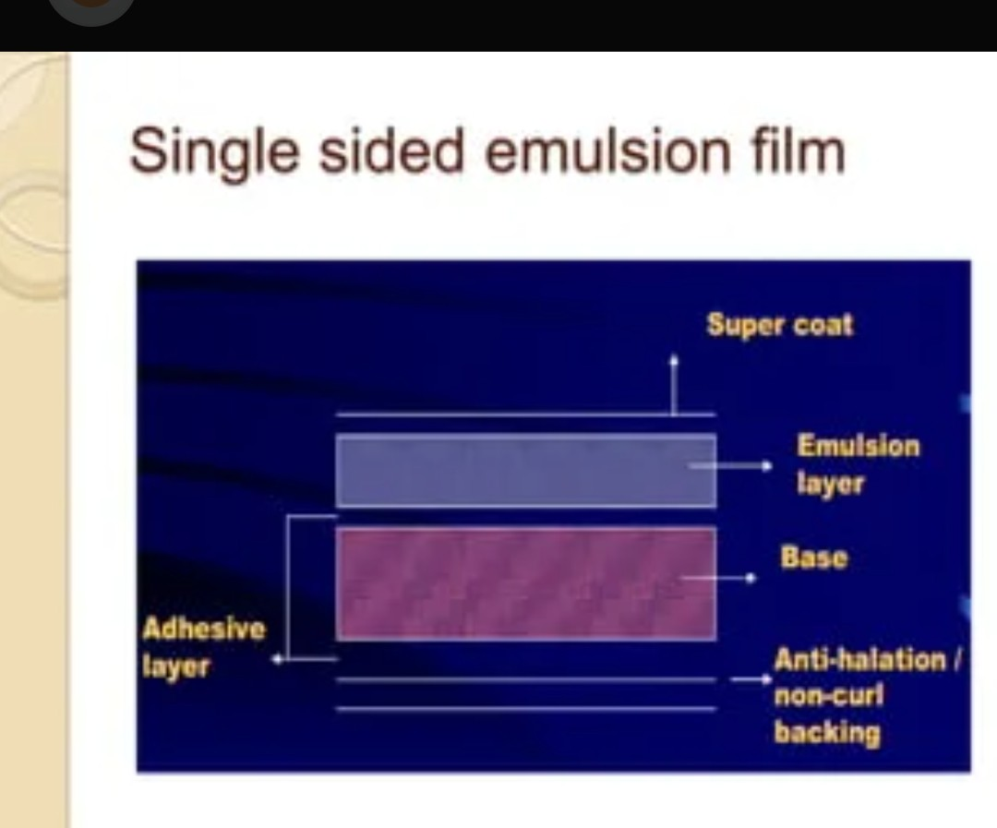

Slide 7
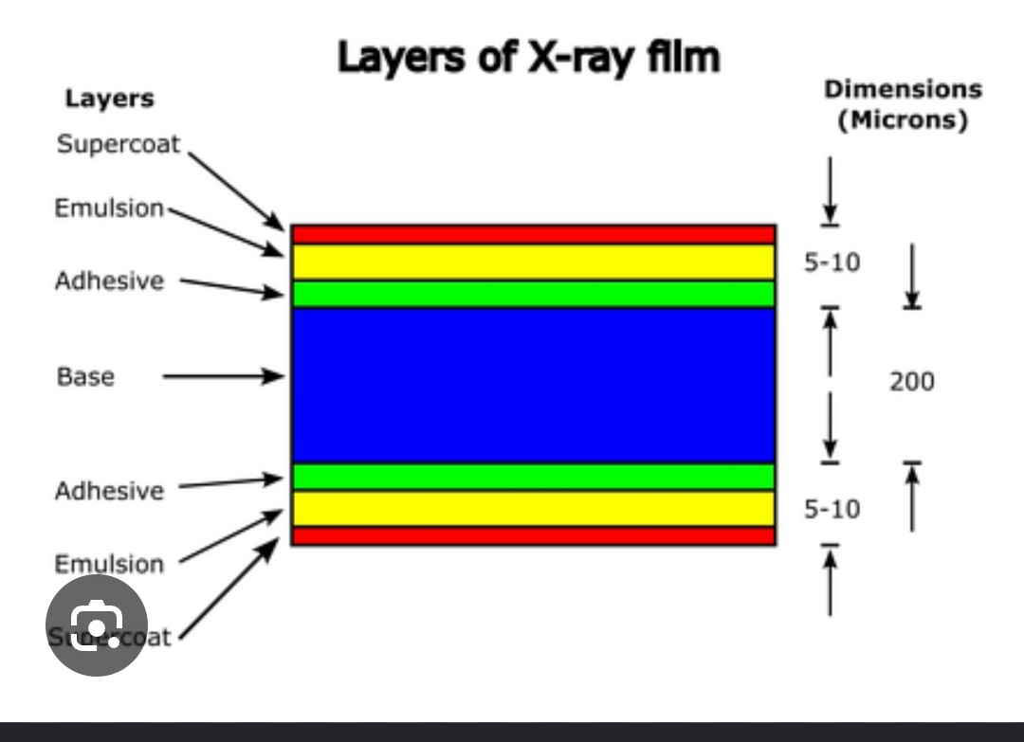
Cross-section of a double-emulsion film

Slide 8
Film structure at a glance
Protective supercoat
Photosensitive emulsion layer
Adhesive/subbing layer
Transparent film base
N/B Some films have emulsion on both sides.

Slide 9
Film base
Supports the emulsion layer and gives strength.
Usually made of polyester (polyethylene terephthalate, about 0.18 mm thick) in modern radiographic film, before it was cellulose triacetate
Polyester is usually tinted blue to reduce eye strain when viewing
Gives the film its rigidity so it can be handled and illuminated on a viewbox
N/B The base is only a support; it carries no image.

Slide 10
Emulsion and gelatin
Emulsion contains silver-halide crystals dispersed in gelatin.
Gelatin holds crystals evenly and permits processing chemicals to reach them.
The emulsion is the image-forming layer.
Scratches or chemical damage may affect processing process.

Slide 11
Silver-halide crystals
They are light sensitive chemical compounds found in emulsion layer of the xray film
They are responsible for forming the latent image when exposed to light from intensifying screen or radiation
Usually contain silver bromide (AgBr), sometimes combined with smaller amount of other silver halides like silver chloride (AgCL) and silver iodide (AgI).

Slide 12
Latent image: from invisible to visible
(from invisible exposure to visible radiographic image)
Summary of events that take place when emulsion is exposed to radiation
Exposure strikes the silver halide crystals producing an invisible chemical changes (latent image).
Developer reduces exposed crystals to black metallic silver forming radiographic image.
Fixer removes most unexposed silver halide crystals, leaving a permanent image made primarily of metallic silver.
Washing removes residual chemicals; drying prepares the film for viewing.

Slide 13
The cassette and intensifying screens
Cassette holds film and excludes ambient light.
Intensifying screens convert X-ray energy into visible light.
Good film-screen contact reduces blur.
Intensifying screen cleanliness and cassette condition are part of quality assurance.

Slide 14
Adhesive layer
Can as well be called compromise, substratum or subbing layer
This layer is made up of cellulose ester and gelatin in water and acetone, earlier made up of collodion.
Bonds emulsion to the base
Stays flexible when film is bent
Stops emulsion lifting in processing

Slide 15
SUPERCOAT
Hard, thin gelatin outer layer spread onto the surface of the emulsion
Protects against scratches and pressure, that is mechanical damage
Gives a shining surface for good appearance and durability

Slide 16
Major types of radiographic film
Screen film
Direct-exposure film
Dental film
Mammography film-screen material
Cine and duplicating film
Special-purpose photographic materials

Slide 17
Screen film
Designed to be exposed mainly by light or xray from intensifying screens.
Usually requires less X-ray exposure than direct-exposure film.
Used in conventional film-screen radiography.

Slide 18
Direct-exposure film
Receives a larger share of exposure directly from X-rays.
Used in selected applications, including some dental techniques.
May require more exposure than screen-film systems.
Technique must follow established protocols to reduced much radiation exposure.

Slide 19
Mammography film-screen systems
Designed for high spatial resolution and suitable contrast
Necessary to obtain good image-quality (high contrast).
Single emulsion film

Slide 20
Dental radiographic films
Made up of intraoral and extraoral film
Intraoral film is placed inside the mouth
Intraoral film is small and enclosed in a light-tight packet.
Protect packet from moisture and handling.
Lead foil backing helps reduce backscatter reaching the film.
Extraoral film-is placed outside the mouth usually in a cassette
Larger than intraoral film.

Slide 21
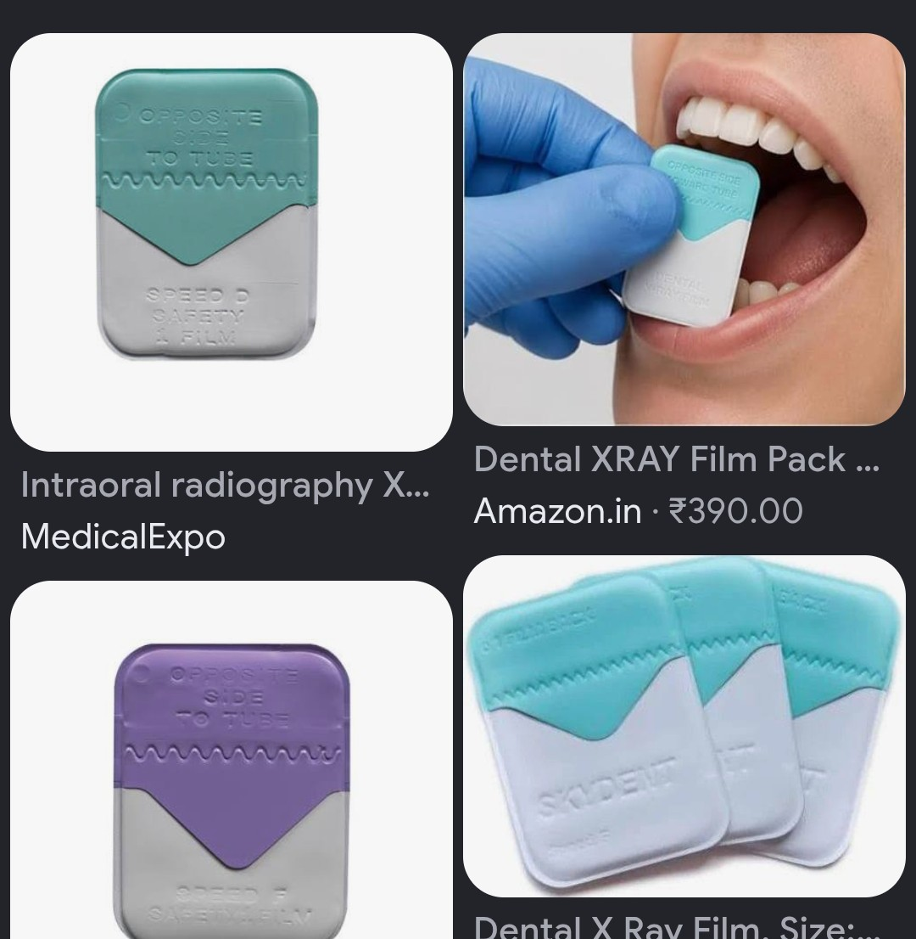
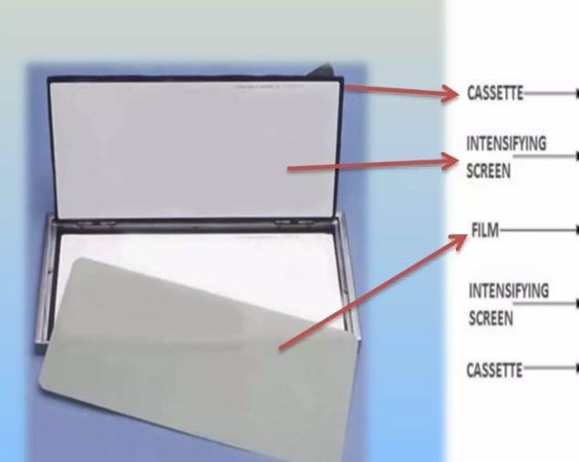
Intraoral and extraoral Dental films

Slide 22
Common film sizes
Metric System | Imperial System
18×24 cm | 8×10 inches
24×30 cm | 10×12 inches
30×40 cm | 12×15 inches
35×35 cm | 14×14 inches
35×43 cm | 14×17 inches

Slide 23
Film processing
Development
Rinsing
Fixing
Washing
Drying

Slide 24
Developer: what it does
Reduces exposed silver-halide crystals to black metallic silver.
Affects film density and contrast(difference in density between between adjacent structures).
Time, temperature and chemical activity (strength) are important.
Depleted or incorrectly maintained developer can cause poor images and affect diagnosis.

Slide 25
RINSE,Fixer, washing and drying
Rinse remove residual developer chemical before fixing
Fixer removes unexposed silver halide.
Washing removes residual processing chemicals.
Poor washing may cause stains and poor archival stability.
Drying should avoid dust, excessive heat and physical damage.

Slide 26
Safe film handling
Avoid fingerprints, bending, pressure and scratches.
Keep film away from moisture, dust and chemicals.
Protect unexposed film from light and radiation.
Hold film by the edges with clean, dry hands
Load and unload only in the darkroom with the door closed
Slide film into the cassette gently to avoid scratches
Never touch screens with fingers or sharp objects

Slide 27
Film storage
Keep film in original packaging within manufacturer limits.
Protect film from heat (10–21 °C), relative humidity (40–60%), sunlight, chemical fumes and radiation.
Use first-expiry-first-out stock or first in first out (FIFO).
Film should be stored in boxes or carton in an upright position
Record batch numbers and expiry dates.

Slide 28
Darkroom and safelight practice
Darkroom should be light-tight, clean and organised.
Use the correct safelight filter, wattage and distance.
Test for safelight fog when required.
Load and unload film only under approved conditions.
15-watt lamp and at least 1.2 m (4 ft) from the work bench
Keep wet and dry areas separate and the room clean and ventilated

Slide 29
Common handling artefacts
Artefact | Appearance | Cause
static | Black branching or tree lines | Low humidity, fast film removal
Crimp | Black or white crescents | Film bent before or after exposure
Fog | Overall grey haze | Light, radiation, heat, age, fumes
Finger marks | Black or white prints | Developer or fixer on fingers
Scratches | Thin white lines | Rough loading or dirty screens

Slide 30
roll films
Roll film records an image from a screen, not from the patient directly.
Comes in widths or sizes of 16, 35, 70, 100 and 105 mm

Slide 31
Roll film sizes and uses
Format | Typical use
16 mm | Cine and fluoroscopic recording cameras
35 mm | Cine and fluoroscopic recording cameras
70 mm | Serial spot cameras, photofluorography
100 mm | Mass chest screening
105 mm | Mass miniature radiography (photofluorography) Widely used for tuberculosis screening of large populations.

Slide 32
Other photographic materials: beyond xray film
Duplicating film-produces copies of existing radiographic film for referral, teaching or record purpose
Photographic paper-produces permanent photographic prints
Slide or reversal film- produces positive transparencies for projection during lectures,demonstration and presentations
Photostimulable phosphor plate (PSP)- Use in computed radiography to store a latent image after exposure to xrays. They are reusable
Microfilm-for reducing size of documents and images to save storage space
Developer- reducing agents such as hydroquinone and phenidone in alkaline solution
Fixer-that removes unexposed silver halide. It contains sodium or ammoniumthiosulphate,acidifier,preservative,hardener,buffer and solvent

Slide 33
Spectral Sensitivity of Films
Is the ability of a film to respond to different wavelengths (colours) of light to form an image
It ensures that the film matches the colour of light emitted by the intensifying screen
It improves image formation and helps prevent unnecessary radiation exposure
It reduces film screen mismatch

Slide 34
Classes of spectral sensitivity
Blue-sensitive film (monochromatic film)
Responds mainly to blue and near-ultraviolet light with a wavelength of 380-495nm.
Used with compatible blue-emitting intensifying screens such as calcium tungstate
Safelight conditions must match the film specification.
Correct pairing supports efficient image formation

Slide 35
Green-sensitive film
Also called orthochromatic film with a wavelength of 495-570nm
Used with green-emitting rare-earth screens.
Best in diagnostic radiography

Slide 36
Panchromatic film
Sensitive across much of the visible spectrum, including red.
Have a wavelength of about 570-750 nm
Used in selected photographic applications.
Requires careful safelight control.
Not interchangeable with all radiographic screen films
Responds to all visible light; rare in radiography; total darkness

Slide 37
Safelights and spectral sensitivity
Film class | Suitable safelight
Blue-sensitive | Amber or light red filter
Orthochromatic | Dark red filter (GBX-2 type)
Panchromatic | Total darkness or manufacturer's dim safelight

Slide 38
Specialised Photographic Materials
Involves Cine, CT, duplicating, MRI and instant films
CINE FILM
Coronary angiography and ventriculography
Dynamic studies of swallowing and gastrointestinal motion

Slide 39
Duplicating film
Necessary for
Teaching- e.g for lectures and conferences
For referral purposes- Sent with the patient for a second opinion
Medico-legal purposes
Back up when necessary

Slide 40
MRI (NMR) film: principle
MRI film usually means a printed hard copy
Images are produced on the workstation and printed from there
Multi-sequence layouts: proton density, T1, T2 and FLAIR on one sheet
Axial, sagittal and coronal
Typical matrix: 256 × 256 or 512 × 512 pixel
N/B MRI film is the same hard-copy film used for CT.

Slide 41
CT film
Many images can be printed per sheet
Separate window settings for soft tissue, lung and bone
Used for referral, surgical planning and oncology follow-up
Soft-copy viewing on PACS reduces filming
N/B Window settings decide image appearance on the film

Slide 42
Instant (Polaroid) film
Quick prints, mostly from ultrasound
Poor long-term stability
Higher cost per print

Slide 43
CONCLUSION
Medical image processing is an essential aspect of radiography that transforms image forming information into useful diagnostic images.

Slide 44
References
1. Bushong SC. Radiologic science for technologists: physics, biology, and protection. 11th ed. St. Louis: Elsevier; 2017.
2. Carlton RR, Adler AM, Balac V. Principles of radiographic imaging: an art and a science. 6th ed. Boston: Cengage Learning; 2019.
3. Bushberg JT, Seibert JA, Leidholdt EM Jr, Boone JM. The essential physics of medical imaging. 3rd ed. Philadelphia: Lippincott Williams & Wilkins; 2012.
4. Ball JL, Moore AD, Turner S. Ball and Moore's essential physics for radiographers. 4th ed. Oxford: Wiley-Blackwell; 2008.
5. Hendee WR, Ritenour ER. Medical imaging physics. 4th ed. New York: Wiley-Liss; 2002.

Slide 45
Thanks for listening

