Slide 1
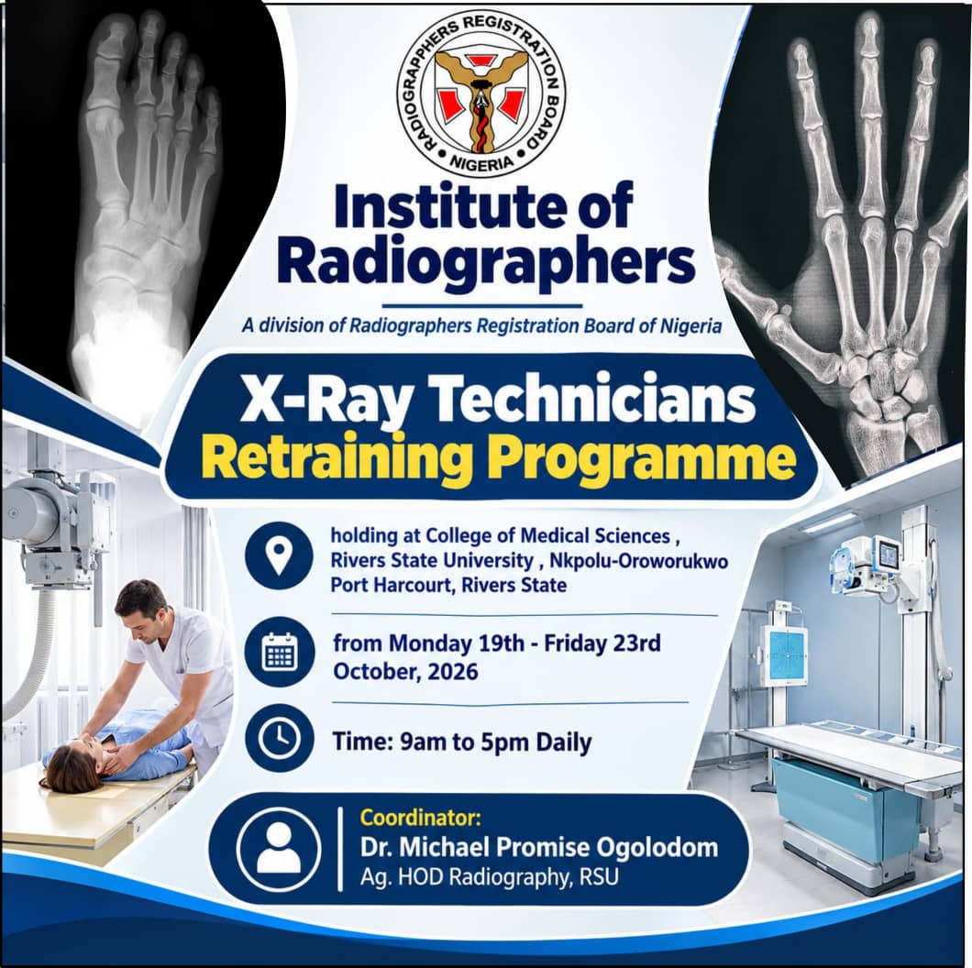

Slide 2
BASIC COMPUTER APPRECIATION IN MEDICAL IMAGING
(MXT 304)
BY
DIR. GBARABE, KENT

Slide 3
COURSE OUTLINE
INTRODUCTION TO COMPUTER
APPLICATION OF COMPUTER IN RADIOGRAPHY
COMPUTER HARDWARE AND COMPONENTS
TYPES OF COMPUTER IN RADIOGRAPHY
COMPUTER SOFTWARE USED IN RADIOGRAPHY
DATA AND INFORMATION IN RADIOGRAPHY
WORD PROCESSING IN RADIOGRAPHY
FILE MANAGEMENT
INTERNET AND DIGITAL COMMUNICATION

Slide 4
COURSE OUTLINE CONTD
FILE MANAGEMENT
INTERNET AND DIGITAL COMMUNICATION
COMPUTER NETWORK
COMPUTER SECURITY AND ETHICS
APPLICATION OF COMPUTERS
EMMERGING COMPUTER TECHNOLOGIES
PRACTICAL COMPUTER APPLICATIONS IN OPERATIONS, FILE MANAGEMENT, WORD PROCESSING, SPREAD SHEETS, PRESENTATIONS, INTERNET RESEARCH AND DIGITAL COMMUNICATIONS

Slide 5
INTRODUCTION TO COMPUTER IN MEDICAL IMAGING
A computer in radiography is an electronic device or system used to process, store, retrieve, display, and transmit radiographic images and patient information in a medical imaging department.
Computers play an important role in modern radiography, especially in digital X-ray, computed tomography (CT), magnetic resonance imaging (MRI), fluoroscopy, and other medical imaging techniques.

Slide 6
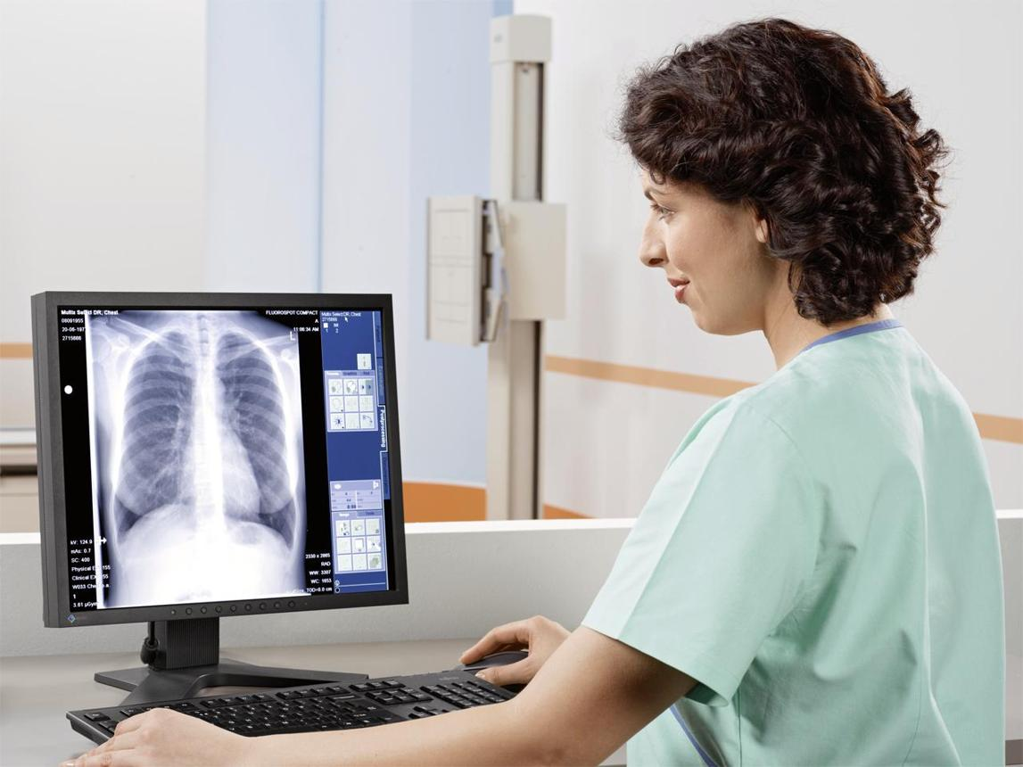

Slide 7
Applications of Computers in Radiography
IMAGE ACQUISITION
Computers receive digital image data from X-ray detectors and other imaging equipment.
IMAGE PROCESSING
They help adjust image brightness, contrast, sharpness, and magnification to improve image presentation
IMAGE STORAGE AND RETRIEVAL
Computers store images in systems such as PACS (Picture Archiving and Communication System) and allow them to be retrieved when needed.
PATIENT AND EXAMINATION MANAGEMENT
Computers manage patient records, examination requests, appointments, and radiology reports.
IMAGE DIAGNOSIS AND INTERPRETATION
They enable radiologists to examine images, perform measurements, and use specialized software to support diagnosis.

Slide 8
Basic Components of a Computer Hardware Used in Radiography
Input devices: Keyboard, mouse, barcode scanner, and digital imaging detectors.
Central Processing Unit (CPU): Processes data and controls computer operations.
Memory (RAM): Temporarily holds data and programs being used.
Storage devices: Hard disk drives (HDDs) and solid-state drives (SSDs) store images and information.
Output devices: Monitors display radiographic images, while printers produce hard copies when required.
Software: Programs used for image acquisition, processing, reporting, and storage.
Network devices: Enable the transfer of images and patient information between computers and hospital systems.

Slide 9
TYPES OF COMPUTER SYSTEMS USED IN RADIOGRAPHY
Computed Radiography (CR) systems: Use imaging plates that are read by a reader to produce digital images.
Digital Radiography (DR) systems: Use digital detectors to capture X-ray images directly.
CT computer systems: Process data collected from multiple X-ray projections to reconstruct cross-sectional images.
MRI computer systems: Process signals from the body to produce detailed images.
PACS: Stores, retrieves, distributes, and displays medical images.
RIS (Radiology Information System): Manages radiology workflow, examinations, patient information, and reporting.

Slide 10
ADVANTAGES OF COMPUTERS IN RADIOGRAPHY
Fast image processing and display.
Improved workflow and efficiency.
Easy storage and retrieval of images.
Easy sharing of images between departments and hospitals.
Image enhancement and measurement capabilities.
Reduced need for physical film storage.
Support for accurate diagnosis and comparison of previous examinations.

Slide 11
DISADVANTAGES OF COMPUTERS IN RADIOGRAPHY
High cost of purchasing and maintaining equipment.
Risk of data loss or corruption.
Cybersecurity and patient privacy concerns.
Dependence on electricity and network connectivity.
Need for trained personnel.
Computer or software failure may interrupt examinations.
Excessive image processing can create misleading appearances or obscure important findings.

Slide 12
COMPUTER SOFTWARE USED IN RADIOGRAPHY
Computer software used in radiography refers to the programs and applications installed on computers to acquire, process, display, store, transmit, and interpret medical images obtained from X-ray, CT, MRI, ultrasound, and other imaging equipment.

Slide 13
TYPES OF SOFTWARE USED IN RADIOGRAPHY
Image acquisition software
Controls image capture and receives image data from the imaging detector.
Example: Digital Radiography (DR) acquisition software.
Image processing software
Improves image presentation by adjusting brightness, contrast, sharpness, magnification, and other display parameters.
Example: Carestream Image Suite.
PACS software
PACS means Picture Archiving and Communication System. It stores, retrieves, displays, and distributes medical images.
Examples: Sectra PACS and Agfa Enterprise Imaging.

Slide 14
Radiology Information System (RIS) software
Manages patient registration, examination requests, appointments, worklists, and radiology reports.
Example: Radiology workflow management software.
Image reconstruction and visualization software
Reconstructs and displays images from CT and MRI data, including cross-sectional and three-dimensional images.
Examples: Siemens syngo.via and GE HealthCare AW.
DICOM viewer software
Opens, displays, and allows measurements on medical images saved in DICOM format.
Examples: RadiAnt DICOM Viewer and Weasis.
Artificial intelligence (AI) software
Assists with detecting or highlighting possible abnormalities, prioritizing examinations, and supporting image analysis

Slide 15
GENERAL-PURPOSE COMPUTER SOFTWARE USED IN RADIOGRAPHY
Software type | Examples | Uses
Software type | Examples | Uses
Operating systems | Windows, Linux | Runs the computer and applications
Word processing | Microsoft Word | Writing reports and documents
Spreadsheet | Microsoft Excel | Recording data and preparing statistics
Database | Microsoft Access, SQL-based systems | Organizing patient and departmental data
Communication | Email and hospital messaging systems | Sharing information
Presentation | Microsoft PowerPoint | Teaching and presenting radiographic cases

Slide 16
Importance of software in radiography
Improves the quality and presentation of digital images.
Makes image storage and retrieval easier.
Reduces delays in radiology workflow.
Supports image measurements and diagnostic interpretation.
Enables electronic transfer of images between hospitals.
Helps manage patient records and examination reports.
Supports research, teaching, and quality assurance.

Slide 17
Difference between PACS, RIS, and DICOM
Term | Meaning | Main function
PACS | Picture Archiving and Communication System | Stores and distributes medical images
RIS | Radiology Information System | Manages radiology workflow and patient information
DICOM | Digital Imaging and Communications in Medicine | Standard for formatting and exchanging medical images and related information

Slide 18
Data and Information in Radiography
Data are raw facts, figures, observations, or measurements collected during a radiographic examination before they have been processed or interpreted into meaningful information.
Examples of data in radiography include:
Patient's age and identification number.
Patient's weight and height.
Exposure factors such as kVp, mA, and exposure time.
X-ray detector readings.
Raw digital image values.

Slide 19
Definition of Information
Information is data that have been processed, organized, or interpreted to give meaningful results that can be used for decision-making.
Examples of information in radiography include:
A patient's completed radiographic report.
A calculated exposure time based on selected parameters.
A processed chest X-ray image displayed on a monitor.
A report describing a fracture identified on an X-ray.

Slide 20
Differences Between Data and Information
Data | Information
Raw facts and figures. | Processed and meaningful data.
May not be meaningful on its own. | Has meaning and can support decisions.
Used as input for processing. | Produced after processing or interpretation.
Example: kVp = 70. | Example: 70 kVp was selected for a particular examination.
Example: Patient age = 45 years. | Example: Patient demographic details recorded for an examination.

Slide 21
Types of Data in Radiography
Patient data: Name, age, sex, identification number, and medical history.
Examination data: Type of examination, anatomical region, projection, and date of examination.
Technical data: kVp, mA, exposure time, mAs, source-to-image distance (SID), and focal spot size.
Image data: Pixel values, image dimensions, brightness values, and contrast information.
Diagnostic data: Findings documented by the radiologist, such as fractures, lung opacities, or joint abnormalities.

Slide 22
How Data Becomes Information in Radiography
Data collection
Patient details, exposure factors and detector signals
Data processing
Computer processing, image reconstruction and enhancement
Information output
Displayed radiographic image and organized examination details
Interpretation and decision-making
Radiologist interprets the image and prepares a report
For example, a digital detector collects numerical signals during an X-ray exposure. The imaging computer processes these signals to form an image. The radiologist then interprets the image and produces a diagnostic report.

Slide 23
Importance of Data and Information in Radiography
Patient identification:- Helps ensure that the correct patient receives the correct examination.
Image production:- Technical data help control image acquisition.
Image quality assessment:- Information helps radiographers evaluate image quality.
Diagnosis:- Radiographic images and reports support disease detection and diagnosis.
Record keeping:- Patient and examination information can be stored for future reference.
Communication:- Enables sharing of examination results among healthcare professionals.
Research and statistics:- Data can be analyzed to assess departmental performance and improve services.
Quality assurance:- Exposure and repeat-examination data help monitor imaging practices.

Slide 24
Characteristics of Good Information in Radiography
Accurate:
Correct and free from errors.
Relevant:
Related to the examination or clinical question.
Complete:
Contains the necessary details.
Timely:
Available when needed.
Reliable:
Obtained from trustworthy sources.
Confidential:
Protected against unauthorized access.

Slide 25
Computer Word Processing in Radiography
Word processing is the use of computer software to create, edit, format, save, print, and share text documents.
In radiography, word processing is used to prepare radiographic reports, patient records, referral letters, departmental memos, research papers, and other medical documents.
Examples of word-processing software include Microsoft Word, Google Docs, and LibreOffice Writer.

Slide 26
Uses of Word Processing in Radiography
Preparation of radiographic reports
Used to type and format reports describing radiographic findings and examination results.
Patient documentation
Helps prepare patient information sheets, examination records, and referral documents, subject to hospital procedures and privacy requirements.
Preparation of official documents
Used for departmental letters, notices, memos, policies, and meeting minutes.
Research and academic work
Helps radiography students and professionals prepare assignments, dissertations, research articles, and case studies.
Preparation of tables and forms
Used to create examination checklists, quality assurance forms, equipment maintenance records, and patient instruction sheets.

Slide 27
Examples of Word-Processing Software
Software | Description
Microsoft Word | Widely used to create and format documents.
Google Docs | Online word processor that supports collaboration.
LibreOffice Writer | Free, open-source word-processing software.
WPS Writer | Software for creating and editing documents.

Slide 28
Basic Functions of Word Processing
Typing and text entry: Entering text using a keyboard.
Editing: Inserting, deleting, copying, moving, and correcting text.
Formatting: Changing font size, font style, alignment, margins, and line spacing.
Spell checking: Identifying spelling errors in medical documents.
Saving: Storing documents for future use.
Printing: Producing hard copies of reports and other documents.
Inserting tables and images: Adding structured data, diagrams, and illustrations.
Mail merge: Producing multiple personalized letters or documents from a template and a data source.
Exporting: Saving documents in formats such as PDF for easier distribution.
Collaboration: Allowing authorized users to review or edit documents.

Slide 29
Advantages of Word Processing in Radiography
Makes document preparation faster.
Allows easy correction of errors.
Produces neat and professional documents.
Simplifies storage and retrieval of documents.
Allows documents to be edited and reused.
Makes sharing and printing easier.
Supports spell checking and standardized report templates.

Slide 30
Disadvantages of Word Processing in Radiography
Requires electricity and functioning computer equipment.
May result in data loss if documents are not saved or backed up.
Can expose confidential patient information if security is inadequate.
May introduce errors through incorrect typing or copying.

Slide 31
Difference Between Word Processing and Other Computer Applications
Application | Main purpose in radiography
Word processing | Preparing reports and documents.
Spreadsheets | Calculating data and preparing statistics.
Databases | Organizing and retrieving patient and examination records.
Image-processing software | Processing and displaying radiographic images.
Presentation software | Teaching and presenting radiographic cases.

Slide 32
File Management in Radiography
File management in radiography is the process of creating, naming, organizing, storing, retrieving, copying, transferring, and deleting computer files related to radiographic examinations and patient records.
It helps radiographers manage digital images, radiographic reports, patient information, and departmental documents efficiently.

Slide 33
Types of Files Used in Radiography
Image files: Digital X-ray, CT, and MRI images, commonly stored in DICOM format.
Report files: Radiographic reports saved in formats such as DOCX and PDF.
Patient record files: Documents containing relevant patient and examination information.
Database files: Files used to organize patient details and examination records.
Administrative files: Staff schedules, equipment maintenance records, and departmental documents

Slide 34
Functions of File Management in Radiography
File creation
Creating new folders and files for radiographic images, reports and patients documentation.
File organization
Arranging files using appropriate folders, examination dates, patient identifiers, and examination types.
Reports, and patient documentation
File retrieval
Locating previously stored radiographic images and reports when required for comparison or review.
File backup
Making secure backup copies of important files to reduce the risk of data loss.
File protection
Protecting patient information through access controls, passwords, encryption, and appropriate security procedures.

Slide 35
Common File Management Operations
Create: Make a new file or folder.
Save: Store a file for future use.
Rename: Change the name of a file.
Copy: Make a duplicate of a file.
Move: Transfer a file from one folder to another.
Search: Find a specific file.
Delete: Remove a file according to authorized retention procedures.
Backup: Create an additional copy for recovery if the original is lost or damaged.
Retrieve: Access a stored file when needed.

Slide 36
Importance of File Management in Radiography
Makes radiographic images and reports easy to locate.
Reduces the risk of losing important patient information.
Supports comparison of current and previous examinations.
Improves the efficiency of radiology departments.
Helps prevent unnecessary repeat examinations when previous images are available and suitable.
Supports continuity of patient care.
Protects confidential patient information.
Promotes proper record keeping and quality assurance.

Slide 37
Internet and Digital Communication in Radiography
The internet is a worldwide network of interconnected computers and devices that communicate and exchange information electronically.
In radiography, the internet allows radiographers, radiologists, and other healthcare professionals to access medical information, share radiographic images, communicate with colleagues, and participate in online learning.
Digital communication is the electronic exchange of information, images, and messages between computers and other digital devices.
In radiography, digital communication is used to transfer radiographic images, patient examination details, and diagnostic reports between healthcare professionals and medical facilities.

Slide 38
Methods of Digital Communication in Radiography
Email: Sending official messages, reports, and documents through electronic mail, where appropriate and secure.
Video conferencing: Conducting virtual meetings, consultations, and educational sessions.
Instant messaging: Exchanging brief messages through approved, secure communication platforms.
Hospital computer networks: Transferring images and patient information between departments.
PACS: Sharing, storing, and retrieving radiographic images.
RIS: Managing examination requests, patient details, and reporting workflows.
DICOM communication: Exchanging medical images and associated information using the Digital Imaging and Communications in Medicine standard.

Slide 39
Advantages of the Internet and Digital Communication
Fast transmission of radiographic images and reports.
Improved communication between radiographers and radiologists.
Access to specialist interpretation through teleradiology.
Reduced delays in diagnosis and treatment.
Easy access to research and educational materials.
Improved collaboration between hospitals.
Reduced dependence on transporting physical films.
Supports comparison of current and previous examinations.

Slide 40
Disadvantages of the Internet and Digital Communication
Risk of unauthorized access to confidential patient information.
Cyberattacks, malware, and data breaches.
Poor internet connectivity can delay image transmission.
High costs of network infrastructure and maintenance.
Technical failures may interrupt communication.
Incorrectly transmitted patient information may cause errors.
Dependence on electricity and functioning digital systems.

Slide 41
Security Measures in Digital Communication
Use strong passwords and multifactor authentication where available.
Use encrypted connections and approved hospital systems.
Restrict access to authorized personnel.
Verify patient identifiers before transmitting images.
Avoid sending identifiable patient images through unapproved platforms.
Maintain secure backups and follow hospital data-protection policies.
Follow applicable patient confidentiality and data-protection requirements.

Slide 42
Difference Between the Internet and Digital Communication
Internet | Digital communication
A global network connecting computers and devices. | The electronic exchange of information.
Provides connectivity and access to online resources. | Uses digital technologies to transmit messages, images, and data.
Example: Accessing an online radiology journal. | Example: Sending an X-ray image to a radiologist electronically.
Can be used for browsing, research, and communication. | Can occur over the internet or a private hospital network.

Slide 43
Practical Applications of Computers in Internet Research
Searching for information
Computers allow users to search the internet for information about X-ray production, CT, MRI, image processing, and radiation protection.
Accessing scientific journals
Students and professionals can find published studies, clinical research, and evidence-based information.
Accessing electronic books and guidelines

Slide 44
Computers help users obtain textbooks, professional guidelines, lecture notes, and educational materials on medical imaging.
Writing research projects
Word-processing software helps prepare research proposals, assignments, dissertations, and scientific articles using information collected online.
. Managing references and citations
Reference-management software helps organize journal articles and format citations and bibliographies.
. Collecting and analyzing research data
Computers support data entry, statistical analysis, preparation of tables, and interpretation of research results.
Online learning and collaboration
Internet services support webinars, virtual conferences, online courses, and communication with research supervisors and colleagues.

Slide 45
Useful Internet Research Resources for Radiography
Resource | Main use
Google Scholar | Finding scholarly articles and citations
PubMed | Searching biomedical and health research
World Health Organization (WHO) | Accessing health guidance and publications
International Atomic Energy Agency (IAEA) | Radiation protection and medical imaging resources
Radiopaedia | Learning radiology through cases and educational articles
Zotero | Organizing research references
Microsoft Excel | Organizing and analyzing research data

Slide 46
Advantages of Internet Research in Radiography
Provides quick access to current scientific information.
Enables access to research articles from different countries.
Supports evidence-based radiographic practice.
Saves time compared with searching only printed materials.
Supports student learning and professional development.
Facilitates collaboration between researchers.
Helps professionals learn about new imaging technologies and safety guidelines.

Slide 47
Challenges of Internet Research
Some journal articles require payment.
False or misleading information may be published online.
Poor internet connectivity may interrupt research.
Large amounts of information can make relevant sources difficult to identify.
Some studies may be outdated or methodologically weak.
Plagiarism can occur when information is copied without proper acknowledgment.
Patient information may be exposed if confidential data are uploaded to unapproved websites or services.

Slide 48
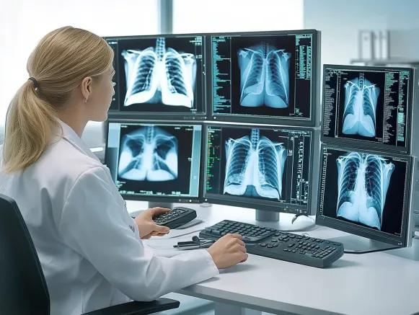
EXAMPLE OF COMPUTER IN IMAGING

Slide 49
QUESTION TIME
ANY QUESTION FROM THE TOPIC ?

