Slide 1
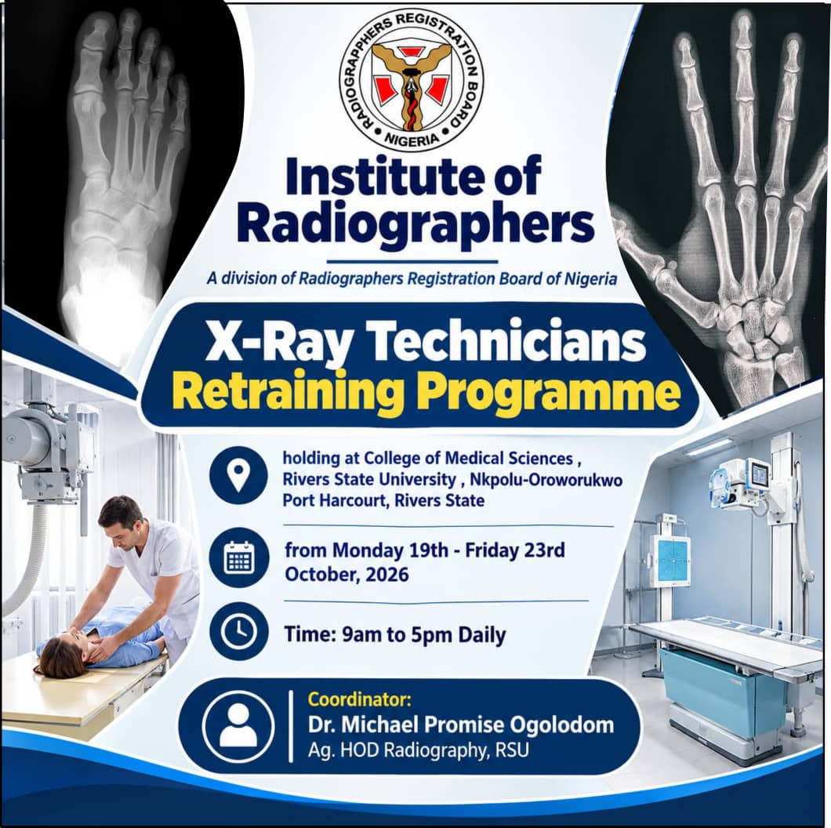

Slide 2
INTRODUCTION TO BASIC RADIOGRAPHIC EQUIPMENT
MXT 302
BY
DIR. GBARABE, KENT

Slide 3
COURSE OUTLINE
INTRODUCTION
X RAY GENERATORS AND TRANSFORMERS
HOW X RAY GENERATOR WORKS
TYPES OF X RAY GENERATOR
FUNCTIONS OF X RAY GENERATOR
BEAM LIMITING AND CENTERING DEVICES
OTHER EQUIPMENT ACCESSORIES
CONCEPT OF X RAY PRODUCTION
TYPES OF X RAY PRODUCTION
SECONDARY AND SCATTERED RADIATIONS
ANTI SCATTER GRID
BUCKY ASSEMBLY
TYPES OF X RAY MACHINES/EQUIPMENTS

Slide 4
INTRODUCTION
The basic of radiographic equipment consist of the component hardware and technical system used to generate and capture x ray images for diagnostic and therapeutic purposes. They consist of machines, devices and accessories used to produced x ray images .
X RAY MACHINES: This is a machine that contains an x ray tube used to produce the images of the internal body tissues and organs.
X RAY TUBE : This is a vacuum sealed tube that has a cathode and an anode which converts electrical energy into a focused beam of x radiations. It has (1) an anode assembly (2) Cathode assembly (3) Glass housing (4) Exit window (5) Voltage supply (6) Collimators (7) Filters

Slide 5
INTRODUCTION CONTD.
ANODE ASSEMBLY: This is the positive electrode and is made of Tungsten metal plate (except for mammography tubes that are made of Molybdenum) that received the bombarded electrons at its target. The anode are of different types, Fixed, and rotatory anode. There are Rotor and stator circuit that enable the rotation of the anode and also help in heat dissipation. It also has a relay that protect the anode circuit against adverse current situations and power overload. There is an interlock system that enable each circuit to function simultaneously during each exposure.
CATHODE ASSEMBLY: This is the negative electrode that is designed for the emission of electrons and are projected and focused to the target. They are made of Tungsten materials. It can be dual focus or single focus.
GLASS HOUSING: This is a vacuum glass void of air and is made of Pyrex glass .
FILTERS: X-ray filters are materials placed in the path of the X-ray beam to absorb low-energy X-ray photons that would increase the patient's radiation dose without contributing much to image formation.

Slide 6
INTRODUCTION CONTD.
VOLTAGE SUPPLY: There are two sources of voltage supply to the x ray tube. The high voltage supply drive the electrons across the x ray tube to be bombarded at the target while the low voltage supply gives the require low tube current to heat up the filament to produce the emitted electrons.
COLLIMATOR HOUSING: This is a device that restrict and confined the emitted x ray beam that exit from the target surface to the area of interest on the patient. It has two pairs of lead shutters that can be adjusted adjacent to each other. Its main function is to confine the emitted x ray beam towards the area of interest as well to absorbed scattered radiation from the target not to reach the patient.

Slide 7
INTRODUCTION CONTD.
X RAY TABLE AND WALL STAND : This aids positioning of patients and imaging detector placement.
CONTROL CONSOLE : This comprises of the knobs and keys that allows one to select the exposure factors and other parameters that will necessitate good image quality. It has the exposure button, voltage compensator, AEC, anatomical body selection, filters etc.
X RAY GENERATORS : This is a system design to provide the needed high voltage that drives the electron across the x ray tube from the filament to the target. It also houses the Rectifiers, contactors, capacitors, autotimers and the filament low voltage transformers. The generator convert the sinusoidal alternating electrical voltage into a constant potential that enable steady supply of potential difference across the tube. This process is call rectification of alternating current. There is also a stepdown transformer that supply the cathode filament with a low voltage and high current (5-15V and 3-7 A) needed to cause thermionic emission (boiling off of electrons )

Slide 8
X- RAY GENERATOR
An X-ray generator is the part of an X-ray machine that supplies and controls the electrical power required to produce X-rays in the X-ray tube.
It converts the incoming electrical supply into the appropriate voltage and current needed for X-ray production. It also controls the exposure factors, including kVp, mA, and exposure time.
In simple terms, the X-ray generator provides the electrical energy that makes X-ray production possible.

Slide 9
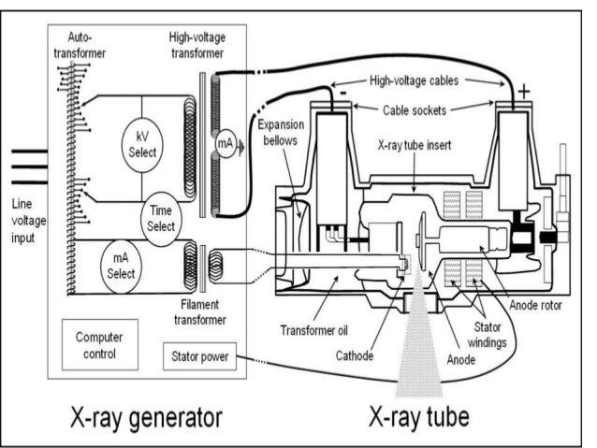
MAIN COMPONENTS OF AN X-RAY GENERATOR

Slide 10
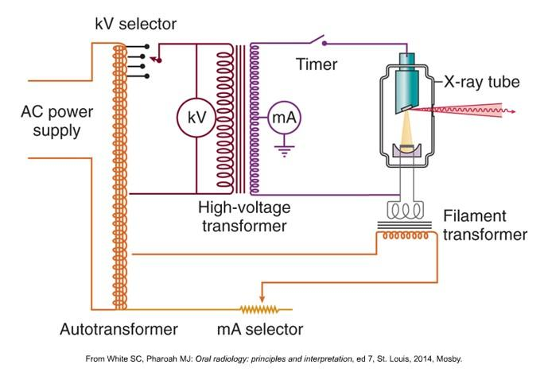
HIGH-VOLTAGE TRANSFORMER

Slide 11
High tension transformer : Increases the incoming electrical voltage to the high voltage required across the X-ray tube to accelerate electrons from the cathode to the anode.
Filament transformer
Supplies low voltage but high current to heat the cathode filament, causing thermionic emission of electrons.
Rectifier
Converts alternating current (AC) into unidirectional current for the X-ray tube.
Capacitors : Store electrical energy and help smooth voltage fluctuations in certain generator designs.
Control console
Allows the radiographer to select exposure factors such as kVp, mA, and exposure time.
Exposure timer
Controls how long the X-ray tube produces radiation during an exposure.
Other important parts include the autotransformer, voltage and current control circuits, and the rotor or stator control circuit for rotating-anode tubes.

Slide 12
HOW AN X-RAY GENERATOR WORKS
Electrical power supply
Provides the incoming AC electricity.
Control circuits
Regulate the selected kVp, mA and exposure time.
Transformers and rectifiers
Adjust voltage and current and provide the required tube supply.
X-ray tube
Electrons travel from the cathode to the anode.
X-ray production
Electrons strike the target, producing X-rays and heat.

Slide 13
STEP-BY-STEP EXPLANATION
Power enters the generator: The mains electricity supplies the X-ray system.
Exposure factors are selected: The radiographer chooses the appropriate kVp, mA and exposure time.
The filament is heated: The filament transformer supplies current to heat the cathode filament, releasing electrons.
High voltage is applied: The high-voltage circuit accelerates electrons across the vacuum inside the X-ray tube.
Electrons strike the anode: Their kinetic energy is converted mainly into heat, with a small fraction converted into X-rays.
The exposure stops: The timer or exposure-control circuit terminates the exposure at the required time.

Slide 14
IMPORTANT EXPOSURE FACTORS CONTROLLED BY THE GENERATOR
Factor | Meaning | Main effect
kVp | Kilovoltage peak | Controls electron energy and strongly affects X-ray beam penetration.
mA | Milliamperage | Controls the rate of electron flow and affects X-ray quantity.
Exposure time | Duration of exposure | Determines how long X-rays are produced.
mAs | mA × exposure time | Determines the total tube current-time product and strongly affects X-ray quantity.

Slide 15
TYPES OF X-RAY GENERATORS
Single-phase generator
Uses single-phase AC and produces greater voltage ripple than modern high-frequency systems.
Three-phase generator - 6 valves
Provides a more constant tube voltage and generally more efficient X-ray production than a single-phase generator.
Three-phase generator -12 valves
Supply high voltage to the X-ray tube with reduced voltage ripple, producing a more consistent X-ray beam and greater X-ray output efficiency than a single-phase generator under comparable conditions.
High-frequency generator
Uses electronic switching to produce a nearly constant tube voltage, allowing efficient operation and consistent exposures.
Constant potential generator: Keeps the selected (kVp) nearly constant throughout the exposure thereby Minimizes fluctuations in the voltage supplied to the X-ray tube.

Slide 16
TYPES OF GENERATOR CONTD.
HIGH TENSION GENERATORS:- This consist of a HTT which is in thousands of turns in the secondary circuit (1:50) step up transformers. It converts the line voltage supply to the generator (415V) to kilo voltage of ranges 30-150kvp these drives the emitted electrons across the polarity of the x ray tube from the cathode filament to the anode target.
EXPOSURE TIMER:- This are electrical or electronic device in the generator circuitry that regulates or controls the duration of time the x ray tube produces x radiation during an exposure. Its main function is to terminate the production of x rays as soon as the selected time for exposure elapses.

Slide 17
FUNCTIONS OF AN X-RAY GENERATOR
Supplies the high voltage needed for electron acceleration.
Supplies filament current for thermionic emission.
Controls the tube current and tube voltage.
Controls the duration of exposure.
Helps maintain the accuracy and reproducibility of exposures.
Works with safety interlocks and exposure-control systems to support safe operation.

Slide 18
BEAM LIMITING /CENTERING DEVICES
The beam limiting are devices used to either limit or restrict the amount of radiation exposed to a unit arear of the medium. They are equally used to control scattered radiation. They are classified into three groups:- Aperture diaphragms, cones and cylinders, collimators. Their main function is to restrict the x ray beam to the arear of interest and to protect the patient for excessive x - irradiation.
The beam centering devices are devices that direct or indicate the direction of the central or primary beam to the arear of interest. Examples are Light beam localizer, centering marks, Varray lamps and beam alignment indicator.

Slide 19
OTHER EQUIPMENT ACCESSORIES IN THE X RAY CIRCUITRY
FUSE:- This is a device that safeguard electrical equipment from excessive high current by breaking the circuit in the cause of a high voltage supply.
SWITCHES:- This device allows the flow of current to the circuit when operated and disallow the flow of current when stopped. Its used to ON and Off the equipments.
INTERLOCKS:- This delay the exposure in situation the anode rotation is not adequate thereby protect the tube from damage. Also in circumstances of power fluctuations, the interlocks disallow the exposure. Its fixed in the anode stator circuitry. It protect the tube against power overload , insufficient rotation of the anode

Slide 20
OTHER EQUIPMENT ACCESSORIES IN THE X RAY CIRCUITRY
RELAY:-This device protect the equipment against high current using the thermal effect of electric current.
CIRCUIT BREAKER:- This protect the equipment from abnormal power supply by discontinue the circuit.

Slide 21
CONCEPT OF X RAY PRODUCTION
X rays are produced when high speed electrons emitted from the cathode filament are converted to x ray photons as they strike and interact with the target material. This process involved the following steps:-
Heated filament at the cathode emission of electrons to saturation points
Fast movement of electron due to high potential difference across vacuum x ray tube.
Bombardment of target surface at anode interaction of anode target material by fast moving electrons.
Deceleration of electrons and subsequent loss of energy of electron to release x ray photons.

Slide 22
TYPES OF X-RAY PRODUCTION
There are two methods of X ray production
Continuous Spectrum (Bremsstrahlung or breaking radiation):- In this process the fast moving electron interact with the target atom and are deflected from their original direction or path thereby loss energy and are decelerated. The kinetic energy loss by the electron is emitted in form of a photon energy called x ray photons. This account for most x rays used in diagnosis
Characteristic radiation:- Is produced when the fast moving electron from the cathode filament interact and eject an inner electron from the orbit of the atom of the target material (Tungsten) thereby causing a vacant orbital shell within the atom of the target material and this vacant orbital shell will cause electron transition from the outer shell to filled the gap.

Slide 23
SECONDARY /SCATTERED RADIATION
This is the radiation resulting from the interaction of x rays with matter such as patients, couch, or any other material within the direction of the x ray beam.
Their effects are deleterious which causes
More patients exposure dose.
Affect image quality by reducing contrast
contributes to detector signals and increase noise . Their effects on the Image can be reduced by using
Grid
Collimators
Air gap technique and shielding

Slide 24
ANTI SCATTERED GRID
This is a device place between the patient and the image receptor to absorbed scattered radiation from getting to the receptor while allowing the primary x ray beam that traverse the patient to reach the detector. It comprise of a thin strip of lead separated by some interspace radio parent materials mostly made of organic compound or aluminum. It operates on the principle that scattered radiation are moving perpendicular to the direction of primary beam and are absorbed by the lead strip
Grid ratio is a statement of the height of the lead strip to the distance of the interspace materials. This tells more of the efficacy of the grid. There are different types of grid
Linear grid: The lead strip are parallel to each other in their longitudinal axis.

Slide 25
ANTI SCATTERED GRID CONTD.
Cross grid: This is made of two linear grids superimpose on each other.
Focus grid: This is ma.de up of lead strip slightly angle in space to form a convergent lines.
Parallel grid : The lead strip are parallel when view in cross section. Mostly used in fluoroscopy
One of the disadvantage of grid is the appearance of grid lines on the image and this can be corrected by the use of moving grid called Bucky.

Slide 26
BUCKY ASSEMBLY
The movement of grid during exposure is aim at removing the grid lines from the image.
The main components are :- Grid moving mechanism, grid drive mechanism, detector holding tray, Bucky housing and grid
The Bucky assembly has its circuit that its energized during prep for exposure and this enable the grid to move until exposure is terminated.
There are two types: Vertical and horizontal or table Bucky.
FUNCTIONS OF GRID
Reduces scattered radiation from the patients reaching the image receptor
Improves image contrast
Improves image quality
Reduces background fog
Improves diagnostic accuracy and visibility of thick body parts
Its also important to note that grid increases patient radiation dose due to increase in exposure factors.

Slide 27
TYPES OF X RAY MACHINES
PORTABLE :- This has a stationary anode x ray tube, its power ranges from 40 -80kvp and 50- 100mA can only be used for extremities . More so it can be dismantled and easily carried to places
MOBILE :- This can be moved from one place to another within the department or hospital , it has low power rating 50-100kvp and 50-200mA, It has a HT generator within its assembly , it can be battery powered or plug into direct Ac supply of 240V. It has a rotational anode.
STATIC :- This has a higher power rating (40-120kvp and 50-500mA) with a dual focus and a rotating anode assembly. It can be ceiling or floor mounted. Its suitable for a variety of examinations. Its limitation are required a large space , requires additional source of power 415V , expensive to purchase and installed

Slide 28
TYPES OF X RAY MACHINE CONTD
MAMMOGRAPHY:-mammography machine is a specialized X-ray imaging equipment used to examine the breasts for the early detection and diagnosis of breast diseases, especially breast cancer.
C ARM:-A C-arm machine is a mobile medical X-ray imaging machine used to produce real-time images of internal body structures during surgical operations, diagnostic procedures and interventional treatments. Is mostly used in theaters.
FLUOROSCOPY:-is a medical imaging device that uses X-rays to produce real-time moving images of the inside of the body.

Slide 29
YOU ARE FREE TO ASK QUESTIONS
ANY QUESTION FROM THE LECTURE ?

