Slide 1
MXT202
MANUAL FILM PROCESSING, EQUIPMENT AND TECHNIQUES
RRBN PREGISTRATION RETRAINING COURSE FOR XRAY TECHNICIAN
BY
EGOP BROWNSON EGOP
21ST 0CTOBER,2026
@
FACULTY OF BASIC MEDICAL SCIENCES
COLLEGE OF MEDICAL SCIENCES
RIVERS STATE UNIVERSITY, PORT-HARCOURT

Slide 2
Course outline
1. Single-Bath Processing
2. Conventional Processing
3. The Integrated System
4. Construction, Layout and Materials
5. Water Supply Requirements
6. Care and Maintenance of Equipment
7. COR: Control and Replenishment
8. Processing Artifacts
9. Sequence of Processing
10. Silver Recovery and Conservation

Slide 3
Learning objectives
Explain single-bath, conventional and integrated processing
Describe darkroom construction, layout, materials and water supply
Care for equipment and control processing chemistry
Recognise processing artifacts and follow the sequence of processing
Apply silver recovery and conservation

Slide 4
Why processing matters
1. X-ray exposure: Photons strike the film emulsion
2. Latent image: Invisible change in silver halide
3. Processing: Chemistry reveals the image and fixes it
4. Visible image: Metallic silver forms the radiograph
5. Diagnosis: Quality decides diagnostic value
Faulty processing can ruin a perfect exposure, causing repeats and extra dose.

Slide 5
What is a single-bath system?
One solution performs developing and fixing in a single step (a monobath)
Developer and fixer chemicals are balanced to coexist in one tank
Development starts first; fixing then clears unexposed silver halide
Key point: One tank, one solution, one timed immersion.

Slide 6
Chemistry inside a monobath
A developing agent and an alkali give the solution its developing power
A silver halide solvent (such as thiosulfate) gives it fixing power
The two actions are balanced, so no one is stronger than the other
Timing and temperature must follow the maker's instructions closely
Key point: A monobath is a chemical compromise: two jobs, one solution.

Slide 7
How a monobath works
1. Immerse: Film enters the single solution
2. Develop: Exposed crystals reduce to silver
3. Fix: Unexposed halide dissolves
4. Wash: Residual chemicals removed
5. Dry: Film hung to dry

Slide 8
Advantages and limitations
Advantages
Simple and quick to use
One tank saves space
Fewer steps to teach or remember
Fewer solutions to mix and change
Limitations
Poor control of contrast and speed
Lower density and image quality
Bath exhausts rapidly
Not suited for routine diagnostic work

Slide 9
Where single-bath is used
Teaching demonstrations of the principle of processing
Emergency or improvised work where tanks are not available
Very small workloads that do not justify several tanks
Not recommended for routine diagnostic radiography

Slide 10
Problems with single-bath processing
Weak contrast and low density compared with standard processing
Fogging if the bath is too warm
Short bath life, so results drift quickly
Residual silver compounds may remain and stain the film
Key point: Quality control is hard when one bath does everything.

Slide 11
What is conventional processing?
Developer, rinse, fixer and wash as separate solutions in separate tanks
The film moves from tank to tank on a hanger
Each stage mostly developing stage is controlled by time and temperature
It is the standard method of manual processing for diagnostic films
Key point: Separate baths, each doing one job well.

Slide 12
Manual processing stages and tanks
1. Developer tank: Makes the latent image visible
2. Rinse tank: Stops development
3. Fixer tank: Clears and fixes the image
4. Wash tank: Running water removes chemicals
5. Drying: Warm, filtered air
Tanks are arranged in the order the film travels.

Slide 13
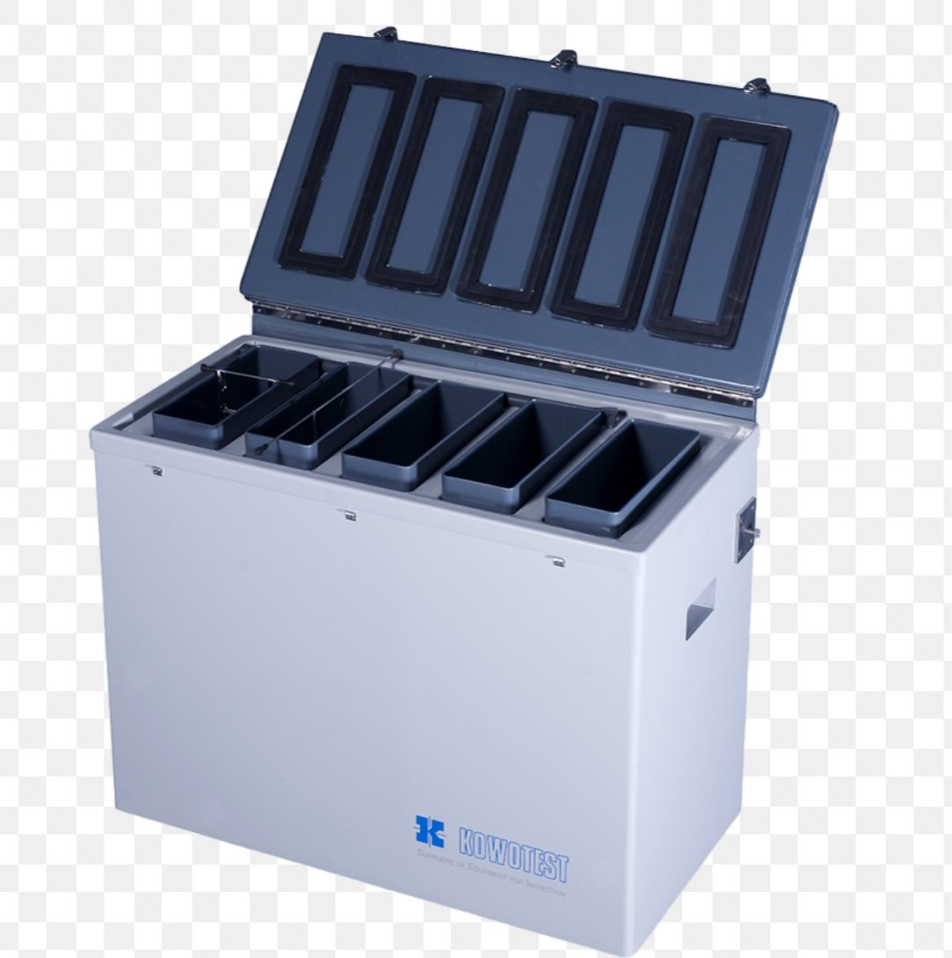
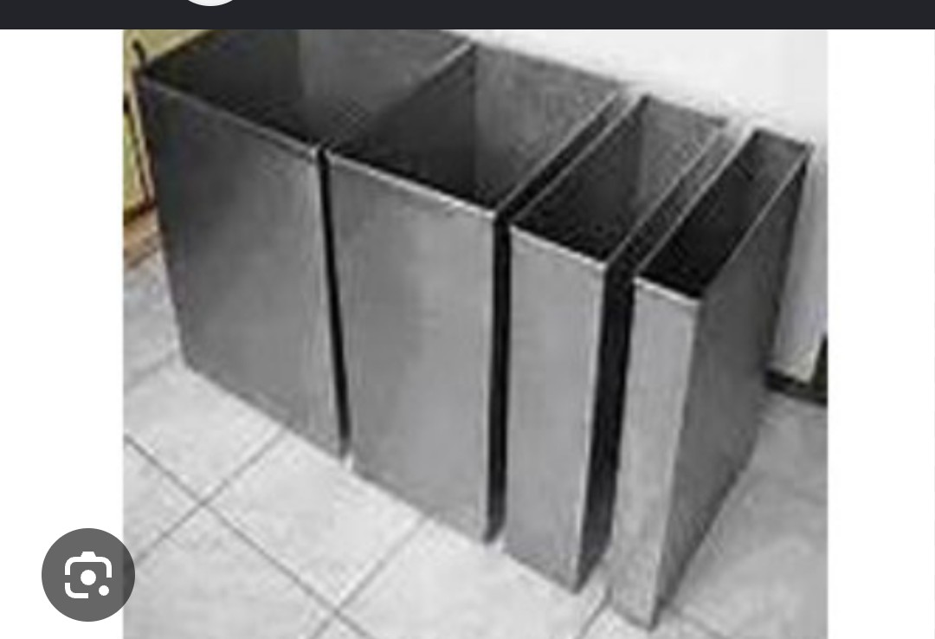
MANUAL PROCESSING TANKS

Slide 14
Why use separate baths?
Separate baths paves way for control and control gives quality.
Contrast and density are controlled through the developer alone
Each solution is replenished and replaced on its own schedule
Results are stable enough for diagnosis and long-term storage
Key point: Developer is alkaline and fixer is acidic, so each works best apart

Slide 15
What each bath does
Developer bath
Alkaline solution
Reduces exposed halide
About 5 minutes at 20 °C
Controls density and contrast
Fixer bath
Acidic solution
Dissolves unexposed halide
About 10 minutes
Hardens and preserves the emulsion

Slide 16
Manual processing technique
Clip the film by its corners on a clean, dry hanger
Lower it smoothly into the developer and start the timer
Agitate at the start and tap to release air bells
Drain, rinse, then fix for the full time
Wash in running water and dry without touching the surface
Key point: Smooth, timed, clean handling prevents most artifacts.

Slide 17
Time and temperature control
Standard development is about 5 minutes at 20 °C
A warmer bath works faster and may fog the film
A cooler bath works slowly and under-develops
Use a thermometer and a timer for every film
Key point: Time and temperature must always be read together.

Slide 18
Tank arrangement
Tanks sit in a line: developer, rinse, fixer, wash
Film never travels back over a tank it has left
Each tank has its own lid and stirring rod
Wash tank sits last, with running water
Key point: A one-way path protects each solution from contamination.

Slide 19
Advantages and limitations
Advantages
Good control of image quality
Reliable, repeatable results
Solutions can be replenished
Low equipment cost
Limitations
Slow and labour intensive
Depends on operator skill
Needs space and running water

Slide 20
Single-bath vs conventional
Solutions: Single bath: One combined bath. Conventional (separate baths): Developer and fixer apart
Control of image: Single bath: Limited. Conventional (separate baths): Good, adjustable by time and temperature
Image quality: Single bath: Lower. Conventional (separate baths): Diagnostic standard
Keeping quality: Single bath: Short bath life. Conventional (separate baths): Longer, replenishable
Typical use: Single bath: Teaching, improvisation. Conventional (separate baths): Routine radiography

Slide 21
What is an integrated system?
Developer, rinse, fixer and wash tanks combined in one unit
Tanks are arranged in the order of processing
Key point: All stages, one unit, one temperature environment.
Moving water keeps both solutions at a steady temperature

Slide 22
Components of the unit
Master tank: Outer tank holding the water jacket (this jacket warms or cools solutions through the tank walls). This jacket has thermostat that regulate the temperature to about 20 degree Celsius. Continuous flow of water keeps the water jacket temperature even.
Inner tanks: Developer and fixer solution tanks
Wash tank: Large tank with running water
Thermostatic mixer: Blends hot and cold water
Overflow and drain: Keep levels safe and empty tanks
Lids and racks: Cover tanks and hold hangers

Slide 23
Layout of the tanks
1. Developer: First tank, in the water jacket
2. Rinse: Short rinse or stop bath
3. Fixer: Second jacketed tank
4. Wash: Largest tank, running water
5. Drying: Cabinet or rack

Slide 24
Advantages and limitations
Advantages
Stable solution temperature
Low cost and simple servicing
Works without complex electronics
Limitations
Low throughput
Labour intensive
Needs water and space
Operator error: timing, agitation

Slide 25
Manual vs automatic processing
Processing time: Manual: About 30 to 60 minutes to dry film. Automatic processor: About 90 seconds to 3 minutes
Throughput: Manual: Low. Automatic processor: High
Consistency: Manual: Operator dependent. Automatic processor: Machine controlled
Labour: Manual: High. Automatic processor: Low
Running cost: Manual: Low equipment cost. Automatic processor: Higher equipment and service cost

Slide 26
Darkroom Construction, Layout and Materials
Darkroom design principles
Complete light-tightness
Separate wet and dry zones
Good ventilation and drainage
Easy-to-clean, chemical-resistant surfaces

Slide 27
Entrances
The entrance should be fitted and completely light proof
Use of double doors advisable.
The doors should be designed in such a way that the one closer to the darkroom opens into the room
Whereas the other opens outwardly

Slide 28
Darkroom equipments
Wet bench and dry bench
Separation: Keep apart wet and dry bench so that water cannot reach the film
Dry bench: where cassettes are unloaded and loaded with new film.
Its top should be large enough to accommodate the biggest cassette.
The surface of the dry bench should be made up of either wood or linoleum
Wet bench: this is an area of processing unit where processing are carried out
Contain tanks, sink and wash facilities

Slide 29
Film storage devices
Include but not limited to hopper,drawers and cupboard
HOPPER: for storage of unexposed film
DRAWERS: use in some radiography department instead of hopper. It should be light tight. They should be of different sizes based on the film size to be stored
CUPBOARDS: to stock recent film supply intended for replenishment of the film hopper. The cupboard dimension should allow film boxes to stand upright to avoid any form of static discharge

Slide 30
Cassette rack: used for housing loaded cassette
Cassette hatch: wall link between the darkroom and exposure room. It allows free passage of cassette from dark room to the exposure room
Proceesing hangers

Slide 31
Materials: use and avoid
Tanks: Recommended: Stainless steel 316, polypropylene. Avoid: Copper, brass, aluminium, galvanised steel
Walls: Recommended: Light, washable matt paint. Avoid: Glossy or flaking paint
Floor: Recommended: Non-slip, chemical resistant, sloped to drain. Avoid: Bare wood or porous tiles
Pipes: Recommended: Plastic or stainless. Avoid: Corroding metal pipes

Slide 32
Safelight and illumination
Amber or red filter matched to the film type
About 15 W bulb, roughly 1.2 m from the bench
Separate white-light switch with a warning

Slide 33
Care and Maintenance of Equipment
Daily care routine
Cover tanks when not in use to limit oxidation and dust
Stir developer and fixer before use
Check levels and temperature
Wipe spills and rinse hangers
Record what was done in the log
Key point: A two-minute check before work prevents a bad hour after.

Slide 34
Maintenance schedule
Daily: Tasks: Stir, check level and temperature, cover tanks, wipe spills
Weekly: Tasks: Clean hangers and rods, scrub tank rims, check safelight and thermometer
Monthly: Tasks: Drain, clean and refill tanks, check filters and drains
As needed: Tasks: Replace exhausted solutions, descale(removing hard deposit), repair leaks

Slide 35
Cleaning a processing tank
1. Drain: Empty and store waste safely
2. Scrub: Non-abrasive pad and mild cleaner
3. Rinse: Flush thoroughly with clean water
4. Descale: Remove deposits if present
5. Refill: Fresh solution, check temperature

Slide 36
COR: Control of Chemistry and Replenishment
Why control processing?
Consistent density and contrast on every film
Fewer repeat and lower patient dose
Chemistry degrades with use, time and air
As a result there is need for replenisher to restores both chemistry and level
Four variables to control: time, temperature, concentration, purity
Key point: Controlled processing protects the image and the patient from radiation.

Slide 37
Developer chemistry
Developing agents: reduces exposed halide. Examples are Phenidone, hydroquinone, metol (elon), ascorbic acid and glycin
Accelerator: Alkali (carbonate) gives the alkaline pH
Restrainer: Potassium bromide limits fog
Preservative: Sulfite slows oxidation
Hardener: Limits gelatin swelling
Solvent: Water carries the chemicals

Slide 38
Fixer chemistry
Clearing agent: Thiosulfate dissolves unexposed halide
Acidifier: Acetic acid stops development
Preservative: Sulfite stabilises thiosulfate
Hardener: Alum hardens the gelatin
Buffer: Holds pH steady
Solvent: Water carries the chemicals

Slide 39
Signs of exhausted solutions
Developer
Low density and weak contrast
Brown or dark solution
Longer time needed
Chemical fog
Fixer
Clearing takes much longer
Milky or cloudy film
Yellow-brown stain later
Sticky or soft gelatin

Slide 40
Processing Artifacts
This can be Classified into different categories
Handling: Crescents, finger marks, static, scratches
Light: Light leaks, safelight fog, white-light exposure
Chemical: Fog, dichroic stain, contamination spots
Agitation and solution: Air bells, streaks, stains, reticulation

Slide 41
Handling artifacts
Crescent marks: Cause: Film bent or kinked. Prevention: Hold by edges, avoid flexing
Finger marks: Cause: Dirty or wet hands. Prevention: Dry, clean hands
Static: Cause: Dry air, quick film removal. Prevention: Humidity control, slow handling
Scratches: Cause: Rough surfaces or hangers. Prevention: Smooth surfaces, careful loading

Slide 42
Light and fog artifacts
Light fog: Cause: Light leak or white light. Prevention: Test and seal darkroom
Safelight fog: Cause: Wrong filter, bulb or distance. Prevention: Correct filter, 15 W, about 1.2 m
Chemical fog: Cause: Warm or contaminated developer. Prevention: Control temperature, fresh chemicals
Dichroic fog: Cause: Fixer in developer, weak fixing. Prevention: Prevent splashes, fresh fixer

Slide 43
Solution and agitation artifacts
Air bells (pale spots): Cause: Bubbles cling to film. Prevention: Tap hanger, agitate
Streaks, uneven density: Cause: No agitation. Prevention: Agitate at the start
Dark spots: Cause: Developer splashes before immersion. Prevention: Keep area clean
White spots: Cause: Fixer splashes before development. Prevention: Keep area clean

Slide 44
How to Prevent artifacts
Handle film by the edges with clean, dry hands
Keep solutions fresh, clean and at the right temperature
Agitate at the start of development and fixing
Wash thoroughly and dry in clean air
Study every artifact film, not only discard it
Key point: Every artifact points to the cause that should be fixed.

Slide 45
Sequence of Processing
The five stages
1. Develop: About 5 min at 20 °C
2. Rinse: About 30 to 60 seconds
3. Fix: About 10 minutes
4. Wash: 20 to 30 minutes
5. Dry: Warm filtered air
Each stage prepares the film for the next, and none can be skipped.

Slide 46
Before processing: preparation
Check developer temperature and set the timer
Confirm safelight only before opening film
Clip film firmly on the correct hanger
Hold hanger by the corners and edges only

Slide 47
Processing stages
Stage 1: Developing
About 5 minutes at 20 °C, or as per the maker's chart
Agitate at the start, then at intervals
Exposed silver halide is reduced to metallic silver
Tap hanger to dislodge air bells
Drain for a few seconds before the rinse
Key point: The latent image becomes visible.

Slide 48
Stage 2: Rinse (stop bath)
30 to 60 seconds in agitated clean water or stop bath
Halts development and removes alkaline developer
Protects the fixer from rapid exhaustion
Drain before moving to the fixer
Key point: A good rinse protects the fixer and prevents stain.

Slide 49
Stage 3: Fixing
About 10 minutes, at least twice the clearing time
Thiosulfate dissolves unexposed silver halide
Acid stops development and hardener firms the gelatin
Agitate on entry for even action
Check clearing time regularly
Key point: Fixing makes the image permanent and stable.

Slide 50
Stage 4: Washing
20 to 30 minutes in running water
Removes residual thiosulfate and silver compounds
Poor washing causes brown stain with time
Key point: An incomplete wash shortens the life of the radiograph.

Slide 51
Stage 5: Drying
Warm, filtered air in a cabinet or rack
Dust and drips cause marks, so keep air clean
Wet film is soft and scratches easily
Remove from hangers only when completely dry
Label and file once dry
Key point: Handle wet film gently; the gelatin is soft.

Slide 52
Processing summary
Developing: Approximate time: 5 min at 20 °C. Purpose: Make latent image visible
Rinse: Approximate time: 30 to 60 s. Purpose: Stop development
Fixing: Approximate time: About 10 min. Purpose: Remove unexposed halide
Washing: Approximate time: 20 to 30 min. Purpose: Remove residual chemicals
Drying: Approximate time: Until dry. Purpose: Finish the radiograph

Slide 53
Silver Recovery and Conservation
Silver recovery and conservation involve reclaiming precious metallic silver from used or discarded xray films.
Why recover silver?
Used fixer carries dissolved silver from unexposed halide
Silver has real economic value
Silver is toxic to aquatic life, so it must not go down drains
Regulations often require recovery or safe disposal
Key point:. Reduce repeats with correct exposure technique is essential for silver conservation

Slide 54
Sources of silver
Used fixer: Main source of dissolved silver
Fixer overflow: Carries silver out of the tank
Waste film: Rejected and old films contain silver
Wash water: Trace silver from carryover

Slide 55
Silver recovery methods
Metallic replacement: Principle: Used fixer is passed through a container containing iron or steel wool.Steel wool or iron replaces silver from solution due to displacement action causing metallic silver to be deposited. Notes: Cheap, simple
Electrolytic: Principle: electric current is passed through used fixer solution. The current plates or collect silver onto a cathode. Notes: High recovery; fixer can often be reused
Chemical precipitation: Principle: Reagent or chemical added to the used fixer solution forms insoluble silver compound that can be separated and collected. Notes: Sludge (solid deposit containing recovered silver and other materials) needs careful handling
Ion exchange: Principle: Resin captures silver ions. Notes: Used on larger scales

Slide 56
Safe storage and disposal
Collect used fixer in labelled, sealed containers
Store away from developer, acids and heat
Use a licensed contractor to collect waste
Never pour used fixer or silver sludge down a drain
Keep disposal records for inspection
Key point: Recover, store safely, and dispose through approved routes.

Slide 57
Conclusion
Single-bath processing is simple but limited, and mainly a teaching concept
Conventional processing uses separate baths and gives reliable diagnostic quality
Always read time and temperature together
Keep developer and fixer apart at all times
Wash fully and dry in clean air
Recover silver and dispose of waste through approved routes

Slide 58
Advice
Make quality processing a habit for accurate diagnosis

Slide 59
References
1. Bushong SC. Radiologic science for technologists: physics, biology, and protection. 11th ed. St. Louis: Elsevier; 2017.
2. Carlton RR, Adler AM, Balac V. Principles of radiographic imaging: an art and a science. 6th ed. Boston: Cengage Learning; 2019.
3. Bushberg JT, Seibert JA, Leidholdt EM Jr, Boone JM. The essential physics of medical imaging. 3rd ed. Philadelphia: Lippincott Williams & Wilkins; 2012.
4. Carroll QB. Radiography in the digital age. 3rd ed. Springfield (IL): Charles C Thomas; 2018.
5. Fauber TL. Radiographic imaging and exposure. 6th ed. St. Louis: Elsevier; 2021.
6. Papp J. Quality management in the imaging sciences. 6th ed. St. Louis: Elsevier; 2018.
7. Ball J, Price T. Chesney's radiographic imaging. 6th ed. Oxford: Blackwell Science; 1995.

Slide 60
Thanks for listening

