Slide 1
MXT112: ATOMIC AND RADIATION PHYSICS
RAD. Patrick Collins
Tuesday 20th October, 2026

Slide 2
INTRODUCTION:
Atomic and radiation physics is the branch of science dedicated to understanding the fundamental structure of matter at the subatomic level and how atoms interact with, emit, and absorb energy in the form of radiation.
At its core, atomic physics explores the structure of the atom- primarily focusing on the arrangement, behavior and quantum transition of electrons orbiting the atomic nucleus. Radiation Physis extends this study to the emissions produced by these atonic and nuclear processes, covering the full

Slide 3
spectrum of electromagnetic waves (such as X-ray and Gamma rays) as well as energetic particles (like Alpha and beta particles). Together, these fields form the physical foundation for modern quantum mechanics, nuclear energy, medical imaging, radiation therapy and advanced spectroscopy.

Slide 4
THE MEASUREMENT AND UNIT IN ATOMIC AND RADIATION PHYSICS
In Atomic and Radiation Physics, physical properties are measured across microscopic length scales, extremely high energy levels, and Radioactive decay process. Because standard SI Units like meters, Joules, and Kilograms are inconveniently large at the atomic level, specialized atomic and nuclear units are used alongside standard SI definitions.

Slide 5
FUNDAMENTAL PHYSICAL QUANTITIES AND BASE UNITS:
1. FUNDAMENTAL PHYSICAL QUANTITIES AND BASE UNITS:
Physical Quantity | Symbol | Common non-SI/atomic unit | Standard Unit
Energy | £ | Electron volt (eV) | Joule (J)
Mass | M | Atomic mass unit (u/Da)

Slide 6
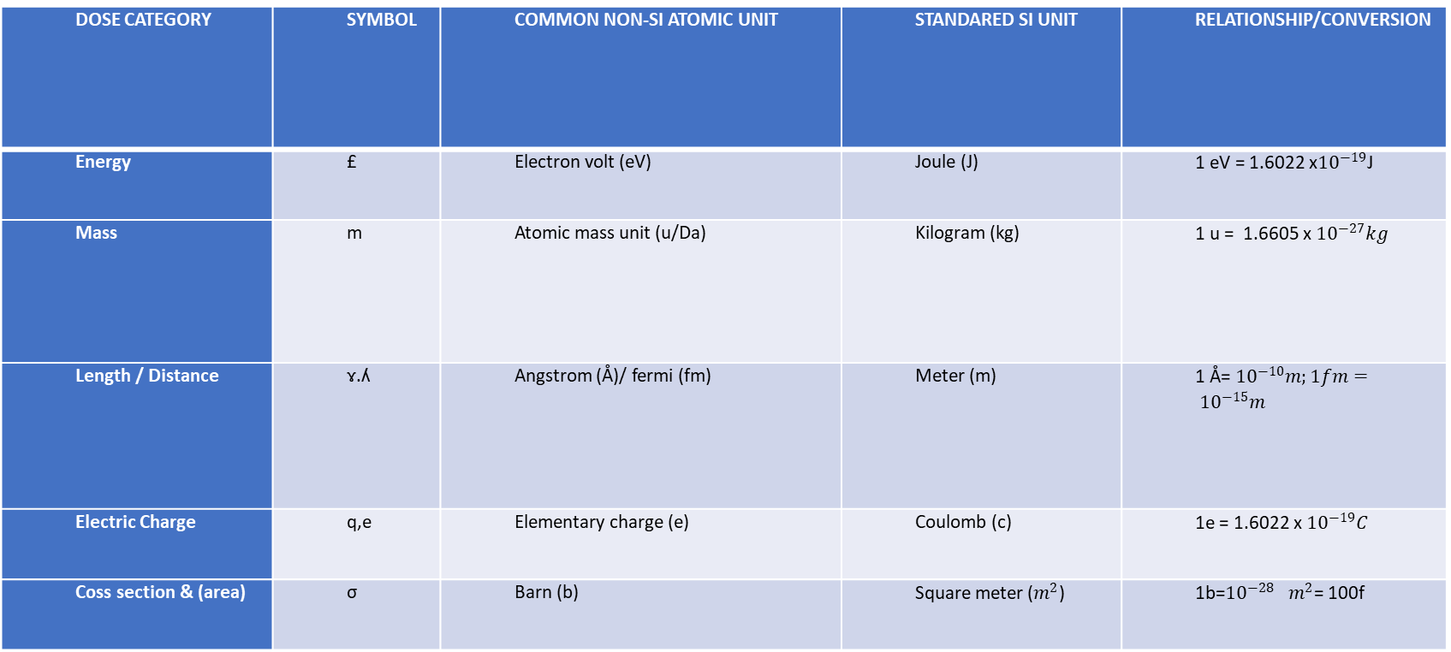
DOSE CATEGORY | SYMBOL | COMMON NON-SI ATOMIC UNIT | STANDARED SI UNIT | RELATIONSHIP/CONVERSION
Energy | £ | Electron volt (eV) | Joule (J) | 1 eV = 1.6022 x${10}^{−19}$J
Mass | m | Atomic mass unit (u/Da) | Kilogram (kg) | 1 u = 1.6605 x ${10}^{−27}kg$
Length / Distance | ɤ.ʎ | Angstrom (Å)/ fermi (fm) | Meter (m) | 1 Å= ${10}^{−10}m;1fm= {10}^{−15}m$
Electric Charge | q,e | Elementary charge (e) | Coulomb (c) | 1e = 1.6022 x ${10}^{−19}C$
Coss section & (area) | σ | Barn (b) | Square meter ($m^{2}$) | 1b=${10}^{−28}$ $m^{2}$= 100f

Slide 7
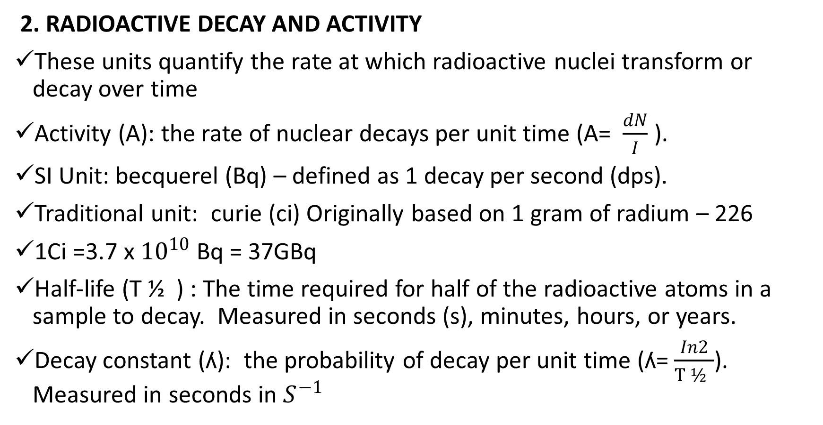
2. RADIOACTIVE DECAY AND ACTIVITY
These units quantify the rate at which radioactive nuclei transform or decay over time
Activity (A): the rate of nuclear decays per unit time (A= $\frac{dN}{I}$ ).
SI Unit: becquerel (Bq) – defined as 1 decay per second (dps).
Traditional unit: curie (ci) Originally based on 1 gram of radium – 226
1Ci =3.7 x ${10}^{10}$ Bq = 37GBq
Half-life (T ½ ) : The time required for half of the radioactive atoms in a sample to decay. Measured in seconds (s), minutes, hours, or years.
Decay constant (ʎ): the probability of decay per unit time (ʎ=$\frac{In2}{T ½ }$). Measured in seconds in $S^{−1}$

Slide 8
3. RADIATION EXPOSURE, ABSORBED DOSE, & DOSIMENTERY
Radiation measurement distinguishes between the energy present in the environment, the energy absorbed by matter, and the biological harm caused to biological tissue.

Slide 9
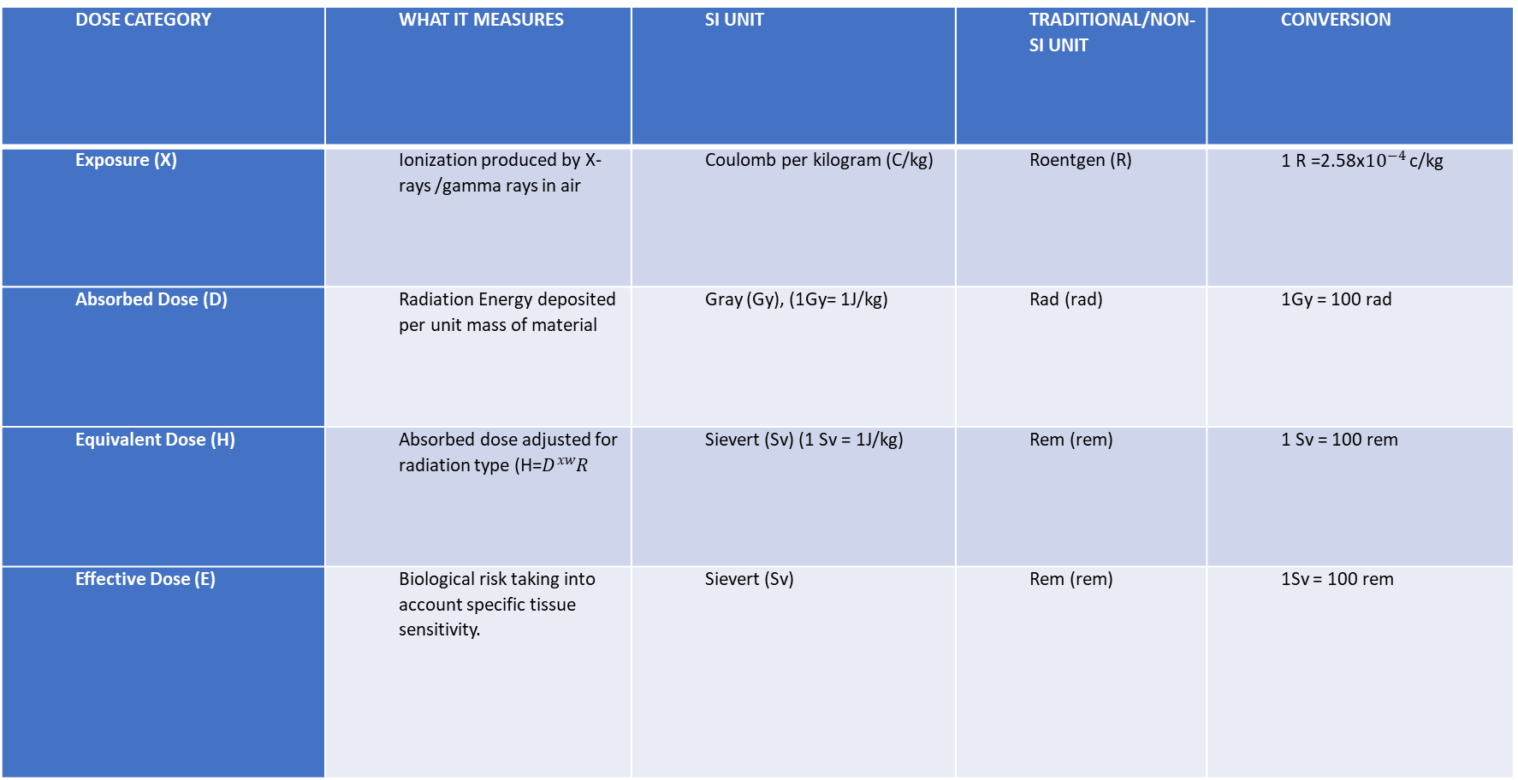
DOSE CATEGORY | WHAT IT MEASURES | SI UNIT | TRADITIONAL/NON-SI UNIT | CONVERSION
Exposure (X) | Ionization produced by X-rays /gamma rays in air | Coulomb per kilogram (C/kg) | Roentgen (R) | 1 R =2.58x${10}^{−4}$ c/kg
Absorbed Dose (D) | Radiation Energy deposited per unit mass of material | Gray (Gy), (1Gy= 1J/kg) | Rad (rad) | 1Gy = 100 rad
Equivalent Dose (H) | Absorbed dose adjusted for radiation type (H=$D^{xw}R$ | Sievert (Sv) (1 Sv = 1J/kg) | Rem (rem) | 1 Sv = 100 rem
Effective Dose (E) | Biological risk taking into account specific tissue sensitivity. | Sievert (Sv) | Rem (rem) | 1Sv = 100 rem

Slide 10
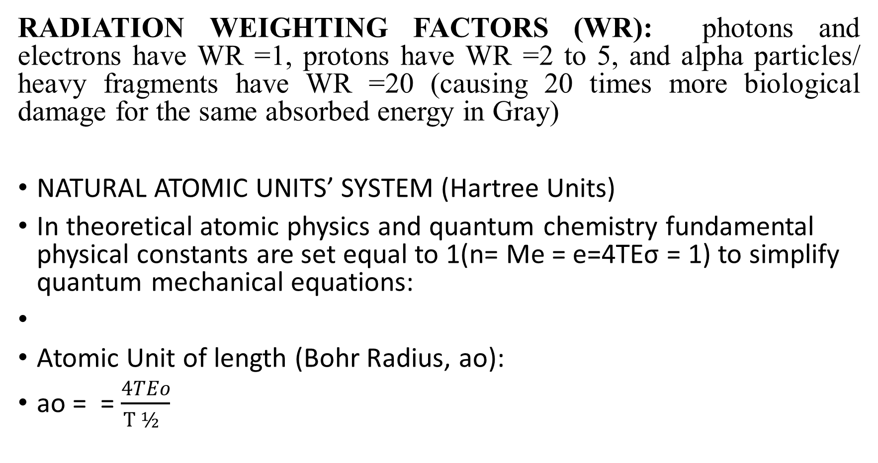
RADIATION WEIGHTING FACTORS (WR): photons and electrons have WR =1, protons have WR =2 to 5, and alpha particles/ heavy fragments have WR =20 (causing 20 times more biological damage for the same absorbed energy in Gray)
NATURAL ATOMIC UNITS’ SYSTEM (Hartree Units)
In theoretical atomic physics and quantum chemistry fundamental physical constants are set equal to 1(n= Me = e=4TEσ = 1) to simplify quantum mechanical equations:
Atomic Unit of length (Bohr Radius, ao):
ao = =$\frac{4TEo}{T ½ }$

Slide 12
FORCE, WORK, ENERGY, TEMPERATURE, AND HEAT
In atomic and radiation physics, these fire core concepts describe how subatomic particles, nuclei and radiation interact, move and exchange energy:
A) FORCE
Definition: force is any interaction that, when unopposed, causes an object or particle to accelerate in the atomic realm, Macroscopic pusses and pulls give way to:
fundamental forces: the strong nuclear force, (holding quarks and nucleons together) the weak nuclear force (responsibility responsible for radioactive decay like beta decay), the electromagnetic force (binding electrons to atomic nuclei), and gravity (negligible at the subatomic scale).
SI Unit: newton (N)

Slide 13
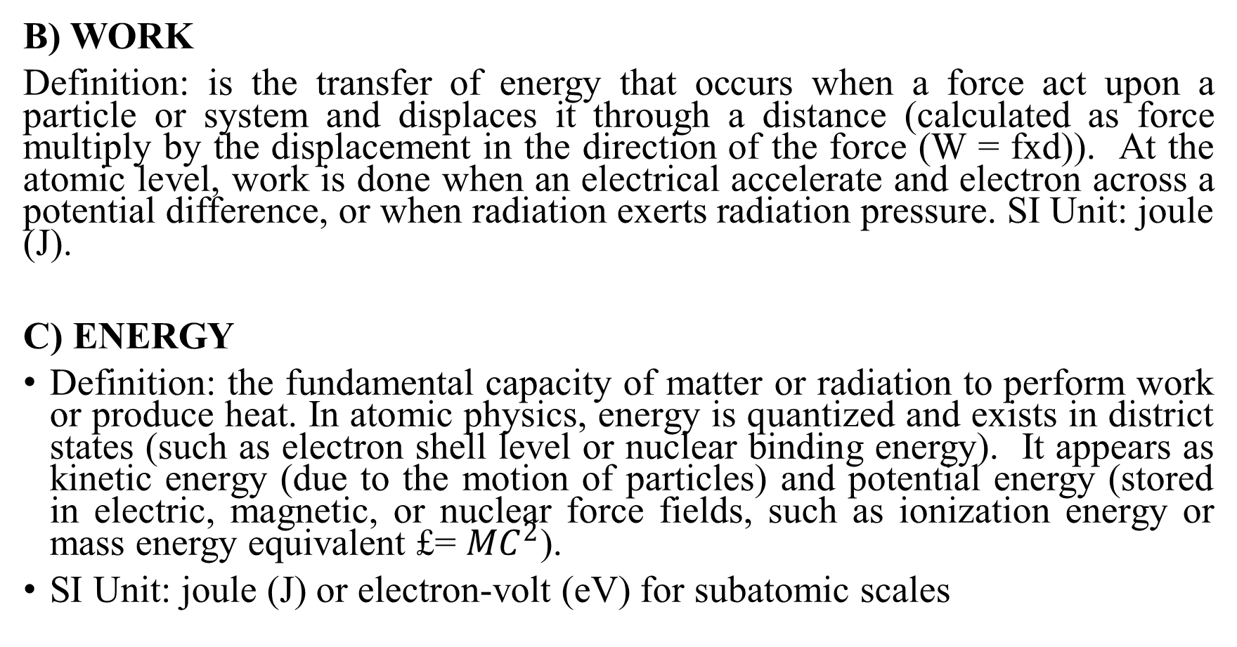
B) WORK
Definition: is the transfer of energy that occurs when a force act upon a particle or system and displaces it through a distance (calculated as force multiply by the displacement in the direction of the force (W = fxd)). At the atomic level, work is done when an electrical accelerate and electron across a potential difference, or when radiation exerts radiation pressure. SI Unit: joule (J).
C) ENERGY
Definition: the fundamental capacity of matter or radiation to perform work or produce heat. In atomic physics, energy is quantized and exists in district states (such as electron shell level or nuclear binding energy). It appears as kinetic energy (due to the motion of particles) and potential energy (stored in electric, magnetic, or nuclear force fields, such as ionization energy or mass energy equivalent £= ${MC}^{2}$).
SI Unit: joule (J) or electron-volt (eV) for subatomic scales

Slide 14
D) TEMPERATURE
Definition: An intensive physical property that measured the average kinetic of the Microscopic transitional, rotation, and vibrational motion of particles within a substance. It dictate the direction of thermal equilibrium and the statistical distribution of particles velocities (such as the Maxwell – Boltzmann distribution)
SI Unit: Kelvin (k) (or Celsius, oC)

Slide 15
E) HEAT
Definition: the spontaneous transfer of Thermal energy from a region or object of higher temperature. Heat is not something an object “contains” : rather, it is energy in transit driven by a temperature gradient. In atomic and radiation contexts, this transfer happens via conduction, conversion, or thermal radiation (the emission of electromagnet waves like infrared or black body radiation).
SI Unit: joule (J) (or calories)

Slide 16
THE ATOMIC STRUCTURE
An atom is the basic building block of matter, consisting of a tiny, dense central core called the nucleus surrounded by a cloud or orbiting electrons. Over 99.9% of an atoms mass is in the nucleus, while over 99% of its volume is empty space.
1: The central nucleus: The nucleus sits at the center of the atoms and contains two types of subatomic particles called nucleons:

Slide 17
PROTONS:
CHARGE: POSITIVE (+1}
Mass: Approximately 1 atomic mass unit {amu}
Role: The number of protons is the atomic number (Z). Which defines the identity of the chemical element (e.g, carbon always has 6 protons).
NEUTRONS:
CHARGE: Neutral (0, no charge)
Mass: Approximately 1 amu (very close to a protons mass)
Role: They act as nuclear “glue “using the strong nuclear force to bind protons together and overcome electromagnetic repulsion. Variants of an element with different numbers of neutrons are called isotopes.

Slide 18
2. the Electron cloud and shells
Surrounding the nucleus is a vast region where electron reside.
ELECTRONS:
Charge: negative (-1, equal in magnitude to a proton’s positive charge)
Mass: Negligible (about 1/1836 the mass of a proton, or approximately 0-amu)
Role: they occupy specific energy levels, shells, 0r orbitals around the nucleus.
ELECTRONS SHELL CAPACITIES:
1st shell: (closest to the nucleus): up to 2 electrons
2nd shell: up to 8 electrons
3rd shell: up to 8 or more electrons depending on the element

Slide 19
VALENCE ELECTRONS:
The electrons in the outermost shell. They govern how the atoms bonds ad reacts chemically with other atoms.
3. Key Atomic Measurements
Atomic number (Z): Total count of protons in the nucleus
Mass: number (A): Total count of protons plus neutrons (A= Z+N)
Electrical Balance: in a standard neutral atom, the number of negative electrons equals the number of positive. If an atom gains or loss electrons, it becomes a charged particle called an ion.

Slide 20
Key features of the periodic table:
Total elements: 118 confirmed chemical elements, ordered by increasing atomic number (number of protons) from Hydrogen ( 1) to organesson ( 118 ).
Periods (rows): There are 7 horizontal rows. Each period indicates the number of electron shells an atom has.
Groups (Columns): There are 18 vertical columns. Elements in the same group share similar chemical properties because they have the same number of valence electrons.
Main classification:
Metals: Found on the left and center.

Slide 21
Non – metals: Found on the upper right (including Halogens and noble gasses).
Special series: The lanthanide and Actinide series (atomic numbers 57 – 71 and 89 – 103) are placed at the bottom to keep the table compact.
THE CONCEPT OF ISOTPES, IONIZATION, AND EXCITATION
Isotopes, ionization, and excitation are fundamental concepts in chemistry and physics that describe the structure of atoms and show how they interact with energy.

Slide 22
1. ISOTOPES ( changes in the nucleus )
Isotopes are variants of a single chemical element that have same number of protons but a different number of neutrons in their nuclei.
The core concept: Because they have the same number of protons ( and electrons 0, isotopes of an element share the exact same chemical properties. However, because their neutrons counts differ, they have different physical masses.
Example: carbon – 12 and carbon – 14 are both isotopes of carbon. Both have 6 protons. Carbon – 12 has 6 neutrons ( stable and common ), while carbon – 14 has 8 neutrons ( unstable and radioactive, used in carbon dating ).

Slide 23
IONIZATION ( loss or gain of electron )
Ionization is the process by which an atom or molecule gains a net positive or negative charge by gaining or losing electrons.
The core concept: Atoms are naturally neutral because they have an equal number of protons ( + ) and electrons ( - ) . If you add enough energy to an atom, you can completely rip an electron away from it. This turns the neutral atom into a charged particle called an ion
Example. When a neutral sodium ( Na ) atom loses an electron, it becomes a positively charged sodium ion ( Na+ ).

Slide 24
3 EXCITATION ( Shifting Electron Energy Levels )
Excitation occurs when an electron inside an atom absorbs energy and jump to a higher energy level ( shell ),without leaving the atom entirely,
The core concept: Unlike ionization – where the electron is permanently kicked out – excitation keeps the electron bound to the atom. The atom simply enters a temporary unstable “ excited state “”. When the electron eventually falls back down to its original, stable “ground state “, it releases that absorbed energy as a flash of light ( a photon ).
Example: Neon sign work because of excitation. Electricity pumps energy into the neon gas atoms, exiting their electrons. As those electrons drop back down to their normal level, they emit the glowing colored light you see.

Slide 25
ELECTRICAL CHARGE:
DEFINITION: Electrical charge is a functional physical property of subatomic particles ( such as a protons neutrons) that causes them to experience a force when placed in an electric or magnetic field. It is measured in coulombs ( C ).
Key Rules : Like charges repel each other, and opposite charges attract each othe. Charge is conserved and quantized.
Example: Rubbing a plastic comb against your hair transfers electrons, giving the comb a negative electric charge that can pick up small pieces of paper.
ELECTRIC CURRENT:
Definition: Electric current is the rate of flow of electric chargepast a giving point in a circuit. It is measured in Amperes ( A ), where 1A = 1 c/s.
Key Rules: current flows through a closed circuit from a higher potential ( Positive terminal ) to a low potential ( Negative terminal )

Slide 26
Example: The stream of electrons flowing through a copper wires inside a wall to turn on a house hold light bulb.
ELECTRIC POTENTIAL ( voltage )
Definition: Electrical potential ( Often called voltage ) is the amount of electric potential energy per unit charge at a point in an electric field , or the work done to move a unit charge between two points . It is measured in volts ( V ).
Key Rules: It acts as the “” Electrical pressure “” that pushes free charges through a conductor.
Example: A standard 1.5- volt AA battery providing the potential difference needed to run a TV remote control.

Slide 27
CAPACITANCE:
Definition: The ability of a component or circuit to store electrical energy in the form of an electrical charge measured in Farads ( F )
Example: A camera flash unit uses a capacitor to store charge rapidly and then release it all at once to produce a bright , instantaneous burst of light.
CAPACITORS:
Definition: Passive electric components made of two conductive plates separated by an insulating material ( a dielectric ), designed to temporarily store and discharge electrical energy.

Slide 28
ELECTROMAGNETIC INDUCTION
Definition : Electromagnetic induction is the process of generating an electromotive force ( Voltage )and an electric current in a conductor by exposing into a changing magnetic field or moving it through a magnetic field.
Key Rules: First discovered by Michael Faraday , the induced voltage depends on the rate of change of magnetic flux and the number of turns in a coil ( Faraday”s Law )’
Example: A bicycle dynamo or a large power plant generator where spinning magnets inside wire coil generate AC electricity for homes.
electrolytic capacitor used inside a computer power supply to smooth out voltage fluctuations filter electrical noise,

Slide 29
RESISTANCE
Definition: The opposition offered by a material or component to the flow of electric current, measured in ohm”s
Example: The tungsten filament inside a traditional incandescent light bulb; it resists the flow of electrons so heavily that it heats up and glows to produce light.

Slide 30
Ohm”s Law
Definition: A fundamental principle stating that the voltage ( V ) across a conductor is directly proportional to the current ( I ) flowing through it, multiplied by the resistance:
Formula: V = I * R .( Also written as I = V/R or R = V/I )
Example: If you connect a 12 – volt battry ( V = 12V ) to a circuit with a 4 ohm”s resistance ( R = 4ohm”s ) the current ( I ) flowing through the circuit will be I = 12V/ 4 ohm”S = 3amps.
To calculate total resistance ( Rtotal ) , use simple algebraic formulas depending on whether the component are wired in a series or parallel configuration.

Slide 31
1. Resistance in series
Rules: current flows sequentially through a single path. So you add the individual resistance values together.
Formula: Rtotal = R1 + R2 + R3 + …..; example: you have three resistors in series with the following values: R1 = 100 ohm””s , R2 = 20 ohm”s ,and R3 = 30 ohm”s.
Rtotal =( 100 + 20 + 30 ) ohm””s = 150 ohm”s
Key takeaway: The total resistance in series is always greater than the largest individual resistance

Slide 32
1. Resistance in Parallel
Rule: components share the same voltage nodes and the current splits across multiple branches. You sum the reciprocals of the individual resistances.
Fomula: 1 / Rtotal = 1/R1 + 1/R2 + 1/R3 + …… for just two resistors , use the simplified product – over – sum rule : Rtotal = R1 * R2/ R1 + R2
Example calculation: You have three resistors in parallel with the following values, R1 = 100 ohm”s R2 = 20 ohm”s, and R3 = 50 ohm”s

Slide 33
Find the sum of the reciprocals, 1/ Rtotal = 1/100 + 1/20 + 1/50
1/Rtotal = 0.01 + 0.02 + o.05 = 0.08
Ii} invert the result to find Rtotal. Rtotal = 1/0.08 = 12.5 ohm”s
Takeaway: The total resistance in a parallel always less than the smallest individual resistor in the branch.
Combination ( Series – parallel ) circuits
Rule: Break the circuit down step – by – step , calculate the equivalent resistance of the parallel section first , then treat that result as a single resistor added to the series components.

Slide 34
Example calculation : R1 = 100 ohm”s in series with a parallel pair R2 = 50 ohm”s, and R3 = 50 ohms
Calculate the parallel pair ( R2 and R3 ) ;
Rtotal = 50 * 50 / 50 + 50 = 2500 / 100 = 25 ohms
Add the series resistor { R1 }to the parallel equivalent.
Rtotal = R1 + Rparallel = 100 ohm”s + 25 ohm”s = 125 ohm”s

Slide 35
ENERGY:
Definition: Energy is the capacity or the ability to do work or cause change.
SI unit: joule ( J )
Key concept: Energy can change from one form to another ( such as potential, kinetic, thermal , electrical, or chemical), following the law of conservation of energy.
Examples:
I} Kinetic Energy: a car moving down a high way or a runner sprinting.
Ii} Potential energy: A book resting on a high shelf or a stretched rubber band storing elastic energy.
Iii} Chemical Energy : Food you digest or gasoline burned in an engine.
Iv} Electrical Energy: Electricity powering a refrigerator over a 24 – hour period.

Slide 36
POWER
Definition: power is the rate at which energy is transferred, used, or converted over time.
SI unit: Watt ( W ) , which equals one joule per second ( J/S }.
Fomula: Power = Energy / time ( P = W/ t }.
Key concept : Power tells you how fast energy is being used or delivered , not just the total amount.
Examole:
Light bulb: A 60 – watt light bulb uses 60 joules of electrical energy every single second.
Appliances: A 1.500 – watt microwave cooks food much faster than a lower – powered device because it transfers energy at a higher rate
Human/ Mechanic Work: A weightlifter lifting a heavy barbell quickly exerts more power than some one lifting the same weight very slowly.
Quick comparism

Slide 37
Feature | Energy | Power
Work it measures | Total capacity to do work | Rate of energy transfer or use
Primary unit | Joule ( J ) kilowatt – hour ( KWh} | Watt (w ) or kilowatt ( W )
Analogy | The total amount of water stored | The speed or width of the pipe
 | In a tank | used to let the water flow out

Slide 38
THE HEATING EFFECTS OF A CURRENT.
The heating effect of an electric current – also known as joule heating or resistive heating – occurs when an electric current flows through a conductor and encounters resistance. As free electrons move and collide with the atoms of the conductor, they transfer kinetic energy into thermal energy , making the conductor warm.
Joule”s Law of Heating:
The amount of heat ( H ) produced in a conductor is calculated using the formula:
H = I2 R t where:
I = electric current ( in amperes )
R = Resistance of the conductor ( in ohm”s }
T = Time for which the current flows ( in seconds }

Slide 39
Factors that increases Heat production:
Higher current ( I ); Heat increases rapidly with the squre of the current.
Higher resistance ( R ): Materials with high resistance ( like nichrome } get much hotter than low – resistance materials ( like copper }.
Longer duration ( t ): the longer the current flows , the more total heat accumulates.
Conductor shape: Thinner and longer wires offer more resistance , generating more heat.
COMMON APPLICATIONS
Heating appliances: Devices like electric irons, room heaters , kettles , and hair dryers use high – resistance nichrome coils to convert electricity into usable heat.

Slide 40
Incandescent light bulbs: A thin tungsten wire filament offers high resistance ; it gets so hot when current passes through it that it glows brightly to emit light.
Electreic Fuses: A safty wire with a low melting point is placed in a circuit , if excessive current flows , the intense joule heating melts the wire , breaking the circuit to prevent fires or damage

Slide 41
SOURCE OF ELECTRICAL ENERGY
Electrical energy is a secondry energy source produced by converting primary energy sources – such as fossil fuels , nuclear reactions , and natural forces – into an electrical current via generators or photovoltaic cells. The primary sources of electrical energy are divided into non – renewable and renewable categories.
NON – RENEWABLE SOURCES
Fossil fuels : Coal , natural gas , and petroleum are burned to creat heat, which produces steam to drive turbines and generators.
Nuclear Energy : Uses the heat generated from splitting atomic nuclei ( Nuclear fission ) in a reactor to produce steam and turn turbines.

Slide 42
RENEWABLE SOURCES:
Hydropower. Uses the kinetic energy of falling or flowing water in rivers and dams to spin water turbines.
Solar Energy: Converts sunlight directly into electricity using photovoltaic solar panels, or uses solar thermal systems to create steam.
Wind Energy: Harnesses the movement of air to turn wind turbine blades connected to generators.
Geothermal Energy: Utiliizes heat from deep inside the earth to produce steam that drives poer plant turbines.
Biomass : Burns organic materials like wood , agricultural crops , or waste to create heat and steam.

Slide 43
Tidal and Wave Energy: Captures the kinetic and potential energy of ocean tidesand waves to power underwater turbines.
OTHER SOURCES AND METHODS
Chemical energy ( batteries and fuel cells ): Voltaic cells and electrochemical reactions produce direct current ( DC } electricity.
Physical/ Mechanical Generation: Small - scale or specialized generation can occure via friction/ heat ( thermoelectricity ) , light ( photoelectric ) or pressure ( piezoelectric crystals ).

Slide 44
E M F AND P D
Electromotive force ( E M F ) and potential difference ( P D ) are both measured in volts ( V ) , but they describe different stages of energy movement in an electric circuit.
ELECTROMOTIVE FORCE ( E M F )
Definition: The total energy supplied by a power source ( like a battery or generator ) per unit charge to move electricity around a complete circuit . Think of it as the total “push ) or open – circuit voltage available.
Key trait: It exists even when no current is flowing ( open circuit ) . It is the cause that drives charges.
Example:
A brand – new 1.5 – volt AA alkaline battery sitting on a table has an EMF of 1.5v.

Slide 45
A 12 – volt car battery measured across its terminals before anything is turned on has an EMF of 12v.
The voltage rating printed on the side of a 9 – volt battery ( 9 v ).
POTENTIAL DIFFERENCE (PD )
Definition: The amount of electrical energy converted into other forms of energy ( like light , heat , or motion ) as charge passes through a specific component . It is the effect of current encountering resistance.

Slide 46
Examples:
The voltage measured across an active light bulb shinig in a circuit ( eg. 1.2 v dropped across the filament ).
The voltage drop across a resistor in a phone charger circuit.
The terminal voltage of a 12 v car battery while the headlights and engine are turned on , which drops slightly below 12 v ( eg 11.5 v ) because of internal resistance.

Slide 47
QUICK COMPARISM
FEATURE E M F P D
What it represents Energy provided to charges Energy used by a component
By a source or load
Scope The entire circuit/ source Between any two points in a circuit
When current is zero Present ( equal to open zero
Circuit voltage )
Unit Volts ( V ) Volts ( V ).

Slide 48
THE PROPERTIES OF X – RAYS
X-RAYS are high – energy forms of electromagnetic radiation.
CORE PHYSICAL PROPERTIES
Electromagnetic nature: They belong to the electromagnetic spectrum with short wavelength ( typically 0.01 to 10 nanometers ) and high frequencies.
Speed: They travel in a straight line at the speed of light ( 3* 10 8 m/s)in a vacuum.
No mass or charge : X-ray photons are pure energy; they carry no electrical charge or mass.
No Direction: Because they are electrically neutral, electric and magnetic fields cannot deflect or steer them.
Penetrating power: They can pass through materials that block visible light , such as wood , paper, flesh , and soft tissues’.

Slide 49
Differential Absorption: Denser materials like bone and metal absorb or block x-rays, while soft tissues let them pass through, which creates contrast in medical images’.
Ionization ability: They carry enough energy to strip electrons from atoms and create ions, which can trigger chemical changes or damage living cells.
Photographic and fluorescent effects: They expose photographic and x-ray film ( turning it dark/ black where exposed) and cause certain crystals to fluoresce ( emit visible light ).
Refraction and reflection: They have extremely small wavelengths, making them difficult to reflect or refract the way visible light does ( though they can undergo diffraction and scattering ).

Slide 50
THE PRODUCTION OF X-RAYS
X-rays are produced inside an evacuated glass x-ray tube through a process where fast moving electrons are rapidly decelerated or cause atomic transitions when they strike a metal target.
THE PRODUCTION PROCESS IN AN X-RAY TUBE
The generation of x-rays requires three main steps happening inside the tube
Electron emission ( thermionic emission ) : An electrical current heats a tungsten filament at the negative cathode , causing it to”” boil off”” electrons and form a cloud of free electrons.

Slide 51
Electron Acceleration: A high electrical voltage ( measured in kilovolts or kvp) is applied between the cathode and the positive anode. This voltage pulls and accelerates the electrons across the vacuum toward the anode at up to half the speed of light.
Sudden deceleration ( Target impact ) : When the high – speed electrons crash into a heavy metal target ( usually tungsten ) on the anode, roughly 99% of their energy converts into heat while about 1% converts into x-ray photons.
TWO MECHANISMS OF X-RAY GENERATION
When electrons hit the target , x-rays are emitted through two distinct physical interactions.

Slide 52
BREMSSTRAHLUNG ( BRAKING RADIATION ):
An incoming high-speed electron passes close to the nucleus of a tungsten atom.
The strong positive pull of the nucleus sharply bends and slows down ( brakes ) the electron.
The lost kinetic energy is released as an x-ray photon. This produces a continuous range of x-ray energies and accounts for the majority of x-rays generated’

Slide 53
CHARACTERISTIC RADIATION
An incoming electron collides directly with an inner-shell ( eg k-shell ) electron of a target atom and knocks it out of orbit.
An electron from outer , higher –energy shell drops down to fill the empty space .
This drop releases a burst of energy in the form of an x-ray photon with a specific , sharp energy level unique to the target material .

