Slide 1
Anatomy of the Upper Limbs
Dr Clinton David Orupabo
Department of Radiography, Faculty of Basic Medical Sciences, Rivers State University.
Lectures for Pre-registration Re-training Course for X-ray Technicians. Radiographers Registration Board of Nigeria.

Slide 2
Table of contents
Introduction
Osteology of the upper limbs
The shoulder region
The Pectoral region and axilla
The Arm
The Forearm
Blood supply to the upper limbs
The Hand, hand spaces and compartments

Slide 3
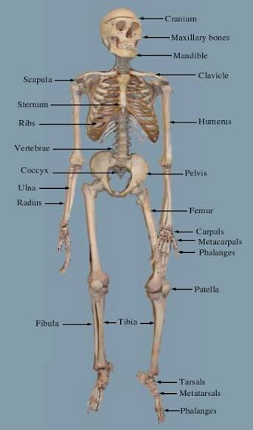
Introduction
The upper limb is made up of four segments: pectoral girdle, arm, forearm and hand
The pectoral girdle is a bony ring formed by three bones: scapulae, clavicle and manubrium of sternum
Both pectoral girdle and bones of upper limb forms the appendicular skeleton
The appendicular skeleton then joins the axial skeleton

Slide 4
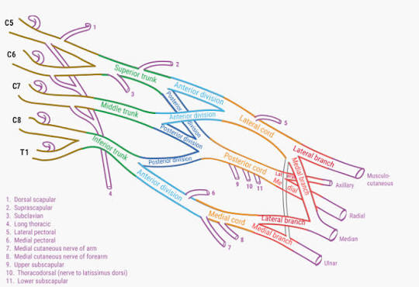
Introduction – Innervation of the upper limbs
The upper limb derives its nerve supply primarily from branches of the brachial plexus
A plexus of nerves arising from the ventral rami of spinal nerves from C5 – T1
Roots → Trunks → Divisions → Cords → Branches

Slide 5
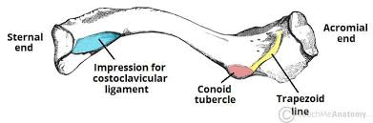
Osteology - clavicle
Also called collar bone, bilateral
Lies horizontally in the body
Type of long bone
Has medial and lateral ends; sternal or acromial ends
Divided into two halves: lateral 1/3rd and medial 2/3rd
Medial is convex anteriorly while lateral is concave anteriorly
Triangular-shaped with double curvatures, like s-shape
Has 2 surfaces: superior and anterior
Superior: deltoid tubercle for attachment of deltoid muscle
Inferior: rough; conoid & trapezoid ligament(acromial end), costoclavicular ligament & subclavian groove (medially)

Slide 6
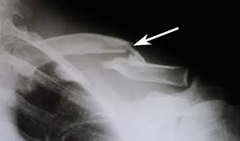
Ossification of the clavicle
First bone to ossify in the body at 5th and 6th week intrauterine life
Begins with intramembranous ossification and ends with endochondral or cartilaginous ossification
Two primary centres at medial and lateral ends
Secondary ossification appears at the sternal end at 18th and 25th year of life and is complete by 25th and 31styr
Thus, it is also last of epiphysis of long bones to fuse
Clinicals
Commonly fractured in children
Greenstick fractures
Common site of fracture is junction of lateral and medial thirds

Slide 7
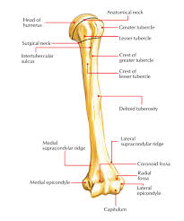
Osteology -Humerus
Largest long bone of the upper limbs
Forms the shoulder joint with the scapula at the glenoid cavity
Has a head, an anatomical and surgical neck and shaft, and distal and proximal ends
Possesses two elevations at the neck region: greater and lesser tubercles separated by the bicipital groove
Distal ends has capitulum laterally for articulation with head of radius, and trochlea(pulley-like) medially for articulation with ulna
Distal ends terminate in two projections; lateral and medial epicondyles

Slide 8
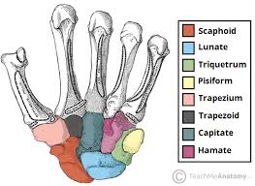
Osteology - The carpal bones
Small bones of the hands occupying the wrist region
Has 2 rows of bones attached to each other by interosseous ligament
Proximal row: L2M: Scaphoid→Lunate→Triquetrium→Pisiform (SLTP)
Distal row: L2M: Trapezium→Trapezoid→Capitate→Hamate (TTCH)
5 Metacarpals (head and base) and 14 phalanges(distal, middle and proximal ends)

Slide 9
The shoulder region
The shoulder muscles are divided into major 2 groups:
Extrinsic muscles
Intrinsic muscles
The Extrinsic muscles are divided into 2 groups:
Superficial posterior thoracoappendicular
Deep posterior thoracoappendcular
Examples:
Extrinsic superficial: trapezius and latissimus dorsi
Extrinsic deep: levator scapulae and rhomboids
Intrinsic: deltoid, teres major and rotator cuff muscles

Slide 10
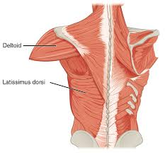
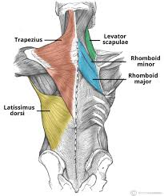
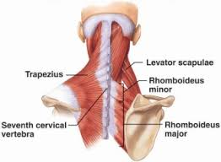
Shoulder region- muscles

Slide 11
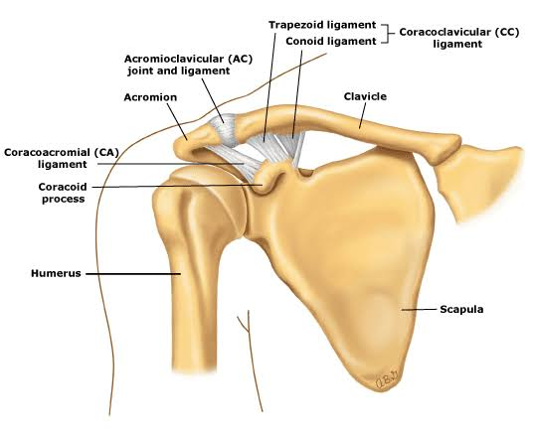
The Shoulder region – Shoulder joint
Also called glenohumeral joint
Ball & socket type of synovial joint
Head of humerus articulates with the shallow glenoid cavity of the scapular
Articular surfaces lined by hyaline cartilage
The glenoid cavity is slightly deepened by a ring-like fibrocartilaginous glenoid labrum
It accommodates just a little above a third of the humeral head

Slide 12
The Shoulder region – Shoulder joint
Joint support
Several ligaments and muscles provide strength and support for the shoulder joint
Rotator cuff muscles (SITS) provide tone
A loose fibrous articular capsule covers the joint leaving 2 openings:
Between greater and lesser tubercle for passage of tendon of long head of biceps brachii
Inferior to coracoid process allowing for communication between subscapular bursa and the synovial cavity
Shunt muscles prevent dislocation:
coracobrachialis, short head of biceps, long head of triceps which assist deltoid in preventing inferior displacement
Ligaments strengthen the articular capsule:
Glenohumeral ligament
Coracohumeral ligament
Transverse humeral ligament (bridges the intertubercular sulcus converting it a canal that holds the synovial sheath and biceps brachii tendon)
Coracoacromial arch prevents superior displacement

Slide 13
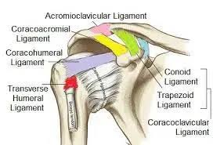
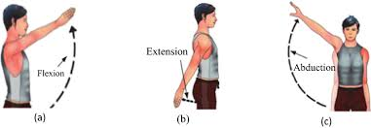
Shoulder joint - movements
Flexion: pectoralis major (clavicular part)(chief muscle) and anterior fibres of deltoid. assisted by coracobrachialis and biceps brachii
Extension: latissimus dorsi (chief), assisted by posterior fibres of deltoid
Abduction: entire deltoid (chief) esp. middle fibres after initiation of movement by supraspinatus
Adduction: P. major and latissimus dorsi
Medial rotation: subscapularis
Lateral (external) rotation: infraspinatus
Circumduction

Slide 14
Shoulder joint
Blood supply: Anterior and posterior circumflex humeral arteries and branches of suprascapular artery
Innervation: Suprascapular nerve, Axillary nerve, Lateral pectoral nerves
Clinical importance
Rotator tendon tears
Shoulder dislocation
Bursitis
Synovitis
osteoarthritis
Subluxation
Tendinitis

Slide 15
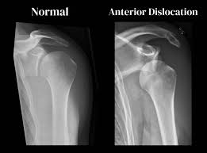
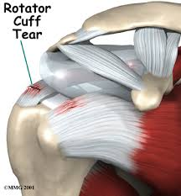
Shoulder joint – clinical importance

Slide 16
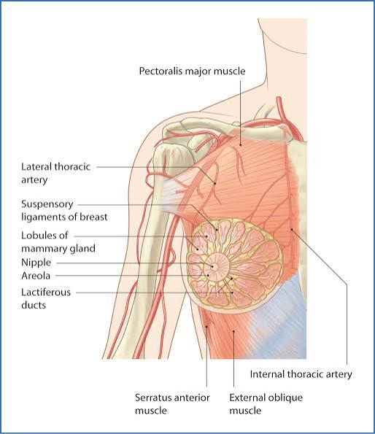
The pectoral region
This is the most anterior part of the upper chest wall
It contains primarily four muscles: the pectoralis major and minor, subclavius and serratus anterior
The muscles act to stabilize the shoulder and upper limb
And also bears the breast and wall of the axilla

Slide 17
The pectoral region
Pectoralis Major:
largest and most superficial muscle of the chest
shaped like a fan
Origin: clavicle, sternum, and upper costal cartilages
Insertion: humerus
Action: adducts and medially rotates the arm
Innervation: Medial and Lateral pectoral nerves
Pectoralis Minor:
smaller, triangular muscle
located directly beneath the pectoralis major
Origin: 3rd to 5th ribs
Insertion: coracoid process of the scapula
Action: protract and depress the scapula
Innervation: Medial and Lateral pectoral nerves

Slide 18
The pectoral region
Subclavius Muscle
Origin: Junction of the first rib and its costal cartilage
Insertion: Subclavian groove on the inferior (underside) surface of the middle third of the clavicle
Serratus Anterior Muscle
Origin: Outer surfaces and superior borders of the ribs 1-8 and sometimes 9th rib.
Insertion: Costal (anterior) surface of the medial border of the scapula (shoulder blade), spanning from the superior angle down to the inferior angle
Action: Anchors the scapula to the thoracic cage, as in protraction
Nerve supply: Long thoracic nerve of Bell
Clinicals: Winging of the scapula

Slide 19
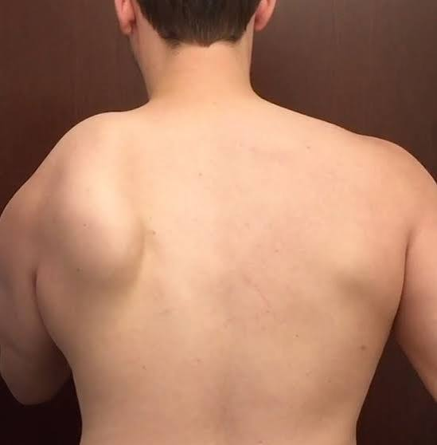
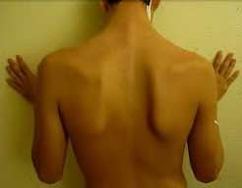
The pectoral region - clinicals

Slide 20
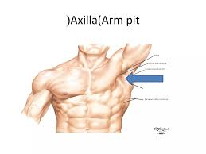
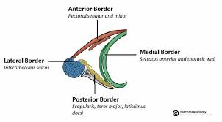
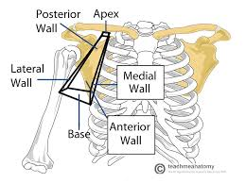
The Axilla
Introduction
Boundaries
Contents
Clinical anatomy

Slide 21
The Arm
Region of upper limb between the shoulder and elbow
Divided into anterior and posterior compartments
Anterior (flexors):
Muscles include biceps brachii, brachialis and coracobrachialis
Innervation by musculocutaneous nerve
Posterior (extensors):
Muscles include triceps brachii (long head, lateral and medial heads) and a small triangular muscle near the elbow joint called anconeus
Innervation by radial nerve
Look up elbow joint and elbow anastomosis

Slide 22
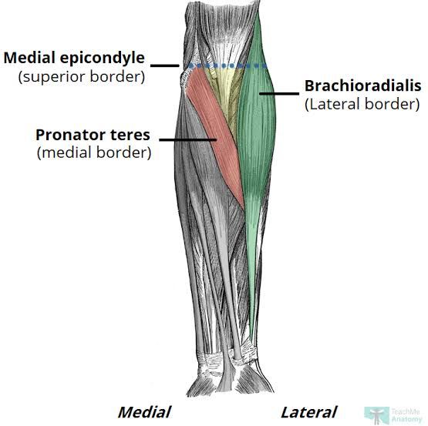
The Arm – cubital fossa
Introduction
Boundaries
Contents
clinicals

Slide 23
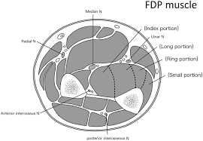
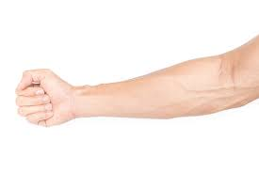
The Forearm
Lies btw the elbow and the wrist and contains two bones: the ulna and radius
Both bones are joined by the interosseous membrane
It is made up of two compartments: Anterior and Posterior compartments
The muscles of the forearm pass as tendons into the wrist, hand and digits

Slide 24
Forearm- Anterior compartment
Also termed flexor-pronator compartment
Contains the flexor muscles with origin from the common flexor origin (the medial epicondyle of the humerus)
They are responsible for the pronation of the forearm, hence the name
These muscles on exit into the hand are held in place at the wrist by the flexor retinaculum (transverse carpal ligament) and palmar carpal ligament
Ligaments are the thickenings of the antebrachial fascia
The muscles are divided into 3 layers
A superficial layer: pronator teres, flexor carpi radialis, palmaris longus, and flexor carpi ulnaris (FCU)
An intermediate layer or group, consisting of one muscle: flexor digitorum superficialis (FDS)
A deep layer or group of three muscles: flexor digitorum profundus (FDP), flexor pollicis longus (FPL), and pronator quadratus

Slide 25
Forearm- Anterior compartment
The five superficial and intermediate muscles cross the elbow joint but the three deep muscles do not
Functionally, the brachioradialis is a flexor of the forearm, but it is located in the extensor (posterior) compartment and is thus supplied by the radial nerve
Therefore, the brachioradialis is a major exception to the generalization that the radial nerve supplies only extensor muscles and that all flexors lie in the anterior compartment
The long flexors of the digits (FDS and FDP) also flex the metacarpophalangeal and wrist joints
Innervation
Median nerve supplies medial 3 1/2
Ulnar nerve supplies lateral 1 1/2

Slide 26
Forearm- Posterior compartment
Also termed extensor-supinator compartment
Contains the extensor group of muscles responsible for the supination of the forearm
These muscles are divided into 3 groups based on their action or function
They originate from their common extensor origin (lateral epicondyle of the humerus)
All supplied by the radial nerve
Muscles that extend and abduct or adduct the hand at the wrist joint:
extensor carpi radialis longus, extensor carpi radialis brevis, and extensor carpi ulnaris
Muscles that extend the medial four digits:
extensor digitorum, extensor indicis, and extensor digiti minimi
Muscles that extend or abduct the thumb:
abductor pollicis longus (APL), extensor pollicis brevis (EPB), and extensor pollicis longus (EPL)

Slide 27
Forearm- clinicals
Carpal tunnel syndrome
The tunnel is formed btw the carpal bones (pisiform and hamate medially as well as scaphoid and trapezoid laterally)
Carpal bones are overlaid by the flexor retinaculum which converts it into a tunnel
Flexor tendons run under (FDP) and above it (FDS)
Compression of the median nerve within this tunnel following trauma leads to median nerve palsy
Forearm – Blood supply
The brachial artery ends in the distal part of the cubital fossa opposite the neck of the radius by dividing into the ulnar and radial arteries, the main arteries of the forearm
The ulnar artery descends through the anterior (flexor-pronator) compartment of the forearm, deep to the pronator teres

Slide 28
Forearm – Blood supply
Pulsations of the ulnar artery can be palpated on the lateral side of the FCU tendon, where it lies anterior to the ulnar head
The ulnar nerve is on the medial side of the ulnar artery
The radial artery leaves the forearm by winding around the lateral aspect of the wrist and crossing the floor of the anatomical snuff box to reach the hand
The pulsation of the radial artery is usually measured on the distal radius between the tendons of flexor carpi radialis and abductor pollicis longus
There are superficial and deep veins in the forearm: superficial veins ascend in the subcutaneous tissue; deep veins accompany the deep arteries

Slide 29
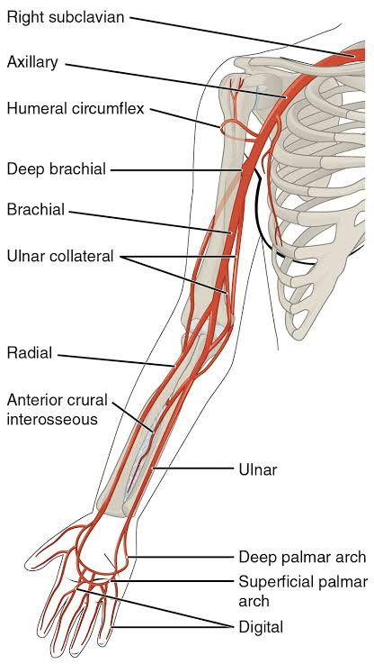
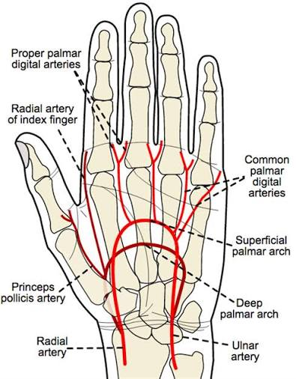
Blood supply to the Upper limbs

Slide 30
The hand
The hand is a musculoskeletal region
It consists of 8 carpal bones, 5 metacarpals and 14 phalanges, as well muscles and tendons
Muscles: extrinsic and intrinsic groups
The extrinsic groups arise from both medial (flexors) and lateral (extensors) epicondyles
They cross the wrist through the carpal tunnel deep to the flexor retinaculum
The Intrinsic groups:
Thenar group: Form the base of the thumb (abductor pollicis brevis, flexor pollicis brevis, opponens pollicis)
Hypothenar group: Form the base of the little finger (abductor, flexor, and opponens digiti minimi)
Midpalmar group: Includes the lumbricals and interossei (dorsal and palmar)

Slide 31
Hand compartments and spaces
The palm and hand are divided by deep fascial septa into primary spaces housing specific muscles, nerves, and vessels
Thenar compartment:
Base of thumb
Contents: Abductor pollicis brevis, opponens pollicis, flexor pollicis brevis, and branches of the median nerve
Hypothenar compartment:
Base of little finger
Contents: Abductor digiti minimi, flexor digiti minimi brevis, opponens digiti minimi, and branches of the ulnar nerve
Adductor compartment:
deep in the central palm
Contents: Adductor pollicis muscle

Slide 32
Hand compartments and spaces
Central (Midpalmar) Compartment:
middle of the palm
Contents: Long flexor tendons, lumbrical muscles, superficial/deep palmar arterial arches, and portions of the median and ulnar nerves
Interossei and Other Spaces:
Includes dorsal and volar (palmar) interossei compartments between the metacarpal bones
And spaces like the carpal tunnel and digit compartments

Slide 33
Hand compartments and spaces
The hand spaces are potential anatomical spaces within the hand
Formed by septa and deep fascia penetration into the hand
They are filled with loose connective tissues and are thus tightly closed
They are important clinically in localizing infections and pus discharge
Deep palmar spaces:
Midpalmar
Thenar
Hypothenar
Forearm space of Parona
Digital spaces:
Pulp space of the fingers
Interdigital or web spaces

Slide 34
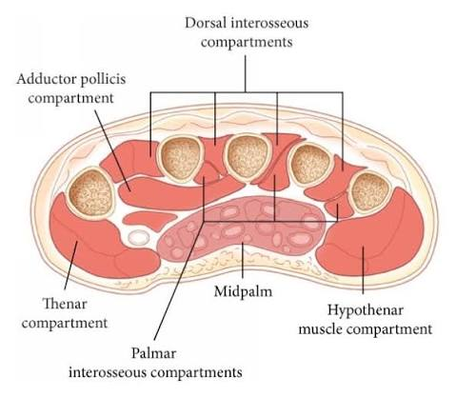
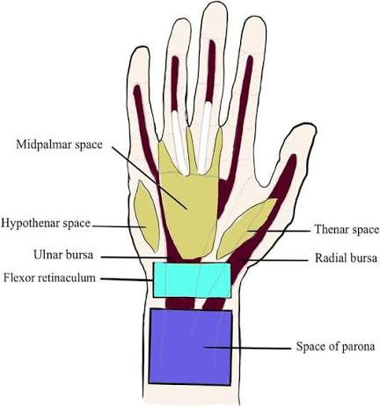
Hand compartments and spaces
Dorsal spaces:
Dorsal Subcutaneous Space
Dorsal Subaponeurotic Space

