Slide 1

DETECTION AND INTERVENTION SIMULATION FOR POSTPARTUM DEPRESSION RISK
Integrating Sentence-Level Emotion Modeling with Causal Analysis of Online Narratives
-Deepali Dange(AIHC)
Panopto Video Link: https://utexas.hosted.panopto.com/Panopto/Pages/Viewer.aspx?id=92aca50d-56ac-4e31-adc5-b33400381f5d
GitHub code link: https://github.com/WisdomWizard99/HRProject/blob/main/HRP_code.ipynb

Slide 2
Introduction
Postpartum depression (PPD) is a critical maternal mental health crisis, affecting ~1 in 7 new mothers within the first year after childbirth.
Severe consequences: Increased risk of self-harm, impaired infant development, disrupted family stability, and long-term mental health disorders.
Alarming gap: Up to 50% of cases go undiagnosed, often due to stigma, fear of judgment, and difficulty articulating emotional pain.
Why it matters now: Online forums (e.g., Reddit) reveal raw, unfiltered emotional struggles in real time, offering a window for earlier detection before escalation to crisis.
Our goal: Transform these unstructured narratives into actionable early-warning signals through emotion trajectory modeling and causal analysis.

Slide 3
Methodology - Workflow
Data Extraction &Preprocessing
Emotion Trajectory Extraction
Trajectory Labeling
Rule based Risk Prediction
Causal Inference
Data extracted from Public Reddit posts from postpartum communities
Preprocessing: Sentence tokenization, stopword removal
Emotion Extraction: NRCLex assigns dominant emotion to each sentence
Trajectory Labeling:
E.g., sad → joy = neg_to_pos
Flat sadness = stable_neg
Risk Prediction:
Rule-based model combines trajectory + keyword indicators
Causal Inference:
CausalForestDML estimates if neg_to_pos shifts reduce high-risk outcomes

Slide 4
Dataset Extraction and PrePROCESSING
Source: Public Reddit posts from postpartum communities.
Nature: Anonymous but genuine accounts of post-pregnancy challenges - ranging from daily stress to severe mental health crisis
Language: A rich mix of formal and informal, with community specific jargon, acronyms, slangs and emotional intensity.
Annotations:
Trajectory:
neg_to_pos → Emotional recovery arc
pos_to_neg → Emotional decline
stable_neg → Persistent distress
stable_pos → Sustained positivity
Risk Label:
0 → Low risk
1 → Moderate risk
2 → High risk

Slide 5
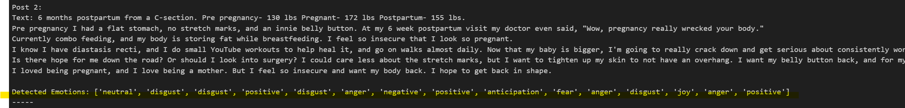
Emotion Trajectory Extraction
Emotion Detection Tool: NRCLex (8 core emotions + polarity)
Per Sentence Analysis:
Tokenize → Score → Identify dominant emotion
Trajectory: Sequence of dominant emotions
Valence Scoring: joy = +2, sadness = -2, etc.
Output: Emotional timeline per post

Slide 6
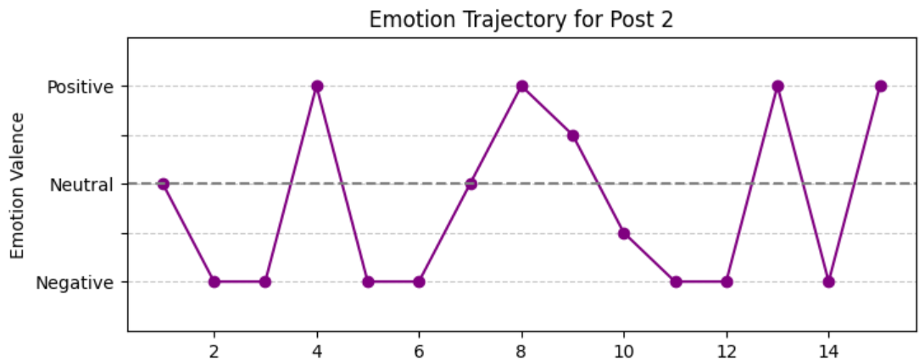
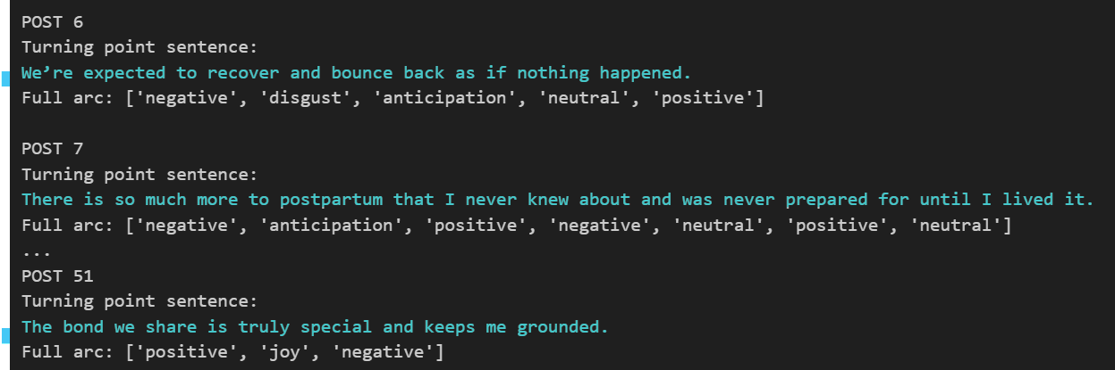
Trajectory Classification
Trajectory Types:
neg_to_pos
pos_to_neg
stable_neg
stable_pos
Evaluation:
Confusion matrix vs manual annotations
Precision, recall, agreement rate
Emotion Arc Plot:
Visualizes sentence-level emotional valence across a post
X-axis: Sentence number; Y-axis: valence from negative to positive
Turning Points:
Detect emotional reappraisal moments

Slide 7
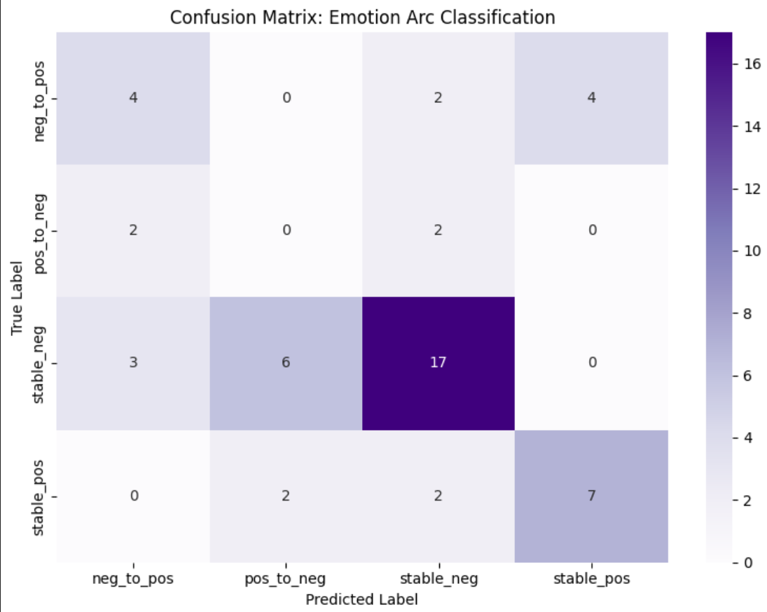
Evaluating Emotion Arc Classification
Classify emotional arcs of posts using valence mapping of NRC emotions.
Approach:
Map each sentence’s emotion to a valence score.
Classify each post into one of four arc types:
neg_to_pos, pos_to_neg, stable_neg, stable_pos
Overall Accuracy - 55%
Label | Precision | Recall | F1-score | Support
neg_to_pos | 0.44 | 0.40 | 0.42 | 10
pos_to_neg | 0.00 | 0.00 | 0.00 | 4
stable_neg | 0.74 | 0.65 | 0.69 | 26
stable_pos | 0.64 | 0.64 | 0.64 | 11

Slide 8
Rule-Based Risk Prediction
Inputs for Risk Scoring:
Emotional trajectory type
High-risk keywords (e.g., “hopeless,” “suicide”)
Risk Levels:
2 = High risk
1 = Moderate risk
0 = Low risk
Output: Explainable and actionable risk labels
Post Excerpt | Trajectory | Keywords | Risk Score
“I feel numb every day. I’ve thought of ending it.” | stable_neg | suicide, numb | 2 (High)
“I’m anxious but hopeful about tomorrow.” | neg_to_pos | anxious, hopeful | 1 (Moderate)
“Just tired. But overall, I’m okay.” | stable_pos | tired | 0 (Low)

Slide 9
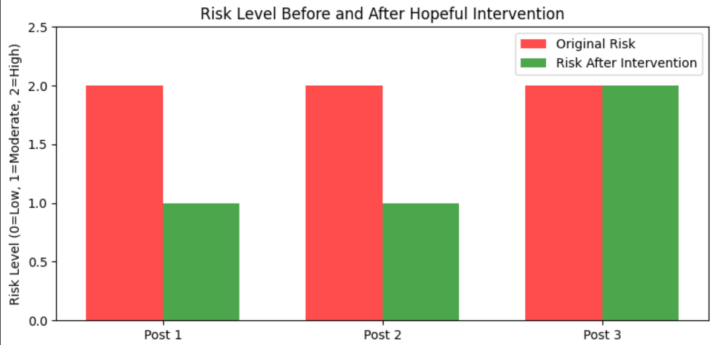
Intervention Simulation
Goal: Test if hopeful language reduces risk
Method:
Add cognitive reappraisal statement to post
Re-evaluate risk score
Example Additions:
“I know this will pass.”
“I’m learning to cope.”
Metric: Change in predicted risk score
E.g. Original Ending of a post: “I cry every night and I don’t think I’m a good mom.” Original Risk: 2 (High)
Modified Ending with hopeful sentence: “I cry every night and I don’t think I’m a good mom. But I know I’m trying my best, and I have people who love me. I’ll talk to my doctor.” New Risk: 1 (Moderate)

Slide 10
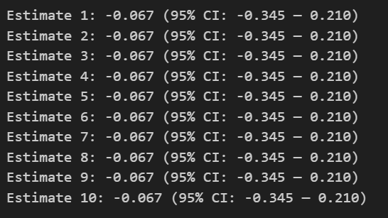
Causal Analysis
Method: CausalForestDML (from econml)
Treatment: neg_to_pos trajectory
Outcome: High-risk classification
Covariates: Emotion counts (NRC categories)
Average Treatment Effect (ATE): –0.067 → Small but uncertain reduction in risk → 95% CI: [–0.345, 0.210]
Boxplot analysis: → Higher benefit variability observed in stable_neg and neg_to_pos groups
Top Emotion Drivers (Feature Importance): → Sadness (–), Trust (+), Fear (–), Joy (+)
Example: User A → Predicted risk before shift: 1.6 → After shift: 1.2

Slide 11
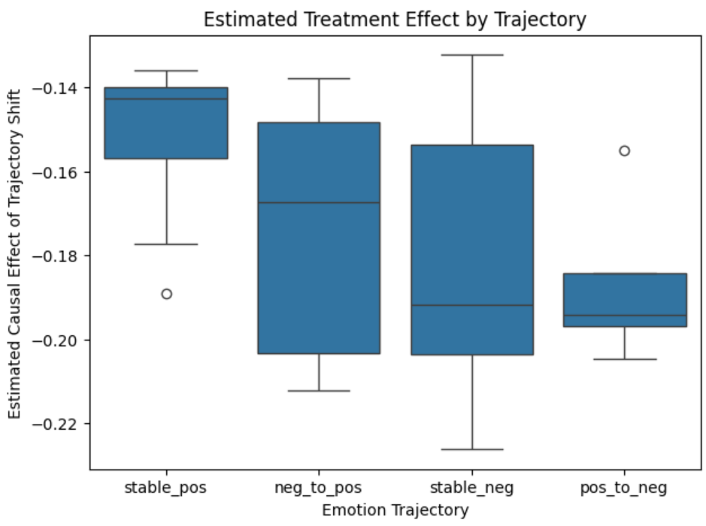
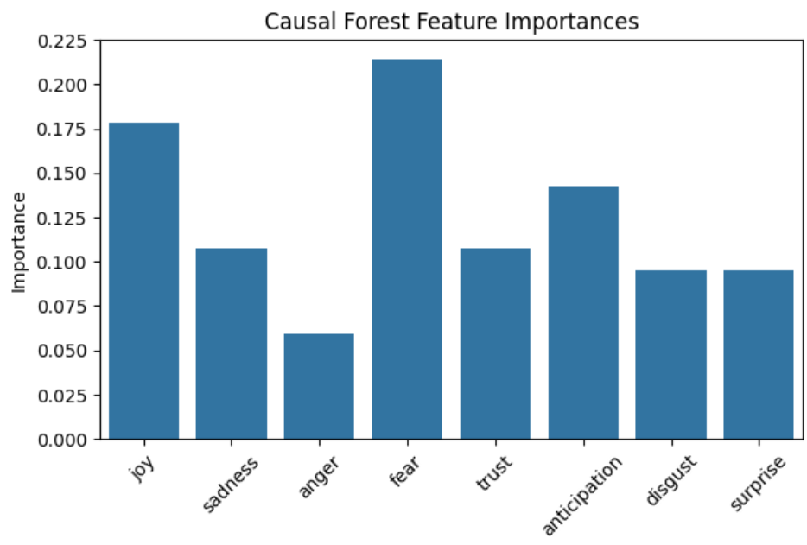
Visualizing Causal Effects and Emotion Drivers
Estimated Treatment Effects by Trajectory
Feature Importance from Causal Forest
Boxplot for comparing the distribution of causal effect estimates across emotion trajectories -
Shows how neg_to_pos, pos_to_neg, and stable categories differ in terms of impact on risk
Highlights that shifting from negative to positive has the most favorable causal impact
Bar plot of which emotions most strongly influence the model’s treatment effect estimation
Top influencers: sadness, trust, fear
These drive the magnitude and direction of predicted risk changes

Slide 12
Results
The risk model effectively flagged high-risk posts with stable negative emotions and crisis keywords.
Hopeful reframing lowered risk scores in some posts, supporting cognitive behavioral therapy ideas.
Posts with explicit suicidal language remained high risk, ensuring safety.
Emotion arc classifier achieved 55% accuracy; stable emotions were easier to detect than emotional shifts.
Key positive emotional shifts (“turning points”) appeared mid-post, offering intervention opportunities.
Causal analysis found a small, uncertain risk reduction from shifting emotions toward positivity, driven mainly by sadness, joy, and fear.

Slide 13

CONCLUSION
Sentence-level emotion trajectories combined with rule-based keyword models show strong potential for early detection of postpartum depression risk.
Emotion arcs provide an interpretable view of emotional patterns and moderately align with human annotations.
The system effectively identifies high-risk posts, particularly those with persistent negativity or explicit distress.
Simulated shifts toward positive language can lower predicted risk, emphasizing the role of emotional tone in screening.
Incorporating causal inference enables personalized insights, helping target individuals who benefit most from emotional improvement.

Slide 14
LIMITATIONS
Lexicon-Based Emotion Detection:
NRCLex is lightweight and interpretable, but not robust to : Informal language, sarcasm, idioms, metophors.
It leads to misclassification or oversimplification of nuanced posts.
Emotion Arc Classifier Performance
Struggles with dynamic arcs: neg_to_pos and pos_to_neg, though perform better on stable arcs: stable_pos and stable_neg.
Sensitive to short, ambiguous, and mixed tones
Simplicity of Rule-Based Risk Model
Relies on fixed keywords(e.g “suicidal”) and arc types.
Tranparent but rigid- fails to account for conflicting emotional signals.
Causal Inference Sensitivity Causal Forest Model is vulnerable to – data sparsity, treatment imbalance, unobserved confounders and Interpretability is limited, especially in small and noisy data.

Slide 15
ThANK-YOU

Slide 16
Future work
1. Context-Aware Emotion Detection
Replace lexicon-based methods with transformers (e.g., MentalRoBERTa)
Capture nuanced, sarcastic, and context-sensitive emotional language
2. Neural Modeling of Emotion Arcs
Move beyond rule-based arcs
Use RNNs, GRUs, or Transformers to learn dynamic emotion patterns (e.g., escalation, recovery)
3. Smarter Risk Prediction
Upgrade from rigid rules to learned models combining arcs, keywords, and embeddings
Better handle conflicting signals (e.g., hope vs. harm)
4. Longitudinal & Personalized Analysis
Track multiple posts over time per user
Use personalized baselines to detect emotional shifts more accurately
5. Larger & Clinically Validated Datasets
Expand to larger, diverse datasets
Include clinical or crowd-sourced labels for better generalization
6. Human Oversight & Ethics
Integrate human-in-the-loop for critical posts
Ensure privacy, consent, and ethical safeguards in deployment

