Slide 1
Understanding
MVC
Model :: View :: Controller
WiseMan CAx™ - Computer Aided eXchange (All purpose) system
A PacketCode production

Slide 2
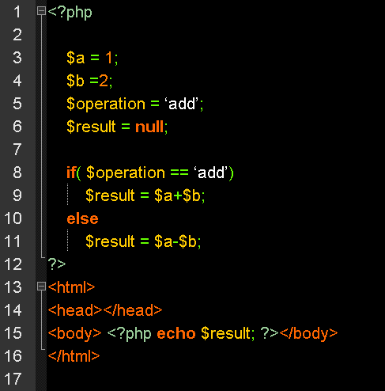
File : Index.php
Basic
Setup
If control
structure
Html
Display

Slide 3
MODEL
MVC - FRAMEWORK
CONTROLLER
Browser Request
VIEW

Slide 4
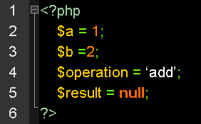
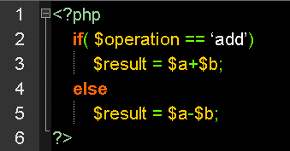
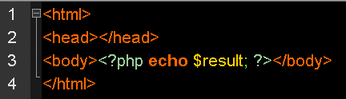
Index.php
Setup.php
control.php
Display.php
db.php

Slide 5
Index.php
Setup.php
controller.php
View.php
Model.php

