Slide 1

Elevator pitch
.

Slide 2
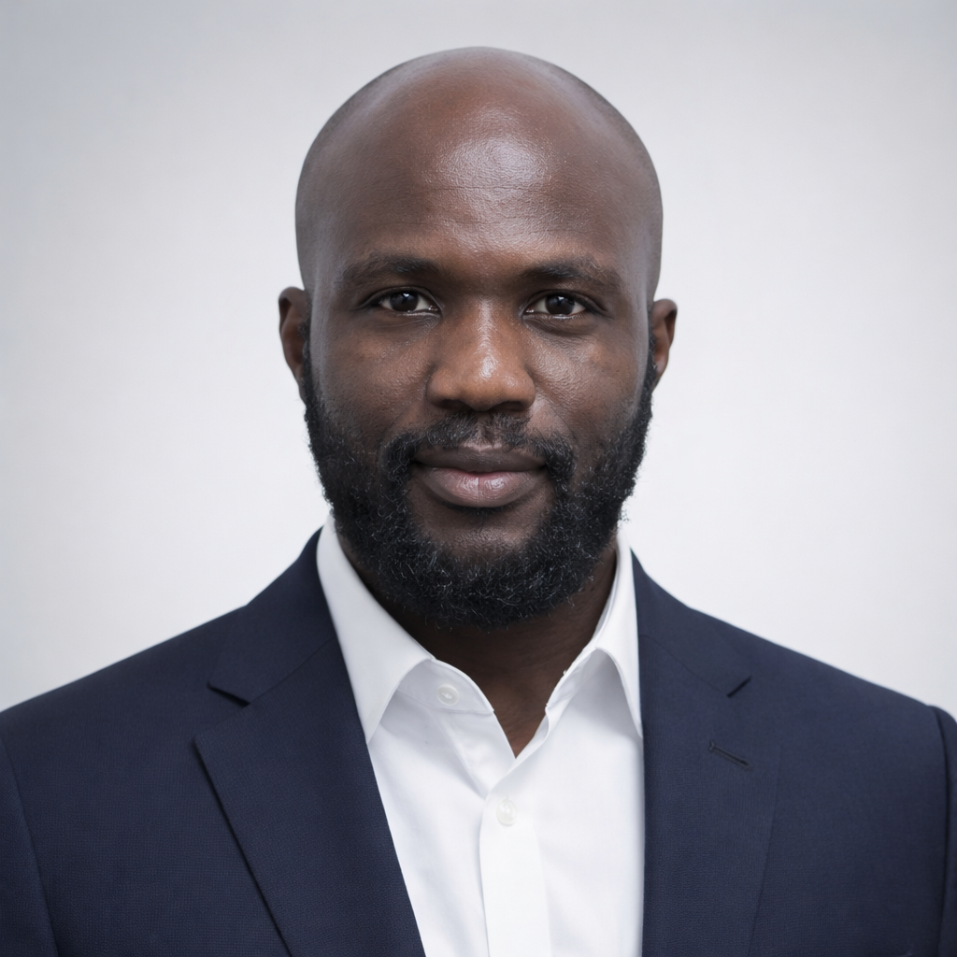
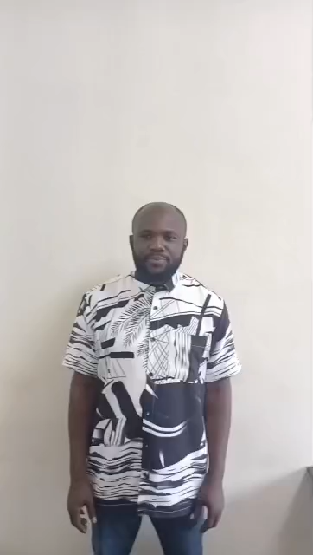
ELEVATOR PITCH
I’m David Addo with degree in Strategic Communication and currently pursuing an MSc in Risk Management and Insurance. With 5 years experience as a claim assessor and service consultant at aYo Ghana, I have developed skills in risk assessment, customer relations, and process optimization. My goal is to help build resilient, customer‑centric insurance systems through effective risk management and compliance.

