Slide 1
User Database With Arrays
Presented by:
Fhulufhelani Mudumela
Date: 10/10/2023

Slide 2
Agenda
01
Problem Statement
Solution
Other Options
Decisions
Conclusion

Slide 3
Problem Statement
02
The user wants a program that can allow the user to input their data and their data gets saved in the database.

Slide 4
03
Solution
Develop a program that will prompt their user for their details and store them in an in-memory array. The program should also calculate users age and store in the database.

Slide 5
Other Options
I added the email validation class, and the calculator class calculates year based on the year we are currently in.

Slide 6
05
Decisions
Using the modularity method helped a lot to divide our code into particles or parts so that our class logic

Slide 7

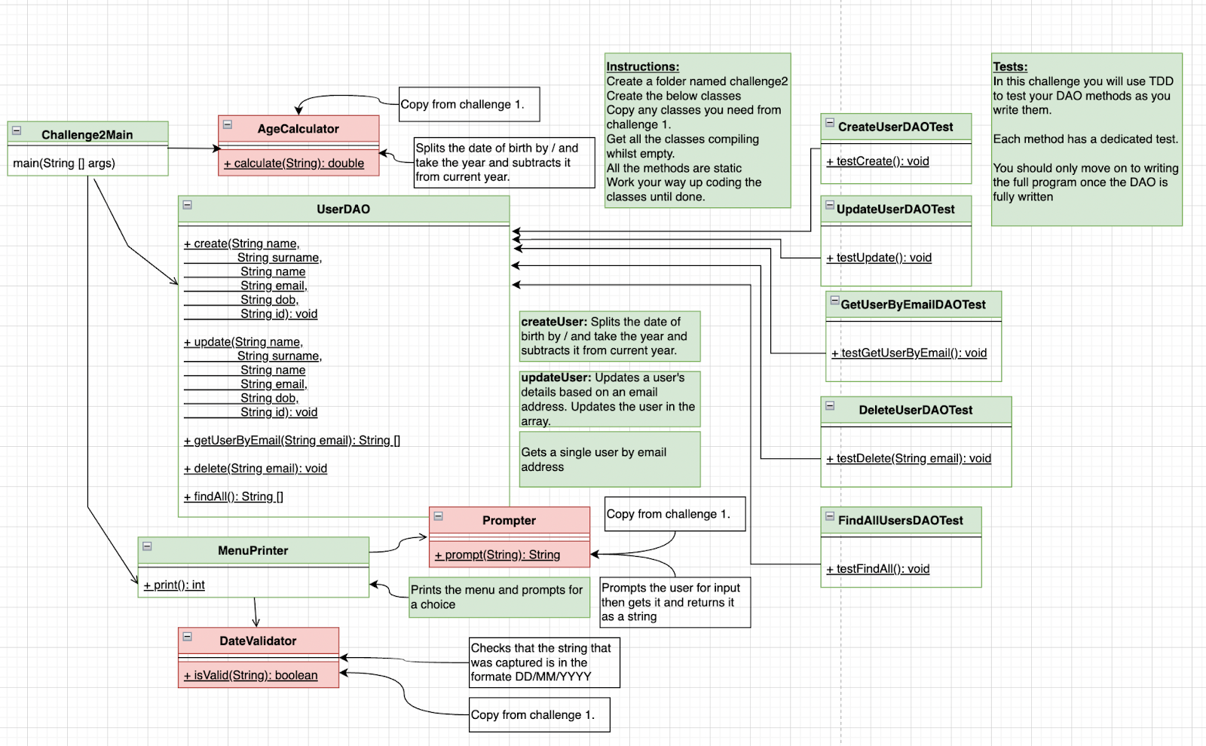
07

Slide 8
Summary
07
This program has been designed to allow the user to input their data in the database. It has been designed in a way that it would be easy for the user to walk through the program

Slide 9

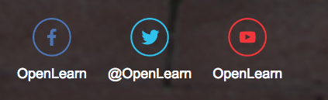

Follow us on these platforms for more :

