Slide 1
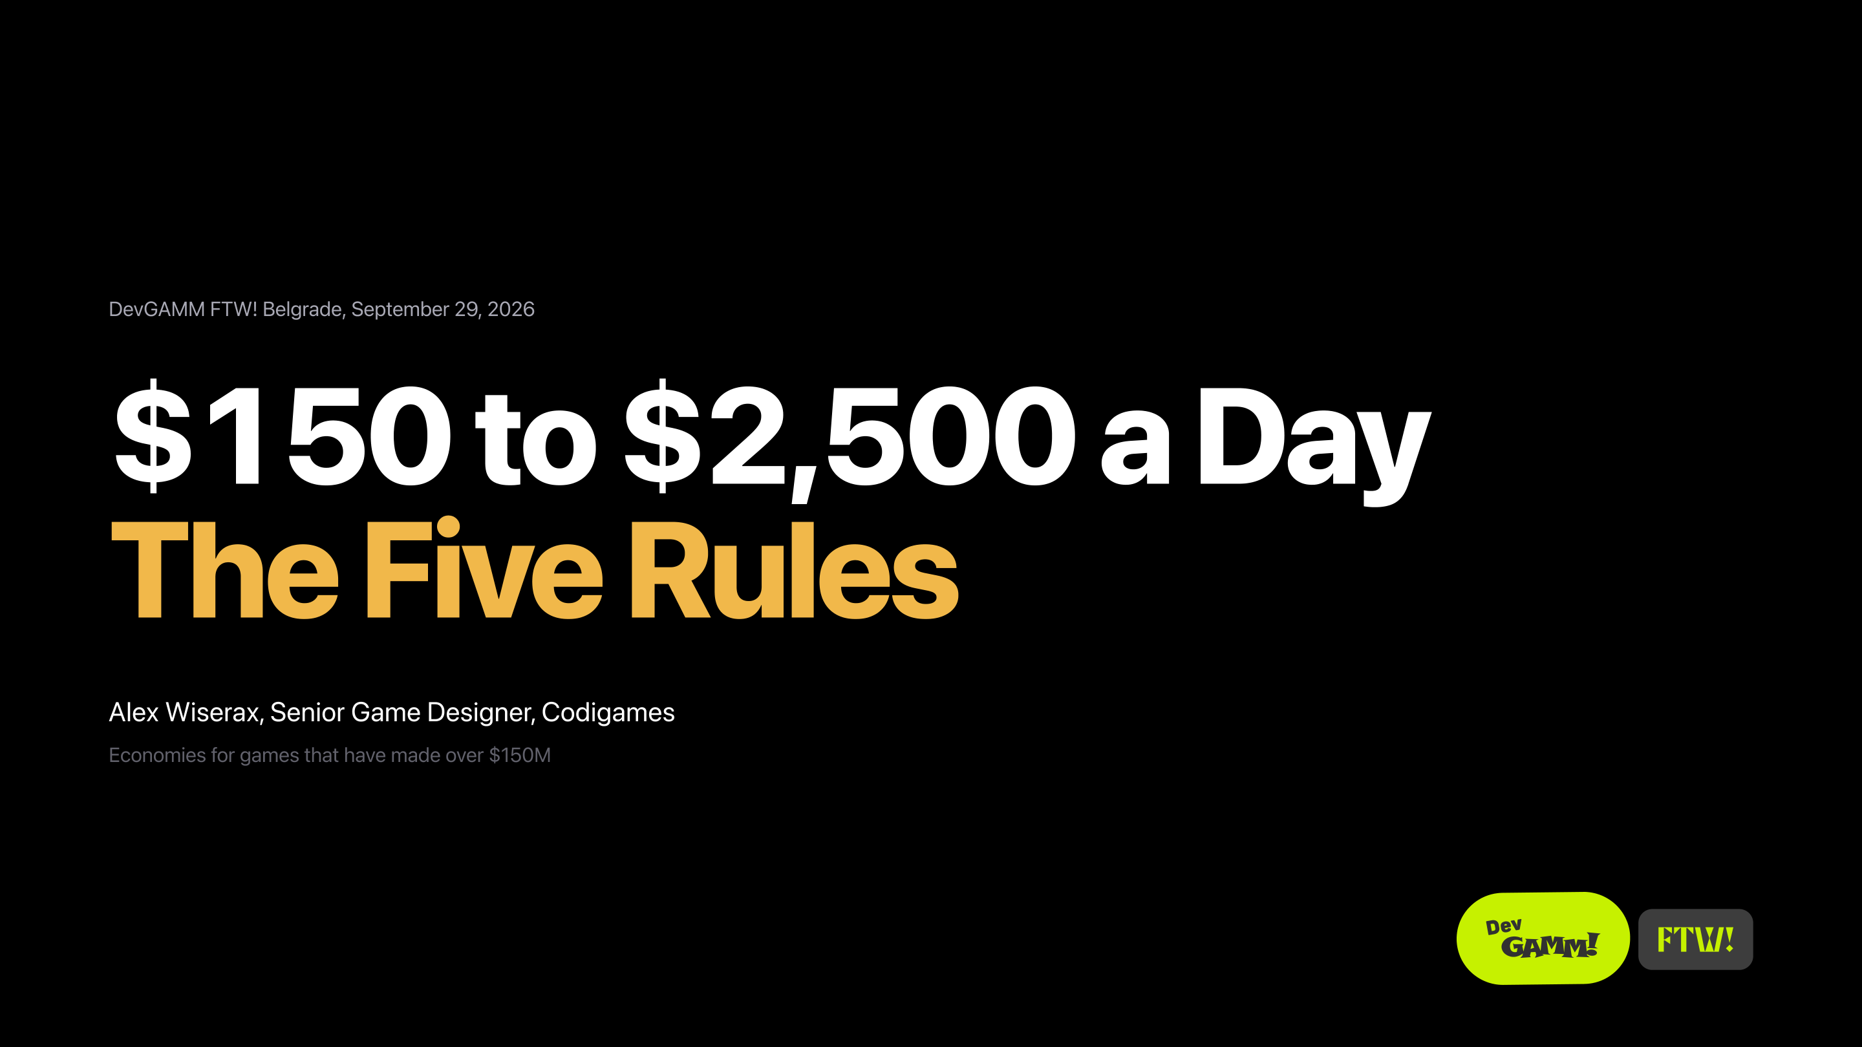
Notes:
Slide 1
[Say nothing. The MC introduces you. Let the slide sit, then go.]

Slide 2
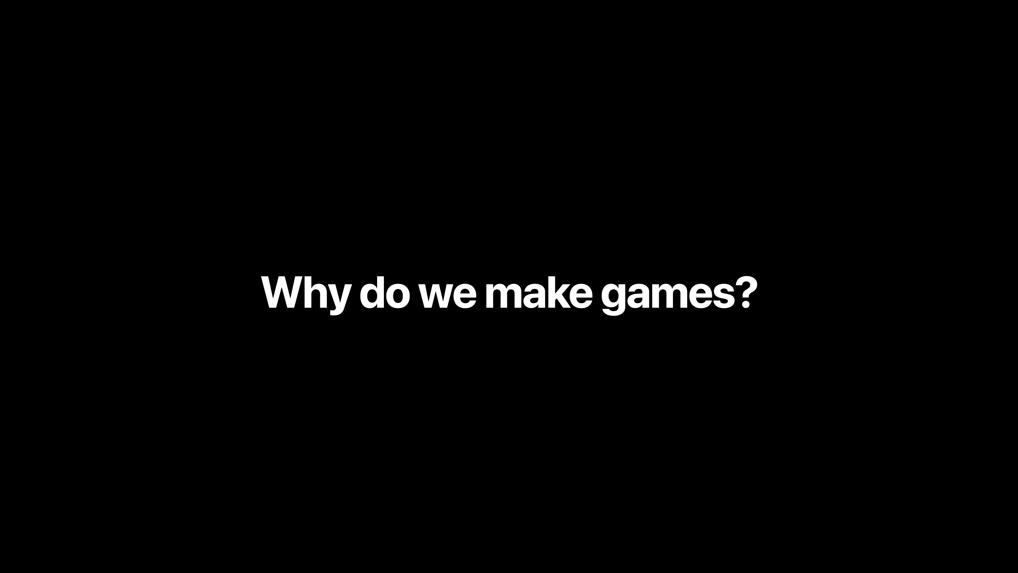
Notes:
Slide 2, build 1 of 2
Let me start with a question, and I really want you to answer it. Why do we make games? Just shout it out.
[Three or four answers. Repeat each one back. Remember two of them, you need them at the very end. Hard cap 60 seconds. Cold room: "OK, I will start. Art. Money. And because we cannot do anything else."]

Slide 3
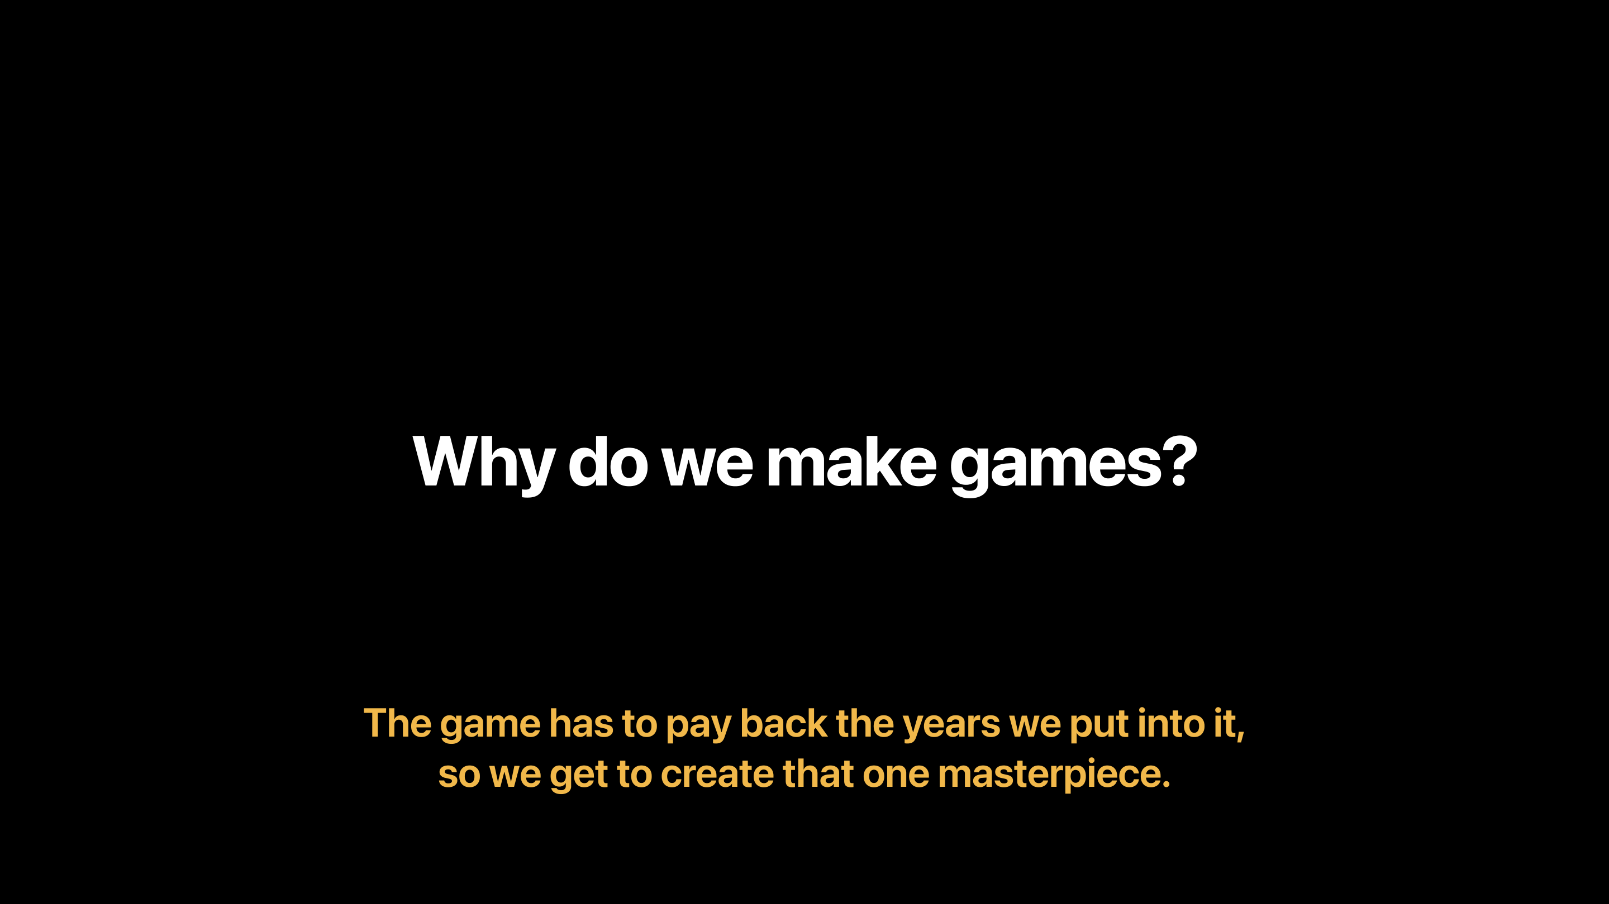
Notes:
Slide 2, build 2 of 2
All of that is true. But there is one more thing, and nobody likes to say it out loud. The game has to pay back the years we put into it. If it does not, we never get to make the next one, and the next one might be our masterpiece. That is why I care about game economy. Let me show you what it can do.

Slide 4
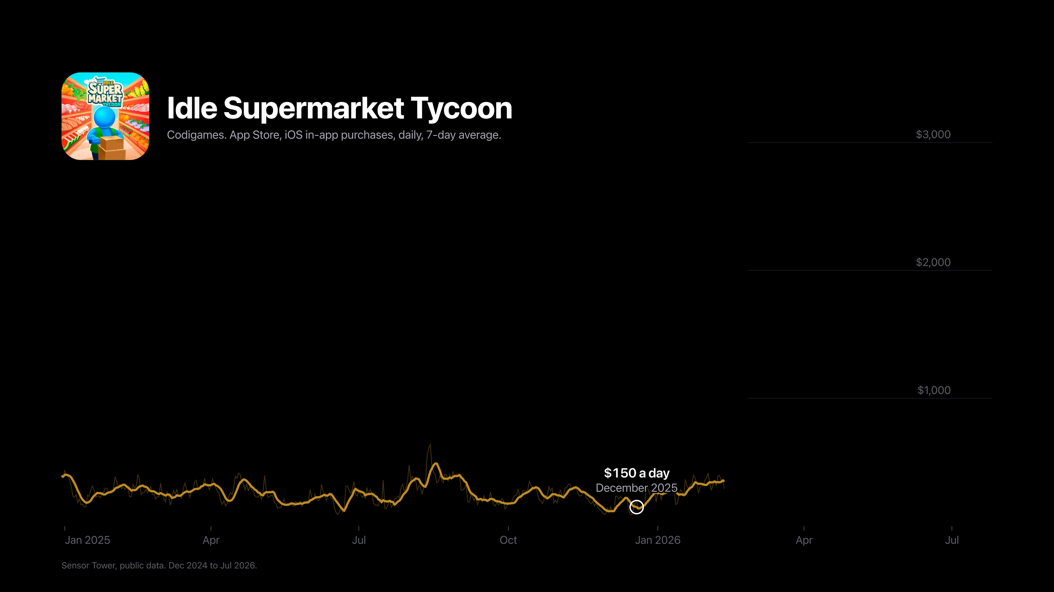
Notes:
Slide 3, build 1 of 2
At the start of this year I was handed an old idle supermarket game. The game was dead. Nobody was working on it, and it lived on pure organic traffic. And I came to it after a whole year on another project, where most of my experiments had failed. So I was not feeling like a genius.
I opened the revenue chart, and this is what I saw. A hundred and fifty dollars a day.
[Beat.]
That does not pay for one developer. It does not even pay for me.
So what can one person do with a dead game? Honestly, not much, right?
[Beat.]
Well. I looked closer, and I saw something strange. Players loved this game. They stayed, and they came back. But the game almost never asked them for anything. For an economy designer, that is the best news in the world.

Slide 5
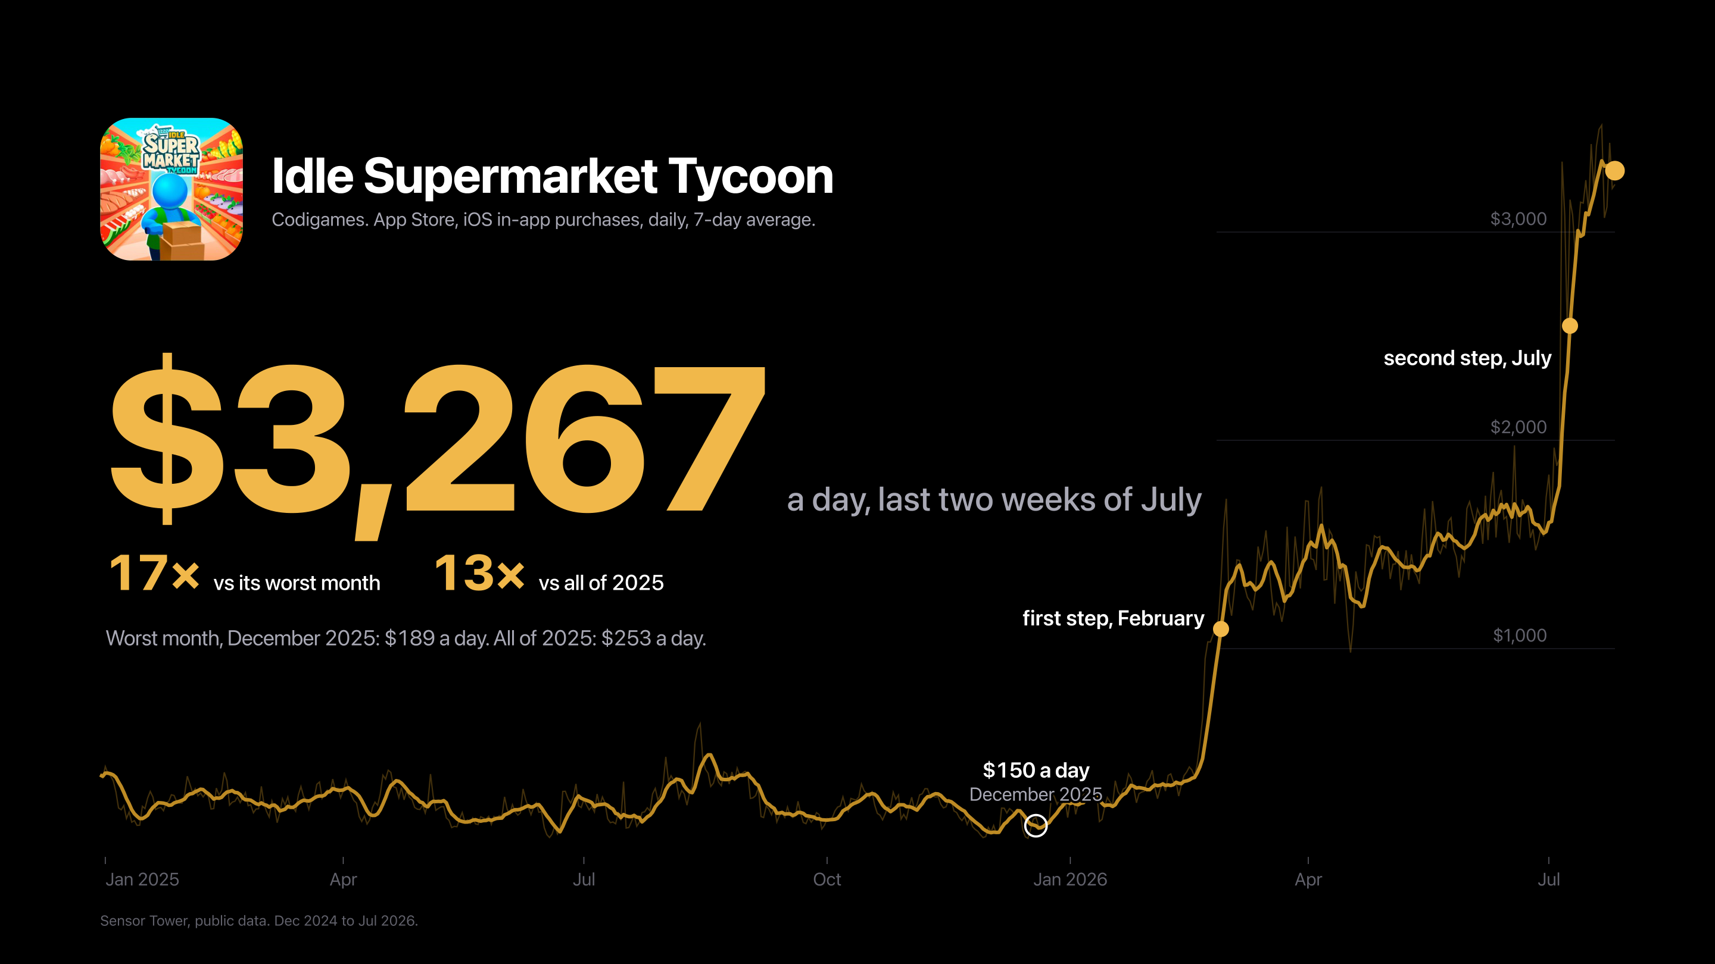
Notes:
Slide 3, build 2 of 2
[The line draws itself to July. Wait until it stops.]
Now look at the end of the line. Late July: three thousand two hundred dollars a day. That is seventeen times its worst month.
I own the whole product there: economy, balance, progression, in-app purchases, ads. And look at the shape. A step in February, four flat months, and another step in July. There was no magic feature. Seven months of work, and two big pushes.

Slide 6
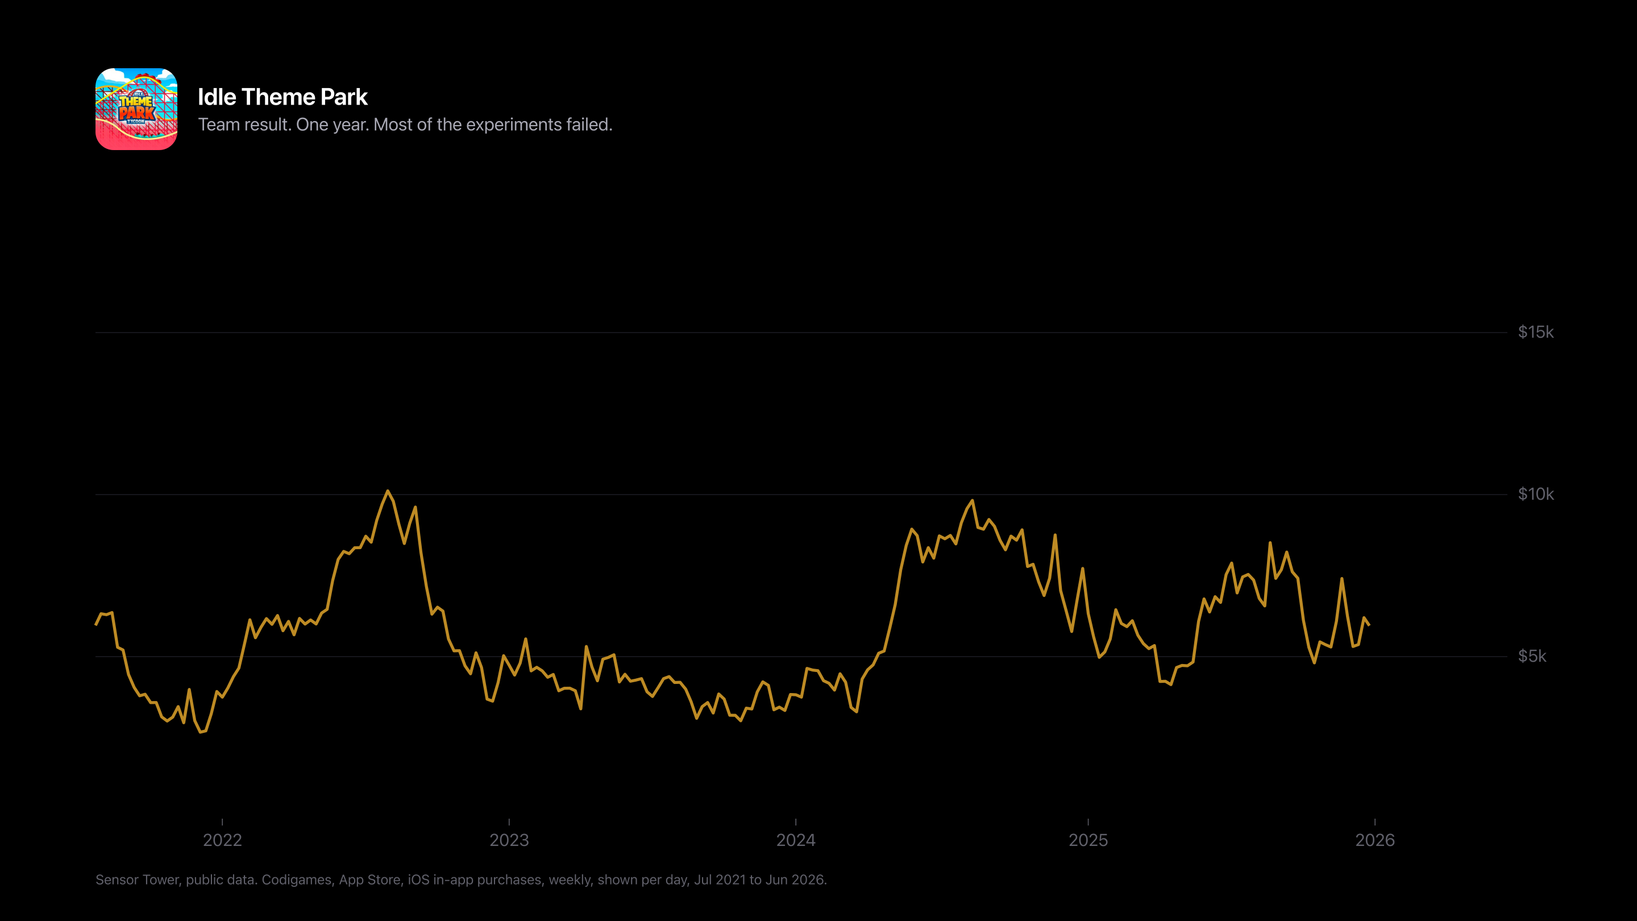
Notes:
Slide 4, build 1 of 3
The second game is that other project, the one with the failed experiments. It is an idle theme park from 2019. Seven years old, and in mobile a game that old is usually slowly dying.
We worked on it for a whole year, and it was a real roller coaster. Which is fine for a theme park, and not so fine for the team. Most of our experiments failed.
[Beat.]
Some of them failed twice.
After a year like that, you start to doubt everything. The game, the numbers, your own rules. I was unsure, as always. And then the rules started working.

Slide 7
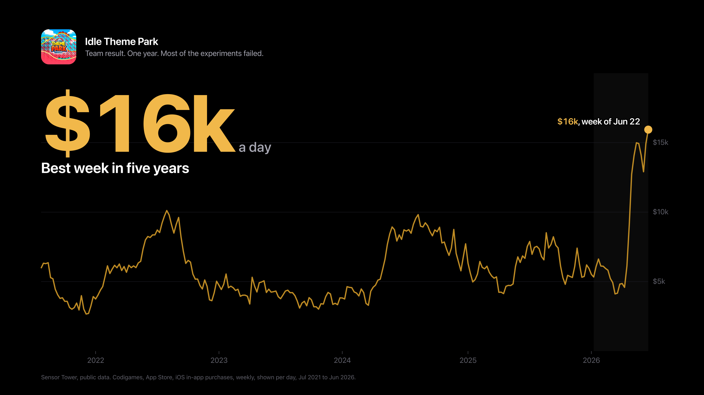
Notes:
Slide 4, build 2 of 3
[The line climbs to June. Wait until it stops.]
And then, this June: sixteen thousand dollars a day. Its best week in five years.

Slide 8
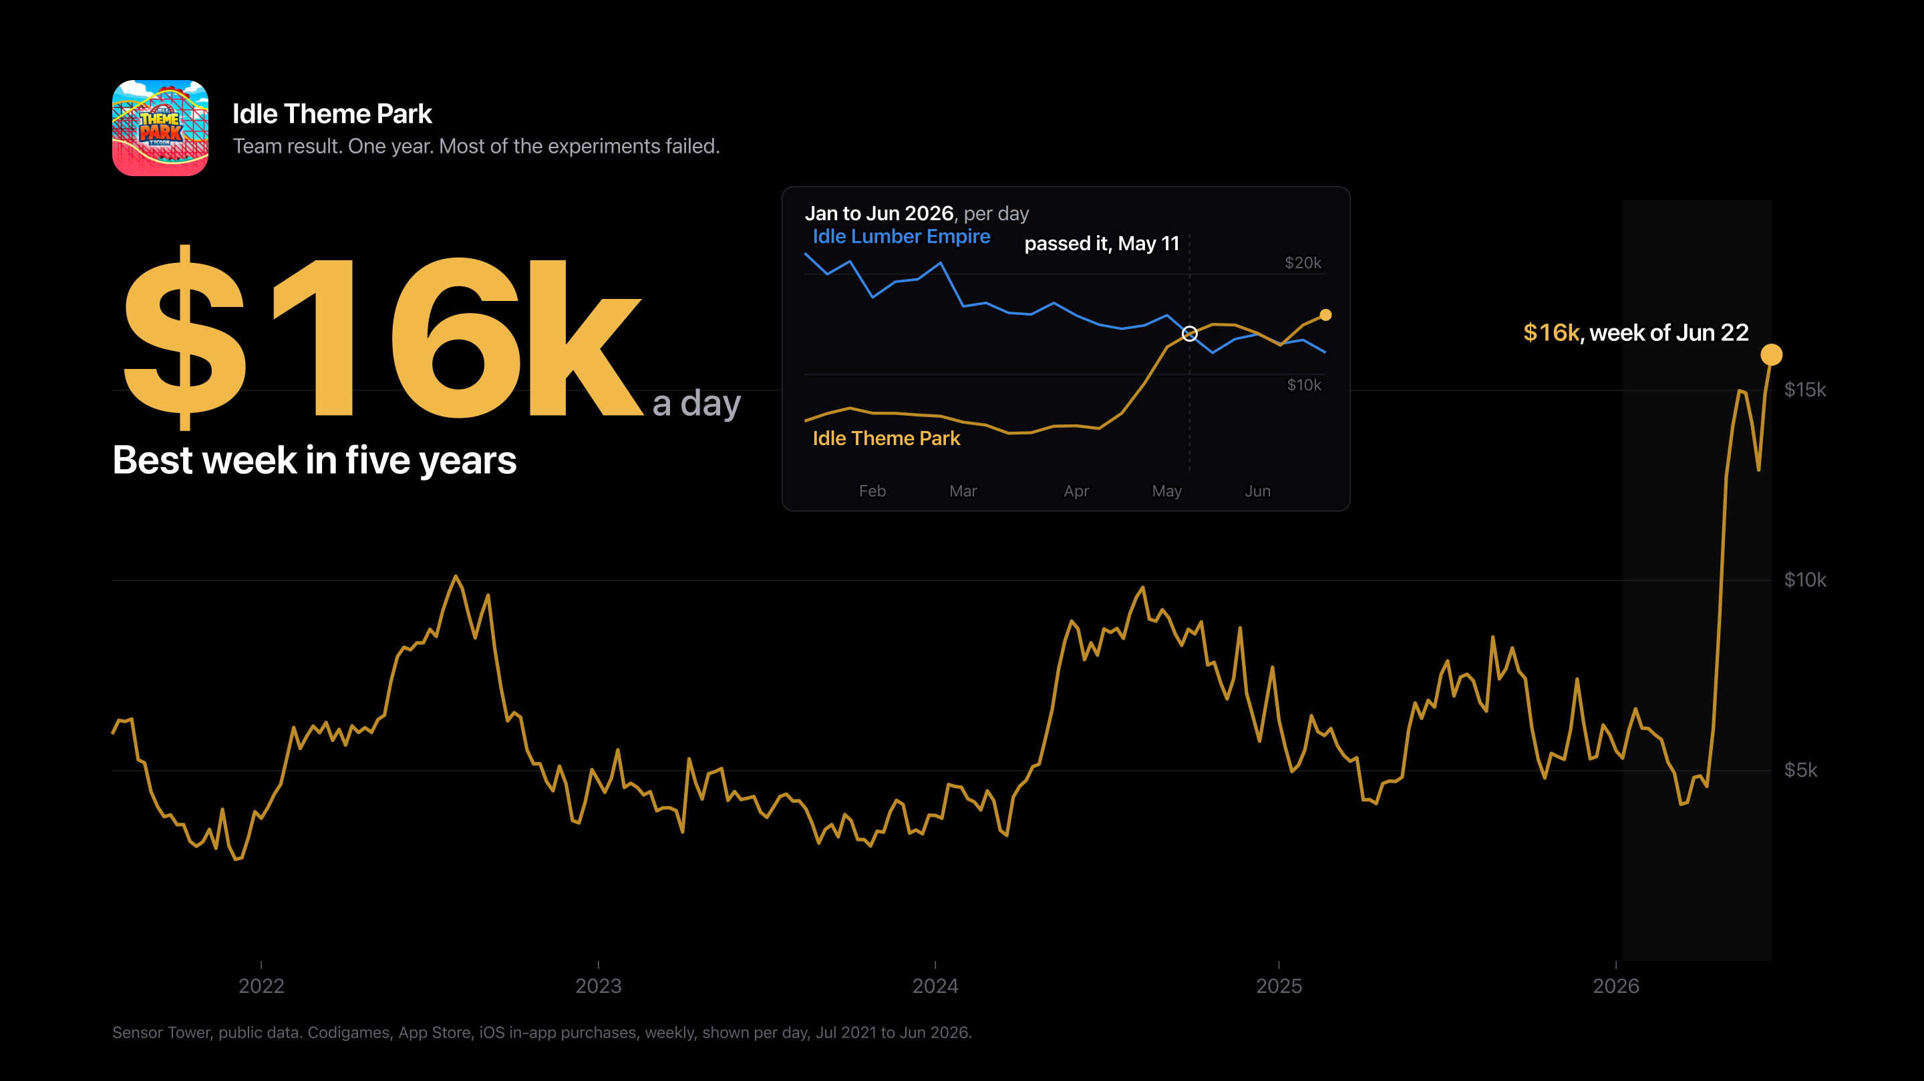
Notes:
Slide 4, build 3 of 3
Now the small chart. The blue line is Idle Lumber Empire, a game that made over a hundred and fifty million dollars. It was my previous project. In May, the theme park passed it.
So this year we beat my own old game. I am still not sure how I feel about that.

Slide 9
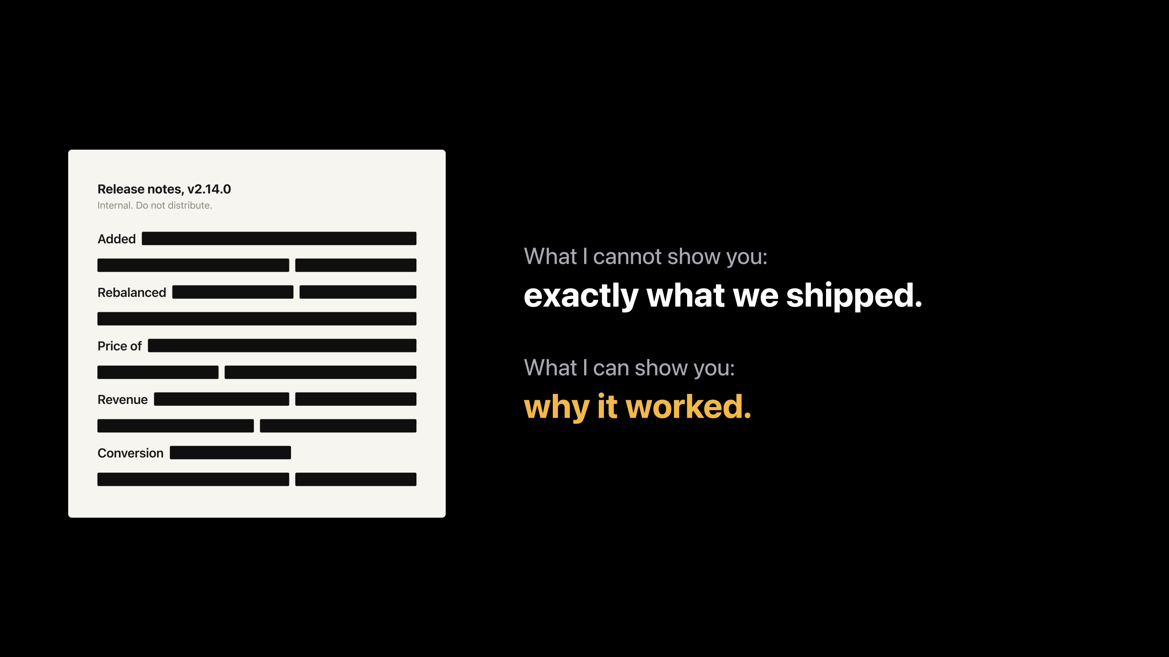
Notes:
Slide 5
Now I have bad news and good news. The bad news: my company does not let me show what exactly we shipped. I asked. Twice. No features, no internal numbers. The charts you saw are public data, and that is the only reason I can show them.
The good news: the features would not help you anyway. What works in a supermarket is not going to work in your shooter.
But the rules behind them will. So let me give you the rules.

Slide 10
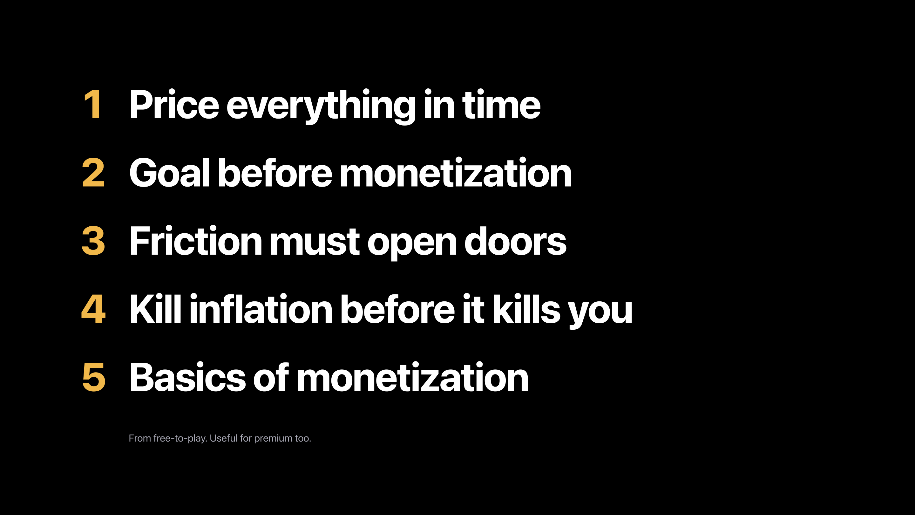
Notes:
Slide 6
Here they are. Five rules. This is the whole talk on one slide, so take a photo now, and then you can relax.
[Wait. Count to five.]
Got it? Good. Technically, you can leave now.
I use these on every game I touch. They come from free-to-play, but even if your game is premium, you will find something useful here.
And if you forget all five by tonight, keep one idea. Players pay you with time long before they pay you with money.

Slide 11
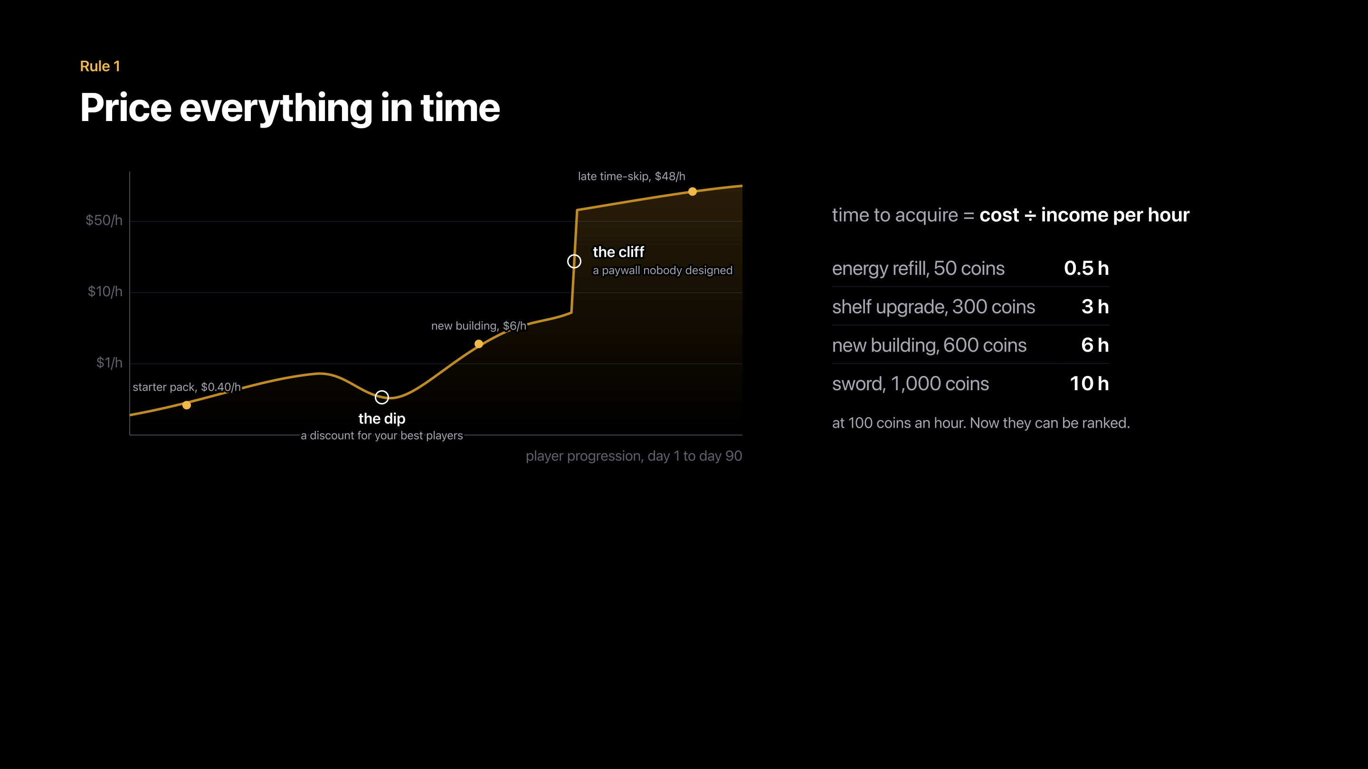
Notes:
Slide 7, build 1 of 2
Rule one. Price everything in time.
Your coins are not real. You made them up. I checked, no bank accepts them. And you can print a million more tomorrow. But the player's time is real, and they never get it back.
So turn every price into hours. How long does a player need to earn it? Let's do one together. A player earns a hundred coins an hour, and a sword costs a thousand. How many hours is the sword?
[Wait for "ten".]
Ten hours. Thank you. Do this for everything, and you get the table on the right. Now you can compare a sword with an energy refill.
Then do the same with real money. How many dollars does your game charge for one hour? Draw that line across the whole game, and you will find two surprises. A dip, where your best players get a discount nobody wanted to give. And a cliff, a paywall that nobody on your team ever planned.

Slide 12
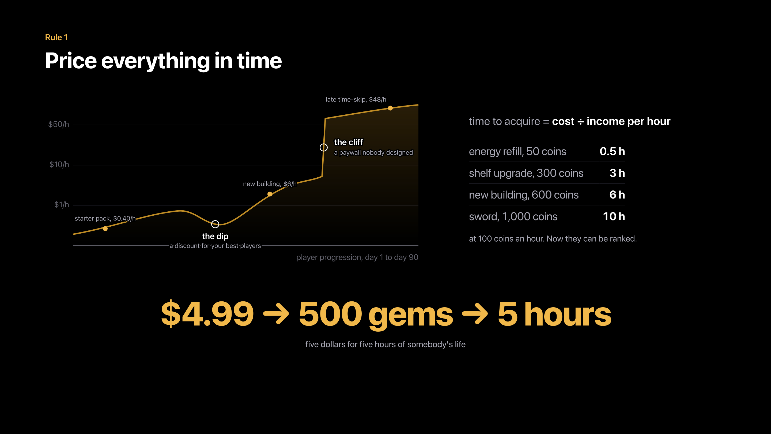
Notes:
Slide 7, build 2 of 2
Four ninety-nine buys five hundred gems, and five hundred gems save five hours. That is five dollars for five hours of somebody's life.
[Pause. Let the three numbers sit.]
Is that a fair price? That is your decision. But you have to know the number.
One warning: price late-game items against the income players will have later, not the income they have today.
You already have this curve in your game. The only question is whether you drew it, or it drew itself.

Slide 13
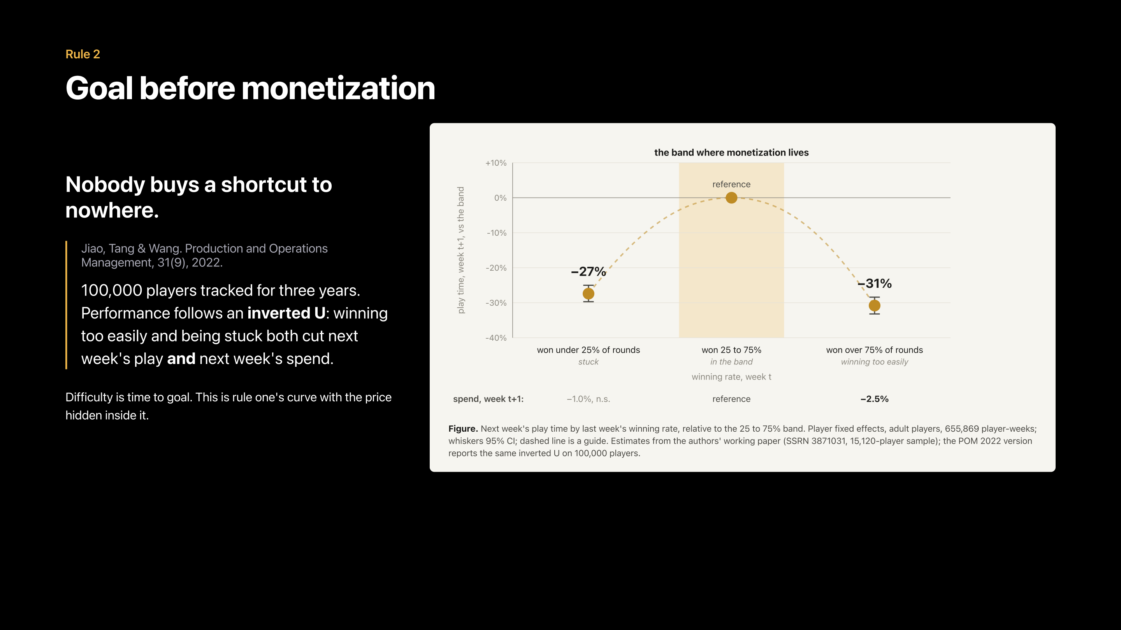
Notes:
Slide 8
Rule two. Goal before monetization.
Hands up, please. Who has ever built a shop that nobody opened?
[Beat. Raise your own hand.]
Me too. And mine looked great.
Here is why it happens. Nobody buys a shortcut to nowhere. Players do not want gems. They want what is at the end of the road, and gems are just a faster way to get there.
And somebody measured this. A study followed a hundred thousand players for three years. Win more than seventy-five percent of your games, and next week you play thirty-one percent less. Win less than twenty-five percent, and you play twenty-seven percent less. Too easy and too hard give the same result: people play less, and they pay less.
Your money lives in the middle, in that gold band.
So design the goal first, and the shop second.

Slide 14
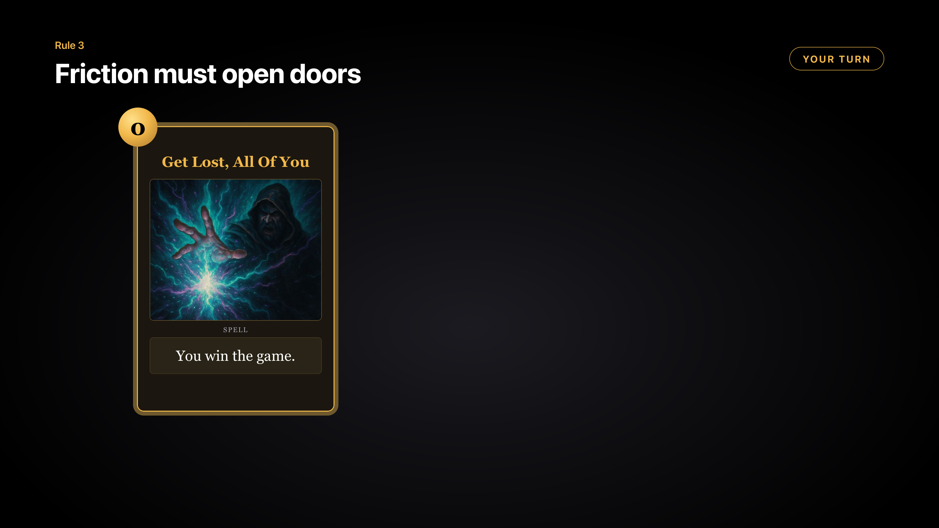
Notes:
Slide 9, build 1 of 3
Rule three. Friction must open doors. And now it is your turn to play.
Imagine a strategy card game. The main resource is mana, and even the weakest card costs at least one mana. Now somebody adds this card. It costs zero. Please read what it does.
[Beat. Let them read "You win the game."]
So what happens to this game? Nobody builds decks any more. There is only one strategy left: draw this card as fast as you can. One card decides everything, so there is no choice. And without a choice, there is no game.

Slide 15
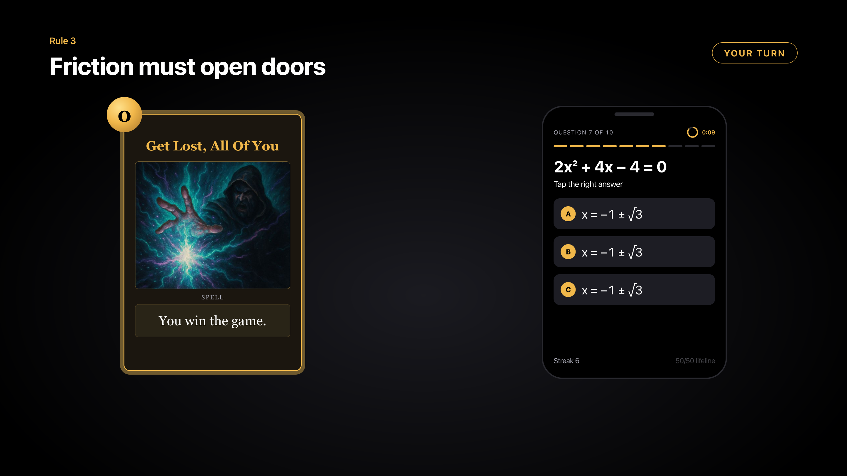
Notes:
Slide 9, build 2 of 3
Now the opposite. A quiz. Please pick the right answer. Take your time. It is a hard one.
[Beat. Someone will say they are all the same.]
Yes, they are all the same. The task can be interesting, but your choice does not matter. So this is not a game either.

Slide 16
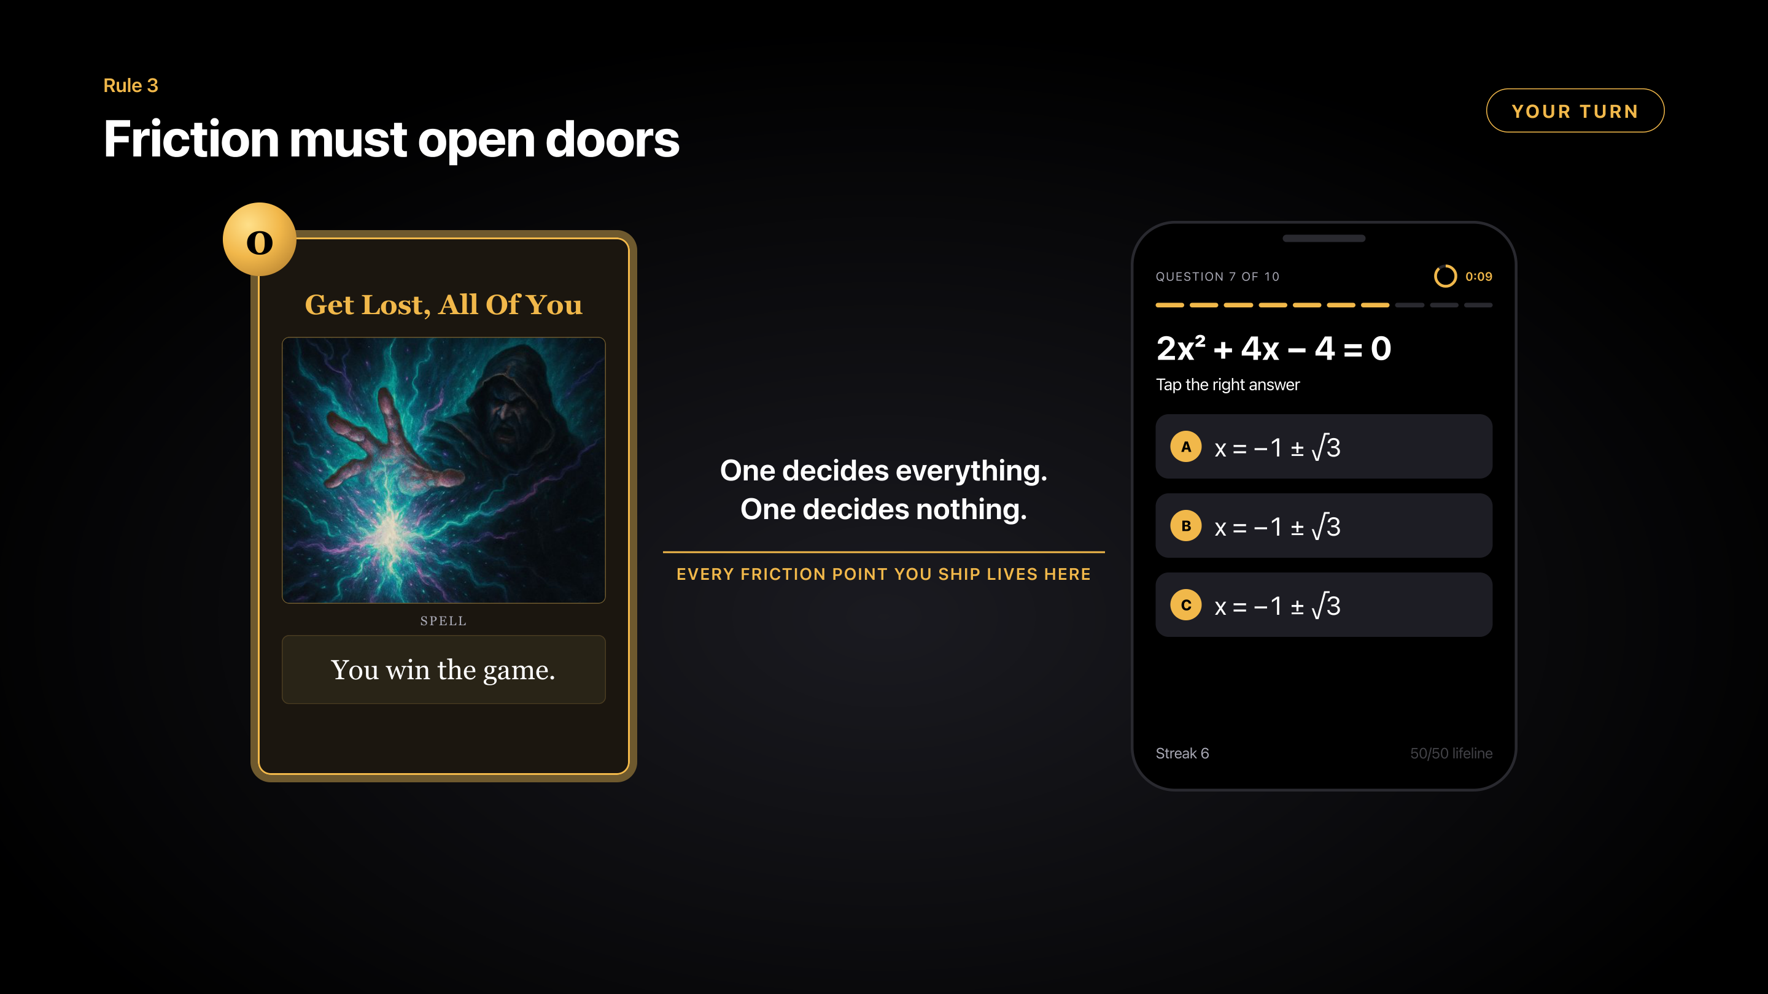
Notes:
Slide 9, build 3 of 3
Every hard moment in your game lives somewhere between these two.

Slide 17
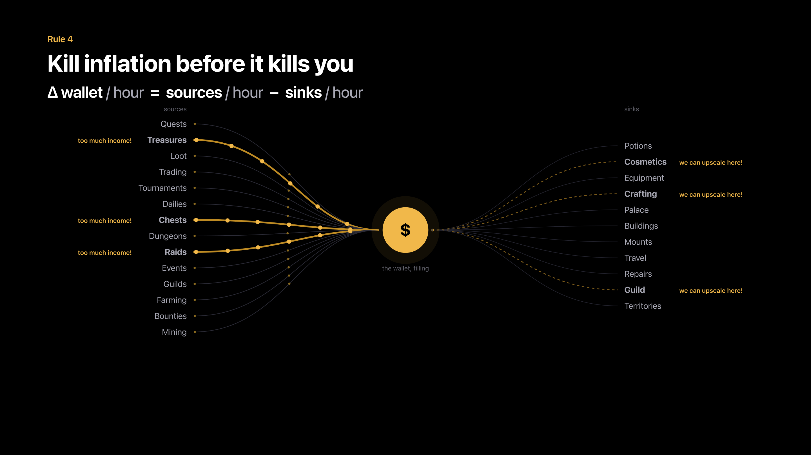
Notes:
Slide 10, build 1 of 2
Rule four. Kill inflation before it kills you.
One more question. Who has played a game where you had so much gold that it meant nothing?
[Beat. Hands.]
I see a lot of rich people here.
For a player, that is boring. For us, it is lost money.
The formula is on the screen: money in, minus money out, per hour.
Look at the picture. On the left, money comes in, and three of them are really pouring. On the right, money should go out, but most of them are dry, because there is nothing good to buy. So the wallet grows, and grows, and grows.

Slide 18
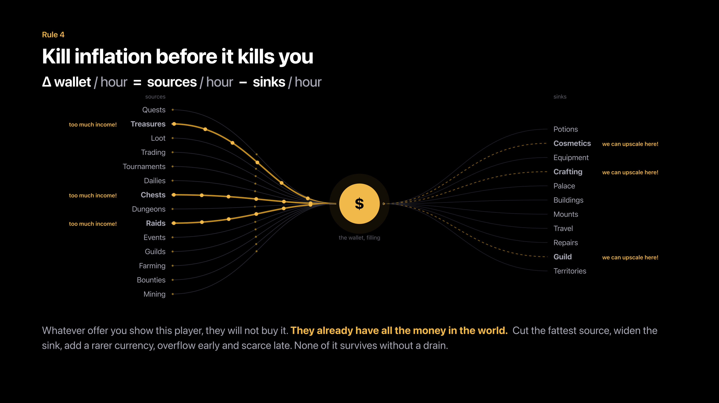
Notes:
Slide 10, build 2 of 2
And here is the cost. Whatever offer you show this player, they will not buy it, because they already have all the money in the world.
Diablo 2 had exactly this problem. Gold could not buy anything useful, so players started to pay each other with a ring, the Stone of Jordan. Then people found a way to copy the ring, it lost its value too, and everybody moved to runes.
So what do you do? Cut the biggest source. Give players better things to spend on. Add a second currency that is hard to get. Or give a lot early and very little late.
But remember the ring. A new currency with nothing to buy dies the same way. Every currency needs a drain.

Slide 19
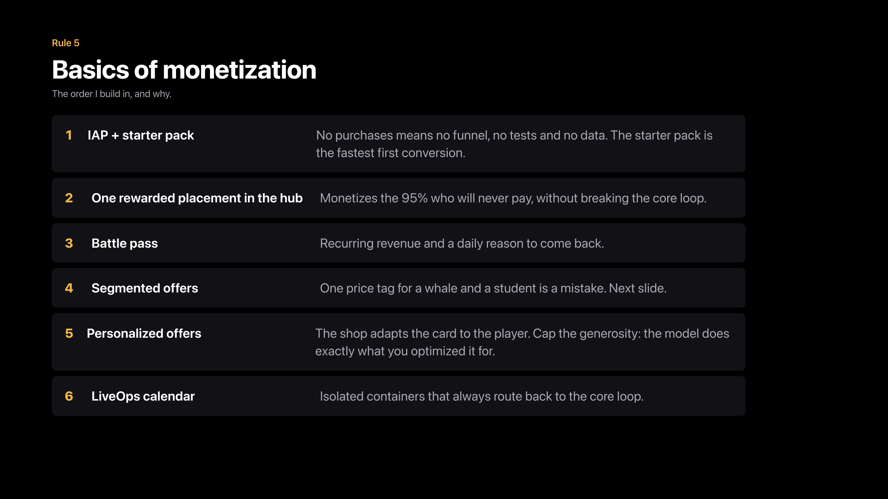
Notes:
Slide 11
Rule five, the basics of monetization. It is the boring rule, and it is also the one that pays the bills.
This is the order I build things in. First, in-app purchases and a starter pack. It is the first time a player says yes to you, and without purchases you have no data. Second, one rewarded ad on the main screen, which earns from the ninety-five percent who will never pay. Third, a battle pass: steady money, and a reason to come back every day.
Then come segmented offers, personalized offers and LiveOps. These three get their own slides.

Slide 20
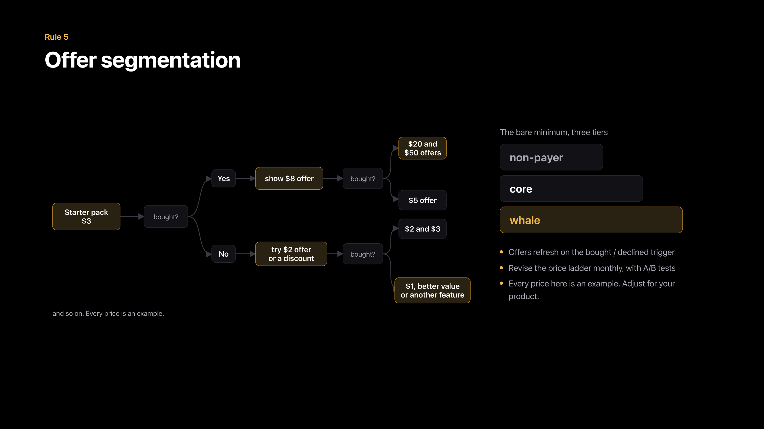
Notes:
Slide 12
Segmentation starts with a simple question. Should a student and a millionaire see the same price? I was the student. I remember. Of course not. And the simplest fix is a tree.
Start with a three-dollar starter pack. If the player buys it, show eight next. If they buy again, twenty and fifty. If they say no, try two dollars, and then one.
The prices are only examples. The rule is at least three groups: non-payers, regular payers and whales. And change the offer when the player buys or says no, not when a timer runs out.

Slide 21

Notes:
Slide 13, build 1 of 6
Personalization goes one step further. Not three groups. One player.

Slide 22
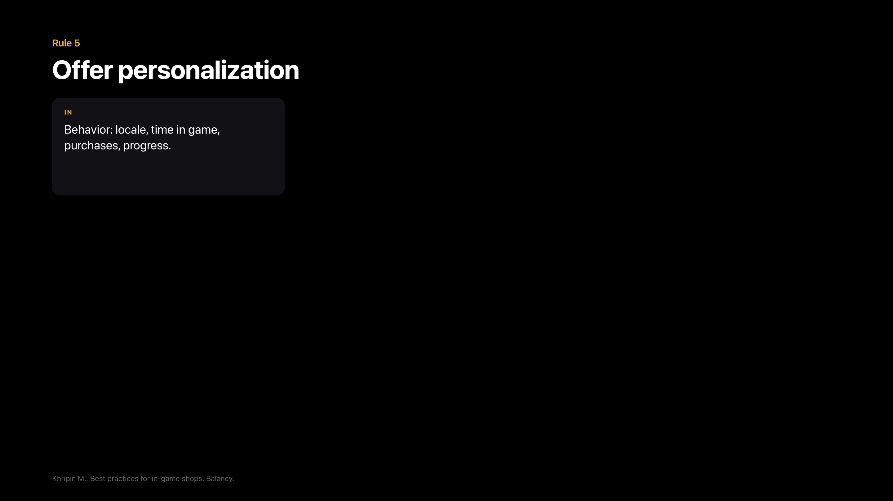
Notes:
Slide 13, build 2 of 6
The game looks at how this player behaves: country, time in the game, purchases, progress.

Slide 23
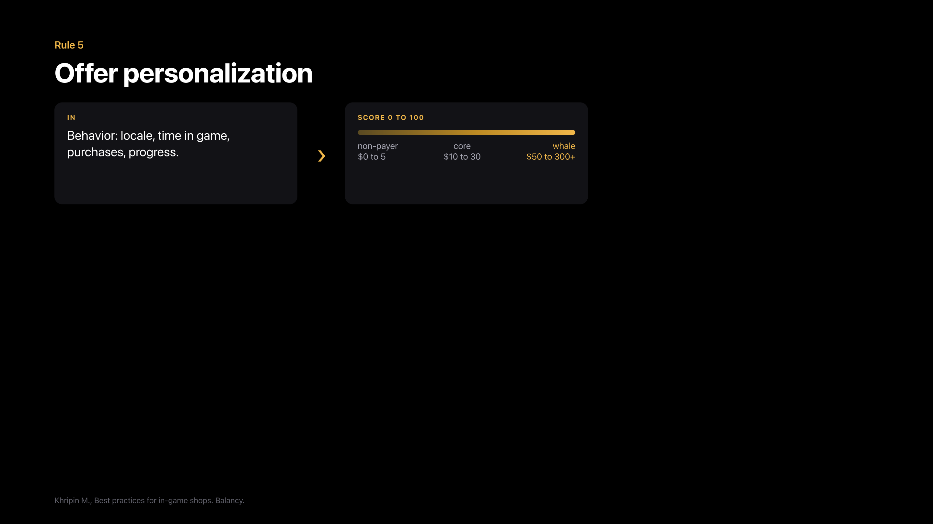
Notes:
Slide 13, build 3 of 6
It gives the player a score from zero to a hundred.

Slide 24
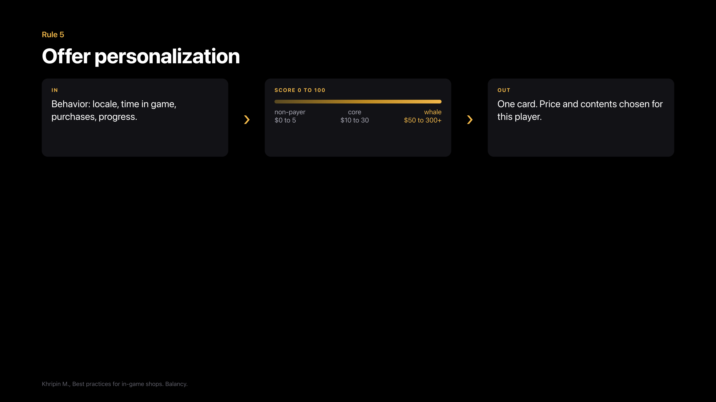
Notes:
Slide 13, build 4 of 6
And it builds one offer just for them, with its own price and its own content.

Slide 25
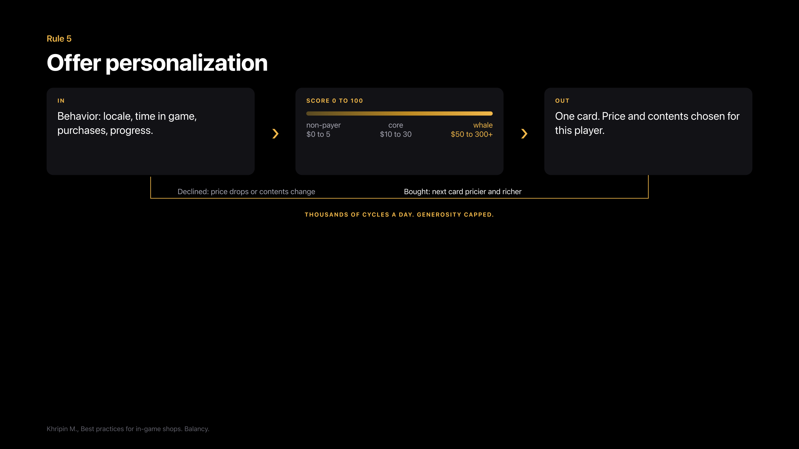
Notes:
Slide 13, build 5 of 6
If they buy, the next offer is bigger. If they say no, the price drops or the content changes. Thousands of times a day.

Slide 26
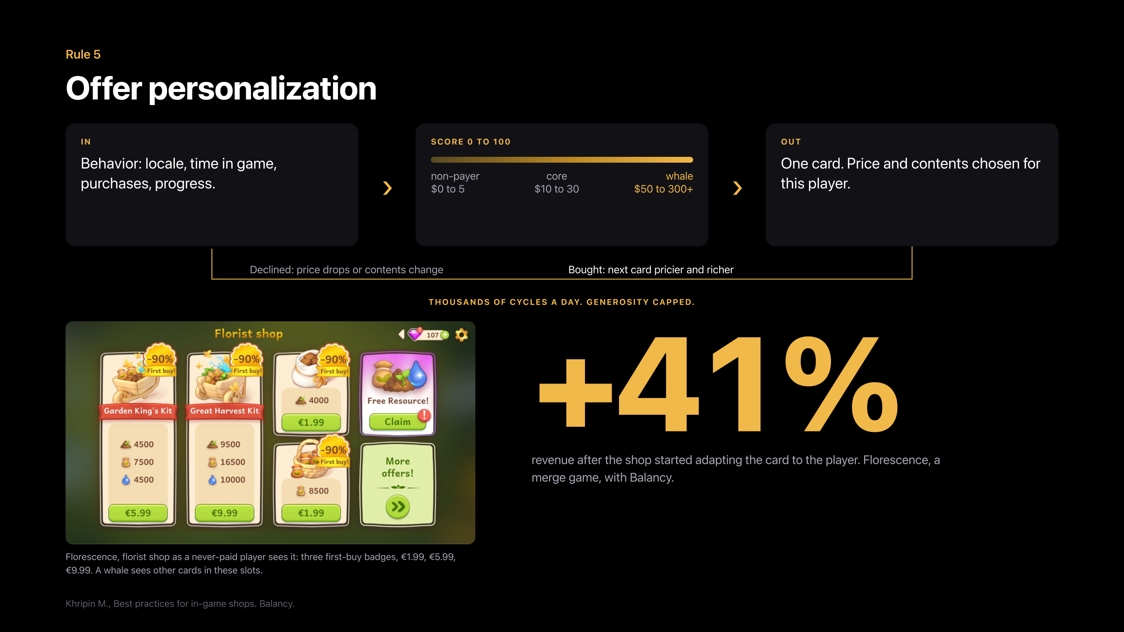
Notes:
Slide 13, build 6 of 6
A merge game called Florescence did this together with the guys from Balancy. Balancy is a small startup, I know them a little, and they are great people. Revenue went up forty-one percent. It is their published case, not mine.
One rule: limit how generous the system can be. It does exactly what you tell it. Tell it to sell as much as possible, and it will happily sell your whole game for ninety-nine cents.

Slide 27
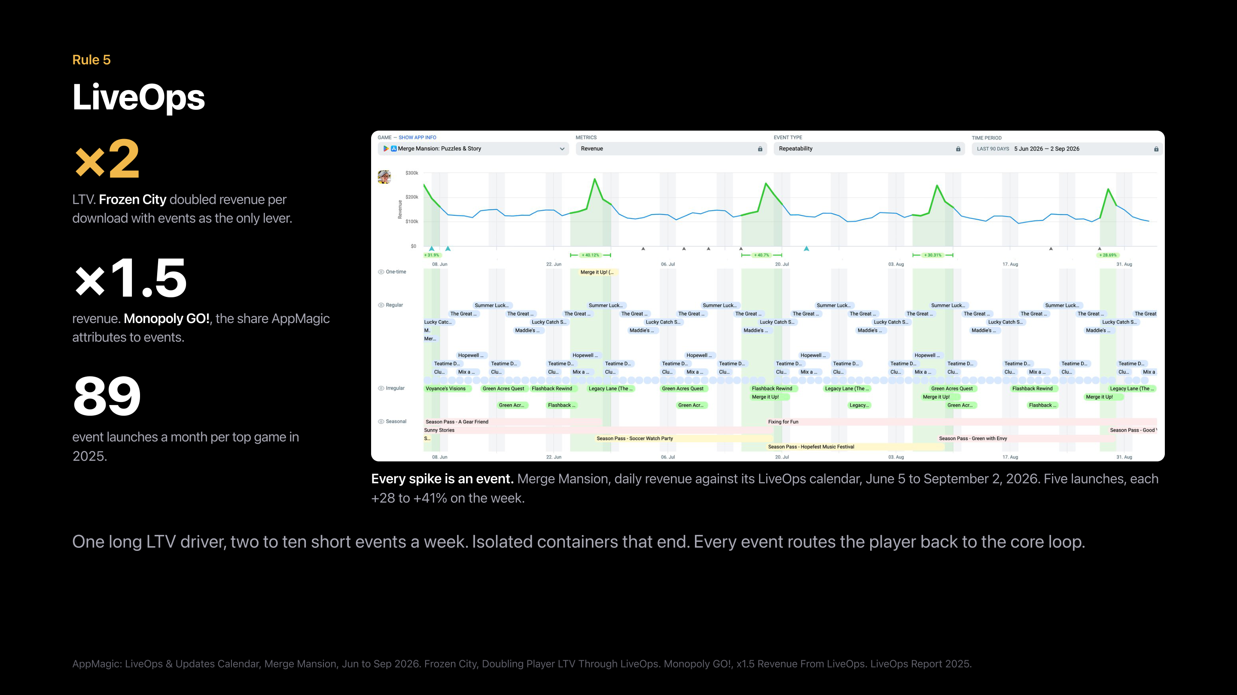
Notes:
Slide 14
And the last one, LiveOps. Buying users has never been this expensive, so the games that win are the ones that earn more from each player. Events do exactly that.
Frozen City doubled its revenue per player with events alone. Monopoly GO earns one and a half times more because of events. The top games run eighty-nine events a month. That is three a day. Somebody on that team is not sleeping. If that is you, and you are in this room: go home. Rest.
Look at this chart. Merge Mansion, this summer. Every spike in revenue is an event, and each one adds thirty to forty percent for that week.
Here is the thing about this calendar. It has not changed in years. Only the events inside it change. A few regular events every day, one bigger event every week, a season pass across the month. The players know the rhythm, and they come back for it.
The recipe is simple: one long event, plus a few short ones every week. Never too many at once. Every event has an end, and every event sends the player back to the main game.

Slide 28
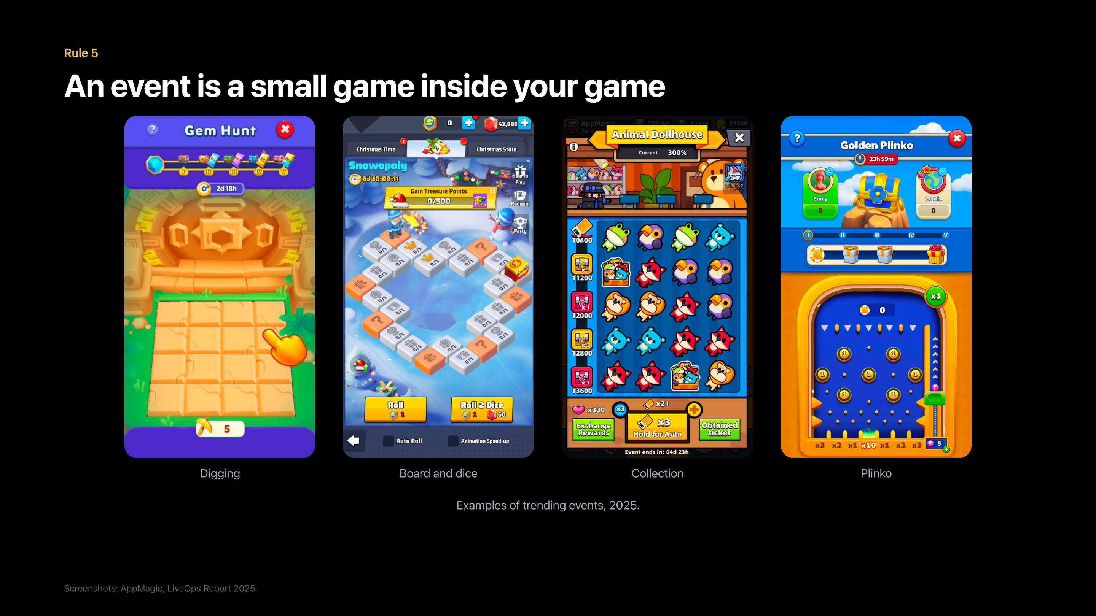
Notes:
Slide 15
And what is an event, really? Look at these four. Digging. A board with dice. A collection. Plinko.
Remember flash games, twenty years ago? That is exactly what these are: small, simple games inside your big game, with good prizes.
All four have the same three things. A goal you can see. A prize you want. And a timer. That is the whole design.
There is no secret here. Billion-dollar studios ship them every single week, and every one of you can build one. So pick one of these four, and build it.

Slide 29
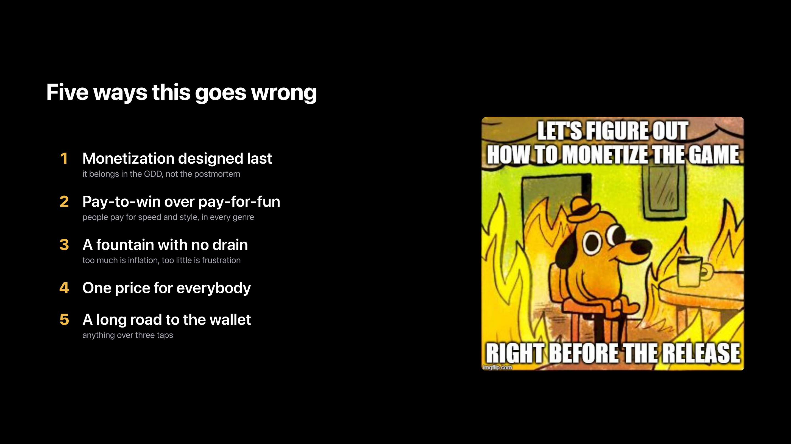
Notes:
Slide 16
Before we finish, five ways this goes wrong. I will be fast.
One: monetization comes last. That is the shop nobody opens. Two: pay-to-win instead of pay-for-fun. That is the wall. Three: a fountain with no drain. That is our rich friend from Diablo. Four: one price for everybody, the student and the millionaire. And five: a long road to the wallet. More than three taps to pay is too many.
[Let the meme work.]

Slide 30
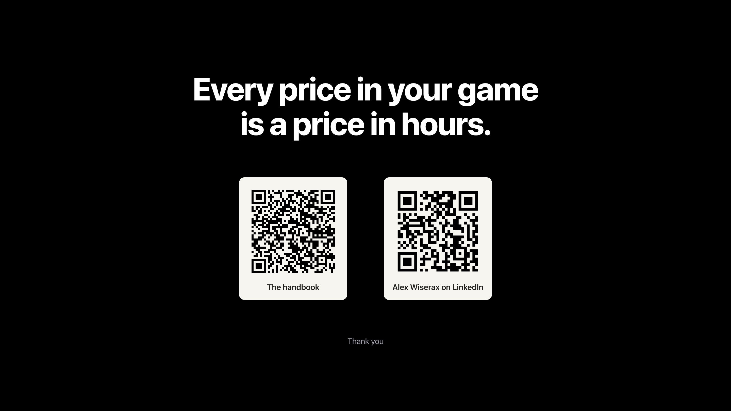
Notes:
Slide 17
Two links on the screen. My handbook, with all of this in detail, and my LinkedIn. If your game is stuck, write to me. I'm happy to help.
If you try only one thing from this talk, try this. Take the three most popular items in your game, and write down their price in hours. Because every price in your game is already a price in hours. It takes ten minutes, and you will never look at your shop the same way again.
And one last thing. At the start I asked why we make games, and you told me.
[Repeat two of their answers from slide 2. Slow down here.]
None of that happens if the game does not pay back the years. A good economy is not about squeezing players. It is what buys you the time to make the next game.
So I wish every one of you a game that pays back your years. And after that, the masterpiece you really want to make.
Thank you.
[Stop. Do not move, do not reach for the clicker. Let the applause start before you do anything.]

