Slide 1

WishList App

Slide 2

Business analysis
Growing popularity of online shopping.
Easy to collect ideas, leave for future reference.

Slide 3
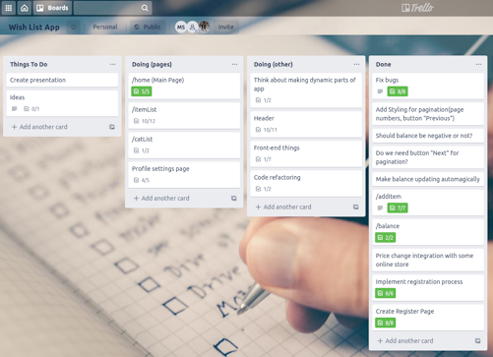
Project planning
Workload management (V-model):
    Put together a full list of processes team is responsible for;
    Break down projects into smaller tasks, allocate resources;
Tools:
    Discord
    Trello
    GitHub
    Google docs

Slide 4
System overall design
Framework: Spring MVC;
Spring Security as framework for authentication, authorization and other security features.
JDBC API to connect with MySql Database

Slide 5
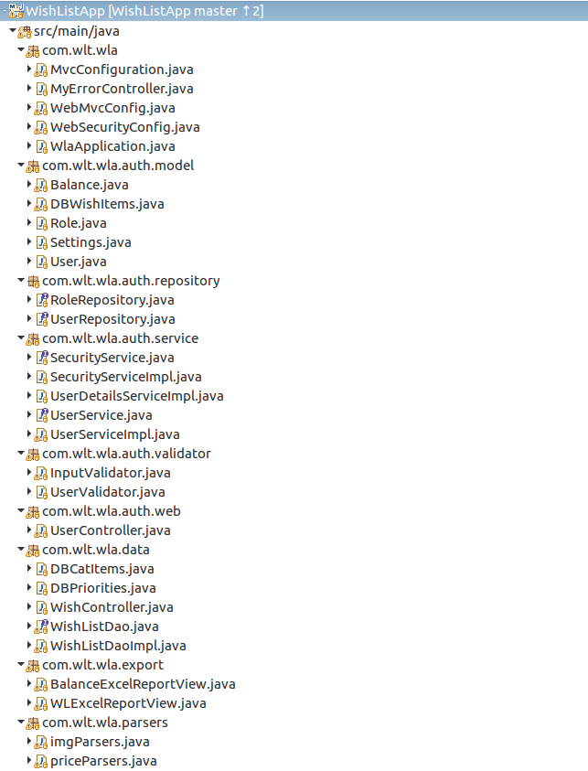
Project tree

Slide 6
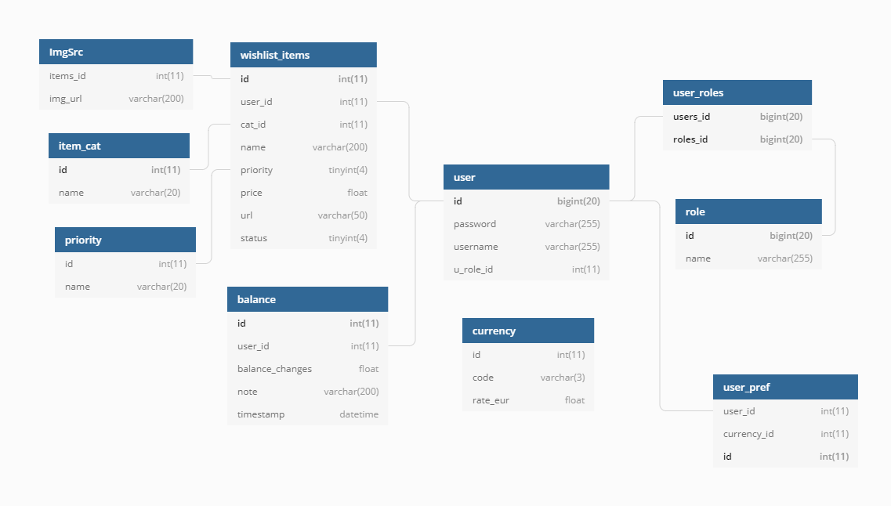
System data model
MySQL: Designed for the Web

Slide 7
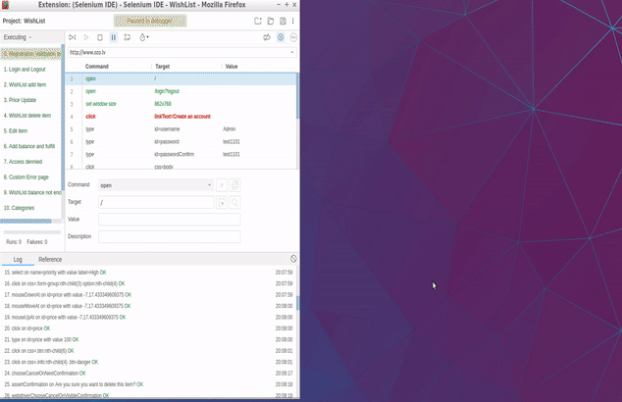
Testing
Manual testing performed by team members after each new functionality developed
Overall WishList App automated testing with Selenium.

Slide 8
System building and deployment
Application itself deployed as jar with dependencies managed with maven.
As a hosting provider was chosen Heroku as a cloud provider which employ a “buildpack” approach. The buildpack wraps deployed code in whatever is needed to start application.
Domain name www.ozo.lv ns setup

Slide 9
Main Features
Organize wishlist:
Add ,Edit, Remove features
View wishlist:
view full list
view by category
view removed and fullfilled item lists
Organize expenses on the wishes:
Set amount of money that can be spent
Keep an eye on price of certain wish, that
Wish removing.
Administrator Panel
Manage categories (add, rename)
Manage users (delete ,change passwords)

Slide 10
Additional Features
Image and price parsing from online store.
-Parsed price automatic conversion based on today’s ECB exchange rate (ECB daily published XML rates)
Possibility to export wish list and balance history to excel file.
View statistics of fulfilled wishes.
Wish restoring from deleted.
Wish copying into main list from list of fulfilled.

Slide 11

Project mid-term commitments
1. Finalize developing Web Application and append it with user input validation, wish item editing and deleted item restoration
2. Implement integration with biggest online stores to take current item prices, as far as integration with European Central Bank daily currency exchange rates
3. Prepare automated JUnit tests for main app Controllers and main features(wish item adding, removing, editing, fulfillment)
4. Prepare presentation and detailed user guide for end users about app's functions and features, as far as DB diagram documentation for system administrators
5. Find hosting solution and deploy web app to be publicly available online

Slide 12
Future development
Possibility to add new websites to parse through Admin Panel.
Separate cron jar module to put in scheduler for notification and automated item price updates.
Import balance from csv or other file formats provided by banks.
Item price history and as a result « Best price » notifications.

Slide 13
Biggest challenges in the project and lessons learned
Team work expirience : Git, Trello..
Get familiar with Spring framework structure and design, Spring Security and JDBC;
Learn how to use GitHub (and as a result with merge) tools properly when working in team;
One of the general lesson learned not to work with same file simultaniously.

Slide 14
Project links
Project URL www.ozo.lv
GitHub
https://github.com/WishListApp/WishListApp/
Detailed user guide
https://github.com/WishListApp/WishListApp/tree/master/docs/WishListApp_user_guide.doc
Project classes documentation
https://github.com/WishListApp/WishListApp/tree/master/docs/WishListDoc.pdf
Mysql structure ready for import
https://github.com/WishListApp/WishListApp/tree/master/docs/dr_wishlist.sql
Selenium tests showroom
https://www.youtube.com/watch?v=GlRdgM9AM2A
other usefull staff
https://github.com/WishListApp/WishListApp/tree/master/docs/

Slide 15
Team 1 - Members
Vladislavs Zimnikovs (7NUL):
Back-End Developer, Team Lead;
Maksims Samsonovs (TmEu):
co-Lead,Back-End/Front-End Developer, DB Architect;
Kirils Gekiss (s3OP):
Front-End Developer, UI Design Architect, Task Management;
Ivo Kalnins (G8So):
Server Setup, Documentation Preparation;
Raimonds (aHcv) – left the project.

Slide 16
Thank You!

