Slide 1
ES6

Slide 2
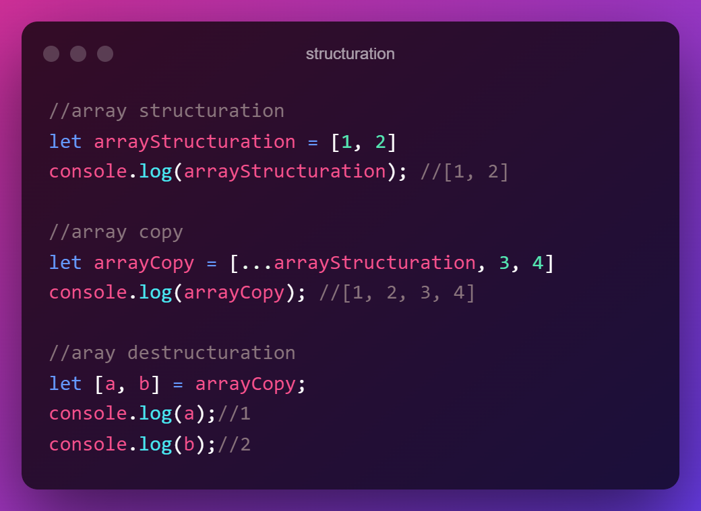
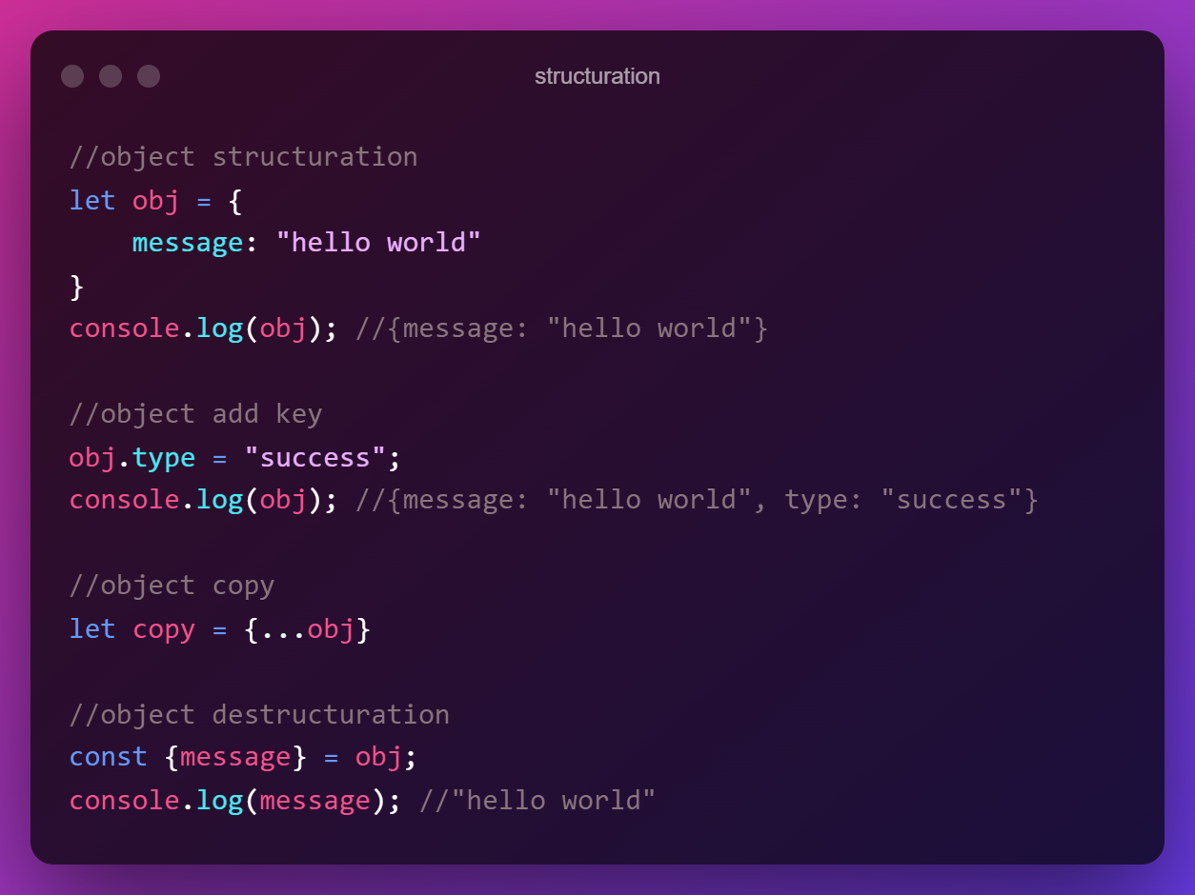
Rappels ES6
Pour vous exercer: https://www.programiz.com/javascript/online-compiler/
Notes:
Compilateur es6: https://www.programiz.com/javascript/online-compiler/

Slide 3
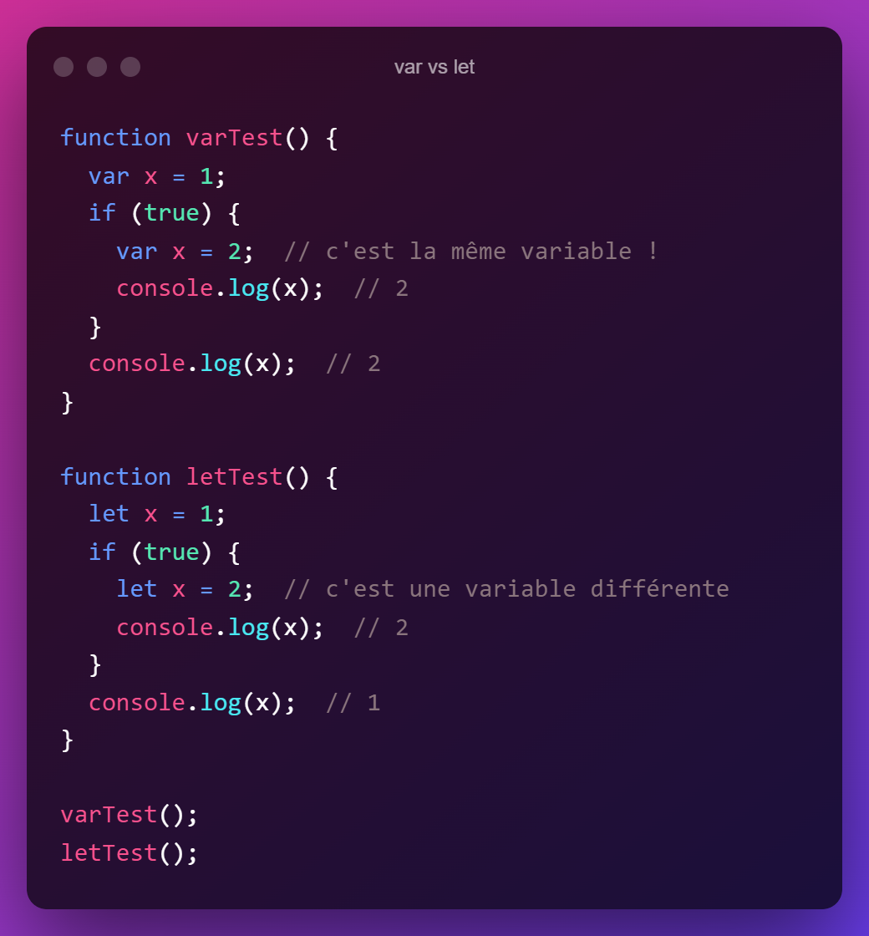
Rappels ES6
Pour vous exercer: https://www.programiz.com/javascript/online-compiler/
Notes:
Compilateur es6: https://www.programiz.com/javascript/online-compiler/

Slide 4
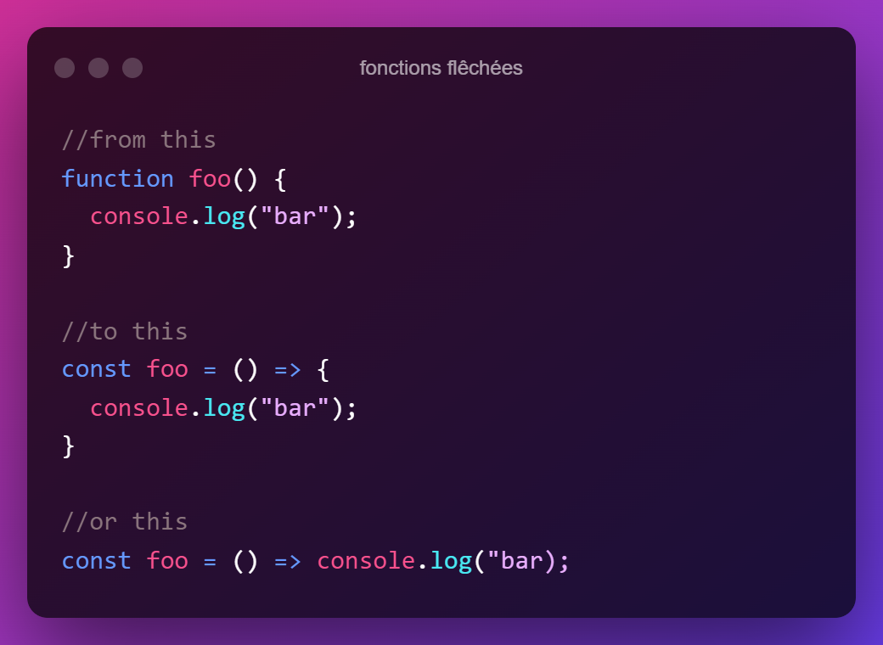
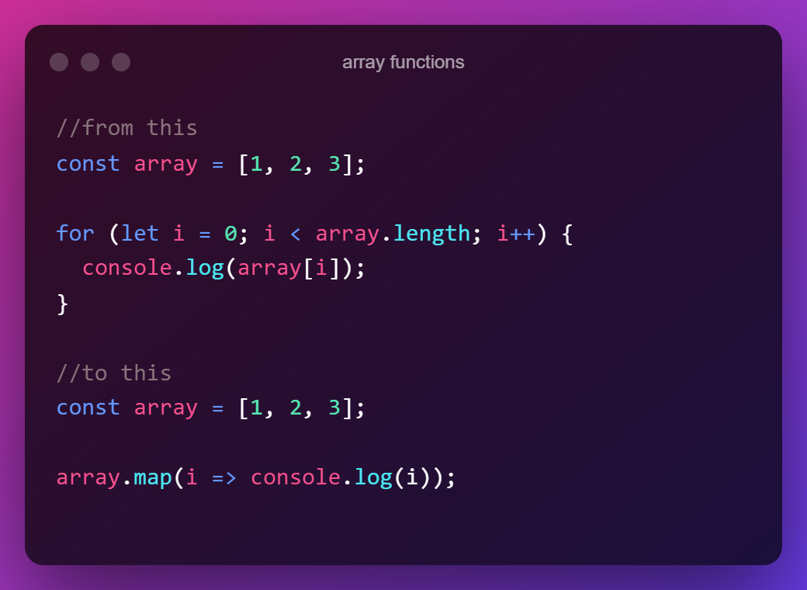
Rappels ES6
Cheat sheet: https://htmlcheatsheet.com/js/
Notes:
Compilateur es6: https://www.programiz.com/javascript/online-compiler/

Slide 5
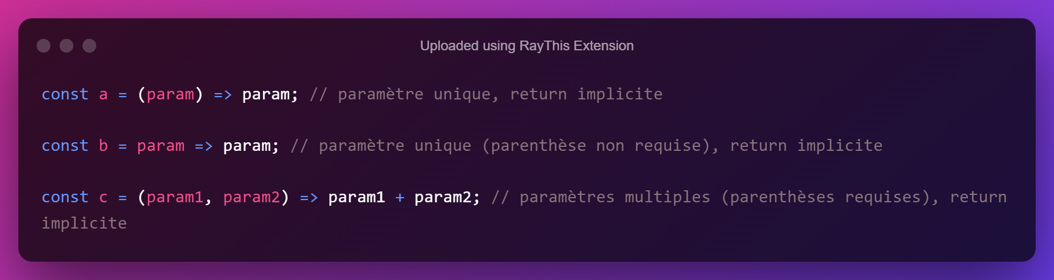
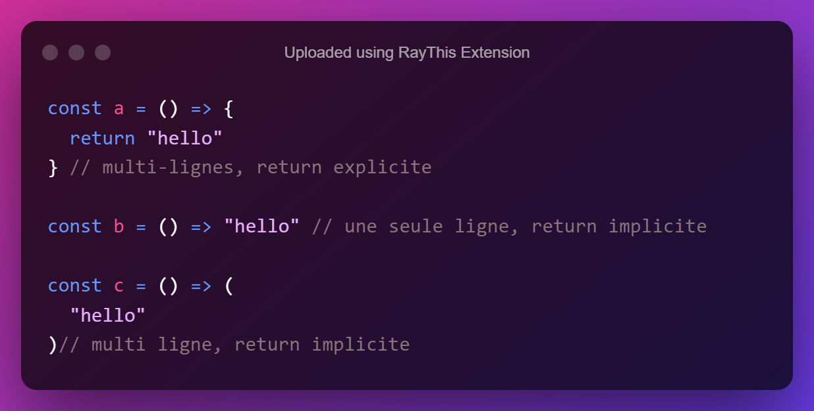
Cheat sheet fonction fléchées
Notes:
Compilateur es6: https://www.programiz.com/javascript/online-compiler/

Slide 6
Rappels ES6
Cheat sheet: https://htmlcheatsheet.com/js/
Notes:
Compilateur es6: https://www.programiz.com/javascript/online-compiler/

Slide 7
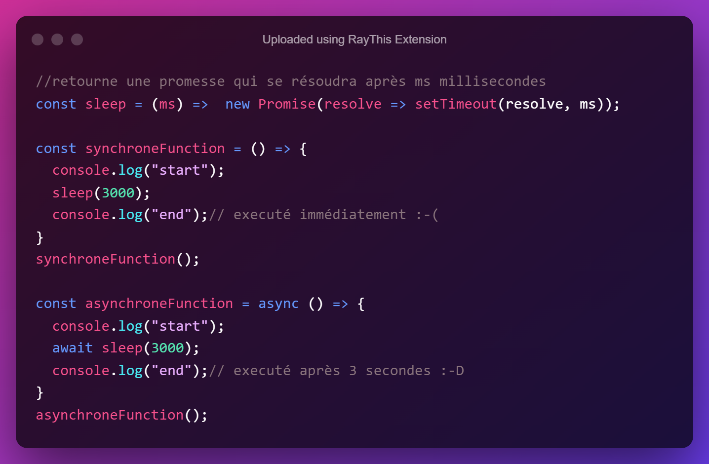
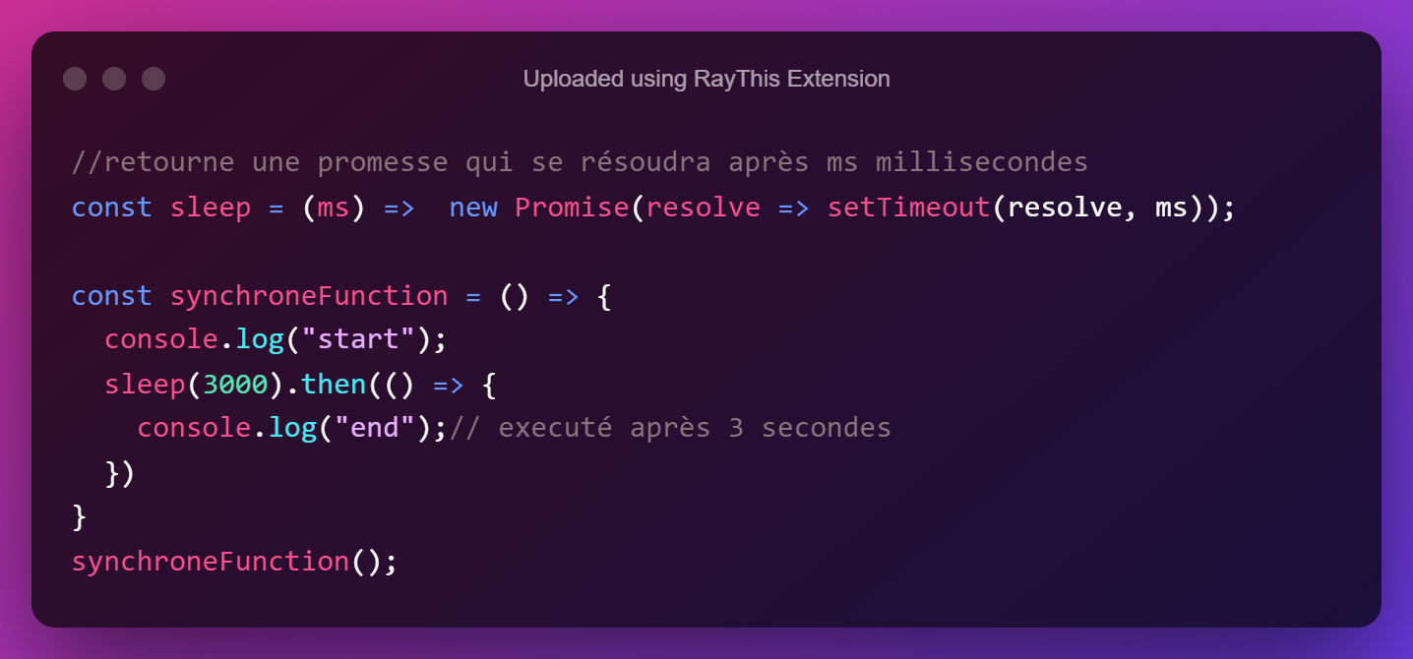
Rappels ES6: asynchrone
Notes:
Compilateur es6: https://www.programiz.com/javascript/online-compiler/

Slide 8
