Slide 1


AraBERT Pre-training BERT for Arabic Language Understanding
Wissam Antoun, Fady Baly and Hazem Hajj

Slide 2
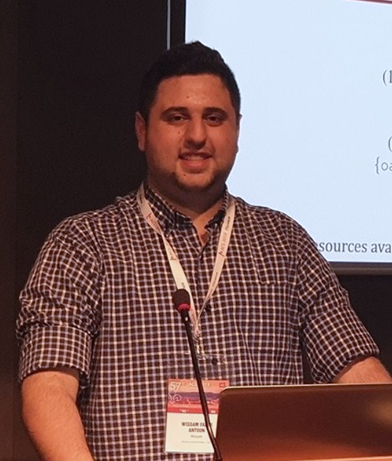



About Me
Master’s Student at the American University of Beirut – AUB MIND Lab
Focused on AI and Machine Learning
Specialized in state-of-the-art NLP techniques
On the support team for Stars of Science (نجوم العلوم) as an ML expert
Participated and ranked in the 1st or 2nd position in several international competitions
wissam.antoun@gmail.com
github.com/WissamAntoun/
twitter.com/wissam_antoun

Slide 3
Outline
Transfer Learning in NLP
The Transformer and Self-Attention
BERT:
Input-Output
Pretraining
Finetuning
Tokenization
Demo
AraBERT
Arabic Tokenization
Pre-training
Results
Demo

Slide 4
A Primer on Transfer Learning
Model 1
Dataset 1
Large Datasets
Knowledge
Knowledge is retained
Model 2
- Better Performance
- Faster Training
Dataset 2
Smaller Datasets
Notes:
Less labels required
Better final performance
Model 1 can be re-used for other similar tasks

Slide 5
Transfer Learning for NLP
Model 1
Self-Supervised
Wikipedia, News articles
Large Unlabeled Datasets
General Language Understanding
Knowledge
Model 2
Supervised
- Better Performance
- Faster Training
Smaller Labeled Datasets
Dataset 2
Notes:
Think about it as if Model 2 didn’t start learning from scratch, since it was initialized with model 1’s weights

Slide 6
Transfer Learning for NLP
Language Model
Pre-training
Language Model
Adaptation
Task Specific
Finetuning
Fox
movie
Positive
Universal Language Model
Universal Language Model
Task-Specific Model
The
quick
brown
…
Avengers
is
a
good
…
Avengers
is
a
good
movie
Movie
Reviews
Movie Reviews
Labels
Wikipedia
Notes:
The year 2018 has been an inflection point for machine learning models handling text
It started with the introduction of the ULMFIT architecture by Jeremy Howard, and Sebastian Ruder

Slide 7
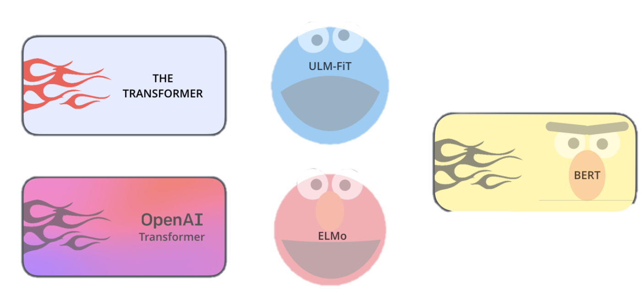
Modern NLP
Figures by http://jalammar.github.io/illustrated-transformer/
Notes:
Elmo introduced Contextualized embeddings using Bi-LSTMs
Then came the Transformer architecture by google
Which formed the building blocks of almost all modern NLP models

Slide 8
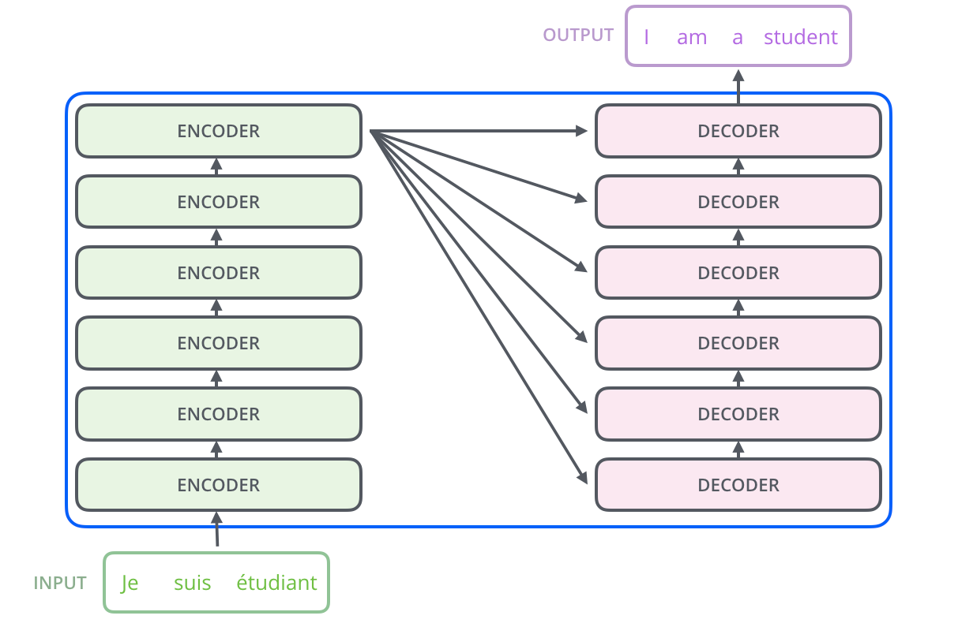
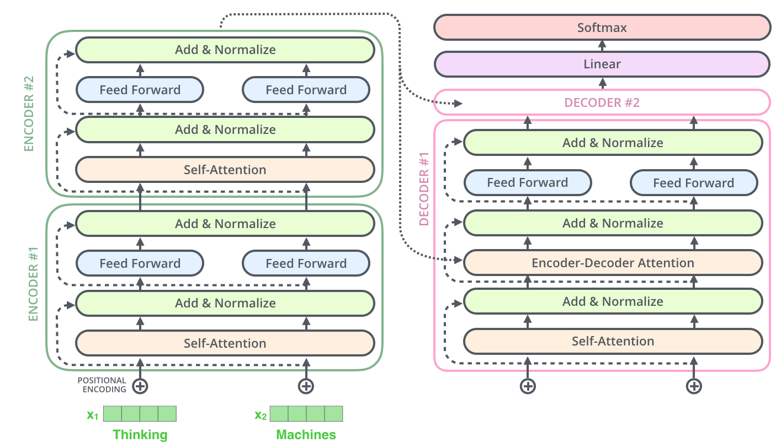
The Transformer
Figures by http://jalammar.github.io/illustrated-transformer/

Slide 9
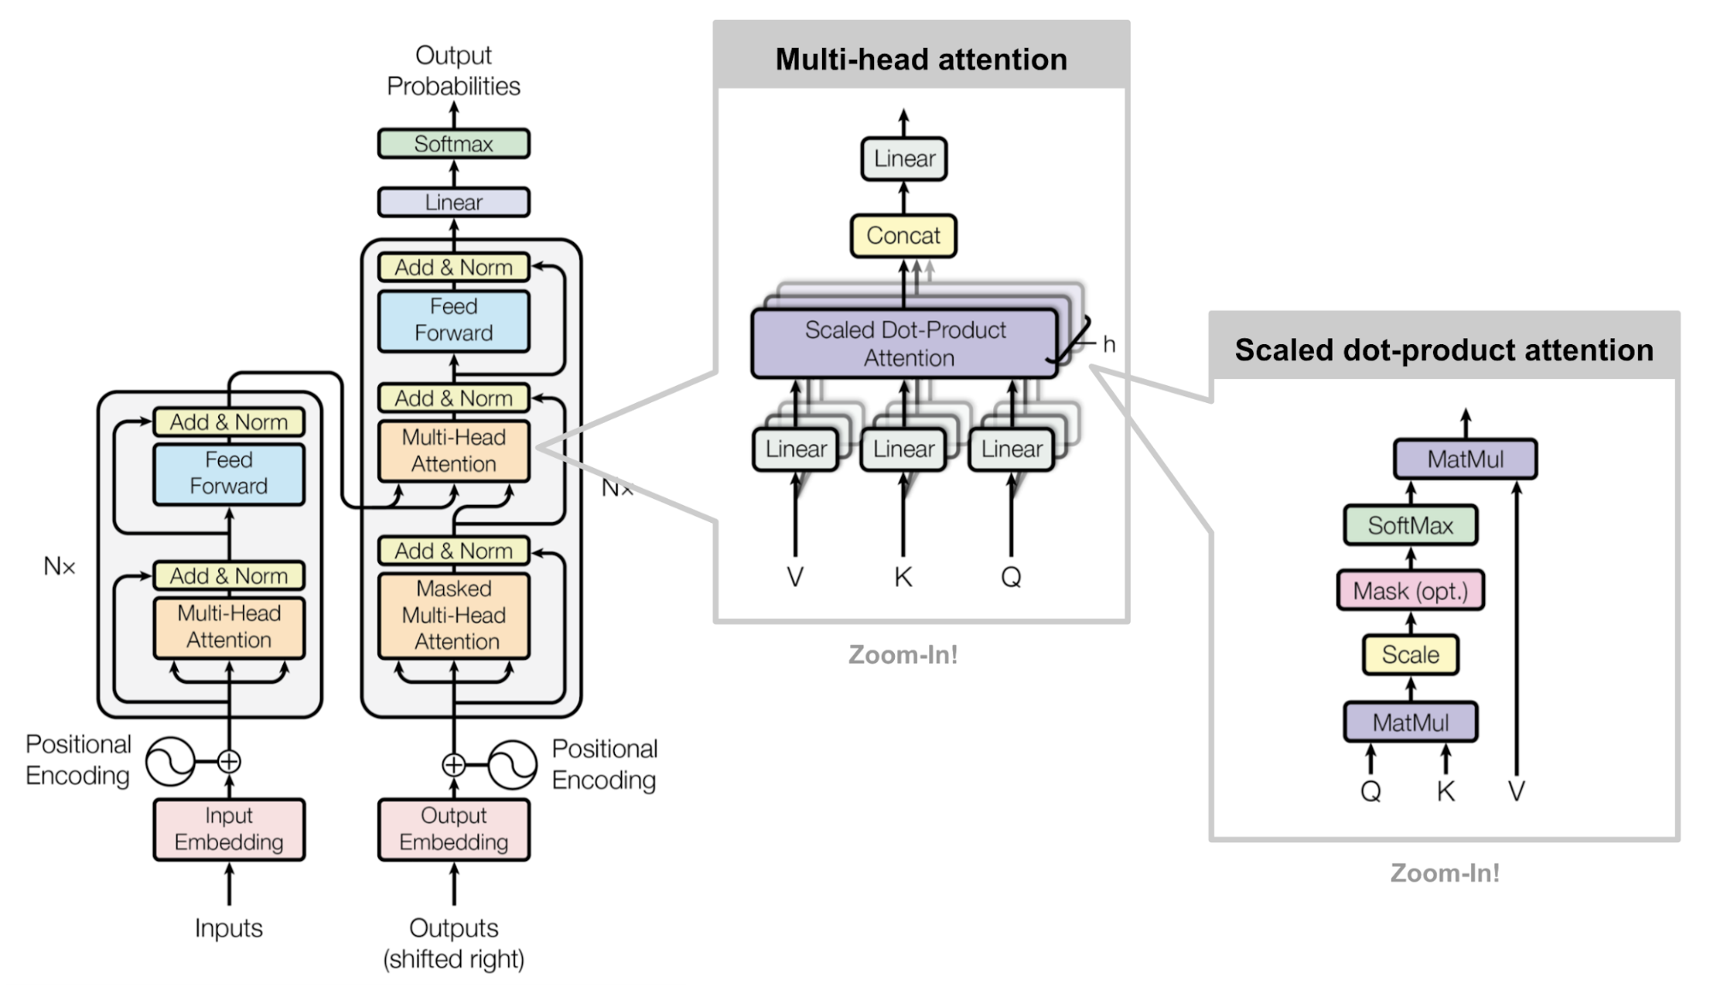
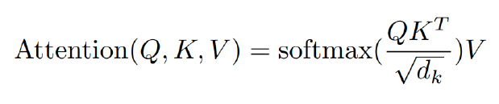
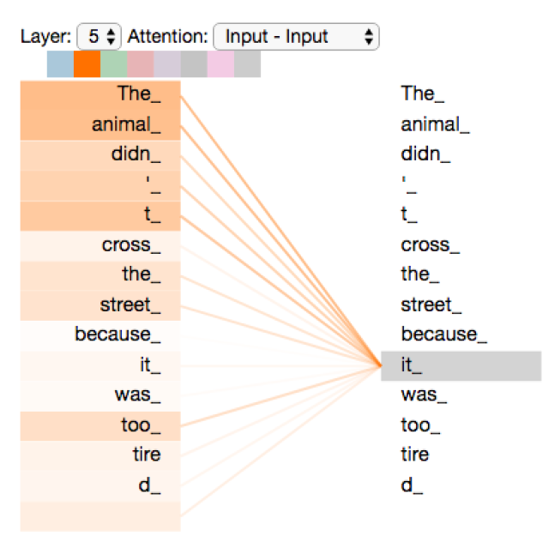
Self-Attention

Slide 10
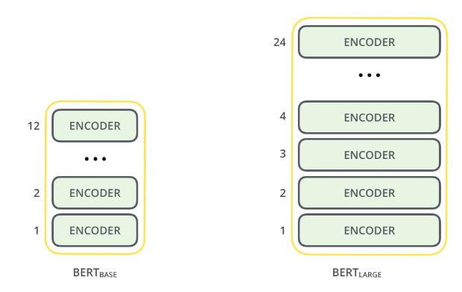
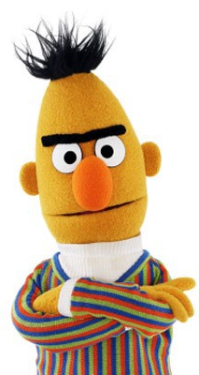
BERT
Bidirectional Encoder Representations from Transformers
Base:
12 encoder layers
12 attention heads
768 hidden units
~110M parameters
Large:
24 encoder layers
16 attention heads
1024 hidden units
~330M parameters
Figures by http://jalammar.github.io/illustrated-transformer/

Slide 11
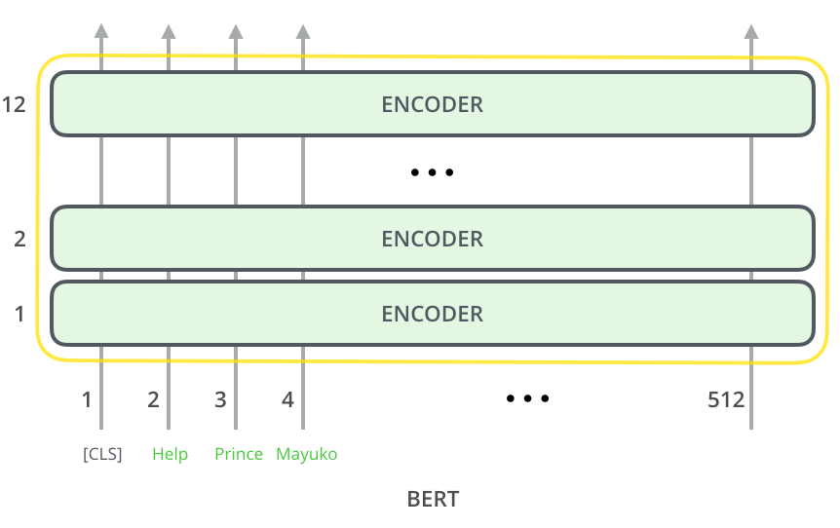
BERT - Input
Notes:
The model takes as input a sequence of words, plus a [CLS] token which we will tack about it later

Slide 12
BERT – Pre-Training
Masked Language Modeling
Requires understanding of left and right context
Doesn’t need labeled data just raw text
weather
car
sky
...
The
[MASK]
is
sunny
and
hot

Slide 13
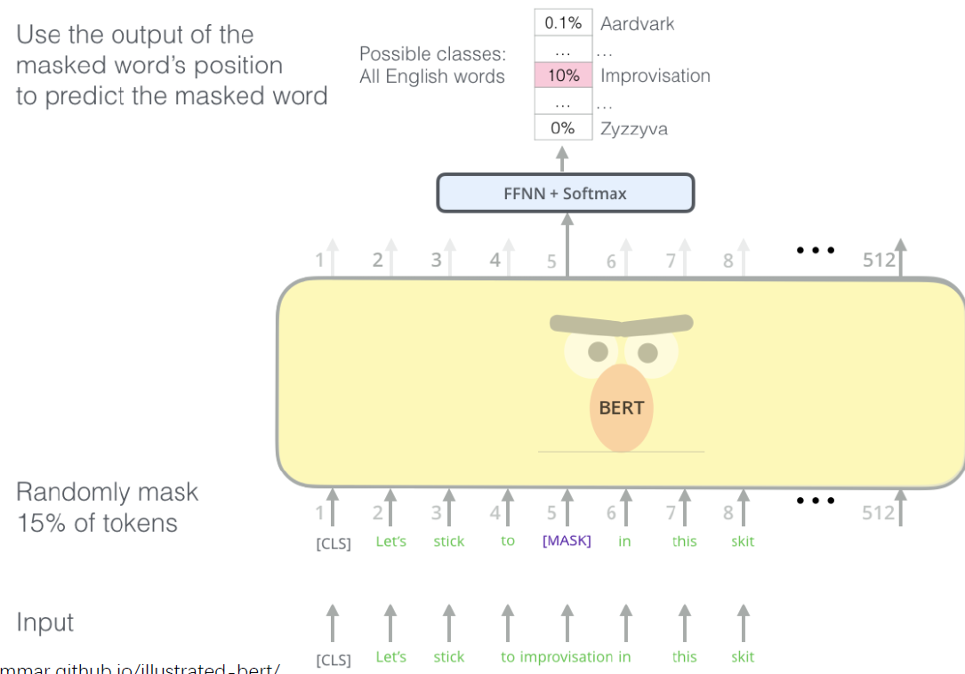
BERT – Pre-Training
Trained on English Wikipedia and the BookCorpus (13GB)
Multilingual : 107 languages
1M steps on Google TPUs
4 days of training
Figures by http://jalammar.github.io/illustrated-transformer/

Slide 14
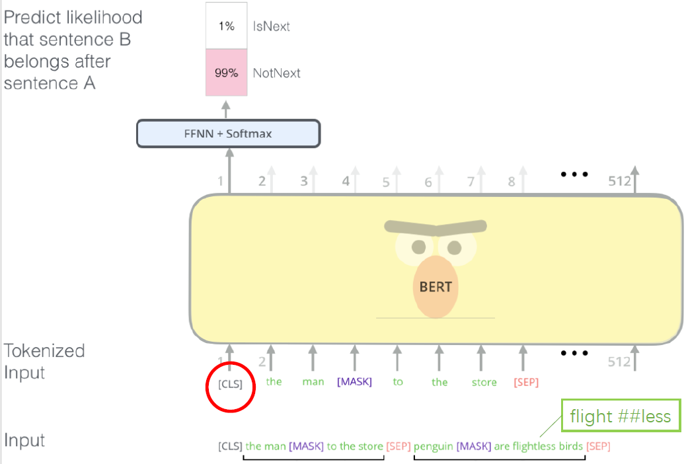
BERT – Pre-Training
Next sentence prediction
Figures by http://jalammar.github.io/illustrated-transformer/
Notes:
Useful for datasets that requires resoning using 2 sentences

Slide 15
BERT - Demo
Fill in the Mask Demo
https://colab.research.google.com/drive/1kKhfoEsc-NbhxtpMI5VIBgr22V05OGeg?usp=sharing

Slide 16
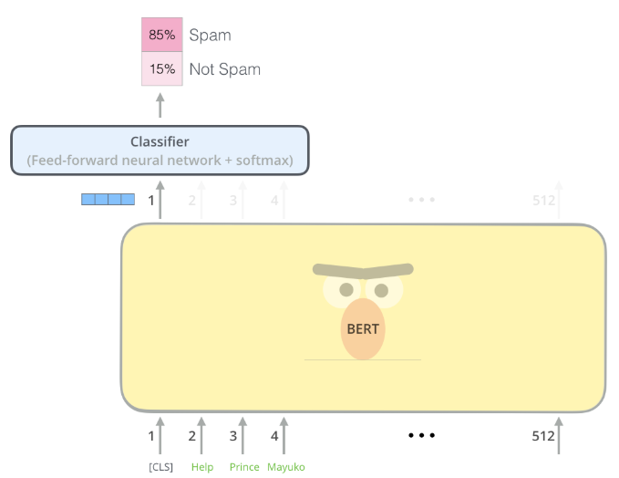
BERT – Fine-Tuning
A single task-specific layer is placed after the body of transformer blocks
Maps the general purpose representation to a task specific output
This method allows SOTA results with “relatively” low amount of labeled data

Slide 17
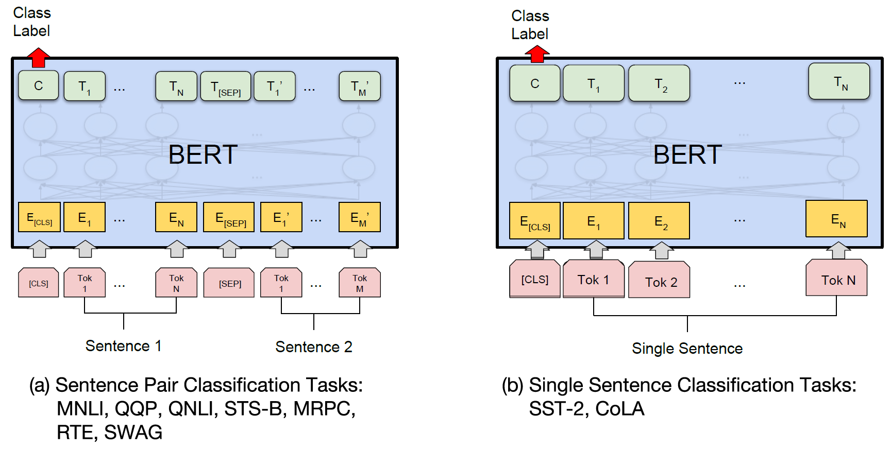
BERT – Fine-Tuning

Slide 18
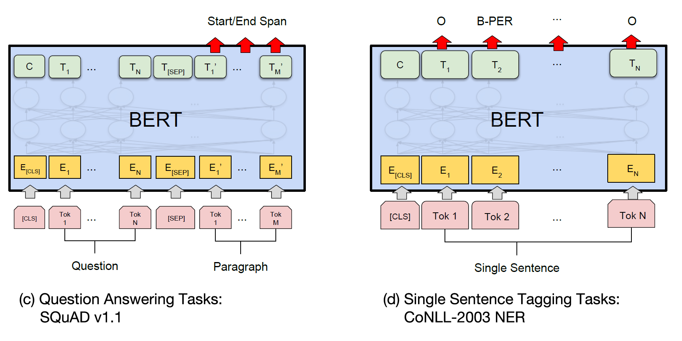
BERT – Fine-Tuning

Slide 19
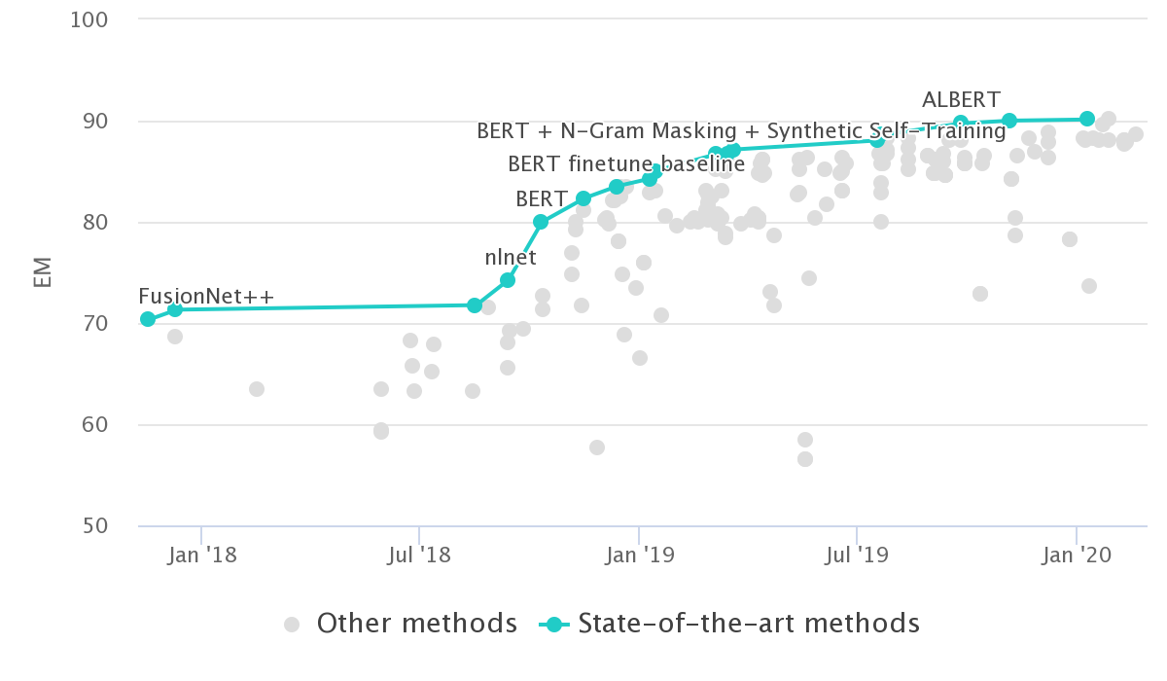
BERT - Results
Humans

Slide 20
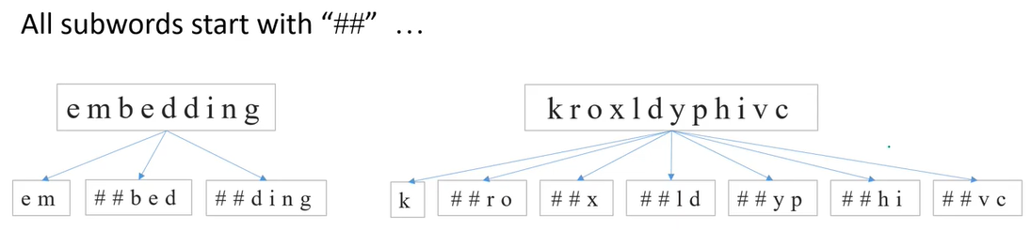
BERT
What happens when you see a word never seen in your fixed vocabulary?
out-of-vocabulary words
BERT uses WordPiece (a variation of BPE)
Notes:
Fixed-size vocabulary with:
Whole words
Subwords occurring at the front of a word or in isolation (“em” as in “embeddings” is assigned the same vector as the standalone sequence of characters “em” as in “go get em” )
Subwords not at the front of a word, which are preceded by ‘##’ to denote this case
Individual characters

Slide 21

AraBERT
We trained the first Arabic only BERT – AraBERT
Same as BERT-base
Trained on 3B words or ~70M sentences or ~23GB of text
Arabic Wikipedia
News Articles from all over the arab region
Training took 5 days on a TPUv3-8 128GB
Model available for free on: github.com/aub-mind/arabert

Slide 22
AraBERT
Arabic comes with its own set of challenges
Data Cleaning:
Removed diacritics
Removed elongation
Left english characters
Training examples needs ~700GB of storage
Tokenization:
Improved on Wordpiece with pre-segmentation: “سيكتبون” → "س+", "يكتب", "+ون“

Slide 23
Arabic Tokenization
If you use Wordpiece only:
Frequent words will use 2 vocabulary places:
We use Farasa to do pre-segmentation
Increased the number of unique word represented in the limited vocabulary
Our vocabulary size is 64000 , with 4000 tokens left unused
يكتب
سيكتب
يكتب
يكتب##
س

Slide 24
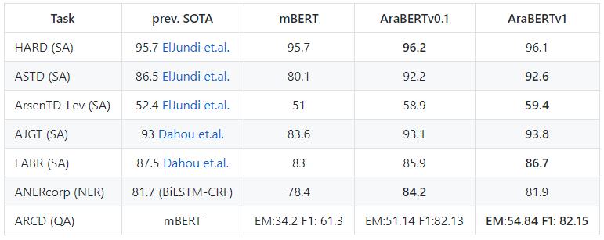

AraBERT - Results

Slide 25
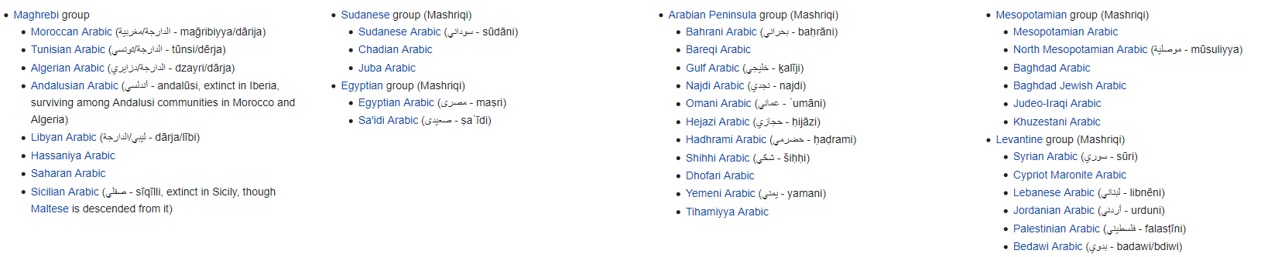
AraBERT – What's Next?
Training BERT-Large
Moving from BERT to other models: ALBERT, ELECTRA, RoBERTA…? Generative Models?
The Arabic Dialects problem:

Slide 26
AraBERT – Demo
Demo on Colab with TensorFlow’s Estimators
Demo using Pytorch: https://colab.research.google.com/drive/14QHSaXv25MCRCQL8PdcscNJ4-0ym1aIG?usp=sharing
COMING SOON: Demo using HuggingFace Trainer API with Pytorch and TF
Classification colab: https://colab.research.google.com/drive/1WhewqK_sFxOyLknbzj8jUqM_bFpkdPi_?usp=sharing
AraBERT: https://github.com/aub-mind/arabert

Slide 27
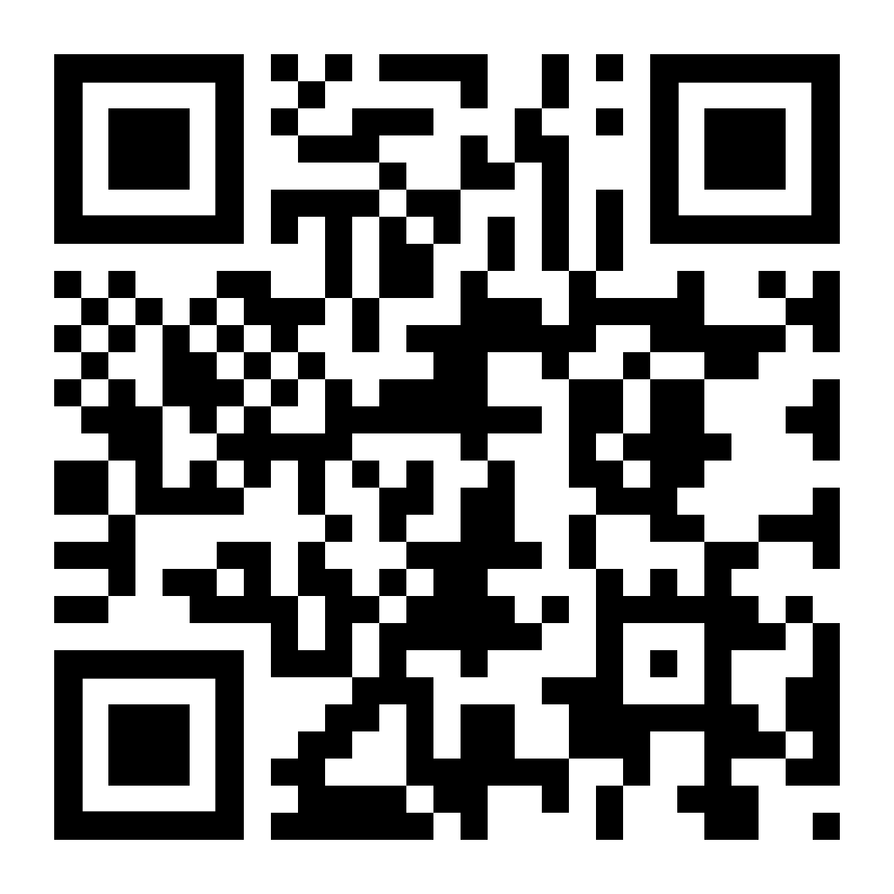
Thank You Q&A
github.com/aub-mind/arabert

