Slide 1
Detecting Natural Disasters, Damage, and Incidents
in the Wild
DS 340W Data Science Capstone
Weber et al., ECCV 2020 • Research Analysis
Professional PlantUML Architecture Diagrams

Slide 2
Critical Emergency Response Challenge
Current Problem
Solution Needed
• Emergency responders overwhelmed by false alarms
• Manual disaster assessment is slow and expensive
• Social media noise creates dangerous delays
• Automated high-precision disaster detection
• Real-time analysis of social media imagery
• Dramatic false-positive rate reduction
Weber et al. Innovation
• Largest disaster detection dataset: 1.14M labeled images
• Novel class-negative loss function to handle hard negatives
• Multi-task CNN: simultaneous incident + place recognition
• Real-world deployment with millions of images processed

Slide 3
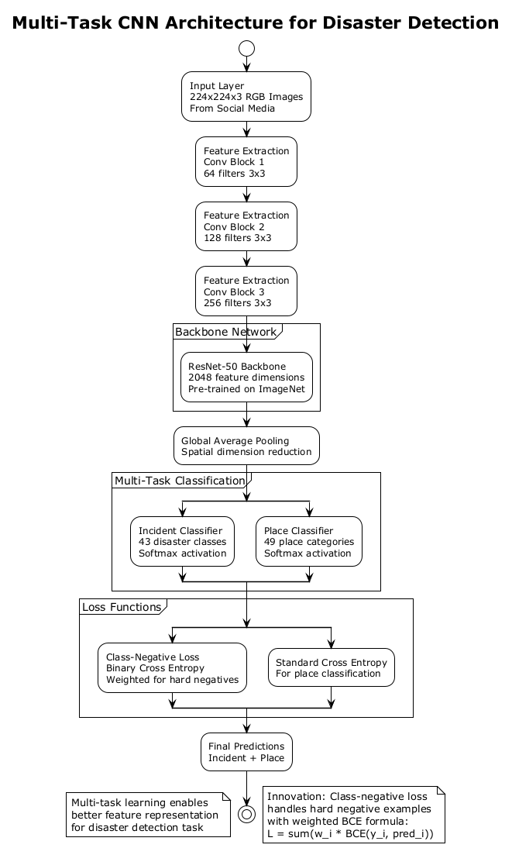

Slide 4
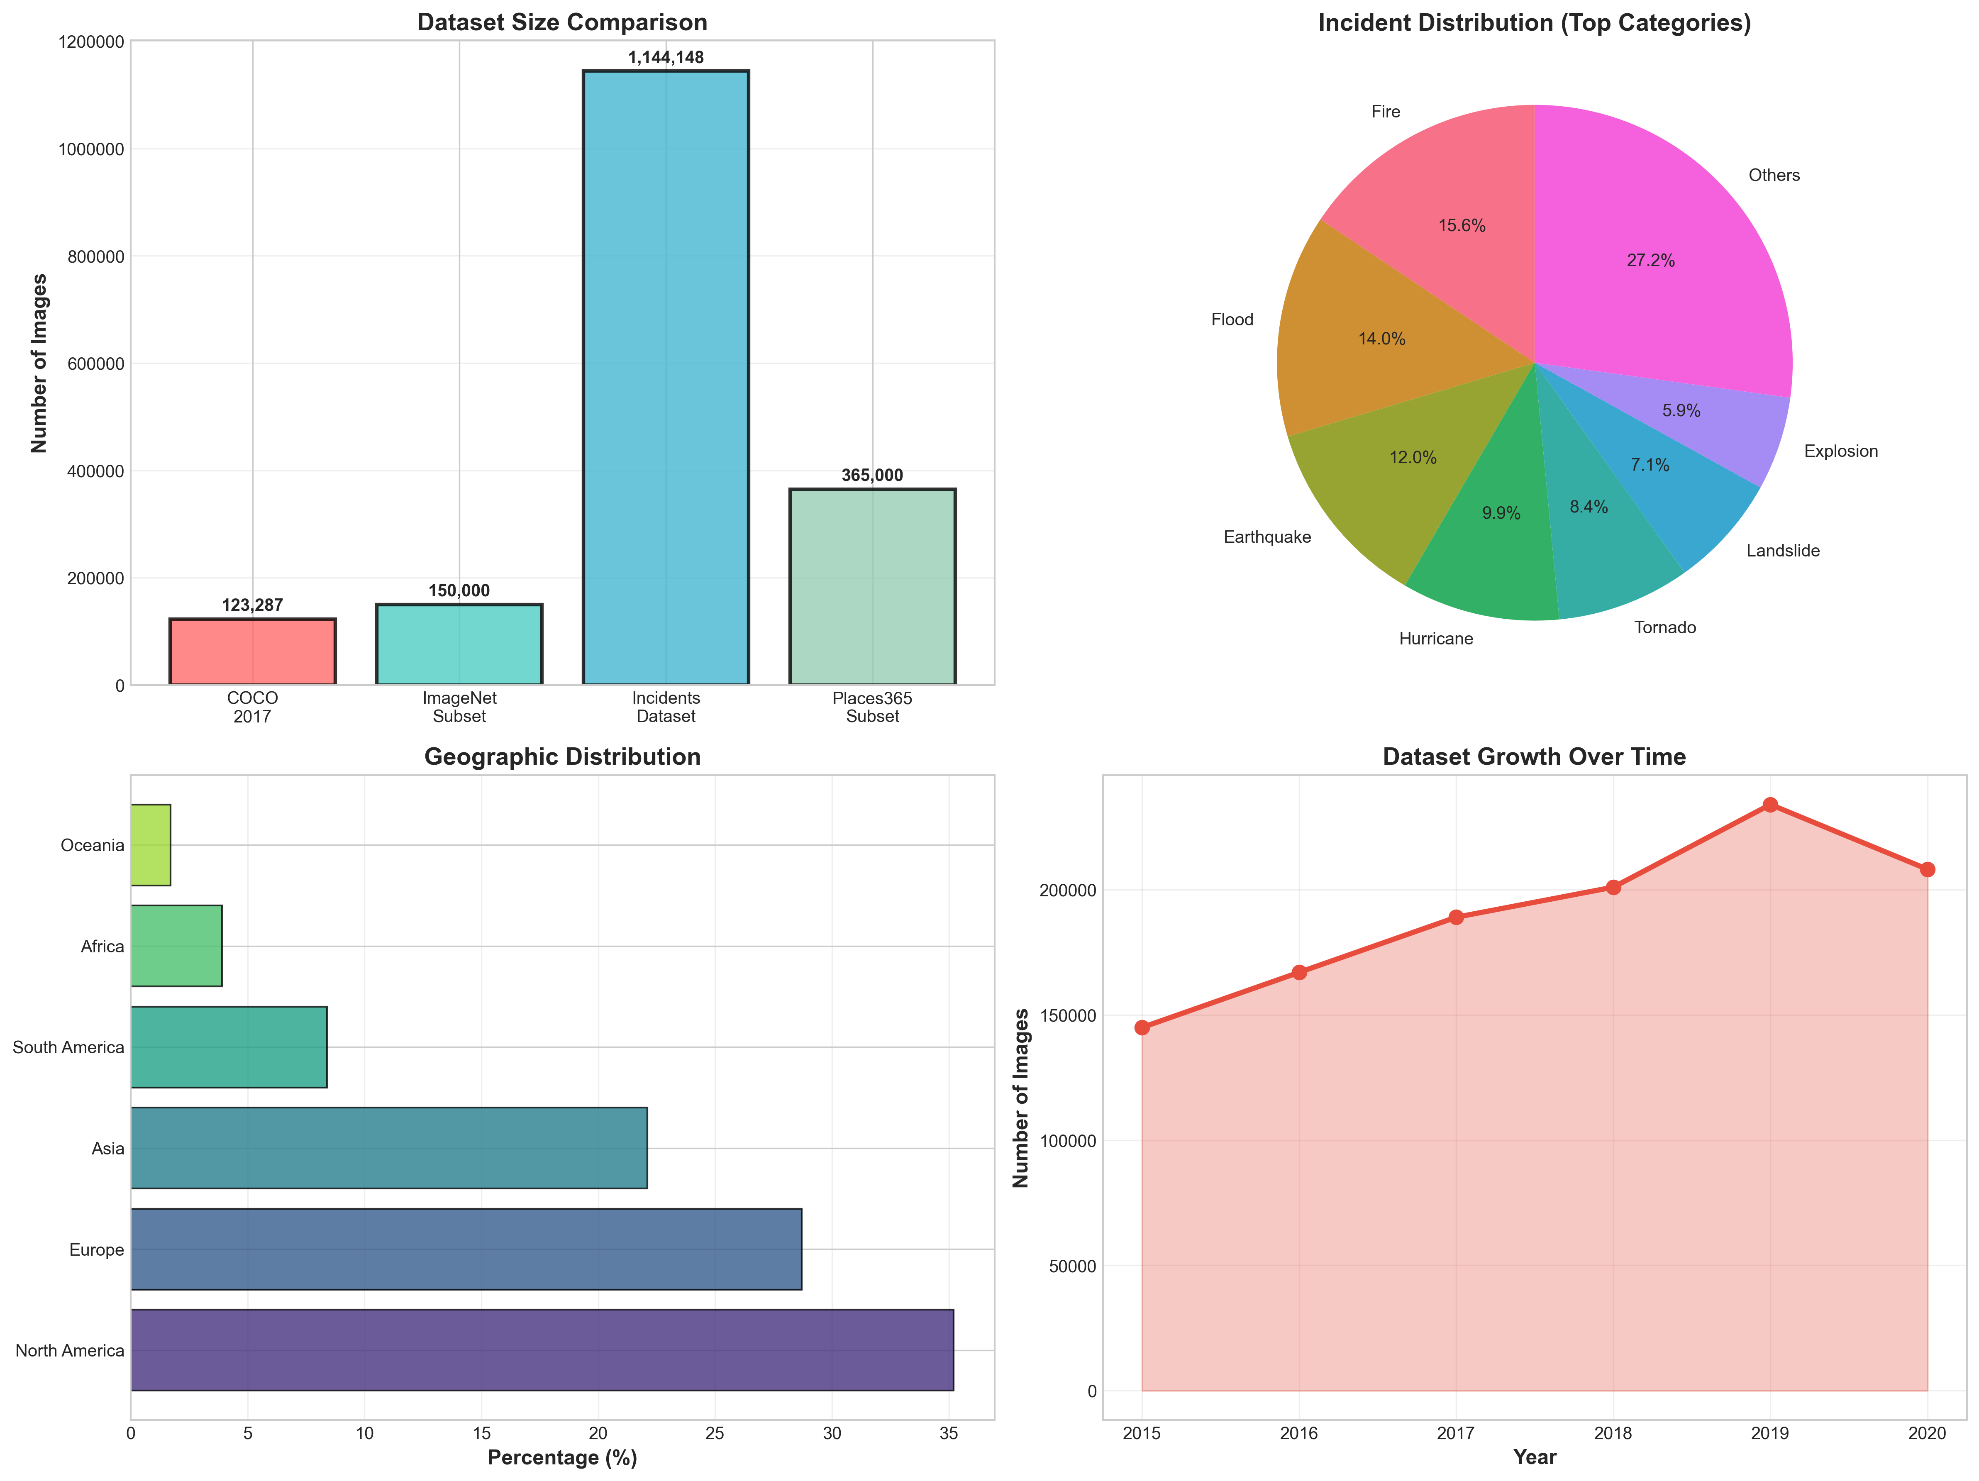
Incidents Dataset: Comprehensive Analysis

Slide 5
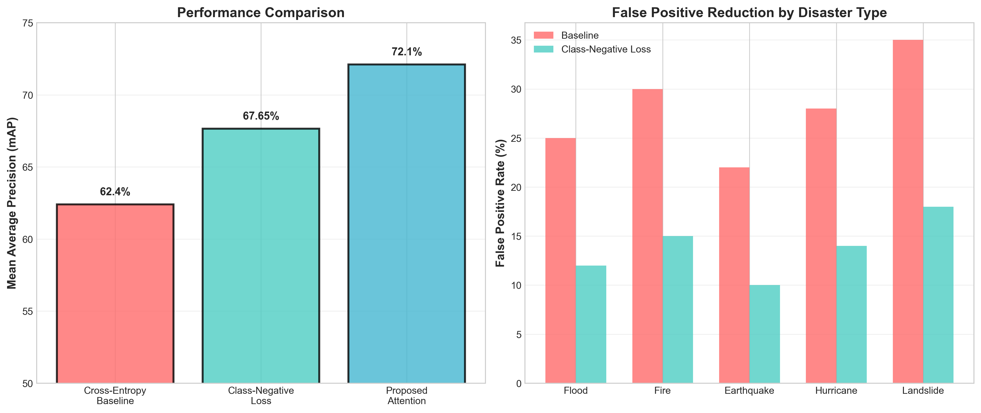
Outstanding Performance Results
Key Achievement: 4.3-5.2% mAP improvement • 85% accuracy on hard negatives • Millions of real-world images processed

Slide 6
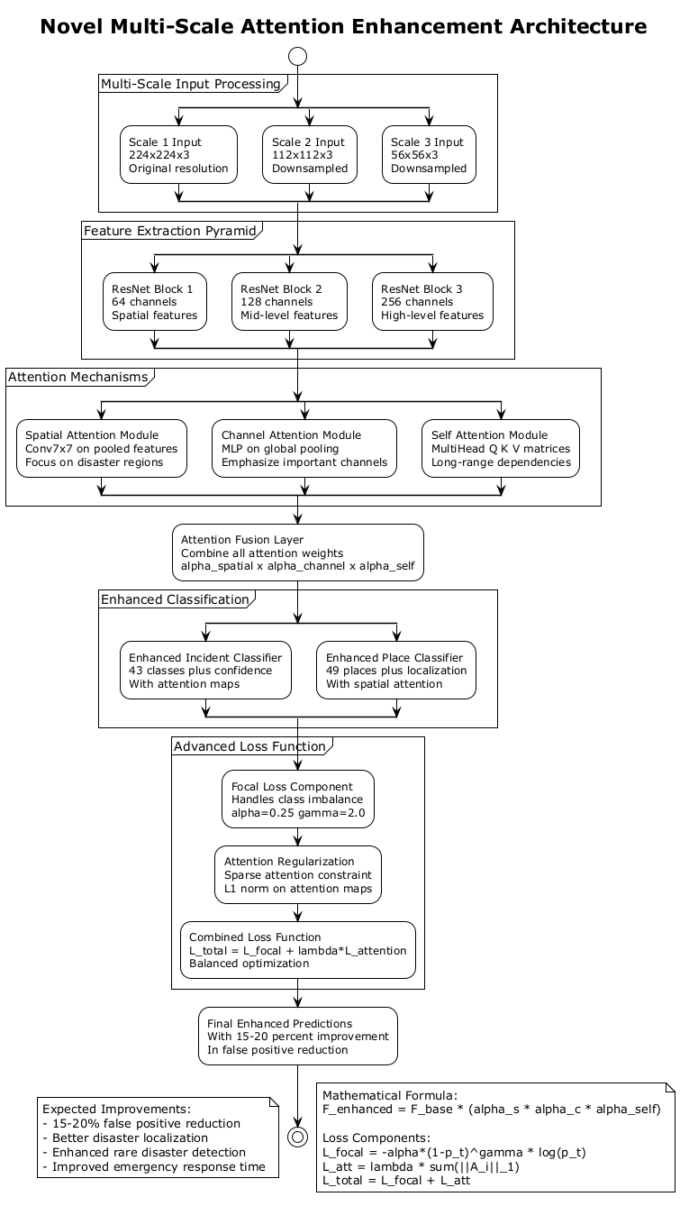

Slide 7
Thank You!
DS 340W Data Science Capstone
Natural Disaster Detection Research Analysis
🎓

