Slide 1
Statistics Review

Slide 2
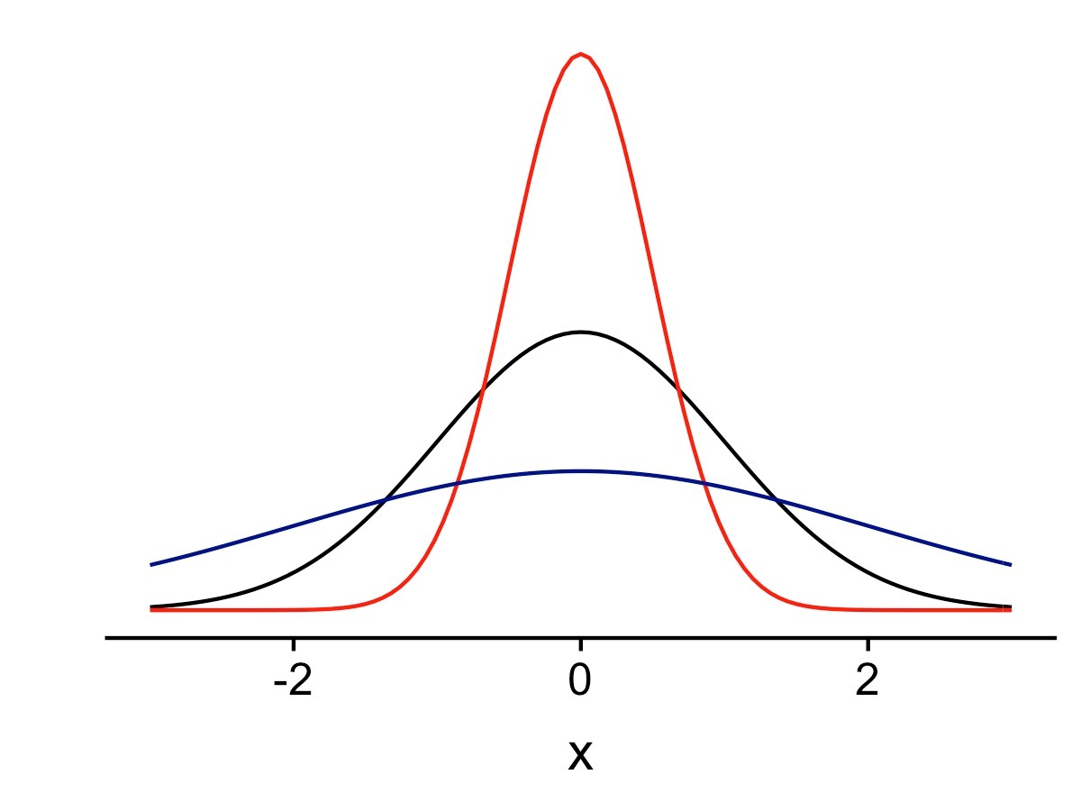
Basic Summary Values
Measures of Central Tendency
Mean - average
Median – central value
Mode – most repeated value
Measures of Spread
Range – difference between the highest and lowest value
Standard deviation – measures the dispersion of the data

Slide 3
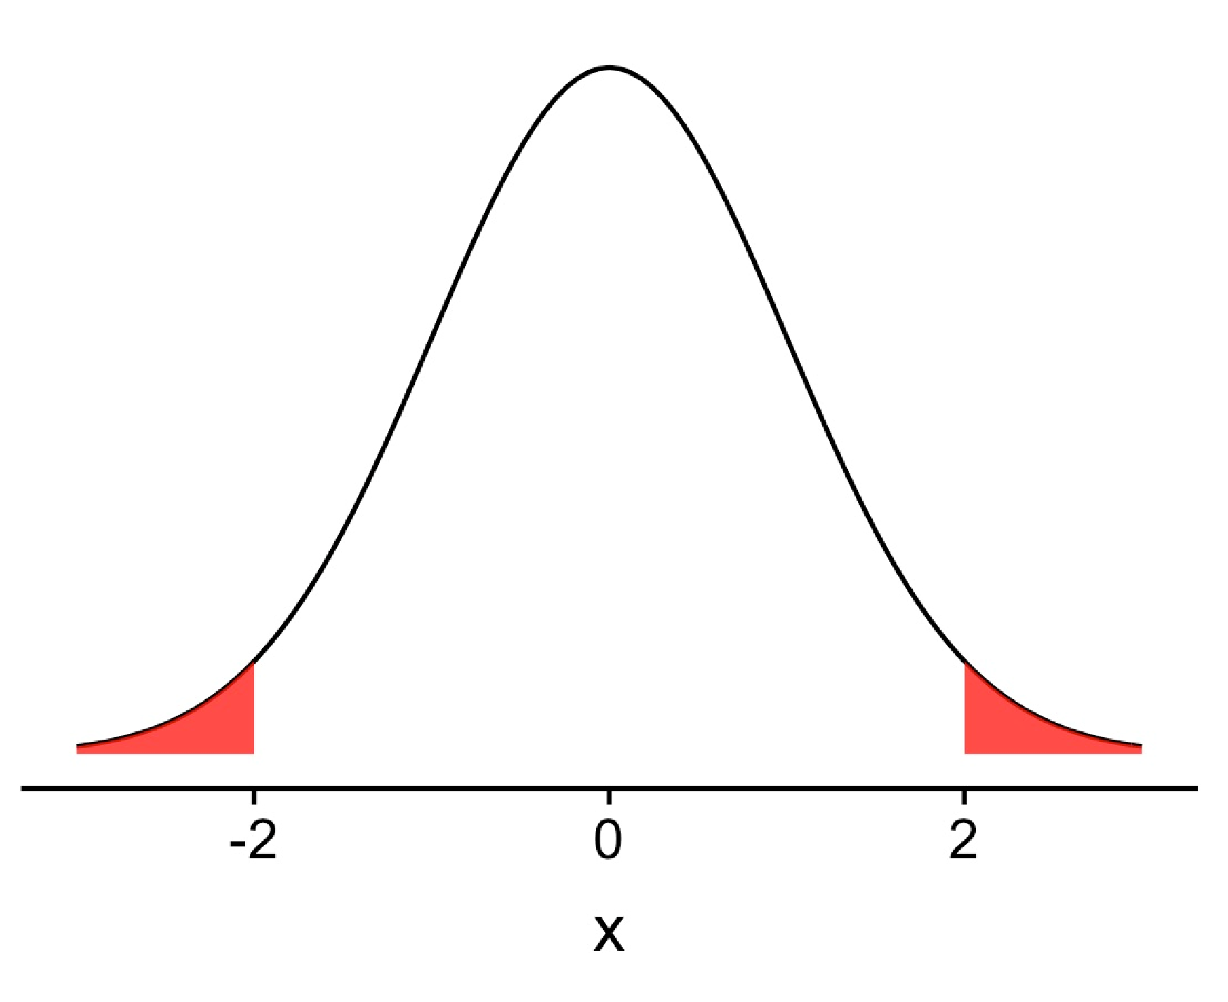
Hypothesis Testing
Hypothesis testing compares your data to a pre-determined null distribution (usually the normal distribution). You state a null and alternative hypothesis and calculate the probability your observations happened under the null hypothesis.
Null hypothesis, H0: Everything happened by random chance.
Alternative hypothesis, H1: My observations happened because of my idea.
Saying p-value = 0.05 means that there’s a 5% chance the observation happened randomly under the null distribution.

Slide 4
Test for Continuous Data: one sample t-test
For testing continuous values against some known mean
I have an iris with a sepal length of 7 inches and I think that it’s because of my new iris fertilizer. Is that iris’ sepal length abnormally large?
H0: There’s nothing different about the fertilizer.
H1: The fertilizer does increase iris sepal length.
> t.test(iris$Sepal.Length, mu = 5.8) One Sample t-test
data: iris$Sepal.Length t = 0.64092, df = 149, p-value = 0.5226 alternative hypothesis: true mean is not equal to 5.8
95 percent confidence interval:
5.709732 5.976934 sample estimates:
mean of x
5.843333

Slide 5
Demo

Slide 6
Statistical interference using Resampling

Slide 7



- jackknife
- bootstrap
- permutation
- cross validation

Slide 8
Permutation
Group comparison
- get p-value of statistic
Group A Group B
27 24
20 29
21 18
26 20
27 17
31 31
24 20
21 25
20 28
19 21
23 27
24 28
19
21 13
22 22
15 20
12 24
21 18
16 20
19 23
15 19
22 24

Slide 9
Permutation
Group comparison
- get p-value of statistic
Group A
> A=c(27,24,20,29,21,18,26,20,27,17,31,31,24,20,21,25,20,28,19,21,23,27,24,28,19)
> mean(A)
[1] 23.6
Group B
> B=c(21,13,22,22,15,20,12,24,21,18,16,20,19,23,15,19,22,24)
> mean(B)
[1] 19.2
Mean difference A vs B: + 4.4

Slide 10
Are Group A and B different?
Is difference 4.4 statistically different?
There are 2 possible way to determine:

Slide 11
Are Group A and B different?
There are 2 possible way to determine:
Classical statistics (analytical method)
Computational method

Slide 12
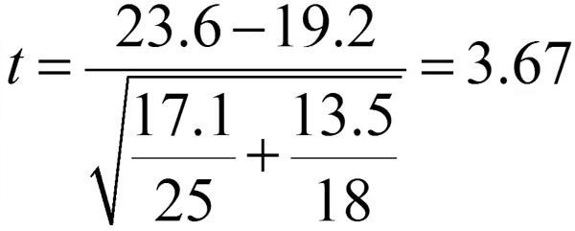
Classical statistics (analytical method)
STAT 101
Student's t-test
Equal or unequal sample sizes, unequal variances
Welch's t-test

Slide 13

Classical statistics (analytical method)
STAT 101
Student's t-test

Slide 14

Classical statistics (analytical method)
STAT 101
Student's t-test

Slide 15
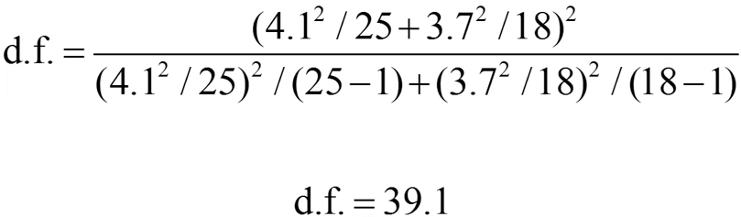
Classical statistics (analytical method)
STAT 101
Student's t-test

Slide 16
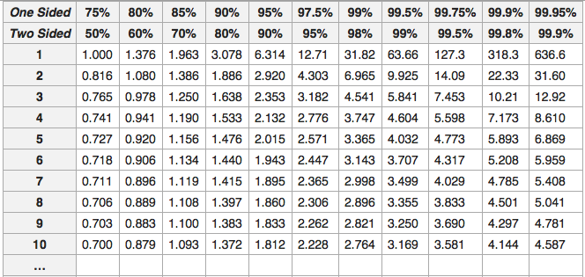

Classical statistics (analytical method)
STAT 101

Slide 17
Classical statistics (analytical method)
STAT 101
3.67 > 2.021

Slide 18
Classical statistics (analytical method)
STAT 101
3.67 > 2.021

Slide 19
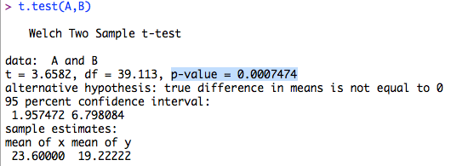
Classical statistics (analytical method)
STAT 101
Difference 4.4 is statistically significant p<0.05 level

Slide 20
2. Computational method
Group A Group B
27 24
20 29
21 18
26 20
27 17
31 31
24 20
21 25
20 28
19 21
23 27
24 28
19
21 13
22 22
15 20
12 24
21 18
16 20
19 23
15 19
22 24

Slide 21
2. Computational method
Group A Group B
22 24
20 29
21 16
26 20
12 17
31 31
18 23
21 25
20 28
22 21
23 27
24 21
19
28 13
22 27
15 20
27 24
21 24
18 20
19 20
15 19
19 24
differencies in mean 2.7

Slide 23
2. Computational method
Ability to follow logical statement
Random number generator - in R sample() command
Iteration
p-val: 0.00075
7-8 of of 10,000
~75 out of 100,000

