Slide 1
THEORETICAL BASIS FOR SEQUENCING

Slide 2
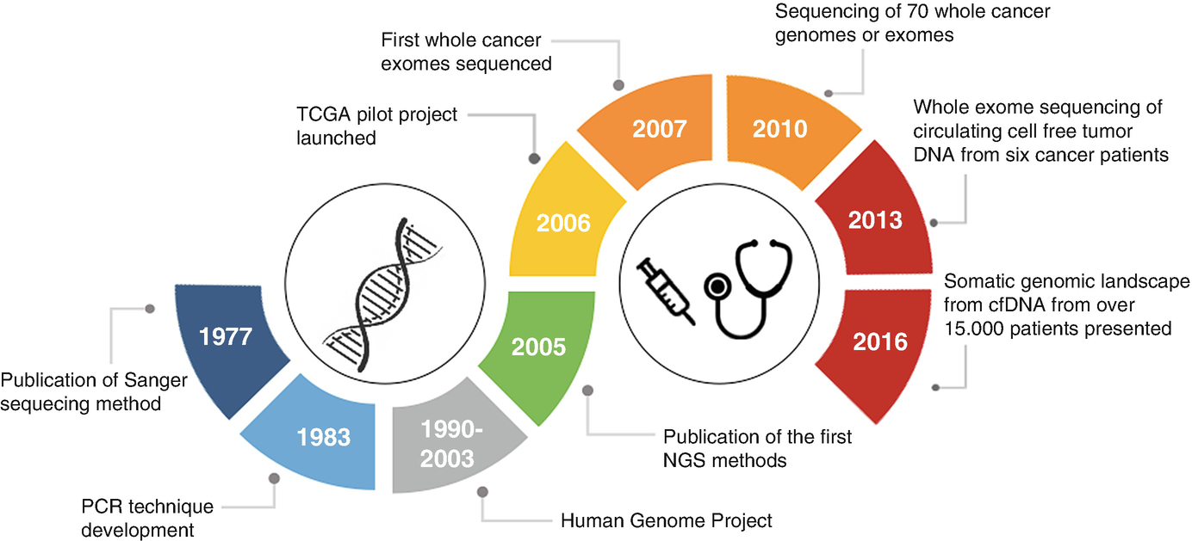
Evolution of sequencing technology and its influence in Scientific Discovery and Medicine
3.
Introduction of long read sequencing
Avg fragment length sequenced: 30,000 bp
400,000 fragments sequenced per run
96 DNA fragments (reads) sequenced per run.
DNA fragments were identical
2-3h run time
Short fragment length sequenced: 700-900bp
1.
2.
20B fragments sequenced per run (10K fold more!)
36-44h run time
Short fragment length sequenced: 300-500 bp
Morganti, S. et al. (2020). Role of Next-Generation Sequencing Technologies in Personalized Medicine. In: Pravettoni, G., Triberti, S. (eds) P5 eHealth: An Agenda for the Health Technologies of the Future. Springer, Cham. https://doi.org/10.1007/978-3-030-27994-3_8

Slide 3
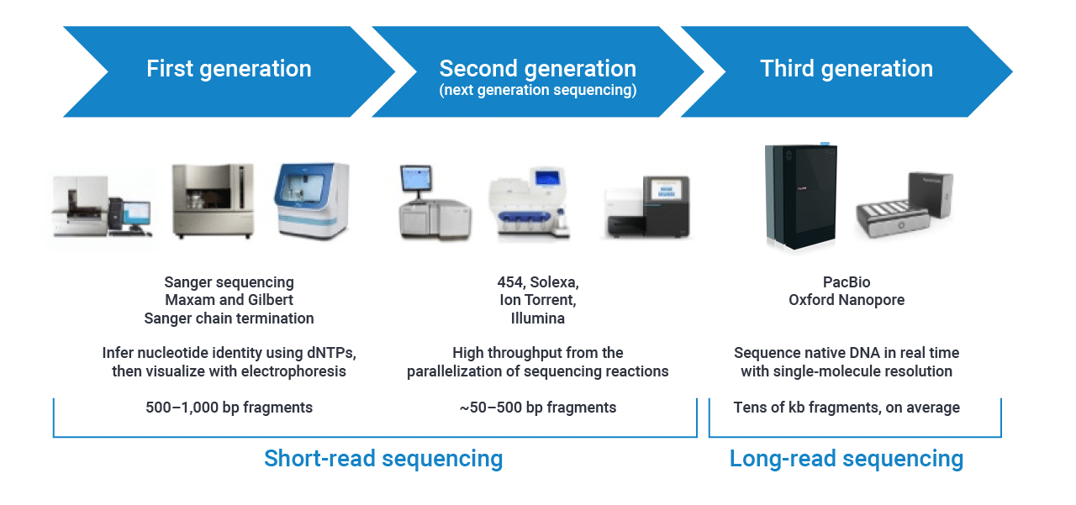
Outline
PacBio: Mar25/2020: Sequencing 101
https://www.pacb.com/blog/the-evolution-of-dna-sequencing-tools/
Past but certainly not obsolete
Fast, cost -effective and highly accurate for low throughput sequencing
Longer read length than NGS and simpler than long read sequencing
Mainly used to confirm:
Genes being cloned
PCR products
Site directed mutagenesis
DNA fingerprinting for cell line authentication
No longer meets sequencing demand for high-throughput sequencing nor is it cost-effective
Present the bread and butter of sequencing
The work horse of sequencers
Used for WGS, transcriptomics (RNAseq), epigenetics, single cell RNAseq, spatial RNAseq and even some spatial proteomic studies
Disadvantage: short read sequencing
Future?
Advantages: long reads can improve de novo assembly, mapping certainty, transcript isoform identification, and detection of structural variants
Disadvantages: high error rate in sequencing, cost and longer time required for data analysis
Notes:
Past present and future

Slide 4
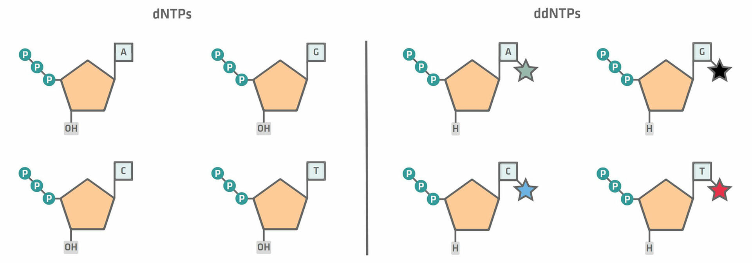
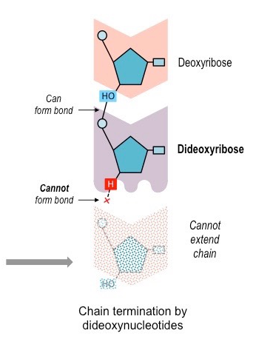
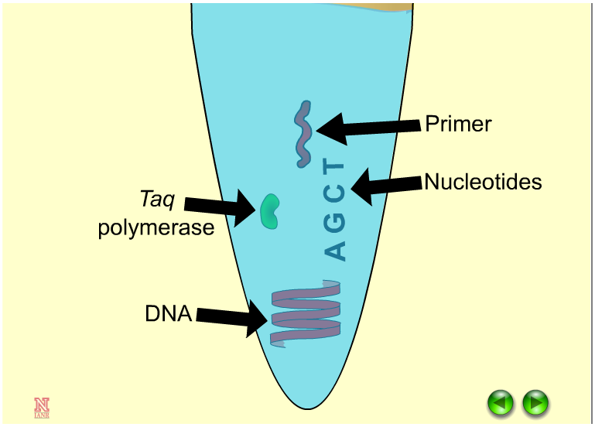
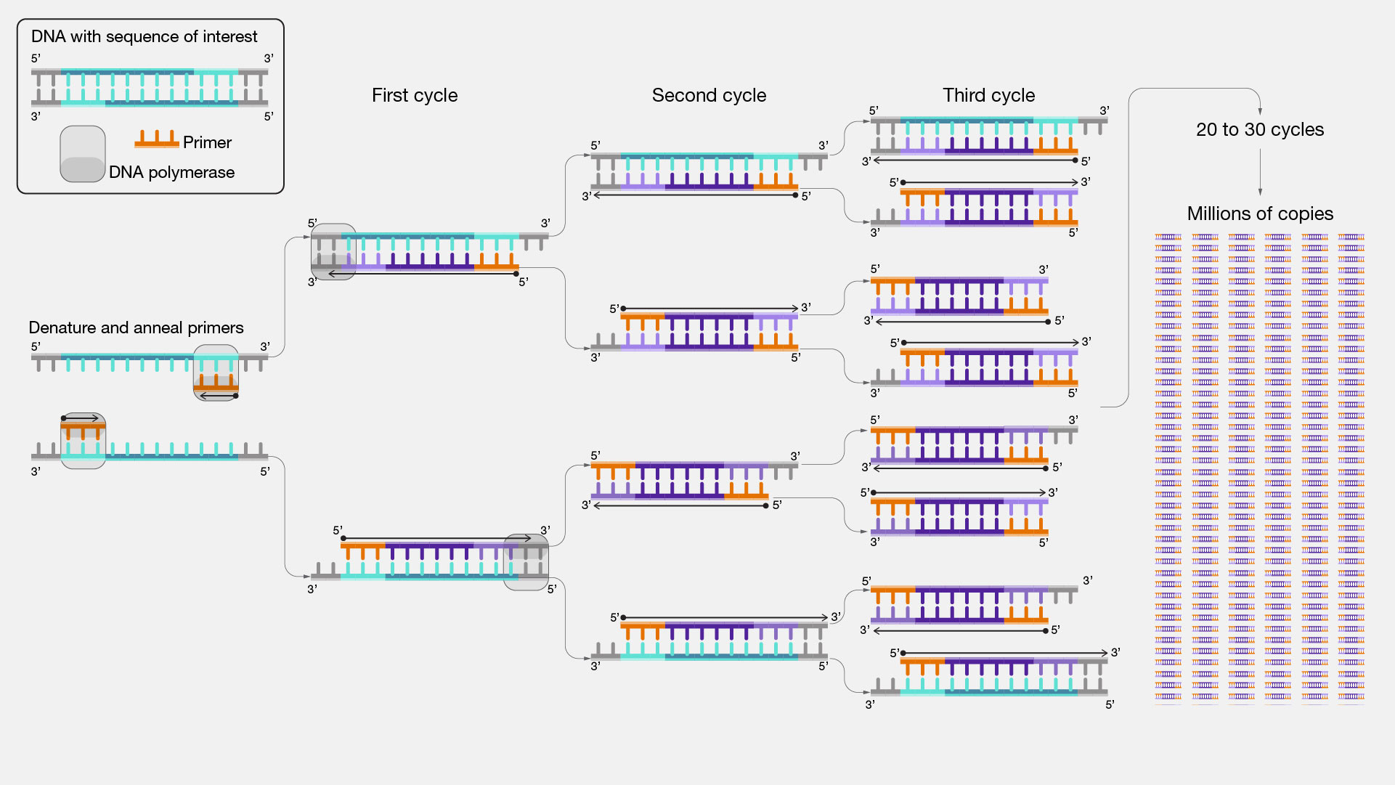
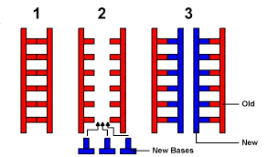
Sanger Sequencing- 1st generation sequencing
Chain termination sequencing which in part relies on PCR methods and a special type of nucleotide call dideoxy NTP (ddNTP)
PCR2: random incorporation of ddNTP into growing nucleotide chain resulting in termination of reaction
PCR1: DNA fragment amplification
Replication in cells:
Notes:
No doubt that the advent of sequencing technologies has revolutionized our understanding of genes and has played a huge role in genetic research and has allowed us to make breakthroughs in medicine.

Slide 5
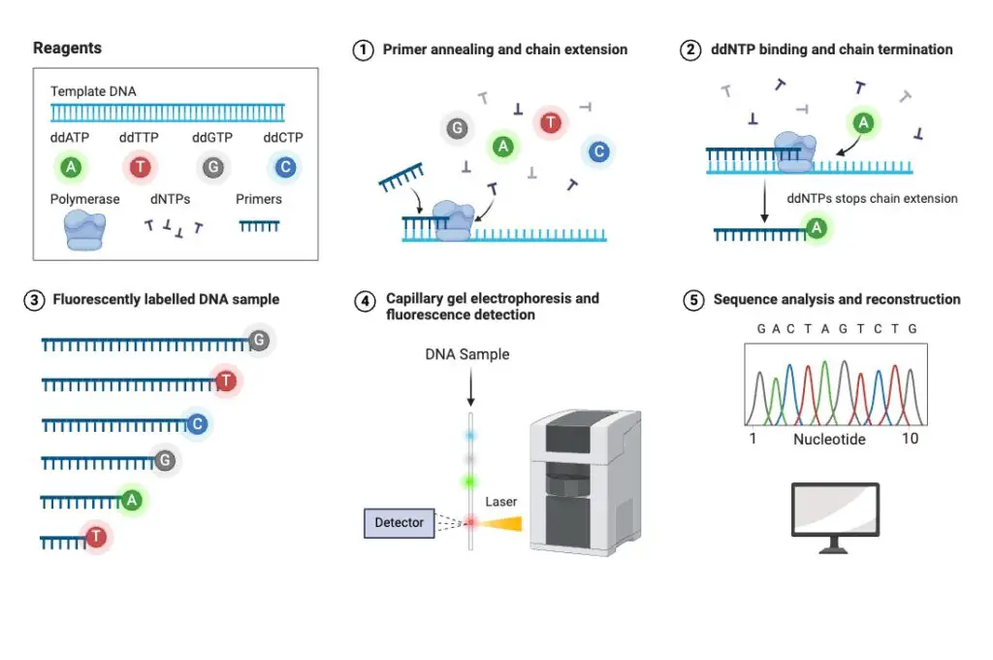
Sanger Sequencing- 1st generation sequencing

Slide 6
https://www.yout-ube.com/watch?v=dVRB4CaLizc
https://www.youtube.com/watch?v=X9566yI2cBo

Slide 7
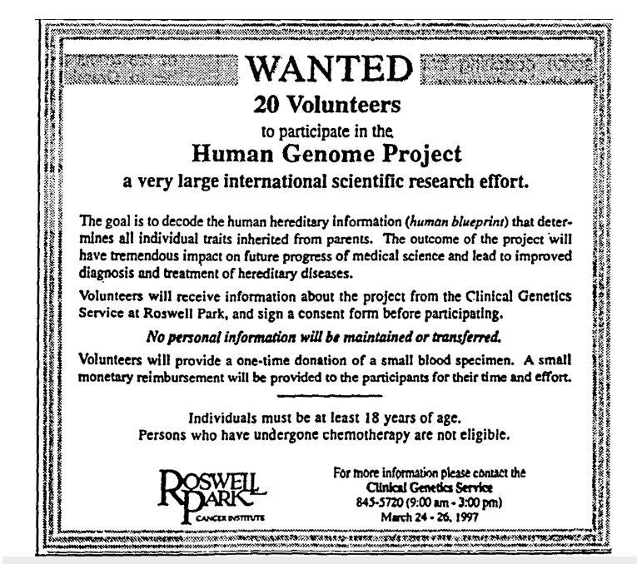
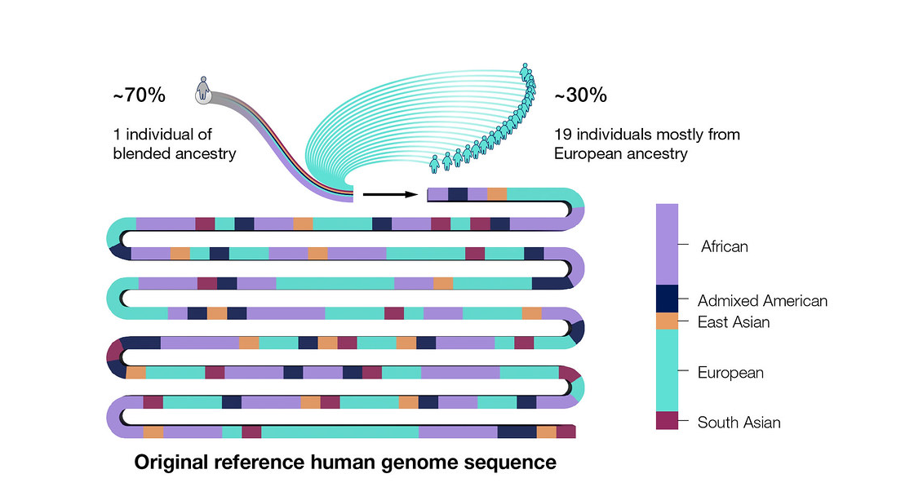
Human Genome Project
The Genome Project was completed 2 yrs ahead of schedule due the dedication of an international consortium of researchers from US, UK, Germany, France, Japan, China
the de facto leader was the US scientist Dr. Collins from the National Human Genome Research Institute (part of NIH)
92% of the genome was sequenced at the time, the rest, around 400 gaps, were difficult to sequence due the limitation of technology at the time
Gaps were highly repeated regions or sequence, often found around the region of telemores and centromers
The enter genome was not actually completely sequenced until 2022 largely due to the advent of long red sequencing
The ENTIRE genome was finished by T2T consortium co-lead by Dr. Karen Niga (UCSC) and Adam Phillippy, a bioinformatician, from NHGRI

Slide 8
Next Generation Sequencing (NGS)- 2nd generation sequencing
Simultaneous, massively parallel sequencing where 100s of 1000s of DNA fragments are being sequenced at the same time instead of one at a time like Sanger sequencing
Not only can an ENTIRE genome or exome or transcriptome be sequenced at once but many individual samples of each can be combined and sequenced in one run.
This is done by indexing all the DNA fragments in one sample with a short unique barcode of 8-12 nucleotide bases
Sample 1: index combo:1.2
Sample 2: index combo:3.4
Sample 3: index combo:5.6
ATCCGTAT
Index 1
GACCTATA
Index 2
TGCAGCGT
Index 3
CCATTACG
Index 4
GAGCTTAC
Index 5
TATGCATC
Index 6
Pool all 3 samples together and sequence all at once
Separate the 3 samples bioinformatically based on the unique indexes on each fragment of each sequencing read generated
A huge amount of data is generated in a short period of time and the method of parallel sequencing is cost effective and well as accurate

Slide 9
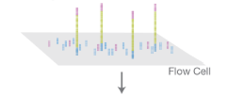
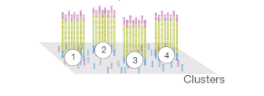
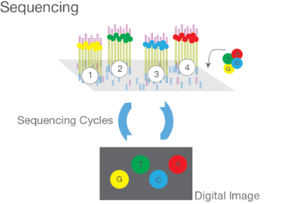
Next Generation Sequencing (NGS)- 2nd generation sequencing
Timeline of technological advancements
2005: Roche-pyrosequencing (SBS)
2007: Helicos- Heliscope
2006: Illumina- Genome analyzer(SBS)
2007: ABI SOLiD
2010: Ion Torrent
Ion Torrent: https://youtu.be/zBPKj0mMcDg
SBS- sequencing by synthesis
DNA fragments bind to flow cell and PCR1
PCR based SBS- sequencing by synthesis
Why did Illumina become the gold standard for NGS sequencing?
Cluster amplification technology enhanced the accuracy of base calling which helped reduce the need for sequencing redundancy and reduce thereby cost
Better optics generated stronger signals

Slide 10
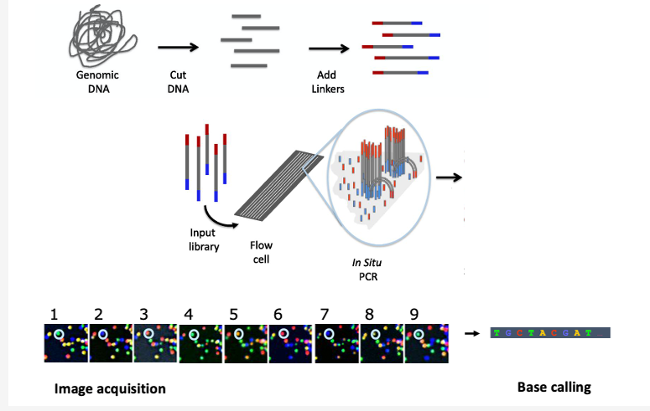
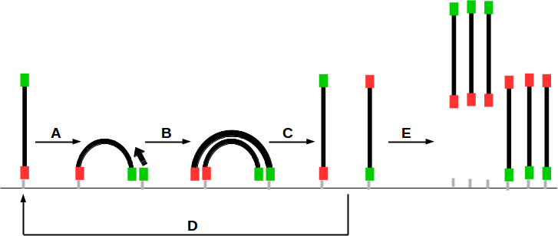
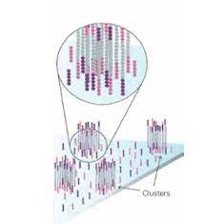
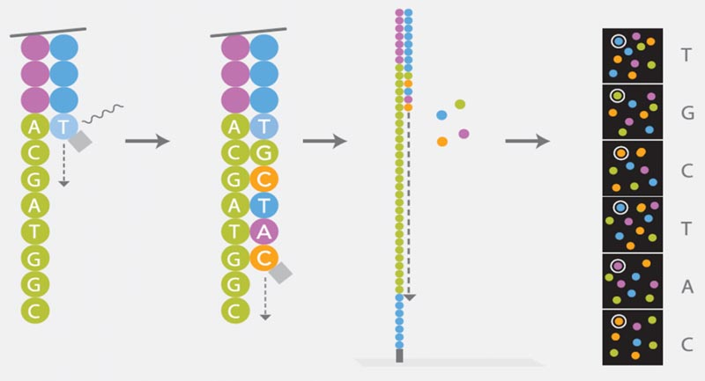
Illumina Sequencing
Library
Cluster generation
Sequencing:
Primer binds
Flow cell flooded with fluorescently- tagged dNTPs w. blocker
Only ONE dNTP binds per DNA fragment (bc of blocker)
Wash away excess dNTP
Records florescence
Cleave blocker = completion of cycle 1
Repeat (usually 50-300 cycles)

Slide 11
https://www.youtube.com/watch?v=fCd6B5HRaZ8
https://www.youtube.com/watch?v=EDVKxSNdSic

Slide 12
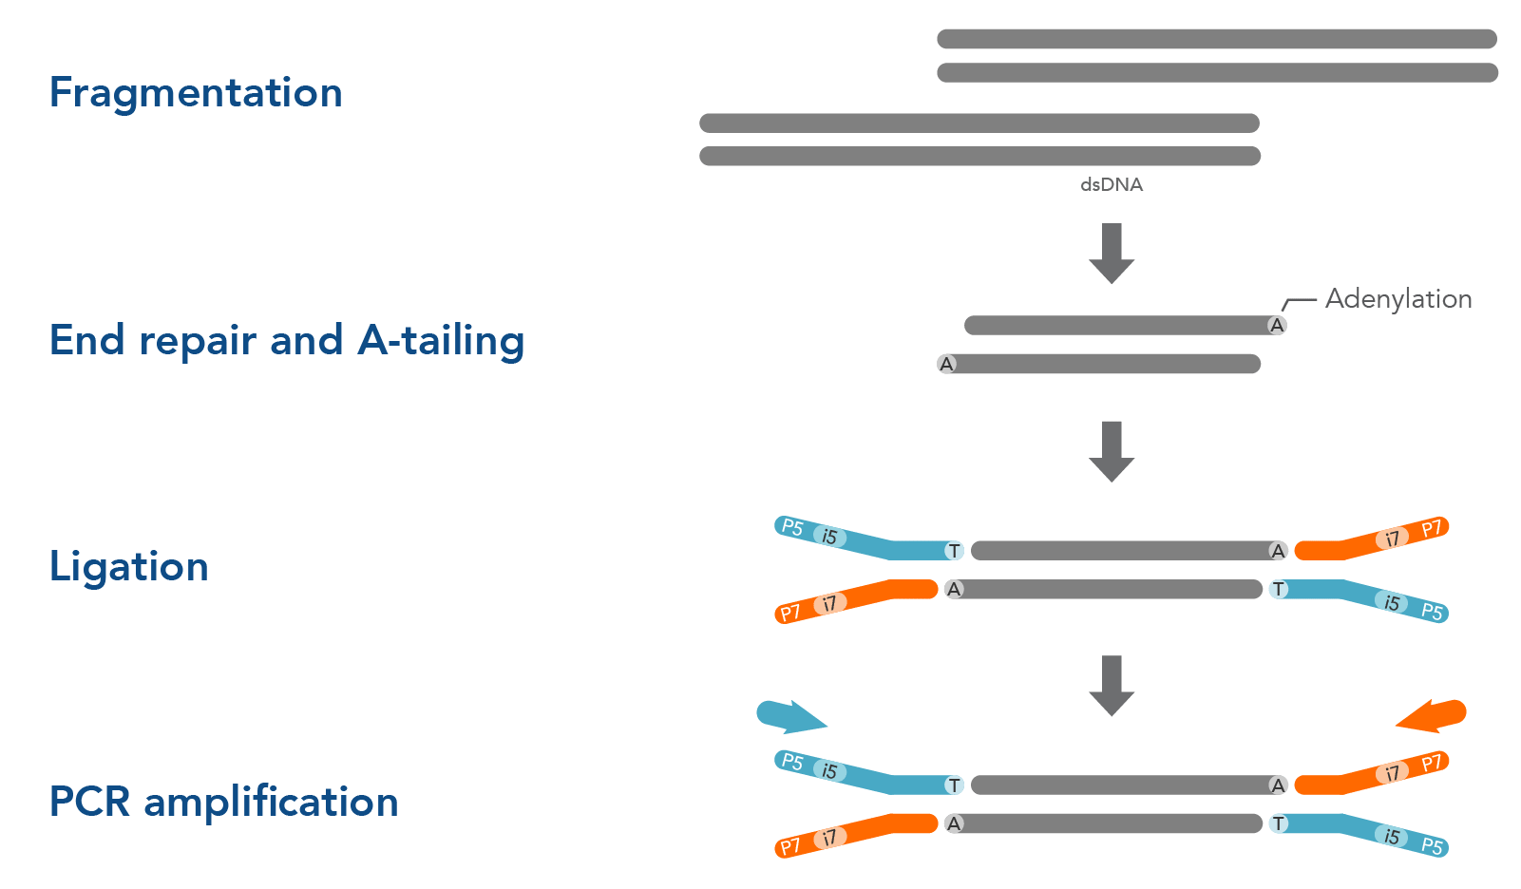
Library Preparation- prepare DNA for sequencing
1. DNAseq: WGS, WES, amplicons
Fragmentation:
Enzyme
Mechanical
transposase
Adenylation:
it activates the DNA ends
provides the necessary energy
ensures the reaction occurs with high specificity.
Adapters:
Flow cell binding site (linkers)
Sequencing primer binding site
Unique indexes to identify individual samples (added during PCR step)

Slide 13
DNAseq
Many types of DNAseq:
WGS- whole genome sequencing-
Determine the complete DNA sequence of an organism’s genome
Provides comprehensive view of the organism’s genetic make-up
Includes both introns (non-coding) and exons (coding)
detects a broad spectrum of genetic variations, including single nucleotide variants, insertions, deletions, and structural variants, which may be missed by targeted sequencing methods.
Disadvantage: cost, complex data analysis, ethical concerns
Exome sequencing-
Exome sequencing focuses on the exons-only the coding regions, rather than the entire genome, making it a more efficient and cost-effective approach.
WGS library 1st made, exomes are enriched and then sequenced
Disadvantage: can miss variants that may be in the non-coding regions that could influence regulation of gene expression
Amplicon sequencing- 1st PCR amplify targeted regions of the genome which are of interest which are then sequenced
Notes:
Genomics, epigenetics and transcriptomics
WGS, Exome, Amplicon, DIPseq- genomics
ChIP, ATAC, Hi-C- epigenetics

Slide 14
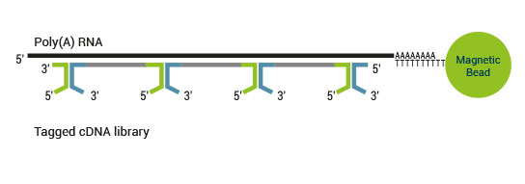
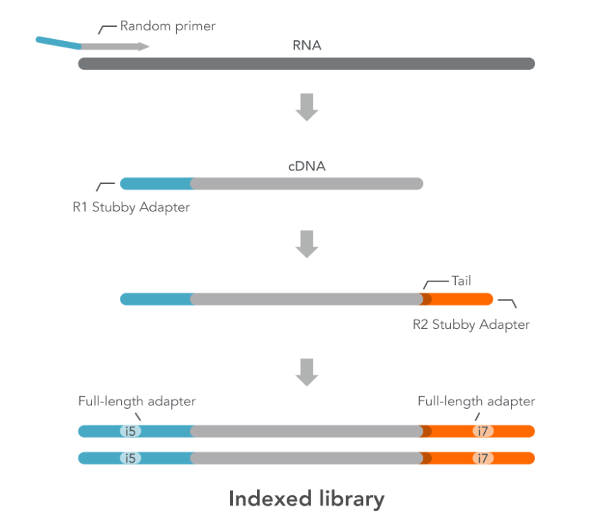
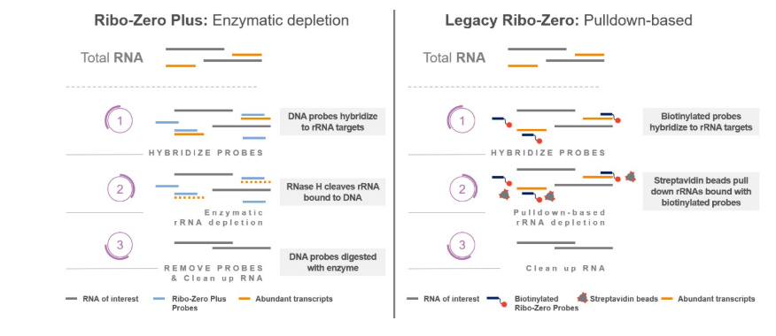
Types of Library Preparations
2 PROBLEMS:
Most of our RNA in cells is rRNA- conserved, won’t see many differences- want mRNA and must remove rRNA
RNA is unstable- can’t sequence directly
2. RNAseq- Transcriptomic studies
POSITIVE SELECTION OF mRNA: mRNAseq (capture mRNA using polyA tail and KEEP)
Reverse transcriptase- generates ssDNA also known as 1st strand synthesis
DNA polymerase- generates double stranded DNA = cDNA
NEGATIVE SELECTION OF mRNA: TotalRNAseq (capture rRNA using probes and DISCARD)
General library preparation workflow (previous slide)
Illumina
IDT Technologies
Notes:
Not all our genes are turned on at once in our cells, only a small portion
It changes over time, throughout our lifespan
Different in disease than in normal functioning (ex. Cancer, other diseases, infections)
Can we sequence RNA? No, not stable
Must convert RNA to DNA- make cDNA
Most of the RNA is our cells is rRNA- less than 5% of our RNA is mRNA
Positive selection- adv. Clean disadv. miRNA long non-coding RNA lost, can only be used on species with polyA tailed mRNA
Negative selection- species agnostic, miRNA and long non coding RNA included in sequencing data, noisy data because not as clean

Slide 15
RNAseq and the study of Transcriptomics
Transcriptomics- study of the whole transcriptome (all the genes that are actively made into mRNA) as it changes over a variety of biological changes
Driving force of how disease state or abnormal biological state FUNCTIONALLY differs from normal state in Genomics
Many types of RNAseq:
mRNAseq- positive selection via polyA tail
total RNAseq- negative selection by eliminating the rRNA using RNAseH or biotin-streptadivin-bead system
miRNAseq- (regulation)
RIP-seq- RNA IP (regulation)
single cell RNAseq
spatial RNAseq

Slide 16
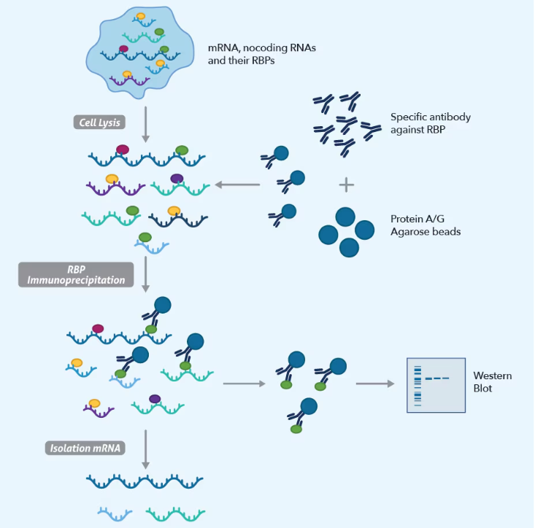
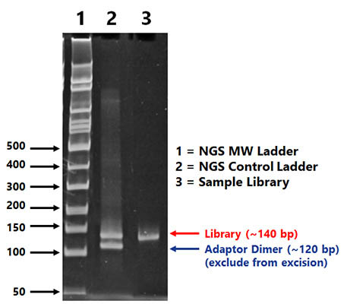
miRNAseq-microRNA
miRNA Function in post-transcriptional regulation of mRNA (inhibit or degrade)
Isolate TOTAL RNA
Proceed with library preparation as normal
After PCR, perform gel electrophoresis to excise bank corresponding to miRNA
Purification of the DNA in the band which corresponds to miRNA
RIPseq
Maps RNA binding sites for proteins.
Crucial for various cellular functions, including DNA repair, RNA splicing, protein synthesis, and gene regulation, and disruptions in these interactions can lead to diseases.
Protein analysis to see what other proteins are part of the complex
Proteintech

Slide 17
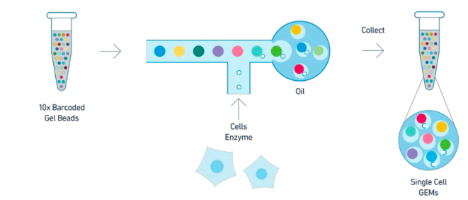
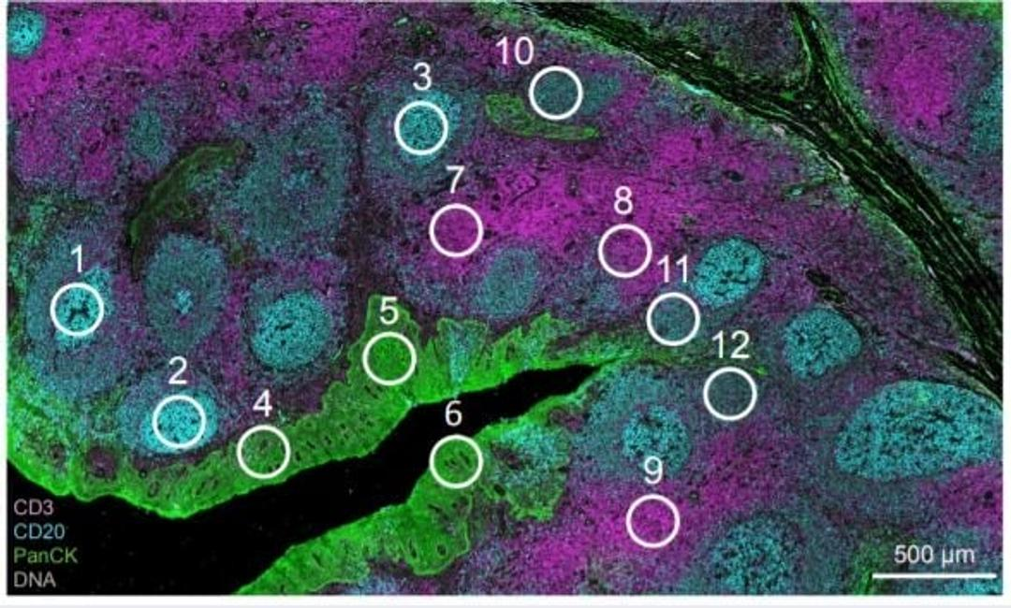
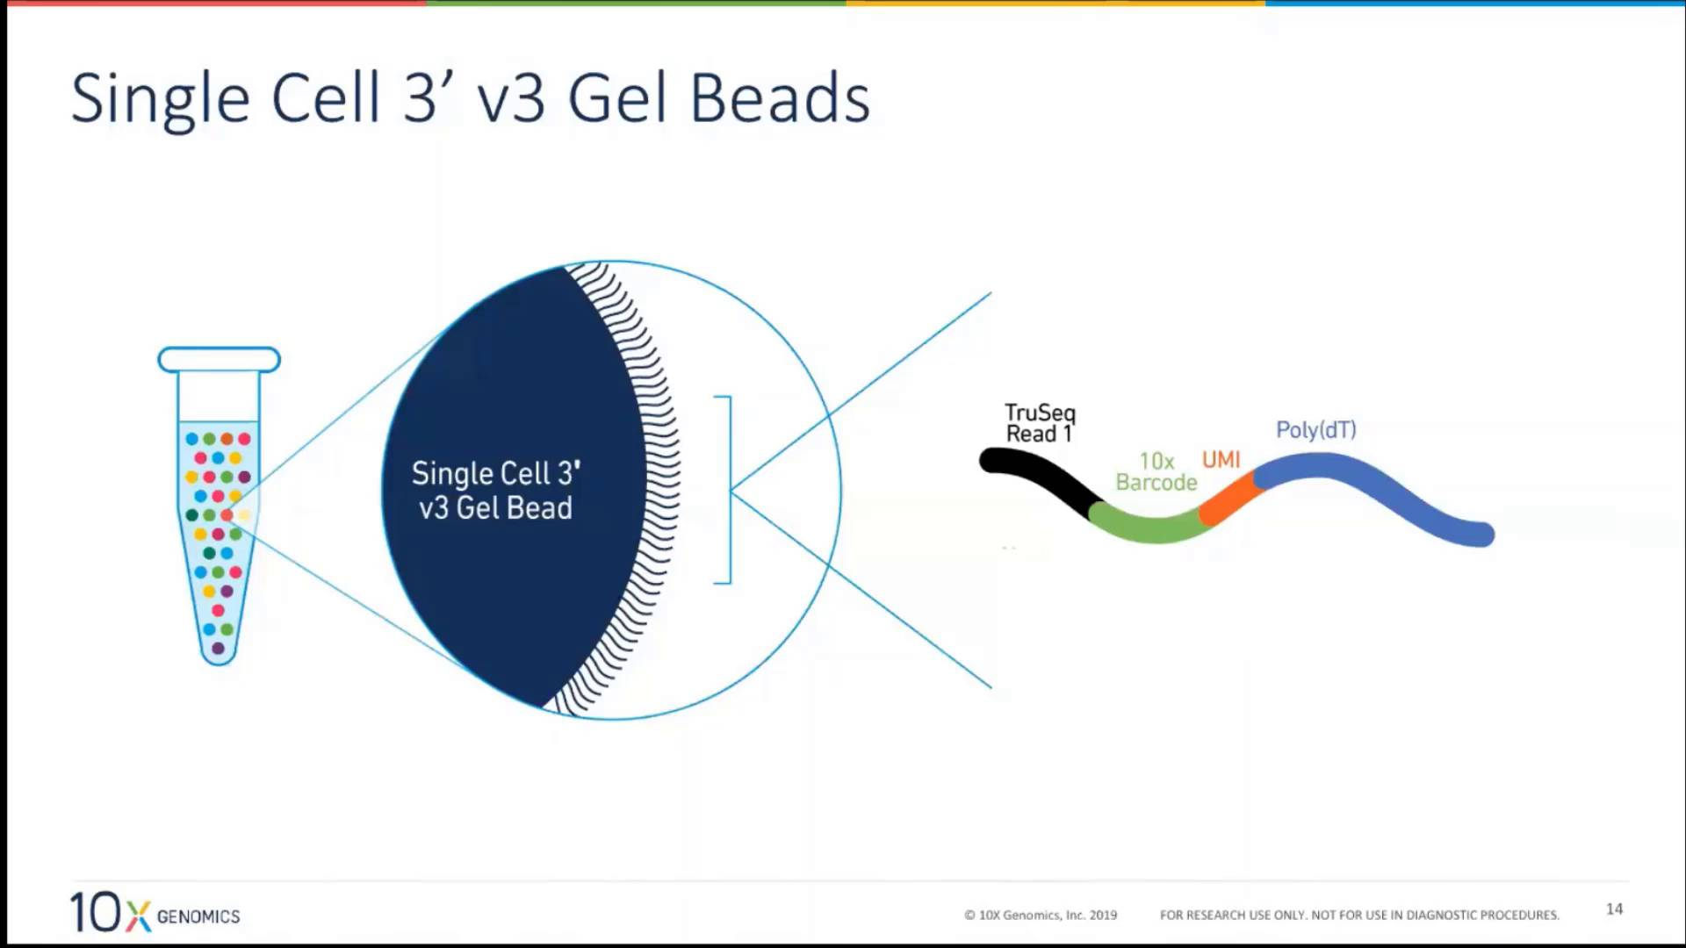
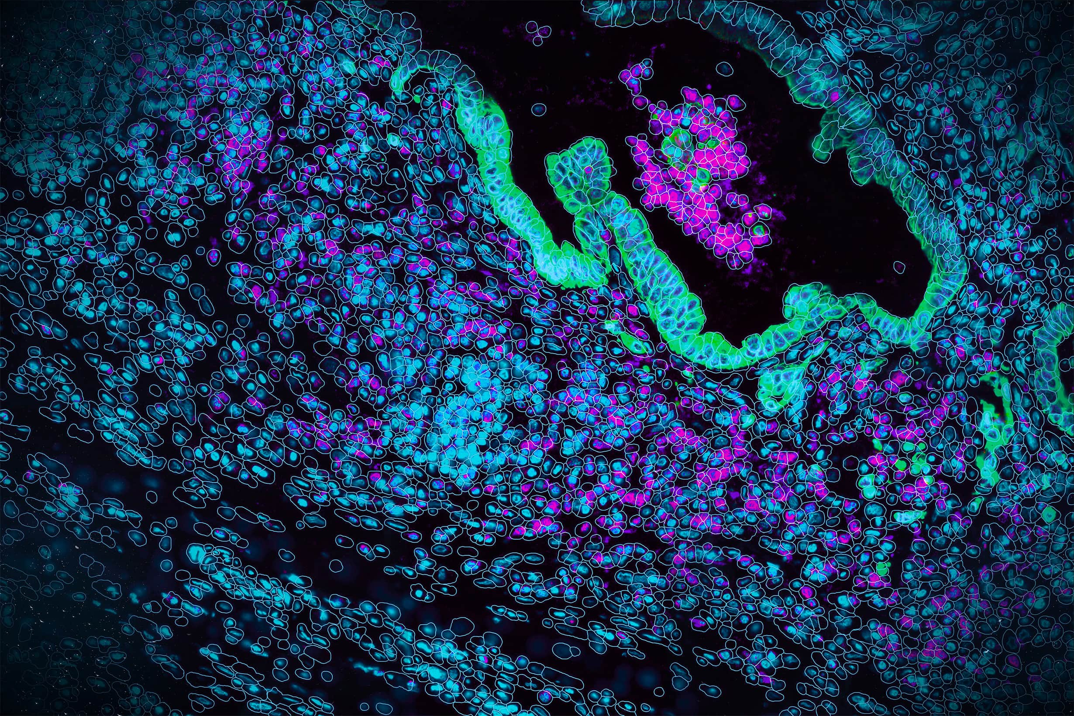
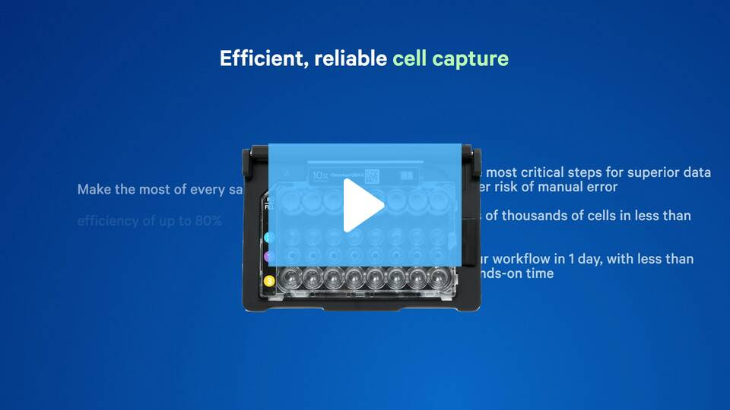
Videos - 10x Genomics
Single-cell RNAseq (Droplet seq)
Spatial sequencing
10x Genomics
Nanostring (formerly)
Bruker Corporation

Slide 18
Types of Library Preparations
3. DNAseq-epigenetics
Epigenetics- study of chromatin structure, organization and function, primarily in gene regulation
ChIPseq- chromatin IP. Offer insight into protein-DNA interactions. Histones
ATACseq- maps chromatin accessibility
Hi-C- investigates 3D chromatin organization
Notes:
Whole genome sequencing (WGS) is a process that determines the complete DNA sequence of an organism's genome, providing a comprehensive view of its genetic makeup, including both coding and non-coding regions.

Slide 19
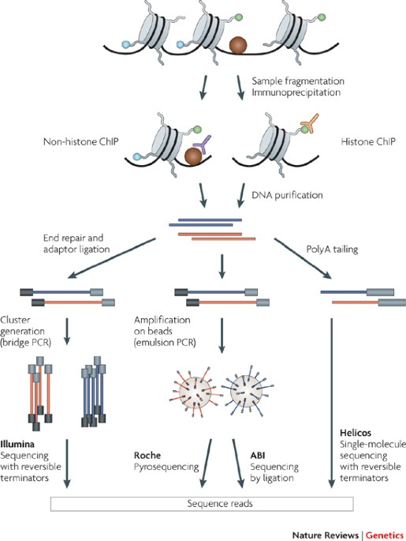
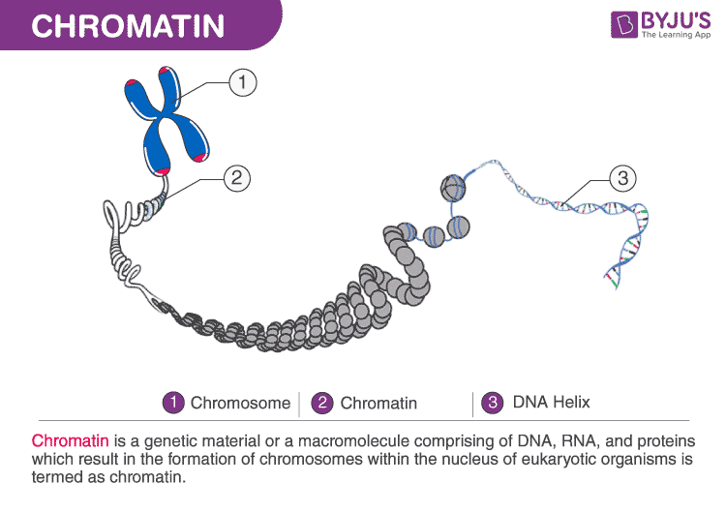
Park, P. ChIP–seq: advantages and challenges of a maturing technology. Nat Rev Genet 10, 669–680 (2009). https://doi.org/10.1038/nrg2641
ChIPseq- (chromatin IP):
2 types of Chromatin in cells:
1. Euchromatin:
Definition: Euchromatin is the less condensed, more open form of chromatin.
Function: Euchromatin is actively transcribed, meaning the DNA within is being used to make RNA and proteins.
Modifications: Euchromatin is often associated with histone acetylation, which helps to loosen the structure and allow access for transcription machinery.
2. Heterochromatin:
Definition: Heterochromatin is the more condensed, tightly packed form of chromatin.
Appearance: It appears as dark, dense regions in the nucleus.
Function: Heterochromatin is generally inactive, meaning the DNA within is not being transcribed.
Histones modification can give us insight on what type of genes are associating with the histone.
Ex. H2K9Ac histones are often associated with genes that function as gene activators
Chromatin immunoprecipitation that will pull down genes associating with H2K9Ac may identify genes involved in activation in a sample
Chemical cross-linking
Reverse-crosslink and digest protein to purify DNA or separate protein from DNA and analyze proteins isolated with the DNA
PCR amplification and index incorporation
Euchromatin
Heterochromatin
https://youtu.be/992RkrUwGfo?si=g24nko9bNq71Z_Oi&t=68

Slide 20
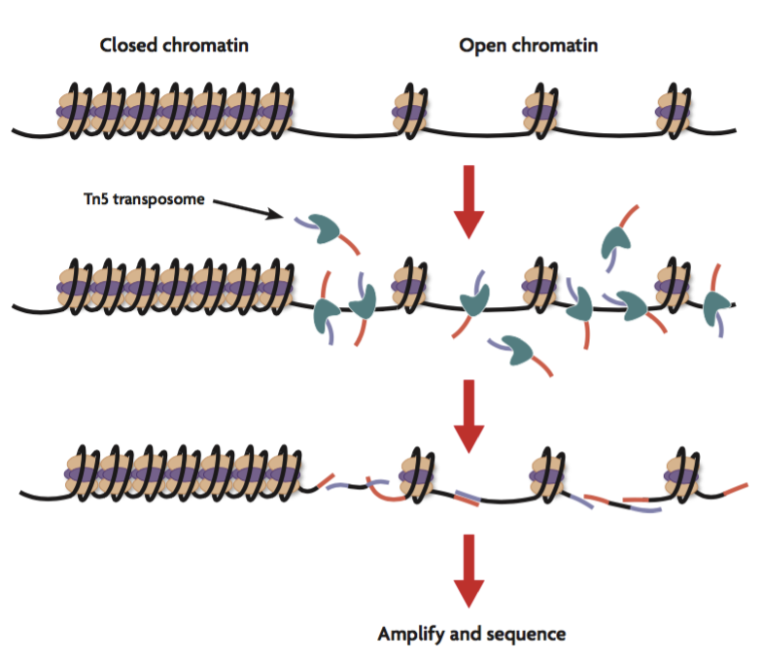
ATAC seq- (Assay for Transpose Accessible Chromatin):
Active Motif

Slide 21
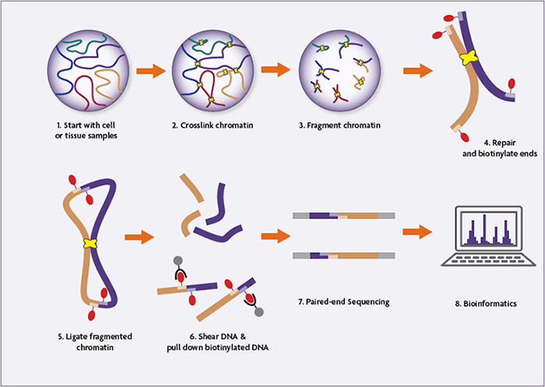
Hi-C- (Assay for Transpose Accessible Chromatin):
a method to study the three-dimensional structure of genomes by mapping chromatin interactions genome-wide, revealing how distant genomic regions interact in the nucleus
Measure how 2 fragments of DNA may interact with each other
Studying the 3D structure of genomes and its relationship to gene regulation and evolution.
Proximity ligation

Slide 22
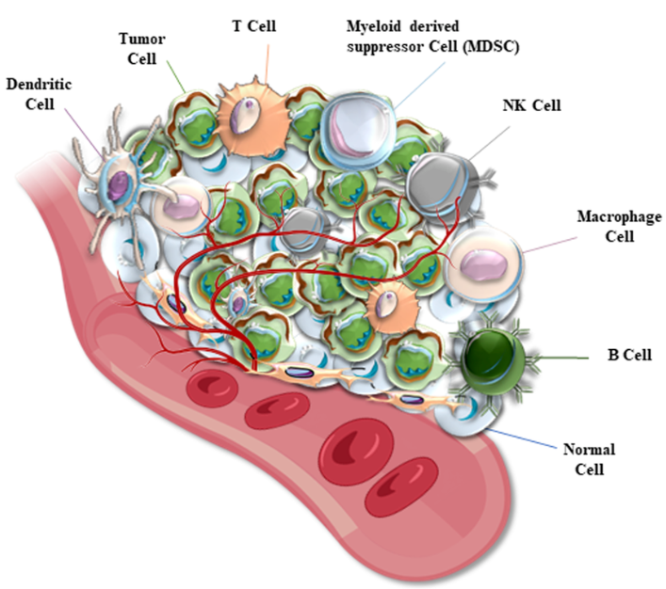
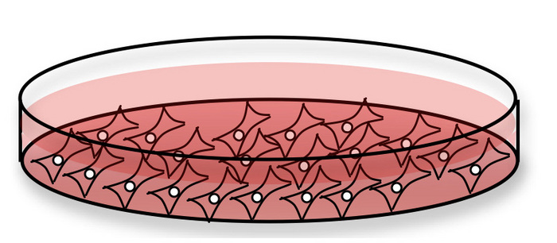
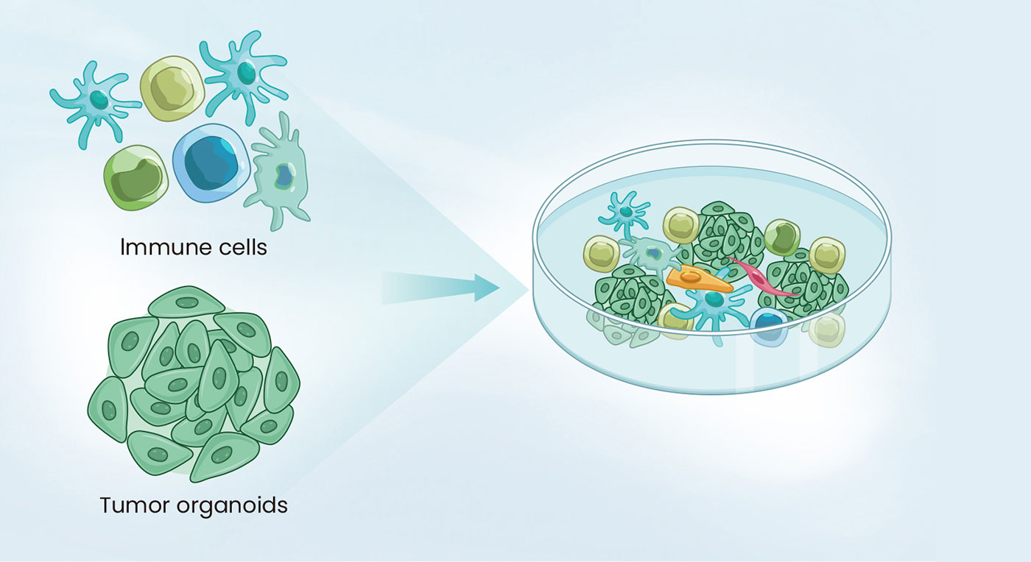
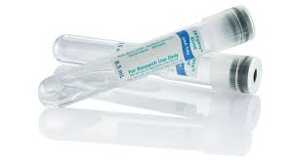
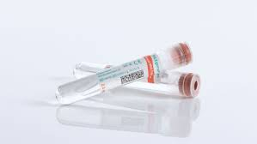
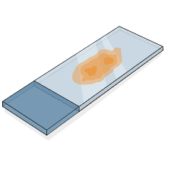
VERSALITLITY OF SEQUENCING
Cells in culture
Zhao, Deyao & Mo, Yingyi & Neganova, Margarita & Yu.R., Aleksandrova & Tse, Edmund & Chubarev, Vladimir & Fan, Ruitai & Sukocheva, Olga & Liu, Junqi. (2023). Dual effects of radiotherapy on tumor microenvironment and its contribution towards the development of resistance to immunotherapy in gastrointestinal and thoracic cancers. Frontiers in Cell and Developmental Biology. 11. 1266537. 10.3389/fcell.2023.1266537
Cells in a 3D co-culture (organoids or spheroids)
Mimic the 3D environment of cells in our bodies
DNA/RNA from blood, serum/plasma, biopsies

Slide 23
Long Read sequencing- 3rd generation sequencing
Avg read length 1000-30,000 bp (unlike 2nd generation 300-500bp)
Longer read length minimizes gaps in sequencing which is common using NGS in highly repetitive regions and areas of structural variation
Single and native (no PCR amplification) DNA/RNA molecule being sequenced
First technology came out in 2010-11. PacBio SMRT technology (Single Molecule sequencing in Real Time)
Between 2011 and 2018 PacBio increased output of 1000 bp per read to 30,000 bp per read!
In 2014 Oxford Nanopore released its first portable nanopore sequencing device, the MinION.
The overall data output was small but enough to identify pathogens
This made it possible for DNA sequencing to be carried out almost anywhere, even with limited resources.
A quarter of the world's SARS-CoV-2 viral genomes were sequenced with nanopore devices.
Both are fast but error rate higher than NGS, this has gotten much better in the recent years and there is lots of excitement about long read sequencing
Cost is still an issue, especially with PacBio. ONT is making headway in this aspect making long read sequencing more affordable.
With ease in cost, researchers can overcome higher error rates by doing redundant sequencing.

Slide 24
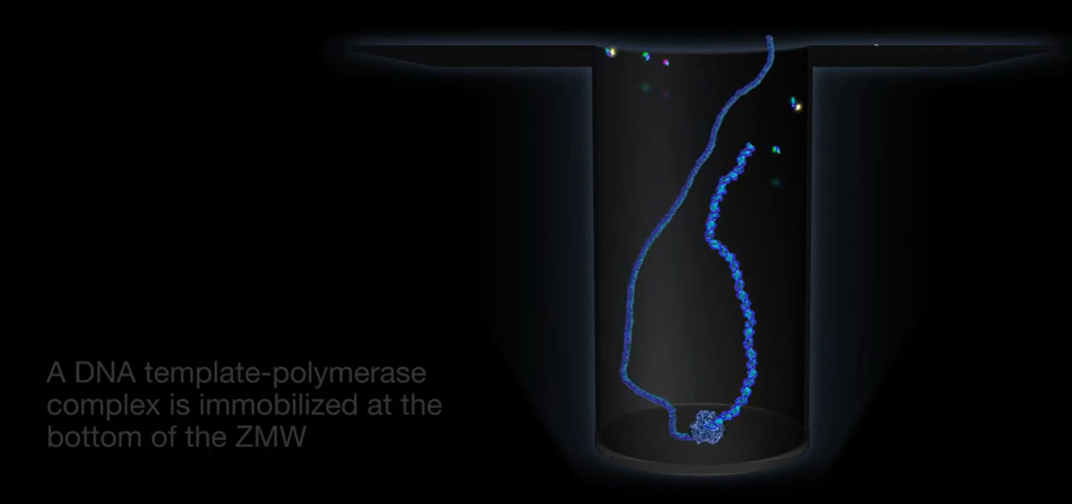
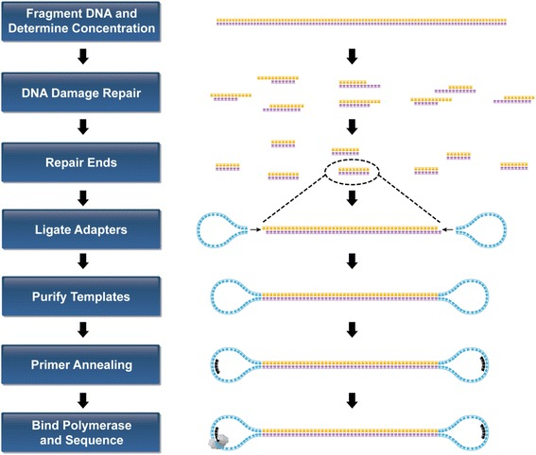
PacBio- SMRT
5000-35,000bp in length
ZMW (zero-mode waveguide) is a nanophotonic device, a tiny well or hole in a conductive layer, that confines light and allows for the real-time detection of nucleotide incorporation events during DNA sequencing.
https://youtu.be/_lD8JyAbwEo
https://youtu.be/NHCJ8PtYCFc
PacBio
Fonte: Kong N, Ng W, Thao K, Agulto R, Weis A, Kim KS, Korlach J, Hickey L, Kelly L, Lappin S, Weimer BC. Automation of PacBio SMRTbell NGS library preparation for bacterial genome sequencing. Stand Genomic Sci. 2017 Mar 23;12:27. doi: 10.1186/s40793-017-0239-1. PMID: 28344744; PMCID: PMC5363030.

Slide 25
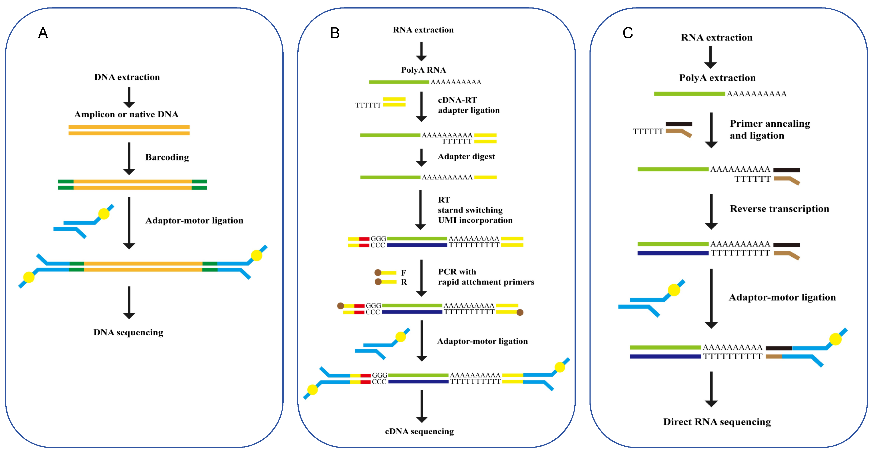
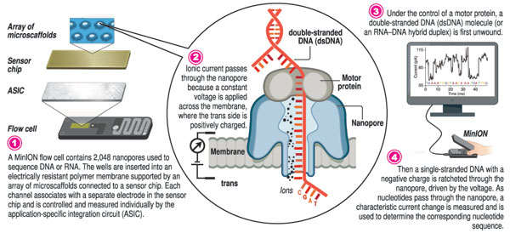
Nanopore- ONT
Unlike all previous sequencing technologies, ONT doesn’t use any DNA polymerases
Instead, it uses a barrel-shaped protein called α-hemolysin – naturally found as a ‘pore’ in a cell membrane, this is called a nanopore
α-hemolysin has a diameter of 1 nanometre – just big enough to allow a single strand of DNA through
α-hemolysin nanopores are embedded into an artificial membrane inside a flow cell
When a current is applied to the membrane, the DNA travels through the nanopore
As the DNA travels through the nanopore, it obstructs the current flowing across the membrane and makes a ‘squiggle’
The four bases of the DNA (A, T, C and G) are of different shape and size, so each base has its own variation of the ‘squiggle’
These variations are measured by an electronic chip. An algorithm converts the data into a sequence which can then be read.
Unique feature of nanopore: adaptive sampling
Viruses 2024, 16(5), 798; https://doi.org/10.3390/v16050798
https://www.youtube.com/watch?v=RcP85JHLmnI
Nanopore sequencing – rapid insights in real time
By Kumudini Hettiarachchi and Ruqyyaha Deane
View(s): Sunday Times Jan 2022
https://www.youtube.com/watch?v=fwHreHs9FHg

Slide 26
SUMMARY
1st generation- Sanger. Sequencing 1 DNA fragment at a time. Read length 700bp
2nd generation- Illumina. Massively parallel sequencing of 100 or 1000s of DNA fragments at one time. Read length: 300-500bp
3rd generation-PacBio or ONT- long read sequencing. Read length 1000-30,000 bp
Majority of sequencing in the last 2 decades have been 2nd generation sequencing, with Illumina monopolizing the market
WGS, Chromatin accessibility and interaction, mRNA expression in bulk, single cell and spatial platforms have given enormous insight into disease states, cancer and has as revalorized Genomics

