Slide 1
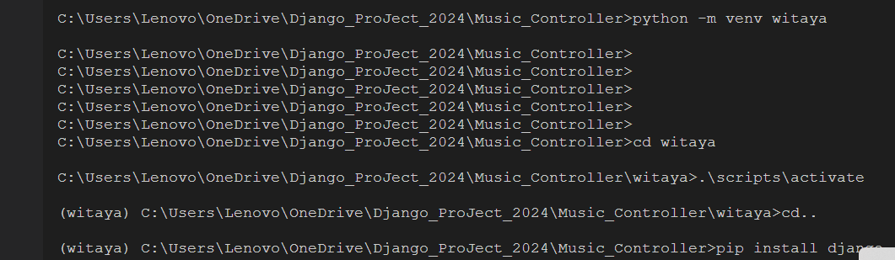
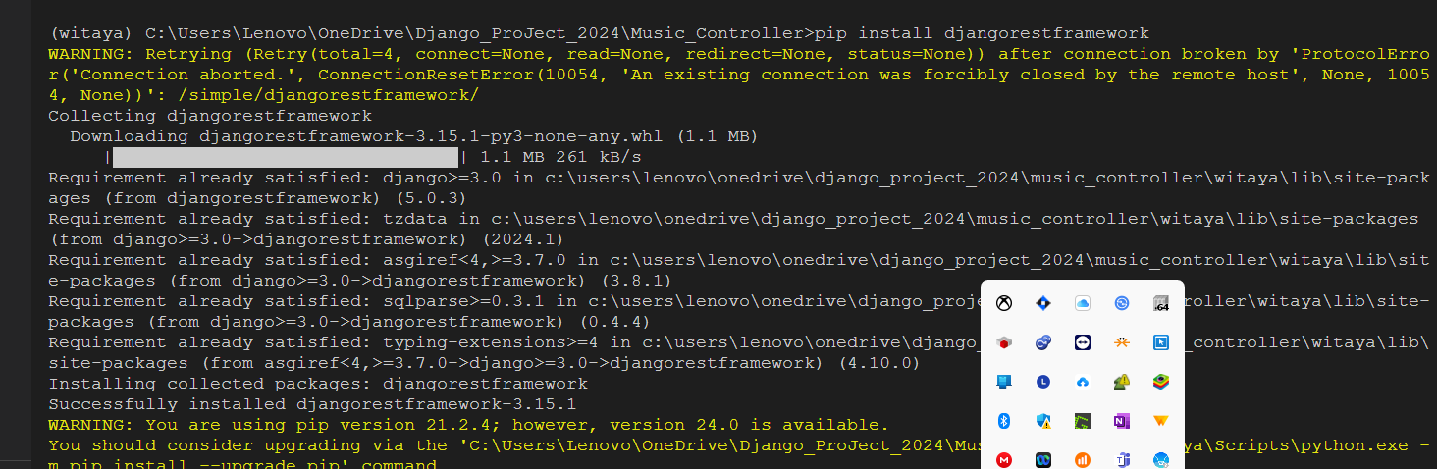

Slide 2
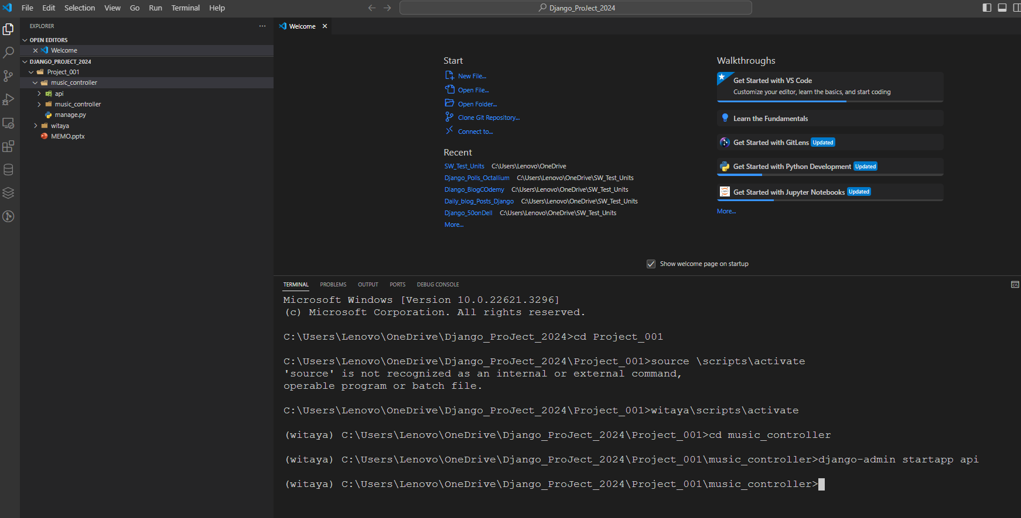

Slide 3
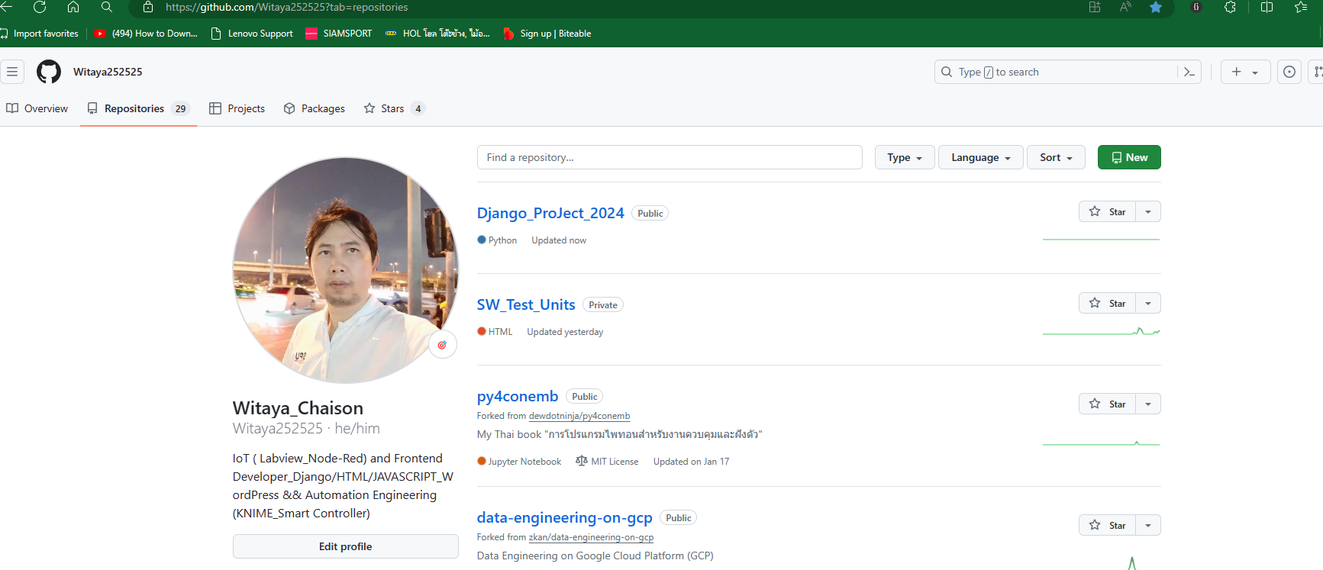
1.Git init on VS code ==> commit and wait
2.Pust git branch or put to remote ➔ Public commit Boom

Slide 4
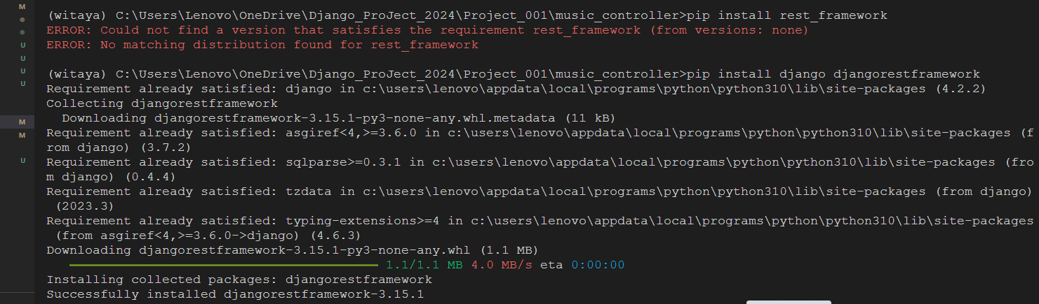

Slide 5
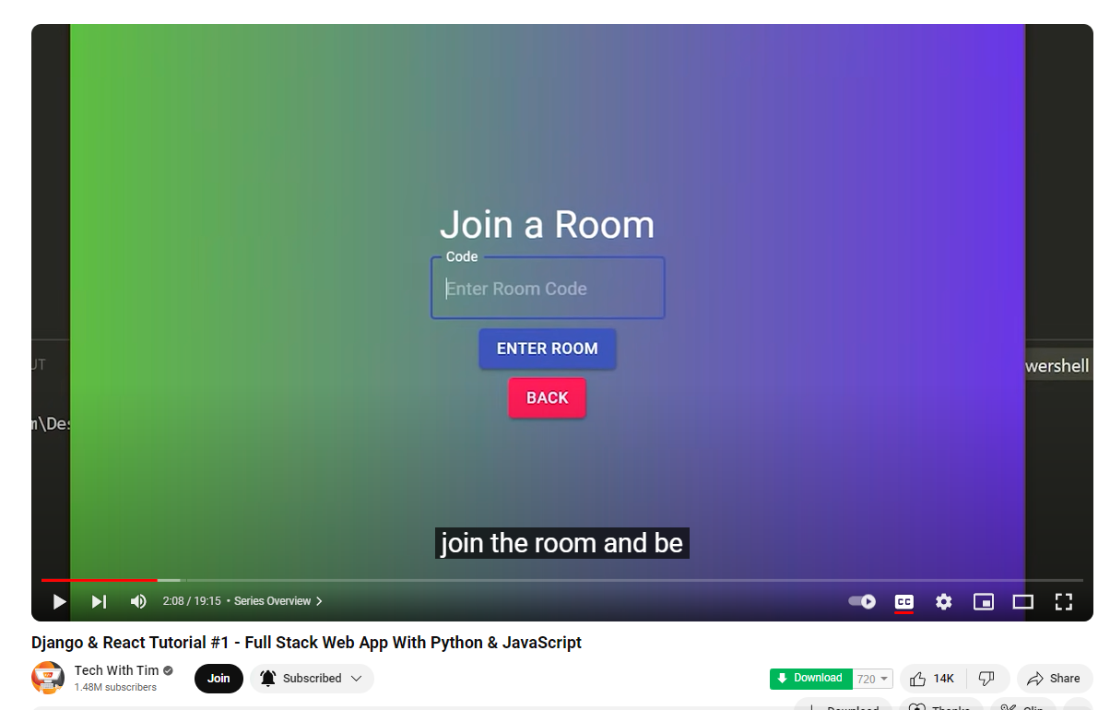
https://www.youtube.com/watch?v=JD-age0BPVo
Link project / Tech with tim

