Slide 1



Slide 2
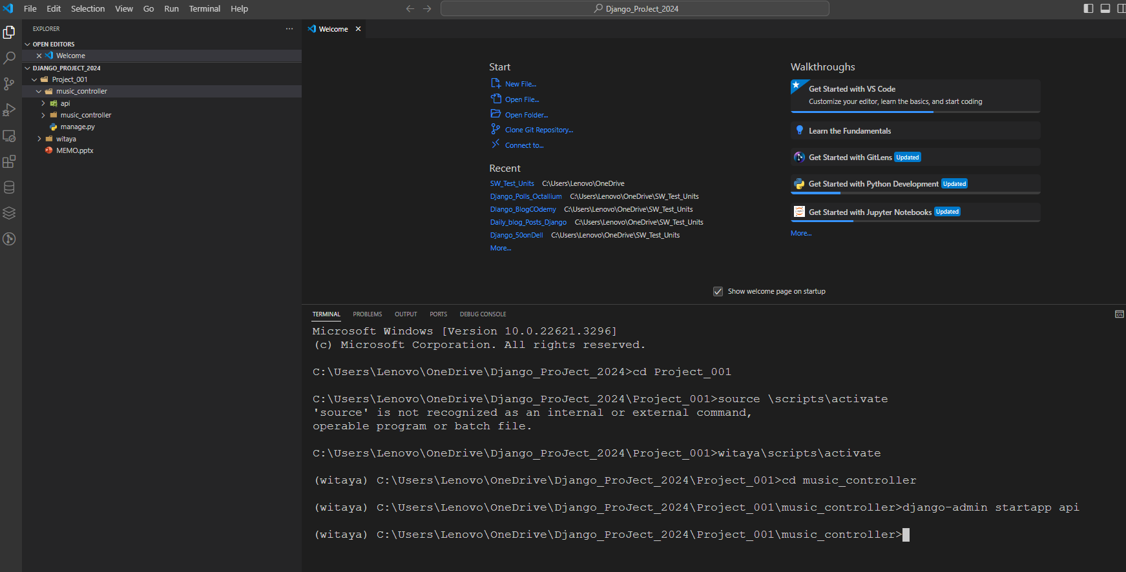

Slide 3
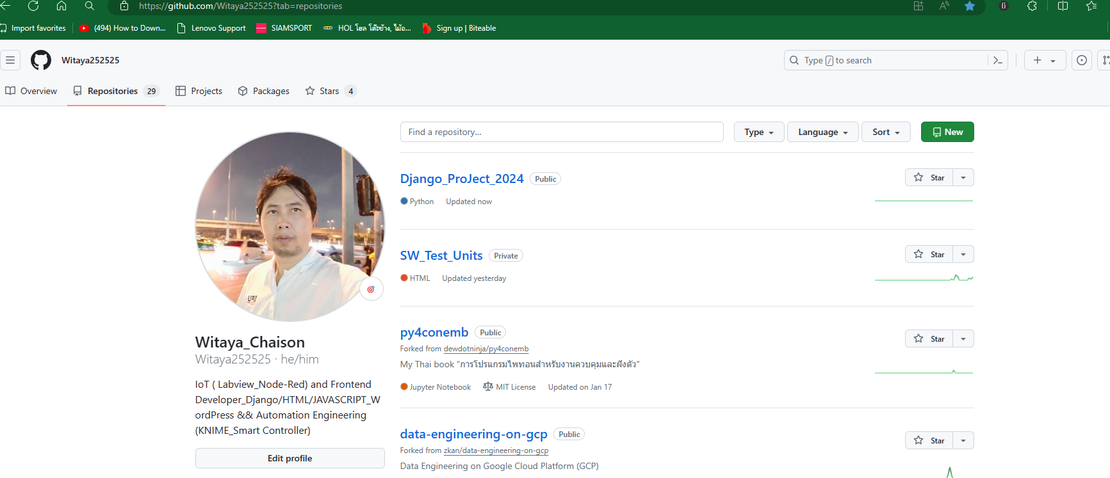
1.Git init on VS code ==> commit and wait
2.Pust git branch or put to remote ➔ Public commit Boom

