Slide 1
https://www.youtube.com/watch?v=0nncLP7UyFI&t=1s
Link This Project

Slide 2
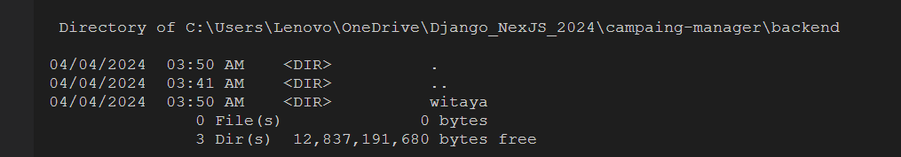
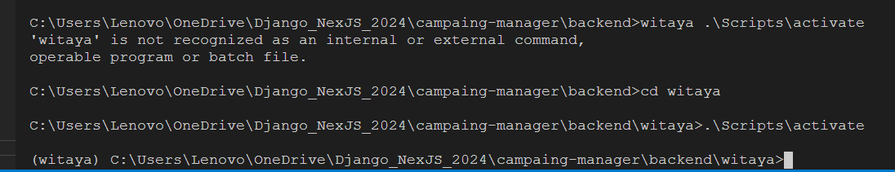

Slide 3
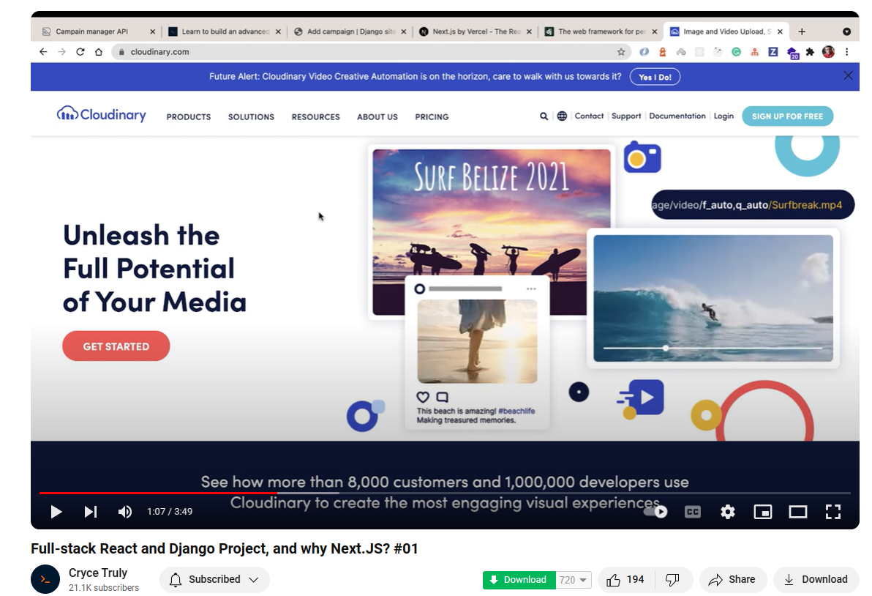

Slide 4
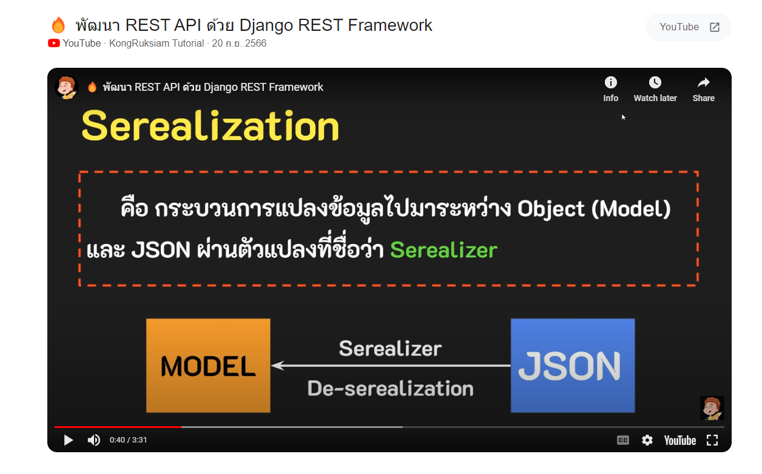

Slide 5
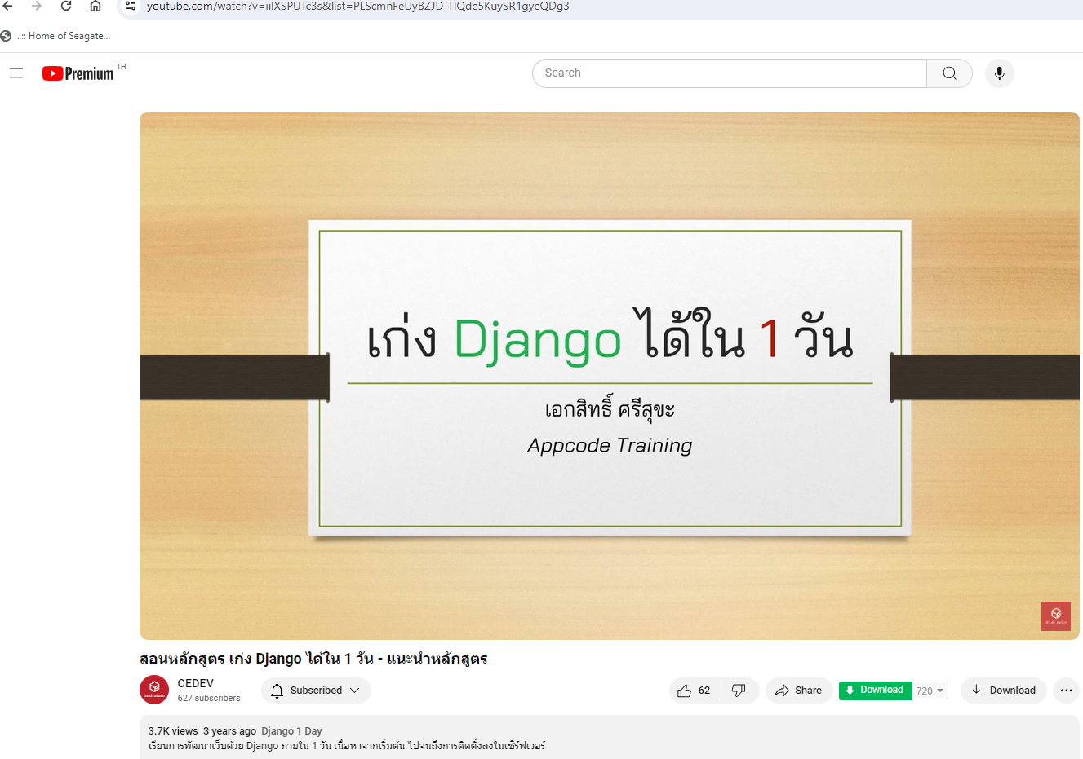
https://www.django-rest-framework.org/
https://www.youtube.com/watch?v=iilXSPUTc3s&list=PLScmnFeUyBZJD-TlQde5KuySR1gyeQDg3

Slide 6
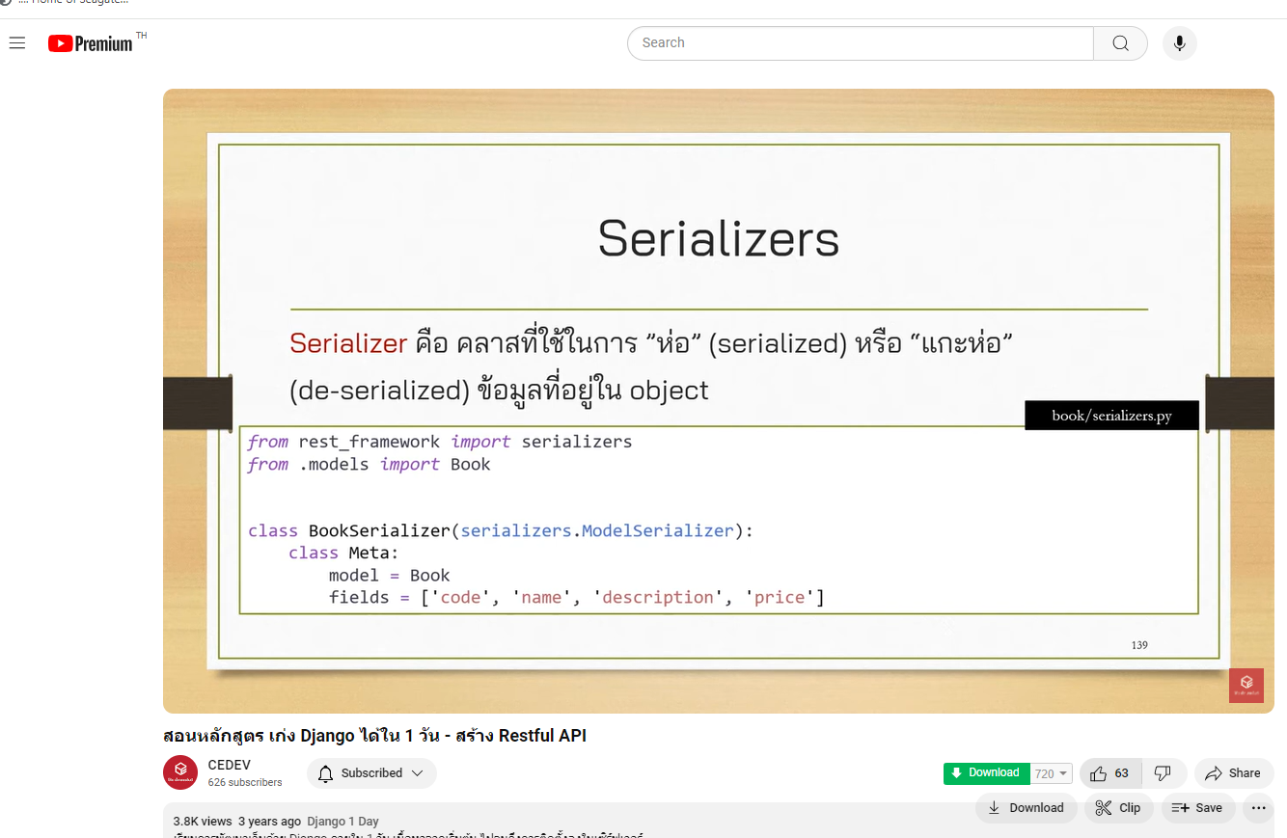

Slide 7
