Slide 1
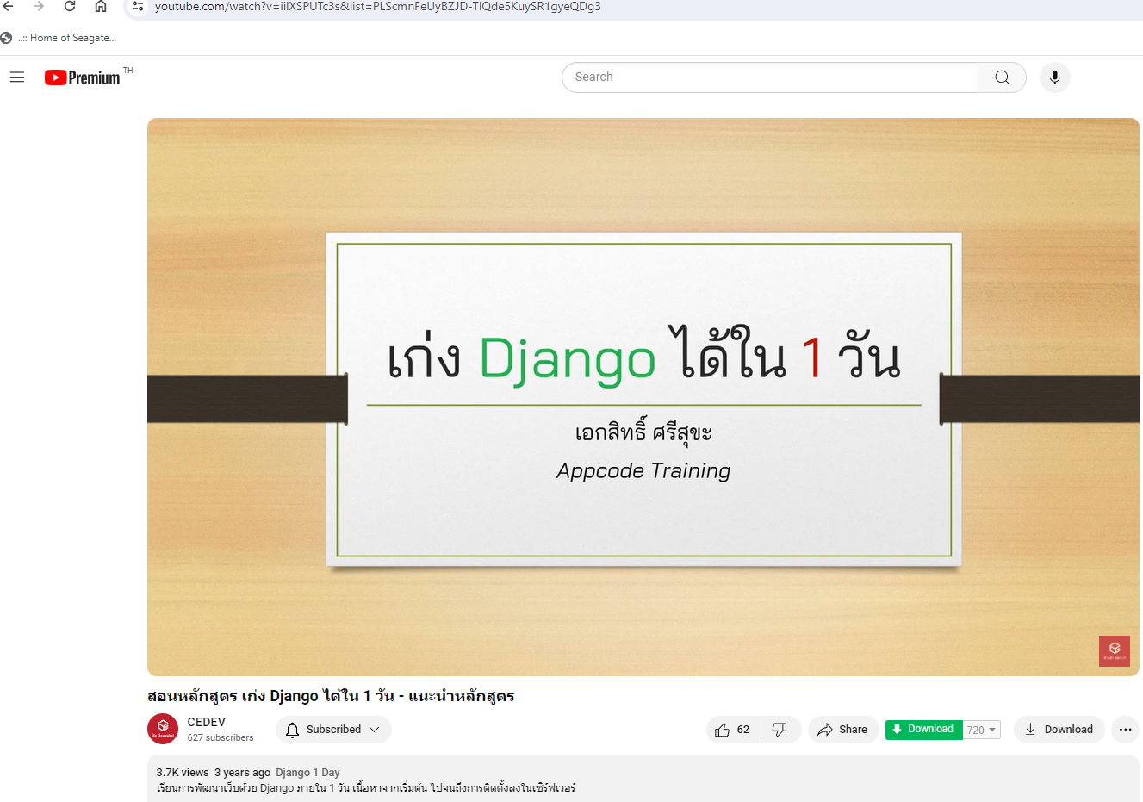
https://www.django-rest-framework.org/
https://www.youtube.com/watch?v=iilXSPUTc3s&list=PLScmnFeUyBZJD-TlQde5KuySR1gyeQDg3

Slide 2
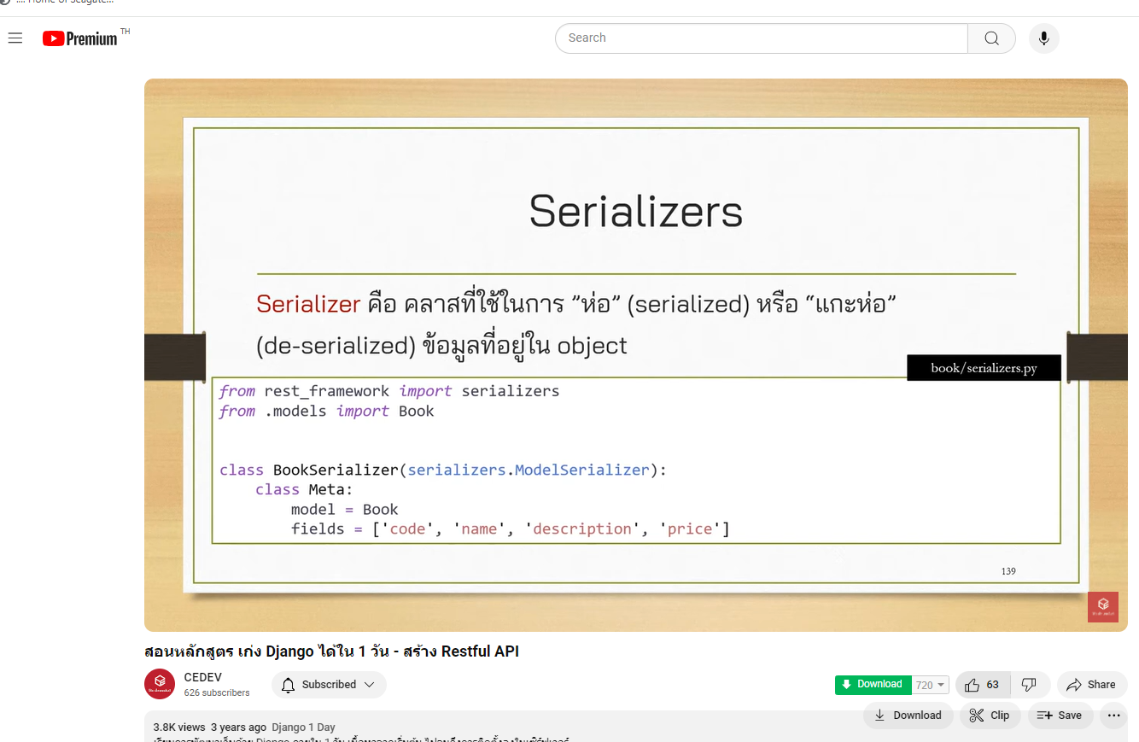

Slide 3
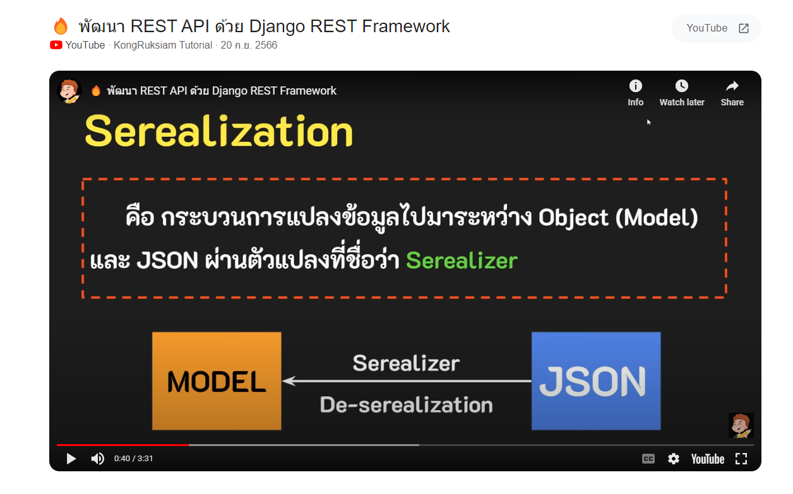

Slide 4
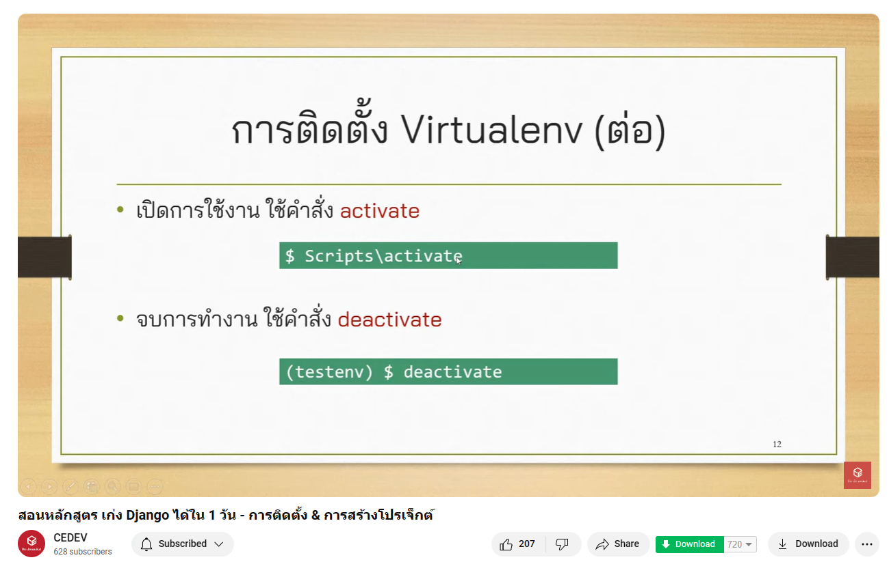

Slide 5
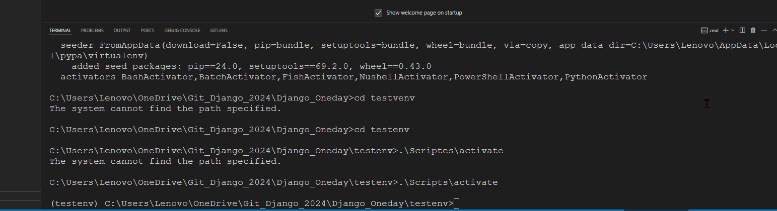
June_24_2024

Slide 6
Install Django with requiment.text

Slide 7
