Slide 1
https://github.com/facebook/create-react-app

Slide 2
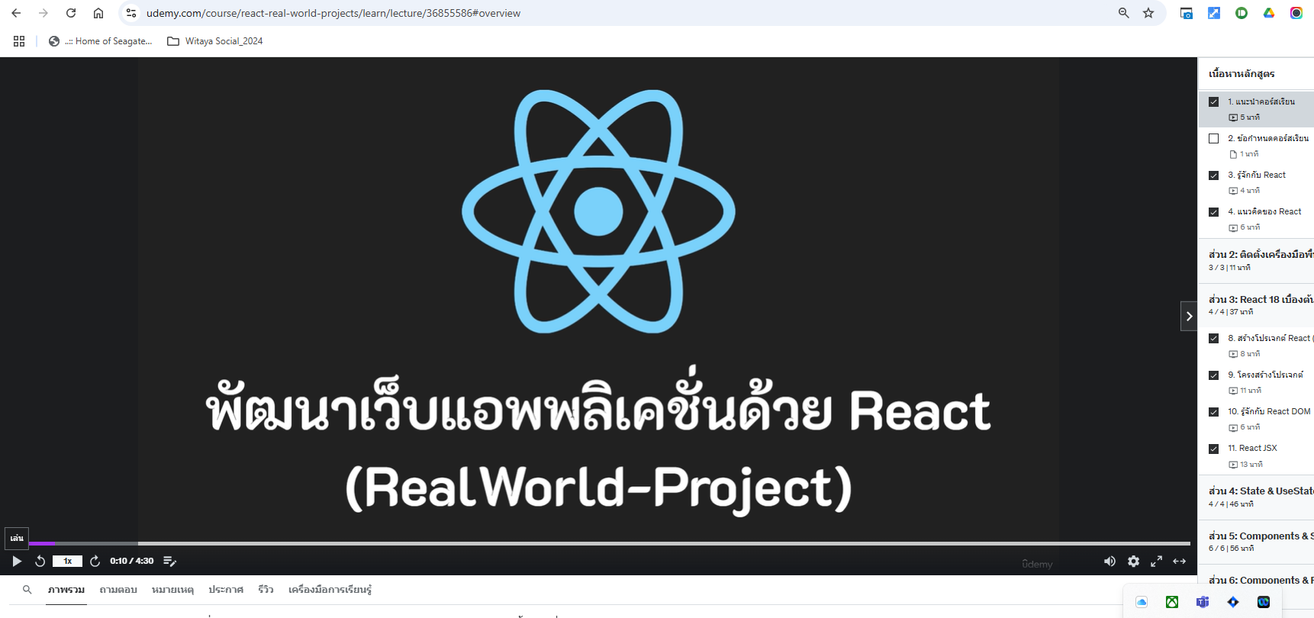
https://www.udemy.com/course/react-real-world-projects/learn/lecture/36855586#overview

Slide 3
HTML5 เบื้องต้น
CSS3 PHASE1
CSS3 PHASE2
JavaScript เบื้องต้น
JavaScript ES6

Slide 6
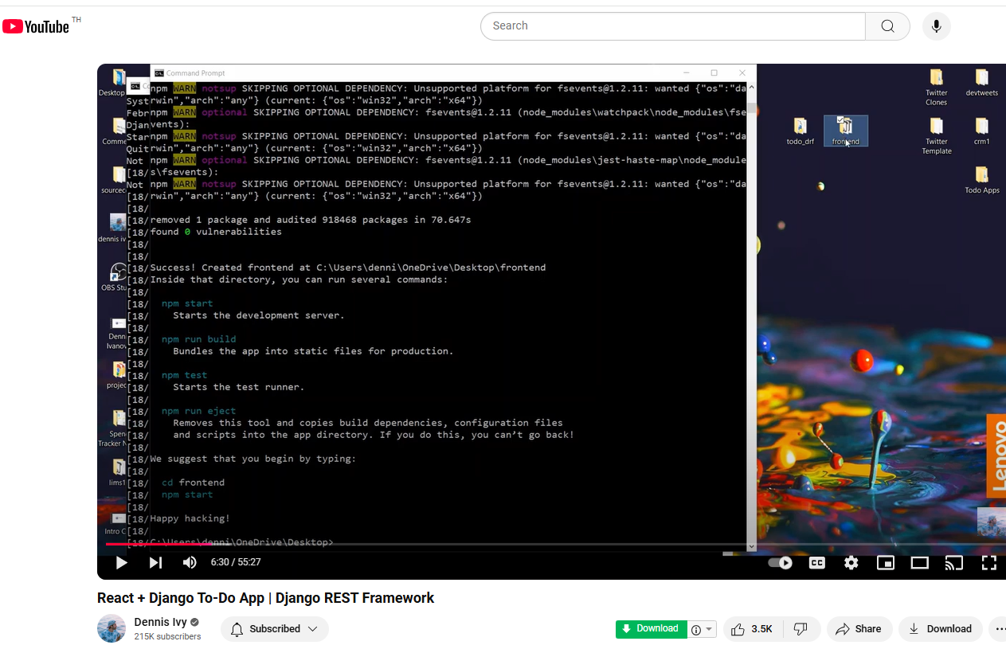
https://www.youtube.com/watch?v=W9BjUoot2Eo&t=425s

Slide 7
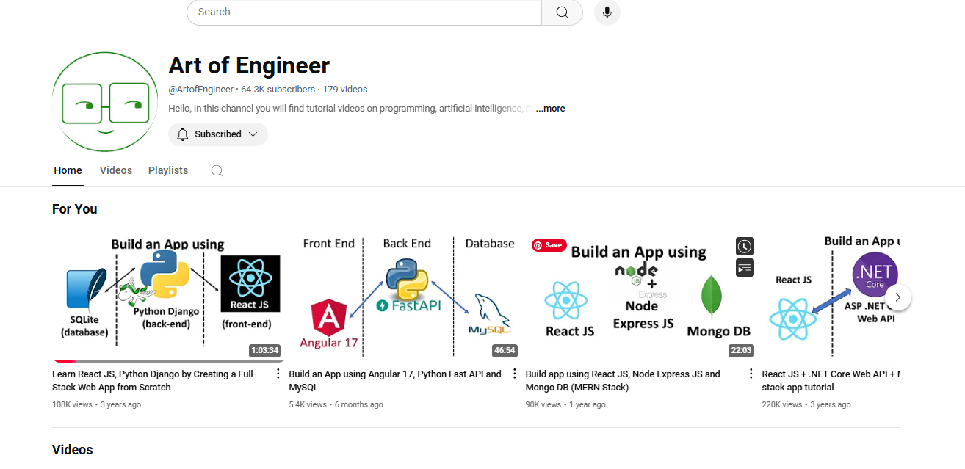
https://www.youtube.com/@ArtofEngineer
https://www.youtube.com/watch?v=qL0VbepWcqk&list=PLN1yQDPWR2SMcMsO7QzMCC_g_sYr4K76Q&index=13

Slide 8
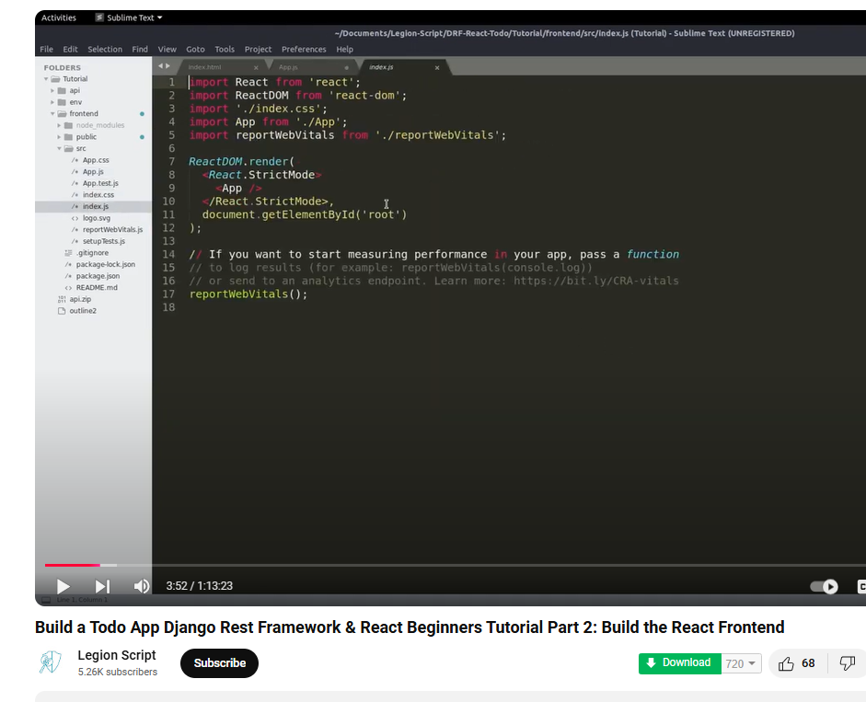
https://www.youtube.com/watch?v=GDh7ayqpo9Q&t=238s

