Slide 1



Comprehensive Evaluation of University Ranking
—— Wang Yi, Wu Yicheng, Wang Yijie

Slide 2

Introduction to the dataset
TITLE HERE
Data source : QS World University Rankings website
Dimensions:
Academic Reputation (ar)
Employer Reputation (er)
Faculty/Student Ratio (fsr)
Citations per Faculty (cpf)
International Faculty Ratio(ifr)
International Student Ratio (isr)
Scores and rankings

Slide 3

CATALOGUE
PCA
Factor Analysis
K-means
Decision Tree & Conclusions

Slide 4
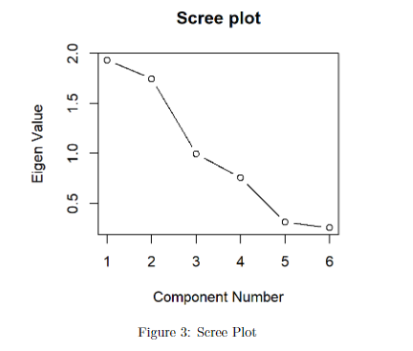
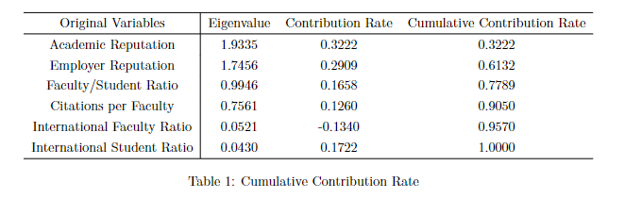


PCA
TITLE HERE

Slide 5
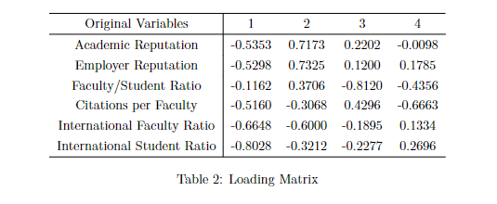
PCA
TITLE HERE
Explanation
International diversity
Overall reputation
Learning and teaching environment
Overall research level

Slide 6
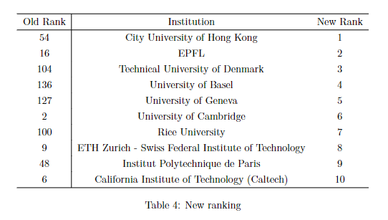
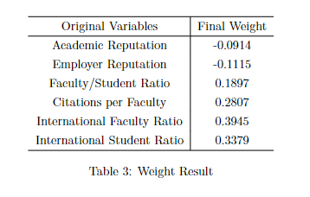

PCA
TITLE HERE

Slide 7
Factor Analysis
TITLE HERE
Assumption Test – Barlett Test
Barlett Test – To test the difference between variance matrix and identity matrix
P-value = 10⁻⁷⁰ which means the variabeles are dependent.

Slide 8
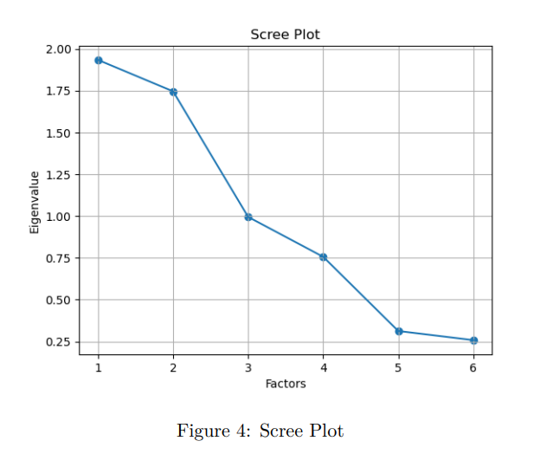
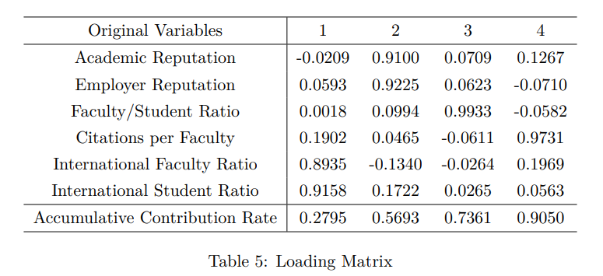
Factor Analysis
TITLE HERE
Determine the appropriate factor numbers

Slide 9
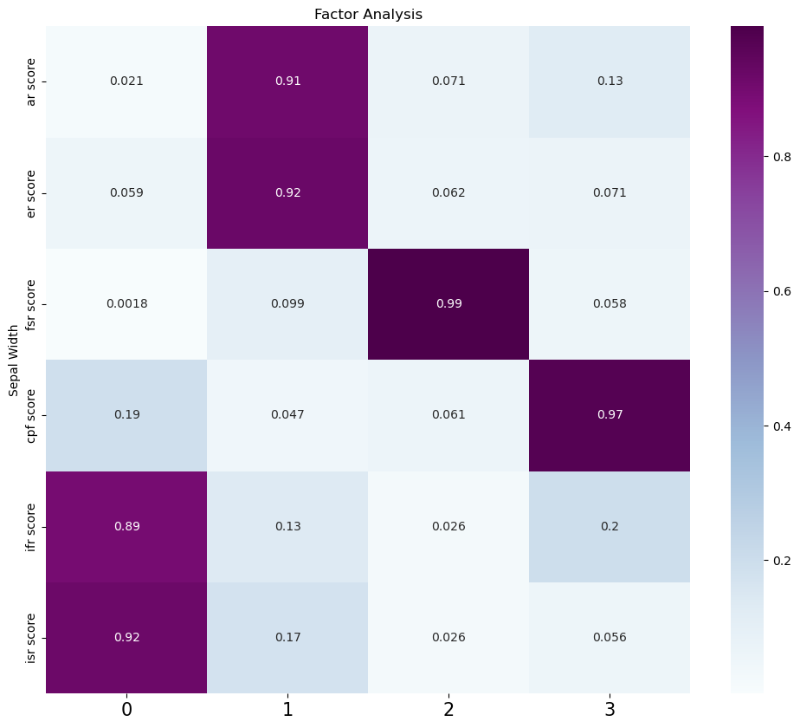
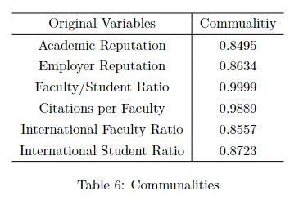
Factor Analysis
TITLE HERE
Explain the factors
First factor: International Diversity
Second factor: Overall Reputation
Third factor: L/T Environment
Fourth factor: Overall Research Level

Slide 10
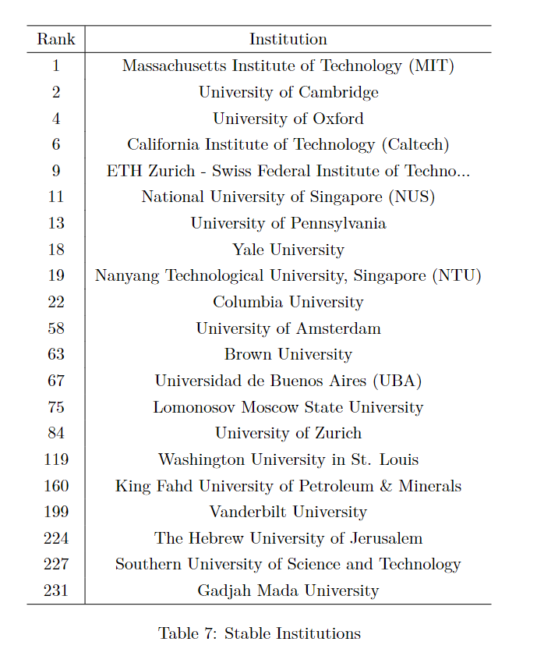
Factor Analysis
TITLE HERE
Calculate the new score & Get the new rank

Slide 11
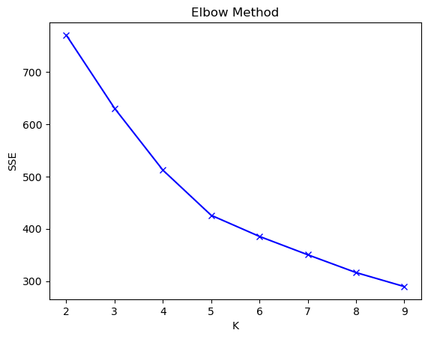
K-means Result
TITLE HERE
Get the appropriate k – elbow method
So we select K = 5

Slide 12
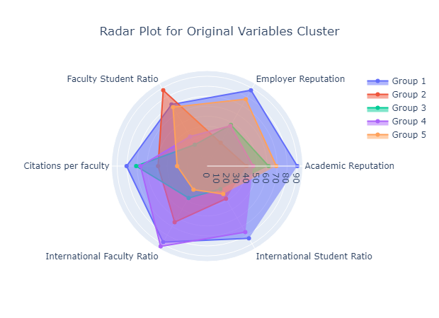
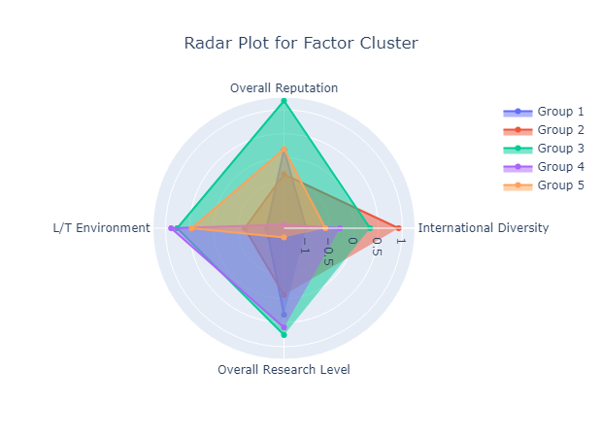
K-means Result
TITLE HERE
K-means on the original variables and factors.
Cluster Center Respresentations

Slide 13
K-means Result
TITLE HERE
Explain every cluster
1. Research Elite School
2. Relaxed International School
3. Comprehensive Strong School
4. Small minority strong school
5. Local Elite Schoool

Slide 14
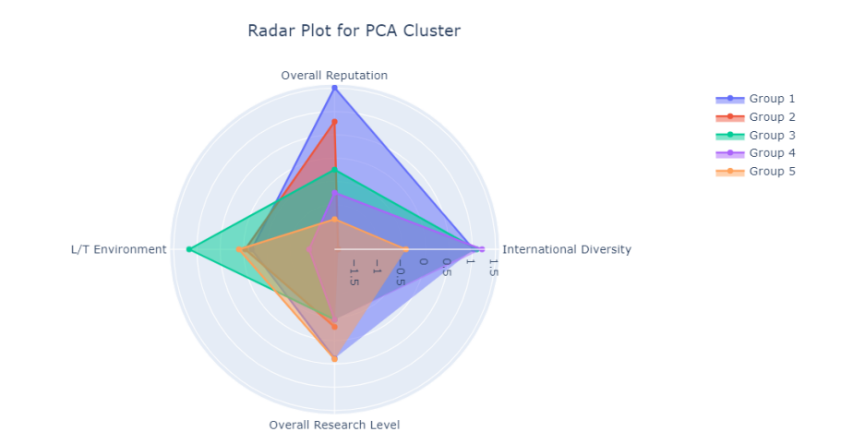
K-means Result
TITLE HERE
Explain every cluster
1. All-around Strong School
2. Education Strong School
3. Liberal Education School
4. International Development School
5. High-Level Reasearch School

Slide 15

Decision Tree
TITLE HERE
Variable weight
信息增益（Information Gain）：信息增益是通过计算每个特征的分裂后的信息熵减少量来衡量的。对于每个特征，它的重要性是所有分裂中使用该特征的节点的信息增益的加权平均值。
基尼增益（Gini Gain）：基尼增益是通过计算每个特征的分裂后的Gini不纯度减少量来衡量的。对于每个特征，它的重要性是所有分裂中使用该特征的节点的Gini增益的加权平均值。

Slide 16
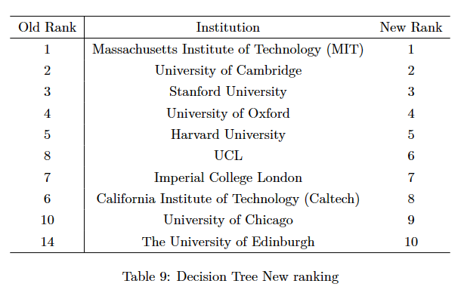
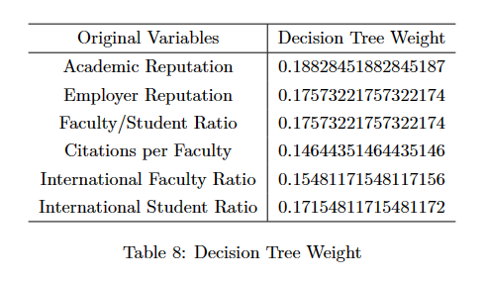
Decision Tree: use all data to fit
TITLE HERE
Final Result:
Variable weight:

Slide 17
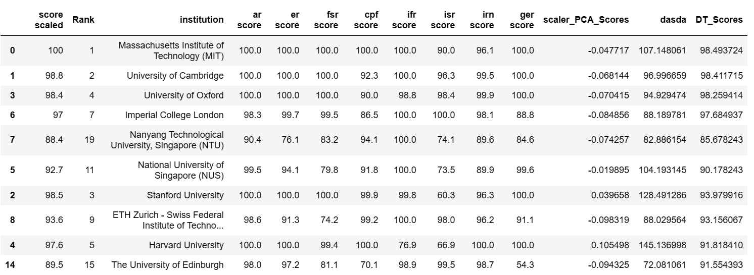
Decision Tree:
TITLE HERE
使用Top 20数据作为测试集，Top30 ~ 240的数据作为训练集来拟合 Decision Tree
对于测试集，我们最终建立的模型的 $R^{2}$ = 0.843
预测Top 10：
Overfitting !!!

Slide 18
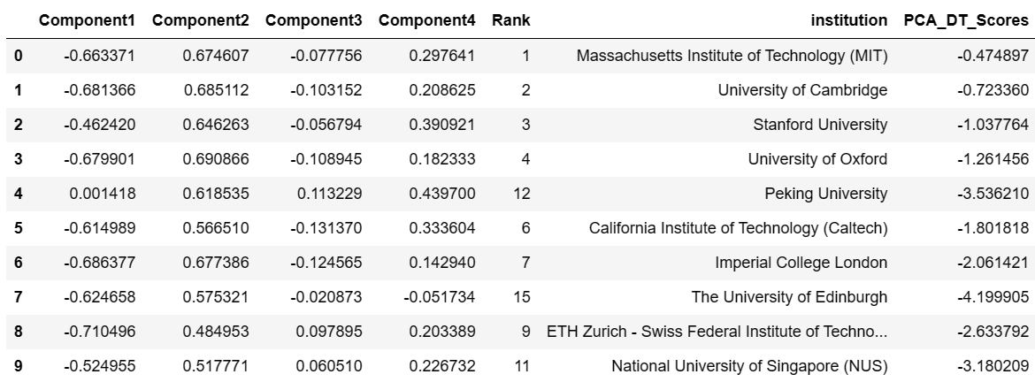
Decision Tree:
TITLE HERE
使用Top 20数据作为测试集，Top30 ~ 240的数据作为训练集来拟合 Decision Tree
使用PCA对原数据进行降维，提取有效信息，减少噪声
预测Top 10：

Slide 19
Decision Tree:
TITLE HERE
Academic Reputation (ar): 48.43%
Employer Reputation (er): 5.64%
Faculty/Student Ratio (fsr): 17.93%
Citations per Faculty (cpf): 16.76 %
International Faculty Ratio(ifr): 4.92%
International Student Ratio (isr): 7.32%
将权重还原成降维之前的权重
Academic Reputation (ar): 40%
Employer Reputation (er): 10%
Faculty/Student Ratio (fsr): 20%
Citations per Faculty (cpf): 20%
International Faculty Ratio(ifr): 5%
International Student Ratio (isr): 5%

Slide 20
Conclusion:
TITLE HERE
在我们的数据集上因子分析评级的结果比PCA好
决策树拟合出来的权重效果比较好，但它需要标签数据进行拟合，容易过拟合

Slide 21

Thank You!
。

