Slide 1



Comprehensive Evaluation of University Ranking
—— Wang Yi, Wu Yicheng, Wang Yijie

Slide 2

Introduction to the dataset
TITLE HERE
Data source : QS World University Rankings website
Dimensions:
Academic Reputation (ar): 40%
Employer Reputation (er): 10%
Faculty/Student Ratio (fsr): 20%
Citations per Faculty (cpf): 20%
International Faculty Ratio(ifr): 5%
International Student Ratio (isr): 5%
Scores and rankings

Slide 3

CATALOGUE
PCA
Factor Analysis
K-means
Decision Tree & Conclusions

Slide 4
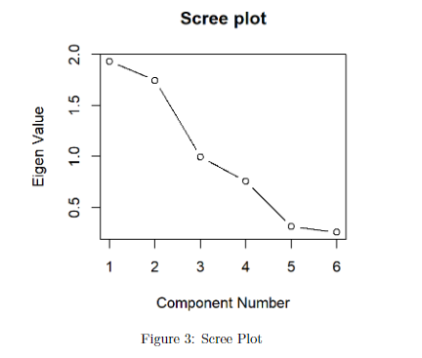
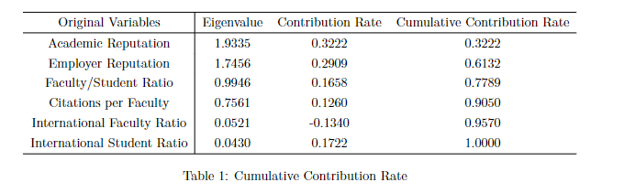


PCA
TITLE HERE

Slide 5
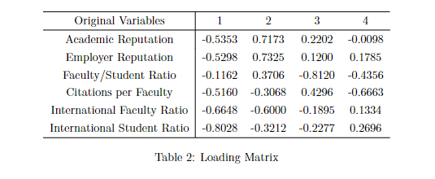
PCA
TITLE HERE
Explanation
International diversity
Overall reputation
Learning and teaching environment
Overall research level

Slide 6
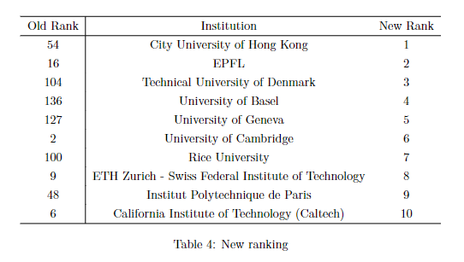
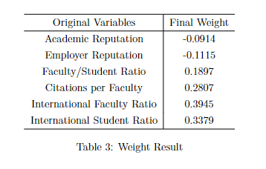

PCA
TITLE HERE

Slide 7

Decision Tree
TITLE HERE
Variable weight
信息增益（Information Gain）：信息增益是通过计算每个特征的分裂后的信息熵减少量来衡量的。对于每个特征，它的重要性是所有分裂中使用该特征的节点的信息增益的加权平均值。
基尼增益（Gini Gain）：基尼增益是通过计算每个特征的分裂后的Gini不纯度减少量来衡量的。对于每个特征，它的重要性是所有分裂中使用该特征的节点的Gini增益的加权平均值。

Slide 8
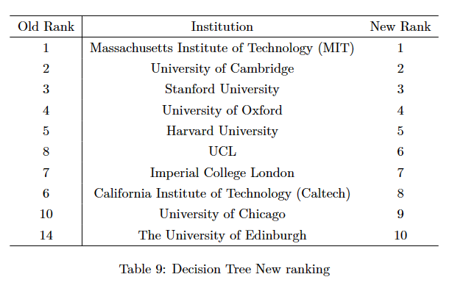
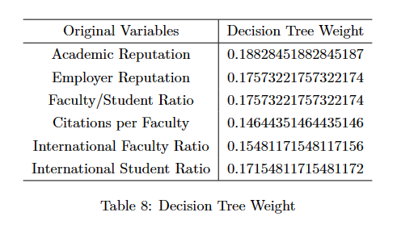
Decision Tree: use all data to fit
TITLE HERE
Final Result:
Variable weight:

Slide 9
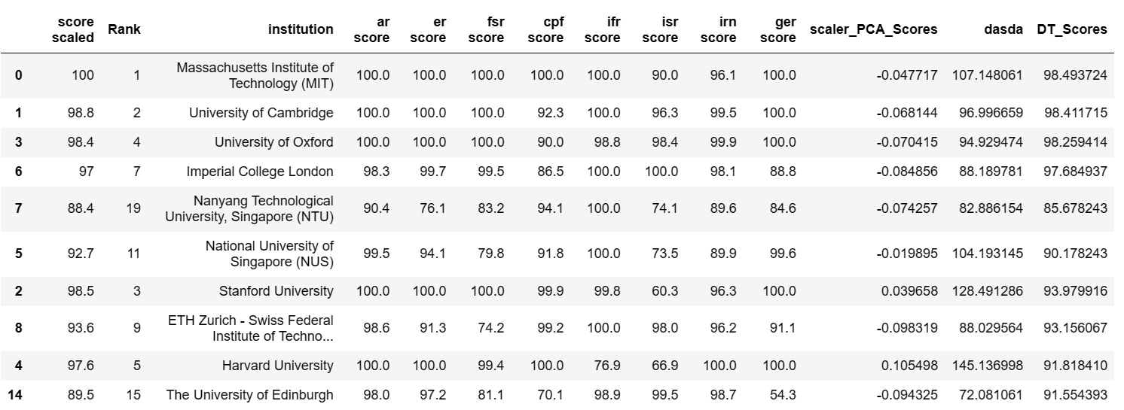

Decision Tree:
TITLE HERE
使用Top 20数据作为测试集，Top30 ~ 240的数据作为训练集来拟合 Decision Tree
对于测试集，我们最终建立的模型的 $R^{2}$ = 0.843
预测Top 10：
Overfitting !!!

Slide 10
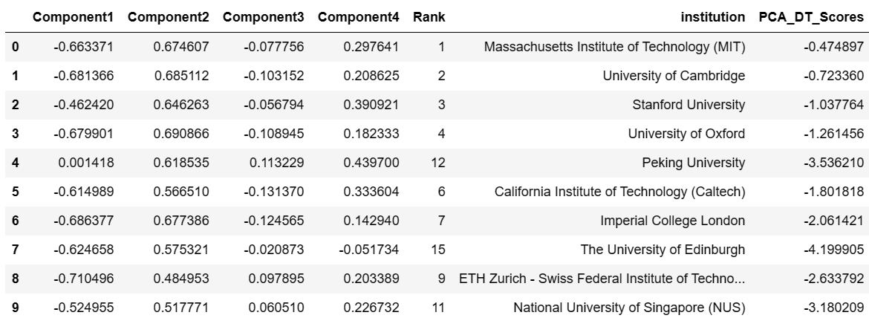
Decision Tree:
TITLE HERE
使用Top 20数据作为测试集，Top30 ~ 240的数据作为训练集来拟合 Decision Tree
使用PCA对原数据进行降维，提取有效信息，减少噪声
预测Top 10：

Slide 11
Decision Tree:
TITLE HERE
Academic Reputation (ar): 48.43%
Employer Reputation (er): 5.64%
Faculty/Student Ratio (fsr): 17.93%
Citations per Faculty (cpf): 16.76 %
International Faculty Ratio(ifr): 4.92%
International Student Ratio (isr): 7.32%
将权重还原成降维之前的权重
Academic Reputation (ar): 40%
Employer Reputation (er): 10%
Faculty/Student Ratio (fsr): 20%
Citations per Faculty (cpf): 20%
International Faculty Ratio(ifr): 5%
International Student Ratio (isr): 5%

Slide 12
Conclusion:
TITLE HERE
在我们的数据集上因子分析评级的结果比PCA好
决策树拟合出来的权重效果比较好，但它需要标签数据进行拟合，容易过拟合

