Slide 1
SOFTWARE DEPLOYMENT WINDOW PLANNER
DeployFlow
Graph coloring applied to daily release coordination
SELECTED SERVICES
SAFE WINDOWS
9
5
CONFLICT EDGES
RECURSIVE CALLS
Plan safe launch windows when services share teams, infrastructure, dependencies, and risk.
15
23
Artem Pasichnyk · Yaroslav Kondratenko
DF
DeployFlow

Slide 2
PROBLEM
From map coloring to release planning
Map coloring
DeployFlow
Result
Region = vertex
Shared border = edge
Color = label
Goal: adjacent regions differ
Deployment = vertex
Unsafe parallel pair = edge
Window = color
Goal: conflicting releases differ
Timeline
Runbook
Conflict graph
Search metrics
DF
DeployFlow

Slide 3
CLASSICAL ALGORITHM
Backtracking graph coloring
COLOR_VERTEX(i): if i == n: return true for color in 1..k: if SAFE(i, color): colors[i] = color if COLOR_VERTEX(i + 1): return true colors[i] = 0 return false
How it behaves
Systematically explores color assignments.
Rejects a branch as soon as a neighbor conflict appears.
Complete for the chosen number of windows.
Can be expensive on dense graphs.
DF
DeployFlow

Slide 4
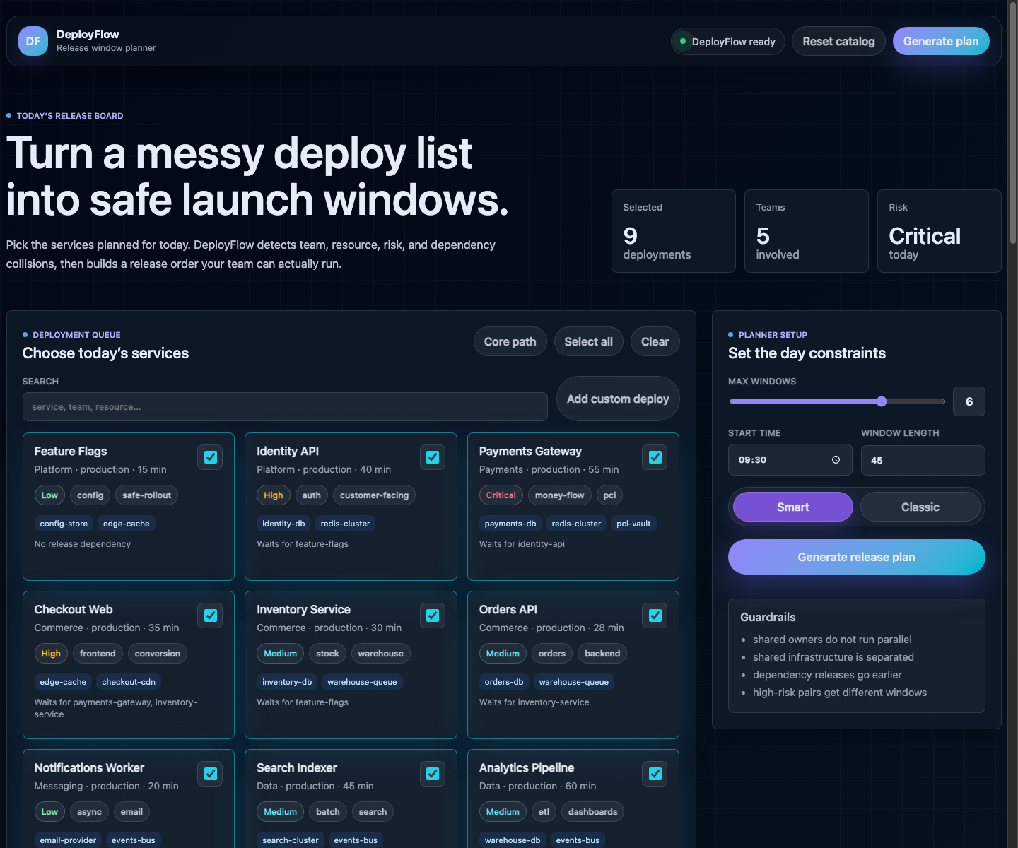
PRODUCT
A useful release board, not a toy demo
What the user does
Select today’s service updates.
Add custom deployments.
Choose available windows.
Switch classic vs smart solver.
Generate a release timeline.
DF
DeployFlow

Slide 5
ARCHITECTURE
One Java application, product-grade layers
Web UI
HTTP driver
Planner
Algorithm
resources/web
DeployFlowApp.java
DeploymentPlanner.java
GraphColoringSolver.java
dashboard, timeline, graph view
→
serves UI and API
→
builds conflict graph
→
classic + improved solver
No Maven, Gradle, Node, or external dependencies are required to run the app.
DF
DeployFlow

Slide 6
IMPROVED ALGORITHM
Smarter search for dense deployment days
Classical
DeployFlow Smart
Fixed vertex order
Try colors 1..k
Only checks colored neighbors
May explore weak branches
Most constrained vertex first
Degree + risk tie-breakers
Least-constraining color
Forward checking
Dependency windows must be chronological
DF
DeployFlow

Slide 7
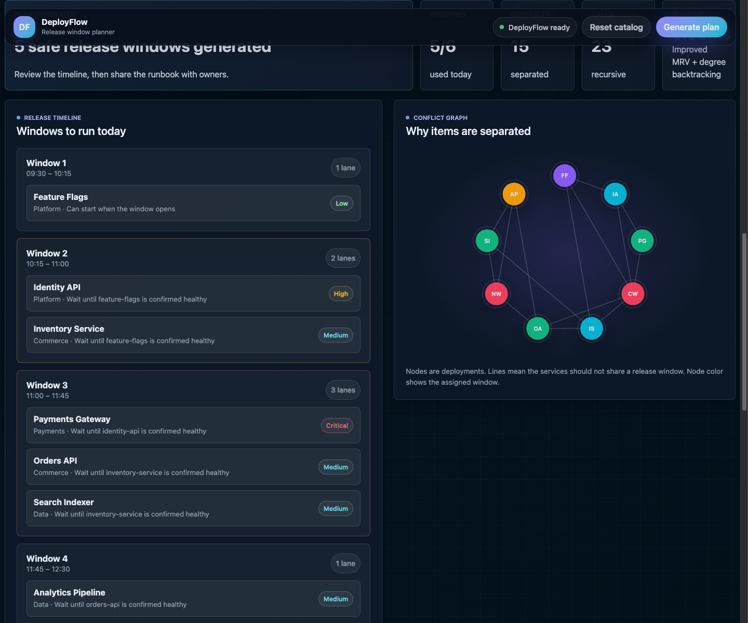
DEMO RESULT
Generated release timeline
Output views
Release windows with parallel lanes.
Conflict graph colored by assigned window.
Operator runbook with step order.
Metrics: calls, checks, backtracks, runtime.
WINDOWS USED
RUNTIME
5/6
10.82ms
DF
DeployFlow

Slide 8
EXECUTION
Correctness checks visible in the product
Conflict rules
Example metrics
Result
Same owner capacity
Shared resource
Direct dependency
High-risk pair
9 vertices
15 conflict edges
9 precedence rules
23 recursive calls
24 backtracks
Feasible plan
Chronological dependencies
No adjacent same window
Trace available
DF
DeployFlow

Slide 9
RISKS
Risks, limits, and mitigations
Dense graph
Backtracking can grow exponentially
MRV, degree ordering, forward checking
Bad input data
Wrong edges create unsafe plans
Show conflict reasons and editable catalog
Too few windows
No feasible coloring exists
Report failure and suggest extra windows
Real-world constraints
People and maintenance windows vary
Add more domain rules as edges/constraints
DF
DeployFlow

Slide 10
FINAL
Final thoughts
What we built
Why it matters
Working Java product
Web dashboard and API
Classical graph coloring function
Improved planner algorithm
Screenshots, report, and demo-ready run scripts
Shows map coloring as a real scheduling engine.
Makes deployment conflicts visible.
Gives teams a practical release order.
Leaves room for future production constraints.
DeployFlow
DF
DeployFlow

