Slide 1
Table of contents
SUBJECT
Time recording
Ad / remove lines from Favorites
Edit / delete registration
Find activity/task - Find project
Register multiple days
Register vacation/absence
Project
Edit project information
Reports
No data in the report
Reconcil. (Balance)
Week completion and approval
Approve project registrations
Approve/reject weektotals
Complete week
Rejected week, what to do
Administration
Change password
E-mail, when password is changed
Forgot password
Support
ALPHABETICAL
Ad / remove lines from Favorites
Approve project registrations
Approve/reject weektotals
Change password
Complete week
Edit / delete registration
Edit project information
E-mail, when password is changed
Find activity/task
Find project
Forgot password
No data in the report
Reconcil. (Balance)
Register multiple days
Register vacation/absence
Rejected week, what to do
Support

Slide 2
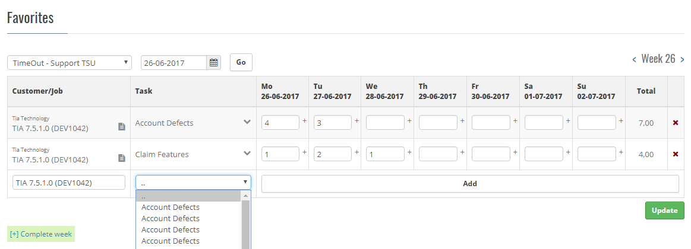
1 Ad / remove lines from Favorites
Search for a project
Type ahead
Choose a project
Choose an activity
Drop-down list
Choose activity
Click ”Add”
Search and add several projects/activities
Click the red x to remove a line for the favorite list
Content

Slide 3
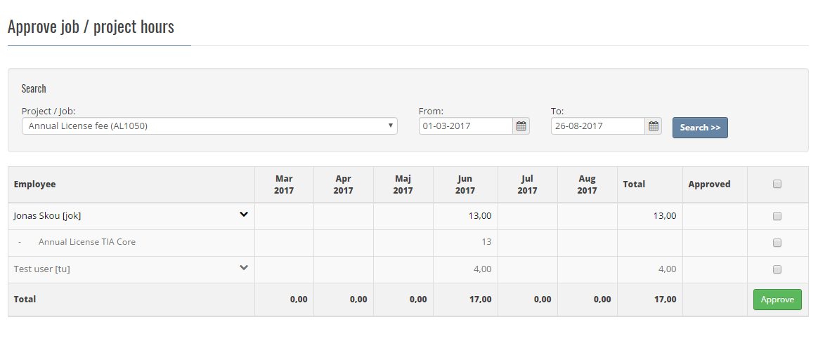
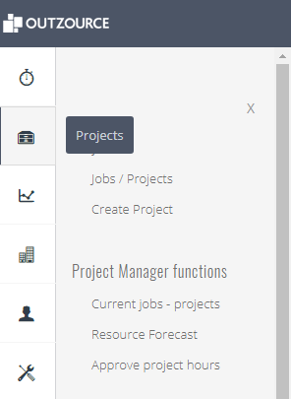
2 Approve project registrations
MENU:
Projects
Approve project hours
Search:
Project
Choose timeframe
Check each employee if the time registration is correct or not
Click the to see the activities which the employee has worked on.
Mark the line(s) which can be approved and click the Approve button.
Content

Slide 4
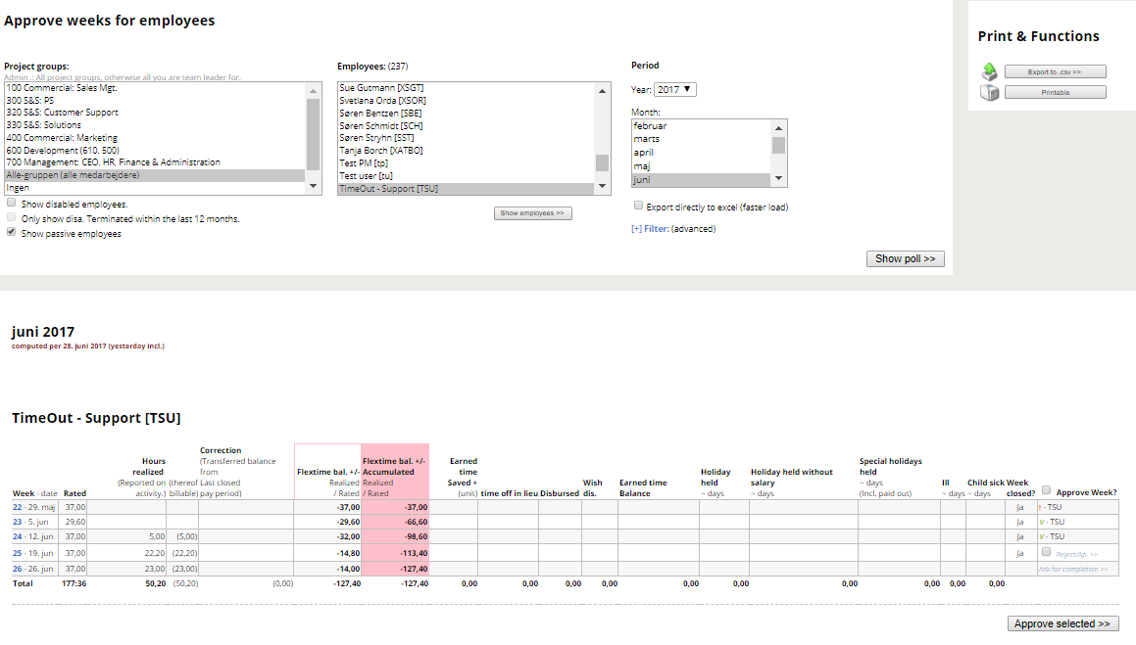
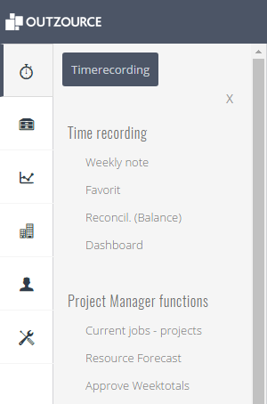
3 Approve/reject weektotals
Menu:
Timerecording
Approve Weektotals
Search:
Project group
Choose ”All”
Choose Timeframe
Click ”Show poll>>”
Check each employee for project hours and absence and if the week has been completed.
If one week IS NOT competed, click ”pls. complete week.” (an e-mail is send to the employee)
If all weeks are completed, approve or reject - one or more at a time.
Content

Slide 5
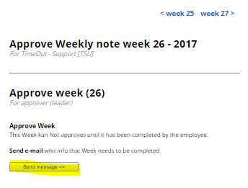
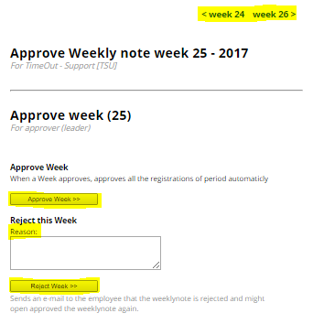
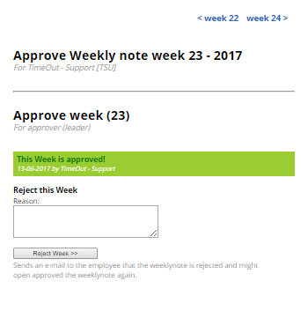
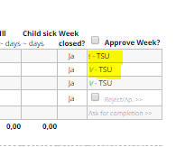
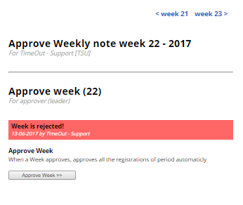
3a Continued - Approve/reject weektotals
Pop-up ”Ask for completion” Pop-up Approve/Reject Pop-up – Confirmation Approve/rejected week (! P)
Content

Slide 6
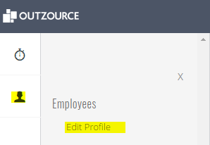
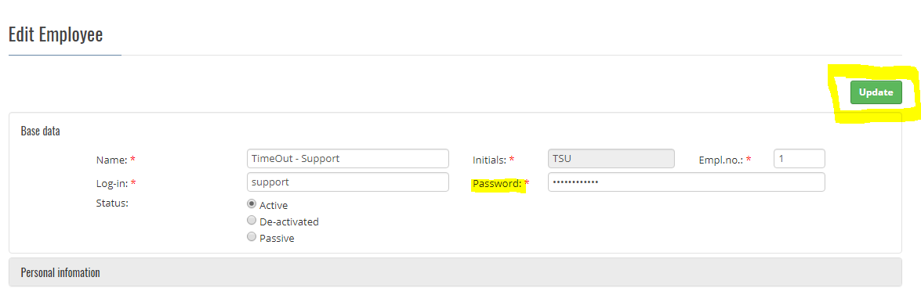
4 Change password
Choose in the Menu:
Employees_Edit Profile
Type new password
Click ”Update”
Content

Slide 7
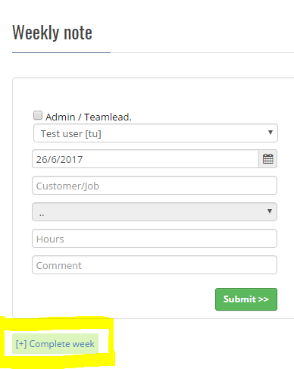
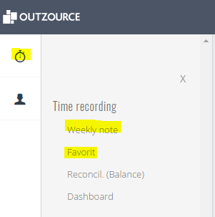
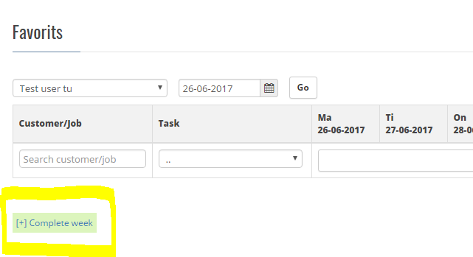
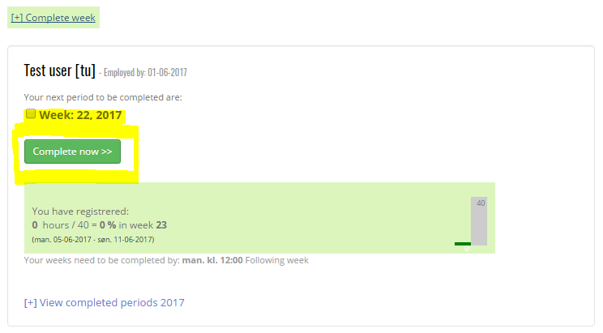
5 Complete week
Where to Complete
Weekly note
Favorite
How to Complete
Mark the week number
Click ”Complete now >>”
Content

Slide 8
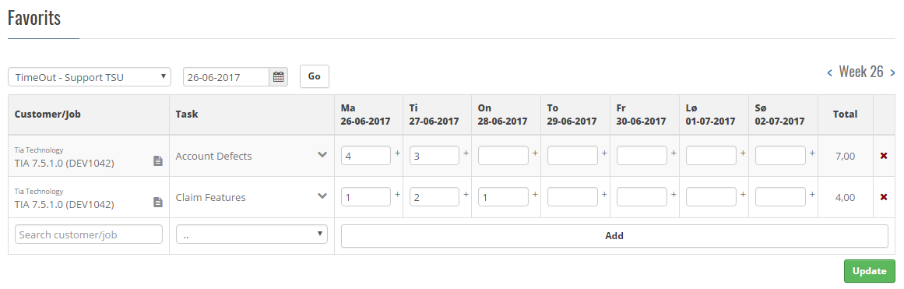
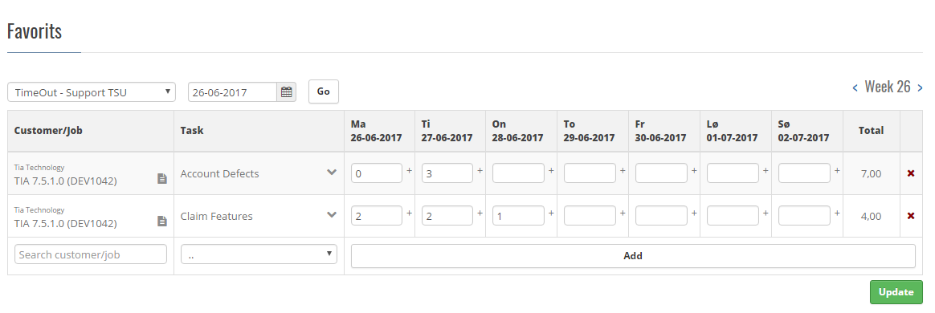
6 Edit / delete registration
Edit or delete a registration by typing
A: a new time (number) –
Replace the number
B: Type 0 (zero) = delete
Before
After
Content

Slide 9
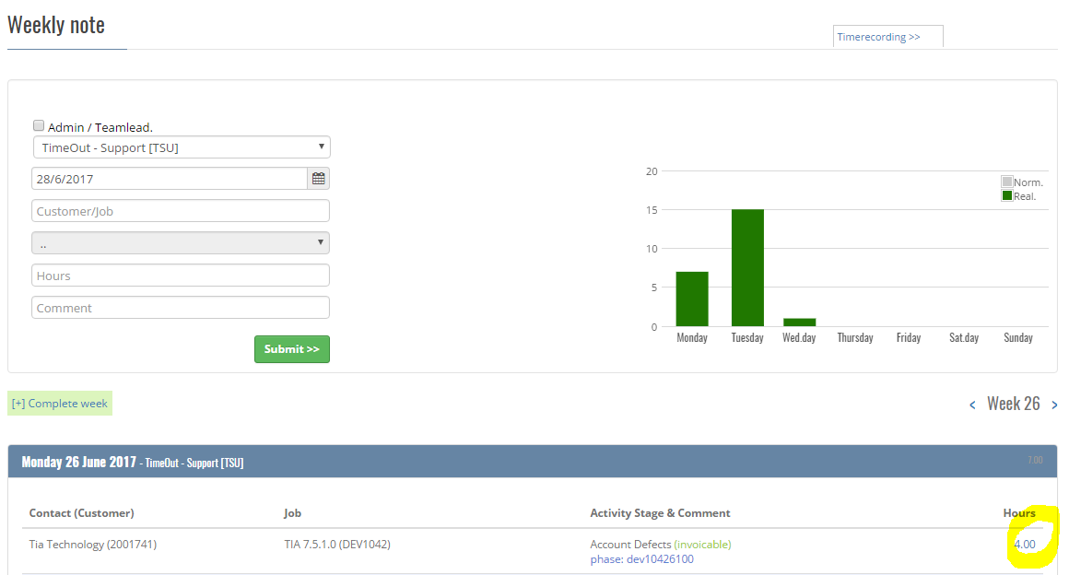
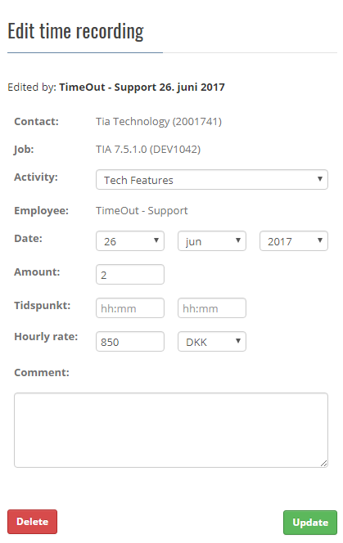
6a Edit / delete registration
Edit and deletion on the Weekly Note
Click the ”Blue” hour-number
A pop-up gives the option to edit the registration
Correct the hour(s) – that is…replace the number.
Click Update
Delete = use the red button
Content

Slide 10
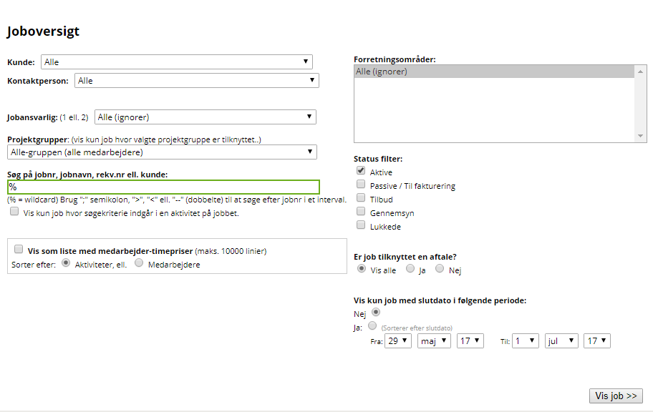
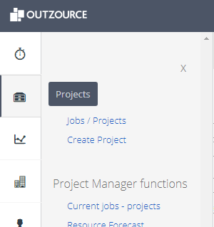
7 Edit project information
Menu:
Projects
Jobs / Projects
Search:
Either:
Customer (kunde)
PM (Jobansvarlig)
Project (Green box)
Click “Vis Job >>”
Content

Slide 11
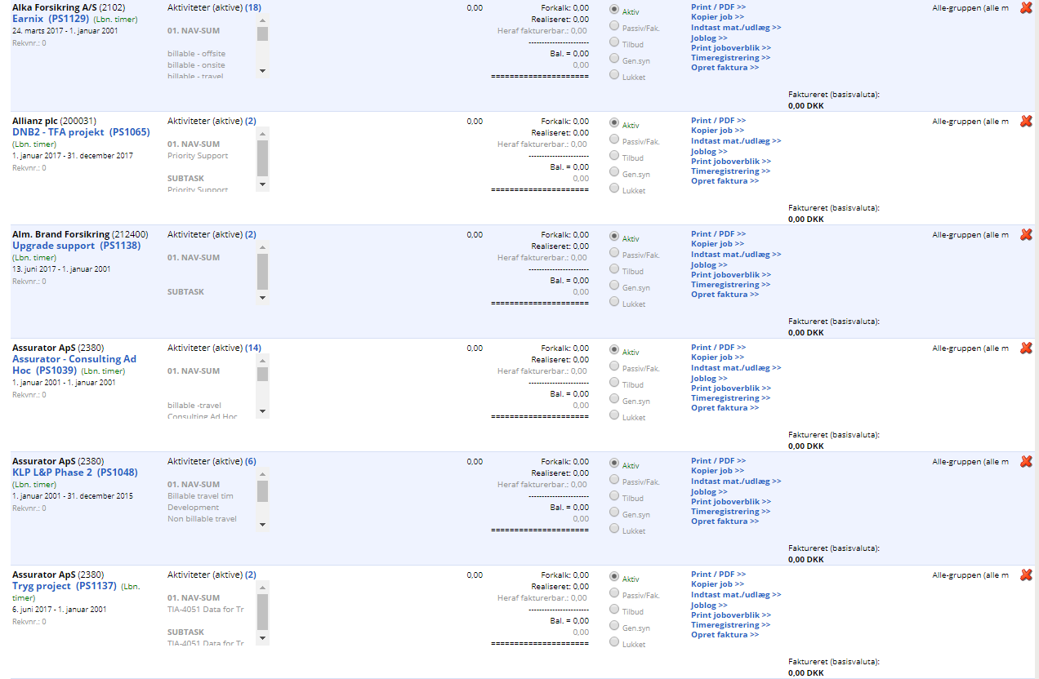
7a Continued - Edit project information
Find project on the list
Click the project name (in blue)
Content

Slide 12
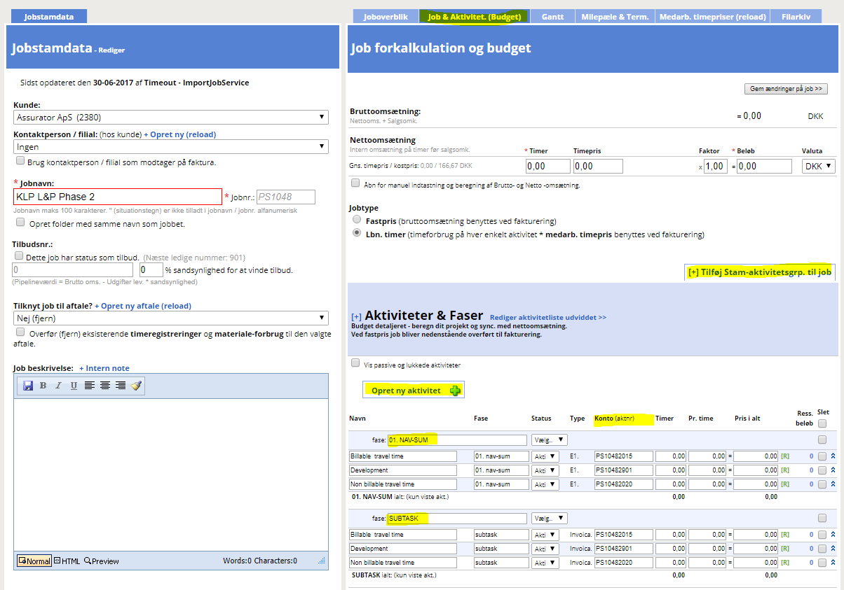
7b Continued - Edit project information
Choose the TAP “Job & Aktivitet”
NAV-SUM are the tasks from NAV
(Do not edit these)
SUBTASK are created automaticly
New tasks can be added in two ways:
Tilføj Stam-Aktivit…
Opret ny aktivitet
REMEMBER.
To give the new task(s) the account number to be used for NAV integration
Content

Slide 13
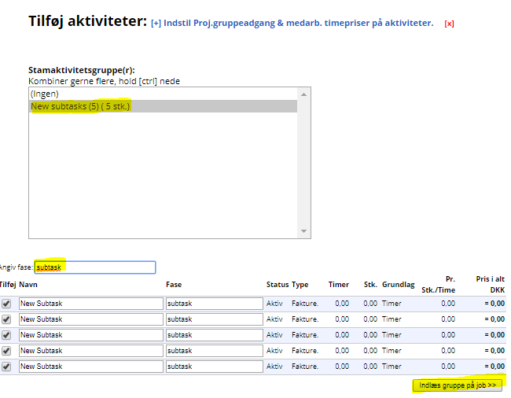
7c Continued - Edit project information
Add Stam-aktivitetsgr.
Mark “New subtasks”
Type the Phase name (TIP. Copy it from project page. It has to be exactly the same)
Click “Indlæs gruppe..”
Content

Slide 14
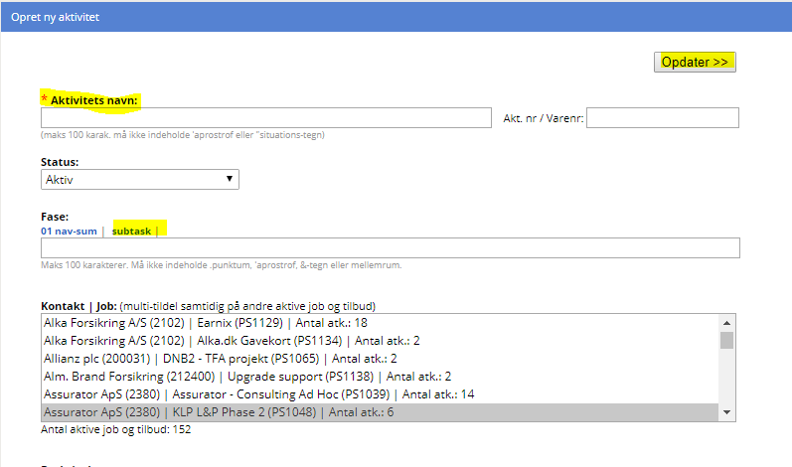
7d Continued - Edit project information
“Opret ny aktivitet”
Type Name
Choose “Subtask” under Fase:
Click “Opdater >>”
Content

Slide 15
8 E-mail, when password is changed
If the administrator or the user changes the password, an e-mail is send to the user with info about the password.
All e-mails are send encrypted.
The e-mail is send to the user, to help, as passwords in TimeOut cannot be seen by anyone – even the administrator.
Content

Slide 16
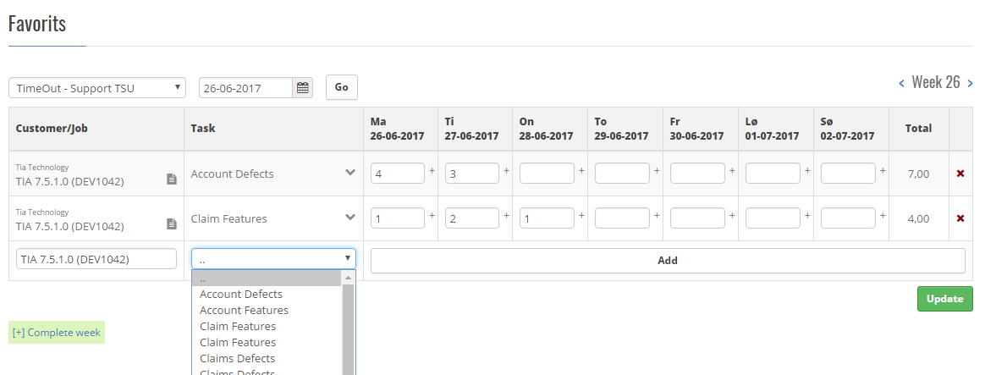
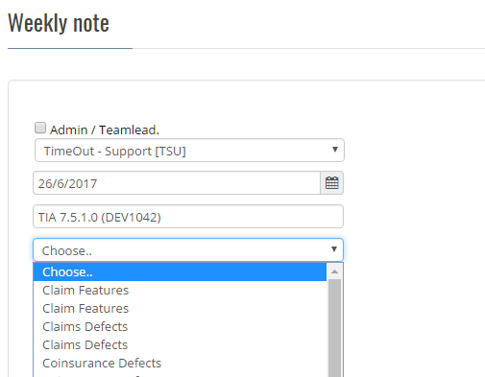
9 Find activity
If an activity cannot be found either on the Weekly note or the Favorite list, it can be because of:
It does not exist
You do not have access to that activity
It is not yes active
A budget has not been added to the specific activity
Solution:
Contact the Project manager for further information
Content

Slide 17
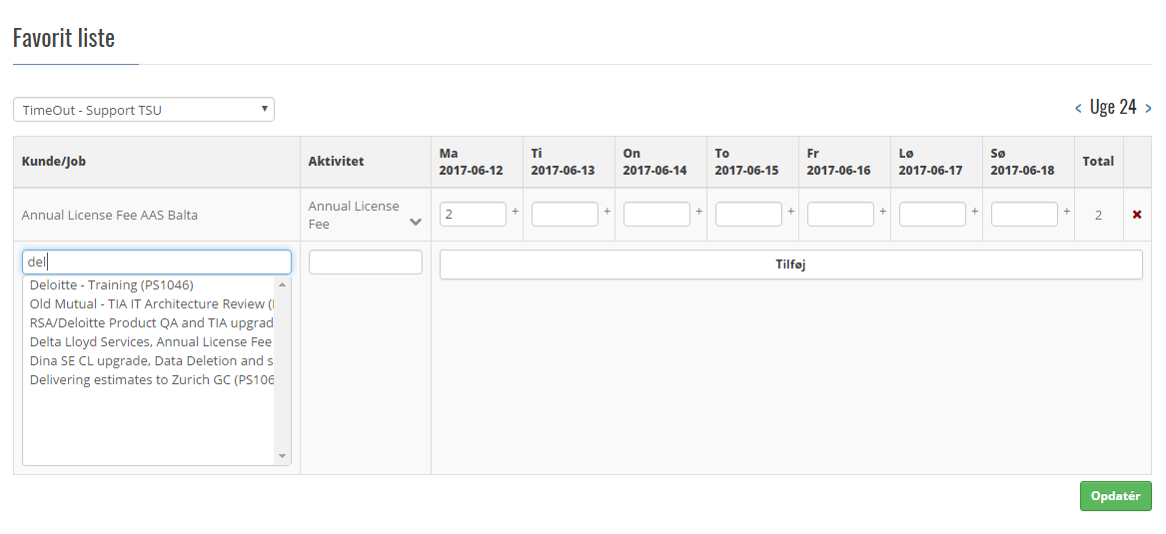
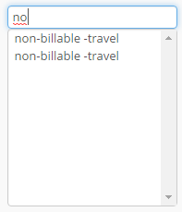
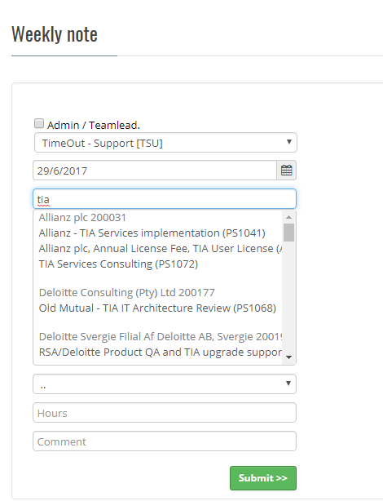
10 Find project
If a project cannot be found on either Favorites or the Weekly Note page, it can be because:
It does not exists
You do not have access to the project
It is not yet active
The start date is later than the chosen time frame
Solution:
Contact the project manager for further information
Content

Slide 18
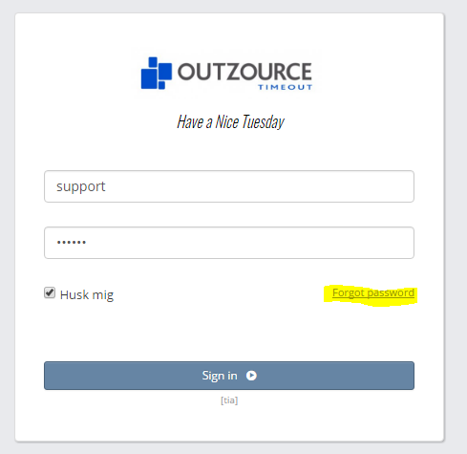
11 Forgot password
If you forget your password a new password can be issued by using the link on the Sign-in page
If you type your password wrong three times, just close your browser and reopen TimeOut.
Alternative to the above is to contact Outzource support on this number: +45 25 36 55 00
Content

Slide 19
12 No data in the report
If a Report is empty (no data), please check for one of these reasons:
Date frame (from and to)
Project status
Employee filter
As well as the status of the employees (active, passive, de-activated)
There are no registrations = no data
Project has been deleted
Customer has been deleted
IF none of the above are the case, please contact Outzource support: Support
Content

Slide 20
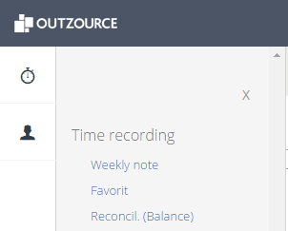
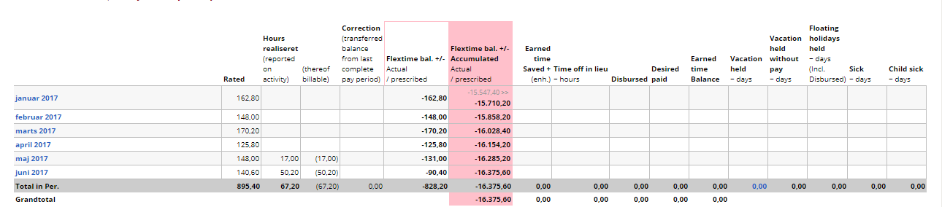
13 Reconcil.(Balance)
MENU:
Time recording
Reconcil. (Balance)
View
The report shows the hours registered as well as all registered absence
NOTE: The report is calculated from yesterday
Content

Slide 21
14 Register multiple days
Both the Weekly note and Favorites support multiple day registration.
Use the *-sign (multiply)
The Multiplier is numbers of calendar days
Eksample
7,4 hours is the stated hours per day
You register two weeks of vacation = 14 calendar days
Type 7,4*14 (wo space) – in the field of the first holiday:
Content

Slide 22
15 Register vacation/absence
Registration of vacation and absence is done the same way as project registration.
The Project is called INTERN
The activities are:
Illness
Holiday
Extra holiday
Unpaid leave
Maternity/Paternity leave
Time off due to travel (LT)
Paid leave Remember to add a comment for the activity
Content

Slide 23
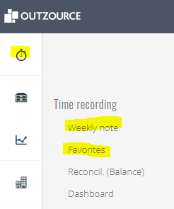
16 Rejected week, what to do
If a week is rejected, all you need to do is correct it and Complete it again.
Corrections are made either:
Weekly note
Favorites
Complete week is described here: Complete week
Content

Slide 24
17 Support
1. Contact superusers:
Sarah +45 26 19 76 12 sni@tiatechnology.com
2. Contact Outzource
Phone + 45 25 36 55 00
E-mail support@outzource.dk
Content

