Slide 1

UCSC Meal Builder App
Oct. 9th 2015
Project Release Plan
Team Name: CHAMP
Team member names:
Dishen Zhao (product owner)
Kevin Thai
James Luu (scrum master)
Sam Fields
Glenn Dayton

Slide 2
Meal Builder
Project Release Plan
We plan to create a mobile app for use by UCSC students to form meals at on-campus non-dining hall eateries that accept meals/flexies.
Users will be able to adjust their spending range and the app will provide options based on the given range.

Slide 3
Meal Builder – Sprint 1
Project Release Plan – User Stories
As a hungry person, I would like to know when and where I can get food on campus.
In addition, as a student trying to conserve meals/flexies, I would like to be able to keep track of them using this application.
As a developer, I would like to have the menu for a single eatery available.

Slide 4
Meal Builder – Sprints 2 & 3
Project Release Plan – User Stories
As a user of the app, I would like the app to be visually appealing and easy to navigate.
As a developer of the app, I would like a way to update the app information in the future, possibly partnering with on-campus restaurants.
As a developer, I would also like to have menus for all of the non-dining hall eateries.

Slide 5
Meal Builder – Sprints 2 & 3
Project Release Plan – User Stories
As a developer, I would like to have a simple meal building calculator functioning properly.
Also as a developer, I would like to have the algorithm for the meal builder to be improved to provide recommendations for items to fill a meal budget.

Slide 6
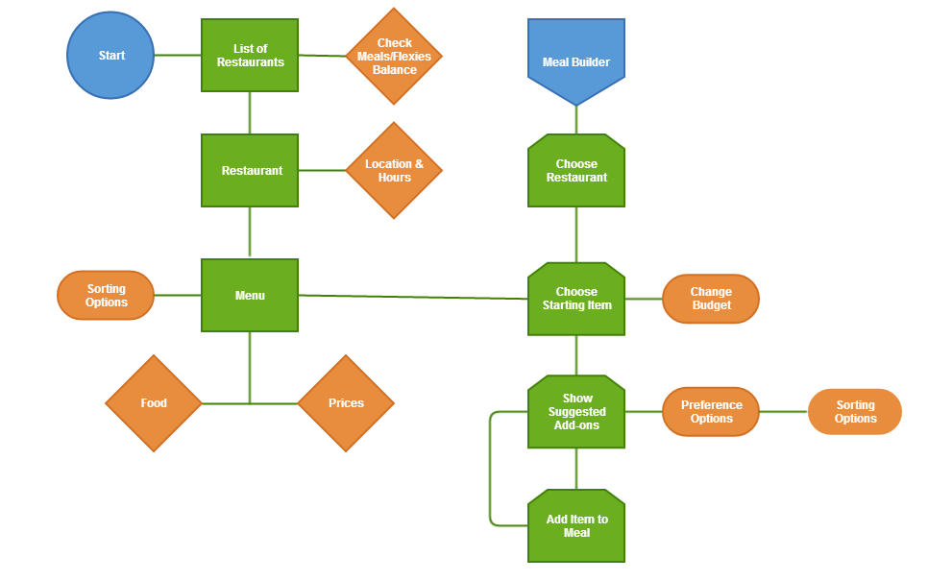
Meal Builder
Project Release Plan – Architecture

Slide 7
Meal Builder
Project Release Plan – Challenges/Risks
Little experience with mobile app development
Using an online database for updates
  Data Gathering
Project Management
Algorithm Design
Stretch Goal: Porting over to a browser app.

Slide 8
Meal Builder
Project Release Plan – Technologies
Android Studio/SDK
  Java/XML
Database
  SQL, Amazon Web Services
Web app
  AJAX, jQuery

