Slide 1
TDD: Tech Design Document
Lorién Portella López

Slide 2
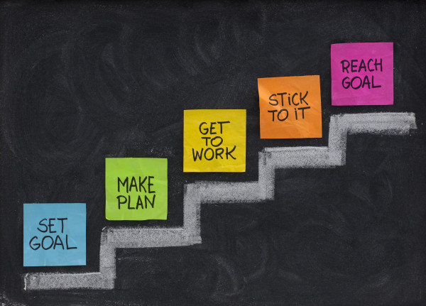

What’s a TDD
Standarize
Keep track of the technology
Goals

Slide 3
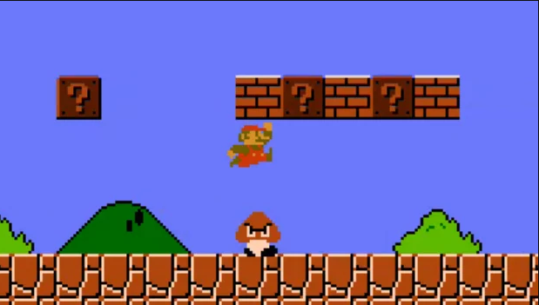
TDD and GDD
Similarities
Ordered project
What it is about
Diferences ?
Designer point of view, how the game is played
Programmer point of view, how the game works and needs to be done

Slide 4
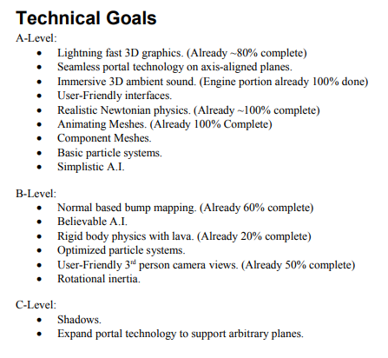
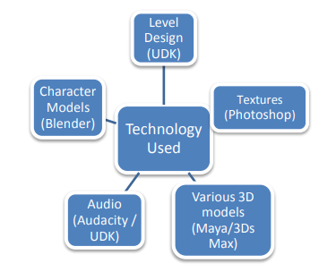
TDD Sections
Summary
Goals
Hardware and Software

Slide 5
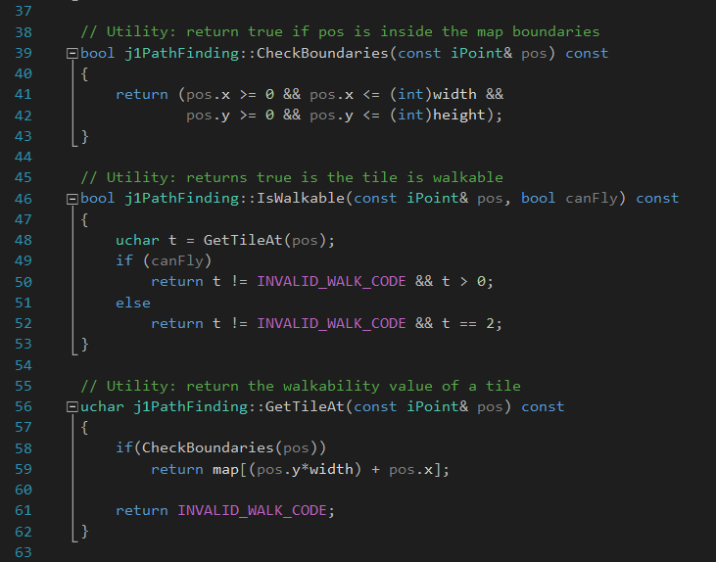
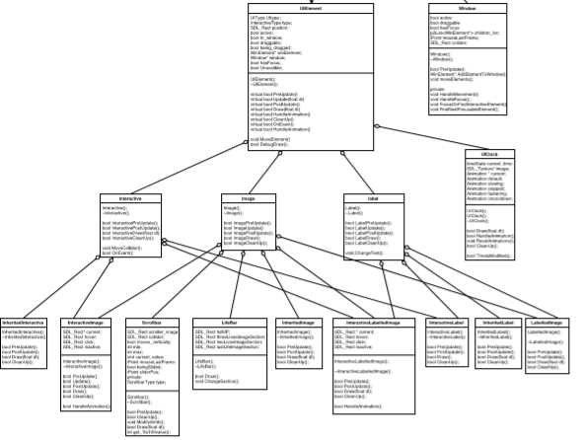
TDD Sections II
Programming Policies
UML
Code Style
Branching
Comments
Versions
Libraries
Builds

Slide 6


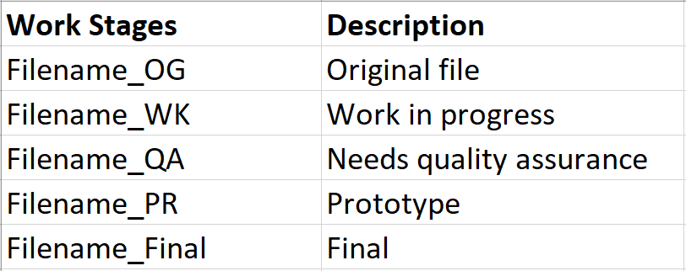
TDD Sections III
Data sharing
File Formats and naming
Changelog

Slide 7
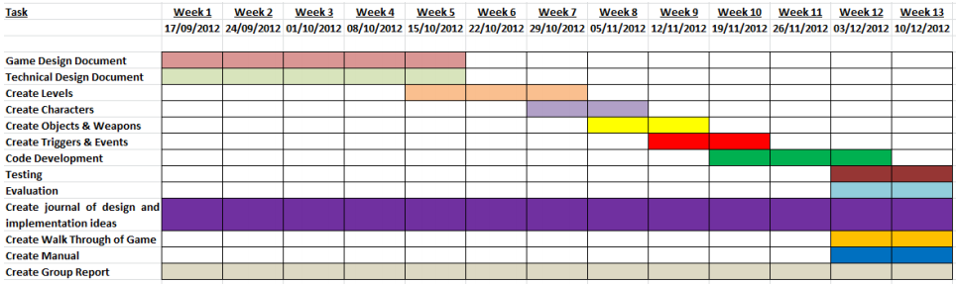
Additional Sections
Features from the GDD
Development Plan

Slide 8
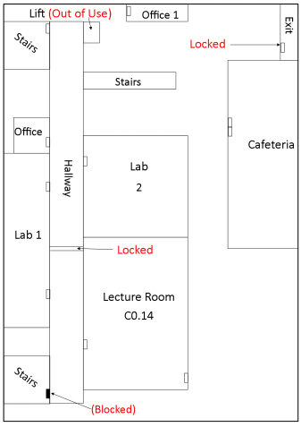
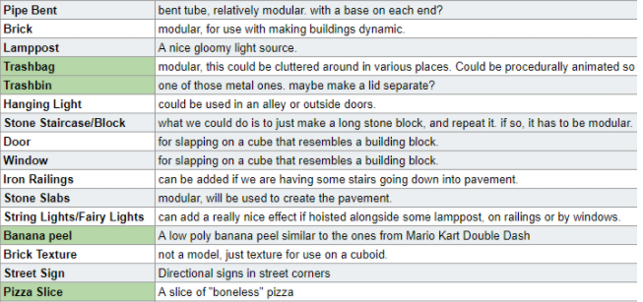
Additional Sections II
Level layouts
Asset lists

Slide 9
Homework and questions
1.- Decide your TDD lenght and sections
Discuss the TDD with the whole team
Planning the TDD before writing it is important
Think about new sections so I can improve my page :)
Quality over quantity. Big documents are Boooooring.
2.- Work on your TDD
Start by dividing some tasks
Do a quick summary of what you want to write.

