Slide 1
TDD: Tech Design Document
Lorién Portella López

Slide 2
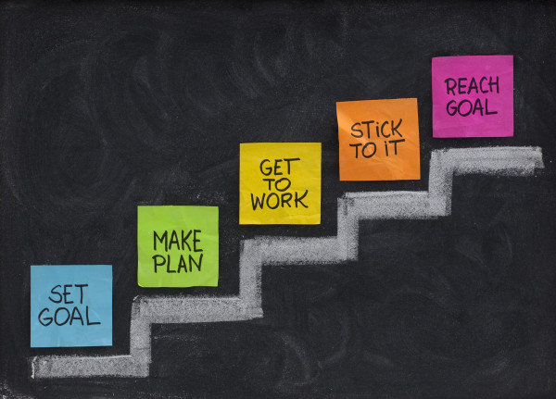

What’s a TDD
Standarize
Keep track of the technology
Goals

Slide 3
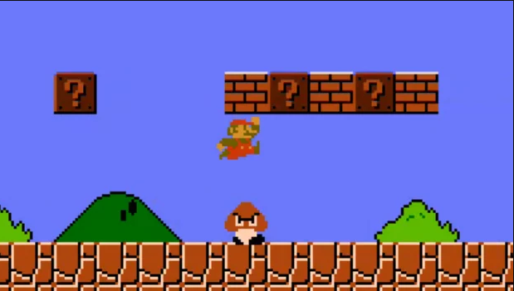
TDD and GDD
Similarities
Ordered project
What it is about
Differences
Designer point of view, how the game is played
Programmer point of view, how the game works

Slide 4
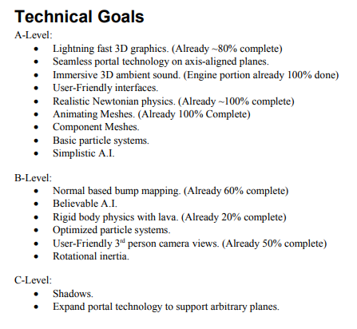
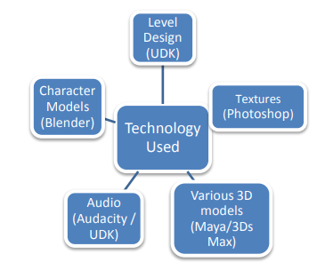
TDD Sections
Summary
Goals
Hardware and Software

Slide 5
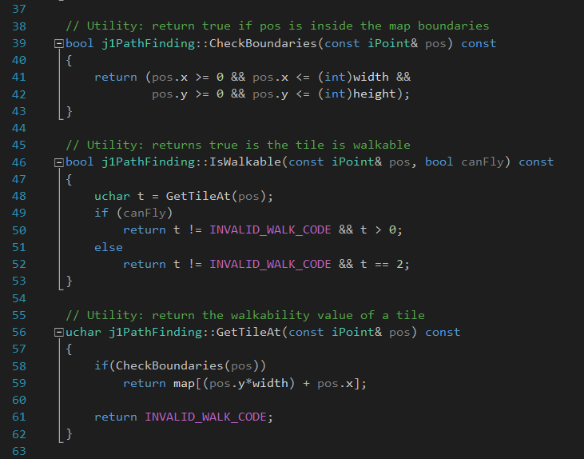
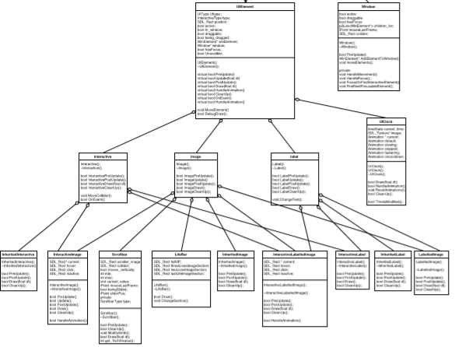
TDD Sections II
Programming Policies
UML
Code Style
Branching
Comments
Versions
Libraries
Builds

Slide 6


TDD Sections III
Data sharing
File Formats and naming
Changelog

Slide 7
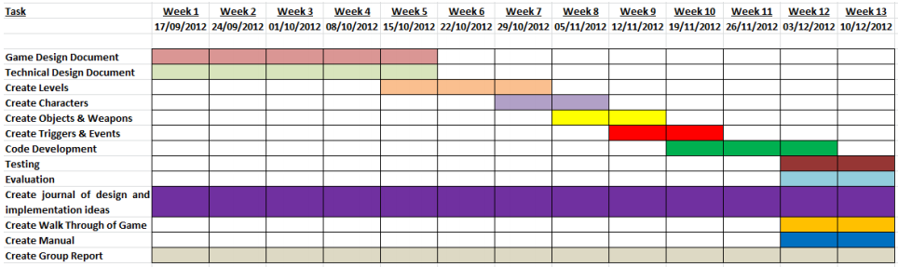
Additional Sections
Features from the GDD
Development Plan

Slide 8
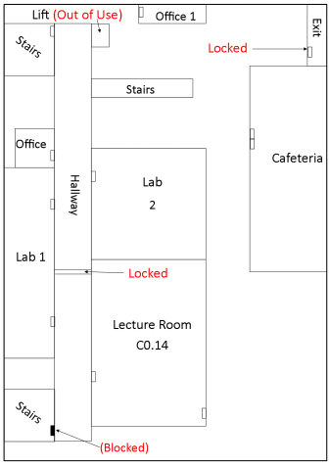
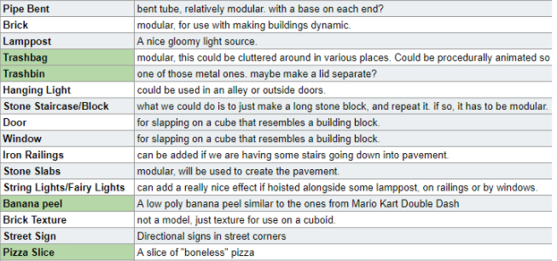
Additional Sections II
Level layouts
Asset lists

Slide 9
Homework and questions
1.- Decide your TDD lenght and sections
Discuss the TDD with the whole team
Planning the TDD before writing it is important
The more complete your TDD is, the less explanations you will need to give, but…
Quality over quantity. Big documents are Boooooring.
2.- Work on your TDD
Start by dividing some tasks
Do a quick summary of what you want to write.

