Slide 1


WHY? WHAT IS THE PROBLEM?
Community policing progressivists want to advance policing. -> THE POLICE FOUNDATION & THE POLICE DATA INITIATIVE. But less than half major police departments participate now.
To increase the transparency of public safety related policy making & budget planning via data analysis. Minor: To make public audit of FBI reports.
To reveal important public data & to inform tourists and locals about safety of a city part and outcomes of taxation.
To support initiative of progressive police departments via science, technology and innovation.

Slide 2
HOW AND DATA
SOURCES -> “Police Data Initiative” https://www.policedatainitiative.org/datasets/incidents/
ROW INPUT FORMAT (min): TIMESTAMP, ADDRESS, OFFENCE_DATA
RAW DATA -> MongoDB
PROCESSED FORMAT (min): YEAR MONTH DAY TIME, longitude, latitude
PROCESSED DATA -> MongoDB
ANALYSIS + VISUALISATION -> Python STATIC + Kepler.gl/vis.gl DYNAMIC TIMELINE

Slide 3
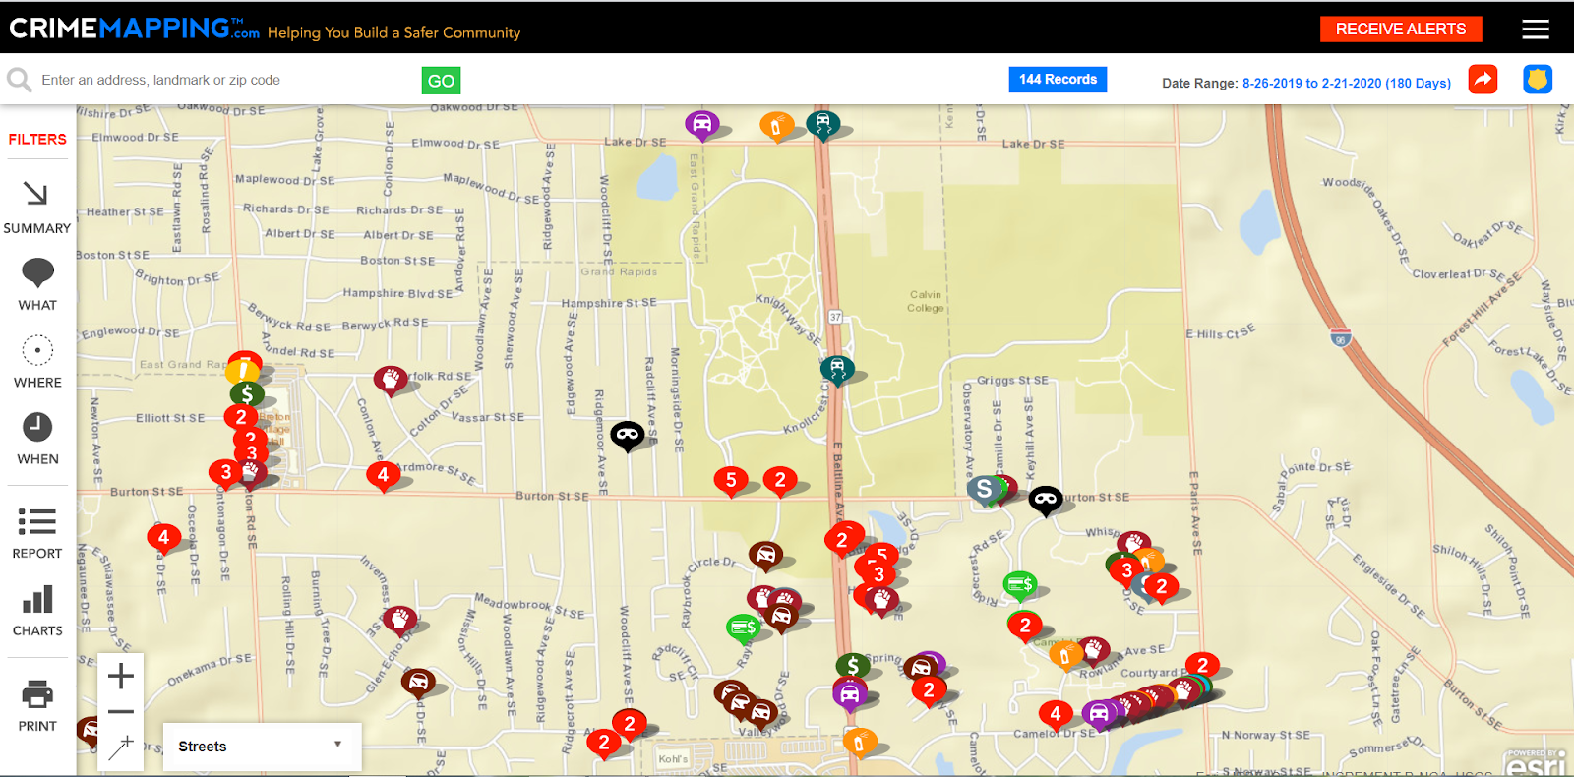
EXAMPLE: GRAND RAPIDS NEAR CRIMES

Slide 4
AMOUNT OF CRIMES PER HOUR PER YEAR CRIMES PER AVERAGE HOUR 3D HIST TIMELINE
Step: 30 min. The highest bar per step is relatively the most crime point.
KEPLER
INTERACTIVE
https://kepler.gl/demo/map?mapUrl=https://dl.dropboxusercontent.com/s/u0aqfbui3muxmoq/keplergl_2ndwn6n.json

Slide 5
GENERAL SCATTERPLOTS DATAMAPS
OPEN DOCUMENT
https://docs.google.com/document/d/1jlCnLkqAA9jwJnflPwdcfXNF8Ofu6TOi9tSdhMpxzNQ/edit#
http://localhost:8888/notebooks/hacks_and_contests/calvinhacks2020/Untitled.ipynb#PRESENTATION

Slide 6
DENSITY BASED PREDICTION FOR CIRCLED CITIES
OPEN DOCUMENT

Slide 7
CRIME AGAINST CATEGORY SCATTER PLOTS DATA
OPEN DOCUMENT

Slide 8








Download
Raw data
Call
Processed data
Processing
Dynamic
Insight
Visualization
Static

Slide 9




