Slide 1



WITS
AHEAD
Research Group for Advancing Human Capabilities through Education, Analytics and Development
RESEARCH GROUP · WITS SCHOOL OF EDUCATION
AHEAD Pathway
Your new postgraduate supervision experience
For candidates supervised within the Wits AHEAD Research Group · from September 2026
Notes:
Welcome to AHEAD Pathway, your new postgraduate supervision experience, from the Wits AHEAD Research Group at the Wits School of Education. This short guide walks you through everything, from setting up the app on your phone to receiving your first round of feedback.

Slide 2
WITS
AHEAD
Research Group for Advancing Human Capabilities through Education, Analytics and Development
WHY THIS EXISTS
Two decades in the School, shaped into your experience
Professor Emmanuel Ojo has served the Wits School of Education for two decades, much of it in the postgraduate portfolio, including in senior leadership.
Pathway carries that understanding of the postgraduate ecosystem, at Wits, nationally and globally, into one place: your record, your documents, your feedback, your meetings and your messages.
Nothing gets lost in email again. Every step is dated and kept, and it counts towards your annual progress report.
You have a front-row seat: the platform is improved every week by the Director and the developers, and your experience shapes it.
2 / 16
Notes:
Pathway was designed by your supervisor, Professor Emmanuel Ojo. He has served the Wits School of Education for two decades, much of that time in the postgraduate portfolio, including in senior leadership. What you are getting is that understanding of the postgraduate ecosystem, at Wits, nationally and globally, shaped into one place: your record, your documents, your feedback, your meetings and your messages. Nothing gets lost in email again. Every step is dated and kept, and it counts towards your annual progress report. You have a front-row seat: the platform is improved every week by the Director and the developers, and your experience shapes it.

Slide 3
WITS
AHEAD
Research Group for Advancing Human Capabilities through Education, Analytics and Development
WHAT CHANGES
Feedback no longer comes by email
From now on, feedback on your chapters and proposals arrives on the portal.
Every round comes with the reviewed documents, your actions to tick off, readings to open, and a recording you can listen to while you read.
Messages to and from the Director are on the portal too, with a notification on your phone.
Email still tells you something is waiting, but the work happens in Pathway.
3 / 16
Notes:
Here is the most important change. From now on, feedback on your chapters and proposals arrives on the portal, not by email. Every round comes with the reviewed documents, your actions to tick off, readings to open, and a recording you can listen to while you read. Messages to and from the Director are on the portal too, with a notification on your phone. Email will still tell you that something is waiting, but the work itself happens in Pathway.

Slide 4
WITS
AHEAD
Research Group for Advancing Human Capabilities through Education, Analytics and Development
WITSAHEAD.ORG
One website, six languages, something new every day
English
Français
Español
Português
中文
isiZulu
The daily briefing at 06:30: the day's news on AI, data and human capability in higher education, checked at source, three to four minutes.
The AHEAD Daily: the briefing read aloud, and a video you can download.
The AHEAD Fortnightly every second Thursday, project context feeds, researcher profiles and the group's global footprint.
Read it in English, French, Spanish, Portuguese, Chinese or isiZulu. Install it on your phone like an app.
4 / 16
Notes:
The group's website, witsahead dot org, speaks six languages: English, French, Spanish, Portuguese, Chinese and isiZulu. Every morning at half past six it publishes the daily briefing: the day's news on artificial intelligence, data and human capability in higher education, checked at source, three to four minutes to read, or to listen to. Every second Thursday comes The AHEAD Fortnightly, and there are project feeds, researcher profiles and the group's global footprint. Install it on your phone like an app, and it is with you every day.

Slide 5
WITS
AHEAD
Research Group for Advancing Human Capabilities through Education, Analytics and Development
STEP 1
Install Pathway on your phone, and bookmark it
iPhone or iPad: open pathway.witsahead.org in Safari, tap Share, then Add to Home Screen, then Add.
Android: open it in Chrome, tap the menu, then Add to Home screen or Install app.
Computer: open it in Chrome, Edge or Safari and click the install icon in the address bar; in Safari, File, then Add to Dock.
Bookmark it as well, in every browser you use. Any phone, any platform: you will never miss a message.
5 / 16
Notes:
Step one: install Pathway on your phone, and bookmark it. On an iPhone or iPad, open pathway dot witsahead dot org in Safari, tap Share, then Add to Home Screen, then Add. On Android, open it in Chrome, tap the menu, then Add to Home screen. On a computer, open it in Chrome, Edge or Safari and click the install icon in the address bar. Bookmark it as well, in every browser you use. Any phone, any platform: with the app installed you will never miss a message.

Slide 6
WITS
AHEAD
Research Group for Advancing Human Capabilities through Education, Analytics and Development
STEP 2
Sign in with a code, no password
Open Pathway from its icon and enter your university email address.
A one-time code is emailed to you within a minute. Type it in, and you are in.
There is no password to remember or to lose.
If the code does not arrive, check your junk folder, then write to Director@WitsAHEAD.org.
6 / 16
Notes:
Step two: sign in with a code. Open Pathway from its icon and enter your university email address. A one-time code is emailed to you within a minute. Type it in, and you are in. There is no password to remember. If the code does not arrive, check your junk folder, then write to the Director.

Slide 7
WITS
AHEAD
Research Group for Advancing Human Capabilities through Education, Analytics and Development
STEP 3
Turn on notifications, once
Inside the app, tap the bell, press Turn on, and tap Allow when your phone asks.
From then on, feedback, messages, calls and meeting records ring on your phone, even when the app is closed.
A small number on the icon shows what is waiting.
7 / 16
Notes:
Step three: turn on notifications, once. Inside the app, tap the bell, press Turn on, and tap Allow when your phone asks. From then on, feedback, messages, calls and meeting records ring on your phone, even when the app is closed, and a small number on the icon shows what is waiting. You will never miss a message again.

Slide 8
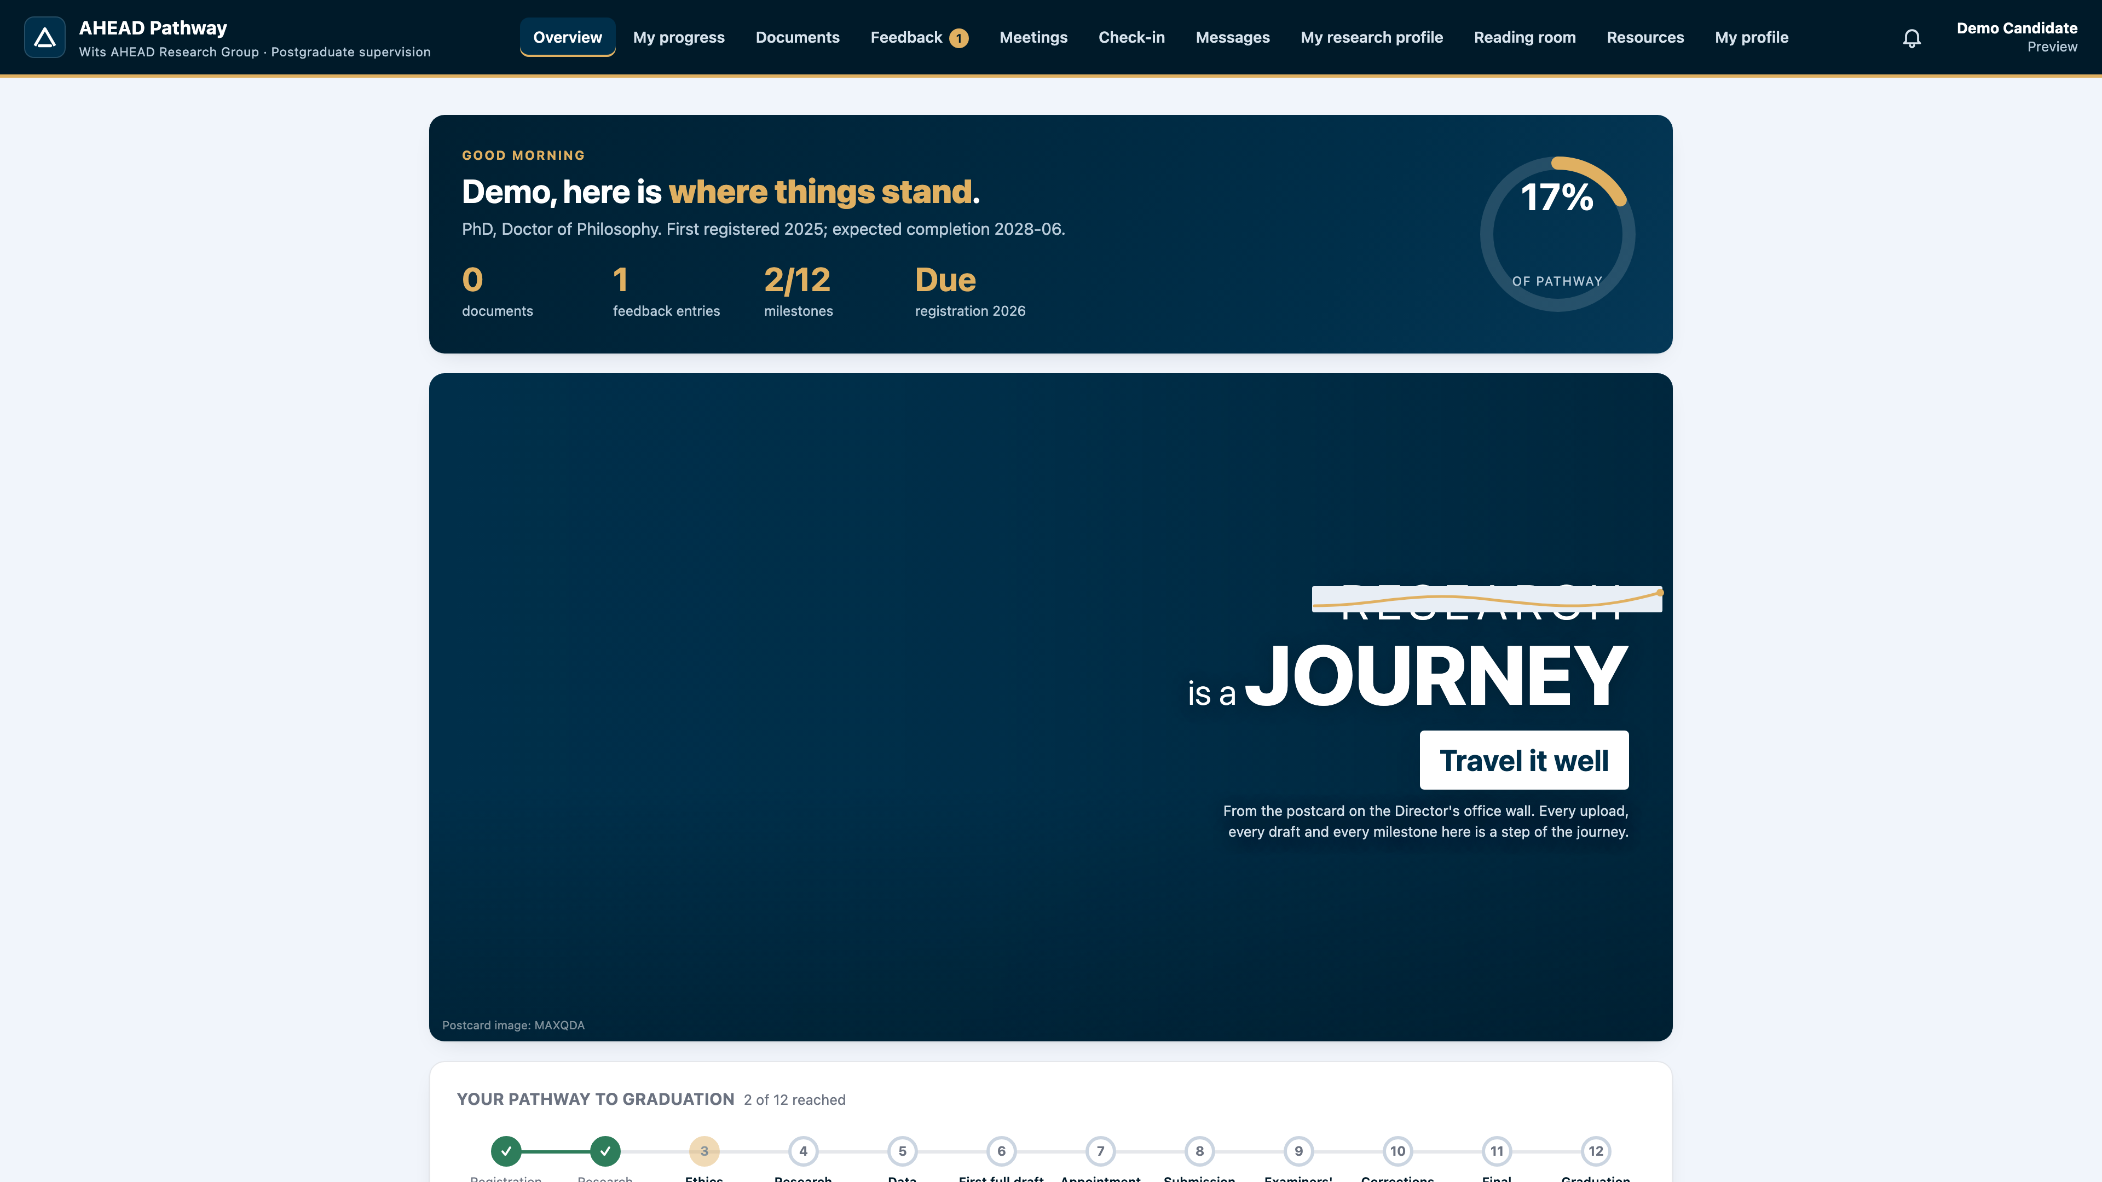
WITS
AHEAD
Research Group for Advancing Human Capabilities through Education, Analytics and Development
YOUR RECORD
Your overview, at a glance
Your milestones from registration to graduation, and how far along you are.
Your registration for the year, your documents, and anything waiting for you.
Complete your profile and the consent statement on your first visit.
The overview: your progress on the pathway, what is due, and quick links.
8 / 16
Notes:
Once you are in, the overview shows your whole journey at a glance: your milestones from registration to graduation, how far along you are, your registration for the year, your documents, and anything waiting for you. On your first visit, complete your profile and the consent statement.

Slide 9
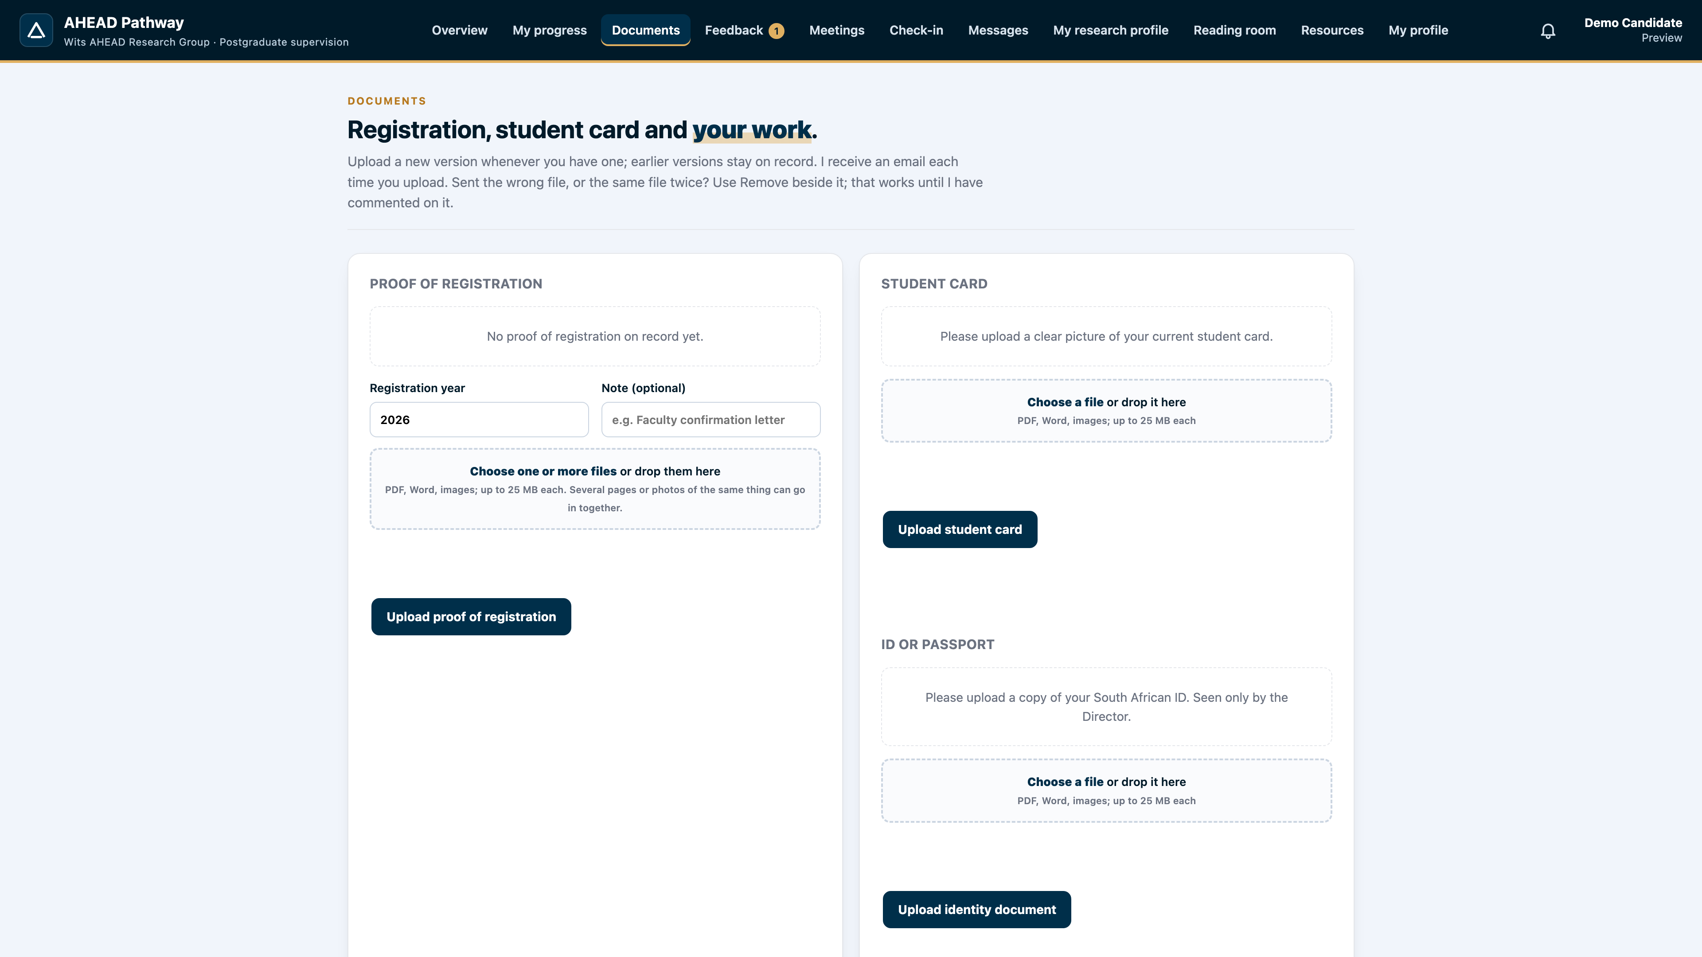
WITS
AHEAD
Research Group for Advancing Human Capabilities through Education, Analytics and Development
DOCUMENTS
Upload your work, version by version
Upload a proposal, a chapter, a full draft, corrections or an ethics form.
Each upload gets a version number, so we both know which one we are talking about.
The Director is told the moment it arrives.
Documents: proposals, chapters, full drafts, corrections and ethics forms, each with a version number.
9 / 16
Notes:
Under Documents, you upload your work: a proposal, a chapter, a full draft, corrections or an ethics form. Each upload gets a version number, so we both know exactly which version we are talking about. The Director is told the moment it arrives.

Slide 10
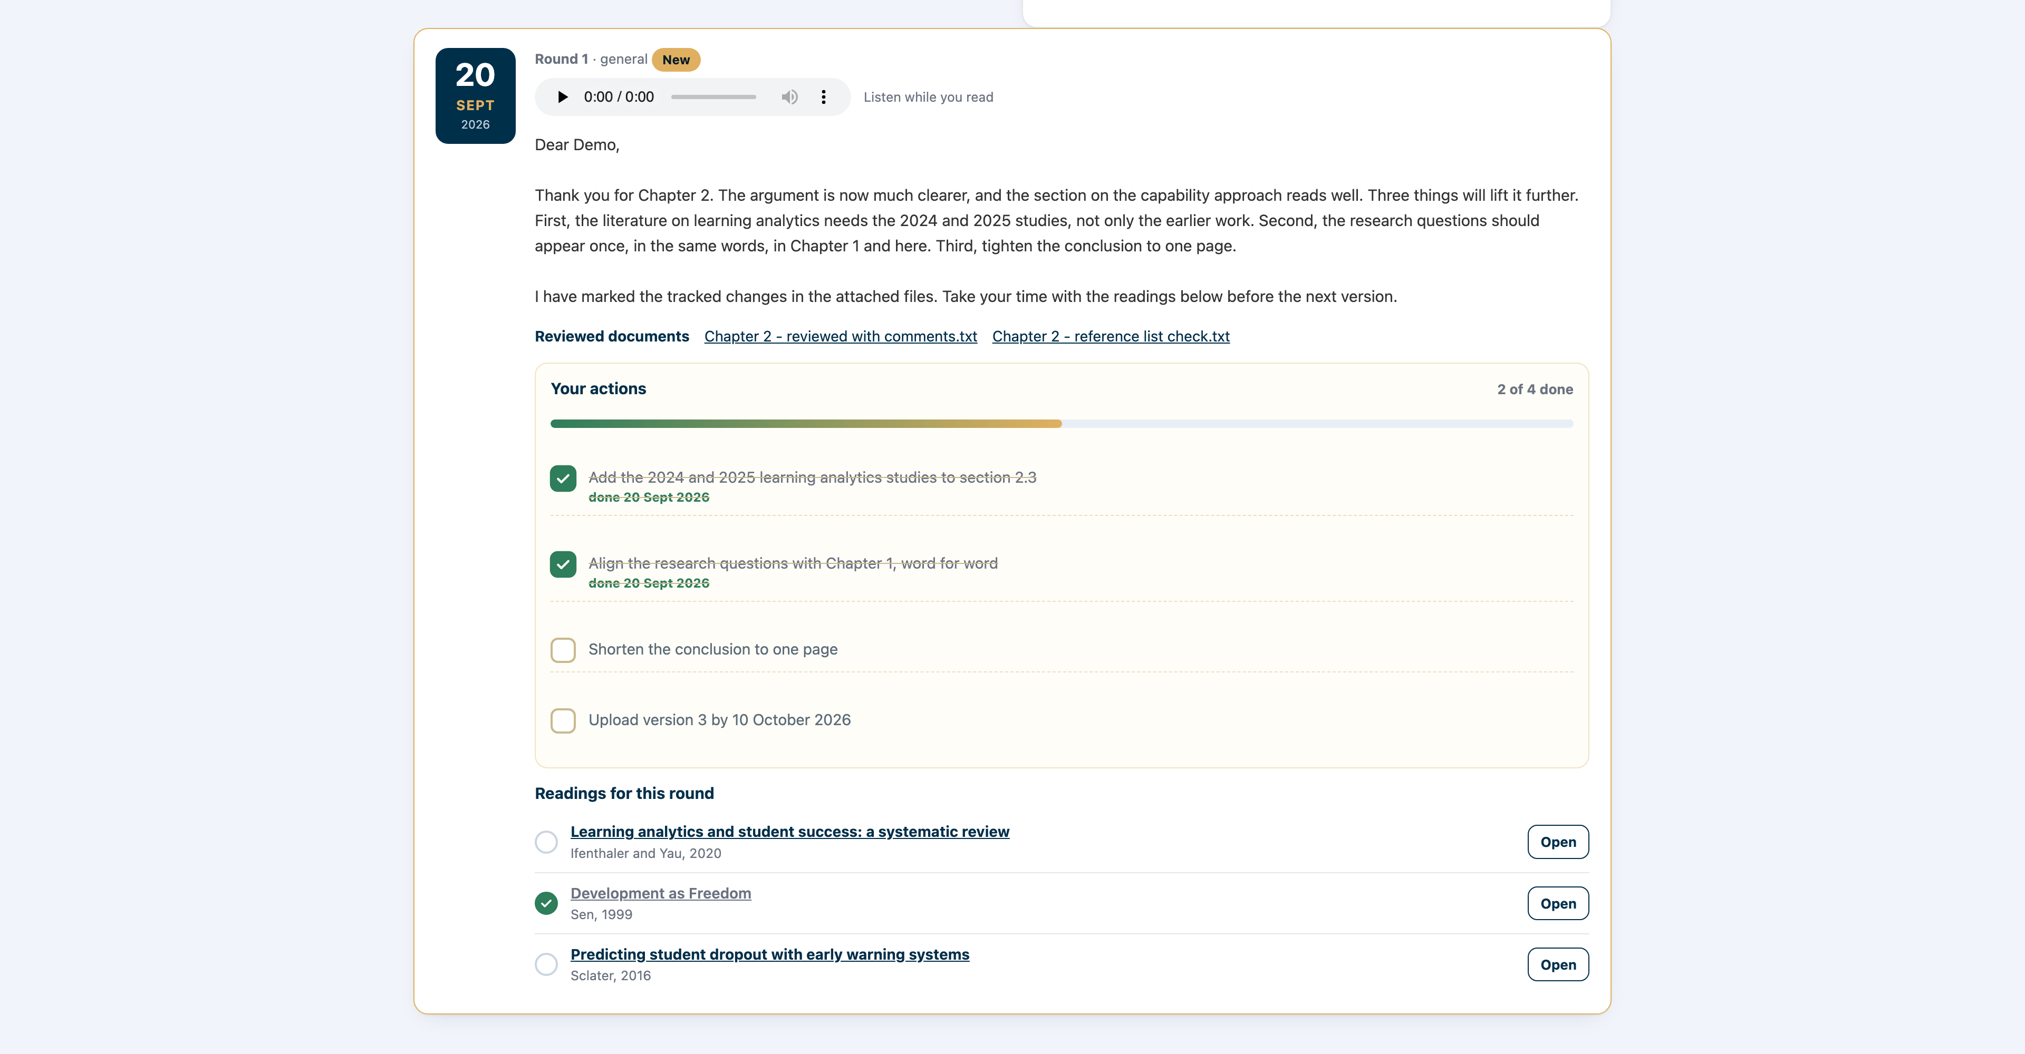
WITS
AHEAD
Research Group for Advancing Human Capabilities through Education, Analytics and Development
FEEDBACK
A round of feedback, made to be enjoyed
Read the comments and listen to them at the same time.
Download the reviewed documents, work online or offline, and upload the next version.
Tick each action off as you do it; the round turns green when it is complete.
Open the readings straight from the round.
One round: the date, the comments, a recording to listen to, the reviewed files, your actions to tick off, and the readings.
10 / 16
Notes:
This is a round of feedback. At the top is the date and what it is about. You can read the comments and listen to them at the same time. Below are the reviewed documents to download, so you can work online or offline and upload the next version. Then come your actions: tick each one off as you do it, and watch the round turn green when it is complete. The readings the Director attached open straight from the round.

Slide 11
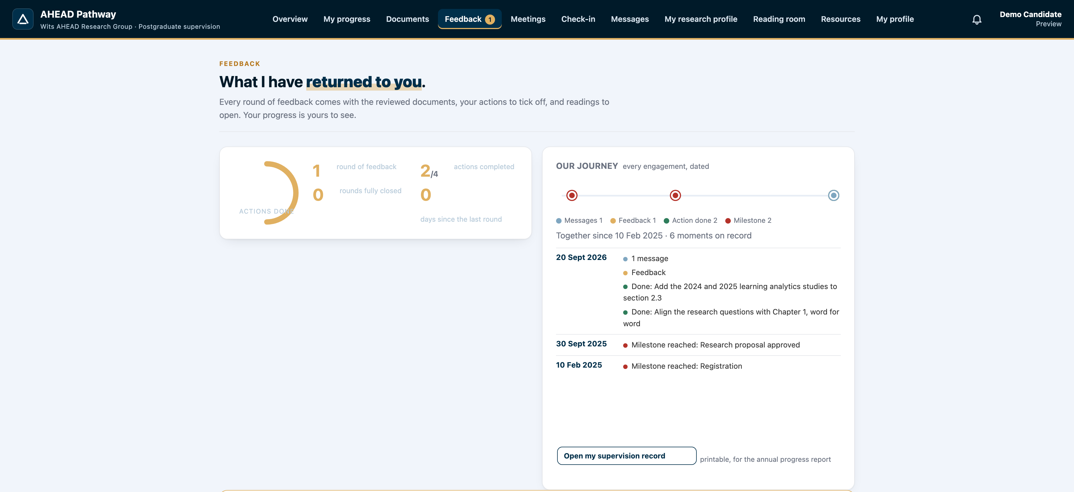
WITS
AHEAD
Research Group for Advancing Human Capabilities through Education, Analytics and Development
YOUR JOURNEY
Every engagement, dated and kept
Every upload, every round of feedback, every action completed, every message and meeting is logged with its date.
Your progress ring shows how many actions you have completed.
Open my supervision record gives you a printable record for the annual progress report.
The journey strip and log: uploads, feedback, actions done, downloads, messages, meetings, calls and check-ins.
11 / 16
Notes:
Everything between you and your supervisor is logged with its date: every upload, every round of feedback, every action you complete, every message, meeting and call. Your progress ring shows how many actions you have completed. And when the School asks for the annual progress report each June and July, one click on Open my supervision record gives you a printable record of the whole year.

Slide 12
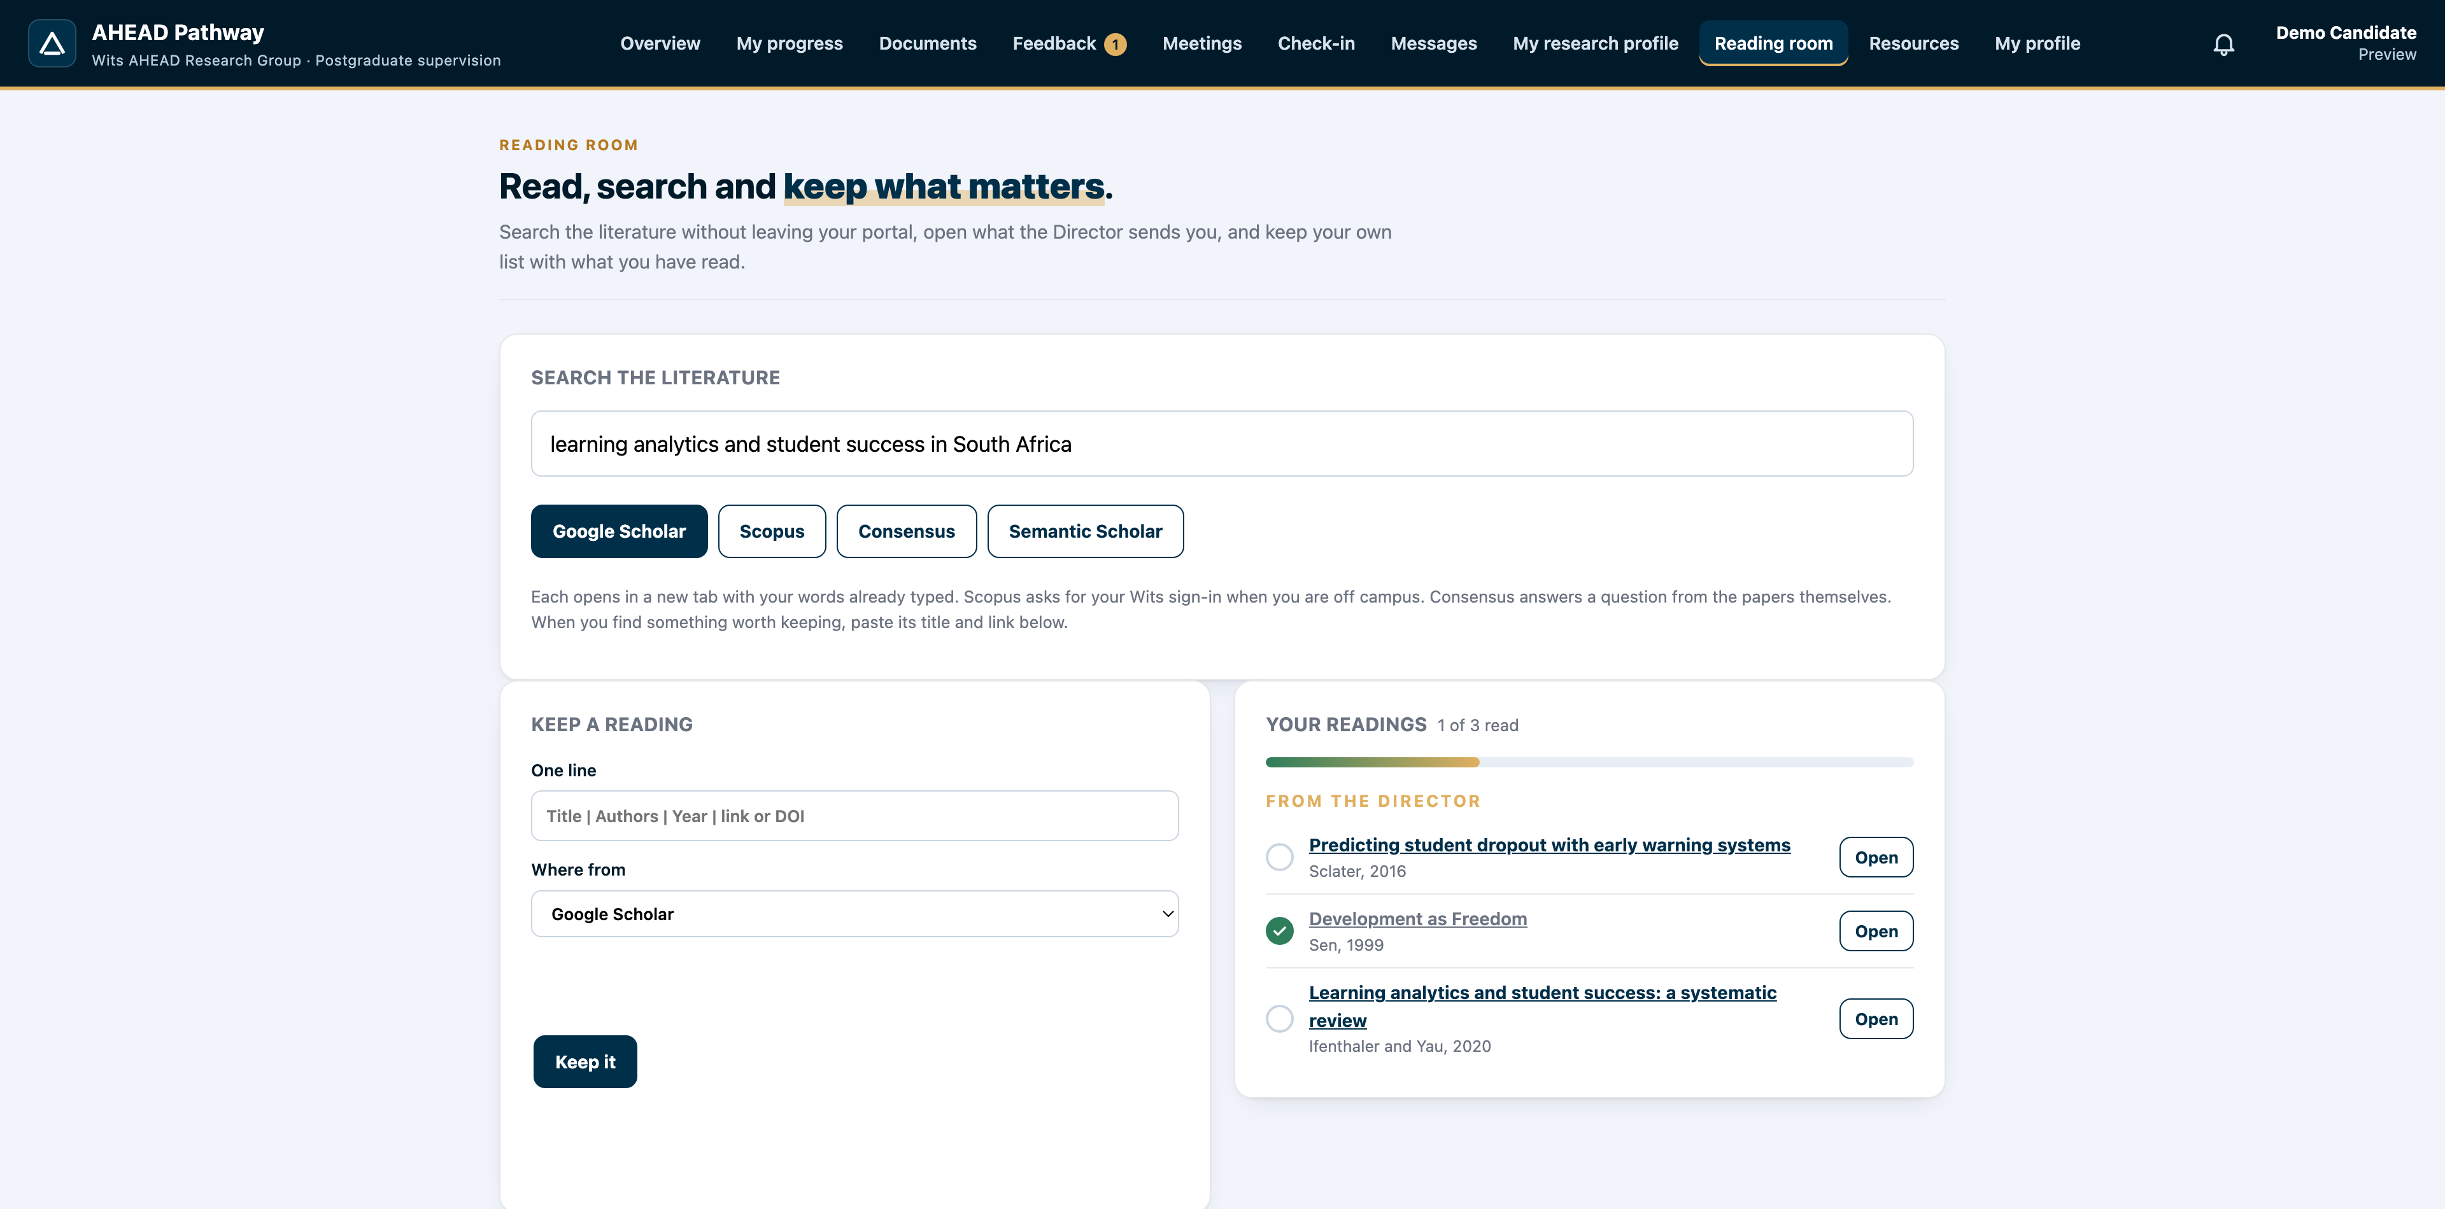
WITS
AHEAD
Research Group for Advancing Human Capabilities through Education, Analytics and Development
READING ROOM
Search the literature from your portal
Type a question or a topic and open it in Google Scholar, Scopus, Consensus or Semantic Scholar.
Keep a reading with one line; mark it read when you are done.
Readings the Director attaches to feedback appear here too.
The reading room: search Google Scholar, Scopus, Consensus and Semantic Scholar, and keep what matters.
12 / 16
Notes:
The reading room lets you search the literature without leaving your portal. Type a question or a topic and open it in Google Scholar, Scopus, Consensus or Semantic Scholar. Keep a reading with one line, and mark it read when you are done. Readings the Director attaches to your feedback appear here too.

Slide 13
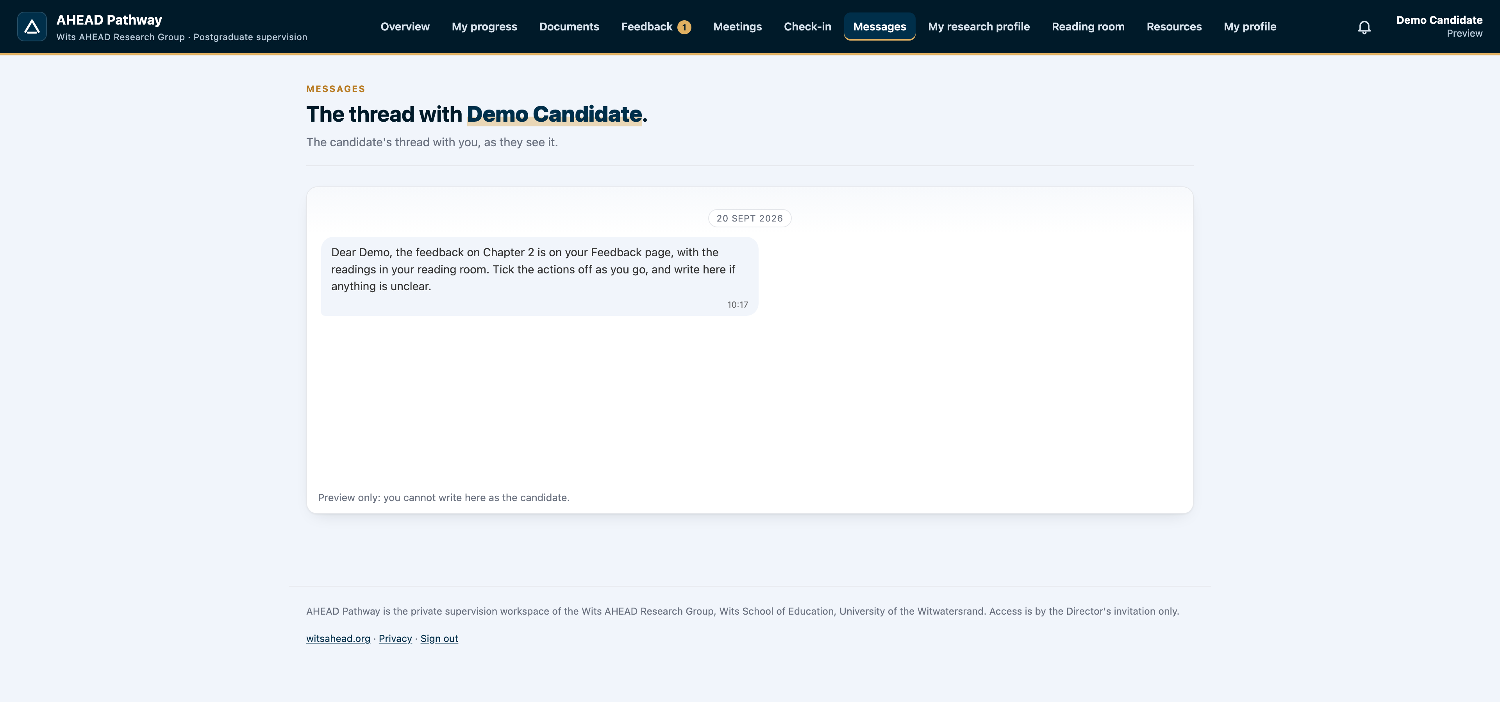
WITS
AHEAD
Research Group for Advancing Human Capabilities through Education, Analytics and Development
MESSAGES, MEETINGS AND CALLS
Talk to your supervisor, on the record
Write to the Director on the portal; it rings on his phone as it rings on yours.
Meetings go into both calendars; a monthly check-in keeps him informed of how you are.
Voice and video calls happen inside Pathway, on your phone or computer, and a written record follows every call.
Messages with the Director, and voice or video calls inside the platform, recorded with a written record sent to both of you.
13 / 16
Notes:
Messages, meetings and calls all live on the portal. Write to the Director and it rings on his phone as it rings on yours. Meetings go into both calendars, and a short monthly check-in keeps him informed of how you are getting on. Voice and video calls happen inside Pathway, on your phone or your computer, and a written record with the summary, decisions and actions follows every call.

Slide 14
WITS
AHEAD
Research Group for Advancing Human Capabilities through Education, Analytics and Development
STAY CONNECTED
Follow Wits AHEAD, every day
Website
www.witsahead.org
WhatsApp channel
whatsapp.com/channel/0029VbDoYzVAInPhU1WTxO38
LinkedIn
linkedin.com/company/witsahead
X
x.com/WitsAHEAD
Instagram
instagram.com/witsahead
Facebook
facebook.com/WitsAHEAD
The daily briefing takes three to four minutes. Follow the channels, install the website as an app, and nothing passes you by.
14 / 16
Notes:
Stay connected with the group. Follow Wits AHEAD on the WhatsApp channel, LinkedIn, X, Instagram and Facebook, and keep the website on your phone. The daily briefing takes three to four minutes every morning, and you can listen to it read aloud. Follow the channels, install the website as an app, and nothing passes you by.

Slide 15
WITS
AHEAD
Research Group for Advancing Human Capabilities through Education, Analytics and Development
THIS WEEK
Four things to do before the launch meeting
Install Pathway on your phone, bookmark it, and sign in with your code.
Turn on notifications in the app.
Complete your profile and the consent statement; upload your proof of registration.
Upload your latest chapter or proposal, so your first round of feedback can begin.
15 / 16
Notes:
So, this week, four things. Install Pathway on your phone, bookmark it, and sign in with your code. Turn on notifications in the app. Complete your profile and the consent statement, and upload your proof of registration. Then upload your latest chapter or proposal, so that your first round of feedback can begin.

Slide 16
WITS
AHEAD
Research Group for Advancing Human Capabilities through Education, Analytics and Development
RESEARCH GROUP · WITS SCHOOL OF EDUCATION
Welcome to the front row
pathway.witsahead.org · www.witsahead.org
Questions: Director@WitsAHEAD.org · The platform is improved every week; tell us what would help you.
Notes:
Welcome to the front row of postgraduate supervision. Open pathway dot witsahead dot org, and we will see you on the platform. If anything is unclear, write to Director at WitsAHEAD dot org. The platform is improved every week, so tell us what would help you. Thank you.

