Slide 1
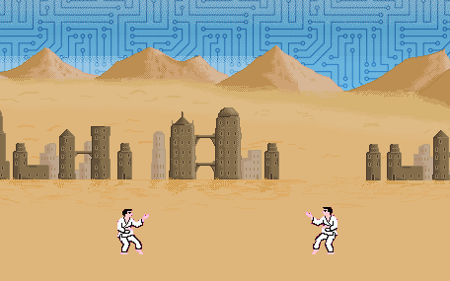
Dynamic Difficulty Adjustment in 2D Games Using MAP-Elites
Anders Roed Kierkegaard & Frederik Tejner Witte

Slide 2
Problem defenition
“How does players of verying level of skill, experience a game with an adaptive AI opponent that dynamically balances the difficulty”

Slide 3
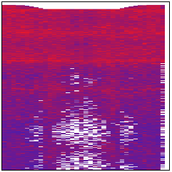
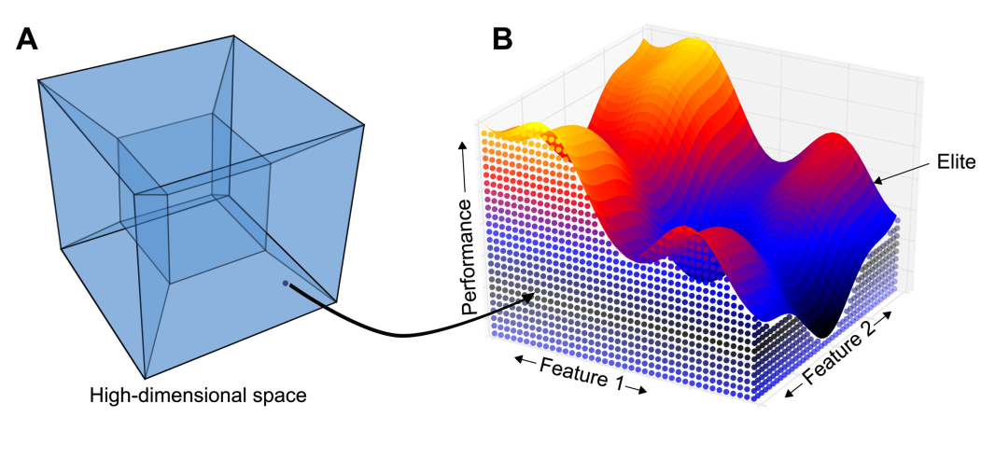
MAP-Elites

Slide 4
Simple sequence genome

Slide 5
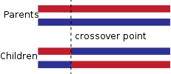
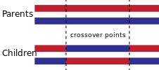
Crossover
One-point crossover
k-point crossover

Slide 9
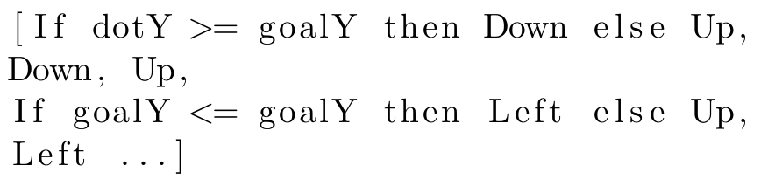
Genome for grammatical evolution

Slide 10
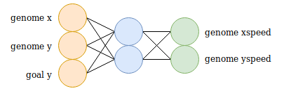

Slide 11
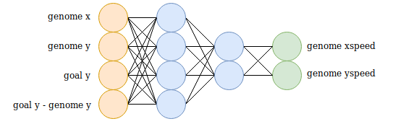

Slide 12
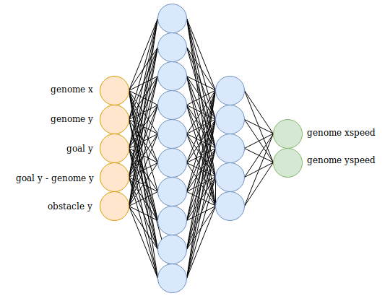

Slide 14
Game Design Theory
How to evaluate the quality of a game is an active field of research
Engaging experiences as a sign of quality:
Flow theory
Player Experience of Need Satisfaction (PENS)
Immersive Experience Questionnaire (IEQ)

Slide 15
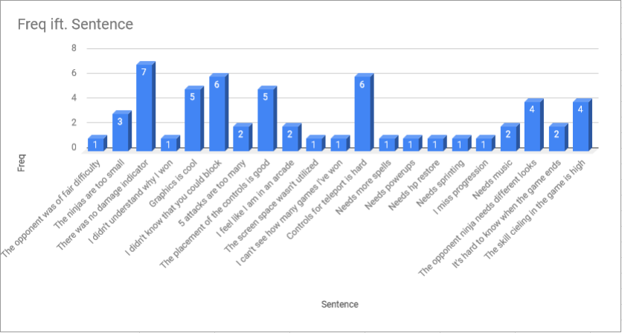
Finalizing Desert Ninja
Qualitative study
PENS-based

Slide 17
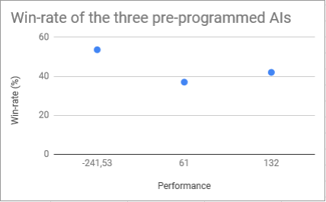
Evolving the AI
Performance range
5 second input
Matchmaking
Evolving diverse opponents
Win-rate benchmark

Slide 18
Adaptive AI Impact
2 gamemodes (non-adaptive/adaptive)
Between-group study
Unique participants
10 rounds before questionnarie
Immersion scores

Slide 19
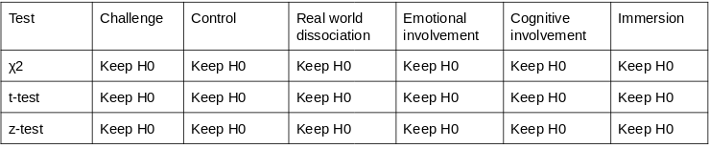
Experimental Results

Slide 20
Discussion
Other studies
Possibly biased results
Player preference
Participants are experienced gamers
Longer session time
Future works
HyperNEAT
Real-time adapting AI

Slide 21
Thank you

