Slide 1

Ship Simulator Volgo-Don 159
https://github.com/WiverNz/VolgoDon159

Slide 2
Overview
Implemented (some partially):
Import of models of ships, height map
User menu (Flash)
User interface (Flash)
Description of properties (RPM of engines, dimensions, weight)
Simple calculation of the ship's trajectory
Game state machine
To do:
Abstract factory for creating ship instances
Physics: drift of a ship (wind, flow, waves)
Some kind of AI
Radar (depths)
Simple navigation map

Slide 3
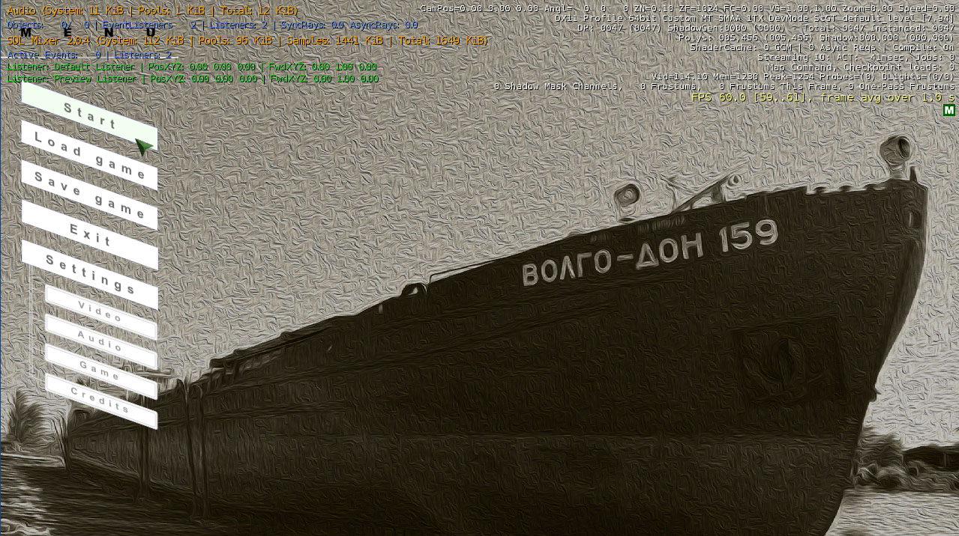

Slide 4
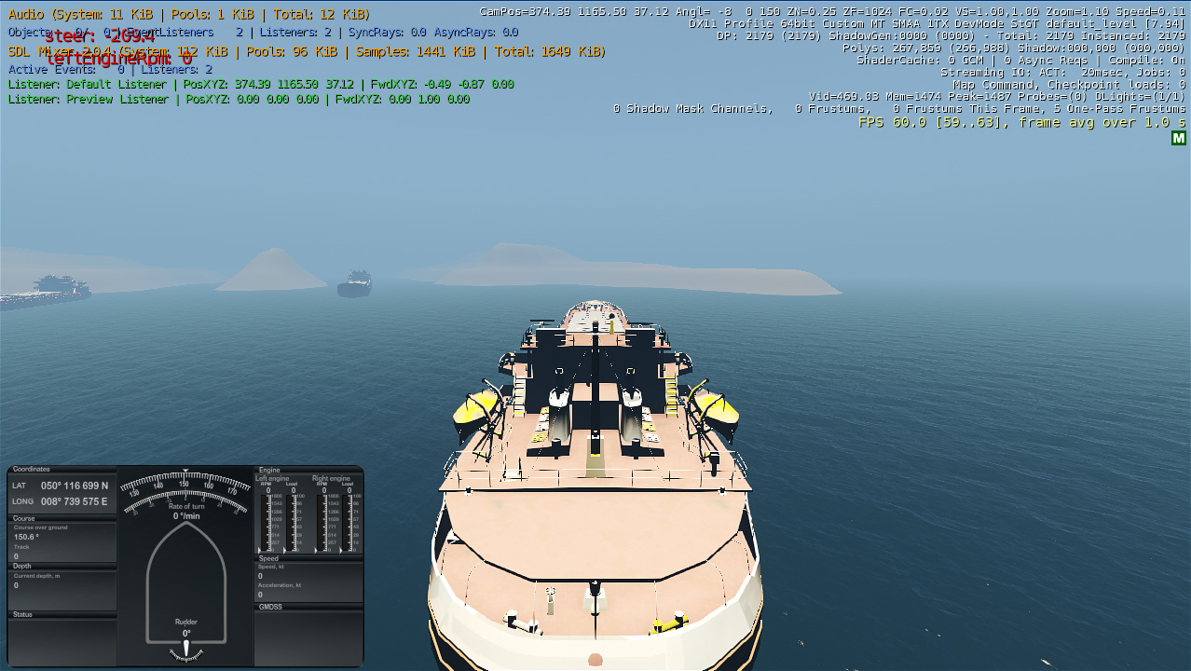

Slide 5
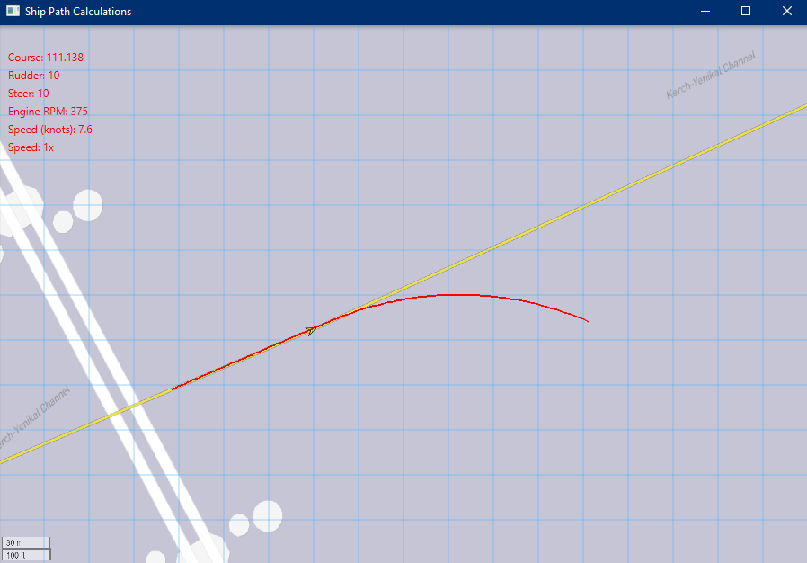

Slide 6
Problems
Unittests
Out of the box not supported - I created stubs from the game engine and a config file that is picked up in cmake with unpacking and compiling of the gtests (UnitTestsMacros.cmake - function include_google_test)
Serialization of small numbers
Using old technologies (Flash)
Crashes, freezes
Doesn't compile out of the box
Solution: Switch the Unity game engine (C#)

Slide 7
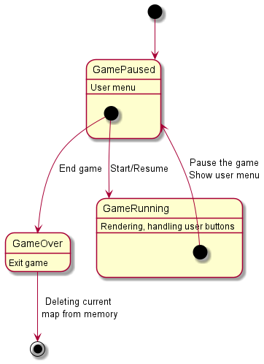
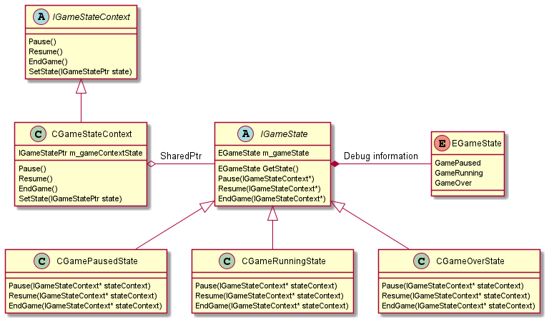
State machine
https://github.com/WiverNz/VolgoDon159/blob/main/Code/GameModules/GameState.h

Slide 8
Unit tests initialization

Slide 9
Future features and links
Future
Web interface (WebAssembly) with charts (Partial load) and display of ship positions.
Multiplayer
Loading and displaying real ships (MarineTraffic)
Links
https://github.com/WiverNz/VolgoDon159
Documentation: /doc/index.html
https://github.com/WiverNz/ShipPathCalculations
https://github.com/WiverNz/marinetraffic_pi
OpenCPN plugin

