Slide 1



Advance Interruptibility management system – Efficient notification delivery
Problem Statement ID: SJ1
Reduce the amount of push notifications required for e-commerce apps
MACHINE WORKS

Slide 2
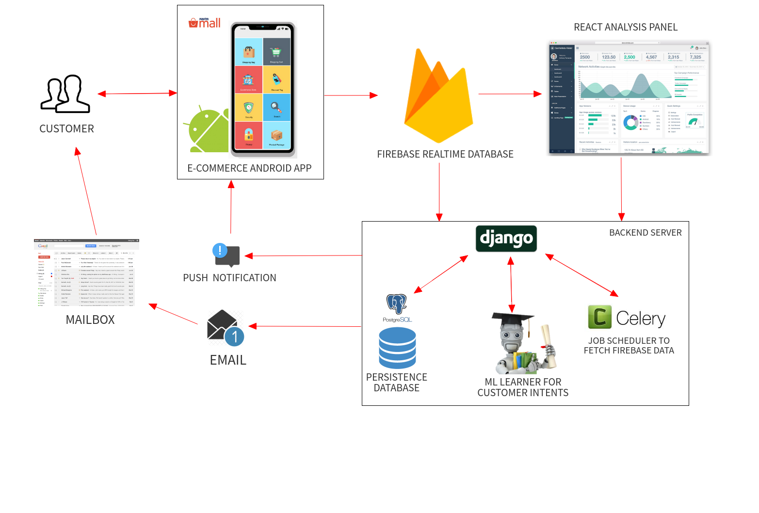
Workflow of proposed solution
MACHINE WORKS

Slide 3
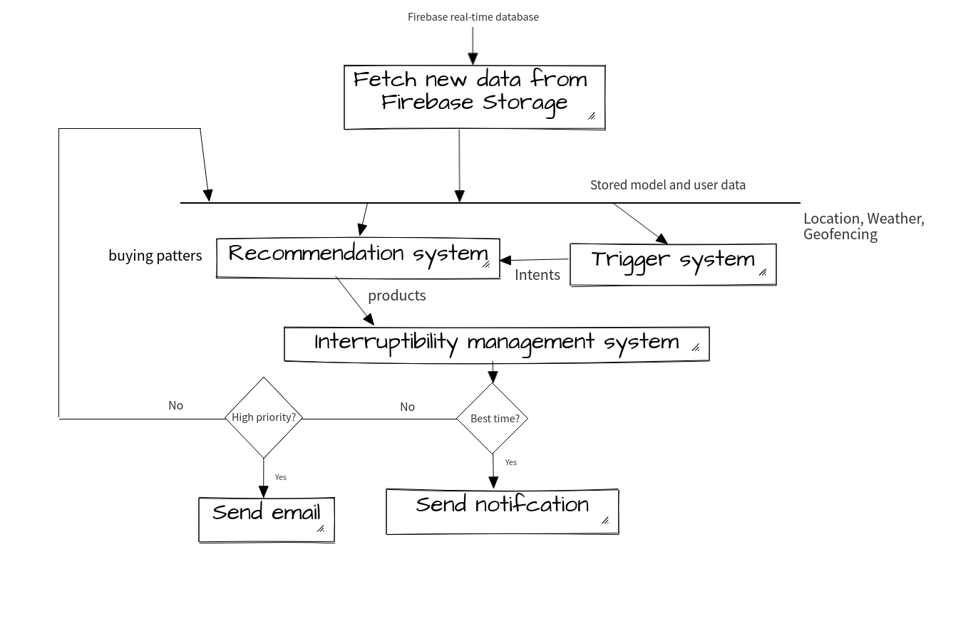
Algorithm
MACHINE WORKS

Slide 4










Technology Stack
+
MACHINE WORKS

Slide 5
Research references:
C-3PO: Click-sequence-aware DeeP Neural Network (DNN)-based Pop-uPs RecOmmendation, TonTon Hsien-De Huang et al.
Automated Extraction of Personal Knowledge from Smartphone Push Notifications, Yuanchun Li et al.
My Phone and Me: Understanding People’s Receptivity to Mobile Notifications, Abhinav Mehrotra et al.
Investigating Episodes of Mobile Phone Activity as Indicators of Opportune Moments to Deliver Notifications, Joel E. Fischer et al.
Personalize or Burst, LeanPlum
PrefMiner: Mining User’s Preferences for Intelligent Mobile Notification Management, Abhinav Mehrotra et al.
MACHINE WORKS

Slide 6
DEMO!

Slide 7
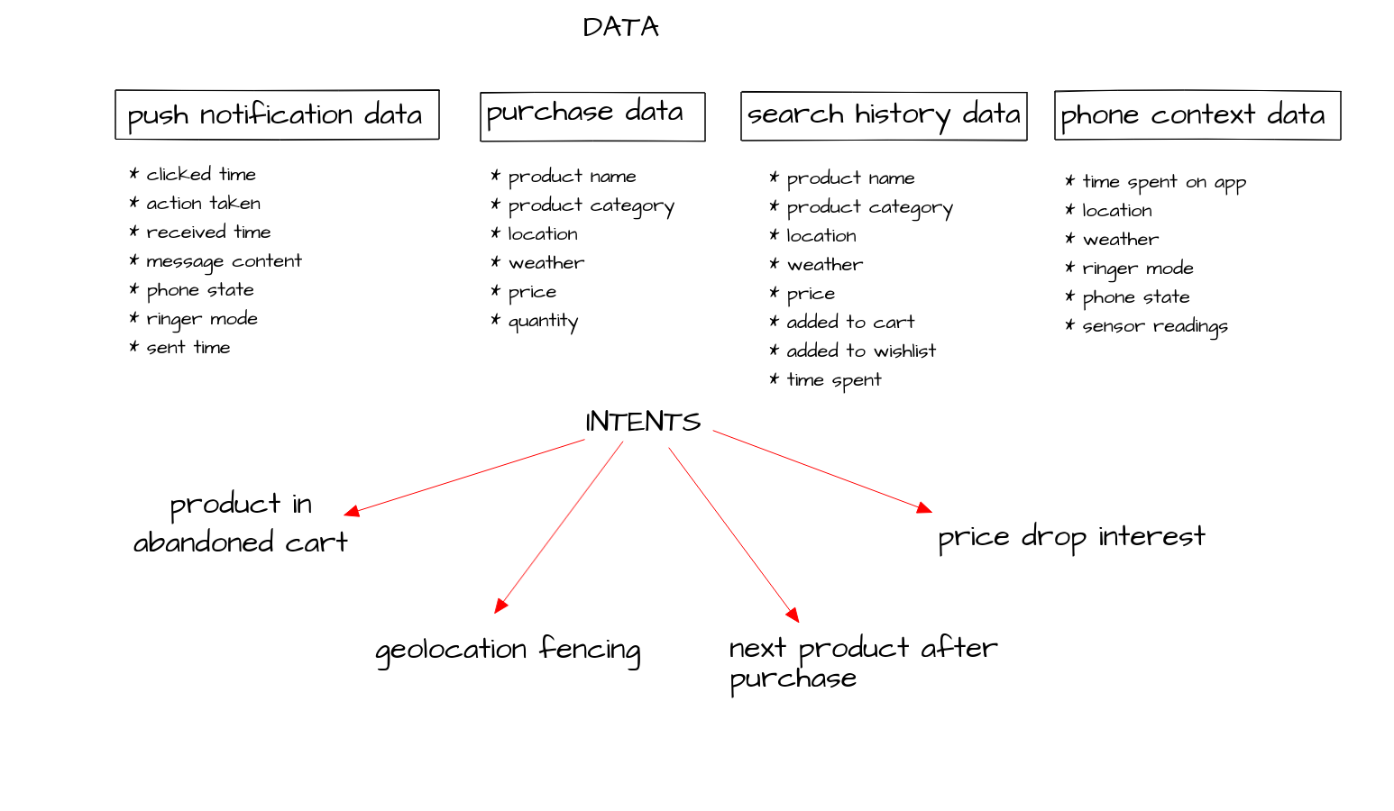
MACHINE WORKS

Slide 8
Goal of ClusTMPay
Recommender system
Optimal delivery time
Increase click-through rate
Personalization
Ease of monitoring
Deploy and forget
MACHINE WORKS

