Slide 1


Slide 2
Overview
With climate change becoming an increasingly important issue, we would like to create a web app in which people can track extreme weather systems such as storms, tornadoes and extreme heat. The app will also provide users with information of where these systems are, and any consequences that could arise from them such as flooding and wild fires.
The app will provide an interactive map that all users can view and navigate. The map will display pins that denote weather systems of interest and all users will be able to interact with them. Clicking on pins will provide further information about the event; such as the location and specific details such as the immediate impact.
There will also be the option for users to create an account which will give the user additional benefits. When logged in, users will be able to edit the map by adding pins if they have details about an extreme weather event. Additionally, account holders will be able to add favourite locations and events in these locations will be displayed on their feed.

Slide 3
Specification
All users must be able to view the interactive map, and click on pins to view extreme weather events.
All users must have the ability to create/edit/delete an account.
Logged in users must be able to add a pin to the map, storing the location and details of an extreme weather event.
Logged in users should be able to add favourite locations to their account.
Logged in users should be able to view a feed of events that are happening in their favourite locations.
All users could sign in through third parties such as Facebook, Google etc…
Logged in users could be able to rate events.

Slide 4

User Persona 1
Noah is a 28-year-old male from Texas. In his spare time, he enjoys travelling across the US, in search of tornadoes and other extreme weather events such as storms caused by climate change. He enjoys the thrill of being in a dangerous situation and taking photographs to remember his adventures. Time is of the essence when it comes to catching these weather systems, so he would like to have access to real time locations of them. This would allow him to accurately track the movement of storms, so that he can make sure he is in the correct location at the correct time, making sure that he never misses an exciting event again.

Slide 5

User Persona 2
Sam is a 34-year-old volunteer fire fighter in the Blue Mountains, Australia. With the devastating fires throughout the summer, she wishes to be able to track the current locations of fires, so that she can be one of the first responders extinguishing them. It would be helpful if she were notified of any new fires which appear in the area she works. Additionally, she would like to be able to post locations of fires which she has come across, to ensure that the members of the public know to stay away from the danger and perhaps notify other firefighters of the blazes.

Slide 6

User Persona 3
Derek is a 32-year-old banker who rides the 46-minute commute from Kentish Town to Canary Wharf on his bike, 5 days a week. As a cyclist, flooding can be a severe obstacle for him, so likes to keep track of flooding in his area. He would like to get real time updates from fellow commuters to avoid flooded routes. This will allow him to minimize the time taken for his daily commute, allowing him to spend more time with his family

Slide 7
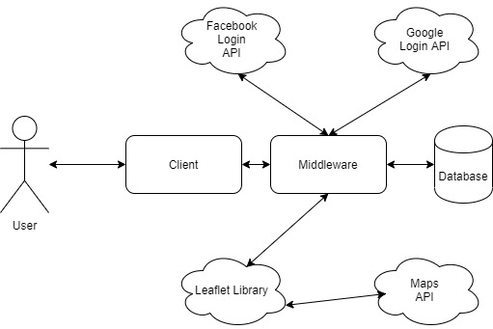
System Architecture

Slide 8
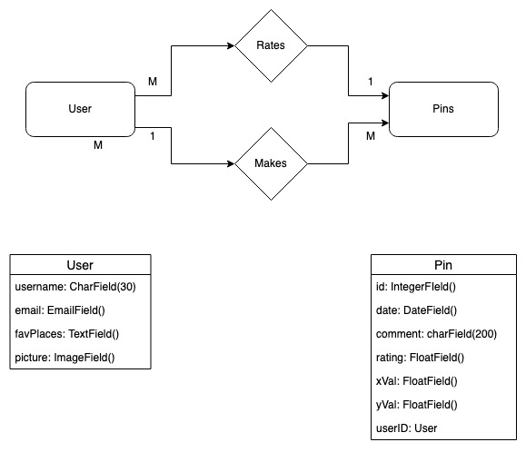
ER Diagram

Slide 9
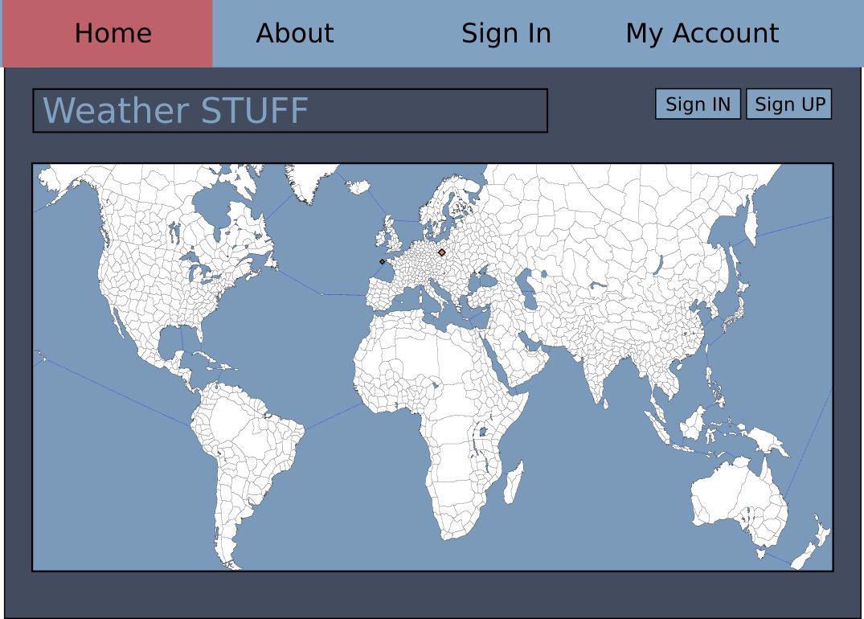
Wireframe: Index

Slide 10
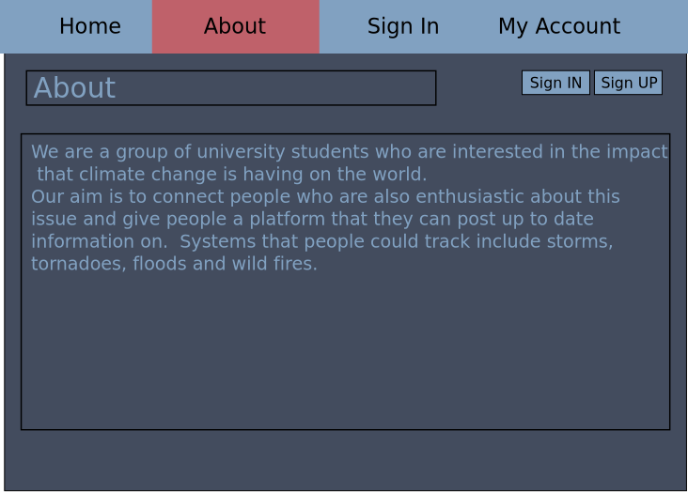
Wireframe: About

Slide 11
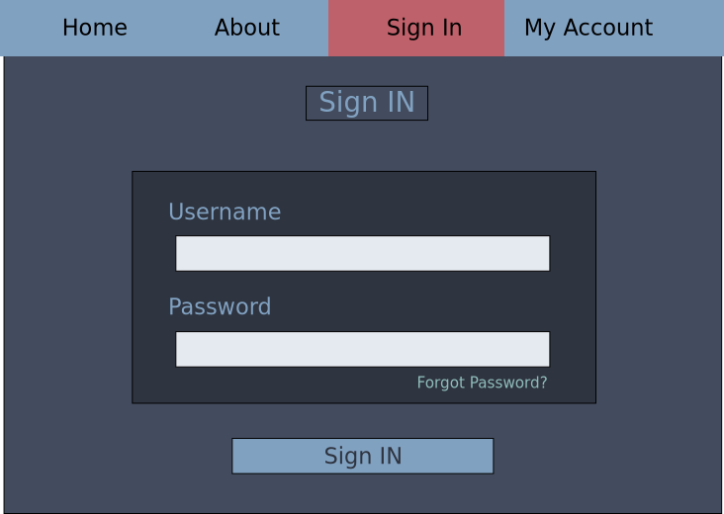
Wireframe: Sign In

Slide 12
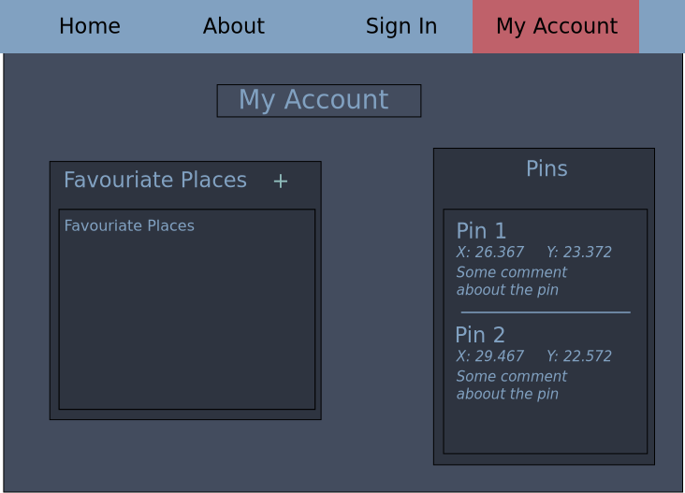
Wireframe: My Account

Slide 13
Site Map & URLs
/index
/about
/login
/login/myaccount
/login/myaccount/changedetails

Slide 14
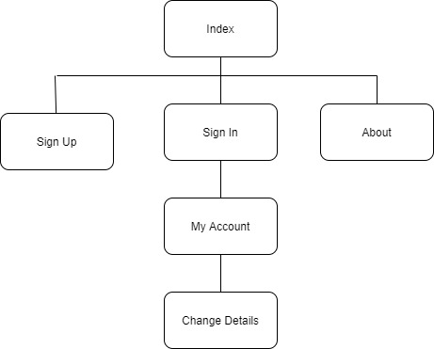
Site Map

