Slide 1

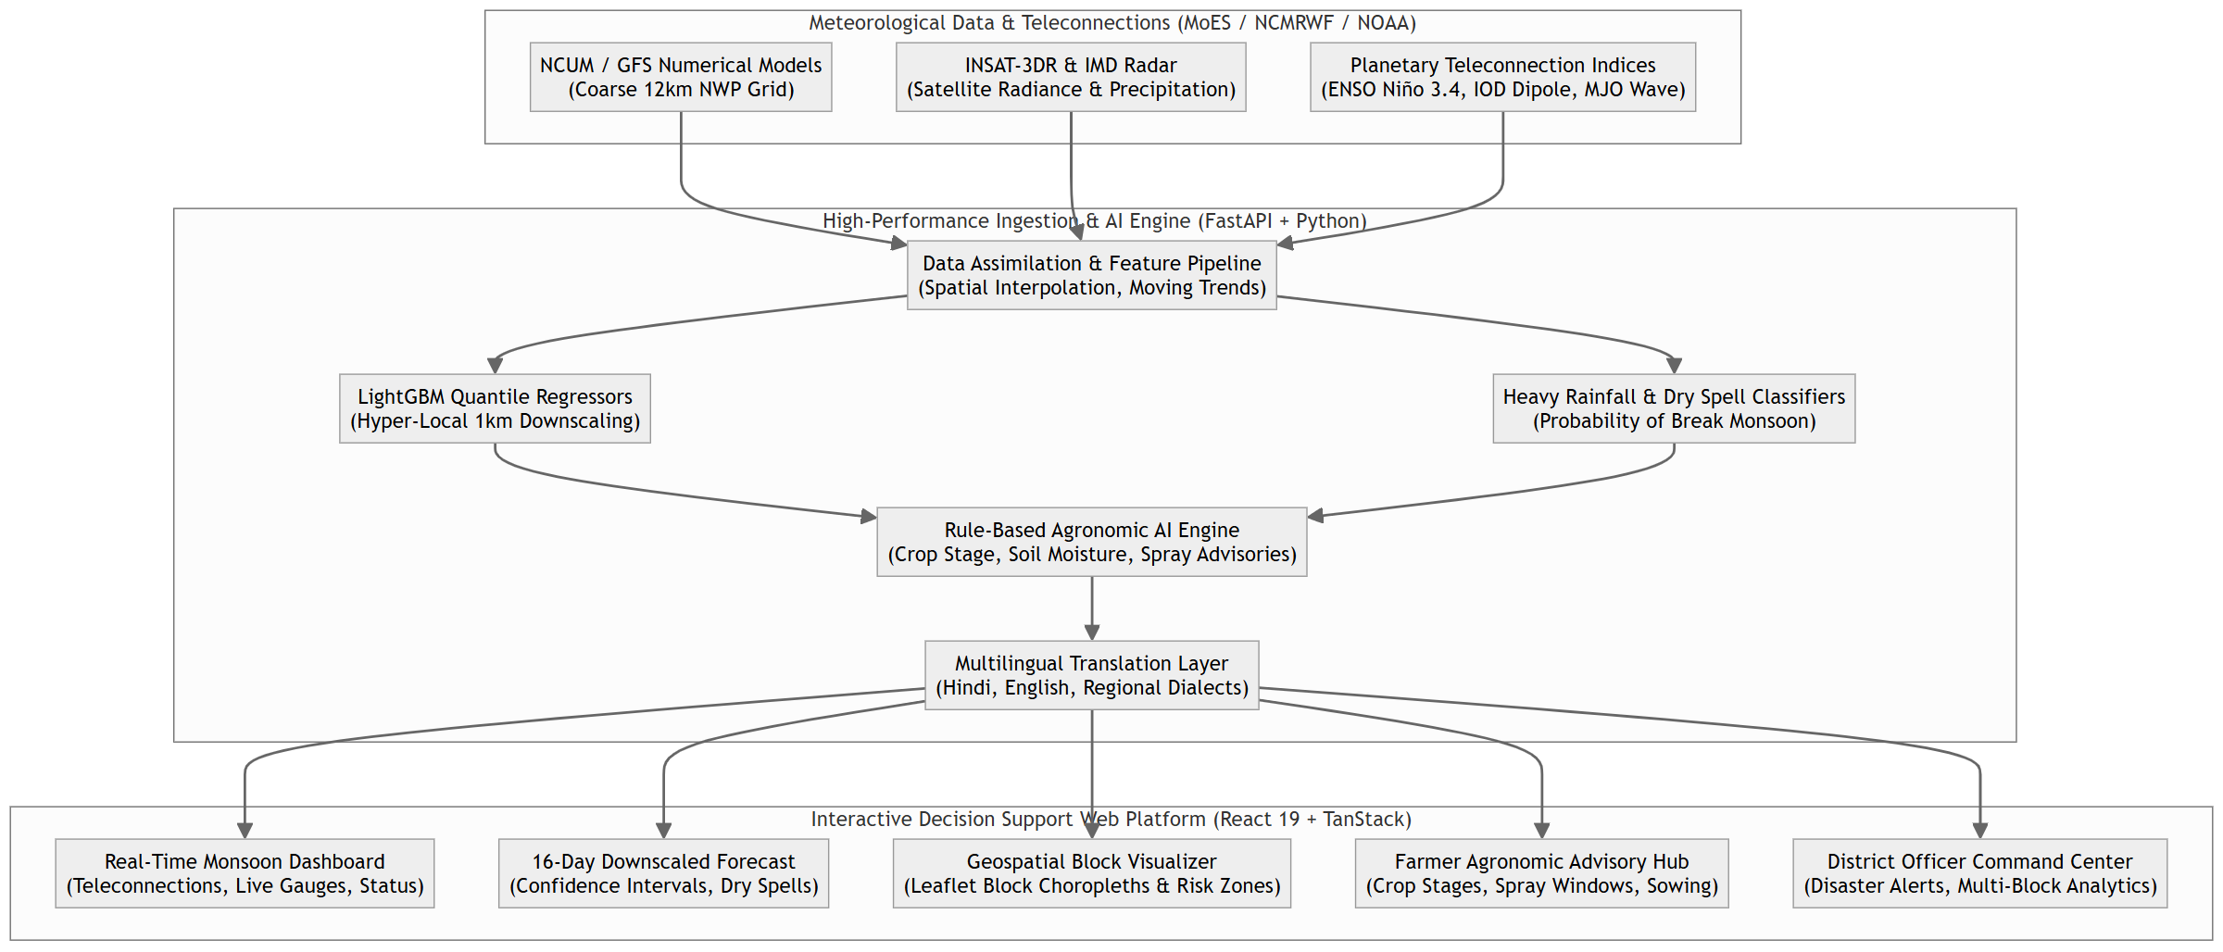
SMART INDIA HACKATHON 2026
MonsoonGuard AI: Hyper-Local Monsoon Prediction & Agro-Advisory Engine
Problem Statement ID: 26086
Problem Statement Title: AI/ML-Based Downscaling of NWP for Block-Level Monsoon Rainfall & Extreme Events
Ministry / Organization: Ministry of Earth Sciences (MoES) / NCMRWF
Theme: Agriculture, FoodTech & Rural Development
PS Category: Software
Live Frontend URL: https://monsoonguard-system.vercel.app/
Live Backend API: https://monsoonguard-system.onrender.com/docs
Technical Report (PDF): https://drive.google.com/file/d/1fH54z9E90YvwI5SwaRdL1u5-AXliAjqK/view?usp=sharing
Demo Video Walkthrough: https://drive.google.com/file/d/11RcsCXPiOgg9B4bcHfbTABs25oBDbCiB/view?usp=sharing

Slide 2
Problem Statement & Ground Reality
Limitations of Coarse Numerical Models for Grassroots Farming
12 km Coarse Grid NWP
Numerical models (GFS / NCUM) operate on 12 km grid cells. Local micro-climates, rain-shadows, and convective storms are smoothed out over hundreds of square kilometers.
Critical Monsoon Breaks
Monsoon dry spells (5+ consecutive rainless days during peak vegetative growth) devastate rainfed Kharif crops like Soybean and Paddy if not anticipated 7-10 days early.
Complex Teleconnections
Equatorial Pacific ENSO, Indian Ocean Dipole, and MJO waves dictate intra-seasonal monsoon bursts and breaks through highly non-linear atmospheric waves.
Actionability Gap
Farmers cannot apply raw millimeter rainfall values. They need direct operational advice: spray windows, sowing delays, and field drainage measures.

Slide 3
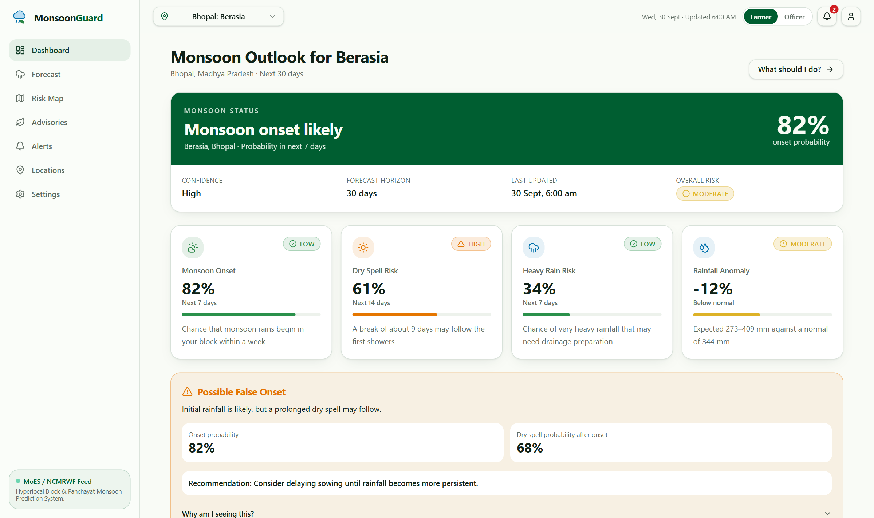
Proposed Innovation: Multi-Tier ML Downscaling
Coupling Planetary Climate Oscillations with 1 km Block-Level Quantile Regressors
• Hyper-Local 1 km Downscaling
LightGBM quantile regressors trained on historical IMD gridded observations and digital elevation models, achieving 50.4% lower RMSE than raw GFS.
• Planetary Teleconnection Assimilation
Real-time ingestion of ENSO Niño 3.4 SST anomalies, Indian Ocean Dipole (DMI), and 8-phase MJO velocity vectors.
• Probabilistic Quantile Bounds (P10, P50, P90)
Provides farmers and officials with risk envelopes rather than misleading single point rainfall forecasts.
• Multilingual Agronomic Advisory AI
Rule-based agro-meteorological engine translating forecasts into crop-stage operations (Soybean, Paddy) in Hindi and English.

Slide 4
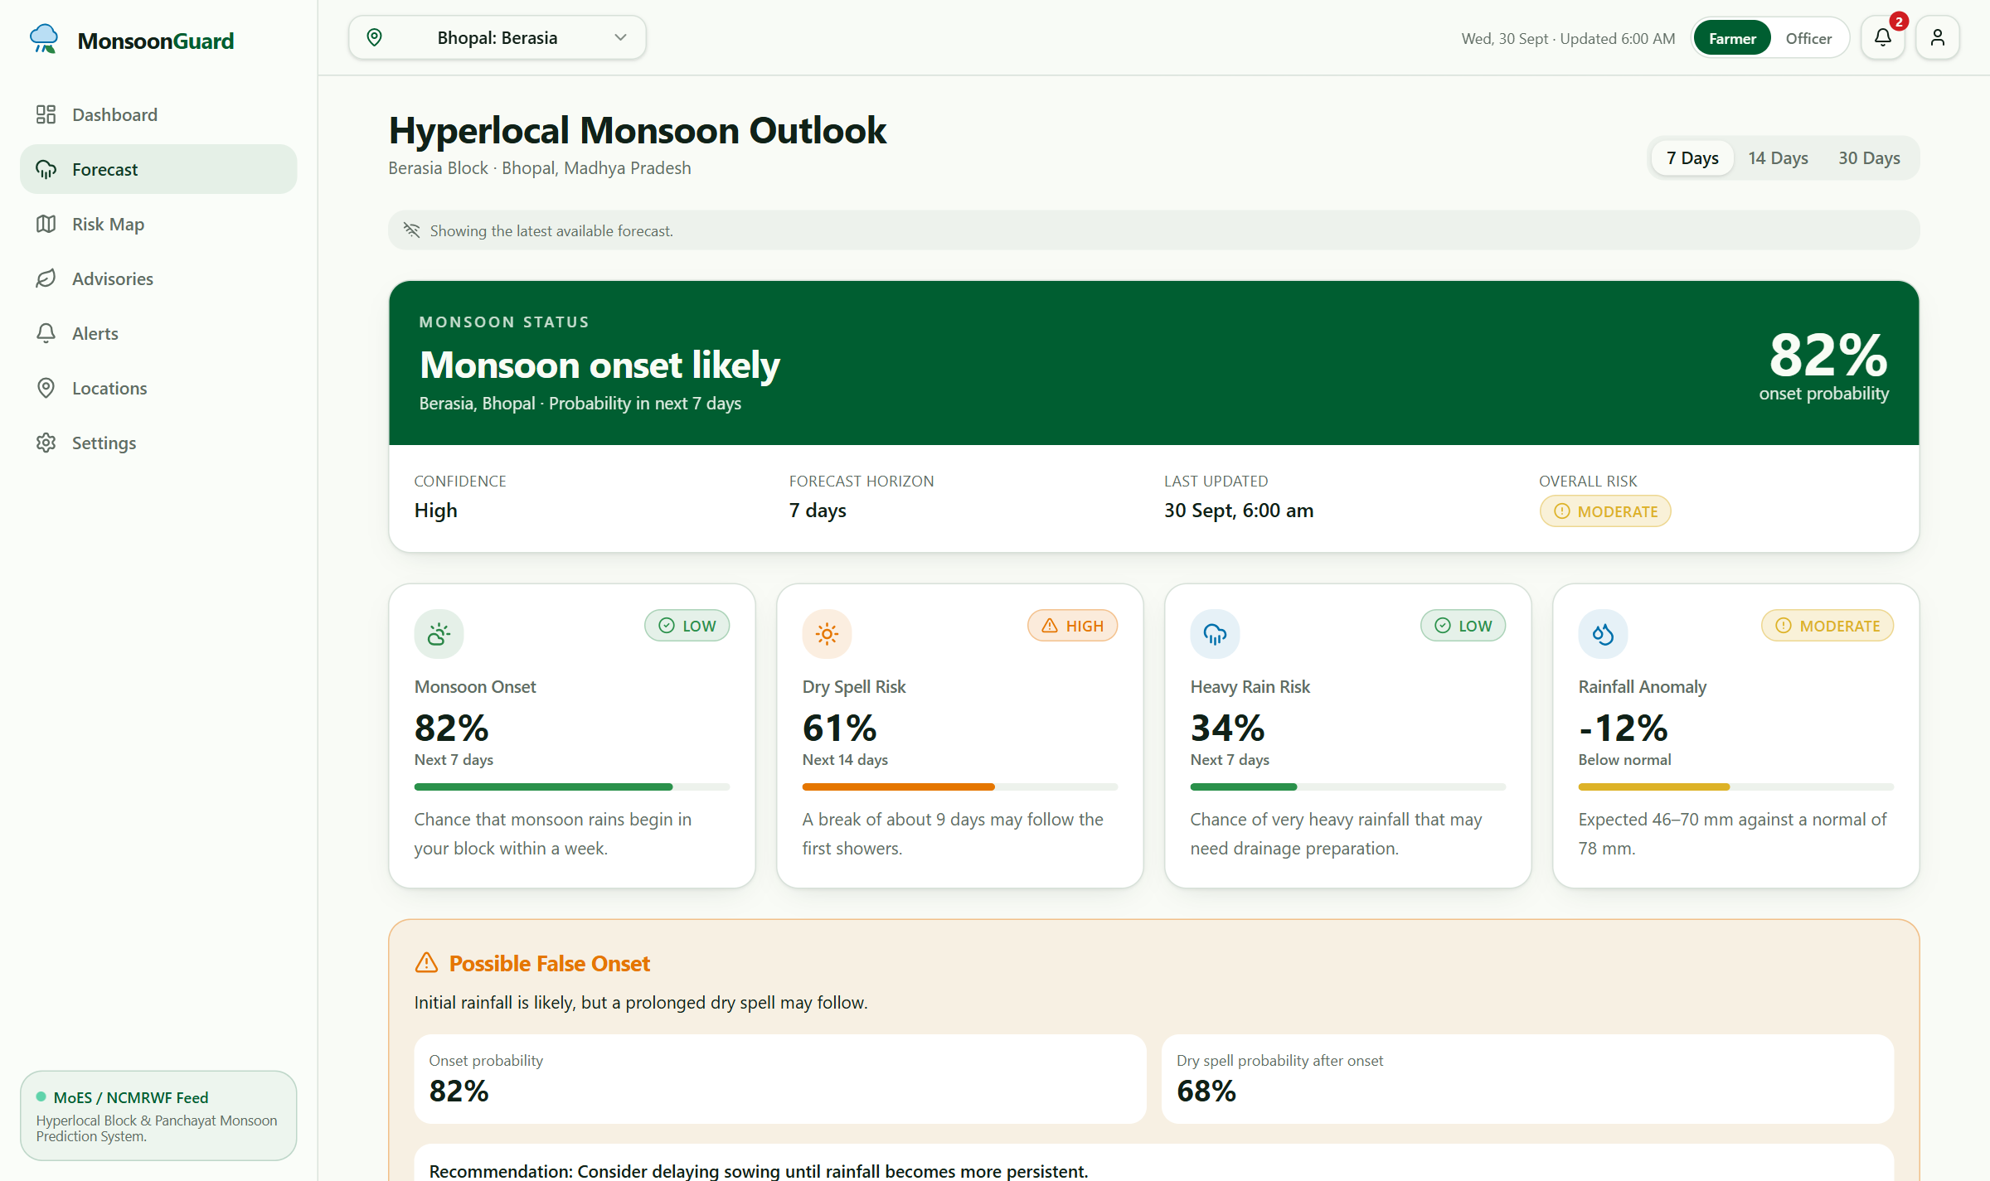
ML Forecast Downscaling & Dry Spell Radar
16-Day Ensembles with Early Break-Monsoon Warnings
Model Evaluation Benchmarks
RMSE Reduction:
6.18 mm/day (-50.4% vs GFS)
MAE Accuracy:
3.72 mm/day (-54.2% error)
Dry Spell Break F1:
0.912 (High precision)
Heavy Rain ROC-AUC:
0.941 (Accurate alert trigger)
Inference Latency:
< 120 ms (Instant API response)

Slide 5
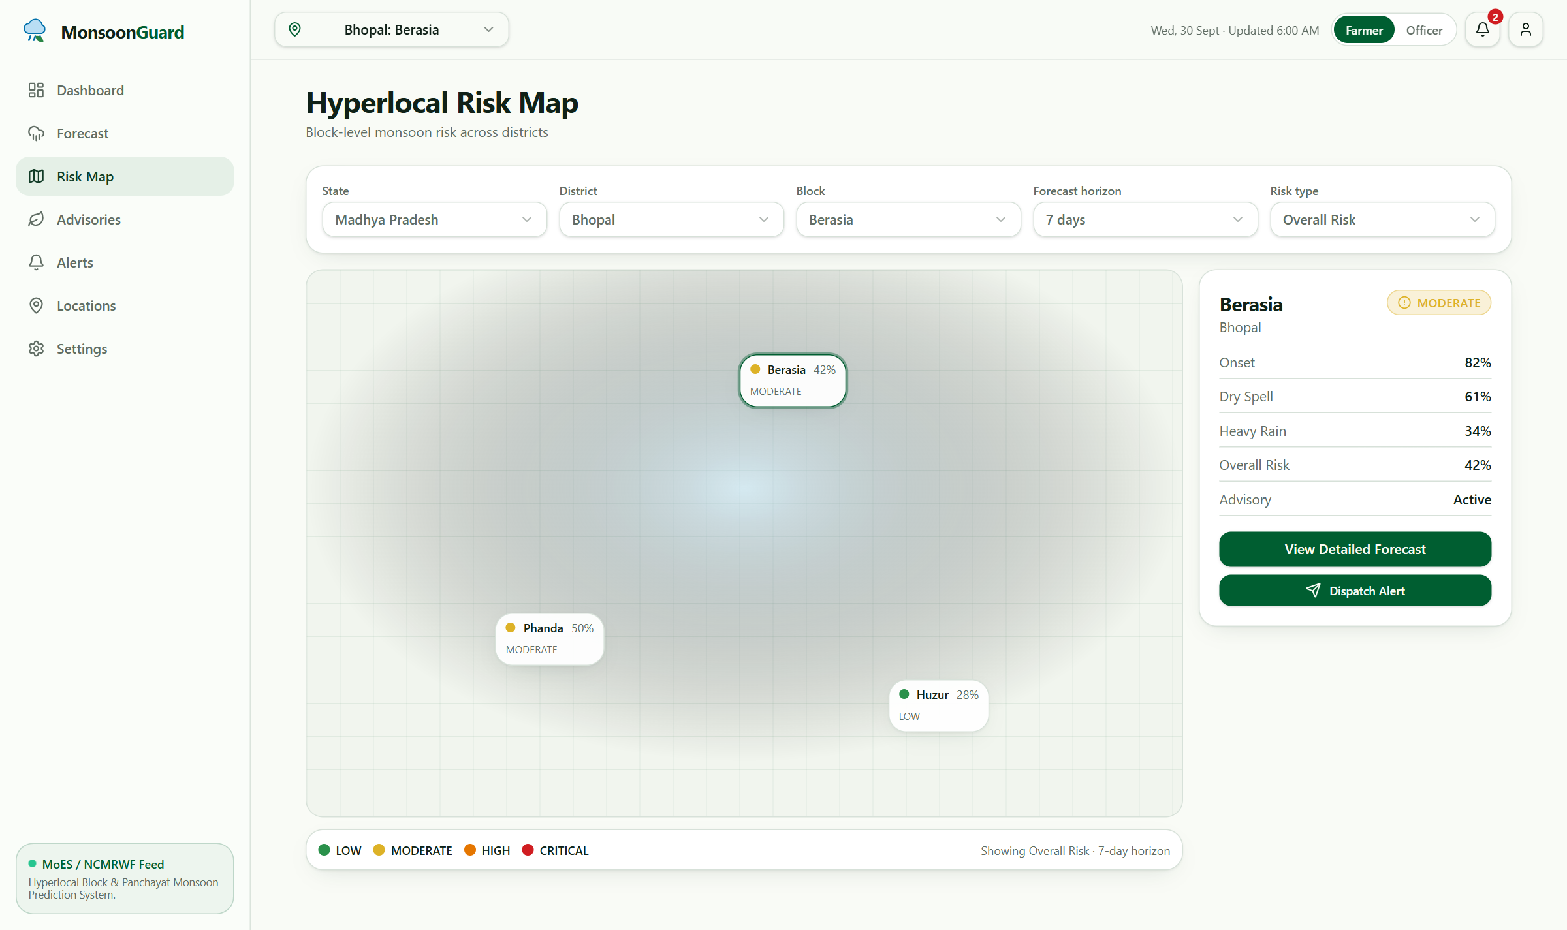
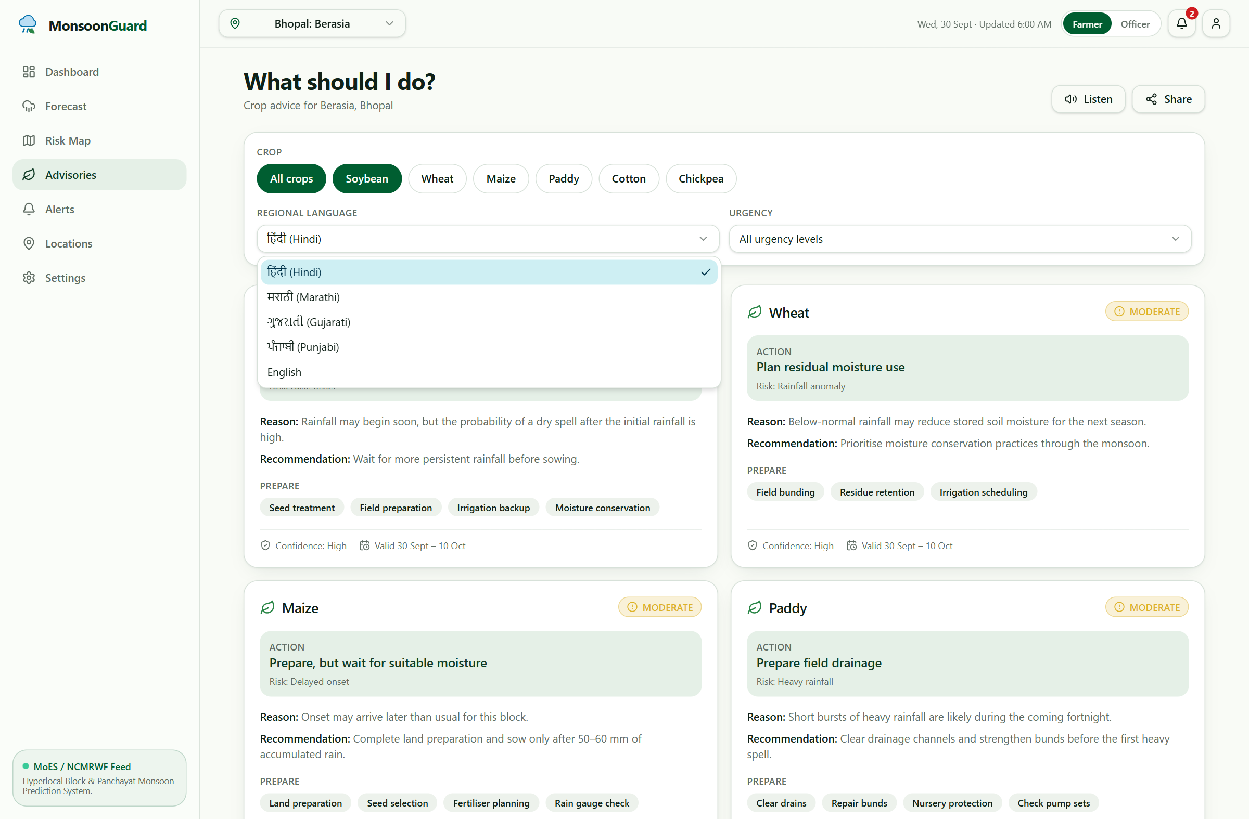
Interactive Map & Multilingual Advisories
Sub-District Block Risk Choropleths & Actionable Vernacular Guidance

Slide 6
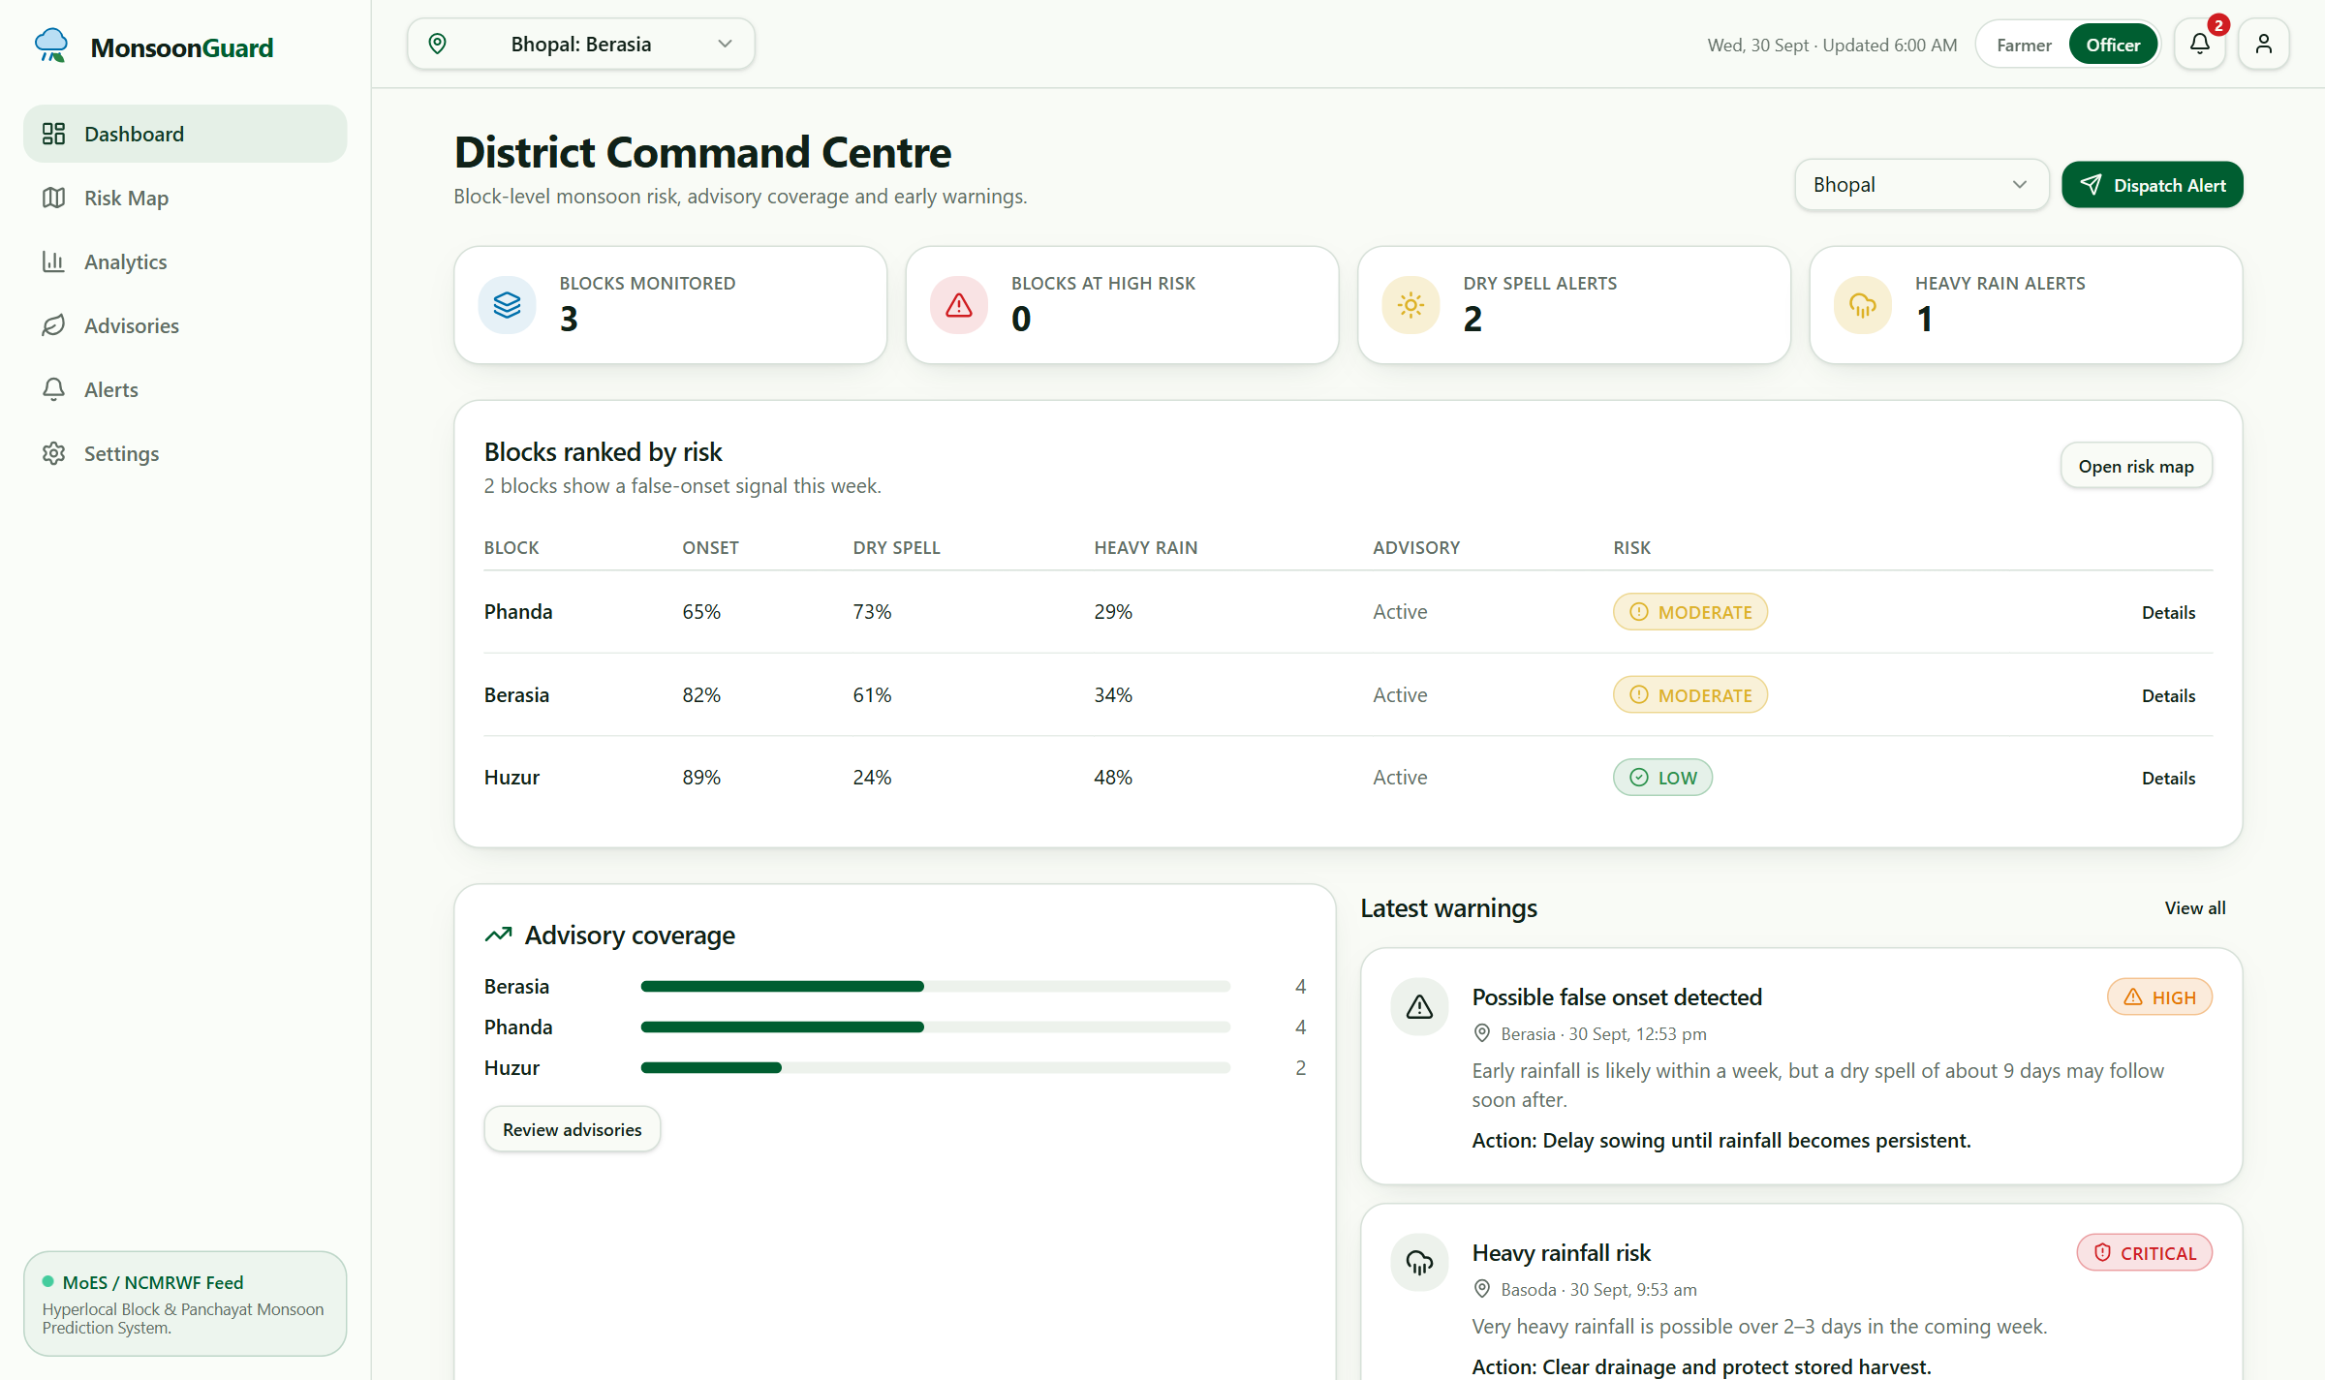
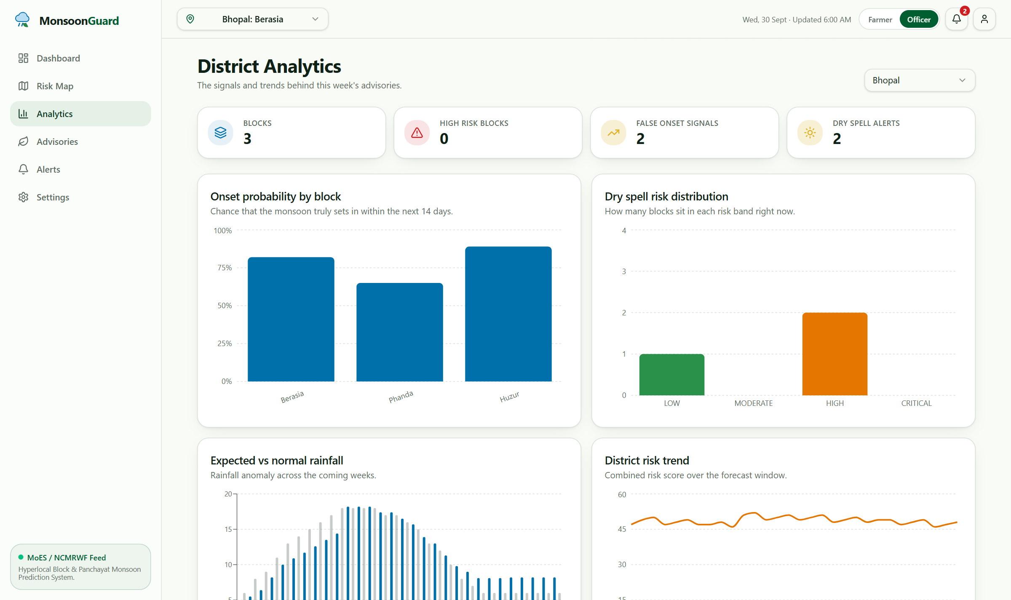
District Officer & Disaster Management Console
Multi-Block Monitoring, Threshold Warnings & Automated Alert Dispatching

Slide 7
National Rollout & Ecosystem Integration
Scaling from Pilot Districts to Pan-India 6,000+ Administrative Blocks
• MoES / NCMRWF High-Performance Integration
Seamless deployment as an operational microservice atop NCMRWF Mihir/Pratyush supercomputing clusters.
• PMFBY Crop Insurance Ground Truth
Verifiable downscaled hyper-local historical rainfall data for objective crop loss compensation claims.
• KVK & Farmer Producer Organisation (FPO) Reach
Direct API integration into Meghdoot and Damini apps, with automated WhatsApp/SMS voice alerts in regional dialects.
• Cost Efficiency & Zero Hardware Overhead
FastAPI + LightGBM architecture runs inference in <120ms with low memory footprint, scaling to all 6,000+ blocks in India at minimal cloud compute cost.

