Slide 1


SMART INDIA HACKATHON 2026
SentinelWell AI
Explainable Welfare-Risk Monitoring for Uniformed Personnel
PROBLEM STATEMENT ID | SIH26186
PROBLEM STATEMENT TITLE | AI-Based Predictive Personnel Stress and Welfare Monitoring System for Uniformed Forces
THEME | MedTech / BioTech / HealthTech
PROBLEM STATEMENT CATEGORY | SOFTWARE
TEAM NAME TEAM ID | Neural Wellness 154315

Slide 2

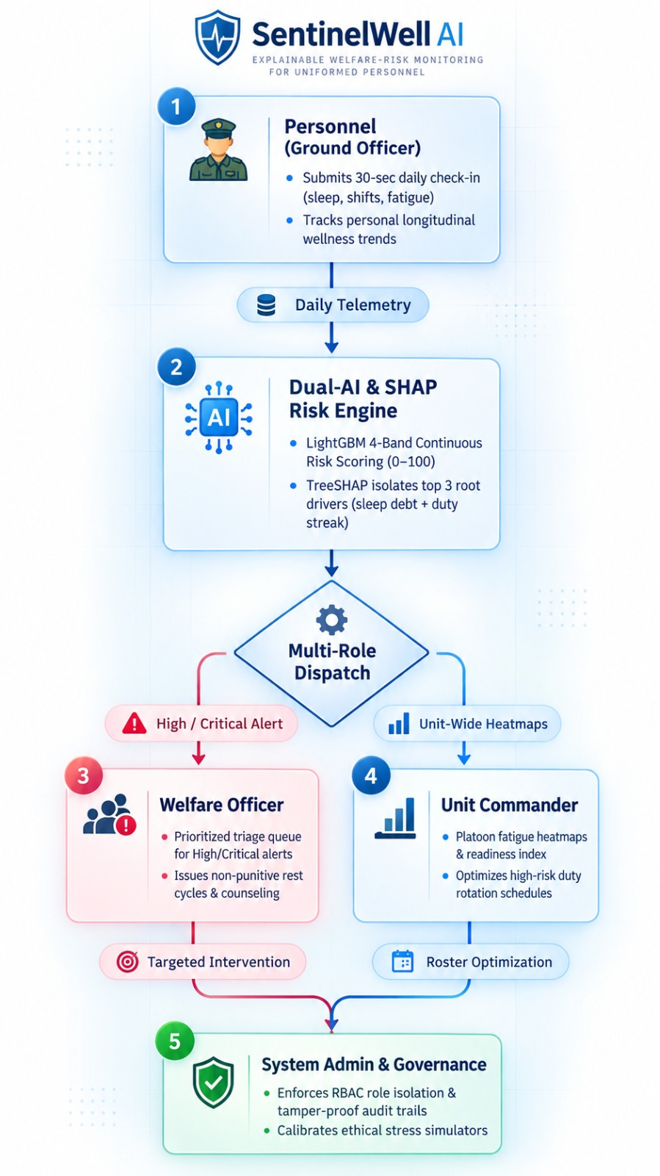
IDEA TITLE
Neural Wellness
PROPOSED SOLUTION
SentinelWell AI is an AI-powered welfare-risk monitoring system designed to support the mental well-being of uniformed personnel. It analyzes duty-related and voluntarily provided wellness data to identify early signs of stress, fatigue, and burnout. Using anomaly detection and risk prediction, it enables timely and proactive intervention. With explainable AI and role-based access, it protects privacy while providing the right insights to personnel, welfare officers and Unit Commanders.
CORE FEATURES
Non-Invasive Risk Engine: Uses existing duty rosters (duty streaks, night shifts, deployment, leave rejections) and a sub-minute voluntary check-in. Isolation Forest flags abnormal duty patterns, and LightGBM converts them into a continuous 0–100 score across Low, Moderate, High and Critical. No wearables.
Compounding-Stress Detection: Derived Sleep Deprivation Index and Burnout Velocity catch stressors stacking up, such as poor sleep on top of a 14-day duty streak.
Explainable, Human-in-the-Loop Alerts: TreeSHAP names the top 3 drivers behind every alert. Officers then accept, schedule or dismiss suggested welfare actions.
Role-Based Portals: Personnel get private self-tracking, welfare officers get a priority triage queue, and commanders see only anonymised unit readiness.
Support-First, Zero Disciplinary Link: Welfare data is kept separate from ACRs and service records. Personnel control consent, and every access is logged.

Slide 3
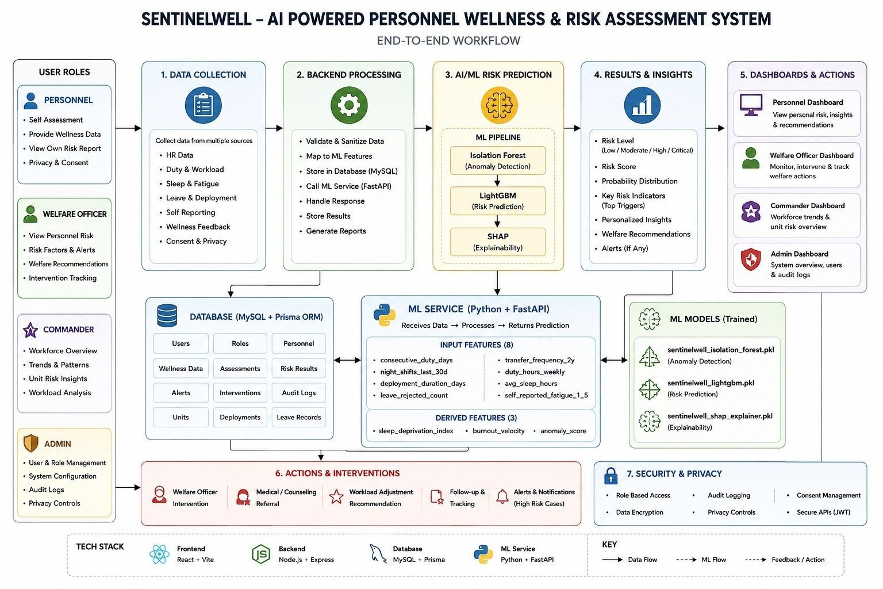
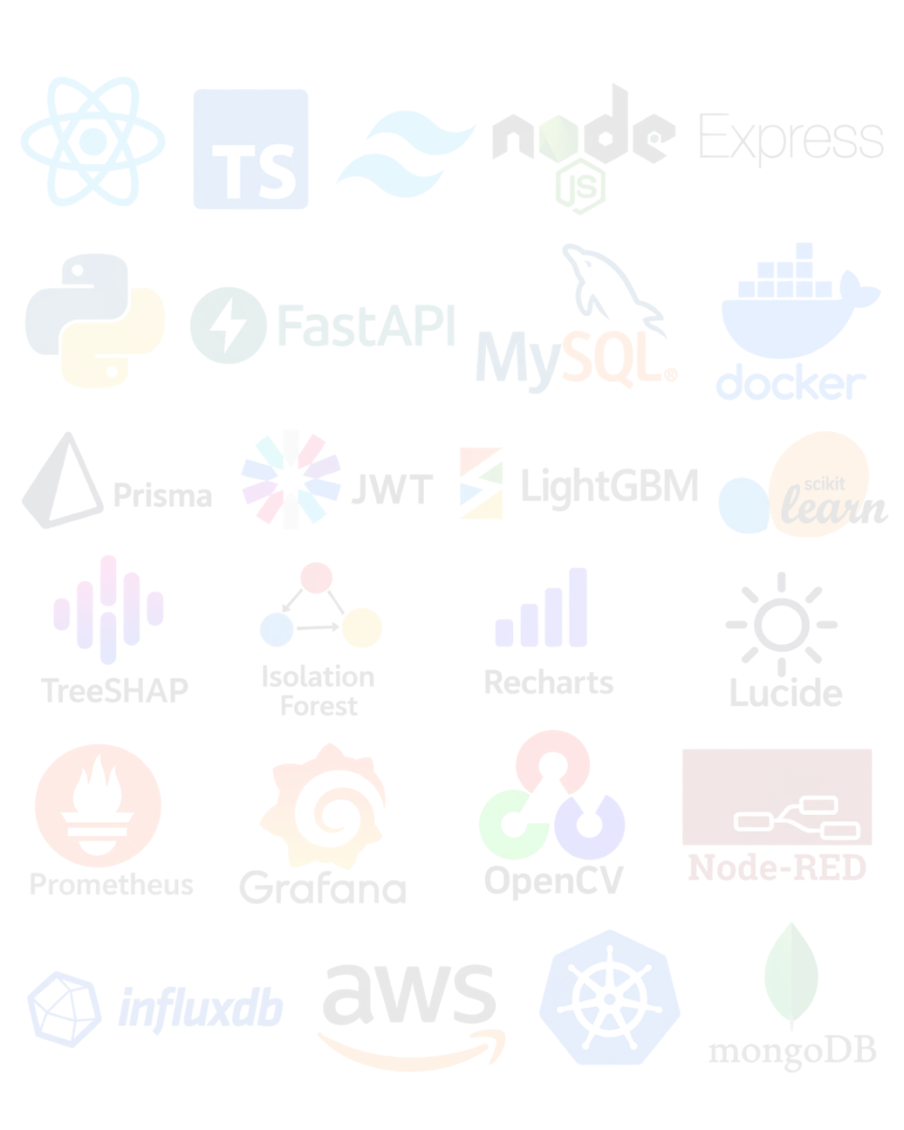
TECHNICAL APPROACH
DUAL-MODEL PIPELINE WITH EXACT EXPLAINABILITY
Neural Wellness
Technology Stack
Frontend: React 19, TypeScript, and Tailwind CSS powering 4 dedicated, responsive role-based portals with Lucide & Recharts.
Backend API: Node.js & Express REST API using Prisma ORM with JWT authentication and strict role isolation middleware.
AI / ML Engine: FastAPI microservice running Isolation Forest (anomaly detection), LightGBM (risk scoring), and TreeSHAP
(root-cause attribution).
Data Persistence: Aiven Cloud MySQL with TLS 1.3 encryption and automated immutable audit logging for governance.
Deployment & Security: Docker containerized, 100% CPU-executable, and engineered for air-gapped defense intranet setups with zero external cloud dependencies.

Slide 4
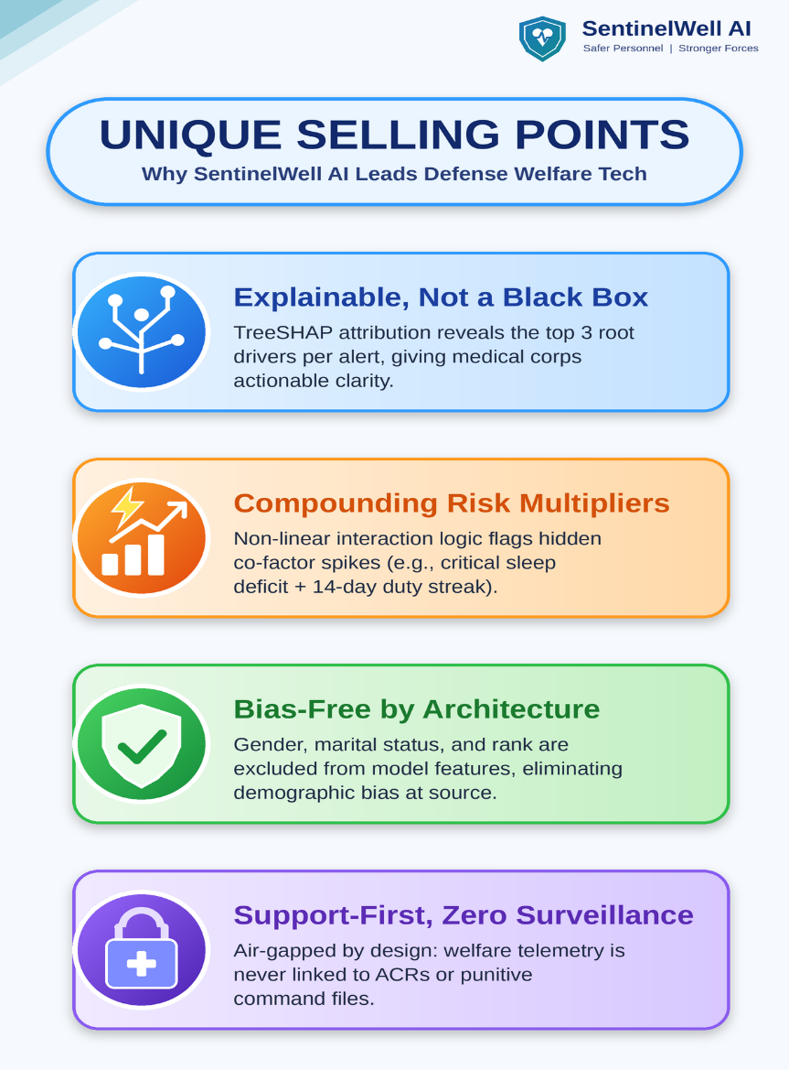
FEASIBILITY AND VIABILITY
Neural Wellness
Deployable Today & Defensible Under Scrutiny: SentinelWell AI runs entirely on standard CPU hardware with zero GPU dependency, engineered specifically for on-premise, low-infrastructure defense field deployments.
Technical & Operational Feasibility
• Zero Hardware Barrier (100% CPU): Trained and run on standard base computers; eliminates costly GPU clusters.
• Native Roster & HRMS Integration: Directly ingests duty schedules via CSV/Excel, adding zero clerical workload.
• 100% Air-Gapped Network Ready: Runs securely on isolated battalion LANs without requiring external internet.
• Zero Wearable Overhead: Built as a pure software overlay, saving crores over fragile smartwatches.
• Lightweight Compute Footprint: Sub-15ms inference latency per personnel record, ensuring real-time response.
Field Viability & Outpost Deployment
• Ethically Calibrated Proxy Data: Trained on validated public benchmarks (IBM HR & Indian Stress) without exposing sensitive files.
• Forward Outpost Ready (Offline-First): Local caching enables isolated border posts to store logs locally and auto-sync when connected.
• Batch Model Retraining: Supports periodic model calibration with newly recorded roster data without pipeline re-architecting.
• Modular Phased Rollout: Scales seamlessly from one CRPF battalion to force-wide deployment across BSF, ITBP, and CISF.

Slide 5
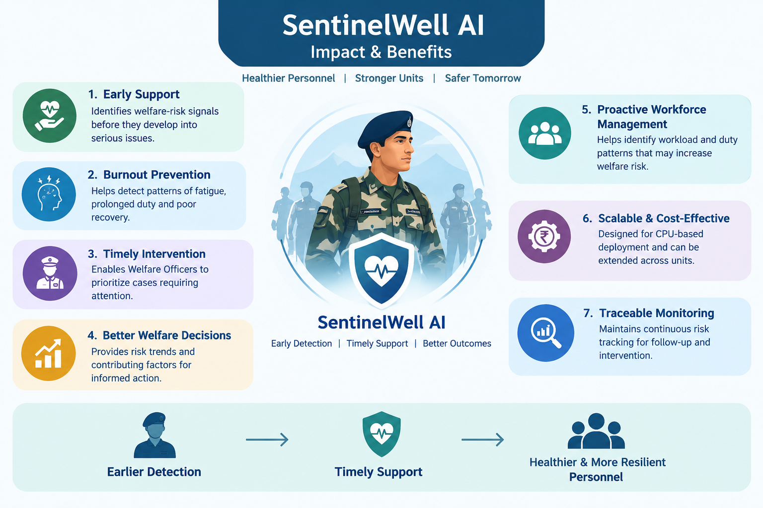
IMPACTS AND BENEFITS
Neural
Wellness
Impacts
➢ Identifies fatigue and welfare risks before
they develop into serious threats.
➢ Helps welfare officers prioritize personnel
who may require timely support.
➢ Provides insights into workload and risk
patterns for informed decisions.
➢ Supports a healthier, more resilient, and
operationally ready force.
Benefits
➢ Enables proactive support instead of waiting
for incidents or crises.
➢ Reduces long-term costs associated with
burnout and personnel recovery
➢ Can be scaled across different units and
high stress environments.
➢ Runs on existing infrastructure without
requiring specialized hardware.

Slide 6
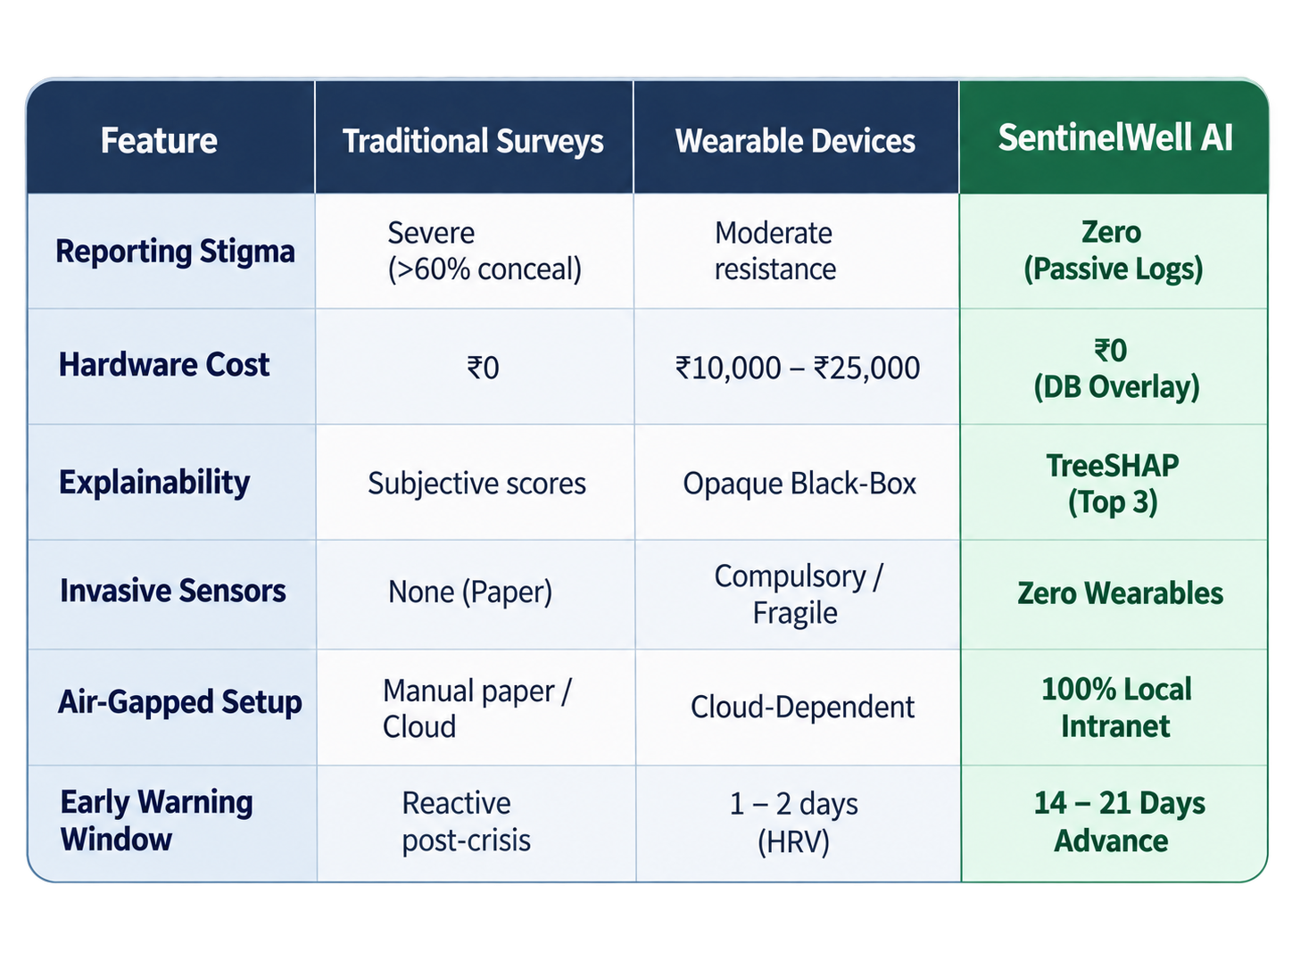





RESEARCH AND REFERENCES
Neural Wellness
SIH Problem & Operational Context
• Problem Statement ID: SIH26186 (Software)
• Ministry / Organization: Ministry of Home Affairs (MHA) / CRPF
• Operational Focus: Proactive, non-punitive stress & fatigue early warning
Scientific Foundations & Datasets
• TreeSHAP (Nature MI, 2020): Local feature attribution providing top-3 stress drivers per alert
• Isolation Forest (IEEE ICDM): Unsupervised multivariate anomaly detection in duty rhythms
• Empirical Proxy Benchmarks: Calibrated on IBM HR Analytics & Indian Stress datasets
Project Deliverables & Verification (Click to Open)
Source Code
GitHub Repo ↗
Demo Video
1080p Pitch ↗
Exec Summary
Project Brief ↗
Live Prototype
Demo ↗
Technical Spec
Documentation↗

