Slide 1
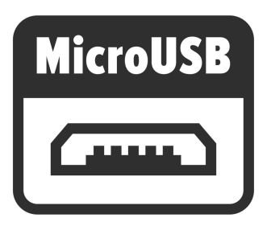




Power
Input 5V
LDO
PoE
LM8805
Micro B Type
Combine WIZPoE Modules to power your specifications
3.3V /~600mA
Available as external application output
Getting Started
USB Driver Install
FW Download
FW Example
VS Code
Installation is required to use Surf 5
Download
Debug
C
ISP
SWD
Keil
C

