Slide 1
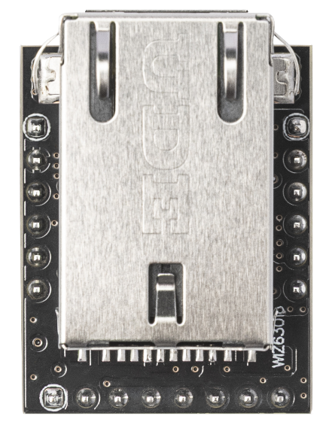
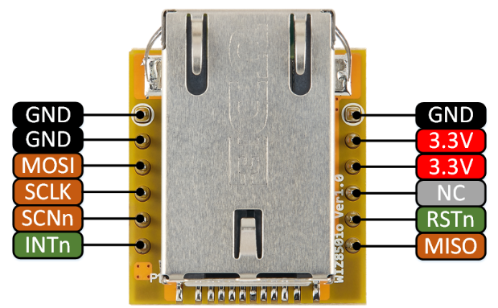
WIZ630io Rev1.1
J1 Pin1
J2 Pin1
WIZ850io
Ground
Ground
DC 3.3V
QSPI Q0
SPI MOSI
SPI Clock
Not Connected
SPI Chip Select(n)
W6300 Reset(n)
W6300 INT(n)
SPI MISO
QSPI Q1
The pin maps on the left and right are the same as other IO modules of Wiznet.
SPI MISO
SPI Master Input Slave Output
SPI MOSI
SPI Master Output Slave Input
J3 Pin1
QSPI Q1~3
Quad SPI Data Line
W6300 INT(n)
W6300 Interrupt : Low activity
QSPI Q3
QSPI Q1
GND
DC 3.3V
SPI Clock
QSPI Q2
QSPI Q0
SPI Chip Select(n)
W6300 Reset(n)
W6300 Reset : Low activity

