Slide 1

The Wonderful World of Wizle
Population 5,250
Mayor: Max “Mad” Cow

Slide 2
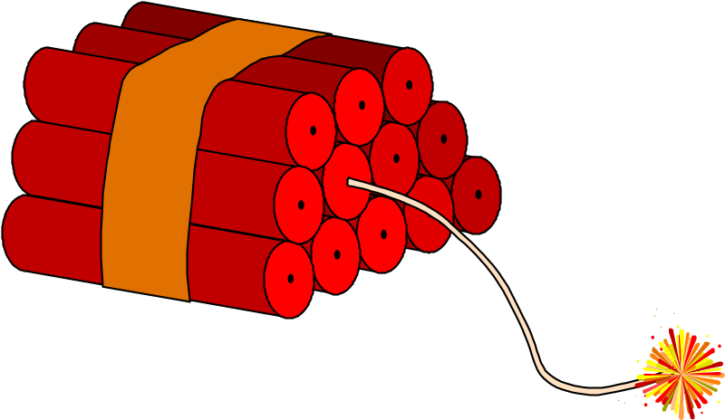
The Time is here!
The year is 1999
The place Wizzle
Why we are here?
We don’t know.

Slide 3
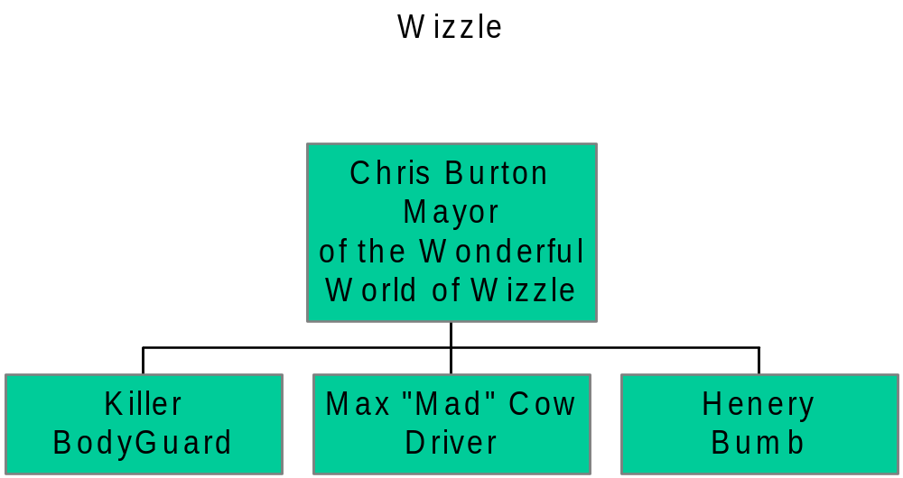
The Wizzle Community

